Slide 1
VIP 2.0
Team Members:
Tiago Moore, Victoriano Vega, Steven Rowe,
Jorge Perez, Andres Villa, Miguel Conde, Rodolfo Viant Product Owner:
Masoud Sadjadi Instructor:
Masoud Sadjadi
School of Computing and Information Sciences Florida International University
Senior Project Final Presentation Spring 2016
4/25/2016
Notes:
Greet your audience, thank them for attending your presentation, introduce yourself, introduce your project, introduce your team members, and quickly indicate what each of you did in a high-level manner, and put more emphasis on your part/contribution.

Slide 2
Problem Definition
Our Project
The Vertically Integrated Projects (VIP) program aims to involve everyone on campus in innovation. VIP unites undergraduate education and faculty research in a team-based context. Undergraduate VIP students earn academic credits, while faculty and graduate students benefit from the design/discovery efforts of their teams.
Enable fluid user registration.
Enable a login system.
Enable a profile management system.
My Part
Notes:
Introduce the problem that the whole project tackles and stay focused on the parts that you have been working. Indicate if there is an existing previous system, enumerate its problems/limitations, etc.

Slide 3
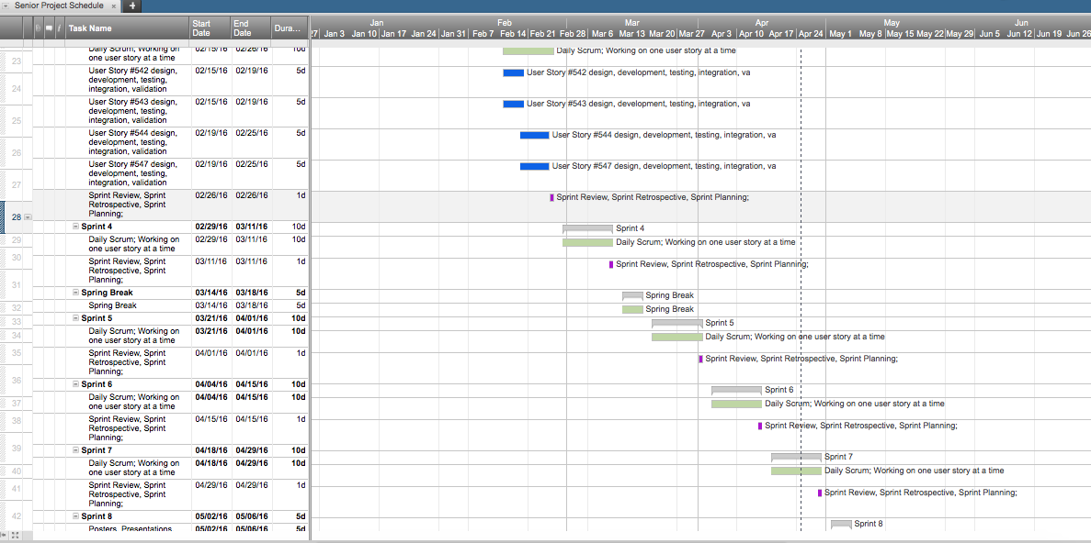
Project Management
Notes:
Project Management (schedule for entire semester) (one slide; Gantt Chart).

Slide 4
Requirements: User Stories
#519 Link Login Accounts
#622 Unlink Login Accounts
#623 Visualize Linked/Unlinked Accounts
#844 Web Page Footer
#746 Manage Profile
#717 Register User
#745 Login
#928 Review User Registration
#672 Validate Email Address
#542-Export Judges
#542-Checkbox on Filter for People Selection
Notes:
4. Requirements:
4.1. User stories implemented (one or more slides).
4.2. UML use cases and the use case diagram for the implemented use cases (one or more slides).
4.3. UML sequence diagrams for the implemented use cases.

Slide 5
Requirements: Use Cases
Notes:
4. Requirements:
4.1. User stories implemented (one or more slides).
4.2. UML use cases and the use case diagram for the implemented use cases (one or more slides).
4.3. UML sequence diagrams for the implemented use cases.

Slide 6
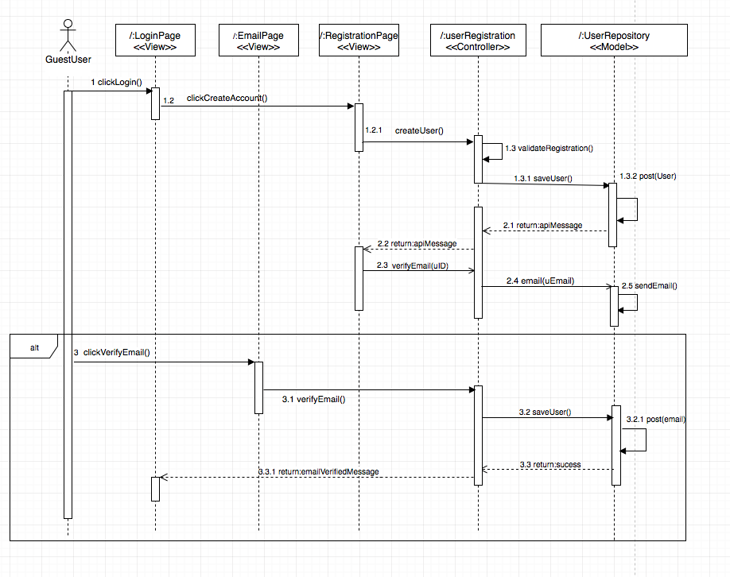
Requirements: Sequence Diagrams
Notes:
4. Requirements:
4.1. User stories implemented (one or more slides).
4.2. UML use cases and the use case diagram for the implemented use cases (one or more slides).
4.3. UML sequence diagrams for the implemented use cases.

Slide 7
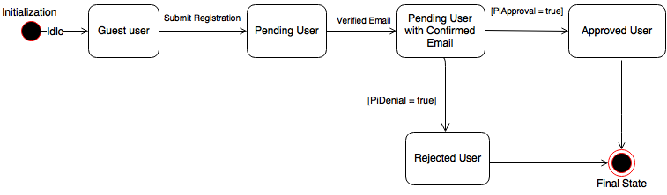
State Chart Diagram

Slide 8
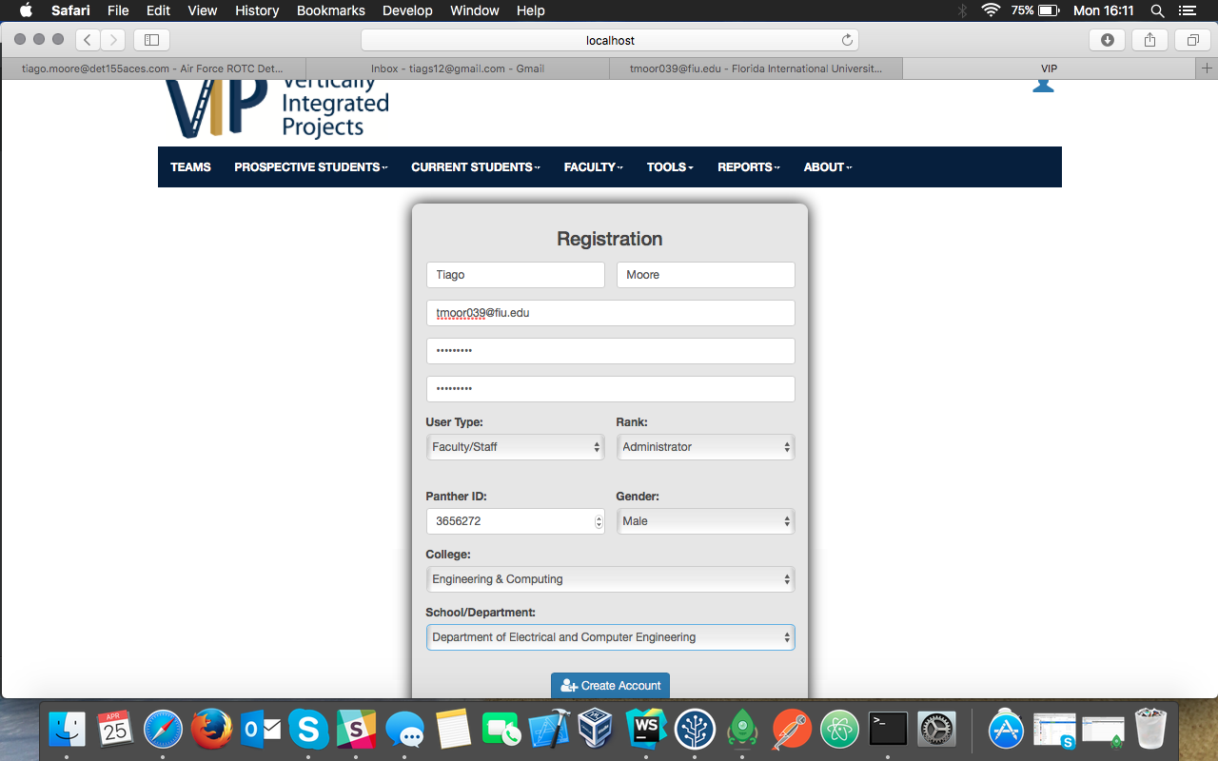
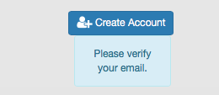
VIP Registration Sequence: Part 1

Slide 9
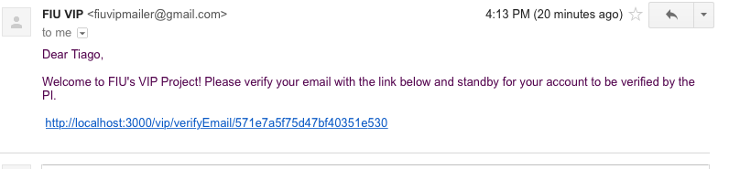
VIP Registration Sequence: Part 2

Slide 10
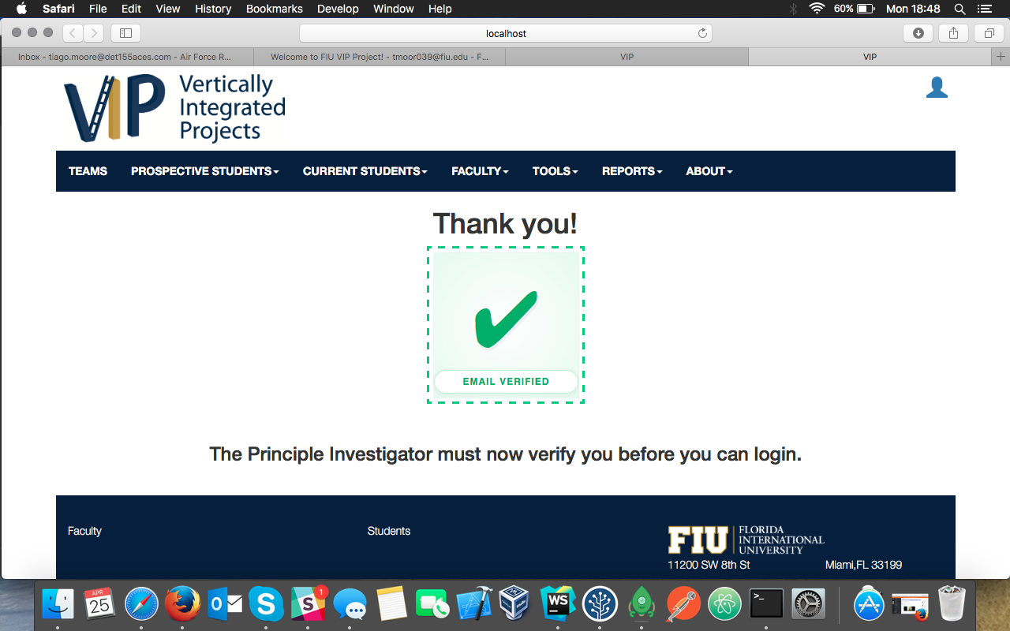
VIP Registration Sequence: Part 3

Slide 11
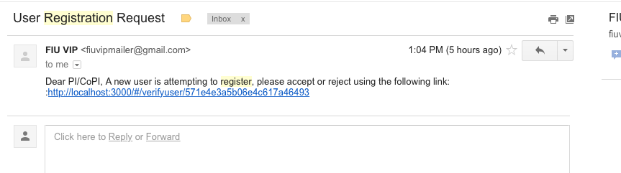
VIP Registration Sequence: Part 4

Slide 12
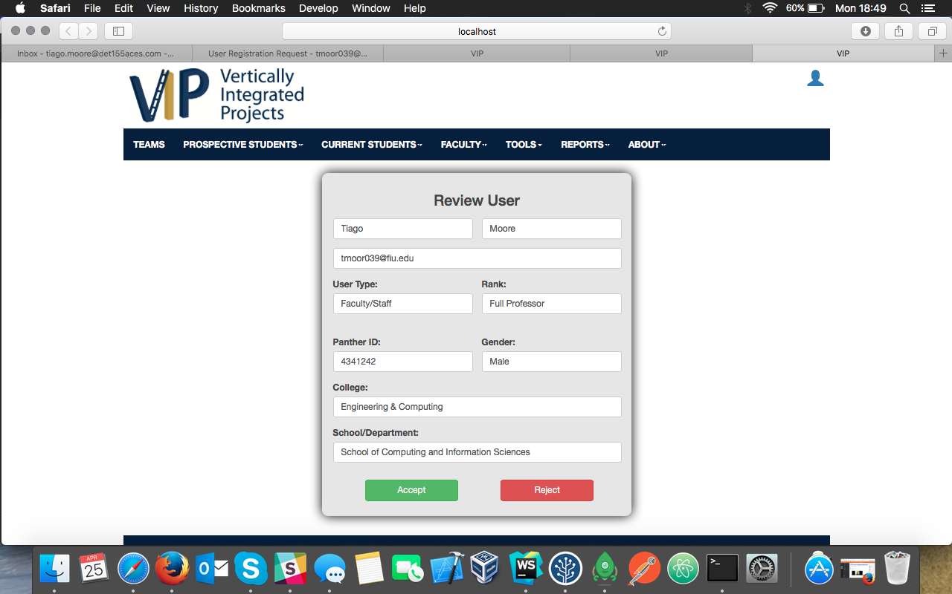
VIP Registration Sequence: Part 5

Slide 13
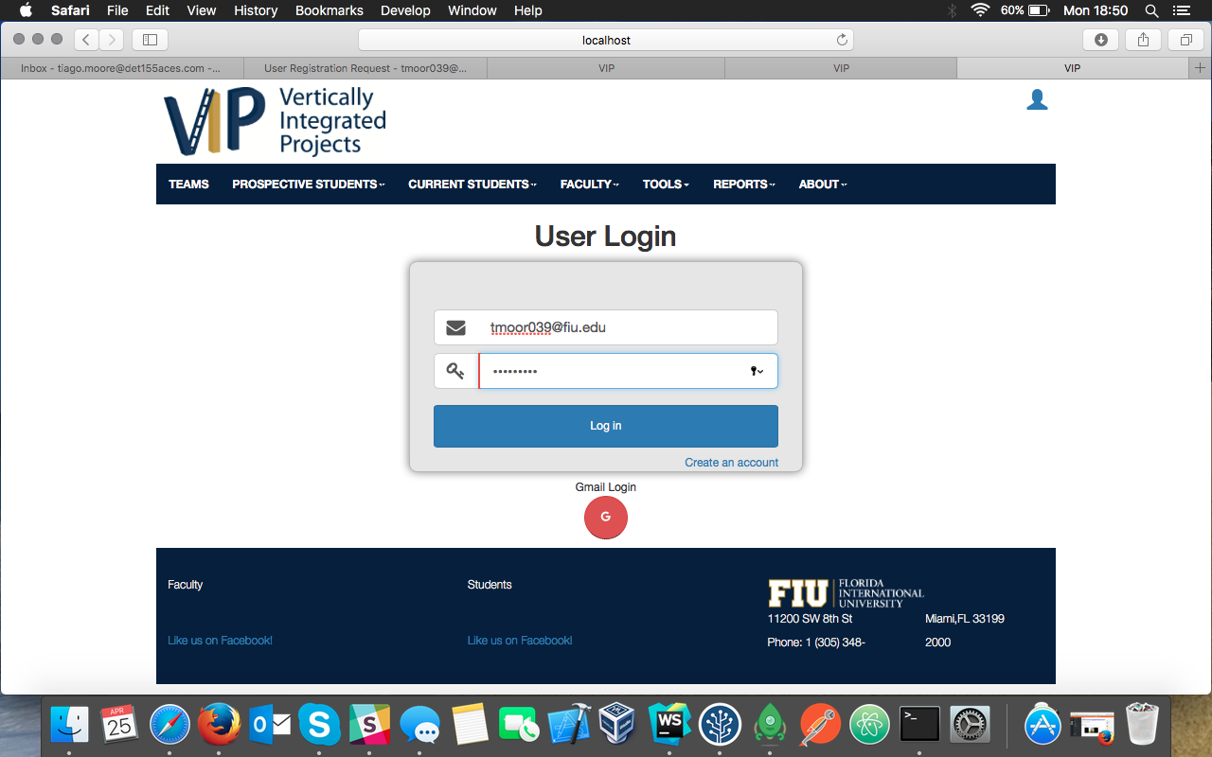
VIP Registration Sequence: Part 6

Slide 14
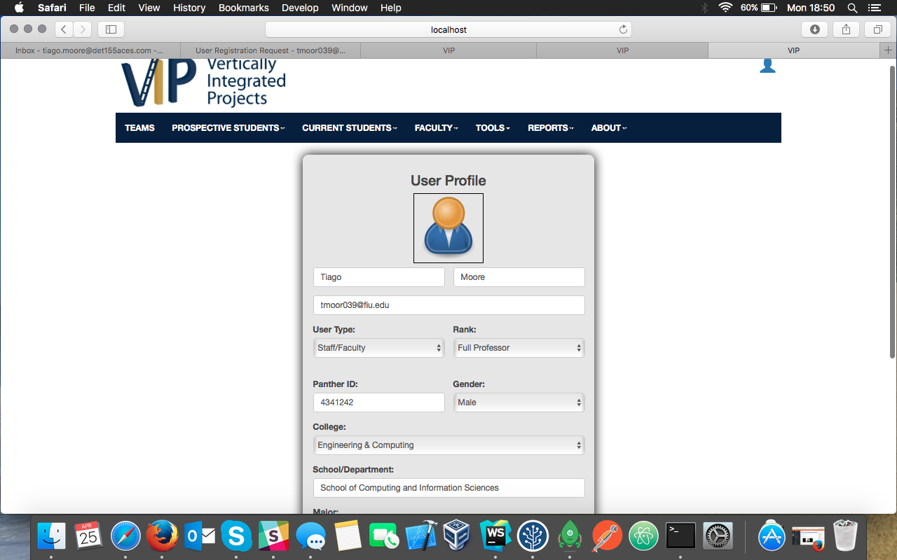
VIP Registration Sequence: Part 7

Slide 15
System Design: Architecture
3-tier architecture and Client-Server
3-tier architecture and Client-Server
Security/Privacy
Oauthd authentication
Hashing and salting of passwords
Sanitizing user input
Token based authentication (bcrypt)
Notes:
5. System design:
5.1. System decomposition; identify the architecture patterns used (one slide).
5.2. System deployment – h/w and s/w requirements (one slide).
5.3. Persistent data design (one slide).
5.4. Security/Privacy (one slide).

Slide 16
Minimal Class Diagram
Notes:
6. Detailed design:
6.1. Minimal class diagram. Identify the design patterns used (one or more slides).
6.2. State machine for the main control object or the most important object of the implemented uses cases (one or more slides).
6.3. Main algorithm used related to an implemented use case described above (one or more slides).

Slide 17
Strong Password Algorithm
var uppercase = "ABCDEFGHIJKLMNOPQRSTUVWXYZ";
var lowercase = "abcdefghijklmnopqrstuvwxyz";
var digits = "0123456789";
var splChars ="!@#$%&*()";
var ucaseFlag = contains(password, uppercase);
var lcaseFlag = contains(password, lowercase);
var digitsFlag = contains(password, digits);
var splCharsFlag = contains(password, splChars);
if(password.length>=8 && ucaseFlag && lcaseFlag && digitsFlag && splCharsFlag)
return true;
else
return false;

Slide 18
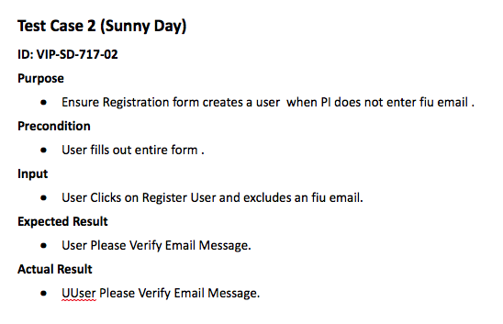
Sunny Day Test
Notes:
7. Test Suites and Test Cases (one sunny day and one rainy day) for the use case represented in part (5) above (2 slides).
7.1 One sunny day and one rainy day for the implemented use cases (one or more slides).
7.2 Automated test scripts for the implemented use cases (one or more slides).

Slide 19
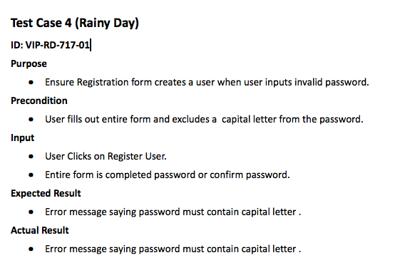
Rainy Day Test
Notes:
7. Test Suites and Test Cases (one sunny day and one rainy day) for the use case represented in part (5) above (2 slides).
7.1 One sunny day and one rainy day for the implemented use cases (one or more slides).
7.2 Automated test scripts for the implemented use cases (one or more slides).

Slide 20
Thank you!
Contact information:
Tiago Moore email: tmoor039@fiu.edu
Notes:
Summarize your contribution
Include your contact information
Ask if anyone has any questions for you.
Thank your audience

