Slide 1
VIP 2.0
Team Members:
Tiago Moore, Victoriano Vega, Steven Rowe,
Jorge Perez, Andres Villa, Miguel Conde, Rodolfo Viant Product Owner:
Masoud Sadjadi Instructor:
Masoud Sadjadi
School of Computing and Information Sciences Florida International University
Senior Project Final Presentation Spring 2016
5/1/2016
Notes:
Hi, my name is Andres Villa and this will be the introduction video for the VIP project for the Spring 2016 semester at Florida International University my Team members are Tiago Moore, Victoriano Vega, Steven Rowe, Jorge Peres, Miguel Conde, and Rodolfo Viant
Masoud Sadjadi was our Product Owner and Instructor for the course

Slide 2
Problem Definition
Problem
No current method for Faculty to share projects for cross-disciplines
Students do not have the ability to easily search for other projects
No ability for students to view description and requirements to join a project
Faculty cannot easily and quickly view students who are interested in a project
Faculty cannot currently propose projects quickly
PI/CO-PI cannot currently view and accept/reject all pending projects that have been proposed by faculty
Notes:
Currently there is no system in place that allows faculty members to quickly advertise any projects they are currently working on or will be working on in the future.
This has 2 problems, it makes it hard for the faculty to get enough members in order to begin work on the project and it makes it harder for students to find projects that are in need of help.
This is where VIP comes in, VIP allows faculty to propose and share projects while also allowing students to directly apply to the projects. Faculty can then review the students abilities and decide whether or not they will be a good fit for the project

Slide 3
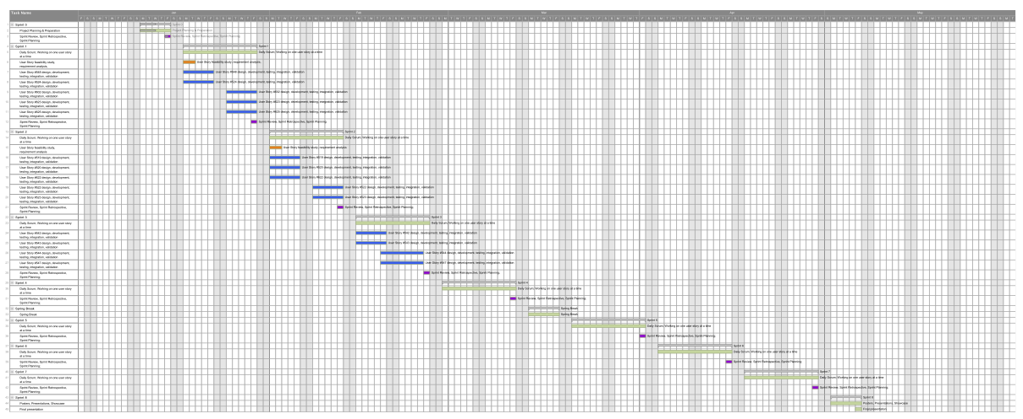
Full Gantt chart
Notes:
This is our teams work schedule for the semester. We spent time early on working on improving the usability of Mobile Judge which is a component of VIP. When we switched over to VIP we continued working quickly and everything continued to go smoothly

Slide 4
Requirements
User Stories
VIP
Propose projects
Register User
To-do list
View current VIP teams
Student Login
Apply for Existing Project
Forgot Password
Notes:
These are some of the core features that we worked on and implemented for VIP and will go more in depth on the use cases

Slide 5
Use Case Diagram
Notes:
This is the use case diagram for the main stories we worked on in VIP, as you can see. we have 3 main actors.
PI/CO-PI will be the ones that accept faculty members into the system, along with accepting projects that facultypropose.
Faculty will be able to propose projects and edit the details of the projects. They will also be able to review and accept students that apply to the projects
Students will instantly be allowed into the system by use of their FIU accounts. They will be able to view all currently active projects and apply to them. They will be able to input information into the applications so that faculty members can then review if they are fit for the project

Slide 6
Use Cases
Use Case ID:(MJ-547) Implement Project Proposal
Details:
Actor: User
Pre-conditions:
User has navigated to VIP website
Description:
Use case begins when user clicks faculty/propose project
User will be returned a form containing required and optional fields for a project
Docker will pull the repository using the latest commit
Post-conditions:
Project proposal is created
Alternative Courses of Action:
User clicks edit on a project detailed page
Project proposal form is returned with data pre-filled from selected project
Certain fields cannot be changed when editing a project(Title)
Exceptions:
N/A
Related Uses Case:
N/A
Notes:
I will now cover the user stories that were previously mentioned in more detail
The project proposal User story is what the faculty members will interact with when proposing their own project.
They will be presented a form with a Title, Image, Description, the number of students required to start this project, and which disciplines the project is intended for.

Slide 7
Use Cases
Use Case ID:(VIP-717) Register User
Details:
Actor: User
Pre-conditions:
User has navigated to VIP website
Description:
Use case begins when user clicks Login button.
Login page will have create account button.
User will click on button and register for an account.
Post-conditions:
User is on registration page.
User does not have a previous account .
Alternative Courses of Action:
N/A
Exceptions:
N/A
Related Uses Case:
N/A
Notes:
The Register User story is used for faculty members. Faculty members must be approved into the system by PI/CO-PI.
Since not all faculty members have email accounts through gmail. They will also have to register an account withthe VIP system

Slide 8
Use Cases
Use Case ID: VIP914 - View ToDo list
Details:
Actor: User
Pre-conditions:
User has logged in
User is either Pi, CoPi or Faculty
Description:
Use case begins when the user signs in
The user is able to see on the top right how many tasks he/she must complete.
Clicking on the tasks icon, will take the user to a page that is categorized based upon the type of task needs to be done. For example, all student applications will be together, project proposals will be together, etc.
The user will be able to click on the task and will direct them to the corresponding page to take action.
Use case ends whenever the user logs out.
Post-conditions:
n/a
Alternative Courses of Action:
n/a
Notes:
The ToDo list is how faculty will be able to see any status changes for a project they have proposed. and PI/CO-PI
will be able to see any projects which have been proposed as well as any faculty members that have registered for
the website

Slide 9
Use Cases
Use Case ID:(VIP-848-1) - Teams page
Details:
Actor: Faculty, Student, PI/CO-PI, Guest
Pre-conditions:
User is logged in.
User is registered to at least one team.
User is in website.
Description:
Use case begins when user clicks on the TEAMs link in the nav bar.
The system shall then redirect the user to the TEAMs page.
The system shall verify the user and request all the teams the user is registered to.
The system shall present the user with a list of all the teams the user is registered to.
The use case ends when the user is page has been loaded with the teams the user is registered to.
Post-conditions: N/A
Alternative Course of Action:
The user clicks on a different link
The system shall then display the new page.
Exceptions: N/A
Related Use Case: N/A
Notes:
The Teams page will serve to show any projects that have been accepted and are currently active, meaning that
they are being worked on for the current term. This is where students will be able to browse for projects and view
them in more detail before applying to it

Slide 10
Use Cases
Use Case ID: VIP745 - Login
Details:
Actor: User
Pre-conditions:
User has not logged into the system.
User has navigated to the Login Page
Description:
The use case begins when the user enters their credentials (Email/Password) into the proper fields.
The user then clicks the “Log in” button
Post-conditions:
User is then logged into the system and a session is initiated to keep track of the user.
Alternative Courses of Action:
Student clicks the G+ icon
Student then enters FIU email address
Student enters FIU password
Student gives Google+ access to VIP
Student is then logged into the system
Notes:
The login page will have 2 separate logins. When a student is attempting to login, the student will use the gmail login.
This will allow him to skip the registration process as long as he uses his FIU email account. If it is a faculty member,
they will have the option to enter a username and password to login, or they can register for the website if they have not
done so.

Slide 11
Use Cases
Use Case ID:(VIP-846 ) Apply for Existing Project
Details:
Actor: Student
Pre-conditions:
User has to be on application Page
Description:
Use case begins when user clicks on Apply button on Apply tab
VIP will fetch user information and all projects in database
VIP will display form with current user information and projects
Student will select project and update any of his information if needed
User will click Save&Submit button
VIP will update user model
VIP will send email notification about application
Post-conditions:
User will be notified that his application has been submitted and navigated to home page
Alternative Courses of Action:
User clicks on apply to project on project page
VIP will populate project dropdown input field with project selected by Student
Exceptions:
N/A
Related Uses Case:
US #848 - View my VIP project page
US #745 - View login Page
Notes:
Once a student has found a project, they will want to be able to apply to it. The student will have 2 methods of doing so.
They will have an application page where there information will be automatically filled out into the form, and can
be modified if they wish, then they will have a dropdown menu where all project titles will be, they can select the one
they desire and submit their application. Alternatively, they can use the Teams page, and when they see a team they like
they can simply click click apply.

Slide 12
Sequence Diagram
Implement Project Proposal
Notes:
These are the sequence diagrams for the user stories that were just discussed, I will go over them briefly.
This is the sequence for the project proposal for faculty members

Slide 13
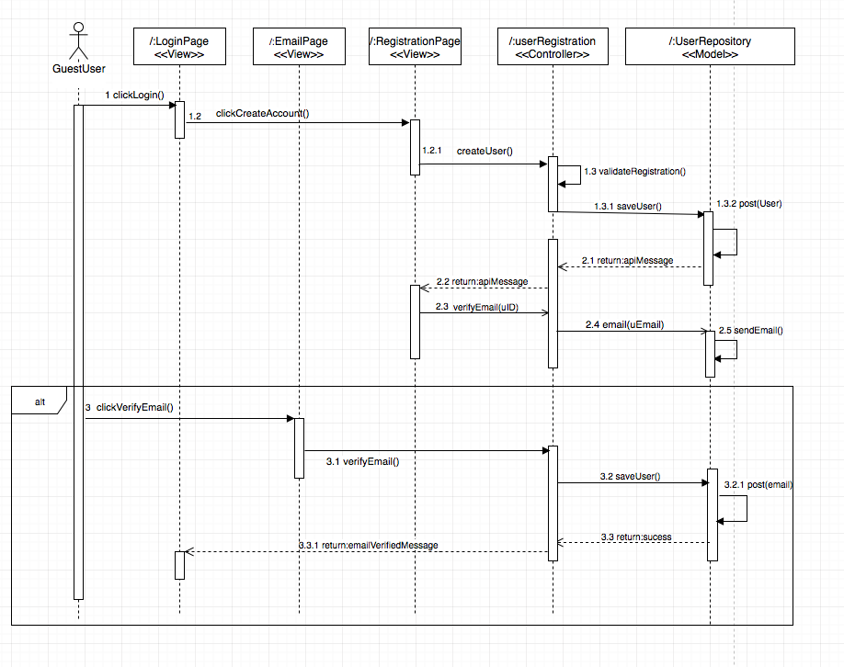
Sequence Diagram
Register User
Notes:
The sequence for registering a user, faculty members will use this, but since they have not registered, any guest
user will be able to register

Slide 14
Sequence Diagram
View ToDo list
Notes:
the to-do list will be used by faculty and the PI whenever there is any work that is pending

Slide 15
Sequence Diagram
View Current VIP teams
Notes:
The VIP teams page can be viewed by anyone, including guests. and it will load all projects that are currently active

Slide 16
Sequence Diagram
Student Login
Notes:
The student login page, which goes through Google's login

Slide 17
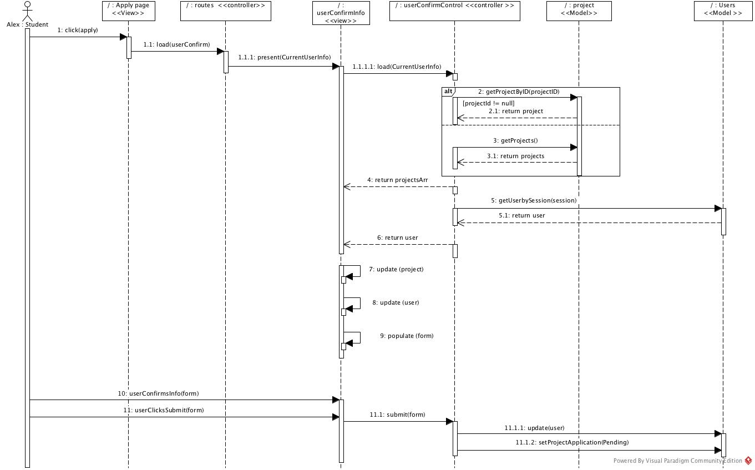
Sequence Diagram
Apply for existing project
Notes:
Applying for an existing project for students

Slide 18
System Design: Architecture
3-tier
Client-Server architecture
Notes:
Now we will discuss some of the system design.
We used a 3 tier architecture and Client-Server because it allows for separation of storage and application from the client which allows
for more security and it allows us to divide the work between developers among the layers

Slide 19
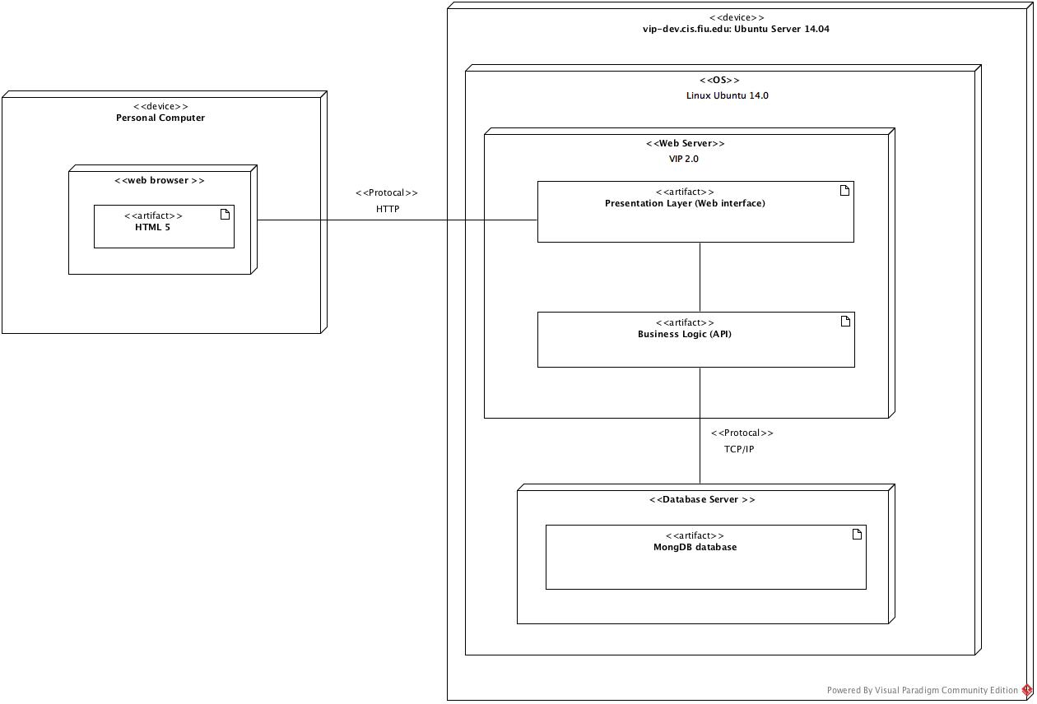
System Design: Deployment
Notes:
For out system deployment, it can be accessed by any browser. Including a browser through your mobile device. It currently connects through HTTP
and begins rendering the application

Slide 20
Persistent Data Design
Notes:
For our persistent Data, we used MongoDB, and we stored Users, projects, terms, and todo data

Slide 21
Security/Privacy
Oauthd authentication.
Hashing and salting of passwords.
Sanitizing user input.
Token based authentication (bcrypt).
Notes:
For the security and privacy, we used oauthd for students, as they login through google api and for the faculty members
we hash and salt the passwords. We also ensure that input from the user is sanitized in order to prevent unwanted
database accesses

Slide 22
Minimal Class Diagram
Notes:
These are all the classes that we used in our VIP project. We are using Angular, and this means that any time a page is loaded
it is injected into the current page, as you can see. Everything leads to the MainApp which is the main page that the user
interacts with

Slide 23
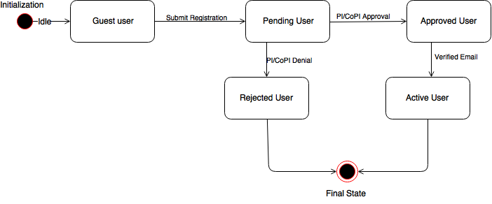
State Machine
Notes:
This is a statemachine for faculty member login. Initially the faculty member accesses the system as a guest, they will
then register for the VIP page, and will be pending approval. at this point, the PI and CO-PI will be able to choose
whether or not they would like to accept or rejet the faculty member, and the status of the account will reflect
their decision, The user will then receive an email notifying the user of the status of their account

Slide 24
Algorithm
Checks if the user is in the system yet
Ensure the email has verified the email
Ensures the password is valid by ensuring it meets all necessary criteria
The password will then be hashed and stored with bcrypt(which salts the password and adds more security)
Checks if the user has been approved by a PI
If all checks pass, the user can then login, otherwise the login will fail
Notes:
The algorithm for the accounts is as follows.
It will check if the user has registered for the system yet, if they have it will perform a series of checks.
It will ensurethe email has been verified
It will ensure the password meets all criteria imposed by the admin
If so, it will salt and submit the password through bcrypt
Then it will check if the user has been approved by a PI.
If all checks pass, the user will be logged in, otherwise he will be notified of the failure

Slide 25
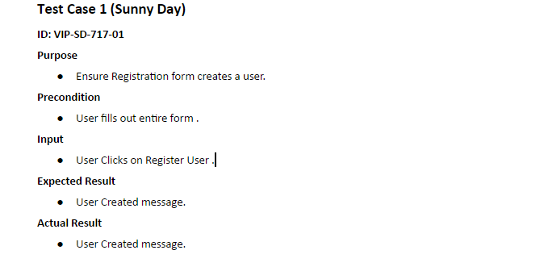
Test Cases
Notes:
1 sunny day case for this user story is to ensure a user can be entered into the system if they enter all
required information successfully. When the user hits submit, the user will be creating and receive a message notifying
them they successfully registered

Slide 26
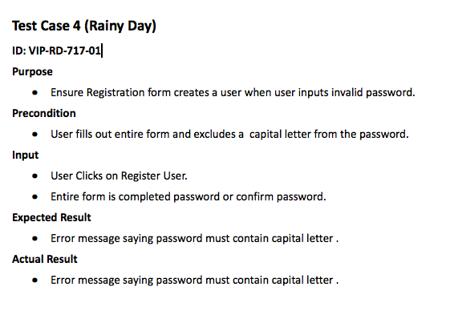
Test Cases
Notes:
one of the rainy day cases for this user story is to ensure that the user will not be created if they input an invalid
password. This was tested by entering a very weak password that did not contain a capital letter. When submit was clicked an error message
notified the user that the password was missing a capital letter

