Slide 1


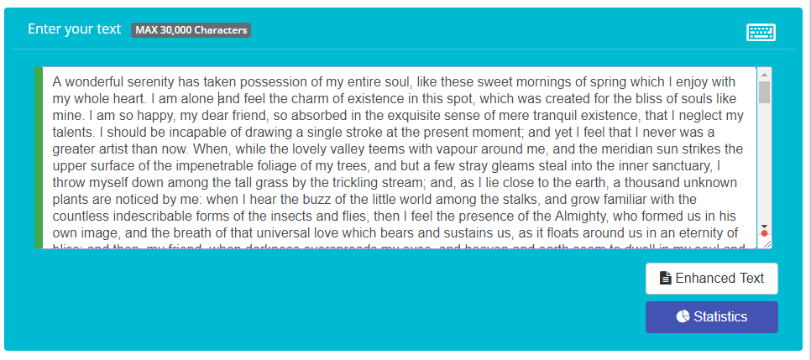
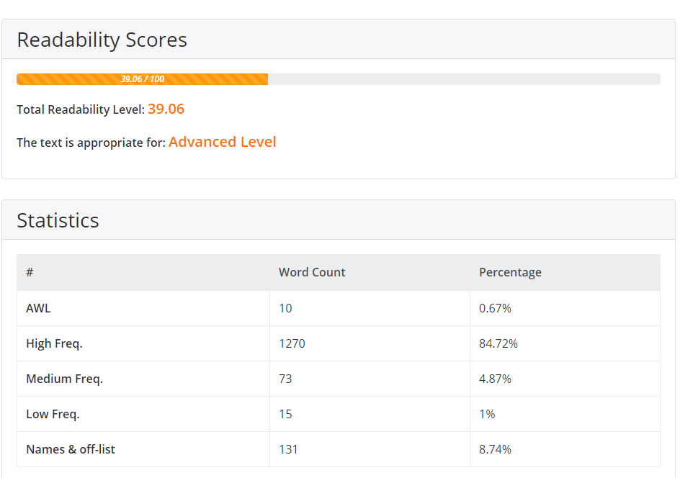
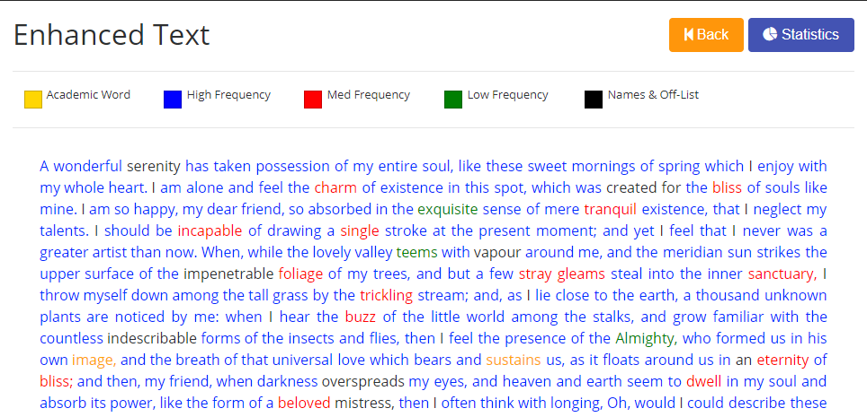
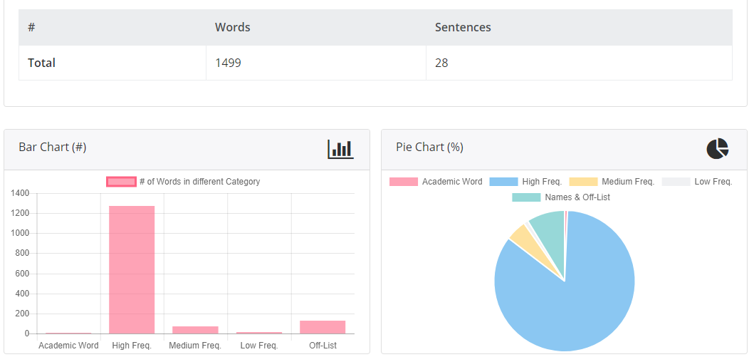
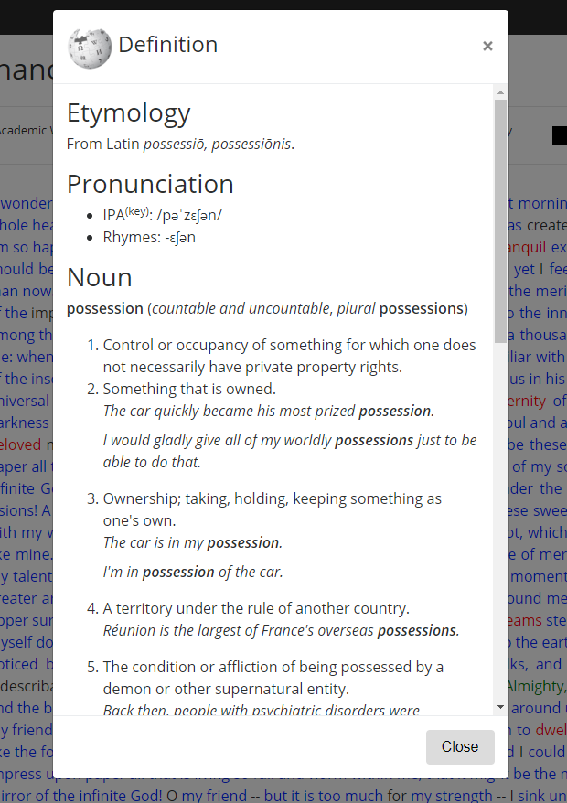
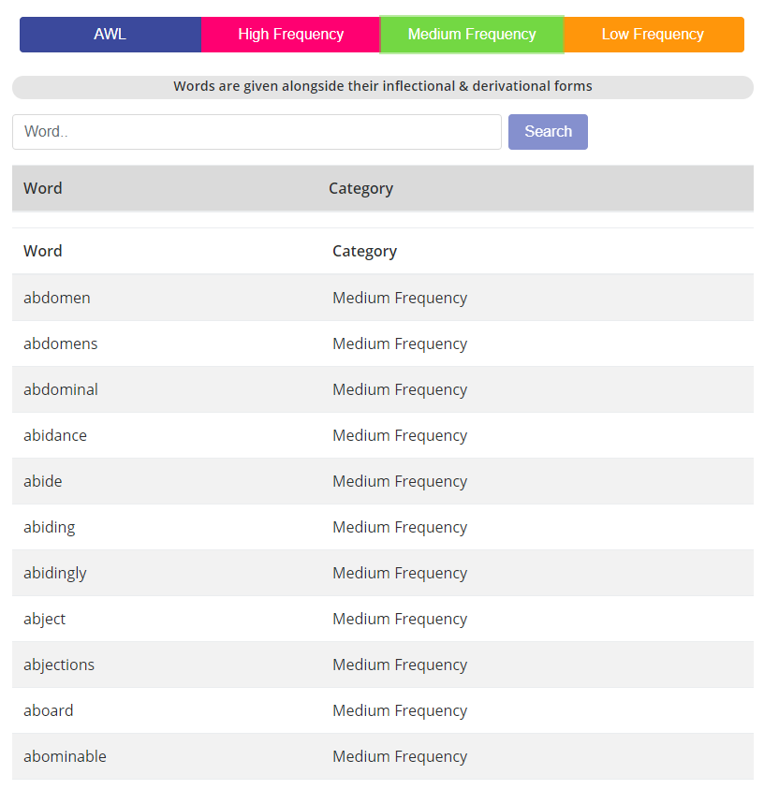
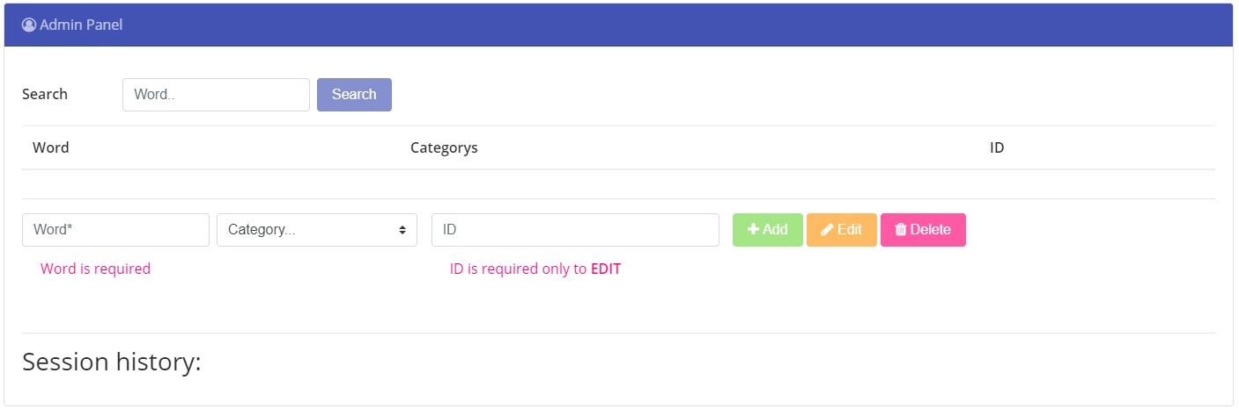
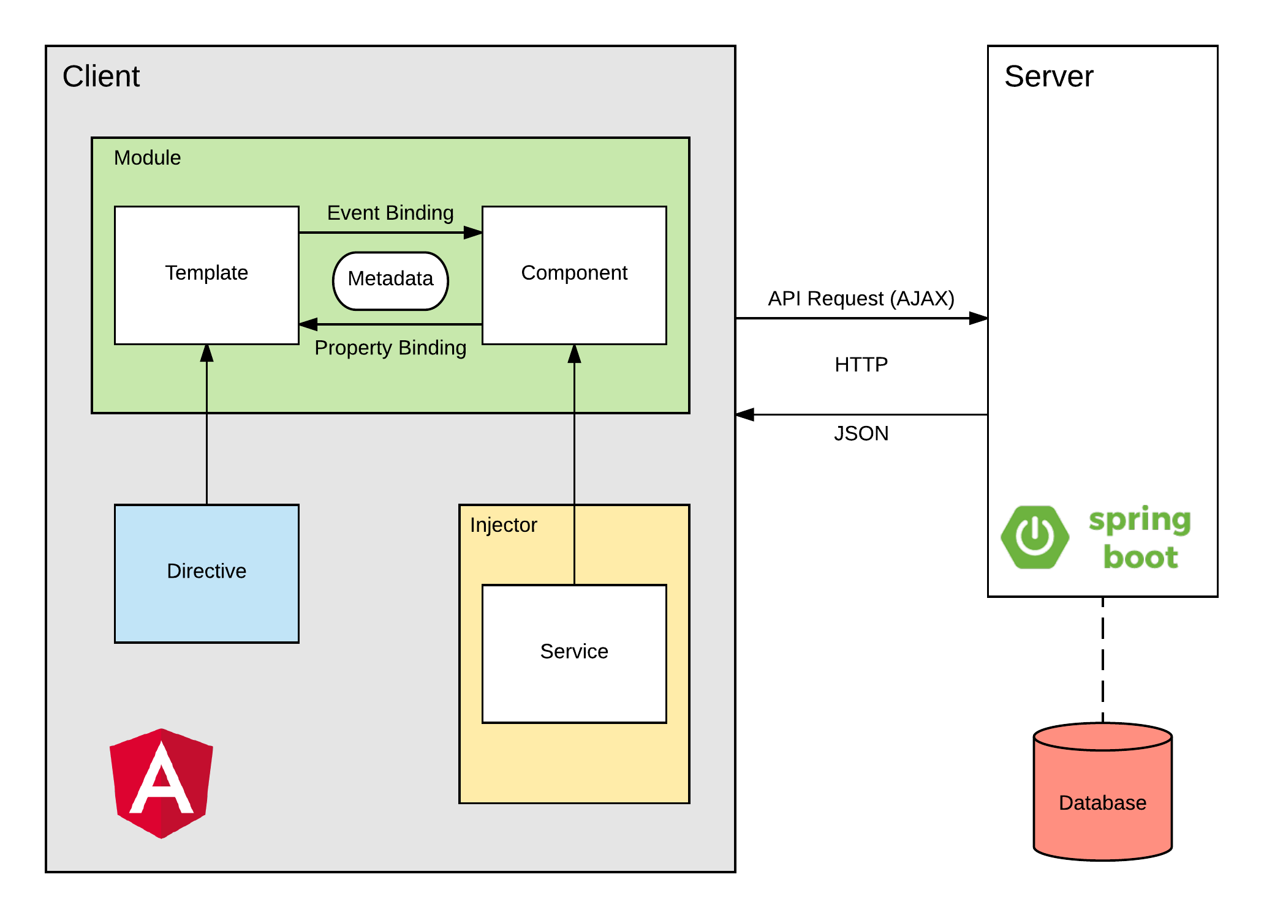
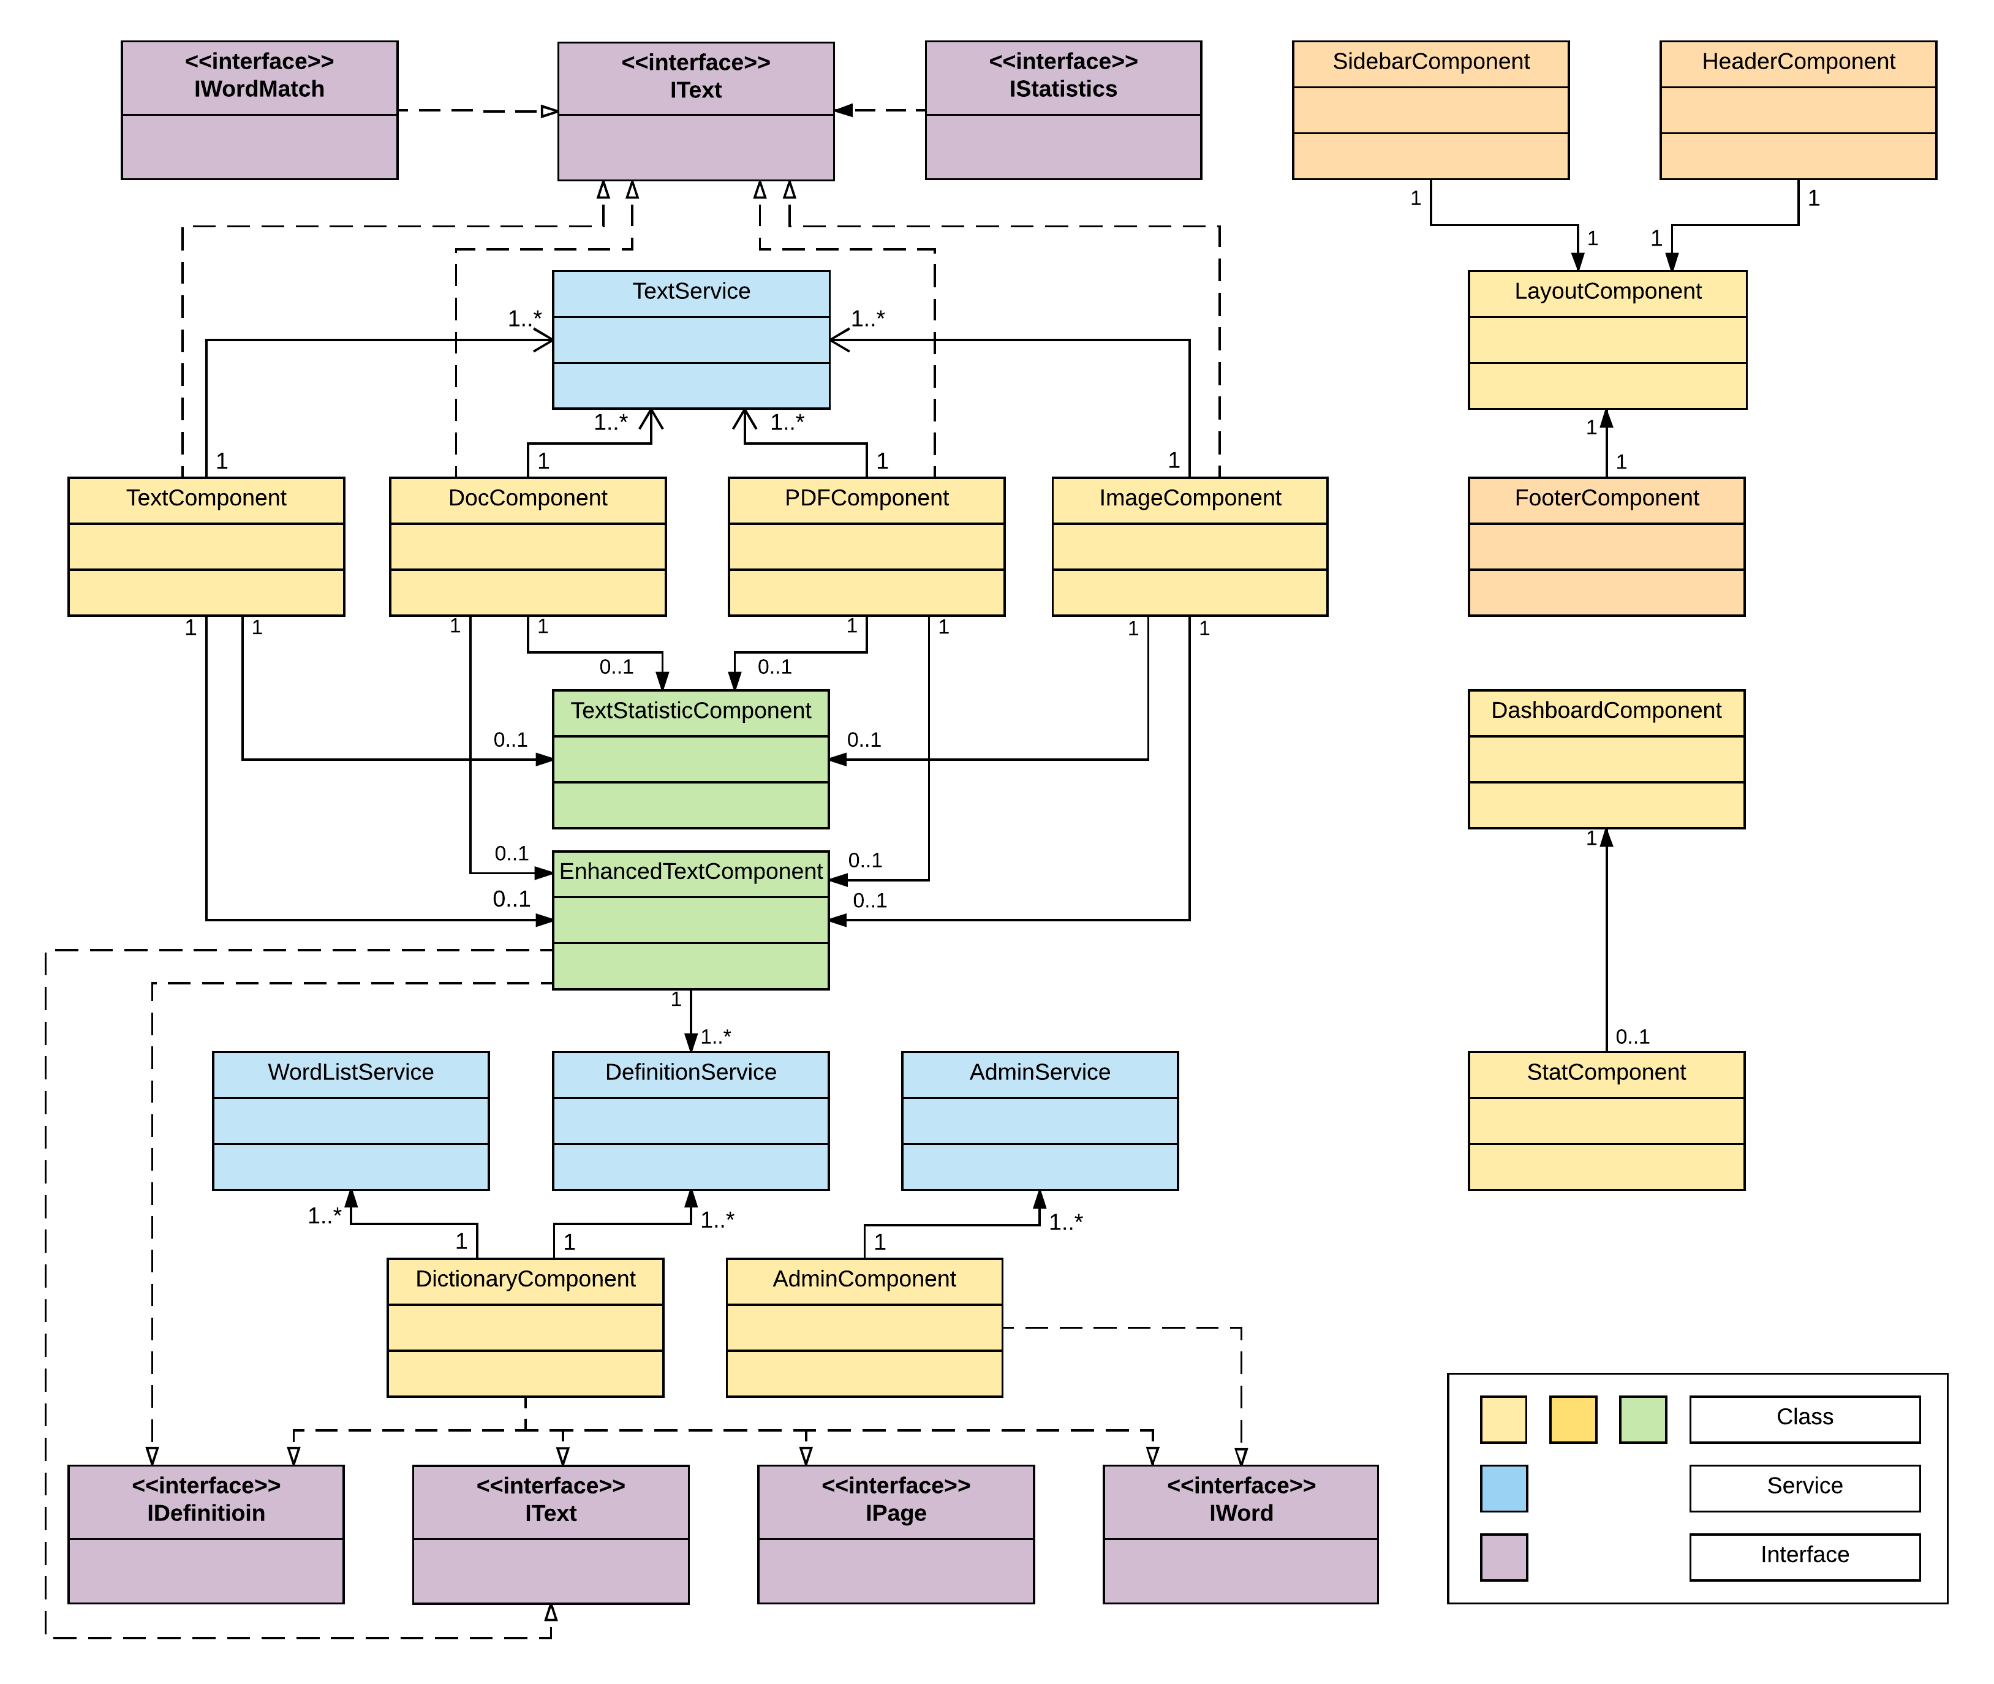
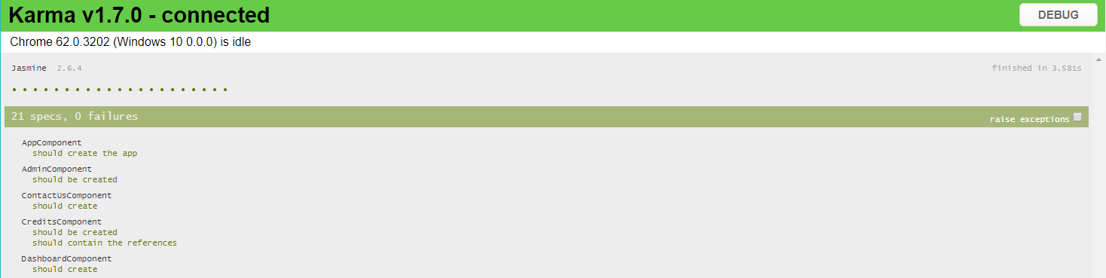
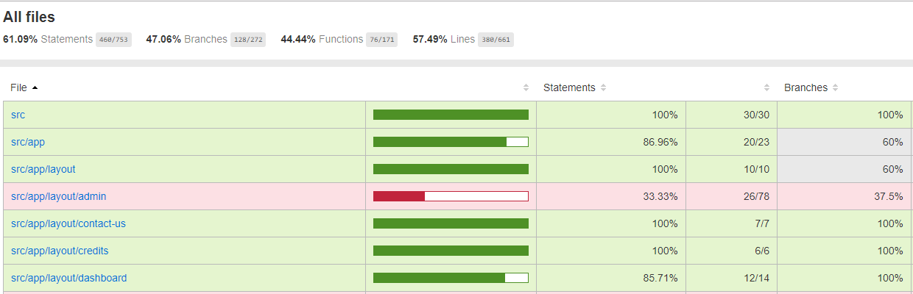
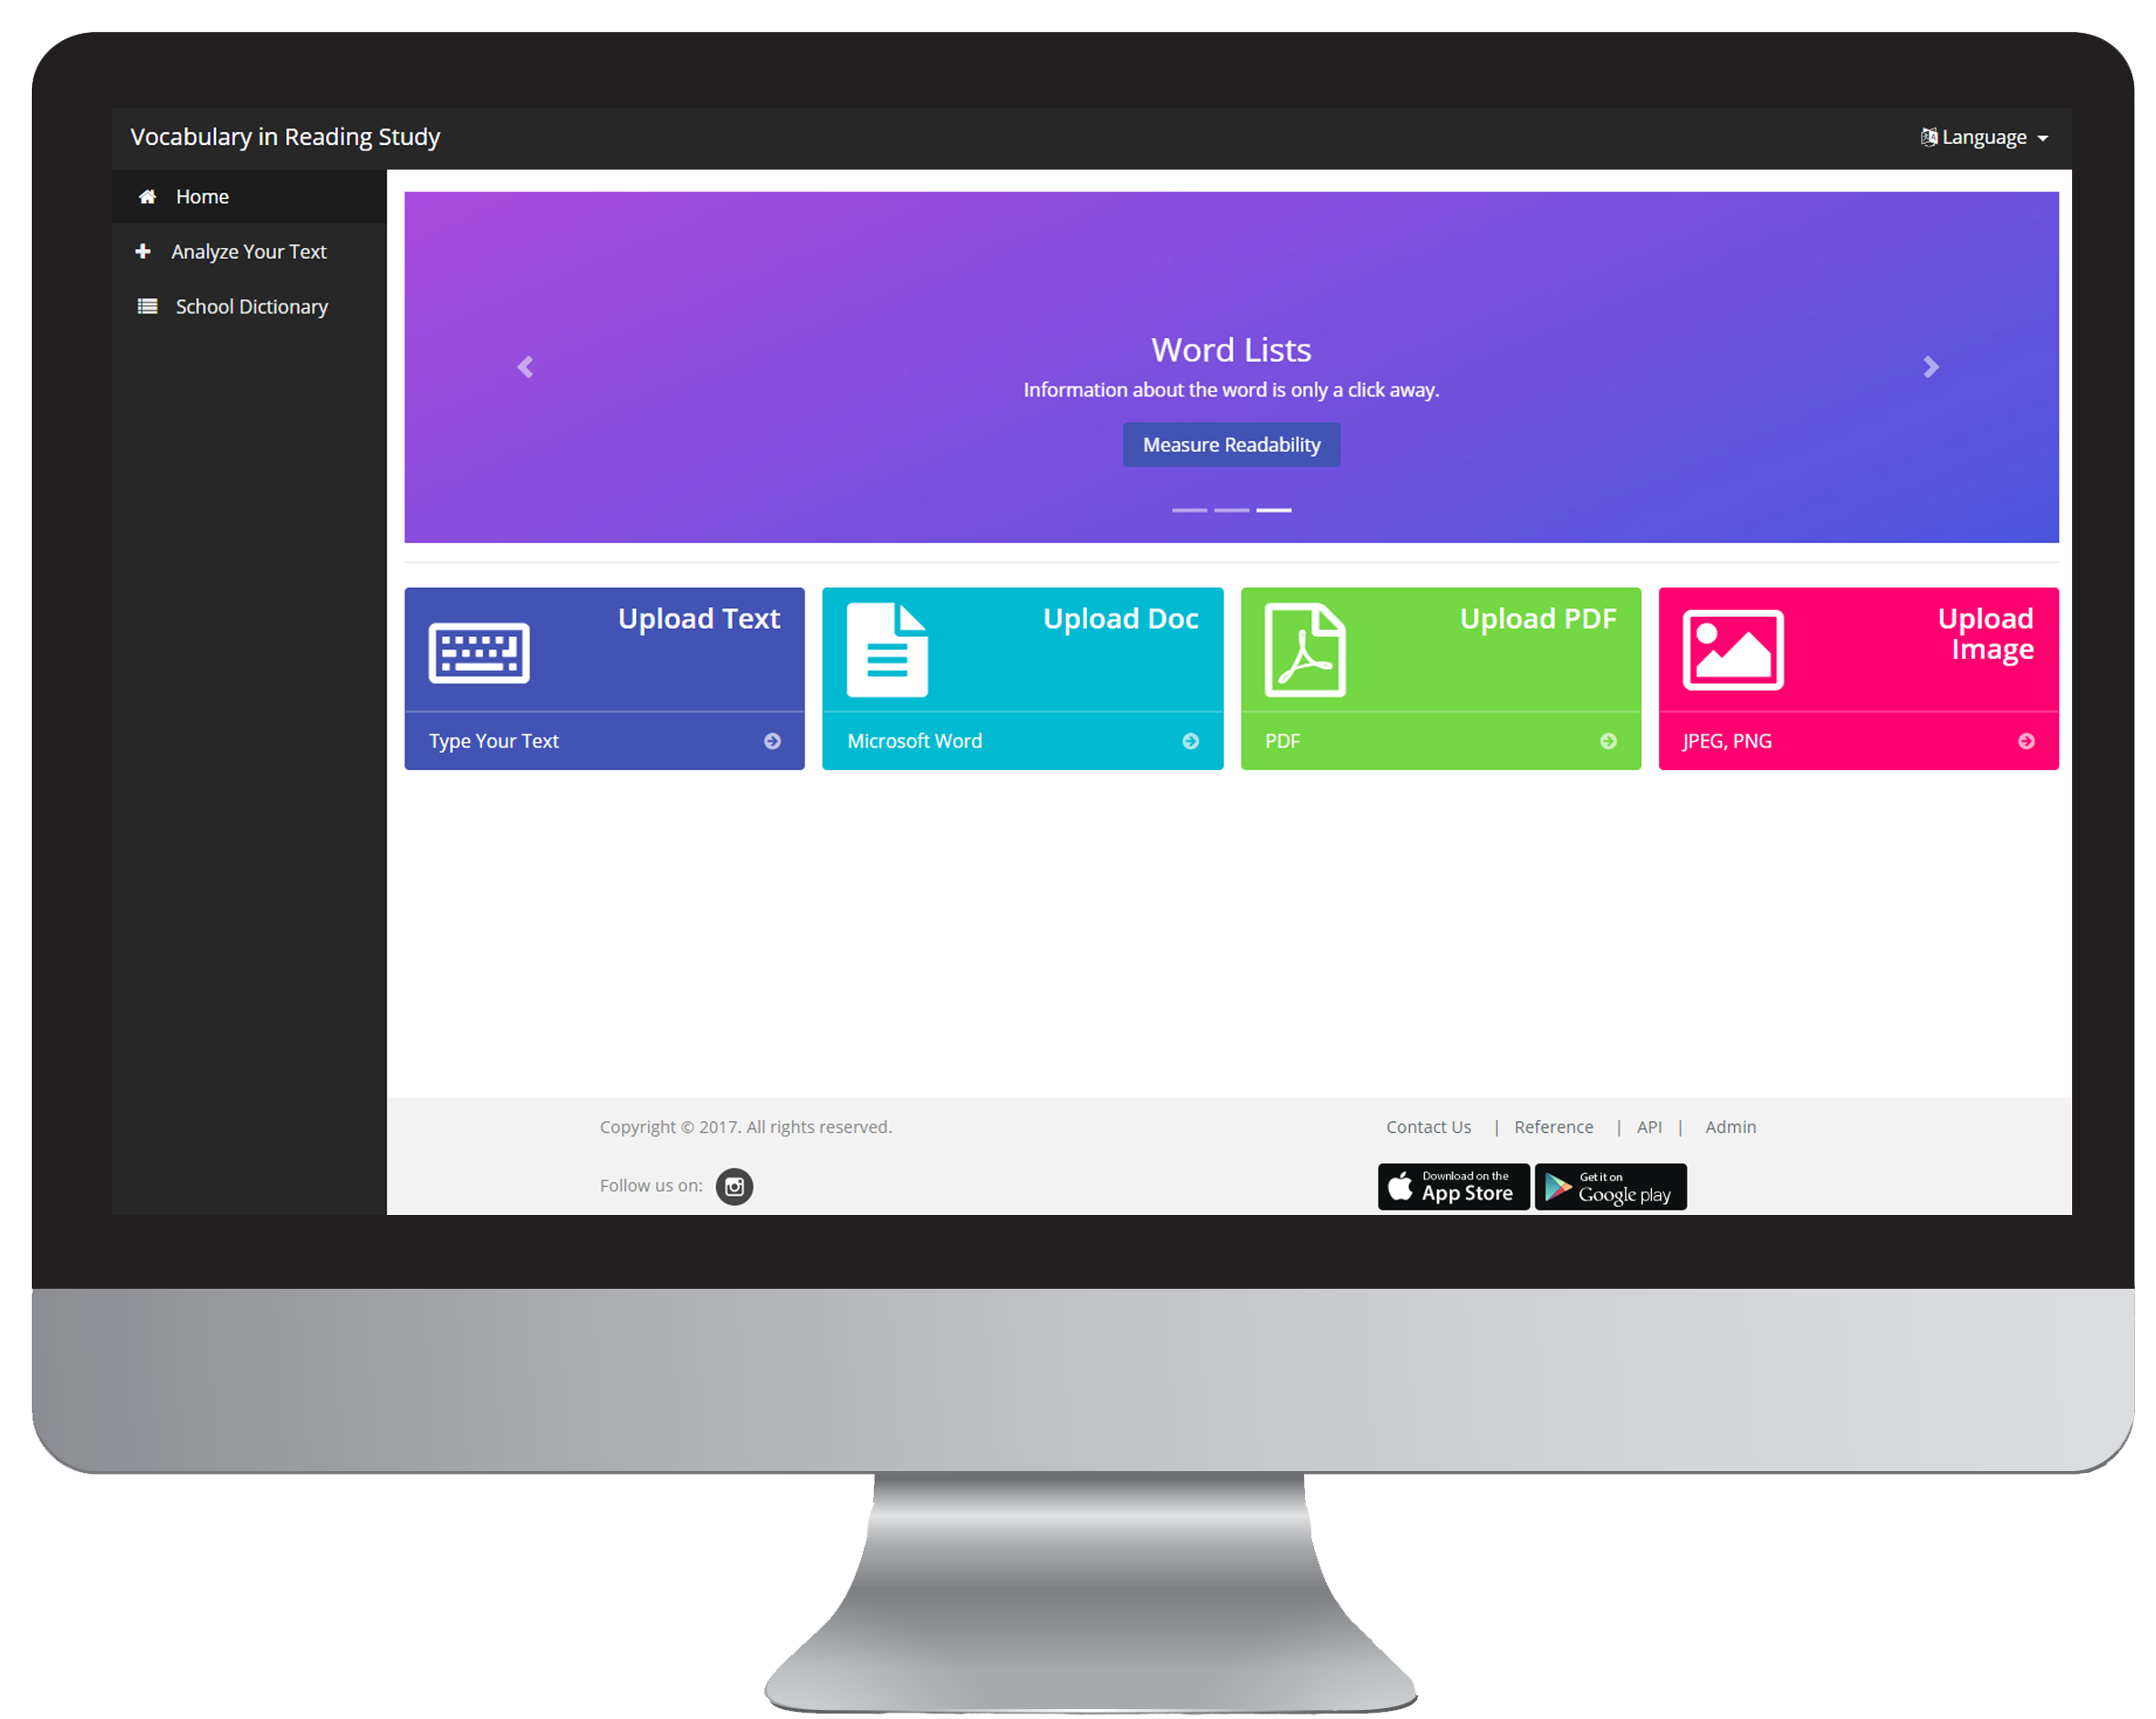
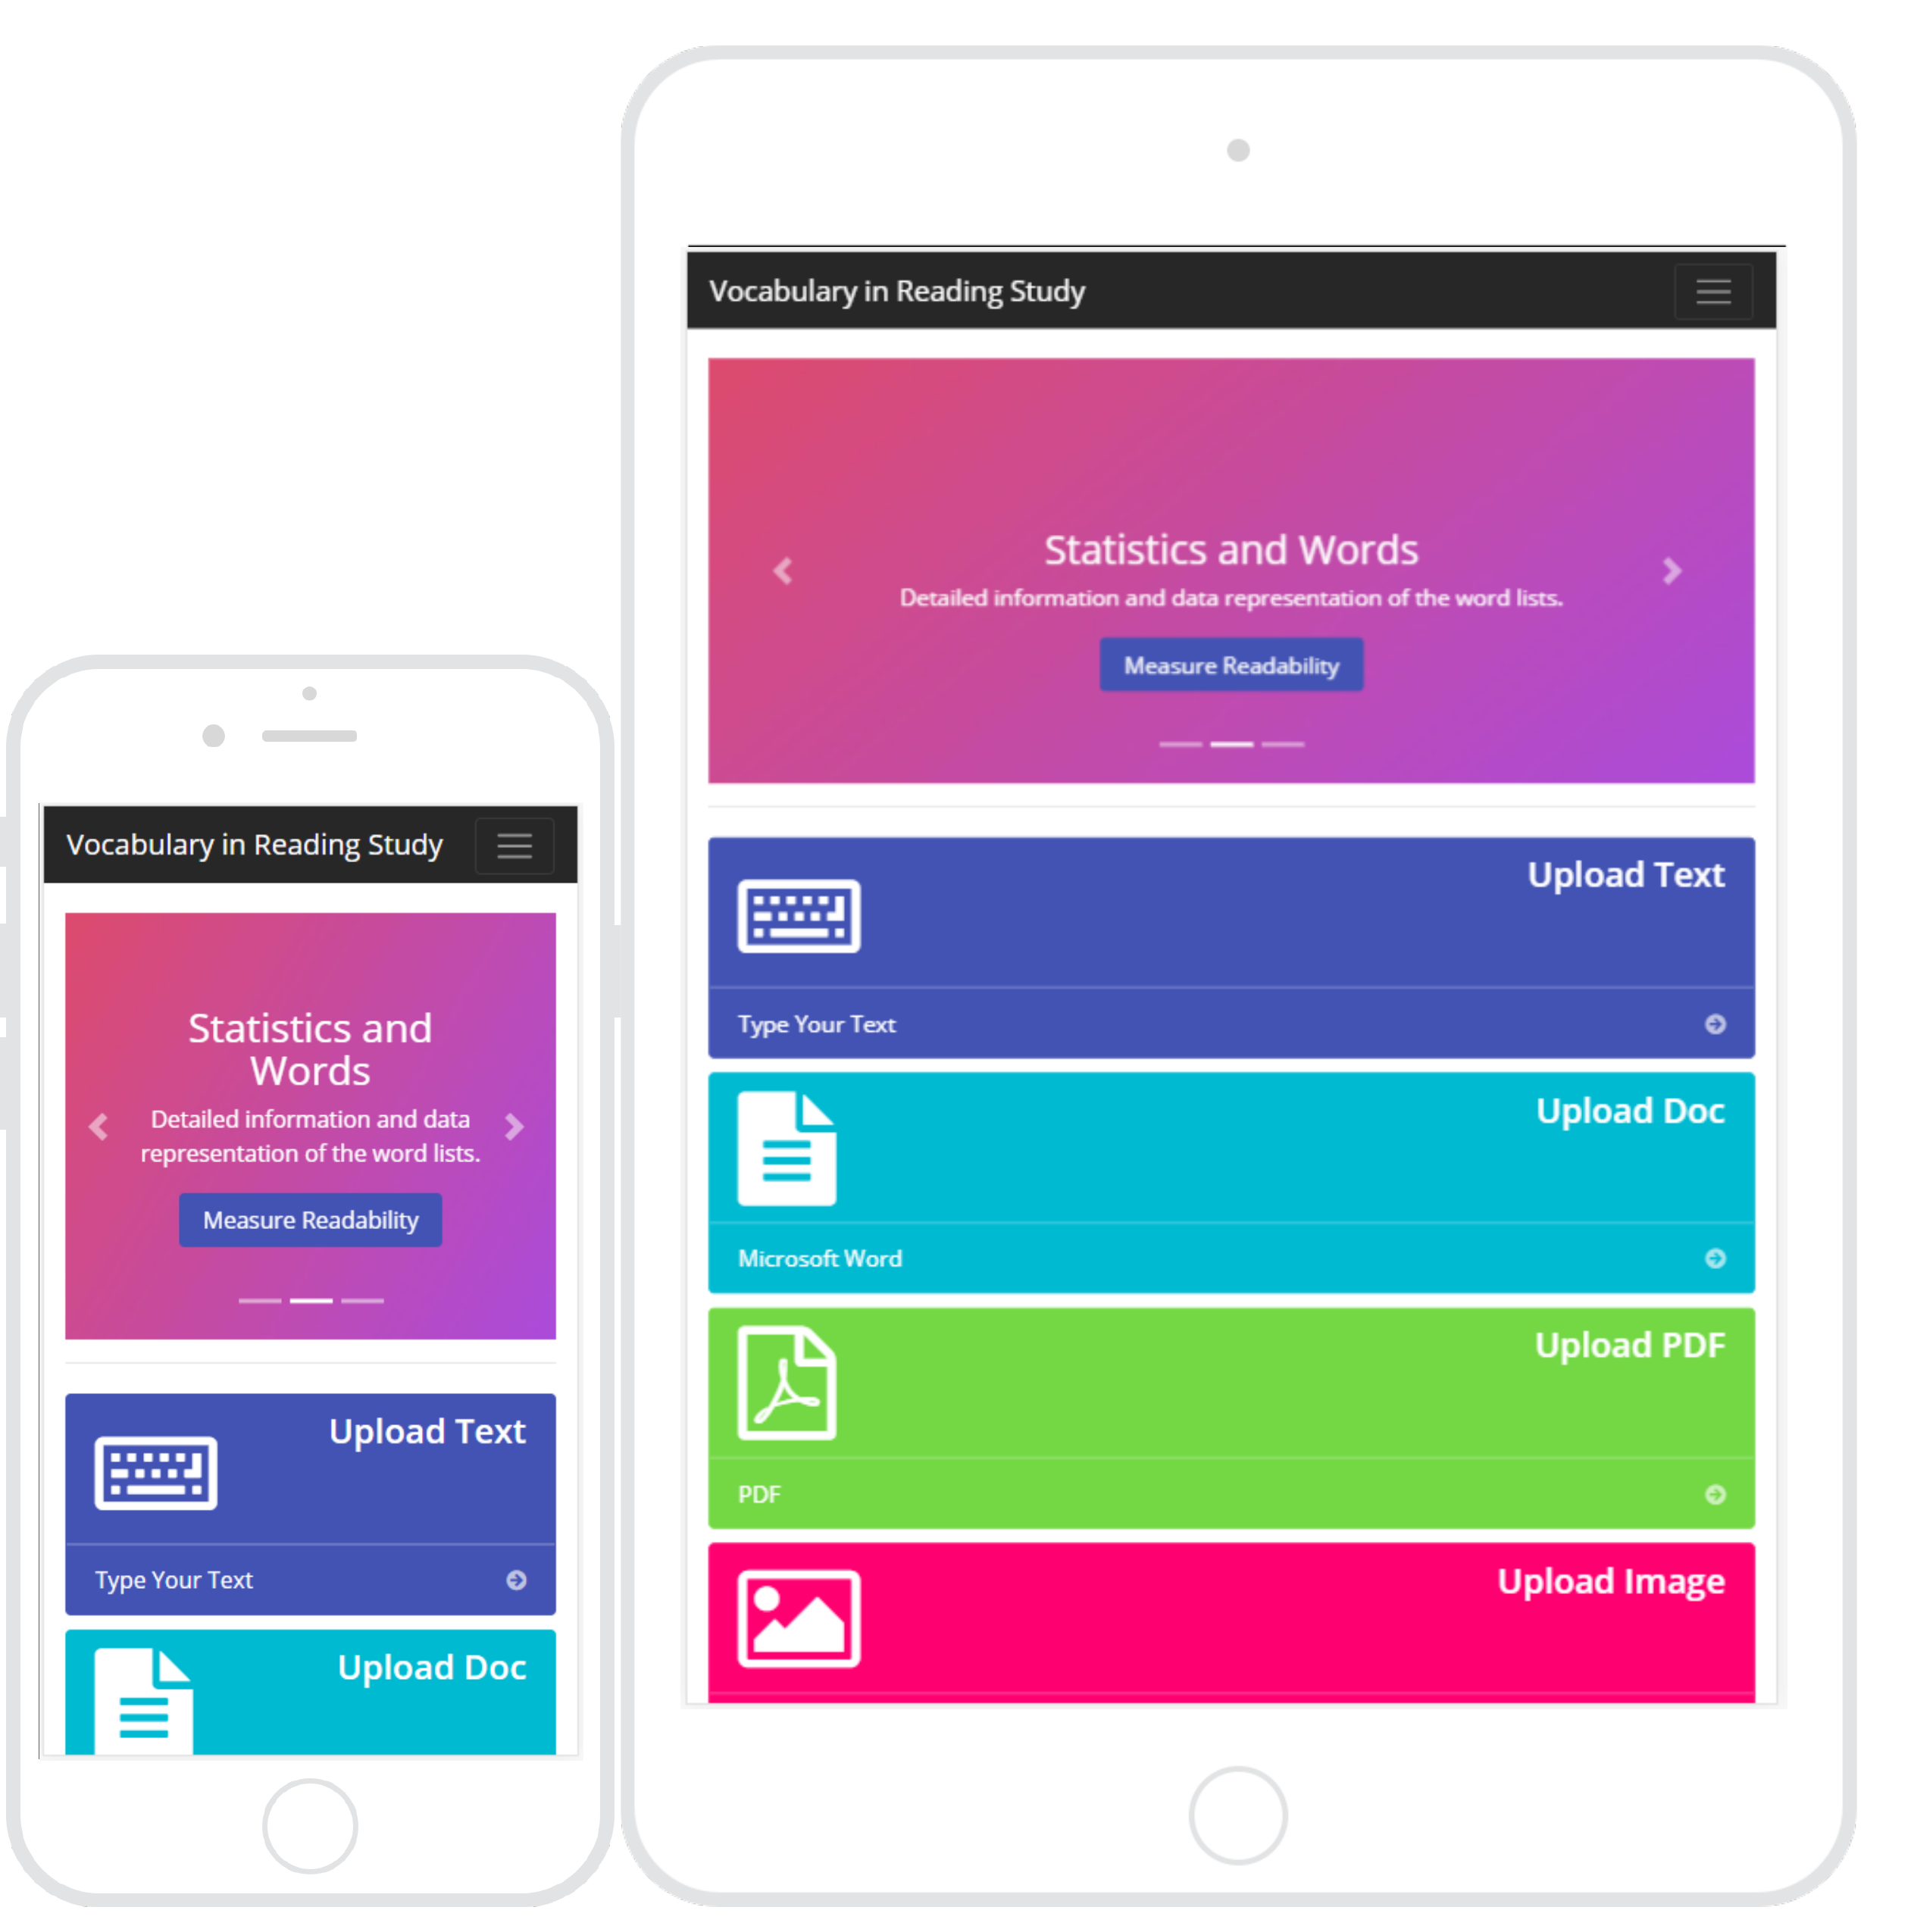



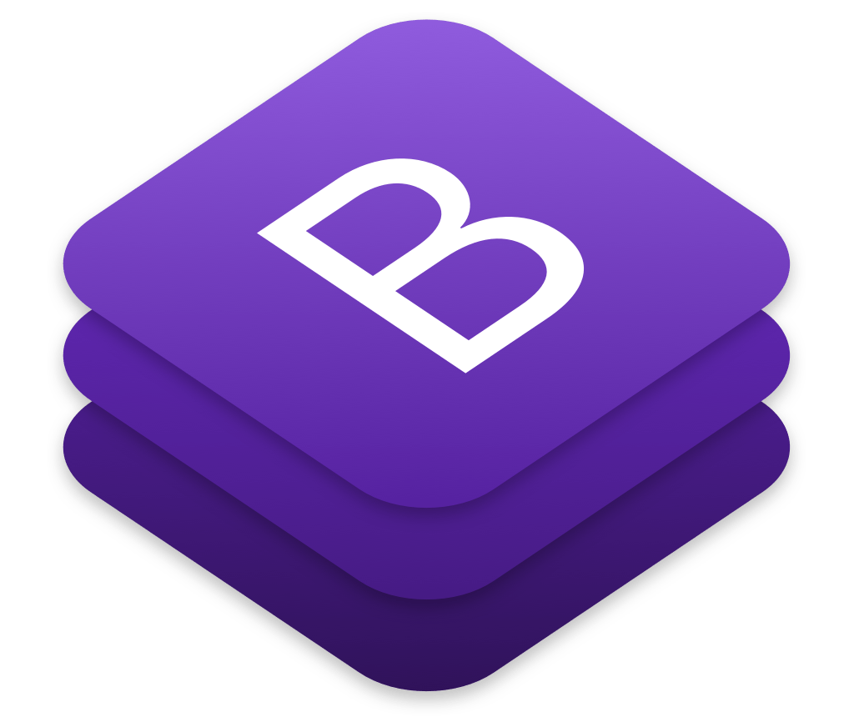
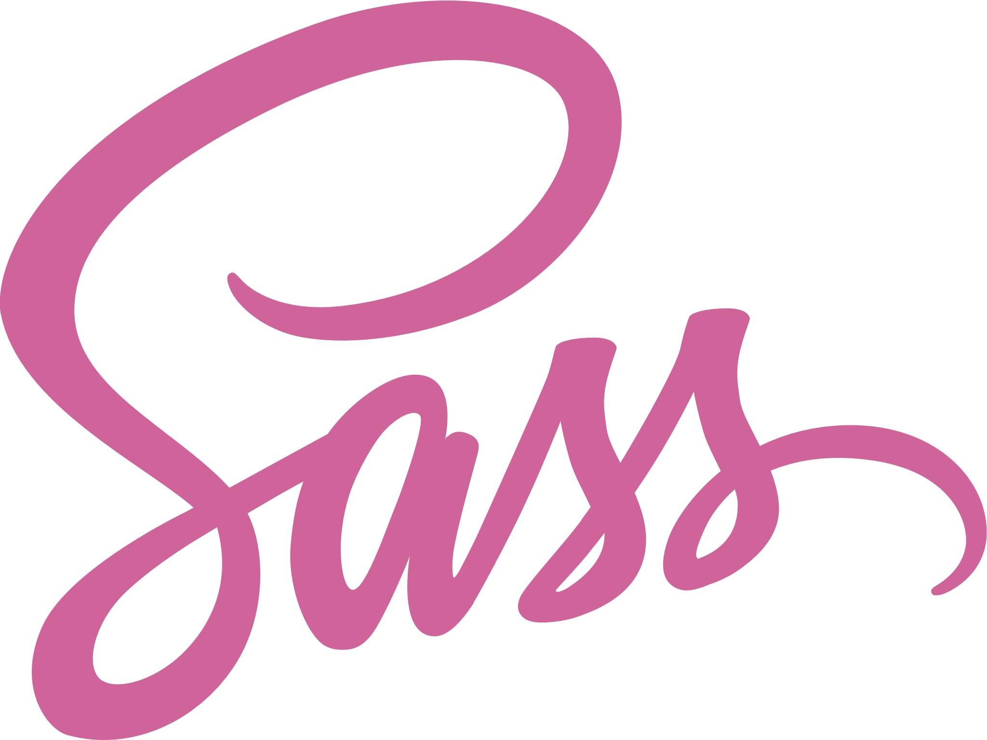


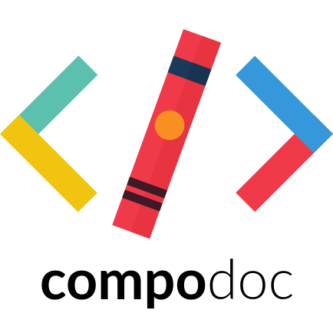


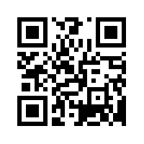
Senior Project, 2017, Fall
VIRS 2.0
Student: Milad Ebrahimi, Florida International University
Mentor: Leila Zahedi, Florida International University
Professor: Masoud Sadjadi, Florida International University
Problem
Requirements
Implementation
The challenges that English language learners (ELL) as well as mainstream students are faced with:
Lack of a reliable source for improving their academic words.
Lack of a reliable source for working on STEM-related words.
Lack of a dictionary particularly designed and developed for school purposes.
Lack of a reliable and validated source for teachers to measure readability.
User must analyze text, doc, PDF and image.
User must be able to see an enhanced text color-coded result.
User must be able to see a test statistics as well as readability score.
User must see the word’s definition.
User should be able to search through the word lists.
Admin should add, edit and delete words from database through the admin panel.
The web application should be accessible from desktops, tablets and mobile devices.
The Frontend was developed with Angular 4 framework along with Typescript to achieve a single-page application that interacts with the user by dynamically rewriting the current page rather than loading the entire pages from the server.
HTML5, Sass, bootstrap and ng-bootstrap were used for UI components of the frontend.
Solution
Screenshots
VIRS meets these challenges through an easily-accessible application and website:
Produces enhanced texts through a color-coded system.
Provides reliable readability index that would help teachers in decisions making.
Gives a detailed analysis of texts that would help in material development.
VIRS helps teachers use OCR technology and then shifts it through a vocabulary profiler.
VIRS has a new frequency-based dictionary that makes it easier to read.
In future, VIRS will also offer these unique features in Spanish, Persian and Arabic.
Current System
VIR 1.0 was two separate applications, one powered by PHP, another one running on MEAN Stack.
The only available feature on that version was to analyze text.
In VIRS 2.0 we accomplished all the requested requirements noted above.
System Design
Object Design
Verification
Karma and Jasmine were used to perform unit testing for frontend.
Compodoc and Istanbul were used to generate a code coverage report.
Acknowledgement
The material presented in this poster is based upon the work supported by my mentor Leila Zahedi and Instructor, Prof. Masoud Sadjadi I am thankful to the help that I received from my group member Alfredo Lopez.

