Slide 1


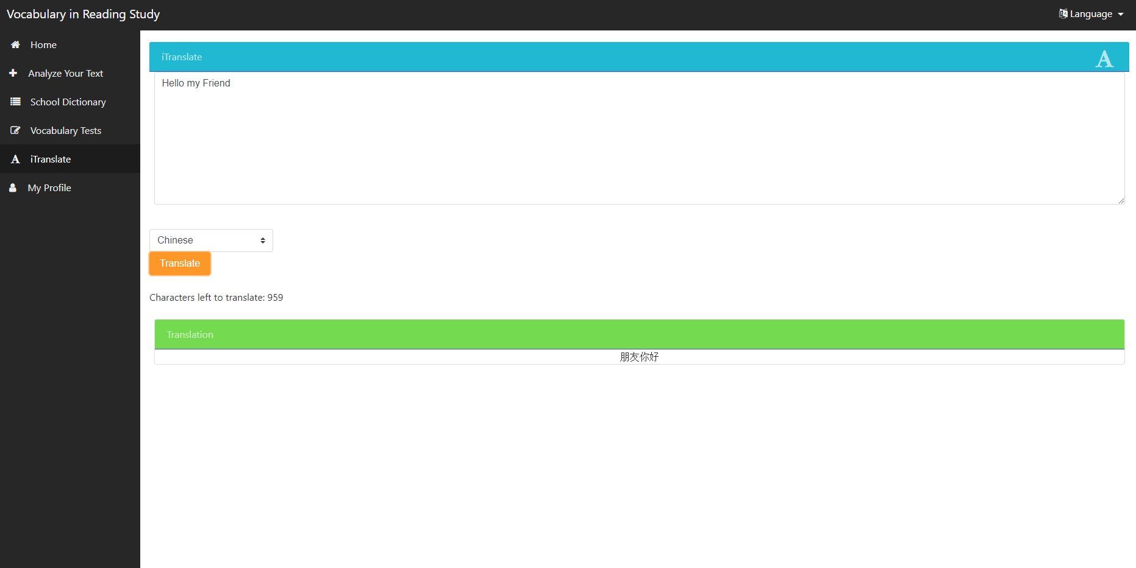
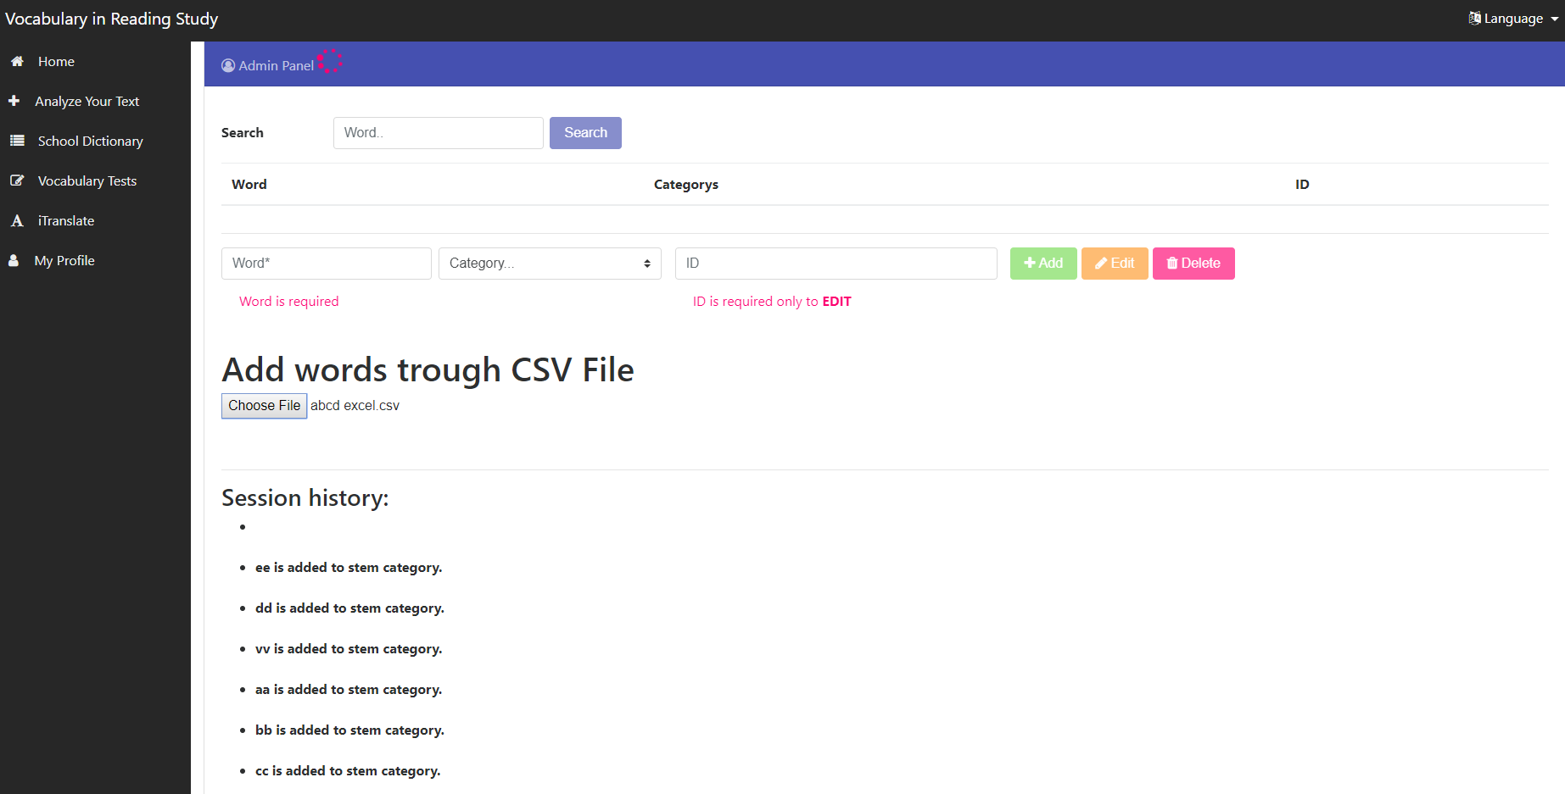
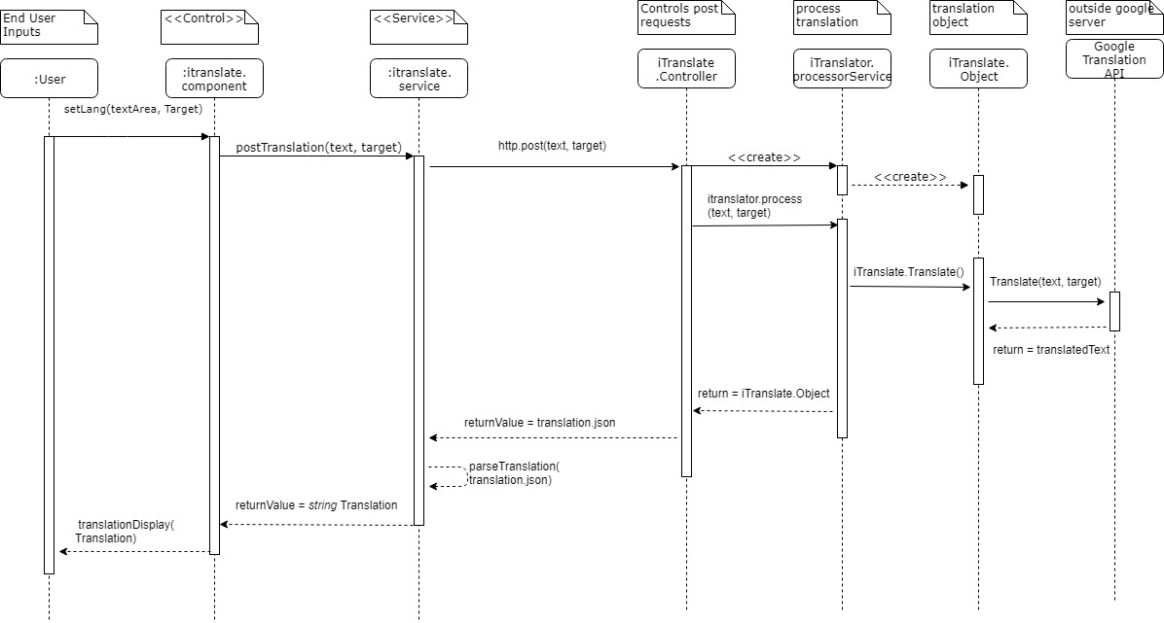
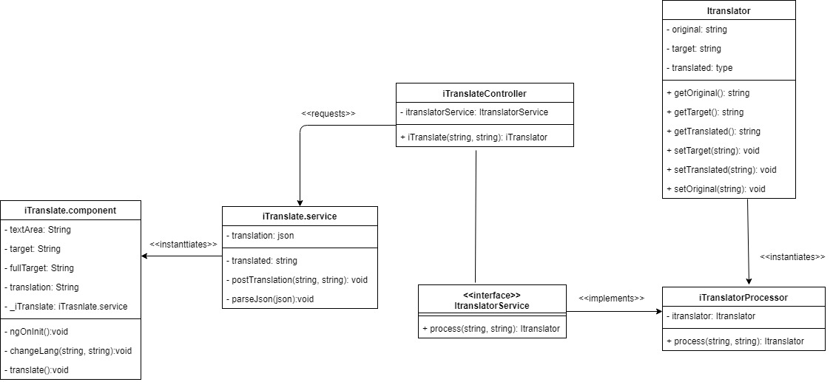
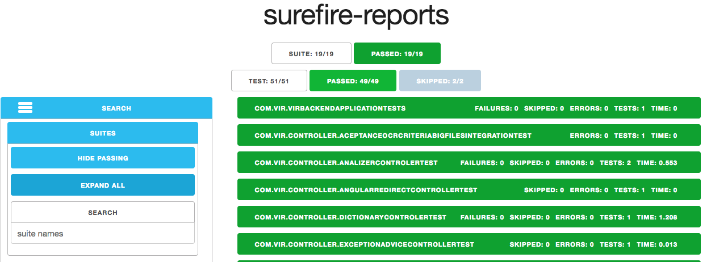
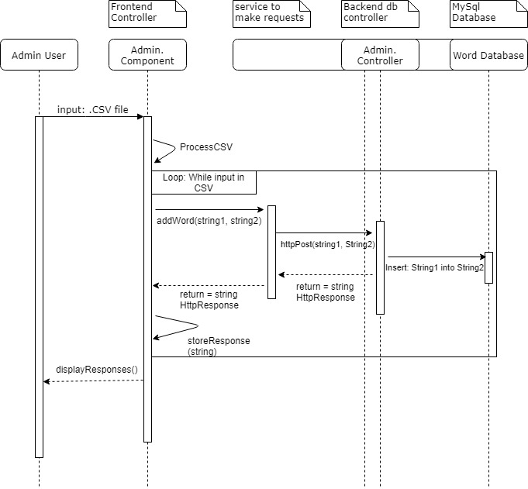








Senior Project, 2018, Spring
VIRS 3.0
Student: Juan Carlos Valladares, Florida International University
Mentor: Leila Zahedi, Florida International University
Professor: Masoud Sadjadi, Florida International University
FOLLOW US @FIUSCIS
Problem
Professor wants to provide a translator for users learning English.
Professors can only add one word to his word database at a time. Wants to be able to add more at once.
Solution
Create, in the current context of the web application, an option for user to input text and have it translated to desired language.
Create a tool for admin to upload a .csv file.
The application will process the csv file and add words to database.
Current System
The current system has features for analyzing texts.
Does not have a translator for the users.
System currently has a tool to add words to the database,
System can only add one word at a time.
Screenshots
.
Requirements
Application can translate users text to desired language
Administrator has to be able to add multiple words to database
Application has to display new added words
Sequence Diagram: iTranslate
Implementations
A user can input a string of text and then the user can select a language to translate to.
We then make a request to Google’s translation API. Google detects the language of input, and we get a translation back as a JSON format.
We extract the translation from the JSON and display it to the user.
The system counts how many characters a ‘user’ has translated. We can then limit their usage through cookies.
The admin can upload a csv file. We check that it is a csv file.
Then we read through the file. and find how many words there are in the csv file.
Then we add each word in the csv file by using existing ‘add word’ functionality in a loop.
Class Diagram: iTranslate
Verification
Junit was the main tool utilized to verify the system.
Implemented several integration tests that are run before deploying to the web.
Sequence Diagram: Add Multiple Words
Summary
Users learning English can now translate words and sentences in the application.
The administrator can now add multiple words to the database by uploading a csv file with the required information.
Acknowledgements: The material presented in this poster is based upon the work supported by my mentor Leila Zahedi and Instructor, Prof. Masoud Sadjadi I am thankful to the help that I received from my group member Christian Hidalgo.
Notes:
1

