Slide 1











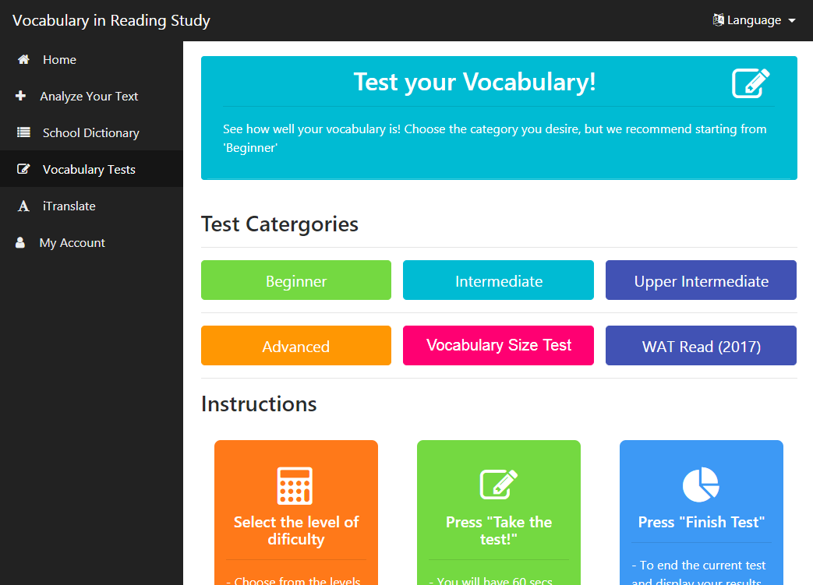
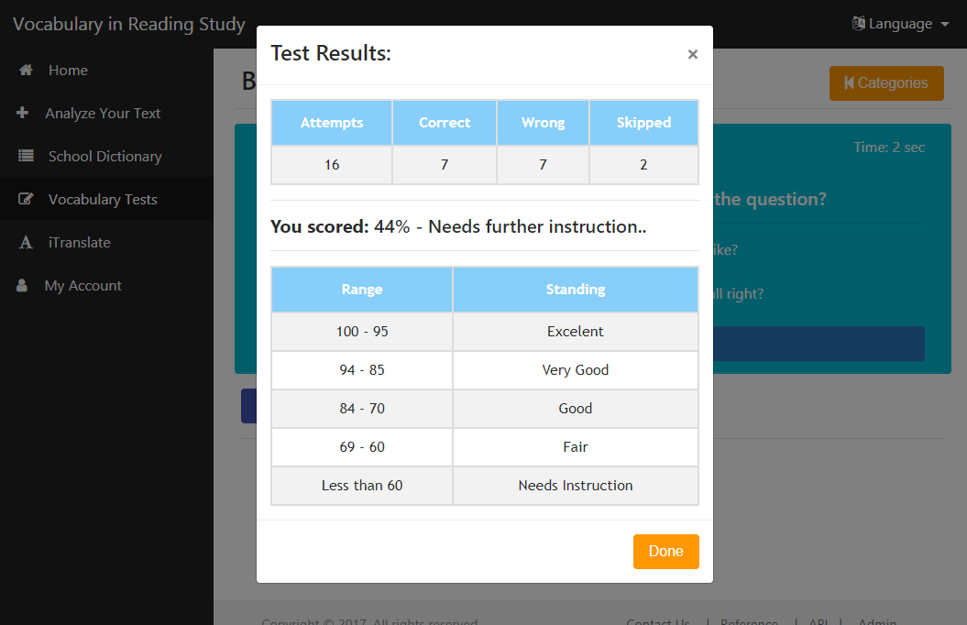
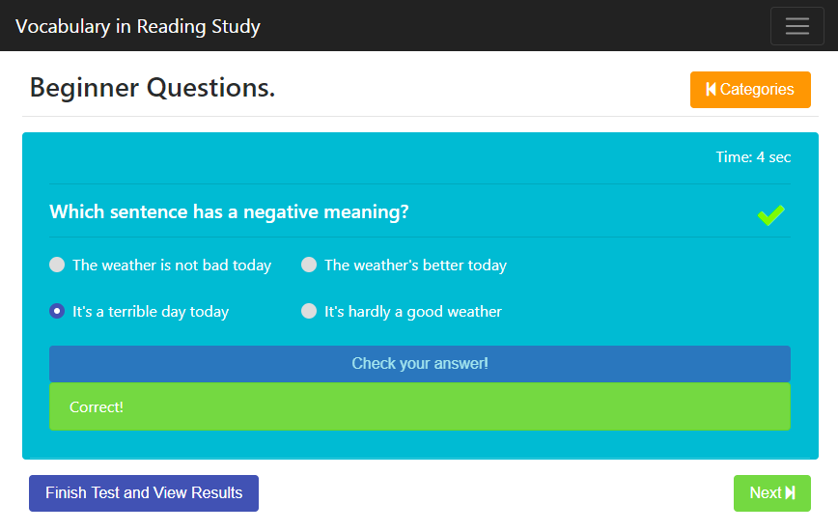
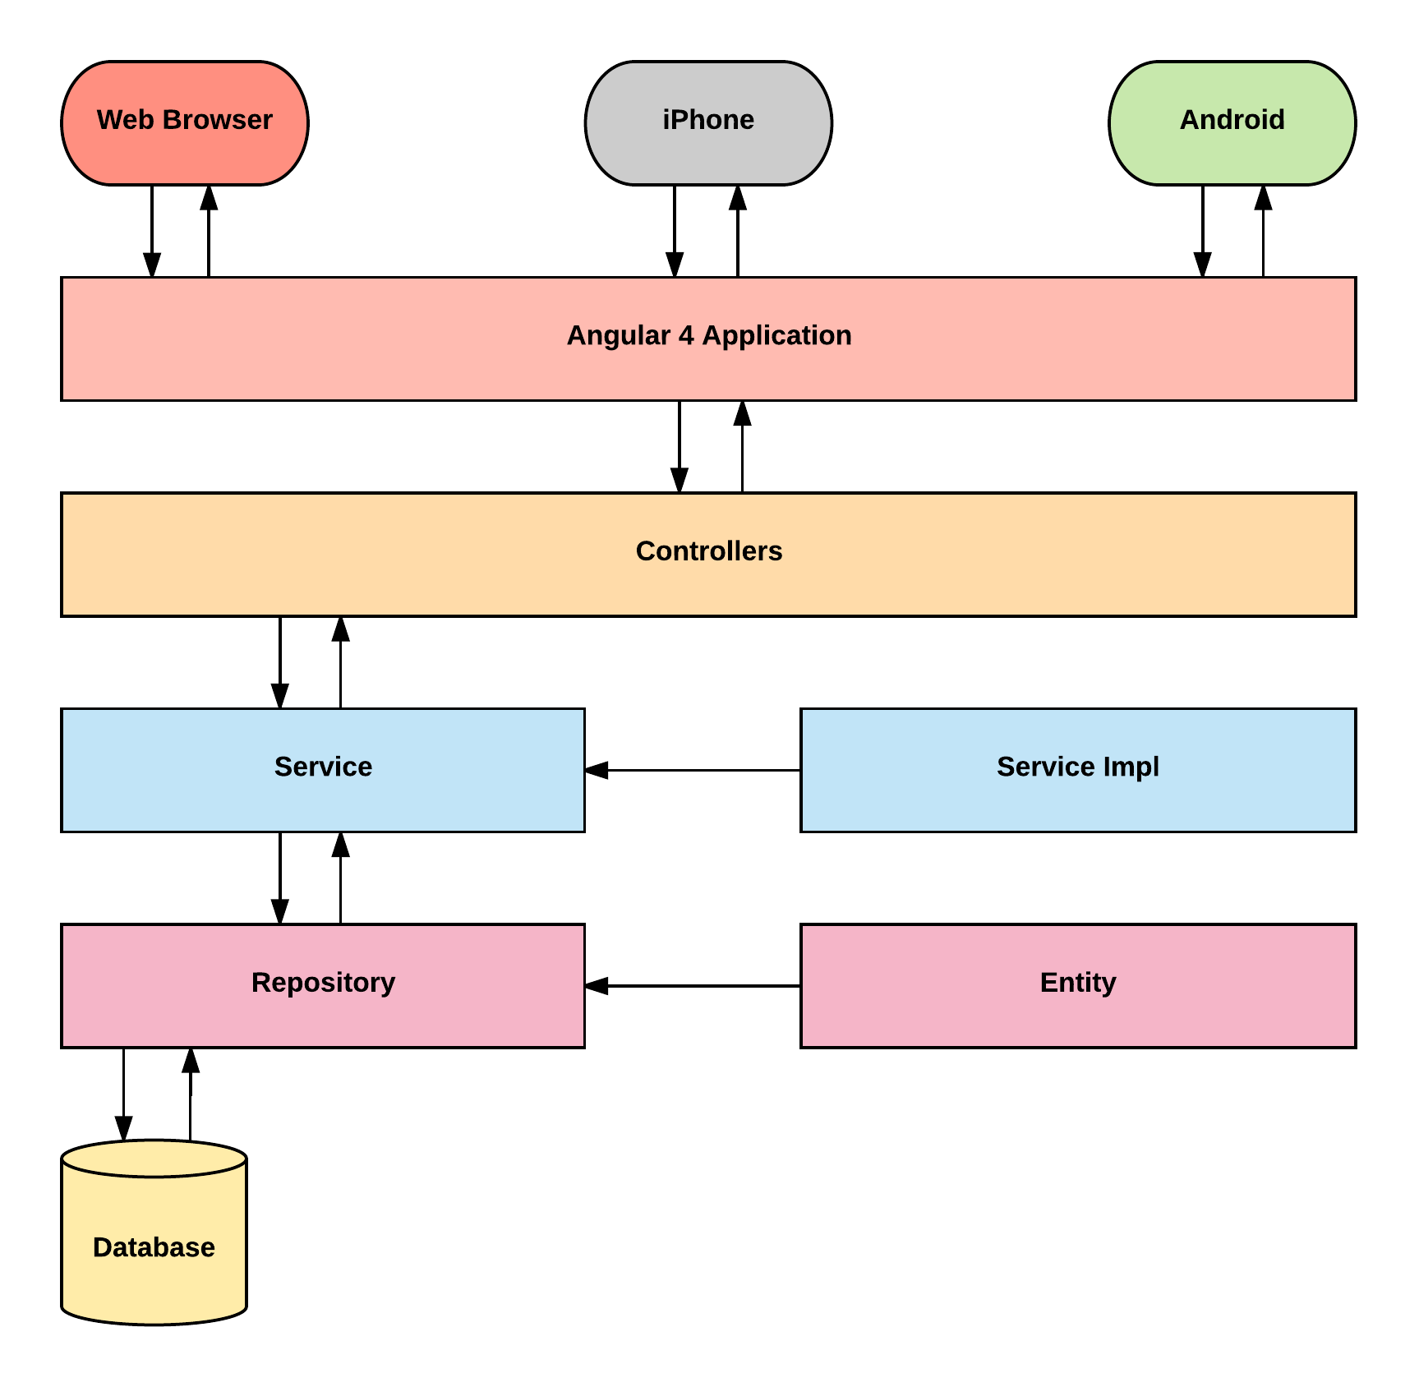
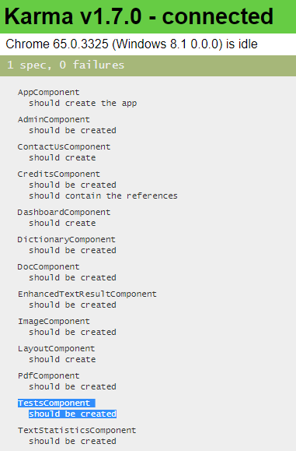
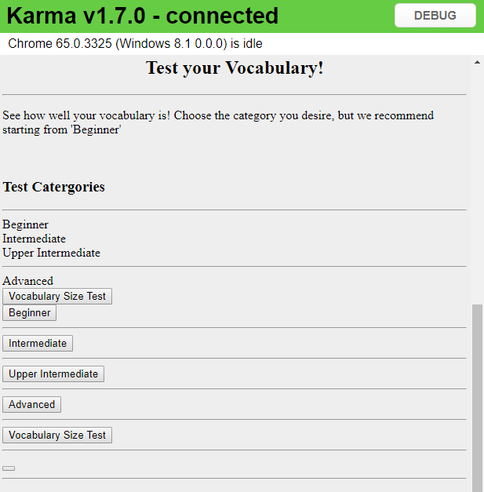
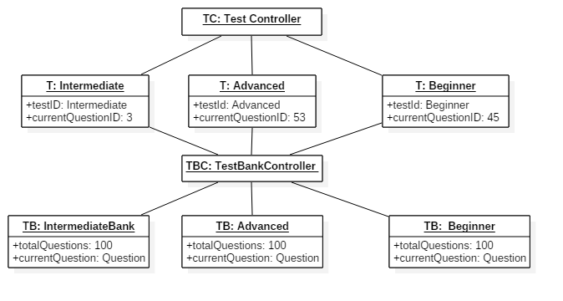
School of Computing & Information Sciences
Senior Project, 2018, Spring
Vocabulary in Reading Study 3.0
Student: Christian Hidalgo, Florida International University
Mentor: Leila Zahedi, Florida International University
Professor: Masoud Sadjadi, Florida International University
Problem
Some difficulties that students face with
while learning the English language are:
Lack of reliable source for improving their academic and STEM vocabulary
- Place where they can challenge their
vocabulary
- Understanding the English vocabulary
Solution
Design a series of tests that will help the student increase/test their vocabulary
Provide instant feedback and give a final evaluation at the end of session.
Make different levels of vocabulary tests available for students.
Current System
- Current system is available in both
Android and IPhone, as well as
Desktop
- VIRS 2.0 did not have testing
implemented
- VIRS 3.0 has been modified to meet
the requirements described below.
Screenshots
.
System Design
Model-View-Controller Implementation
Requirements
- Users must be able to take tests.
- Users must be able to choose the
desired level of testing.
- Users must be able to skip a
questions should they desire.
- Users must be able to submit their
testing attempt.
- The system must be able to provide
feedback to user on his/her
performance.
Implementation
- HTML5, Bootstrap, CSS, and
ng-Bootstrap were used in the
making of the UI components of the
frontend.
- The frontend was developed using
Angular 4 in sequence with
Typescript in order to achieve a
single page that gets rewritten every
time the user interacts with it,
making the whole process dynamic
and prevents the creation of
multiple pages.
Verification
Karma, along side Jasmine were used to perform the unit testing for the frontend.
Object Diagram
Summary
- VIRS 3.0 now has access to
vocabulary tests
- The system provides instant
feedback to users when taking
the tests.
- Different levels of testing have
been implemented
Follow us @FIUSCIS
Acknowledgement
The material presented in this poster is based upon the work supported by my mentor Leila Zahedi and Instructor, Prof. Masoud Sadjadi. I am thankful to the help that I received from my group member Juan Valladares .
Notes:
1

