Slide 1
Vocabulary in Reading Study 3.0
School of Computing and Information Sciences Florida International University
Spring 2018
Team Members: Christian Hidalgo, Juan Carlos Valladares
Product Owner: Eric Dwyer, S.J. Eshanzaseh
Instructor: Masoud Sadjadi

Slide 2
Project Definition:
One of the major problems that ESOL, as well as regular students face is the lack of a reliable source to acquire and expand their vocabulary repertoire. If a student is reading a piece of text and does not know what the definition is, they find themselves stopping their reading and fetching for a dictionary. Making study sessions time consuming. There is also no easy way to validate the difficulty of text, which allows professors to select the correct and most adequate material for the targeted class.

Slide 3
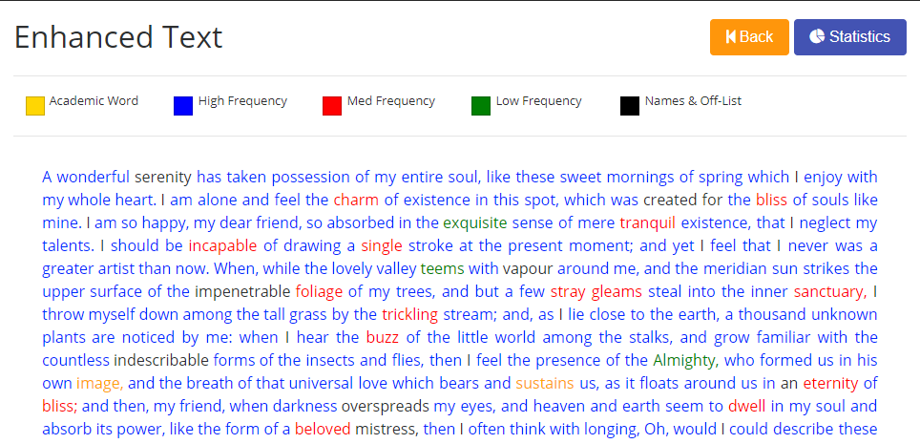
Project Definition
- Sample texts that has been captured by the text analyzer with color coded words.

Slide 4
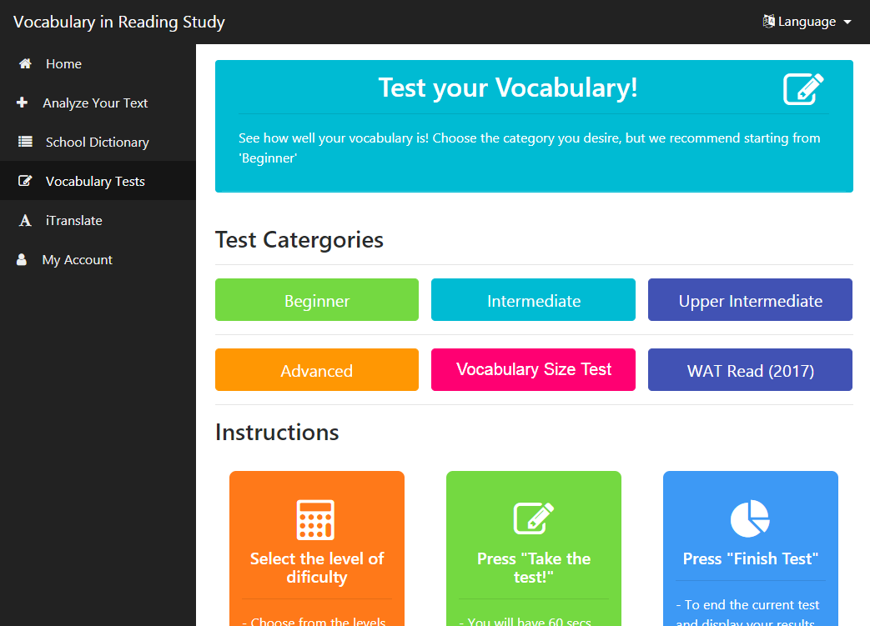
Project Definition
Additions to system:
User registration
Vocabulary testing
Language translator
More admin tools

Slide 5
Requirements: User Stories
[#260] [Frontend] Add STEM word category
[#268] [Frontend] Add Tests section to main page
[#269] [Frontend] Add iTranslate Section
[#259] Add Facebook link
[#257] Fix PDF upload
[#258] Fix .Docs upload
[#265] [Frontend] Add Different Tests Levels
[#266] [Frontend] Skip Questions
[#267] [Frontend] Add external link to ck12 (School Library)
[#284] User Registration API

Slide 6
Requirements: User Stories
[#152] [Frontend] Add Remaining Tests
[#273] [Frontend] Finish Test
[#274] [Frontend] School Library
[#278] [Backend] Register User
[#279] [Backend] Login User
[#280] [Frontend] Account Page
[#281] [Frontend] Edit Profile
[#285] [Frontend] - Limit Test Attempts (Unregistered)
[#286] [Backend] - Fix Wikipedia API
[#287] [Frontend] - Add WAT tests

Slide 7
Use Case: 273 – Finish Tests
Name: Finish_Tests
Actor: User
Preconditions: User must be currently in the process of taking a test and has attempted more than 10 questions
Description <Flow of events>:
Question is currently loaded/displayed. Test in progress.
User hits the “Finish” button
System verifies that the user has done more than 10 questions
If user hasn’t done more than 10, display warning and test proceeds.
If user has done more than 10 questions, test stops and a table displaying the performance is populated.

Slide 8
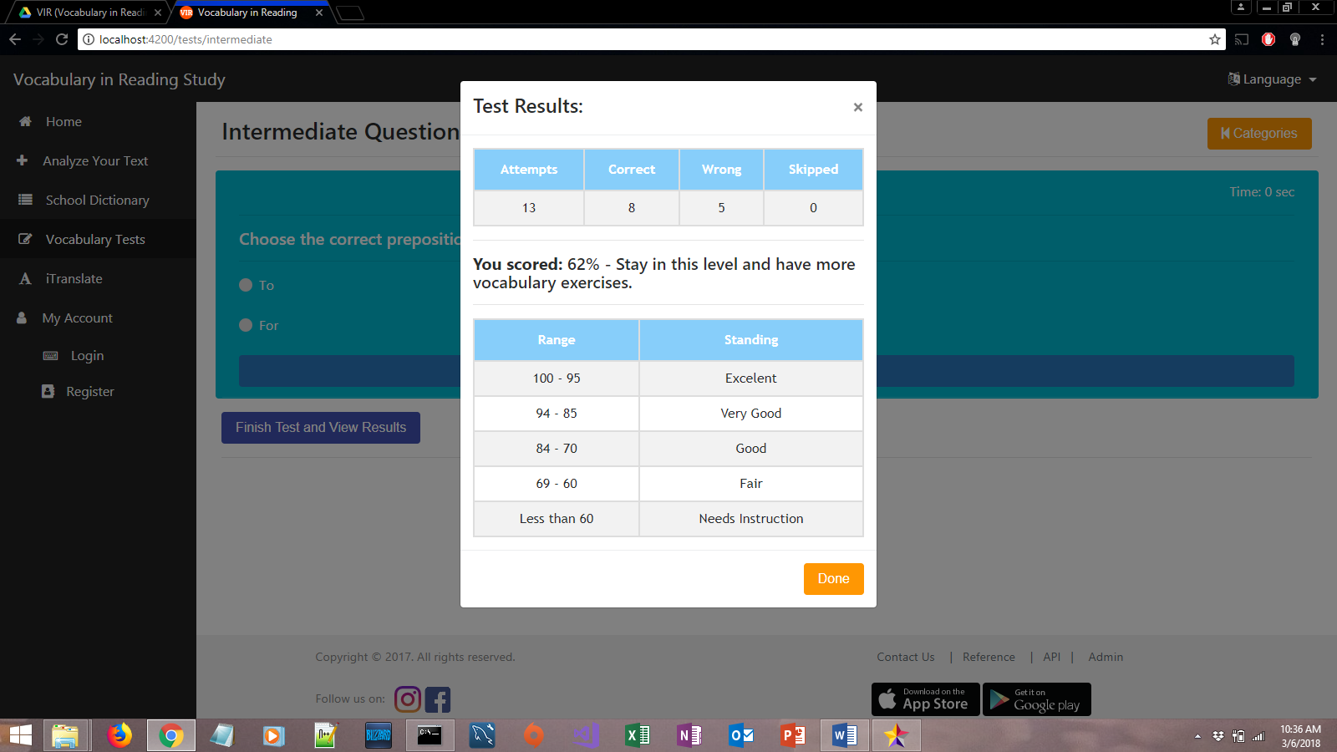
Use Case: 273 – Finish Tests

Slide 9
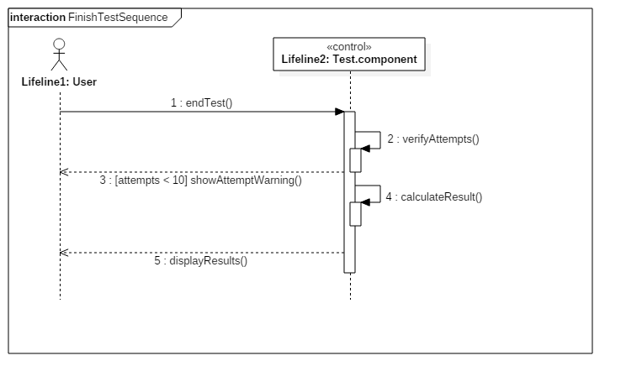
Sequence Diagram:

Slide 10
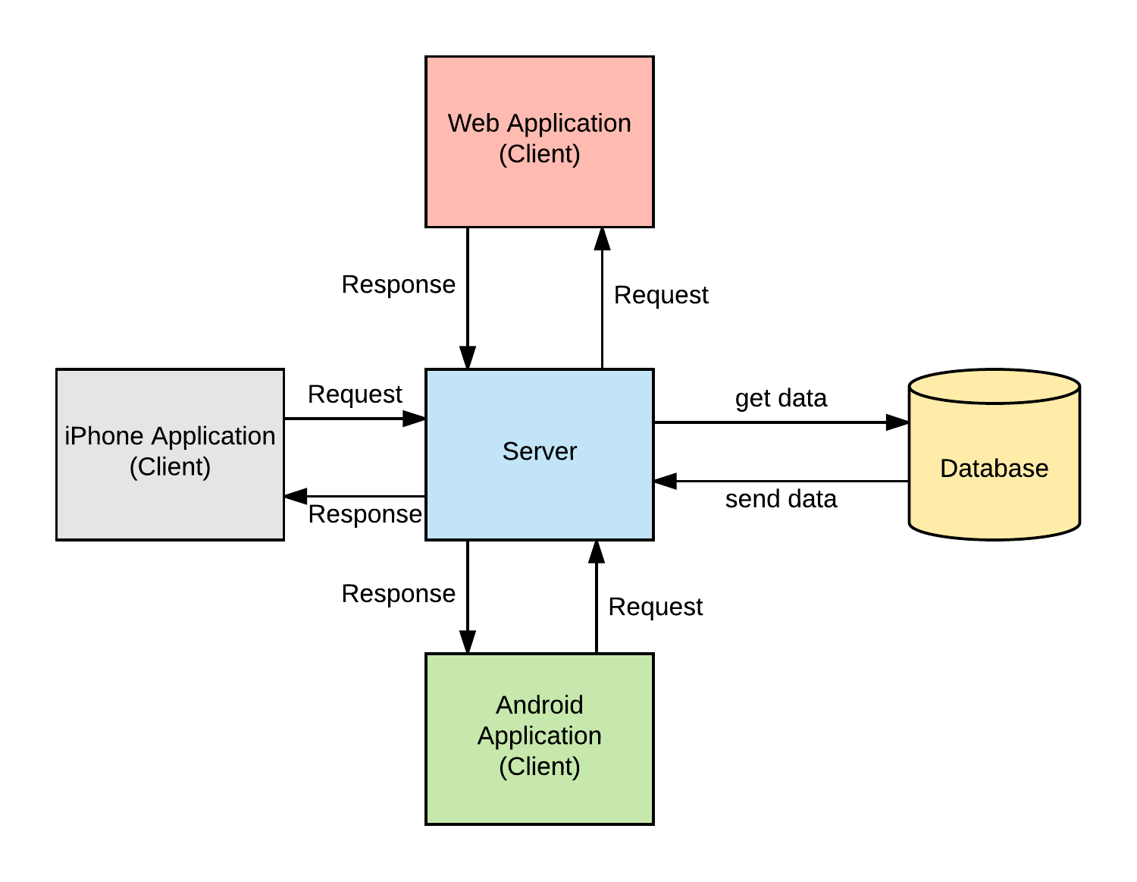
System Design:
Model-View-Controller

Slide 11
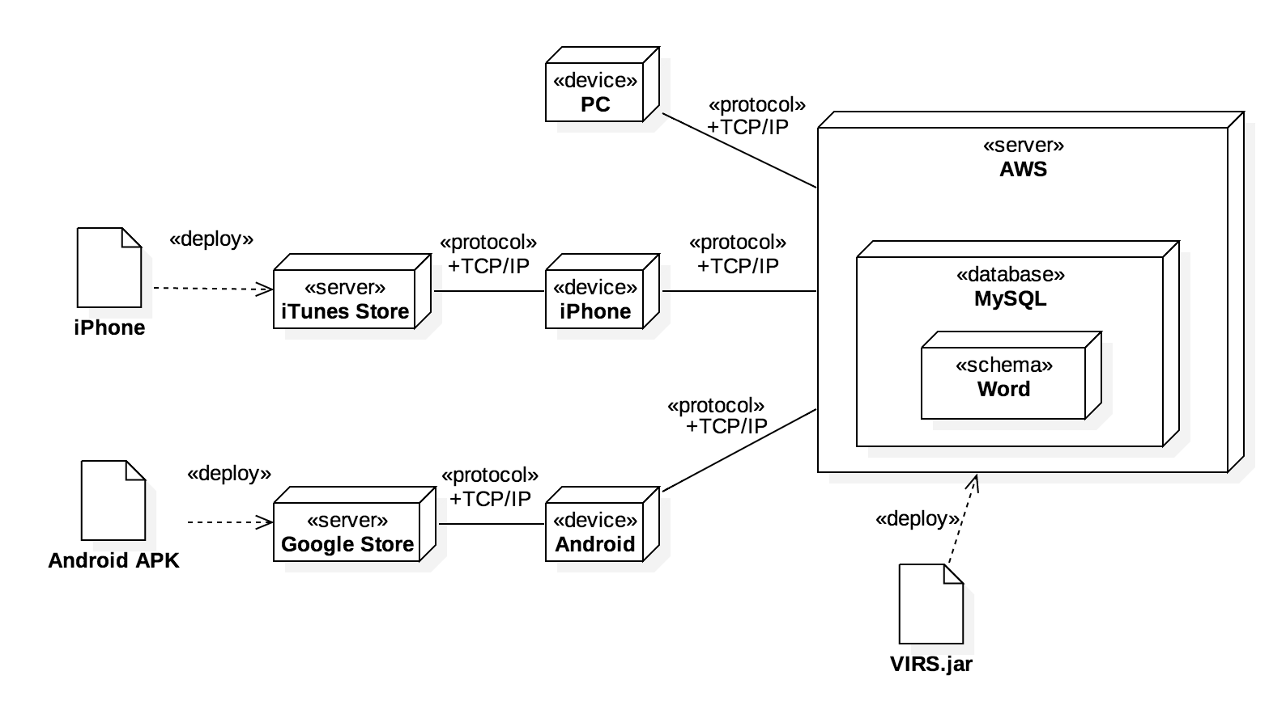
System Design: Deployment

Slide 12
Testing: Test Suite
Karma and Jasmine were used to perform unit testing for frontend.
Test case ID: TestsComponents_ShouldCreate_001
Test case ID: BeginnerComponents_ShouldCreate_001
Test case ID: FinishTest_001

Slide 13
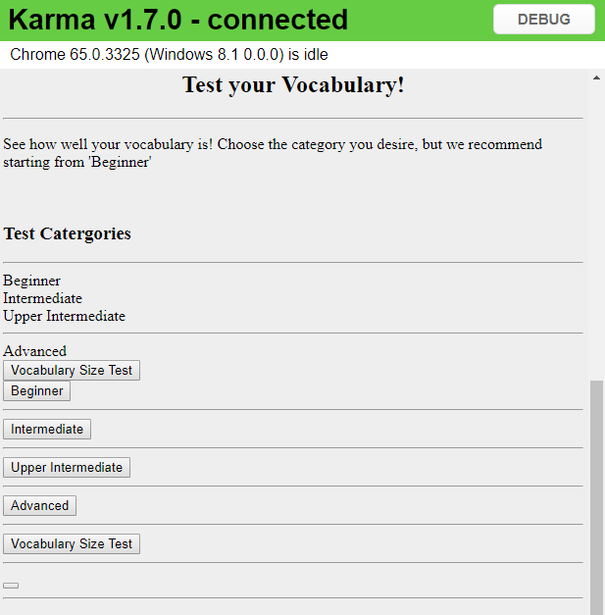
Testing: Test cases
Test case ID: TestsComponents_ShouldCreate_001
Description/Summary of Test: The Tests component should be created
Pre-condition: The server must be running
Expected Results: Pass
Actual Result: Pass
Status (Fail/Pass): Pass

Slide 14
Summary:
VIRS 3.0 has now added features that will benefit and facilitate the expanding of a student’s vocabulary.
The addition of vocabulary tests will not only test a user’s knowledge, it will also help them expand it.
Users can now register/log in
Contact info:
Christian Hidalgo – chida001@fiu.edu
Thank you!

