Slide 1
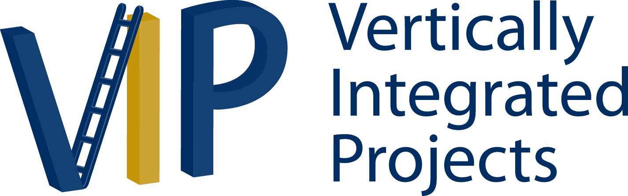

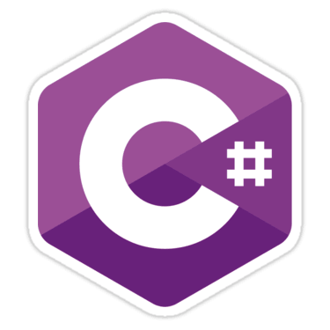
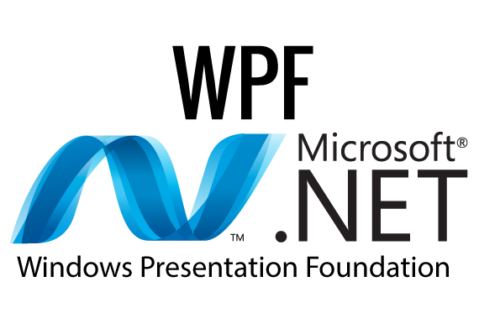
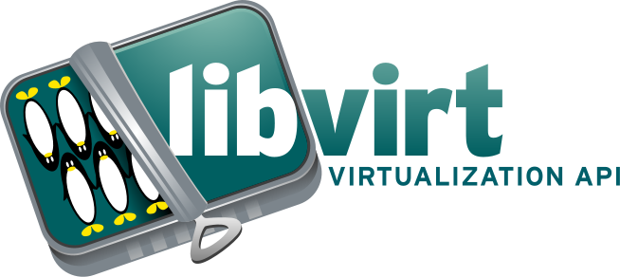
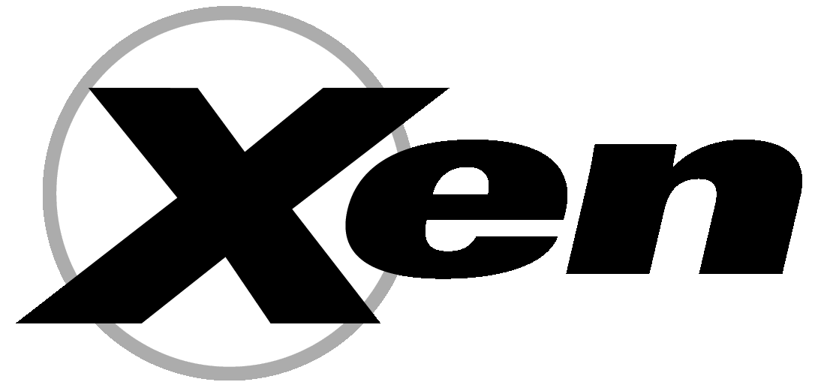

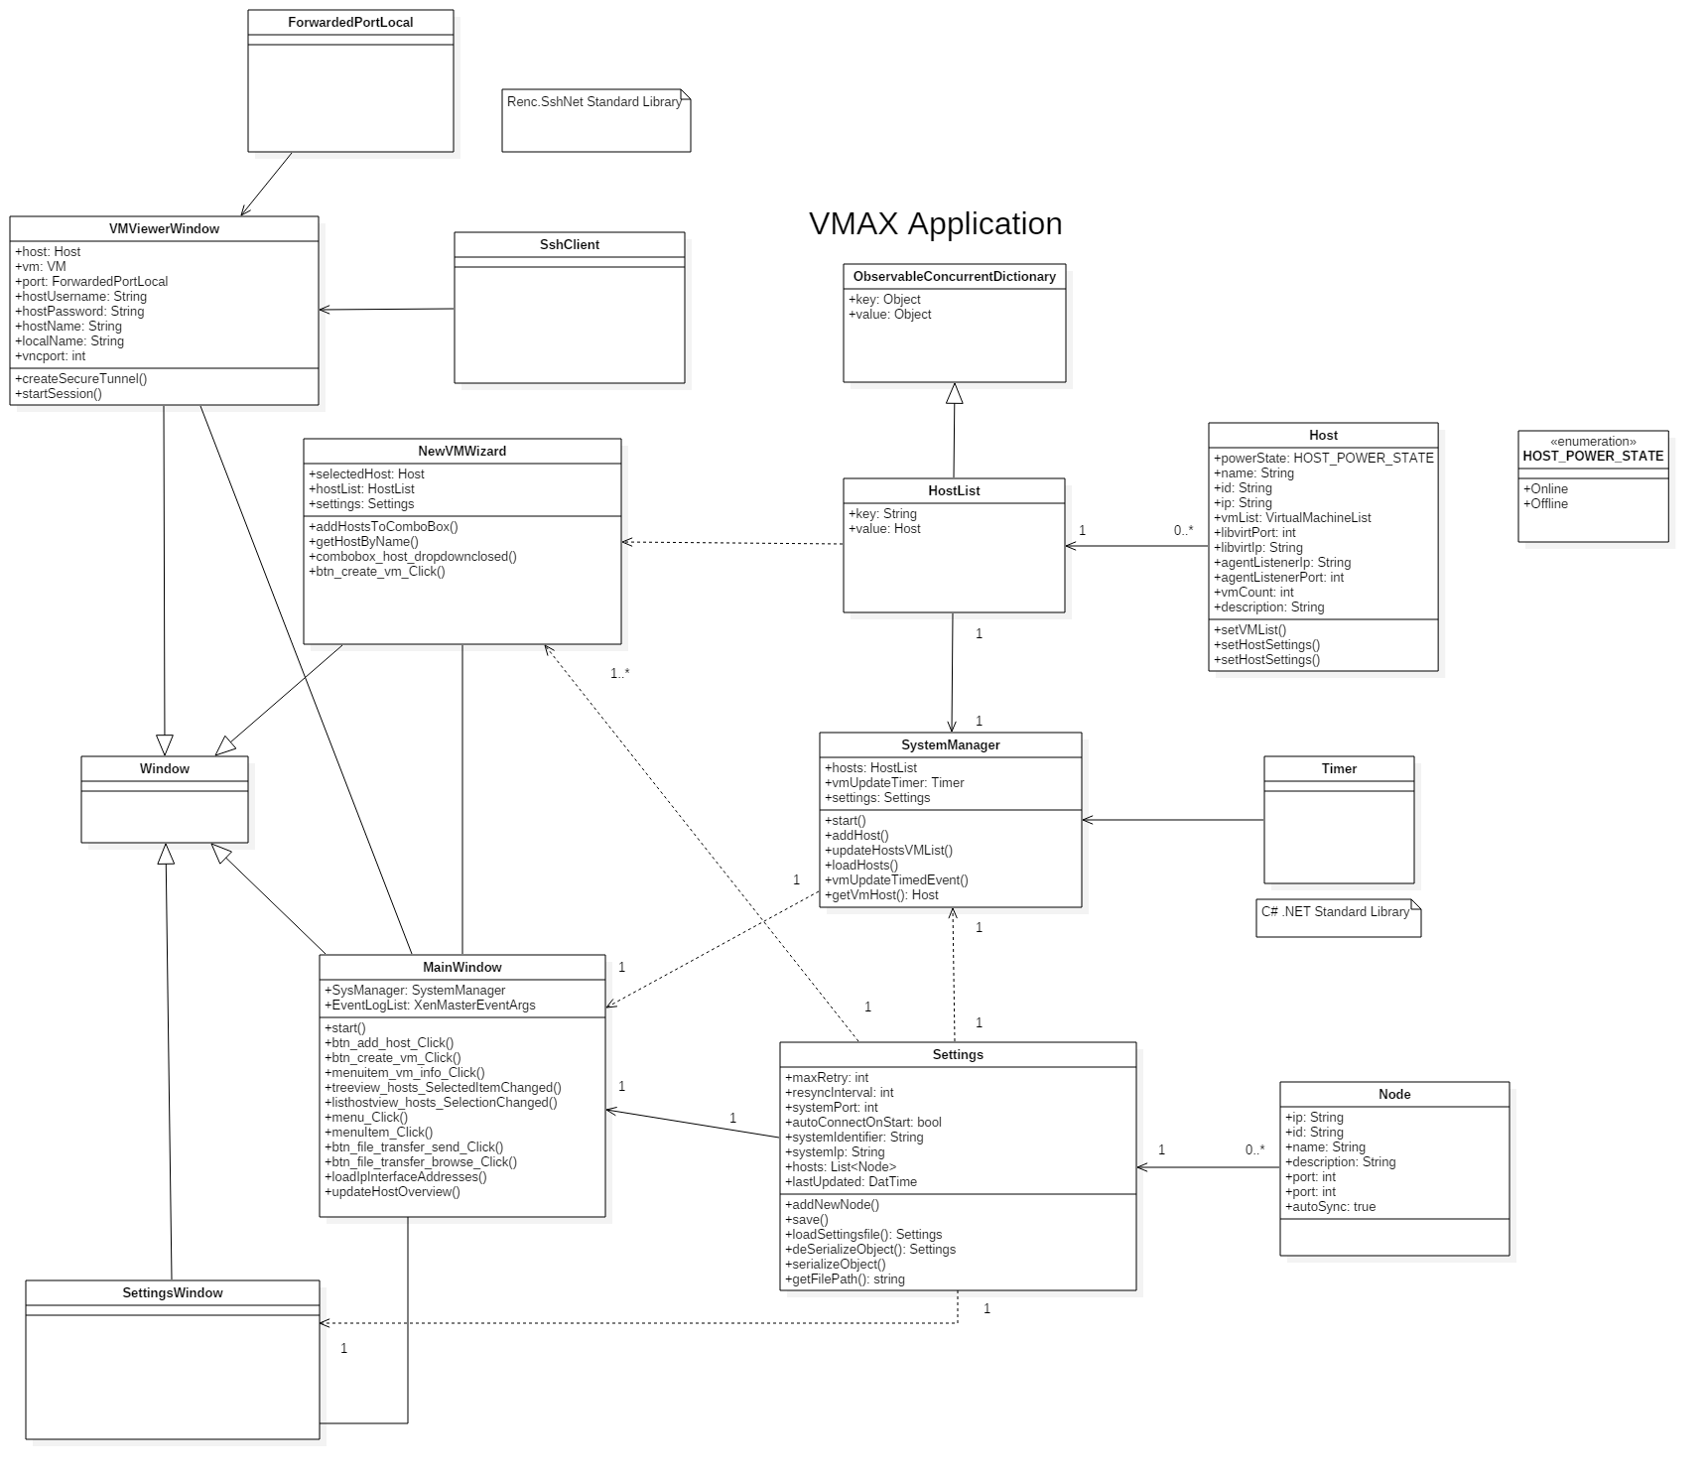

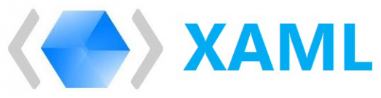
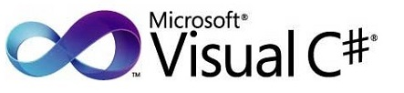


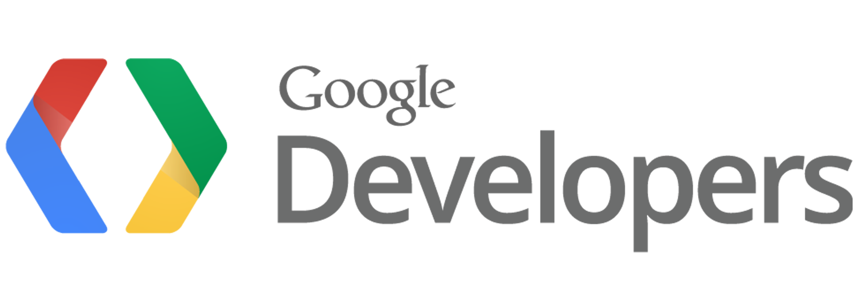
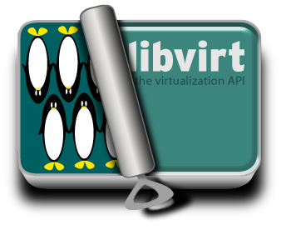

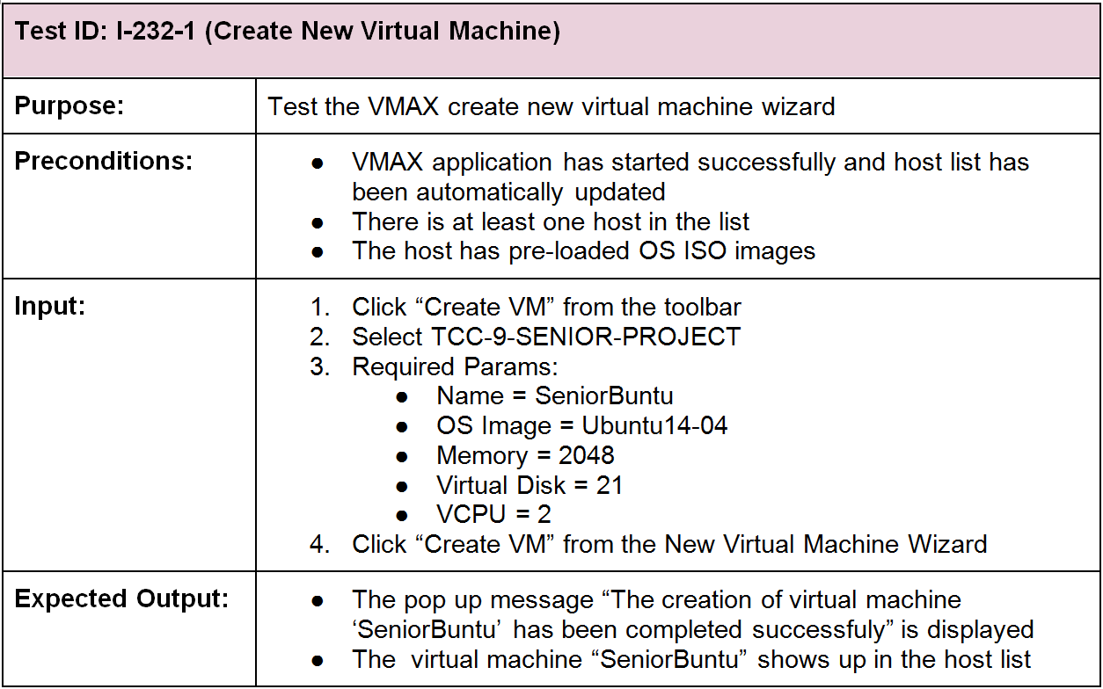
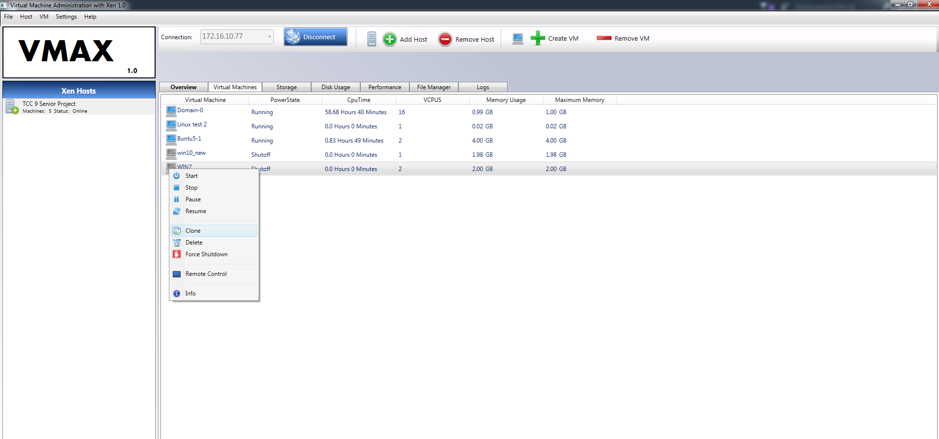
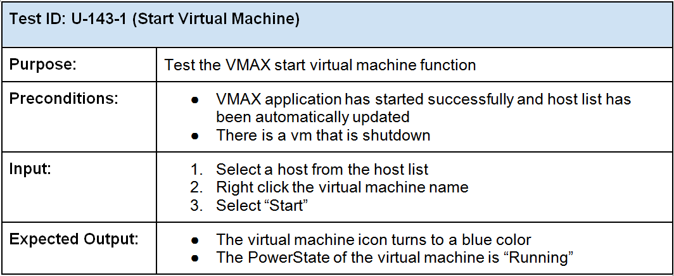
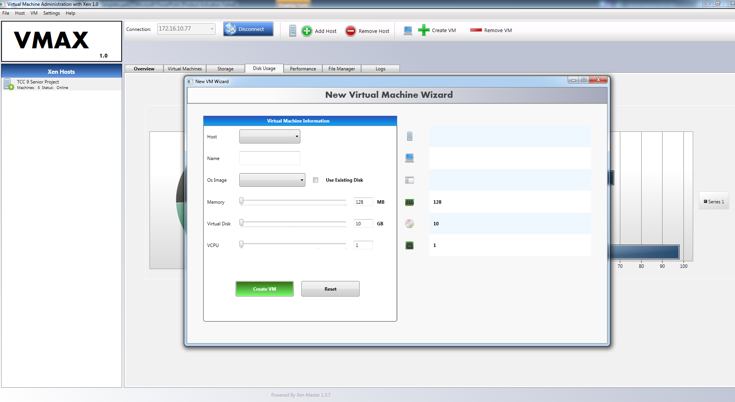

School of Computing & Information Sciences
Senior Project, Fall 2016
Virtual Machine Administration with Xen (VMAX) 1.0
Student: D’Mita Anthony Levy, Florida International University
Mentor: Himanshu Upadhyay, Applied Research Center Florida International University
Mentor: Mohsen Taheri, School of Computing and Information Sciences Florida International University
Instructor: Masoud Sadjadi, Florida International University
Problem
Current System
Requirements
The Xen hypervisor platform does not have a robust, open-source, Windows based application for virtual machine management. In addition, available commercial management applications require expensive licenses and proprietary closed-source versions of the hypervisor.
Status
Manages virtual machines at the Applied Research Center FIU
Integrated into cyber defense research project
Code base planned for future open source community release
Performs all common virtual machine management tasks
The system allows the administrator to manage a remote host and it’s virtual machines including the following capabilities :
Start virtual machine
Stop virtual machine
Pause virtual machine
Resume virtual machine
Force virtual machine shutdown
Create a New virtual machine
Delete virtual machine
Display virtual machine statistics
Display host server disk usage
Display host server CPU performance
Display host server settings
Solution
VMAX makes use of the open-source Xen hypervisor management library Libvirt and provides the following solutions:
Control of the virtual machine lifecycle (start, stop, resume etc.)
Cost effective, open-source implementation of the Xen hypervisor
Targeted application that runs on Windows
Reduced function set that can be extended as necessary
Core Features
Implements host level Golang, native C bindings
Client runs on any Windows version that supports .NET 3.5+
Core C# library supports Web and Windows Application interface
Secures host super user terminal console
Reduces the need to physically interact with the host machine
System Design
Object Design
Implementation
The VMAX client connects to a Go server running on the host and sends custom XML API commands that allow an administrator to manage a virtual machine’s lifecycle (start, stop, resume etc.) as well as retrieve relevant usage and performance statistics from the host server.
User Interface
XML API Library
Client Server Architecture
Server
Hypervisor API
libvirt-go
Hypervisor
Verification
Screenshots
Summary
Virtual Machine Administration with Xen (VMAX) is a client server system that allows the management of a remote host and virtual machines that operate on the Xen Hypervisor platform.
The system uses the extensive Libvirt Application Programming Interface and a Go programming language server to communicate with the Xen Hypervisor and manage virtual machine life cycles remotely.
Administrators interact with the system through a Windows Presentation Foundation (WPF) client developed for the Microsoft .NET 4.6 framework.
Acknowledgement
The material presented in this poster is based upon the work supported by D’Mita Anthony Levy. I am thankful to the help that I received from my group members, Dennis Obando and Qixiu Xin.
Notes:
1

