Slide 1





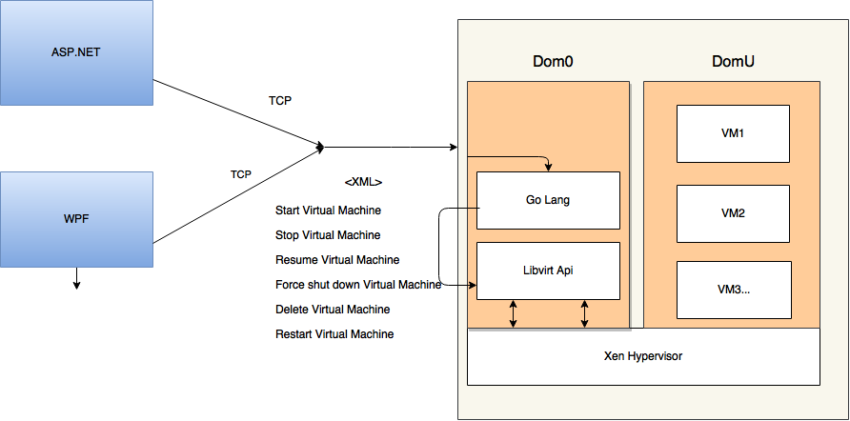
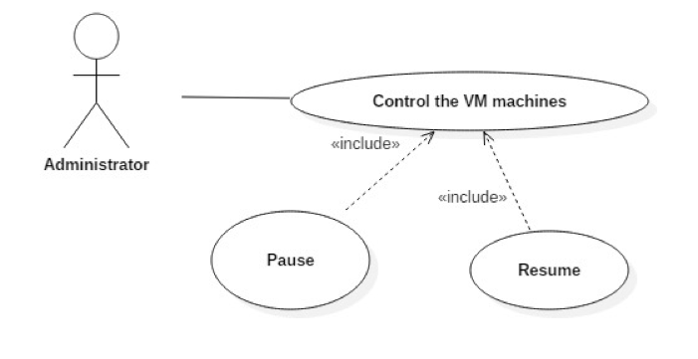


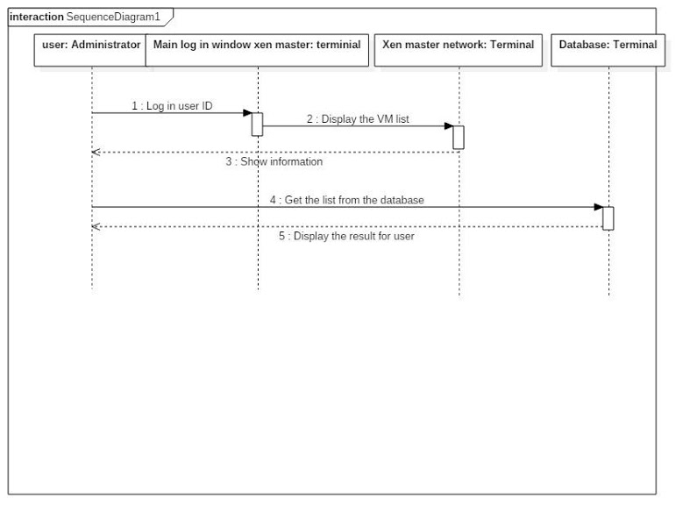


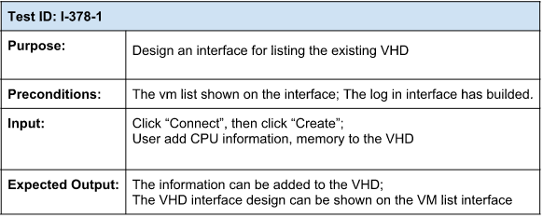
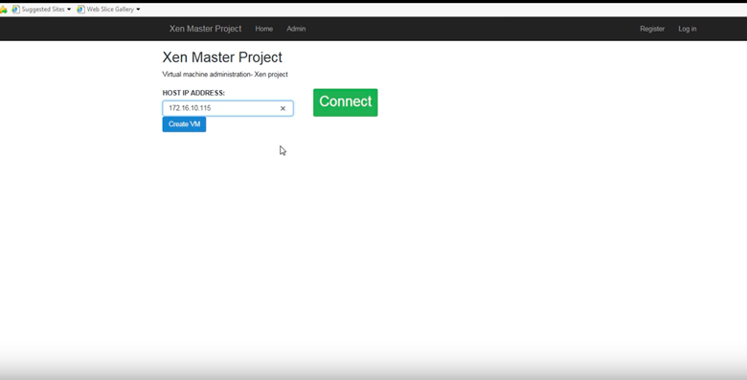
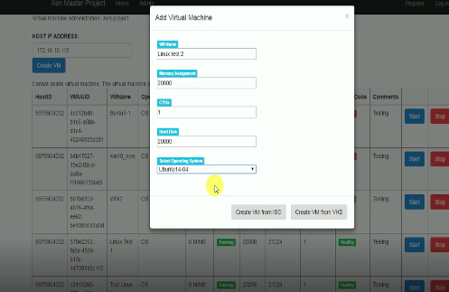
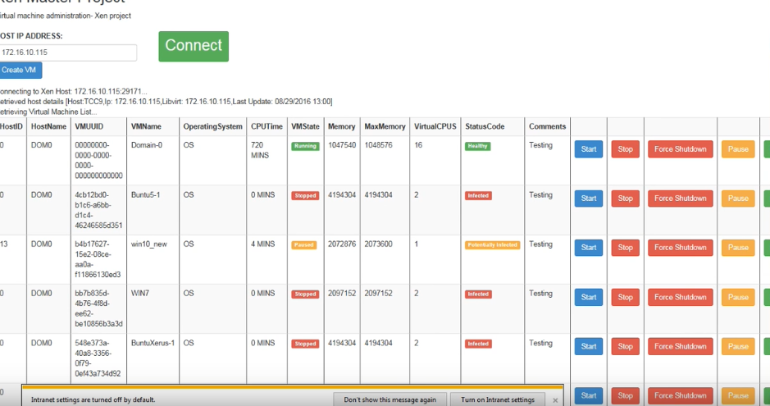
School of Computing & Information Sciences
Advanced Software Engineering, 2016, Fall
Virtual Machine Administration with Xen Master 1.0
Student: Qixiu Xin, Florida International University
Mentor: Himanshu Upadhyay, Applied Research Center, Florida International University
Mentor: Mohsen Taheri, School of Computing and Information Sciences, Florida International University
Instructor: Masoud Sadjadi, Florida International University
Problem
For xen master virtual machine administration system ver 1.0, the system need the web based application for helping user to control the virtual machine list easier.
Current System
Status
1.Control virtual machines through web interface
2.Directly create and delete virtual machine through ISO and VHD
Core features
1.Connect to c# library to web based interface
2.User can directly control the virtual machine list through web
3. User can see the tree view from the hypervisors and user can create and delete virtual machine from ISO or VHD
Requirements
Xen master system can allow clients to do the activities below:
Start VM
Stop VM
Pause VM
Force shut down VM
Create VM
Delete VM
Show VM status in list
Solution
We created the web based interface using html 5 and bootstrap to show the direct view to users.
enter host ID, then click” Connect” button, users can see the direct list of all virtual machines through library.
User create virtual machine through ISO and through VHD.
System Design
Object Design
Web client interface:
Verification
Screenshots
Summary
These system brings two interfaces to let user control the system much easier:
First is WPF, and the second is asp.net web based interface. It connects to the c# library.
In addition, it connects to the hypervisor to control the Virtual Machine.
This is the version one for the xen master administration project.
Acknowledgement
The material presented in this poster is based upon the work supported by Qixiu Xin. I am thankful to the help that I received from my group members, D’mita Levy and Dennis Obando.
Notes:
1

