Slide 1










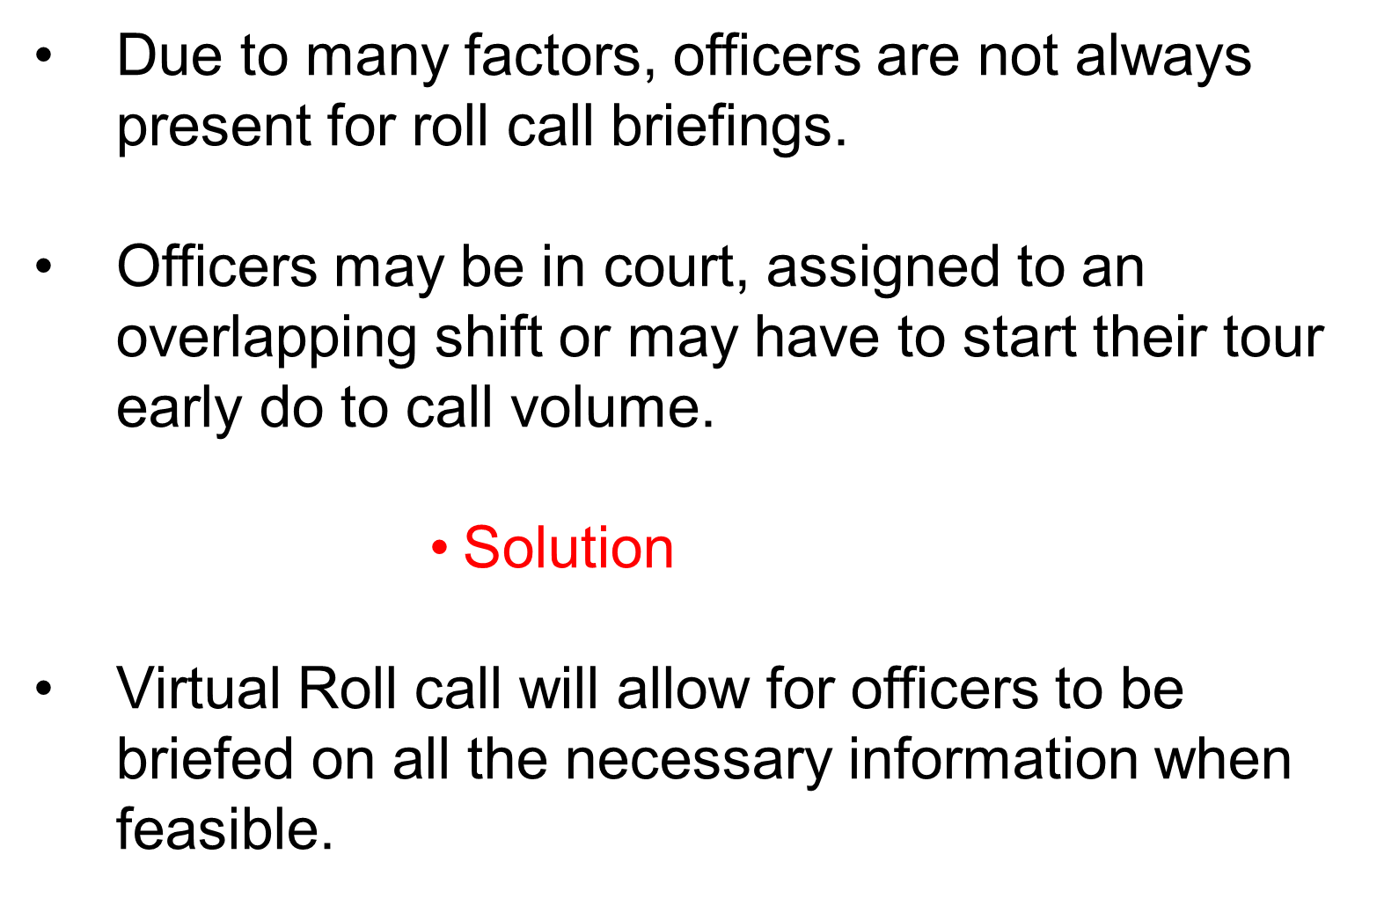
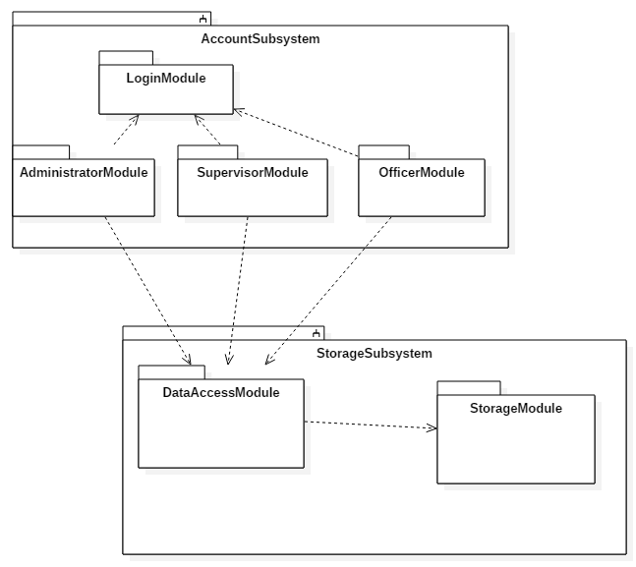
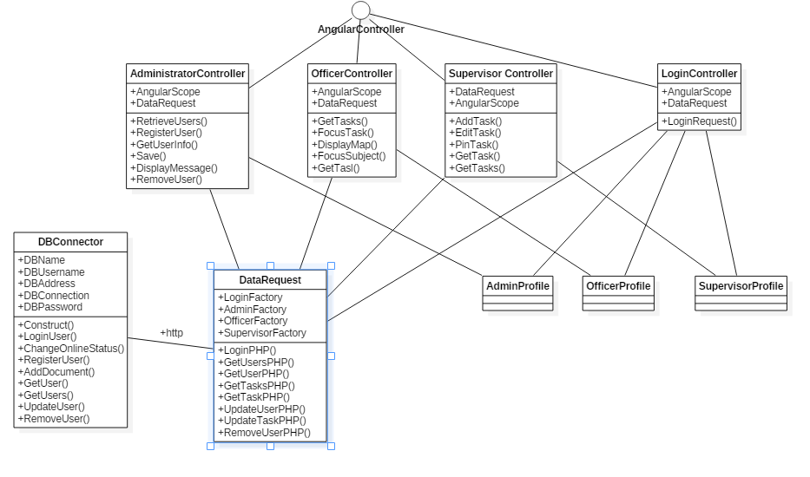
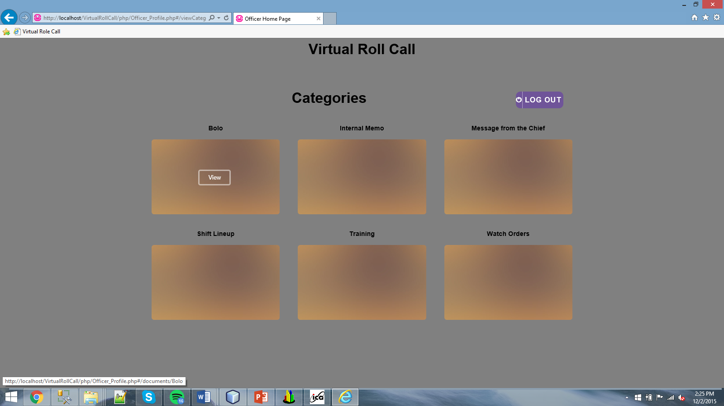
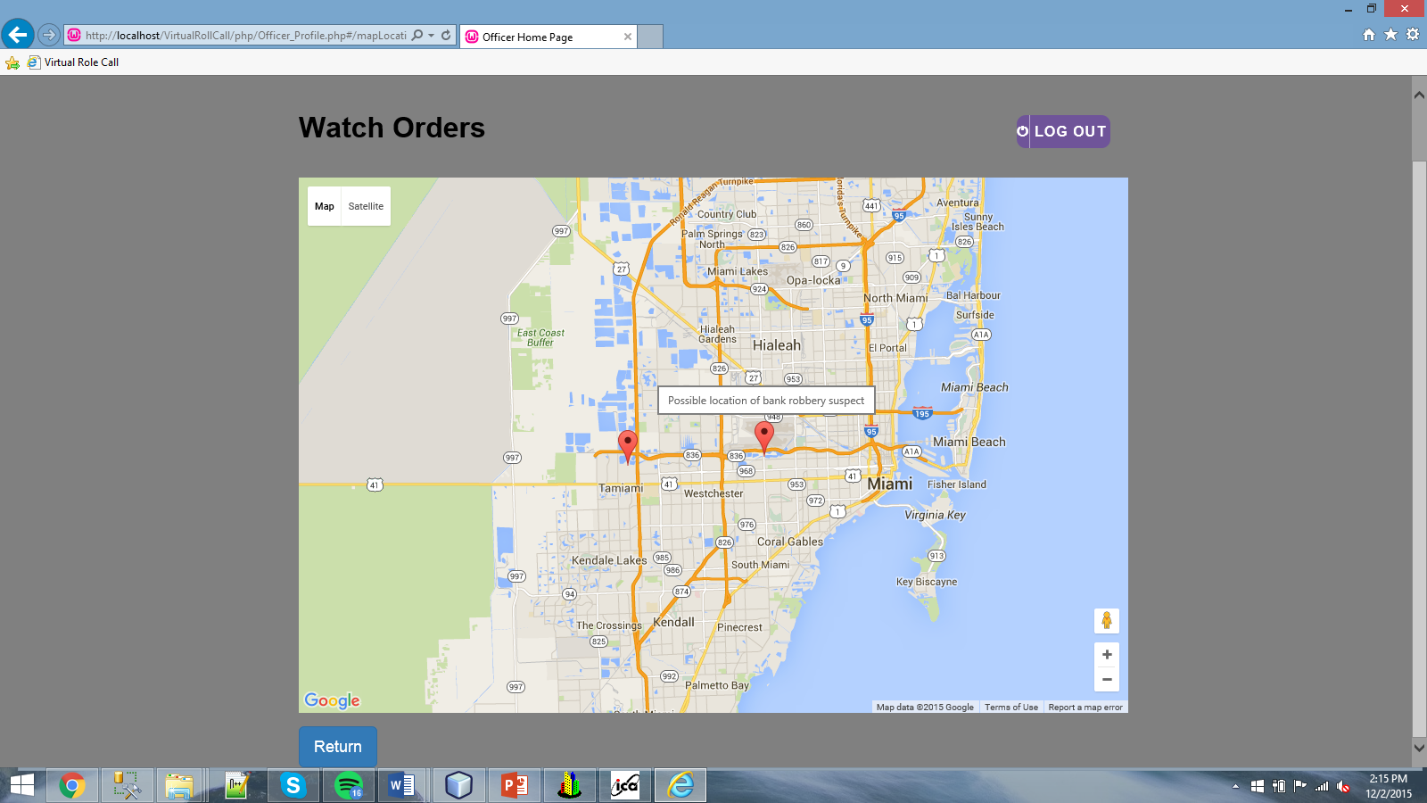
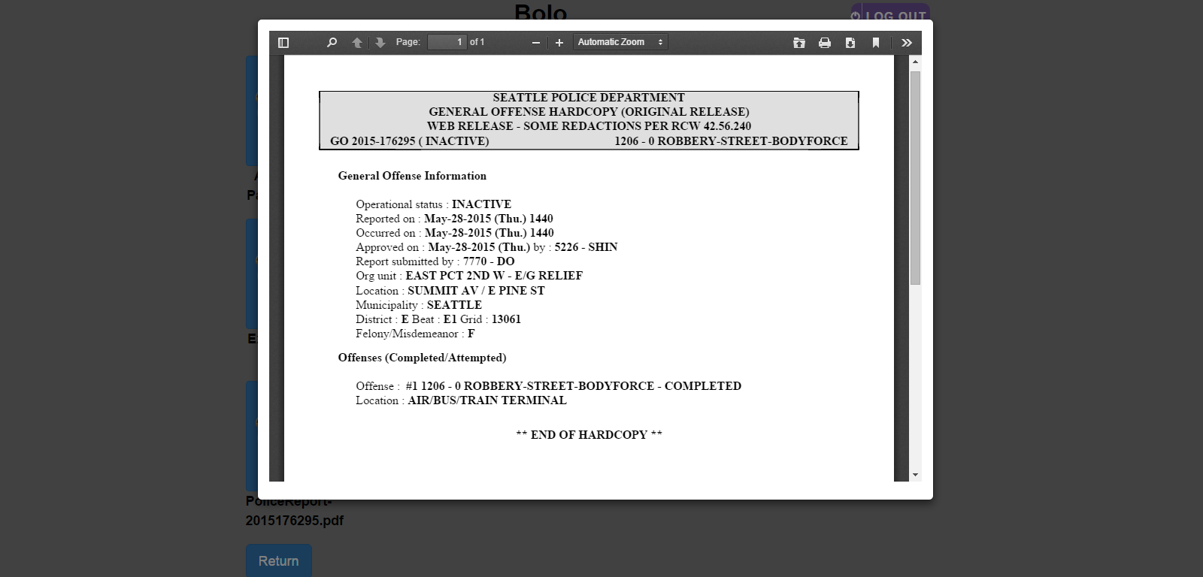
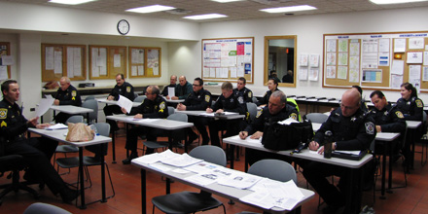
School of Computing & Information Sciences
Senior Project, 2015, Fall
Virtual Roll Call
Student: Frank Vincench, Florida International University
Mentor: Jason Cohen, Pinecrest PD
Instructor: Masoud Sadjadi, Florida International University
Problem
Current System
Requirements
Currently, officers have an in person meeting where an officer’s superior hands down orders, documents, and information down to the officers.
The new system is a web based application that allows superior officers to hand down prior information about a specific task in progress efficiently.
The system allows Officers to view supported documents appointed by their supervisors.
The system maintains simplicity of use regardless of complexity of functionality.
The system assigns user rights according to their credentials.
System Design
Object Design
Implementation
The system is designed Using JavaScript/ Angular JS to handle the client side and PHP to handle the server side.
Information/communication is exchanged between the client/server side through a series of dynamic http post requests that occur depending on the user’s need of the system.
Verification
Screenshots
Summary
Purpose | Create an account with another users credentials
Setup | Logged in as an administrator
Test Data | Last Name: Frank First Name: Vincench username: Frank password: frank type of officer: Supervisor officer Shift: B
Notes | Expected Failure due to the username frank already taken
Virtual Roll Call offers officers a reliable and easy to use interface containing all the information they need regarding their Roll Call.
This project, presented by the Pinecrest PD, is the beginning of a system that could expand to other police departments across the nation for execution of Roll Calls.
Officers will no longer miss the information should they not be able to make it to the briefings.
Purpose | Create an account Properly
Setup | Logged in as an administrator
Test Data | Last Name: Doe First Name: Jane username: Jane password: jane type of officer: Supervisor officer Shift: B
Notes | Expected success due to new username should delete the User In tear down of test
Purpose | Create an account with invalid fields(one may be empty)
Setup | Logged in as an administrator
Test Data
Notes | Expected Failure due to the inability to create user without proper information
Acknowledgement
This project was possible thanks to the free use of online sources and frameworks under the MIT license. I am thankful to the help that I received from my group member Peter Reidy

