Slide 1








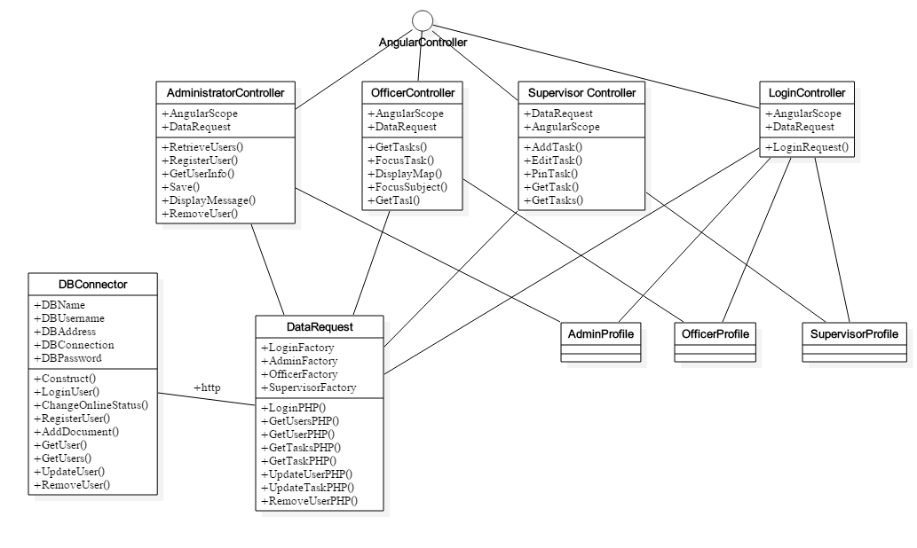
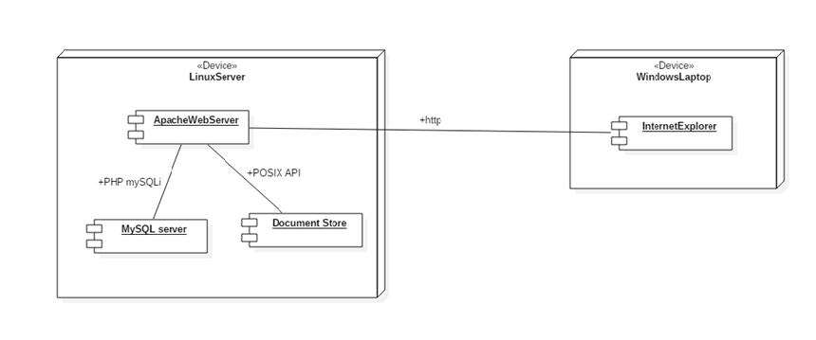
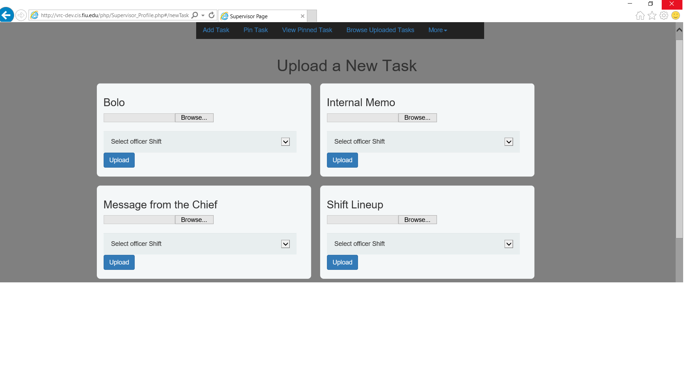
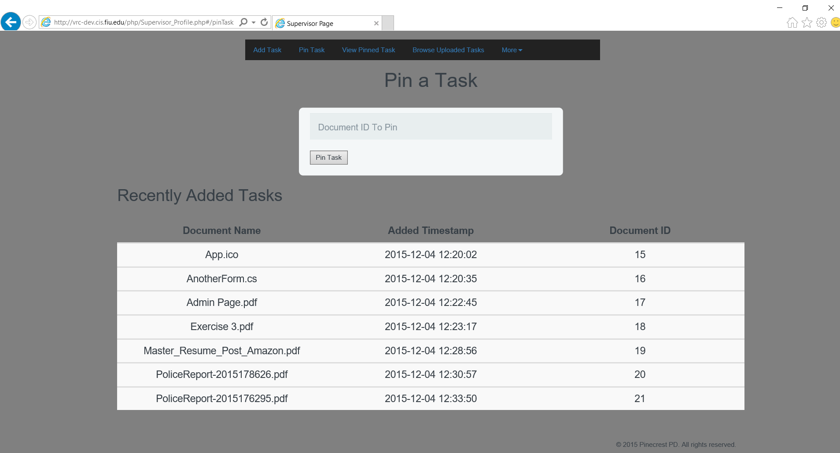
School of Computing & Information Sciences
Senior Project, 2015, Fall
Virtual Roll Call
Student: Peter Reidy, Florida International University
Mentor: Jason Cohen, Pinecrest Police Department
Instructor: Masoud Sadjadi, Florida International University
Problem
Current System
Requirements
Roll Call is a meeting in the beginning of a shift where all officers gather in a meeting room to be presented information about the shift to come. The officers are given information like BOLO’s, Watch Orders, and etc.
The problem with this system is that it requires that all the officers for a shift to gather in one room and have a supervisor read to them. That creates a problem because if an officer misses the meeting, either due to responding to an emergency or being late due to traffic, the officer misses out on the dissemination of the information and has to get it either from fellow officers or the supervisor.
The current system is very centralized and effect of a failure within the system is either an uninformed officer or an officer that will take the working time of another officer to repeat what was said and distributed at the meeting. So in this case, a failure of the system wastes multiple officers’ time.
Roll Call is handled in a physical meeting. Where a supervisor calls all the officers into a room and dreads off the documents and orders that are important to a certain shift. This method may be seen as inefficient and almost wasteful of officers’ time, therefore wasteful to the department. Downsides to this system include:
Cost of a failure is rather high. At the price of either an unknowledgeable officer or taking the time of another officer who was present to be explained.
Failures are not easily fixed or prevented. Traffic or emergencies that need response may prevent an officer from attending.
Further reference to documents at roll call not available to officers on the street at a central location where they may be able to check what needs to be handled during the shift.
The Virtual Roll Call had some clearly defined hard requirements and some softer requirements.
The system should be decomposed into 3 modules with different permission levels. Administrators, Supervisors, and Officers.
The highest level can do anything the lower levels can do, but not vice versa.
The upload of files and viewing of the files by supervisors and officers respectively.
The Officers should be split into different shifts
All files uploaded should be archived after a certain date
Files that have been uploaded can be pinned to bring them to the top of the list of an officer’s views
Pinning the files prevents the archiving and removal of a document from the view of the officers.
An Easy to use UI that is “Too easy to mess up”
Monitoring of user activity while on the web application.
System Design
Object Design
Implementation
The new proposed system implements the Model-View-Controller as the main design pattern. The separation of Data logic from view logic and the handling of events through a controller helped us to create a more efficient and maintainable system.
The proposed design of the system houses the web server, file store, and MySQL server all on the same host because of the small audience of users. The User’s main access to the system would be over http using a web browser.
The access to the database is all handled by a singleton of our class DbHandler so we do not bombard the database server with any new connections at the same time due to the cost of creating a database connection.
The implementation of the system used a variety of frameworks, all for different purposes. The main framework to help implement the MVC of the system was Angular which helped us create a more responsive and dynamic UI.
The testing of the system used PHPUnit alongside the Selenium Webdriver for system and unit level tests. The Dependencies for these two frameworks are brought in with Composer, a PHP dependency manager.
File uploads are handled through PHP’s POST method as angular does not have native support for input types of ‘file’.
For the backend, the files that are uploaded are stored in a directory tree and their metadata is stored in a MySQL database that is interfaced with by PHP’s mysqli database drivers.
Verification
Screenshots
Summary
Test Case | VRC UPLOAD01 – SUNNY
Purpose | To validate the ability to upload PDF files, as they should and the proper metadata is updated.
Preconditions | User needs to be logged into system as a supervisor.
Input | test.pdf Selection of shift A Click of submission button
Expected Result | - The PDF file is successfully uploaded. The Database is updated with a new entry representing the file metadata important to the system. The File is viewable from an officer in the correct shift.
In the end of this semester, Most of the functionality of the Virtual Roll Call system has been implemented. Features Include File viewing, File Uploads, Pinning of Tasks, An Account System, and security measures to protect that account information.
Some of the features that we did not meet included the archiving of tasks, and the viewing of documents other than .pdf’s and mp4’s.
Overall This Project still needs fine tuning and improvements in the usability heuristics. This project will most likely improve the daily routines of officers at the Pinecrest Police Department, and it shows promise to improve the efficiency of officers by getting rid of the previous system’s flaws and adding the flexibility to catch up with assignments on demand.
Test Case | VRC UPLOAD02– RAINY
Purpose | To check the validation of the system to force all proper inputs when submitting a new file for upload.
Preconditions | User needs to be logged into system as a supervisor.
Input | test.pdf Click of submission button
Expected Result | The PDF file is unsuccessfully uploaded. - An error message provider telling the user to choose a shift should appear.
Acknowledgement
The material presented in this poster is based upon the work supported by Major Jason Cohen I am thankful to the help that I received from my group members, Frank Vincench

