Slide 1










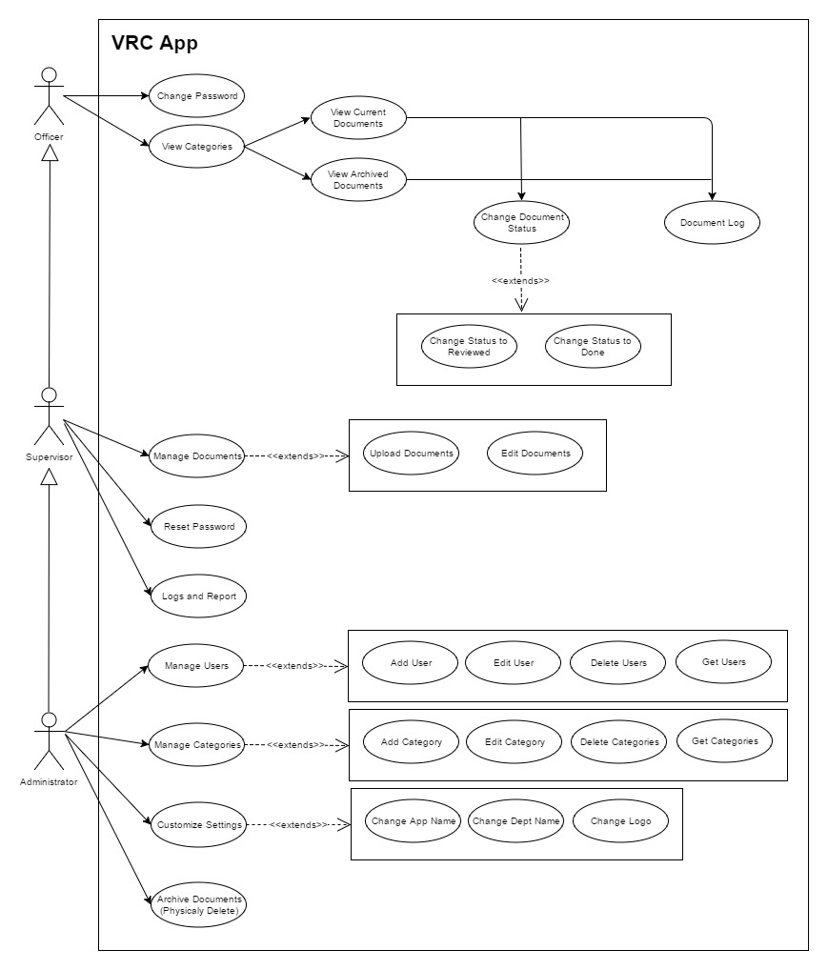
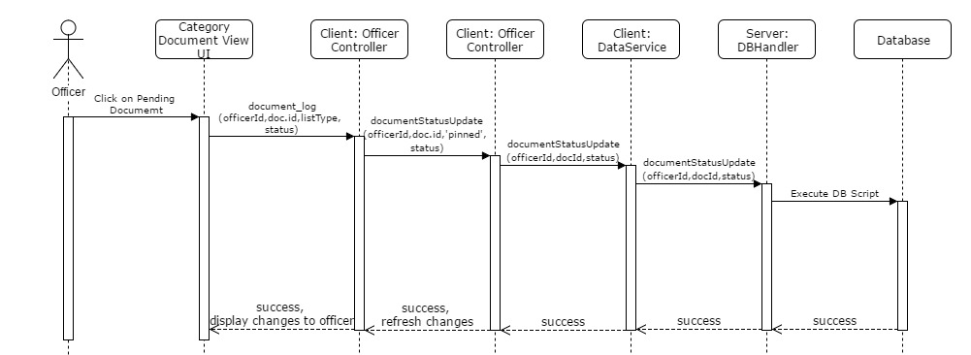
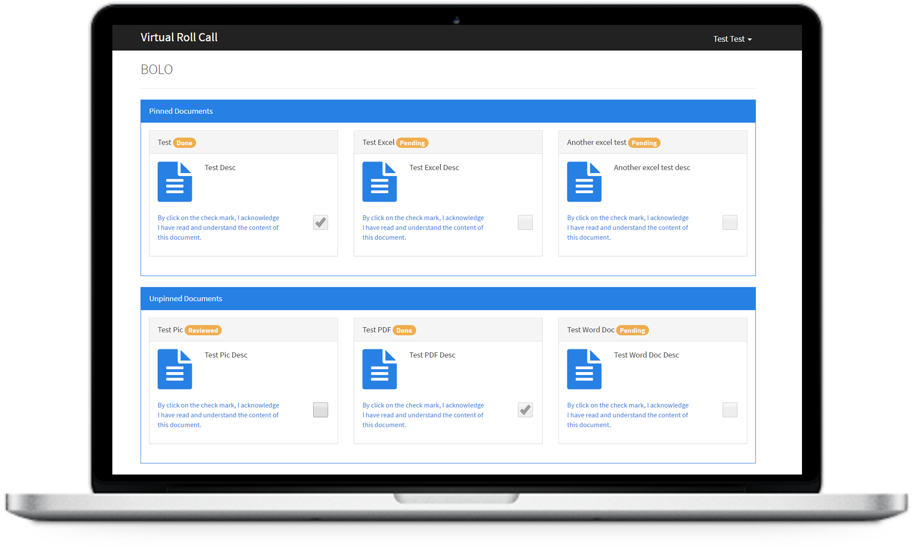
Virtual Roll Call
Senior Project Summer 2017
Florida International University
Student: Eric Fernandez
Mentor: Leila Zahedi
Instructor: Masoud Sadjadi
+
+
+
+
+
Background & Problem
The start of a police officer’s shift is spent in the station’s briefing room where shift supervisors go over a clipboard of critical updates. Due to many legitimate factors, officers are not always present for these “roll call” briefings. As a result, such absences prevent officers from receiving important communications relevant to the commencement of their shift.
The Virtual Roll Call (VRC) web application solves the following problems:
Eliminates the need for meeting in person
Supervisors can push information onto the site in real-time
Gives officers the flexibility of accessing shift updates at any time
Implementation
Frontend: HTML5, CSS3, Bootstrap CSS, Bootswatch Theme, UI-Grid
Frontend Framework: Angular JS
Backend API: PHP
Database: MySQL
Web Server: Apache HTTP
OS: Ubuntu Linux
Verification
Test Case | Story #233: Document Confirmation (Sunny Day)
Purpose | Verify that document status change from default status “Pending” into “Reviewed” after officer clicks on document. for the first time.
Precondition | 1.User is logged in as Officer role. 2.User selects category they wish to filter documents by.
Input | The category will list the documents. Documents pending to review for this officer will have status “Pending”. Officer will click on document for the first time.
Expected Output | Document will display and it will change its status on the list from “Pending” to “Reviewed”.
Object Design
Test Case | Story #233: Document Confirmation (Rainy Day)
Purpose | Verify only documents with status “Reviewed” can be changed to status “Done” by clicking on disclaimer checkmark.
Precondition | 1.User is logged in as Officer role. 2.User selects category they wish to filter documents by.
Input | Officer attempts to click on the disclaimer checkmark for a document that has status “Pending”.
Expected Output | The system will not allow to click on the disclaimer check mark because the status is “Pending”. It will only allow to click on the check mark for documents with status “Reviewed”.
Current System
This is the second release of the VRC app and the main objective was to fix some bugs from previous version as well as develop some new critical features that could make the application usable for the first time in production by the Pinecrest Police Department. My contributions to this second release include:
Enhance UI of officer Documents Dashboard.
Added document status by user as “Pending”, “Reviewed” and “Done”, with a disclaimer as a confirmation that user read and understand the content of documents.
Added archived documents feature to hide documents older than 7 days and make them visible only from the category archived link.
User Documents Log and Status Report.
Summary
We were able to fix previous bug and add required new features to start using app in production.
Enhancement of user interface.
Addition of Logs, Document Status and Document Confirmation.
Added Report Capabilities with option to filter and option to Export Report to PDF and Excel.
System Design
Requirements
Enhance UI of officer Documents Dashboard.
Document Status and Confirmation.
User Documents Log.
User Documents Log and Status Report.
Archive Document older than 7 days.
Option to physically delete archived documents.
Show archived columns on Supervisor Documents Grid.
New field for document description.
Refresh after uploading document.
Fix supervisor edit document screen that was not working.
The material presented in this poster is based upon the work supported by Eric Fernandez. I am thankful to the help that I received from my group members, Oscar Yannelli, Jason Cohen and Frank Alvarado.
Notes:
1

