Slide 1


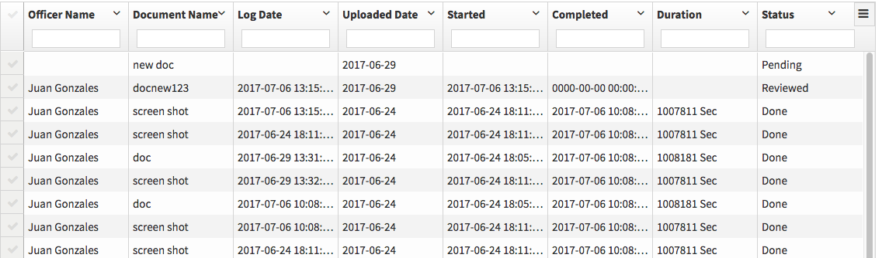
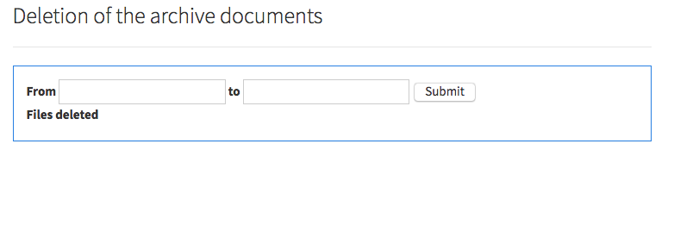
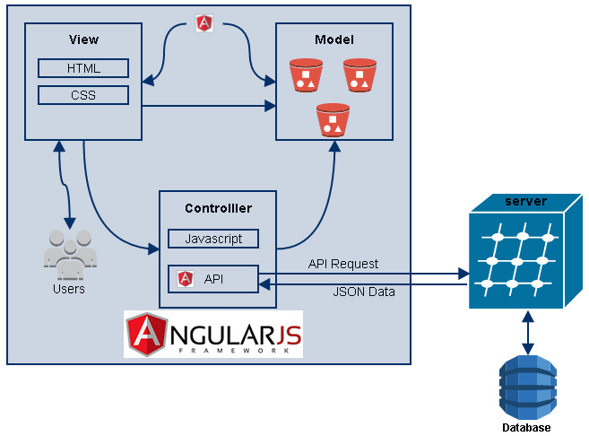
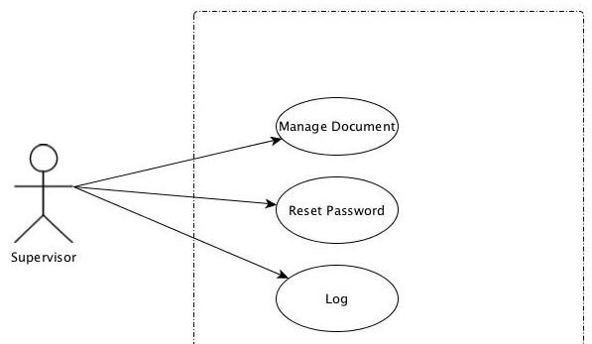
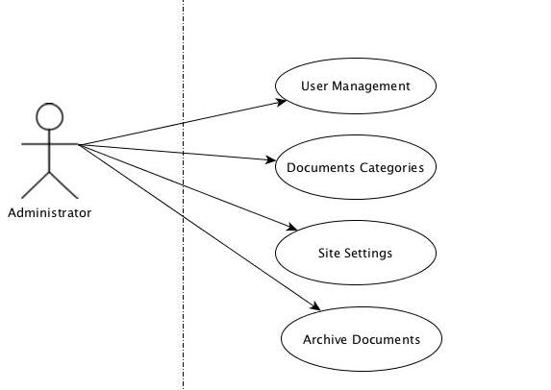
Other Related Logos
School of Computing & Information Sciences
Computer Science, Oscar A Yannelli, 2017, Summer
Virtual Roll Call
Student: Oscar A Yannelli, Florida International University
Mentor: Leila Zahedi
Instructor: Masoud Sadjadi, Florida International University
Problem
As an supervisor, I have certain information that I need that the officer in the street get access to.
I need to be sure that the officer saw the information posted in the system and make him accountable.
I also need to remove all the documents that older than10 years
Solution
1.The solution is a system where the supervisor can post all the necessary documents and the officer can see the posted documents. If the officer is on vacation, when he/she return can go to archive and check an mark the documents an be put it to the day
Current System
The system that we are using is the web, in this way it does not matter where the officer is, or what operation system is using he/she can always check the information and mark the documents as read.
Screenshots
Screenshots are to be relevant to the problem and solution statement.
Requirements
For both the supervisor and the officer a computer with internet/intranet capability is necessary. The officer need a user and a password in order to access the information. Once the officer clicks on the document the information that the officer saw the document will be recorded on the system
System Design
Implementation
Front-end: HTML5, CSS3, Bootstrap CSS, Bootswatch Theme
Front-end Framework: Angular JS
Backend API: PHP
Database: MySQL
Web Server: Apache HTTP
OS: Ubuntu Linux
Verification
Use case 244 Log
Every time an officer clicks on a document the information of the officer the date and the document is saved in the database,
The Officer click several document and the log page show all the entries of the officer.
Object Design
Summary
This is a great App that can be used it no only for the police department but for any organization that need to share information and have confirmation that the document was read. This app is now underdevelopment but can reach unlimited high if it developed
Acknowledgement
The material presented in this poster is based upon the work supported by the Pinecrest Police Depertment am thankful to the help that I received from my Co-Student-Partner Eric Fernandez
Notes:
1

