Slide 1


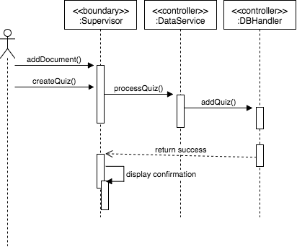

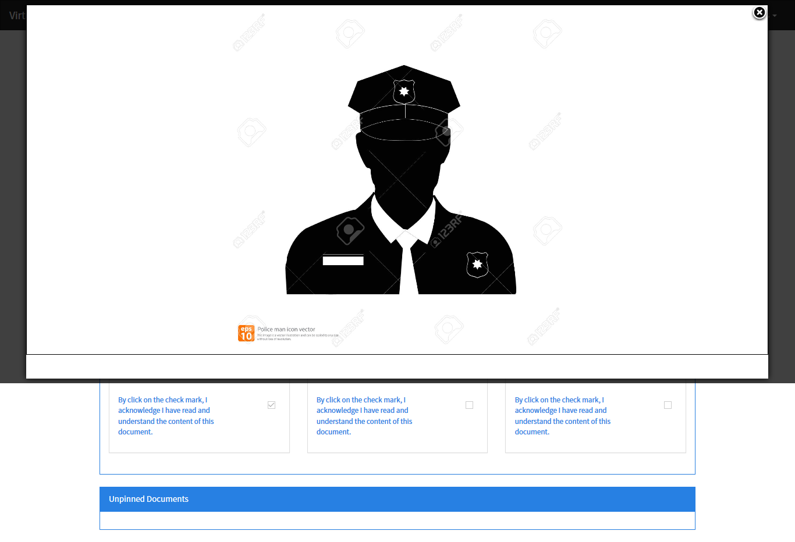
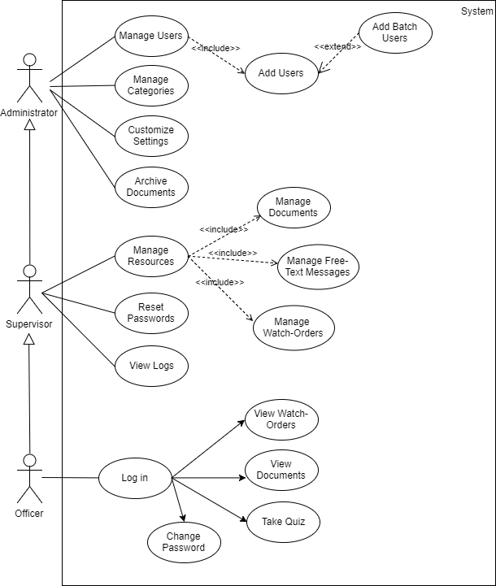
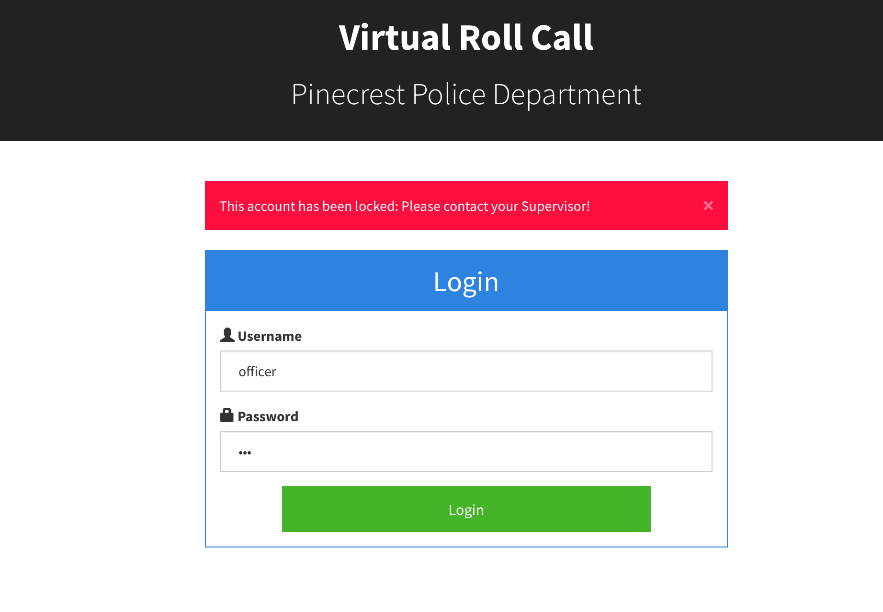
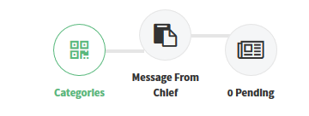
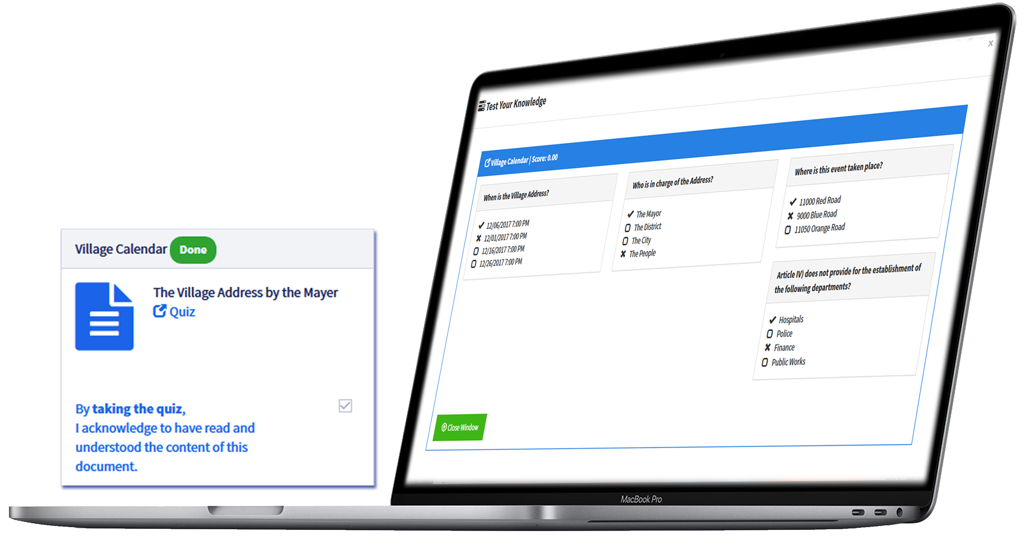







VIRTUAL ROLL CALL
Senior Project Fall 2017
Student: Jean Faustin
Mentor: Leila Zahedi
Instructor: Masoud Sadjadi
Problem
Working as an police officer brings on a range of daily court obligations, traffic stop, crash and injuries, and unexpected events. How do vital information get to Officers? How to know Officers have read important documents or messages? How to protect their privacy?
Verification
Test Case ID | VRC-3003 -Encrypt-250001
Purpose | Verify that an account password is encrypted when new user is added.
Preconditions | An Administrator has successfully logged into the system. The user select the User Management tab.
Input | The Administrator enters the new user information: ~ First Name: Terrell ~ Last Name: Wheaton ~ Username: twheaton ~ Password: test1234 ~ Role: Officer
Expected Output | A new user has been added. Password is encrypted in the database
Actual Output | "User successfully added!"
Status | Pass
Requirements
Create quiz for newly uploaded documents.
Take quiz to review and acknowledge.
Lock account after five consecutive failed login attempts.
Share free-text plain messages
Switch between roles (from Administrator to Supervisor, and Officer, vice versa).
Passwords should be encrypted
Documents and messages should be seen as a popup instead of new tab.
System Design
Solution
Configured via Online, the Virtual Roll Call (VRC) provides response options, created by the Administrator, who can upload documents, messages, images, quizzes and by having the roll call system virtualized, officers are always up to date on the latest briefings,
Current System
Third release of the VRC application extends its previous predecessor with management feature sampling, new data forms, new smart queries and added features such as:
Free-Form Text Messages for short notes.
Quiz Maker to enhance comprehension.
Account Lock for security.
Password Encryption for protection against unwanted access.
Verification
Implementation
Frontend: HTML5, CSS3, Bootstrap CSS, Bootswatch Theme, UI-Grid
Frontend Framework: Angular JS
Backend API: PHP
Database: MySQL
Web Server: Apache HTTP
OS: MacBook Pro, Windows 10
+
+
+
+
+
Summary
VRC app plays a critical role in sharing information among officers as PDF documents, images, and even plain text.
It is brought about on the success of the previous version as it enriches itself with new features and capabilities with key differentiations:
Fast implement in weeks , involving substantial and useful enhancement.
Ensuring the ongoing technology platform changes are maintained.
VRC app seeks to improve level of two-way communication among Officers.
The material presented in this poster is based upon the work supported by Jean R Faustin.
I am thankful to the help that I received from my Co-Student, Juan Lopez, and Product Owners Jason Cohen and Frank Alvarado.
Notes:
1

