Slide 1










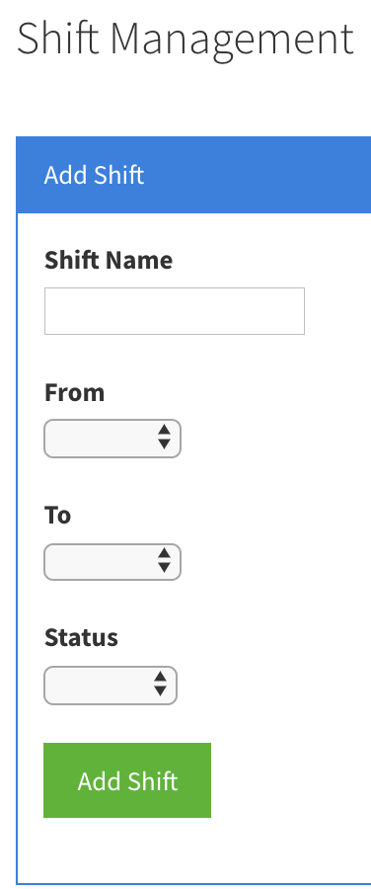
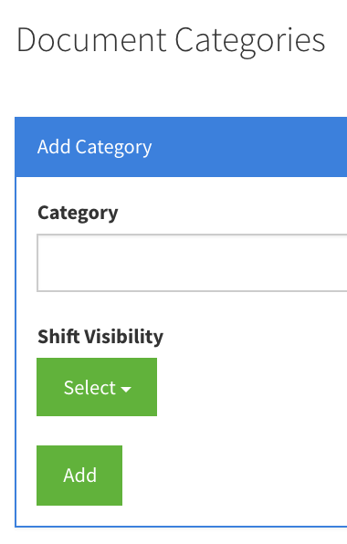
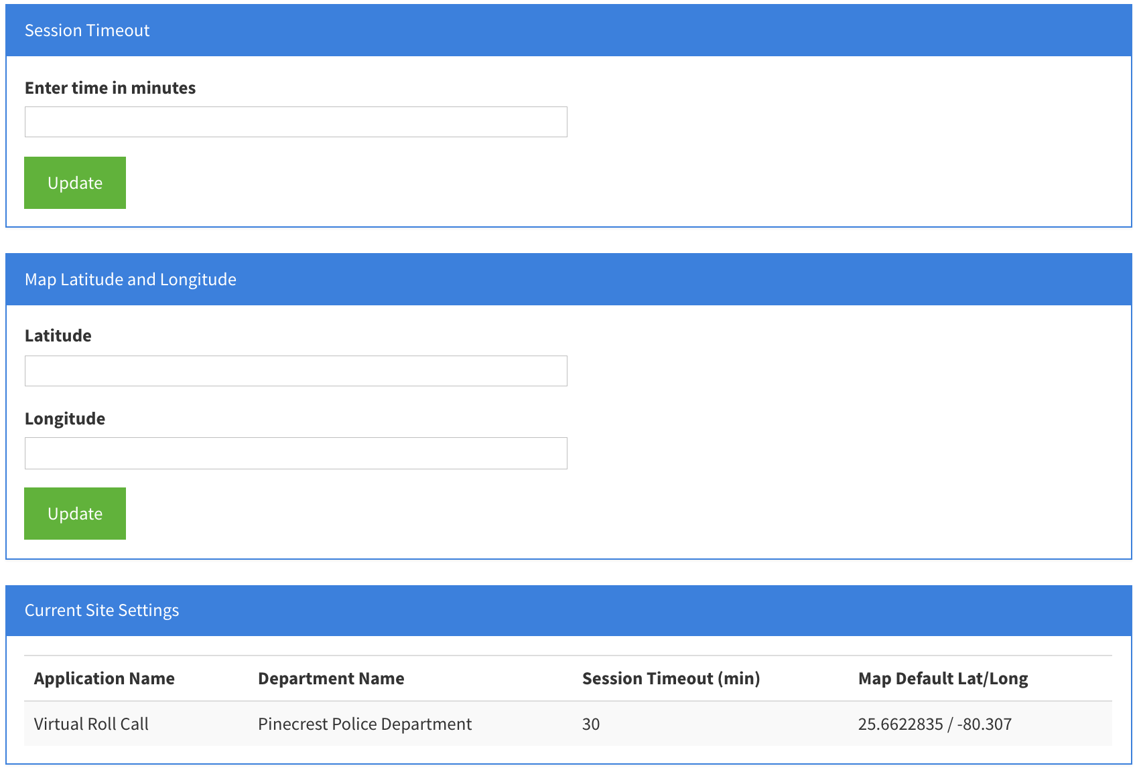
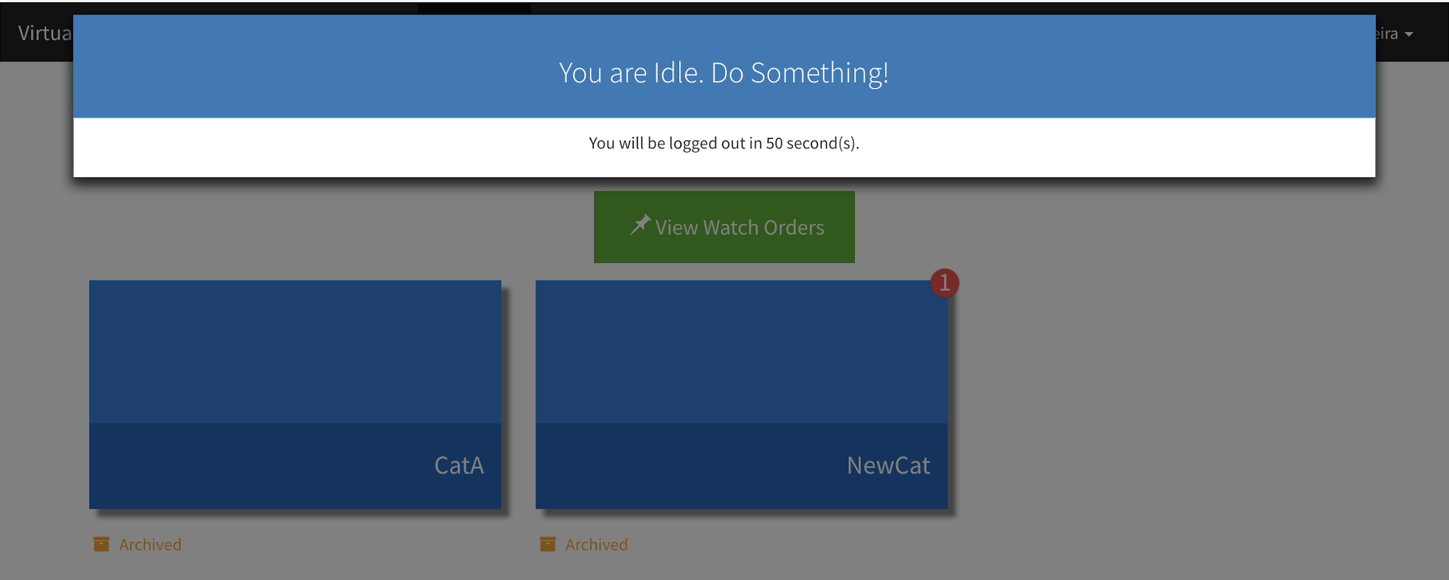
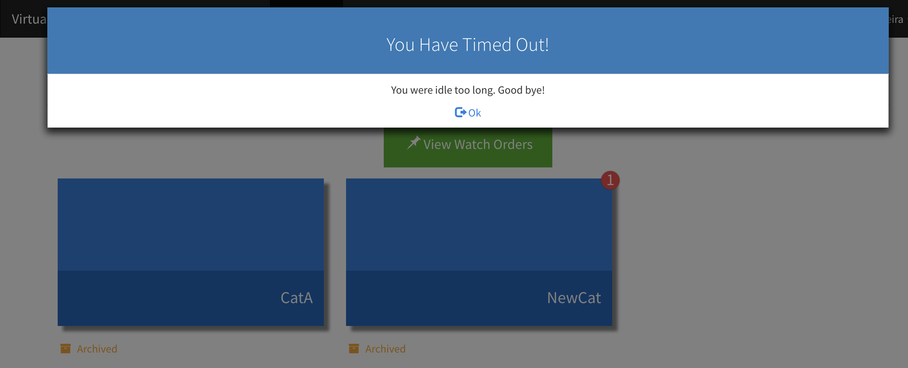
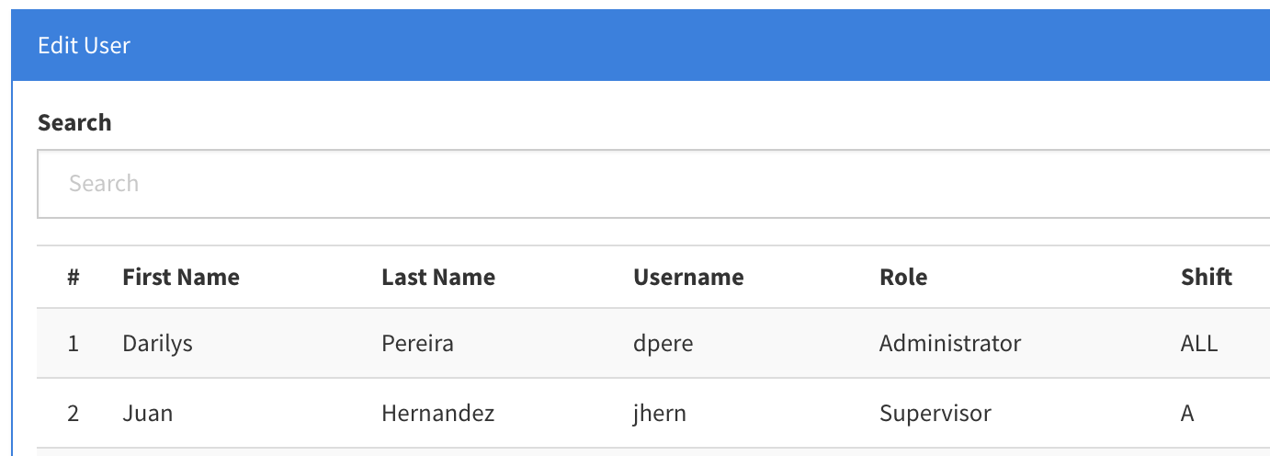
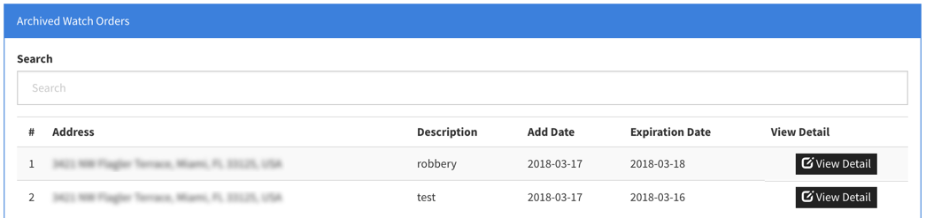
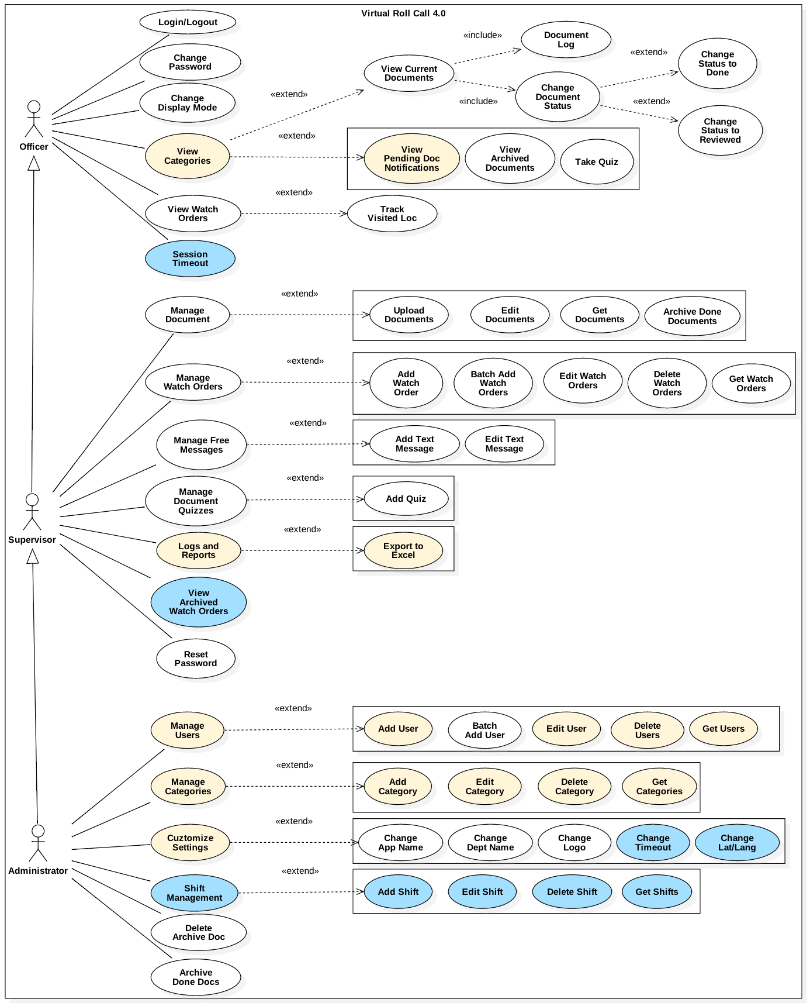
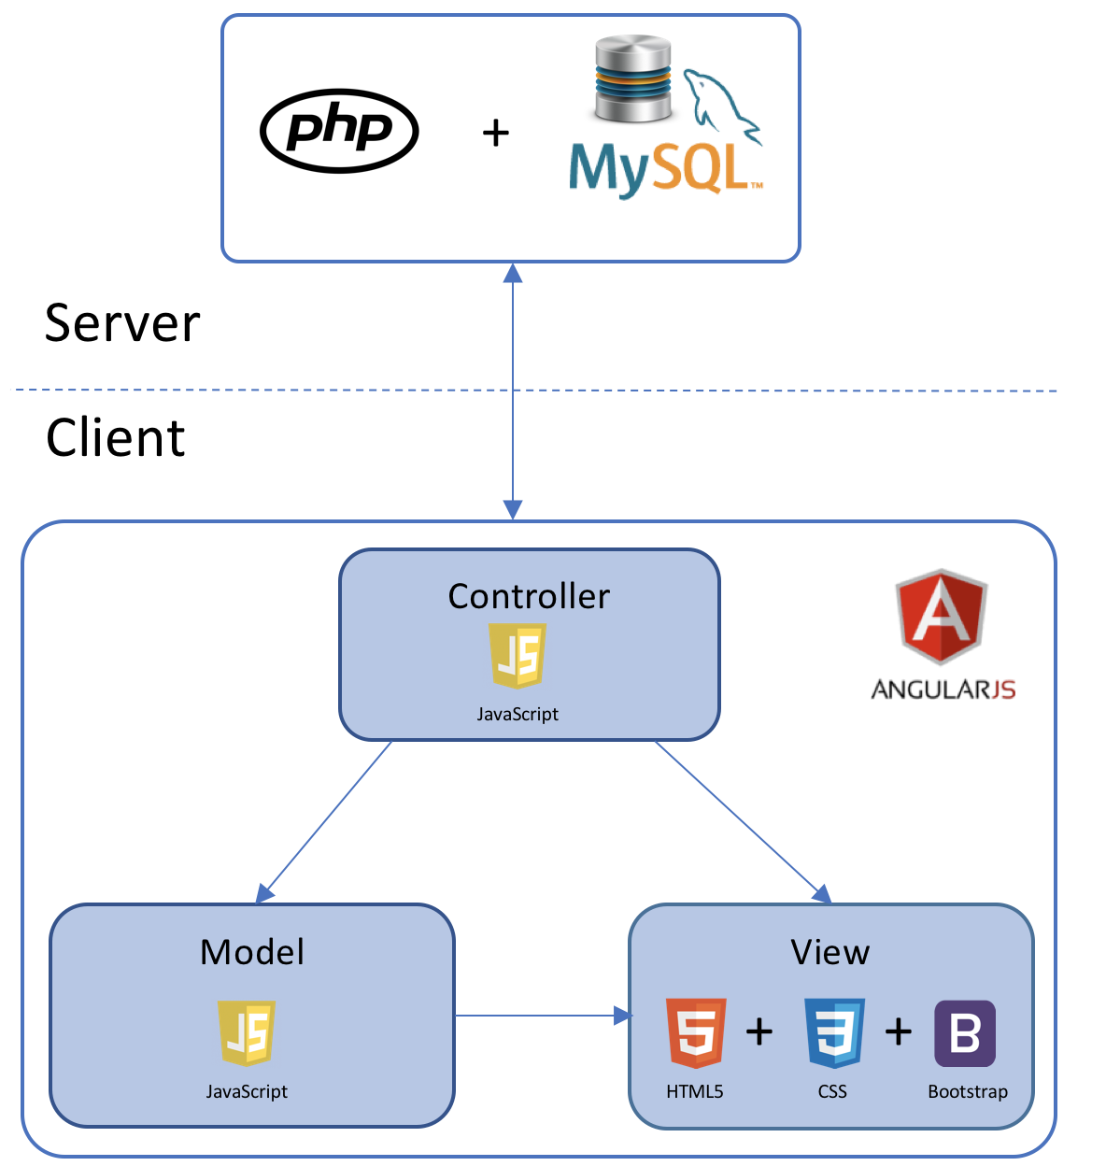

School of Computing & Information Sciences
Senior Project Spring 2018
Virtual Roll Call 4.0
Student: Darilys Pereira Lopez, Florida International University
Mentors: Juan Caraballo, Florida International University
Jason Cohen and Frank Alvarado, Pinecrest Police Department
Professor: Masoud Sadjadi, Florida International University
Problem
Roll call is a briefing meeting in police departments where shift supervisors share critical information with officers.
Officers cannot always be present for these briefings, preventing them from receiving vital information.
It is difficult for supervisors to distribute new material after roll call is over.
Solution
Virtual Roll Call (VRC) Web Application eliminates the need for in person roll calls.
Allows officers to receive information in real-time.
Provides document access and notifications based on officer’s shift.
Facilitates information security and reporting capabilities.
Flexible site settings customizable to police department preferences.
Current System
Version 3.0 is currently used by Pinecrest Police Department. My contributions to version 4.0 include new features such as:
Assign officers to a work shift.
Document visibility based on shifts.
Keep historical data of watch orders.
Set site settings for session timeout and map default latitude and longitude.
Enforce session logout after idle period.
Update supervisor document reporting.
Requirements
Officers must be assigned to only one shift.
Categories are visible to one or multiple shifts.
Document notifications are based on officer’s authorized categories.
Watch orders are archived if expiration date is in the past.
Watch order map center must be customizable by administrator.
Timeout period must be controlled by administrator.
Prompt user to take action to avoid session logout during one minute countdown.
Terminate session if user was idle and did not take action during countdown.
Include done, reviewed, and pending document status in supervisor logs.
Implementation
Frontend: HTML5, CSS3, Bootstrap, JavaScript, Angular JS
Backend: PHP
Database: MYSQL
Web Server: Apache HTTP
Object Design
Verification
Test case: User Story #343 - Add category security based on officer’s shift.
Purpose: Verify user is only able to see categories associates with his/her shift.
Pre Conditions: User is logged in. User is in Dashboard page
Expected Results: User should see categories with his/her shift or ‘ALL’ visibility.
Actual Result: Screen displays categories which view has been set to the user’s shift or access level is ‘ALL’ shifts.
Status: Passed
System Design
Summary
Virtual Roll Call 4.0 gained new features and improvements such as:
Enhanced view document feature by creating visibility layer based in shifts.
Improved system security by enforcing session timeout.
Added flexibility to control system settings like map position and timeout period.
Flexible supervisor reporting.
Use Case Diagram
FOLLOW US @FIUSCIS
Acknowledgement
The material presented in this poster is based upon the work supported by Pinecrest Police Department. I am thankful to the help that I received from my group members, Juan Hernandez, and Product Owners Jason Cohen and Frank Alvarado.
Notes:
1

