Slide 1









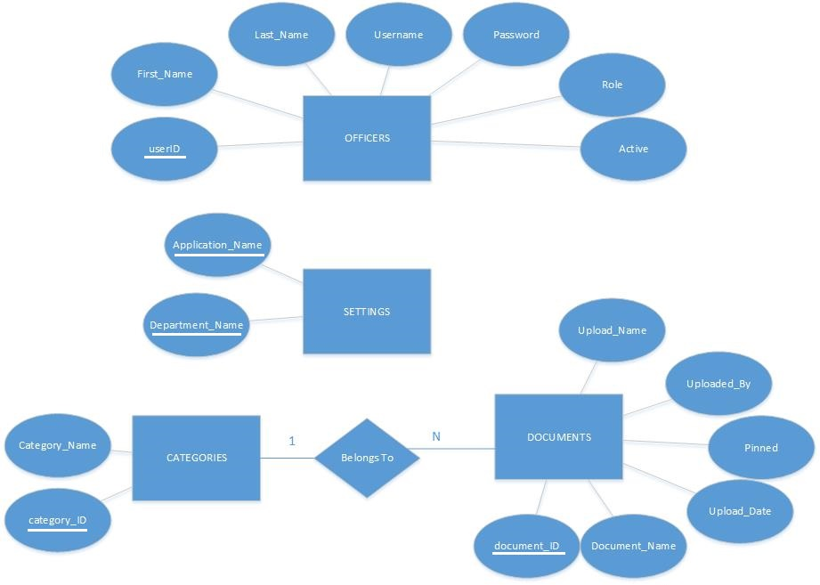
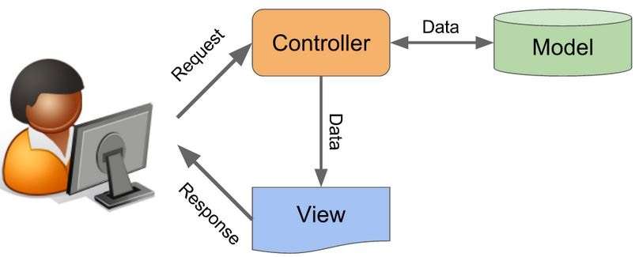
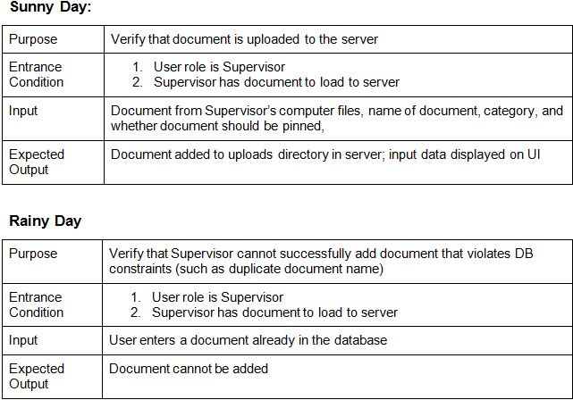
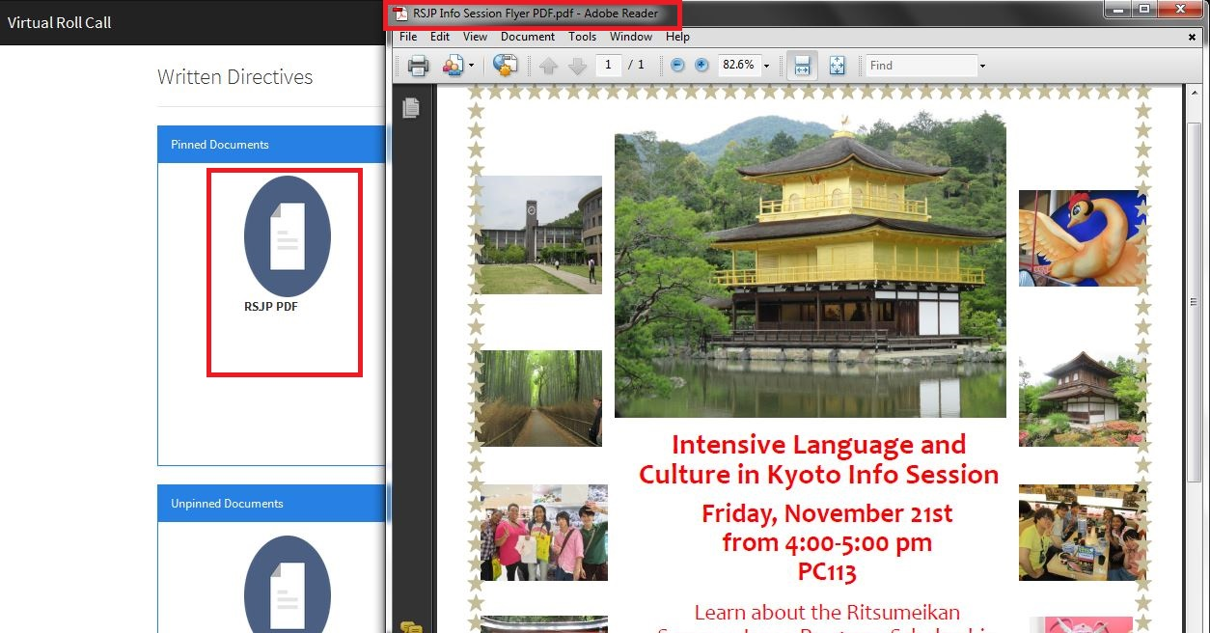
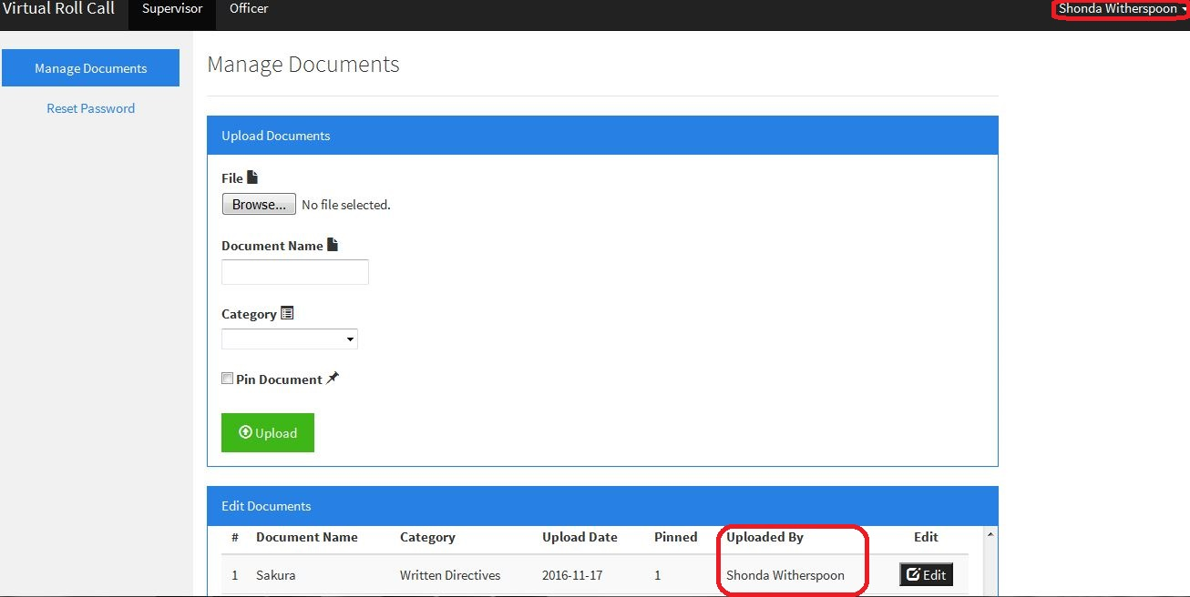
School of Computing & Information Sciences
Advanced Software Engineering, Fall 2016
VIRTUAL ROLL CALL Ver. 1.0
Student: Shonda Adena Witherspoon, Florida International University
Mentors: Jason Cohen, Village of Pinecrest Police Department
Mohsen Taheri, Florida International University
Instructor: Masoud Sadjadi, Florida International University
Current System
Traditionally the first 15 minutes of a police officer’s shift is spent at the station in a briefing room where the shift supervisor, commonly of sergeant rank, goes over a clipboard of information with the officers. This information ranges from internal department matters to crime trends as well as any other information that needs to be passed on to the officers at the commencement of their daily tour of duty.
Problem
Due to many factors, officers are not always present for roll call briefings. Officers may be in court, assigned to an overlapping shift, or may have to start their tour early due to call volume.
Consequently, officers may miss important information discussed during roll call.
Solution
Development of an online software application , where administrators and supervisors can input relevant information into the software ,and officers can log in and review the latest postings
Virtual Roll Call will allow for officers to be briefed on all the necessary information when feasible.
Requirements
The software needs to have three modules:
Officer Module (View Documents)
Supervisor Module (1 + add documents, reset passwords)
Administrator Module (1 & 2 + the ability to add /modify/delete users, and edit site settings)
My Role
Setup and design DB and schema
Backend development
Uploading files
Feature testing
Scrum Master
Implementation
System Design
Verification
Screenshots
Summary
The current roll call system requires officers to be physically present for their shift’s briefings.
Officers who are unable to attend roll call miss valuable information
With the first version of Virtual Roll Call complete, officers are able to hold all current aspects of the roll call system online, with documents conveniently sorted by category.
Each user role has different interactions with the system, each with simple and clear usage and navigation.
Next version can extend version 1.0 features
Unit and integration test were performed manually against sunny and rainy day scenarios.
Acknowledgement
The material presented in this poster is based upon the work supported by the Village of Pinecrest Police Department, Major Jason Cohen, Captain Samuel Ceballos, and Frank Alvarado. I am very thankful for the help and support that I received from my group members, Shalisha Witherspoon, and Ivana Rodriguez. I would also like to thank Mohsen Taheri and Dr. Masoud Sadjadi for their instruction.
Notes:
1

