Slide 1






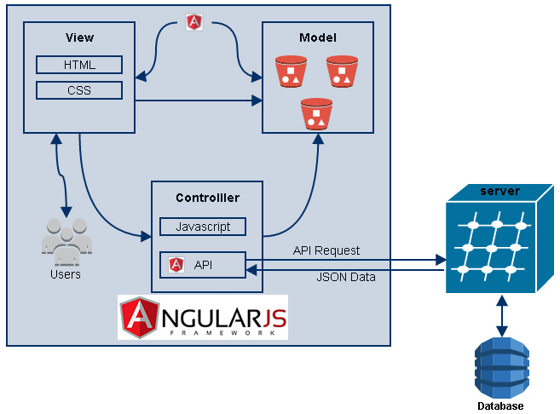
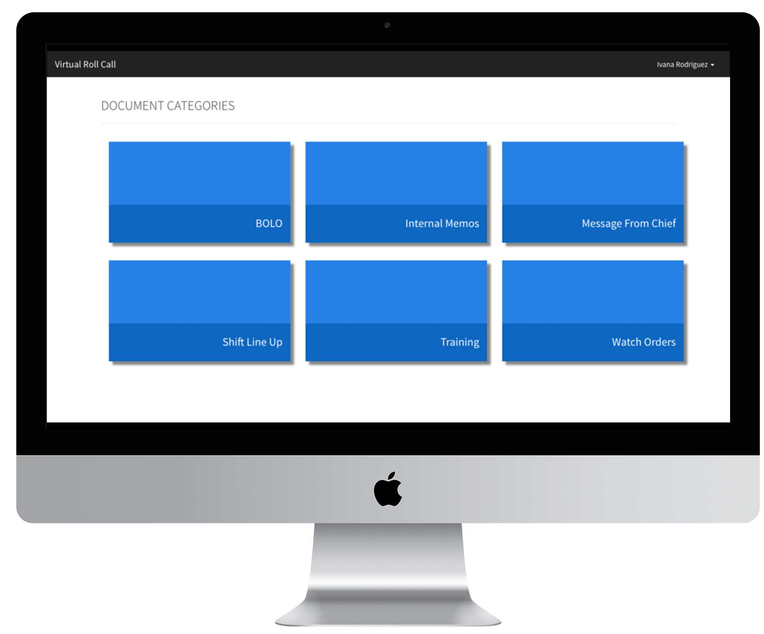
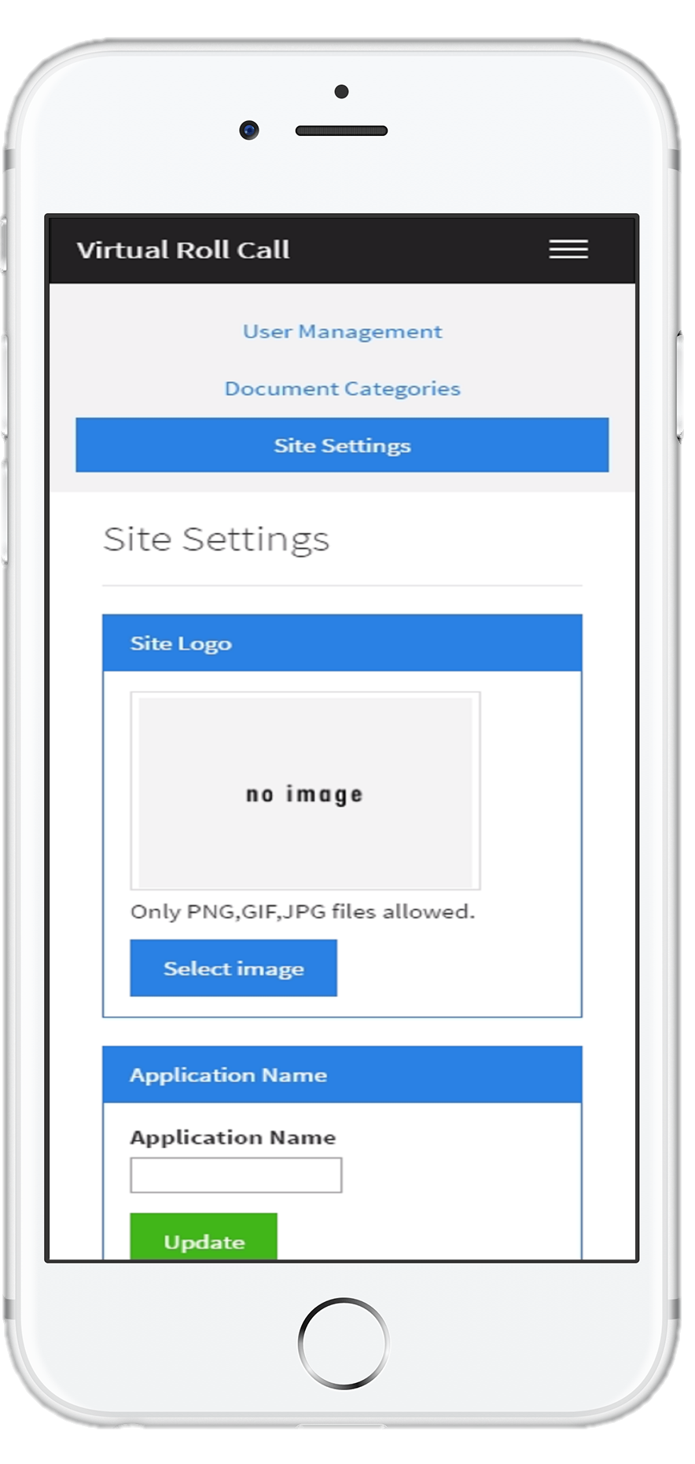
Virtual Roll Call
Advanced Software Engineering
Florida International University
Fall 2016
Ivana Rodriguez | Student
Mohsen Taheri | Mentor
Masoud Sadjadi | Instructor
+
+
+
‘
]]]]]6
Background & Problem
The start of a police officer’s shift is spent in the station’s briefing room where shift supervisors go over a clipboard of critical updates. Due to many legitimate factors, officers are not always present for these “roll call” briefings. As a result, such absences prevent officers from receiving important communications relevant to the commencement of their shift.
The Virtual Roll Call (VRC) web application solves the following problems:
Eliminates the need for meeting in person
Supervisors can push information onto the site in real-time
Gives officers the flexibility of accessing shift updates at any time
Current System
This is the first release of the VRC app. My contributions to it’s realization include:
Allowing for the site to be fully customizable by any law enforcement agency
Allowing users to change their password at their convenience
Allowing supervisors to reset passwords for user’s that are locked out of the system
Allowing admins to manage the categories that supervisors can tag documents with
Designing the UI for the “View Categories” page in the officer’s dashboard
Serving as lead in the application of AngularJS and the inclusion of Angular UI
Requirements
User Authentication
Change My Password
Manage Users (CRUD operations)
Manage Categories (CRUD operations)
Customize Site Settings
Upload Documents
Reset Officer Password
Clean, Easy to Use Interface
Implementation
Frontend: HTML5, CSS3, Bootstrap CSS, Bootswatch Theme
Frontend Framework: Angular JS
Backend API: PHP
Database: MySQL
Web Server: Apache HTTP
OS: Ubuntu Linux
Object Design
System Design
Verification
Test Case ID | Site_Settings_IT_01 (Sunny Day)
Purpose | Verify that if an admin uploads a new logo, the login page is updated accordingly
Precondition | Administrator is logged in and on the site settings page
Input | User clicks on the ‘Select Image’ button User selects a valid image (either PNG, JPG, or GIF) from their file system User previews the image they just selected User clicks on ‘Save’ to replace the logo on the site
Expected Output | The logo on the login site is replaced with the newly uploaded image
Test Case ID | Edit_Category_UT_02 (Rainy Day)
Purpose | Verify that if an admin enters an invalid name, the category isn’t updated on the database
Precondition | Administrator is logged in and on the document categories page
Input | User selects the ‘Edit’ button for the category they would like to edit User enters a name that already exists in the category field User clicks the ‘Update’ button
Expected Output | The category name is not updated on the database and the admin is notified accordingly
Summary
The VRC app grants its users the flexibility that is expected in the world we live today
It has the potential and the power to replace archaic systems that are ridden with inefficiencies and communication headaches
The app has been developed in a manner that is both easy to implement and easy to use
The material presented in this poster is based upon the work supported by Ivana Rodriguez. I am thankful to the help that I received from my group members, Shonda & Shalisha Witherspoon.
Notes:
1

