Slide 1




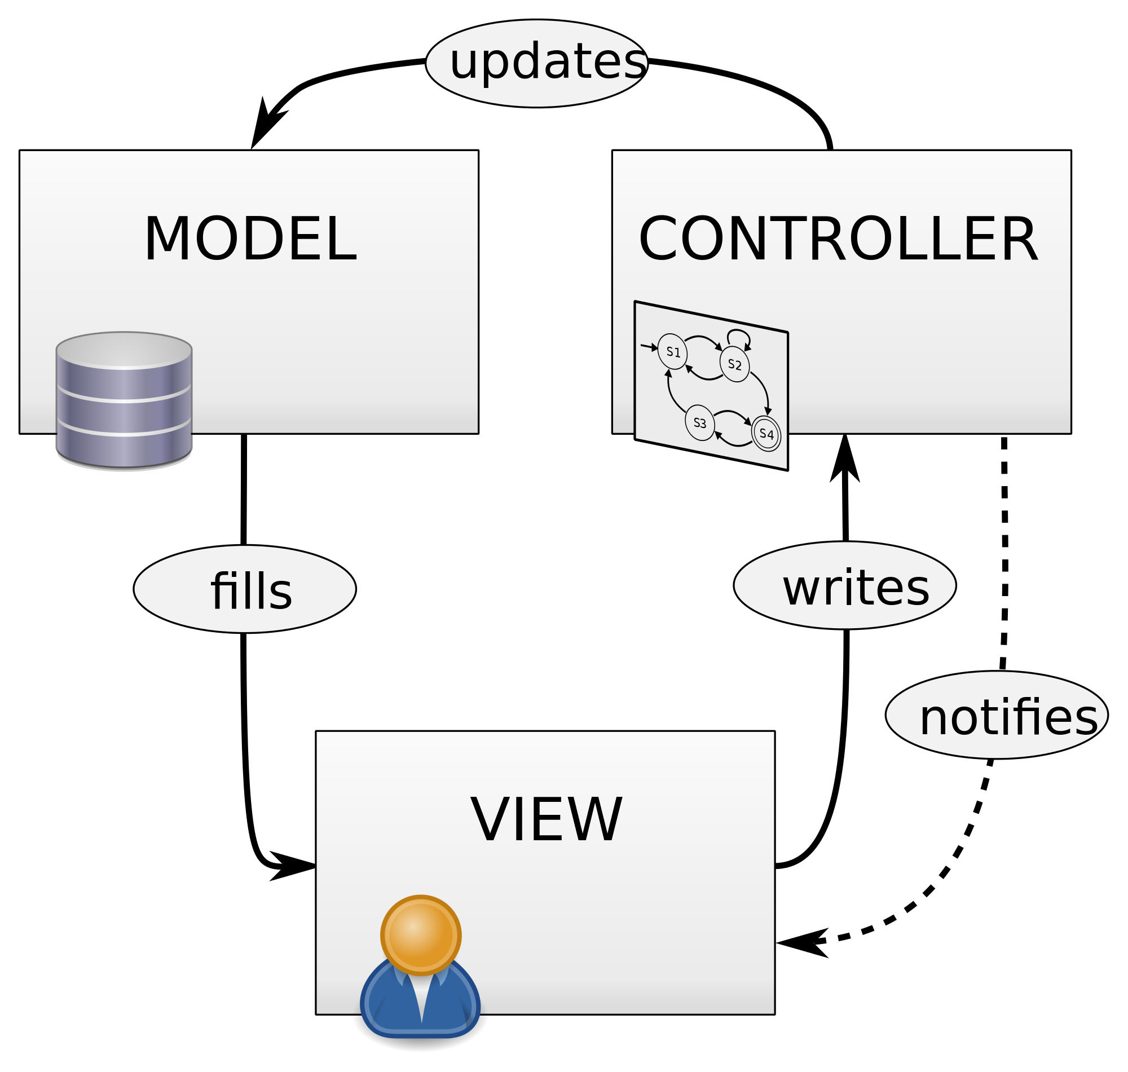
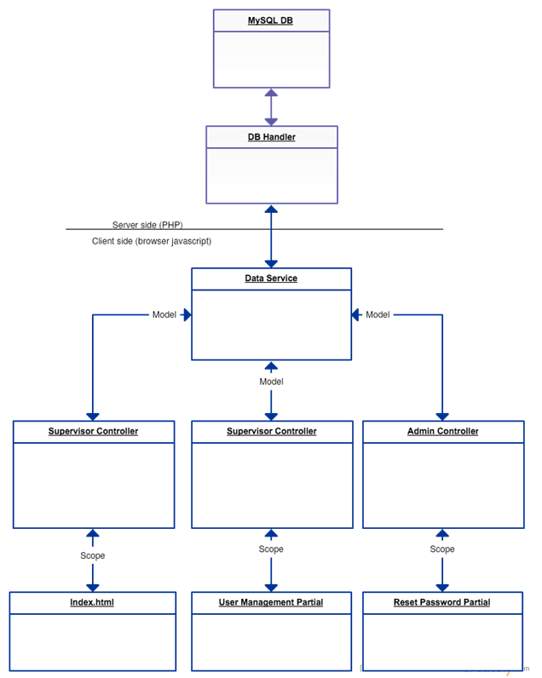




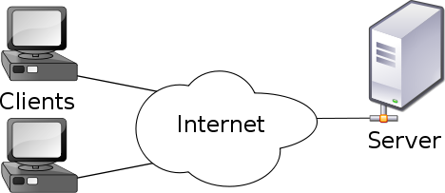
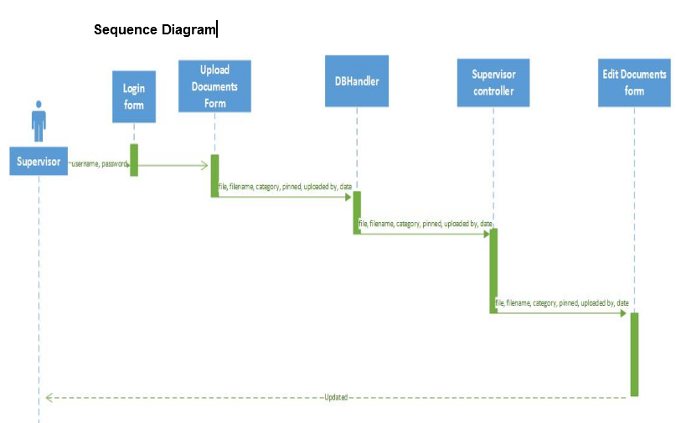


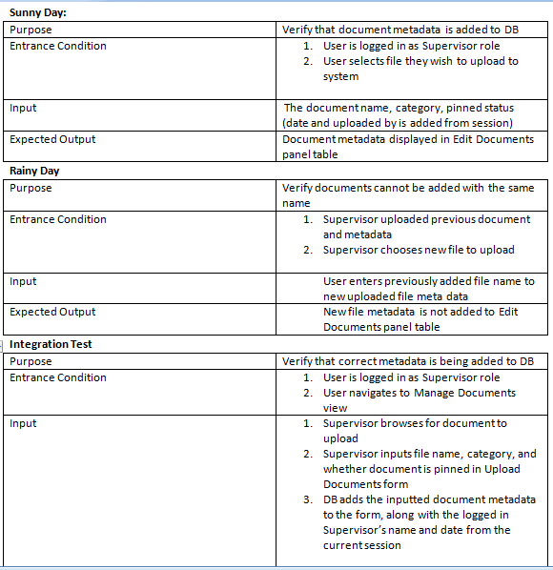
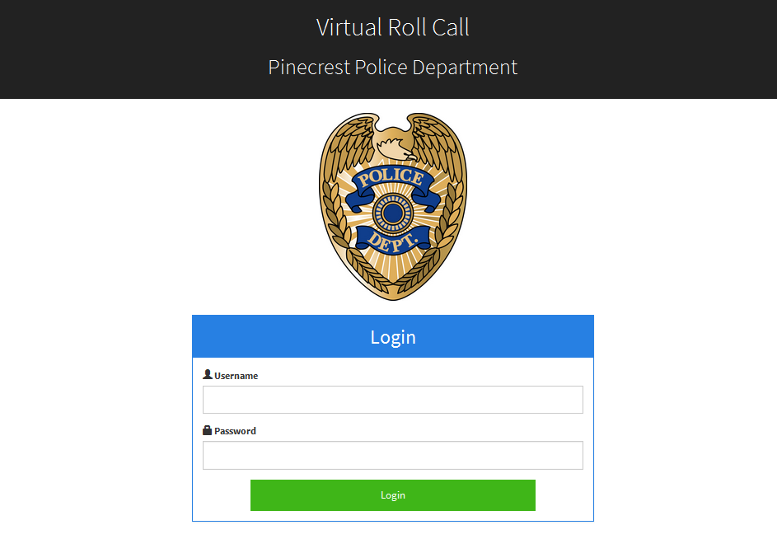
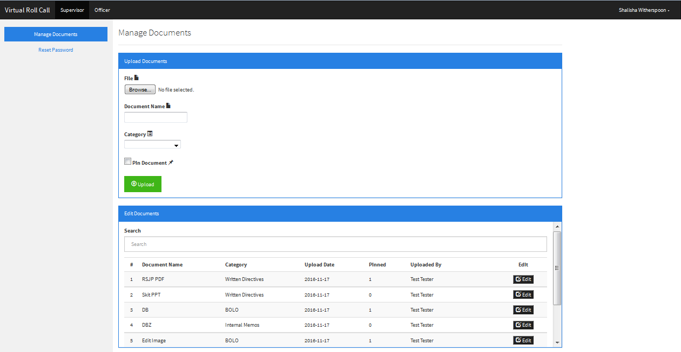
School of Computing & Information Sciences
Advanced Software Engineering, Fall 2016
Virtual Roll Call 1.0
Student: Shalisha Witherspoon, Florida International University
Mentor: Mohsen Taheri, Jason Cohen, Pinecrest Police Department
Instructor: Masoud Sadjadi, Florida International University
Problem
Solution
Requirements
Traditionally the first 15 minutes of a police officer’s shift is spent at the station in a briefing room where the shift supervisor, commonly of sergeant rank, goes over a clipboard of information with the officers.
Due to many factors, officers are not always present for roll call briefings. Officers may be in court, assigned to an overlapping shift or may have to start their tour early due to call volume.
Virtual Roll call will allow for officers to be briefed on all the necessary information when feasible.
Development of a web application where supervisory staff can input relevant information into the software and officers can log in and review the latest postings.
The application needs three modes of access, including:
Officer - views documents
Supervisor - adds documents and resets passwords
Administrator – adds/deletes users to system; customizes site settings
Users need username and password to access system
Users should be directed to appropriate view based on credentials
Administrators should be able to add/delete/edit users in the system
Administrator should customize site settings such as department name, logo, and category lists
Supervisor should upload documents to the system, and pin important ones
Officers should be able to view/download uploaded documents
System Design
Object Design
Implementation
Model-View-Controller
Front end
Back end
Client Server
Verification
Screenshots
Summary
Contributions
Login system
User Interface
Adding document metadata to system
Front end development (adding, deleting, editing user)
Officer view document dashboard
Pinning documents
By the end of the semester, the Pinecrest Police Department’s Roll Call System was successfully virtualized, so that officers can conveniently view uploaded documents anytime and anywhere, which will be of great service to the community.
Test were conducted to verify that Supervisors could add unique documents to the database, and pin them so that important documents appear at the top of the page.
Acknowledgement
The material presented in this poster is based upon the work supported by the Pinecrest Police Department .I am thankful for the help that I received from my amazing group members, Shonda Witherspoon, and Ivana Rogriguez.
Notes:
One ppt/pptx file per personname the file "firstname-lastname.pptx“. Please do NOT use black or dark background colors! Instead of <course name>, you need to add Senior Project or Advanced software Engineering or VIP. For the poster, each team member needs to focus on his/her contribution. Regarding the poster content, those of you who want to play it safe, you may closely follow the format in the template provided to you. However, I would like to see how innovative you guys can get. So, those of you who feel creative, go ahead and do whatever you feel is right for your poster! :) The guideline for the free format is to use the same space for the poster, make sure that your project name, your name, your mentor's name, and your instructor's name are included. The problem is well explained and motivated, and your contribution in the solution, acknowledging others' work, is clearly explained.
1

