Slide 1

VoterCloud
Team Members
Eldar Feldbeine – Primary Developer, System Tester
Raul Garay – architect, UI/UX, secondary developer
Mentor & product owner
Gus Monge
Instructor
Masoud Sadjadi

Slide 2
Problem
Citizen engagement in local government is low
Election, policy, and politician information not always easy to find
Elected officials may not properly represent their community
Elected officials may find it difficult to gauge public opinion

Slide 3
Current System
Citizens gather information from:
Newspapers, internet, word of mouth
Citizens can contact politicians by:
Calling, paper mail, and electronic mail
Signing petitions online and from activists on the streets
Attending public hearings and meetings
Politicians can reach out to citizens by:
Flyers and commercials
Surveys
Social media

Slide 4
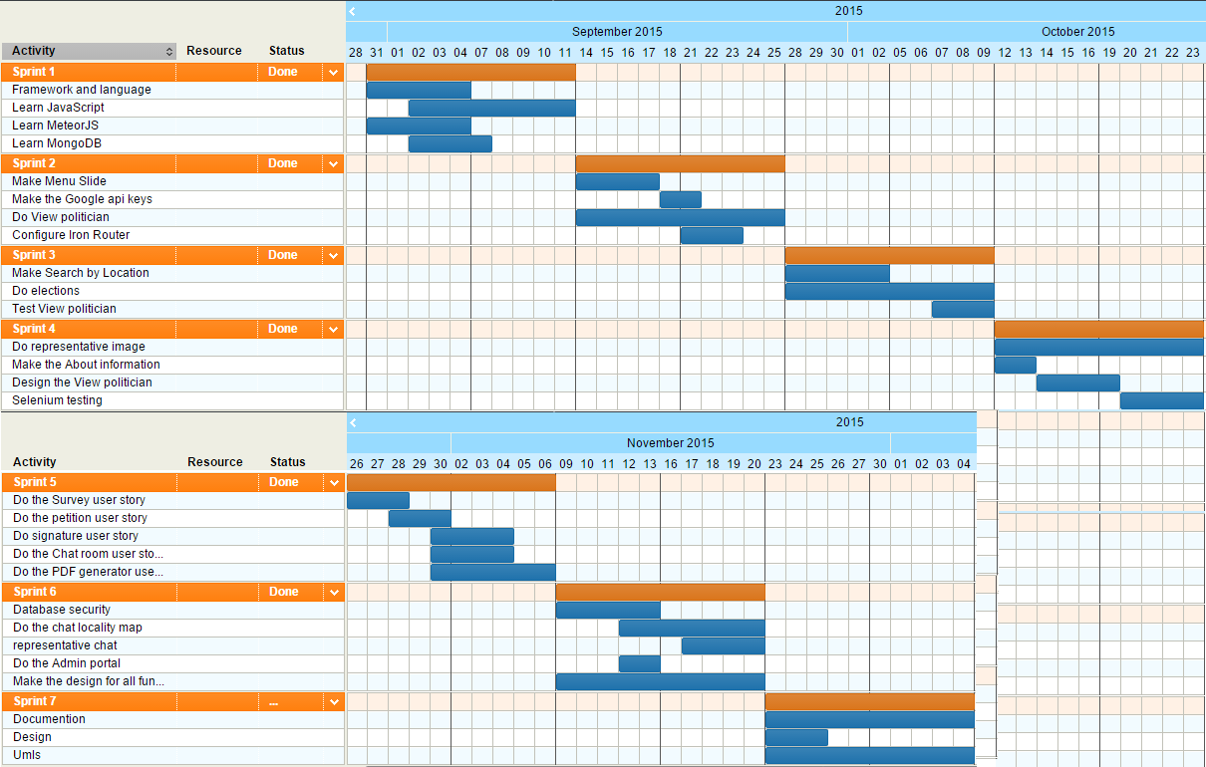
Project Management

Slide 5
Development Setup
Built on the Meteor JavaScript framework
VoterCloud = Hybrid Application
HTML5, CSS, Javascript
MongoDB Persistent Storage
Big Data possibilities
Meteor.com hosting used for staging and testing server

Slide 6
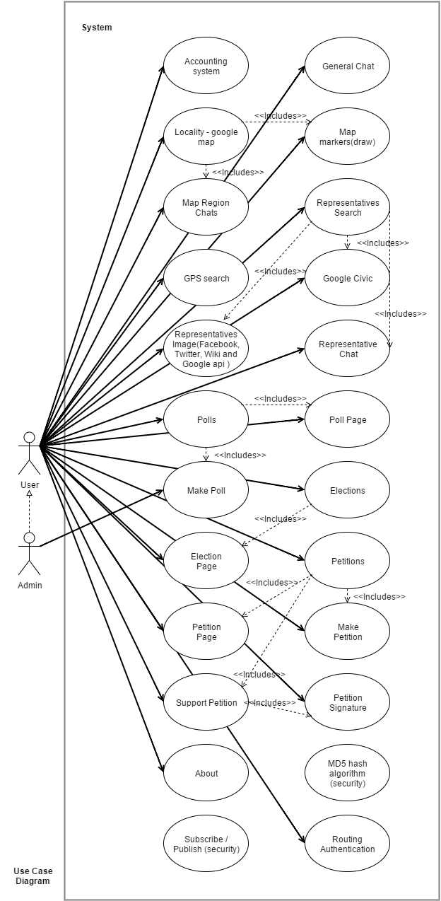
Use Case Diagram

Slide 7
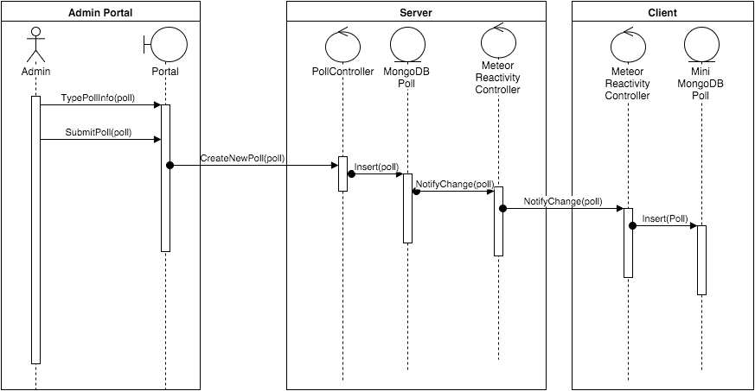
Sequence Diagram – Create Poll
Notes:
This is VoterCloud’s primary data model. At the top half, we see the collections, fields, and relations that belong to the MongoDB in the server, and in the bottom half, we see the

Slide 8
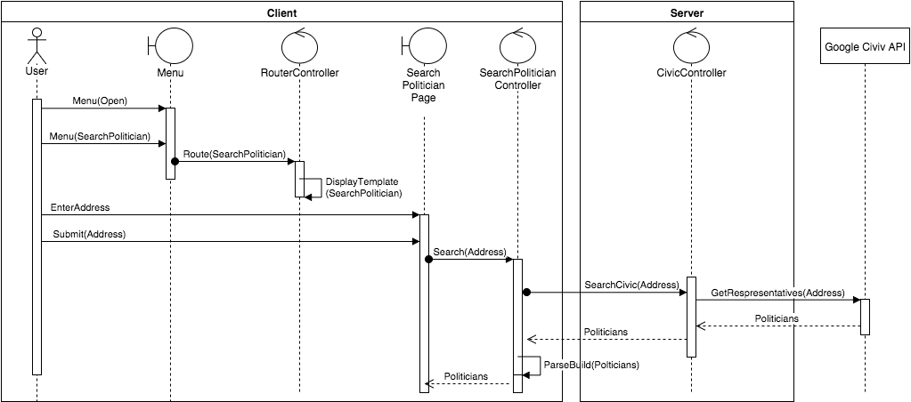
Sequence Diagram – Search Politician
Notes:
This is VoterCloud’s primary data model. At the top half, we see the collections, fields, and relations that belong to the MongoDB in the server, and in the bottom half, we see the

Slide 9
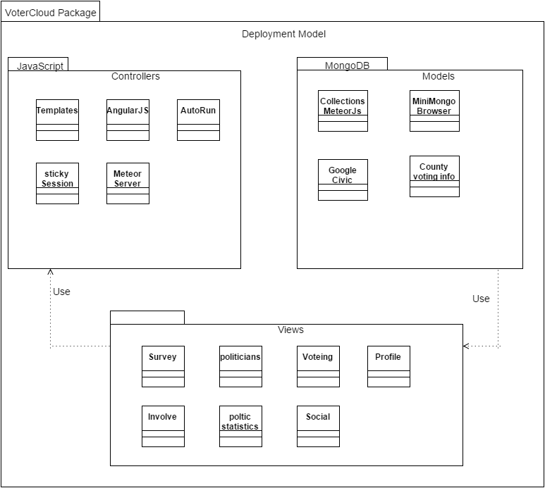
System Decomposition

Slide 10

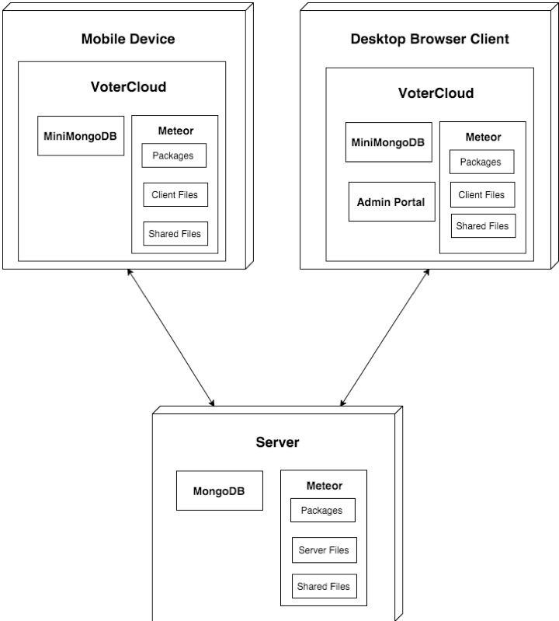


System Deployment
Browser Client
Admin Portal

Slide 11
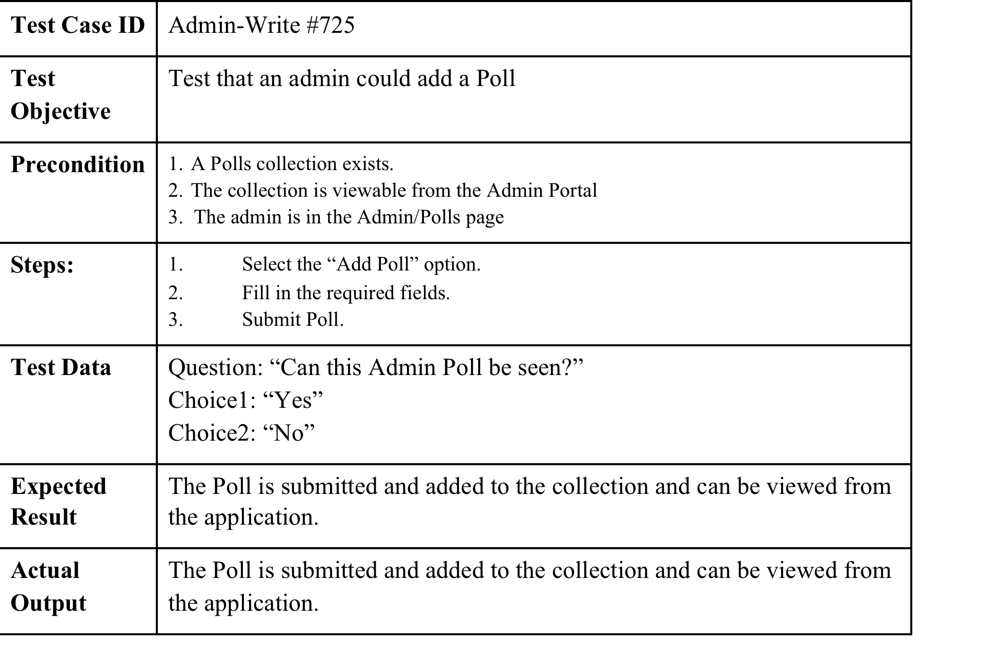
Sunny Day Test Case

Slide 12
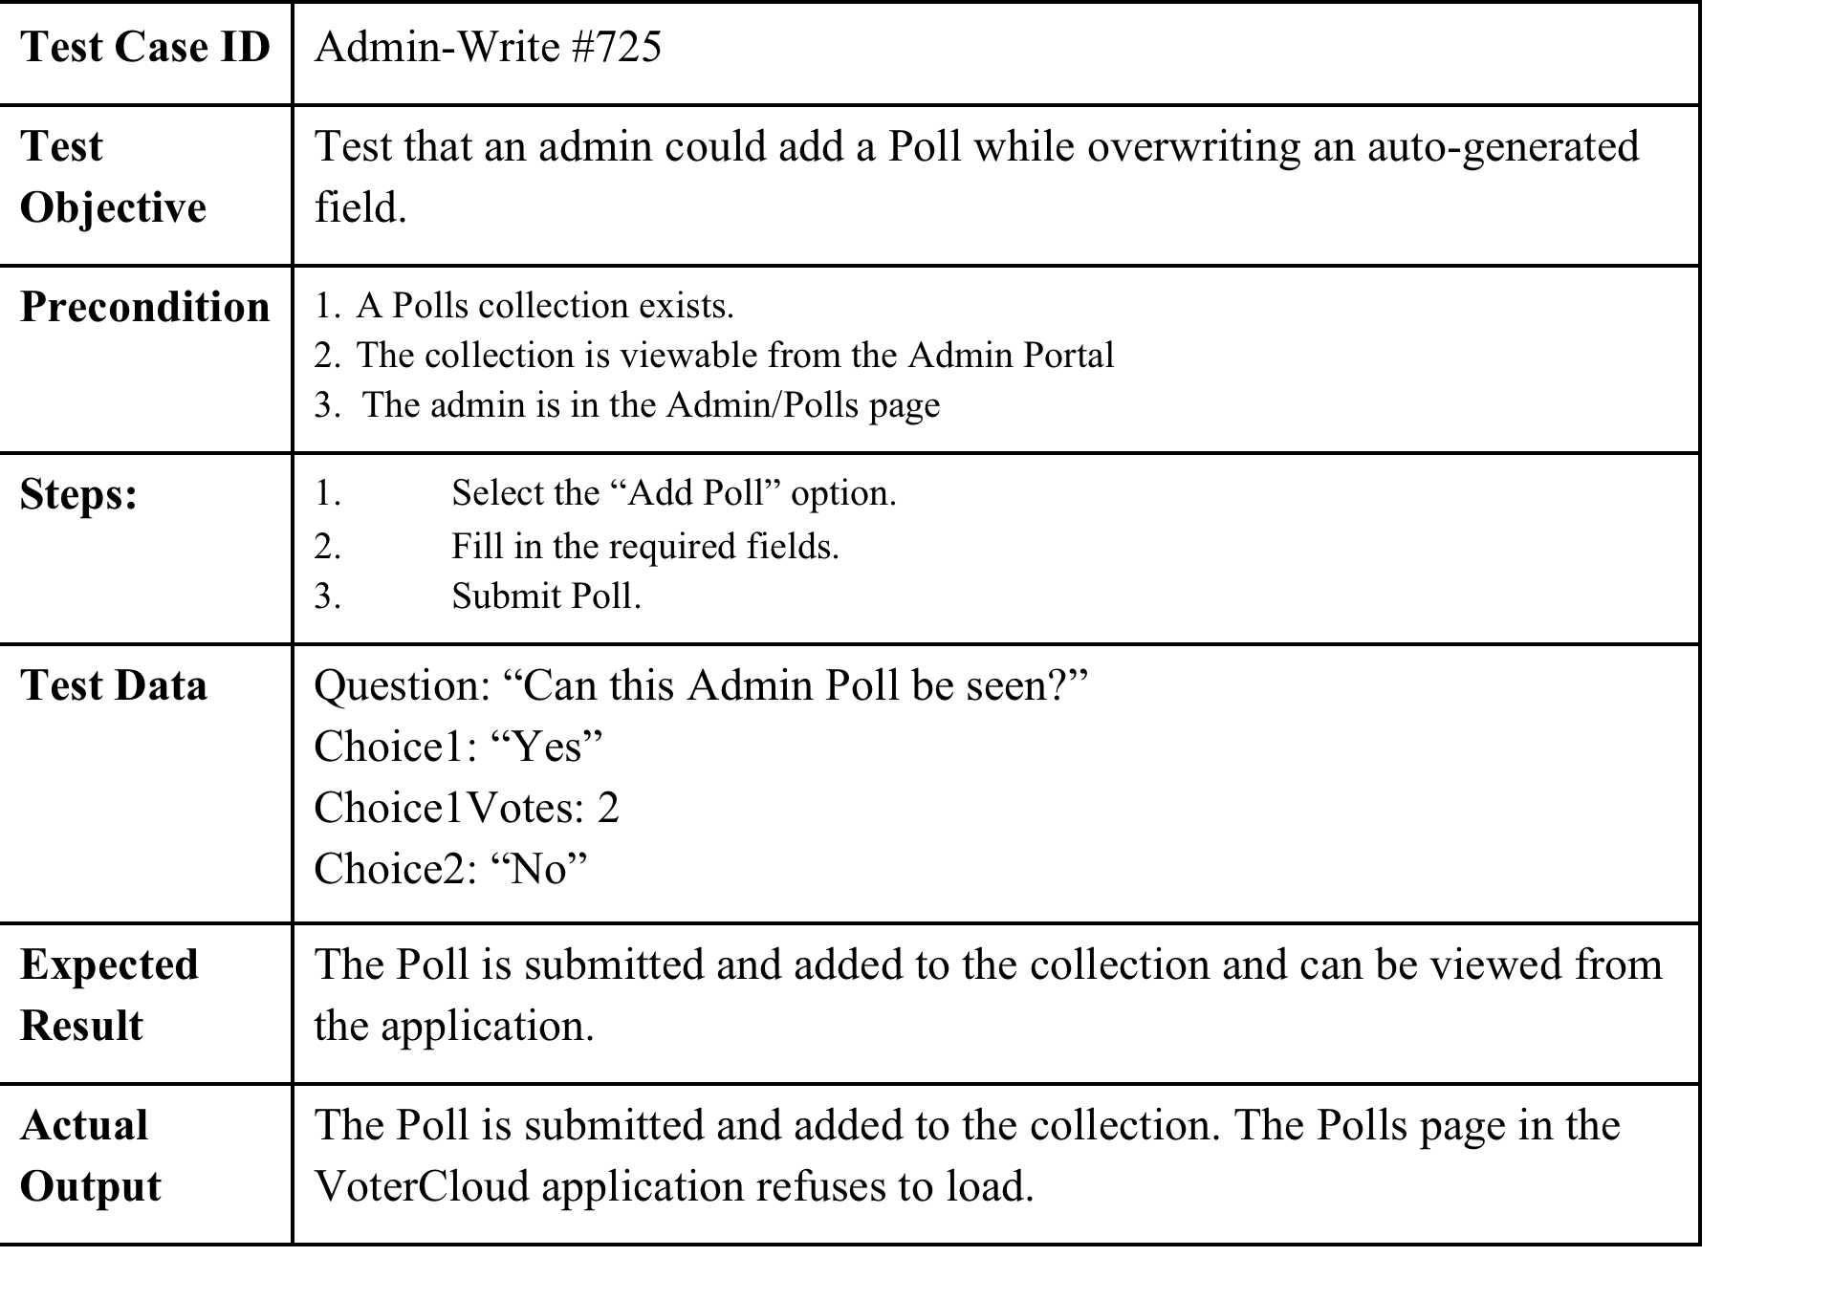
Rainy Day Test Case

Slide 13
Thank you for your time!
Special Thanks To:
Eldar Feldbeine - Gus Monge - Masoud Sadjadi

