Slide 1

VoterCloud
Team Members
Eldar Feldbeine – Primary Developer, System Tester
Raul Garay – architect, UI/UX, secondary developer
Mentor & product owner
Gus Monge
Instructor
Masoud Sadjadi

Slide 2
Problem
problem is the lack of organized portal for the citizens to connect with each other and engage in different activities that can result in real impact on national and local level.
We at VoterCloud designed and implemented an exact solution for this problem. VoterCloud is an application(mobile and web) that enable users to engage and connect on local and national politics.

Slide 3
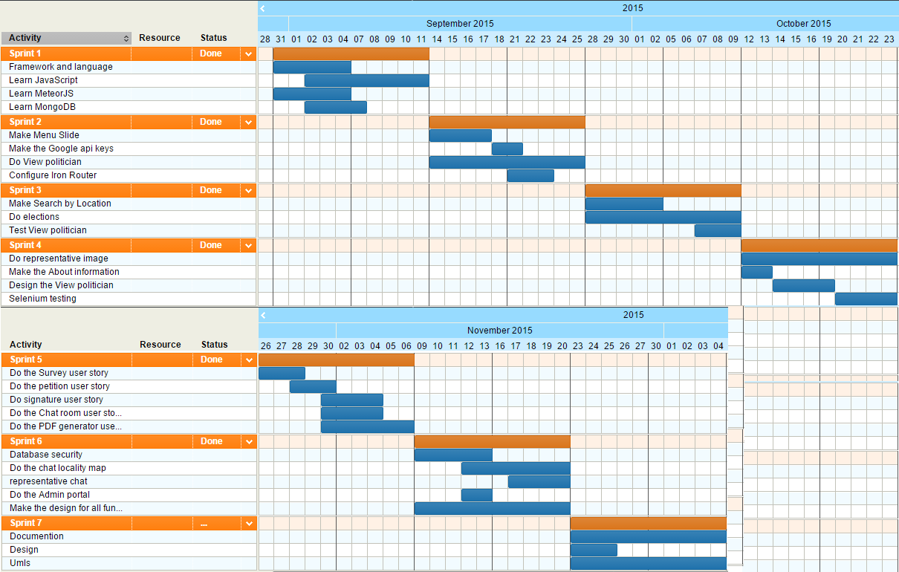
Project Management

Slide 4
User Stories Implemented
Side Menu
View Local Politicians
Search by location
Elections
Representative Image Profile
Polls
Petitions
Signature
Database Security
PDF generator and serving
chat locality
Representative chat
Admin portal
Design
Testing

Slide 5
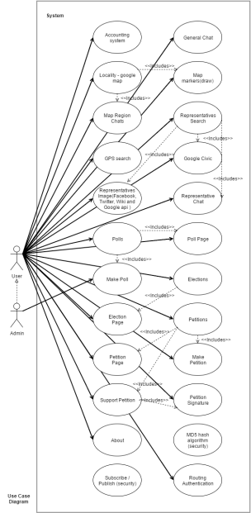
Use Case Diagram

Slide 6
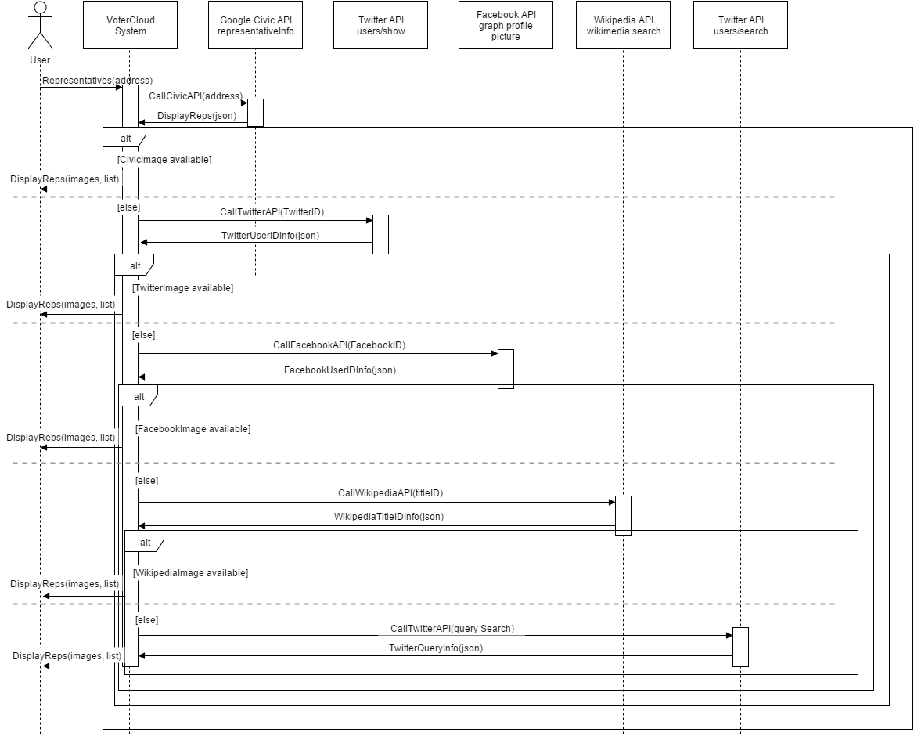
Sequence Diagram – Politician Image

Slide 7
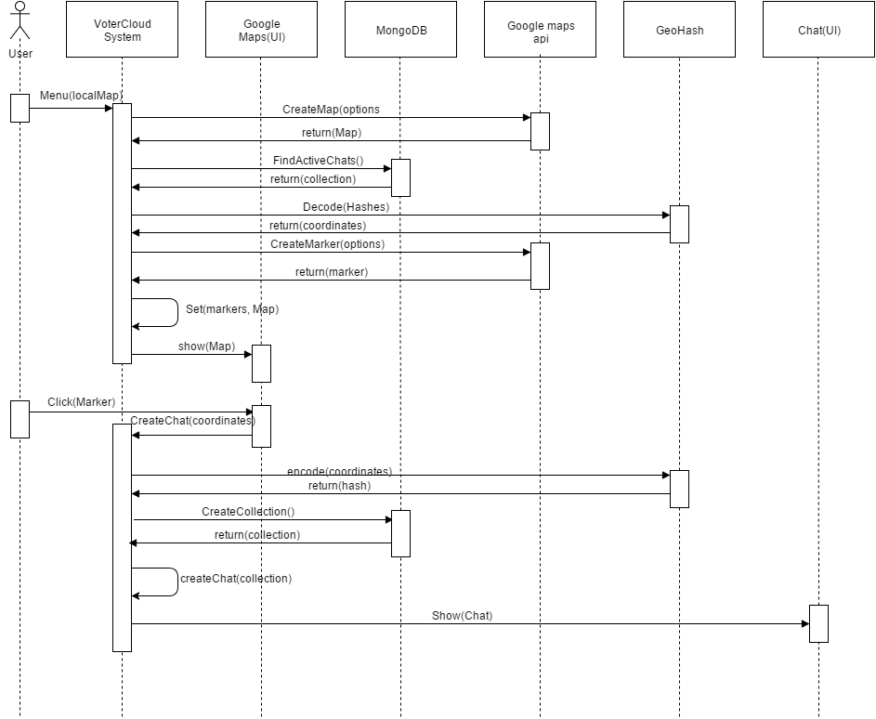
Sequence Diagram – Map locality

Slide 8
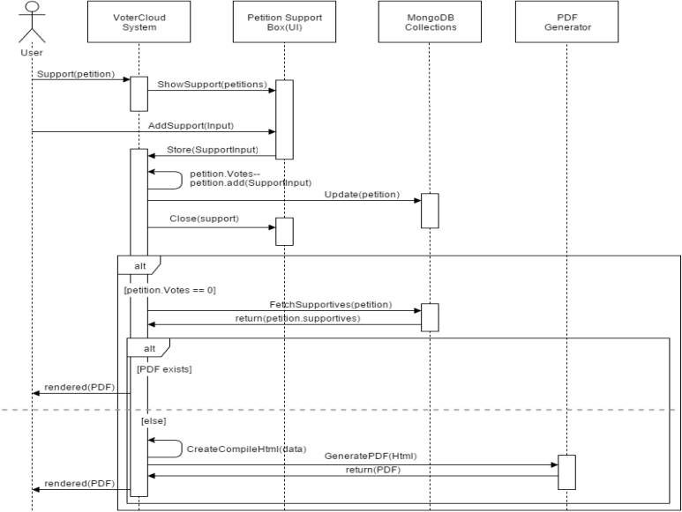
Sequence Diagram – PDF generator

Slide 9
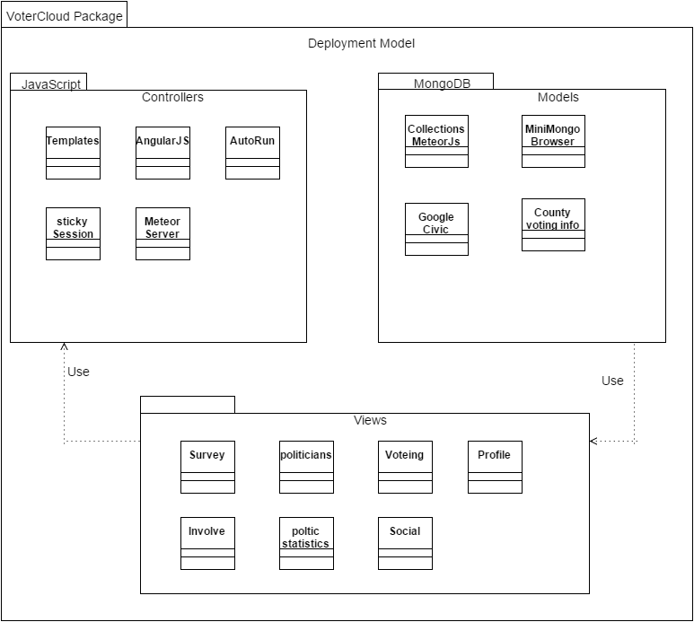
System Decomposition

Slide 10
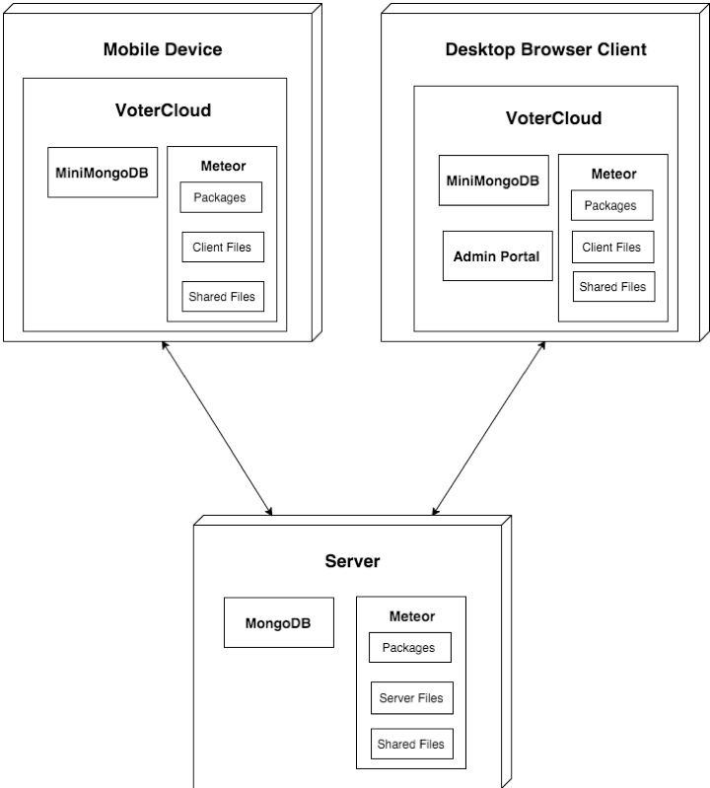
System Deployment
Browser Client
Admin Portal

Slide 11
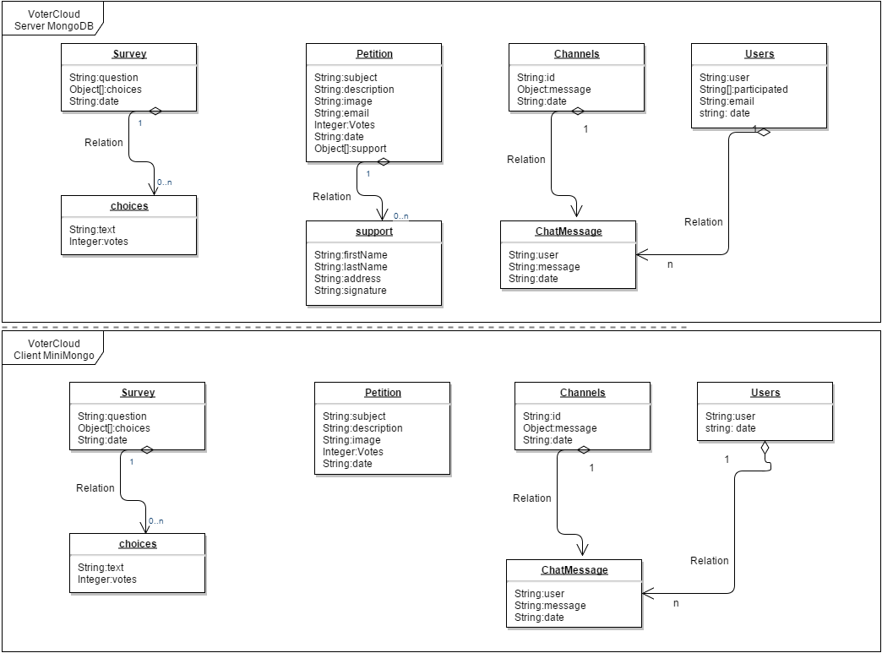
Persistent Storage
Notes:
This is VoterCloud’s primary data model. At the top half, we see the collections, fields, and relations that belong to the MongoDB in the server, and in the bottom half, we see the

Slide 12
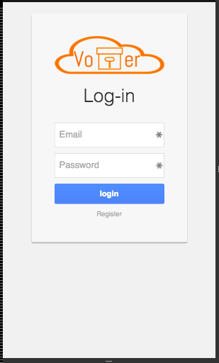
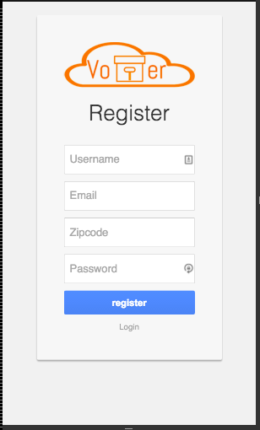
Security/Privacy

Slide 13
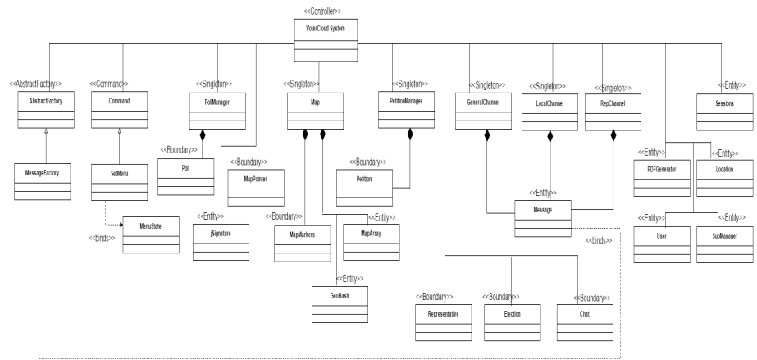
Minimal Class Diagram

Slide 14
Design Patterns
Singleton
Primarily used for security
Limit database objects to a single instance
Command
Meteor Set Menu.
Abstract Factory
Used in creation of the Chat
For each Chat, interface is the same. Content is and metadata is the difference.

Slide 15
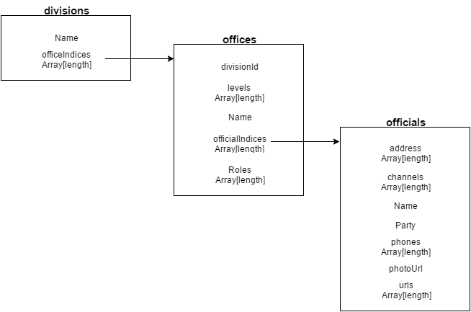
Main Algorithm
Big part of the project was to parse JSON Results like the one on the right.
It’s involves 3 level loop and parsing the different fields.

Slide 16
Sunny Day Test Case
Test Case ID | representative chat #736
Test Objective | Test that the representative page in terms of redirecting and chat participation(checking chat for each representative ).
Precondition | 1. the representative list is already loaded. 2. The lan and lat coordinates are enabled. 3. There are representative in the area.
Steps: | 1. Click on the menu button (to see the menu). 2. Click on the Representative page. 3. Click on search By GPS. 4. Click on the first representative. 5. add a comment to the chat.
Test Data | message: “Hello representative “
Expected Result | the message was added after the page was redirected.
Actual Output | the message was added after the page was redirected.

Slide 17
Rainy Day Test Case
Test Case ID | WiFi Result | 4G LTE Result
chat locality #730 | Map does not load | Map does not load
representative chat #736 | Representative photo does not load | Representative photo does not load
Petition #722 | Petition photo does not load | Petition photo does not load
Surveys #675 | Success | Success
Chat Room #724 | User photos do not load | User photos do not load
Search by location # 710 | Success | Success
Local politicians# 672 | Representatives’ photos does not load | Representatives’ photos does not load
Elections #713 | Success | Success
Registration | Success | Success
Login | Success | Success

Slide 18
Automated Test Scripts

