Slide 1





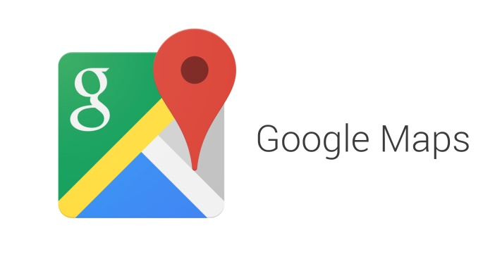








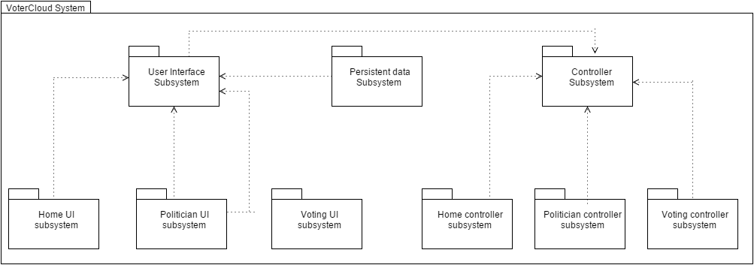
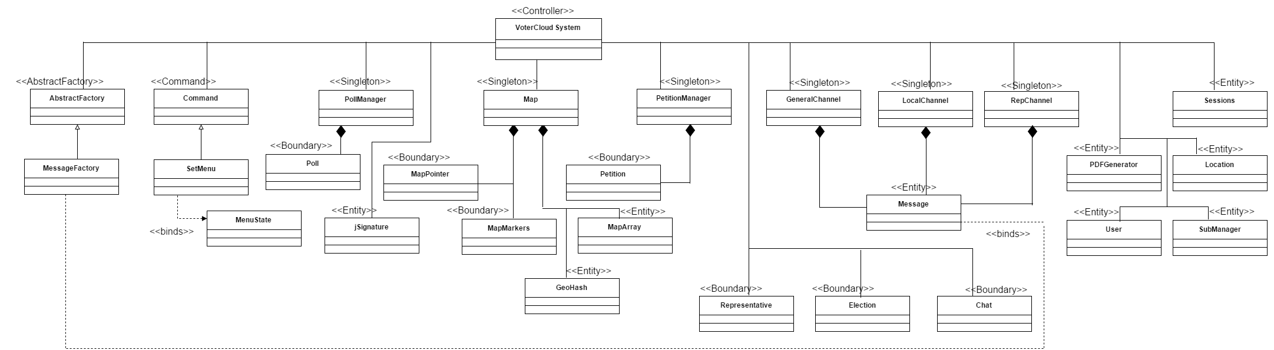
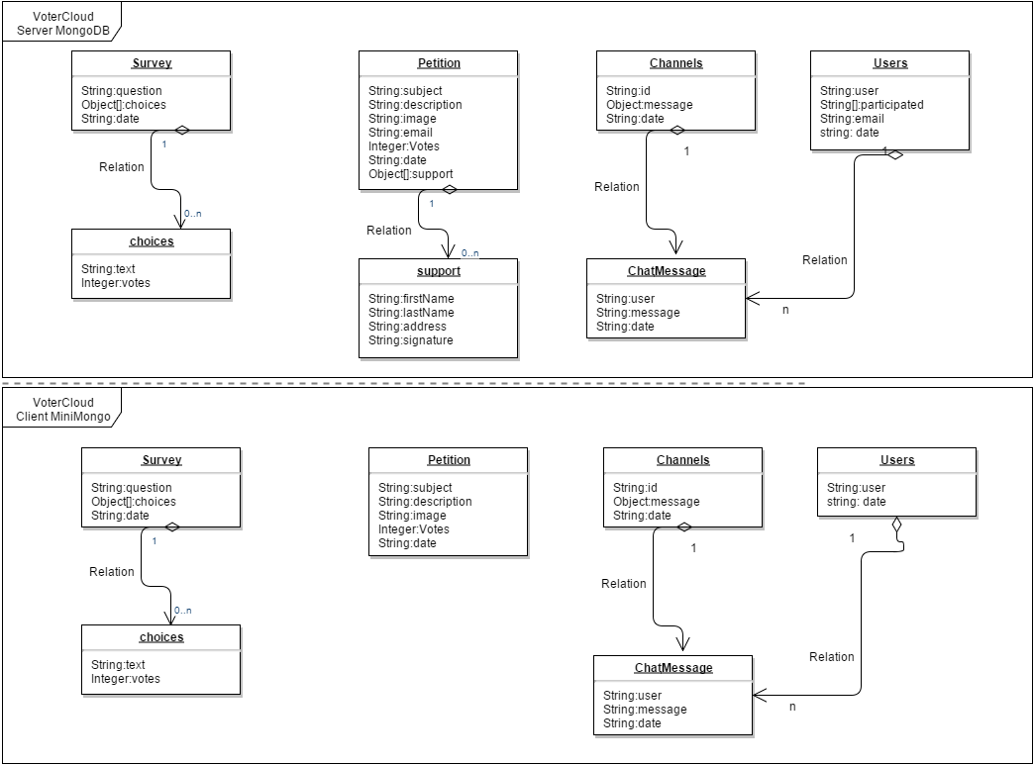
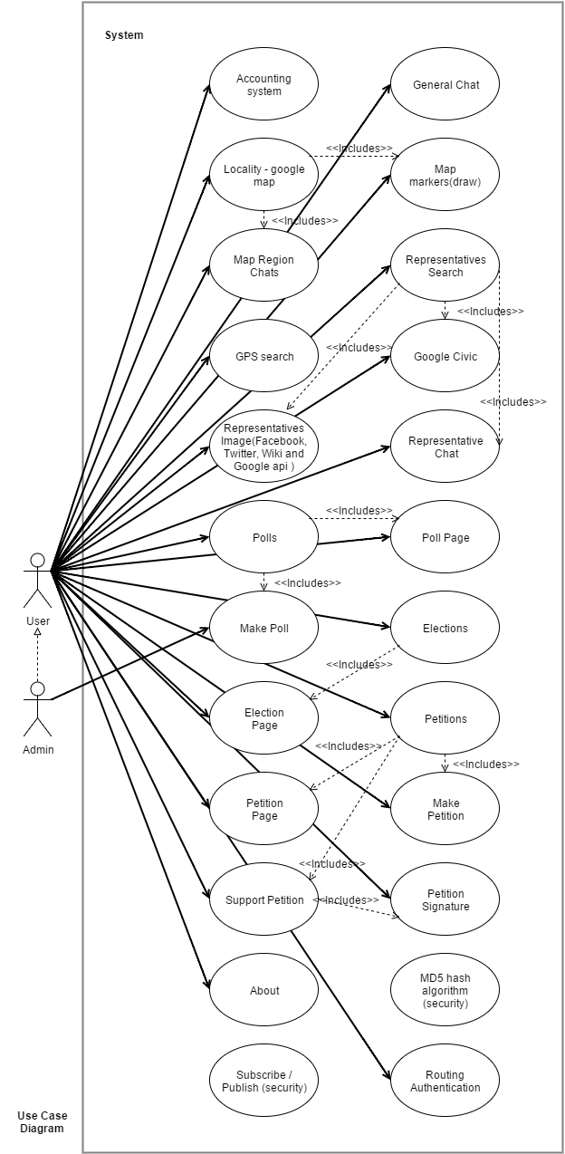
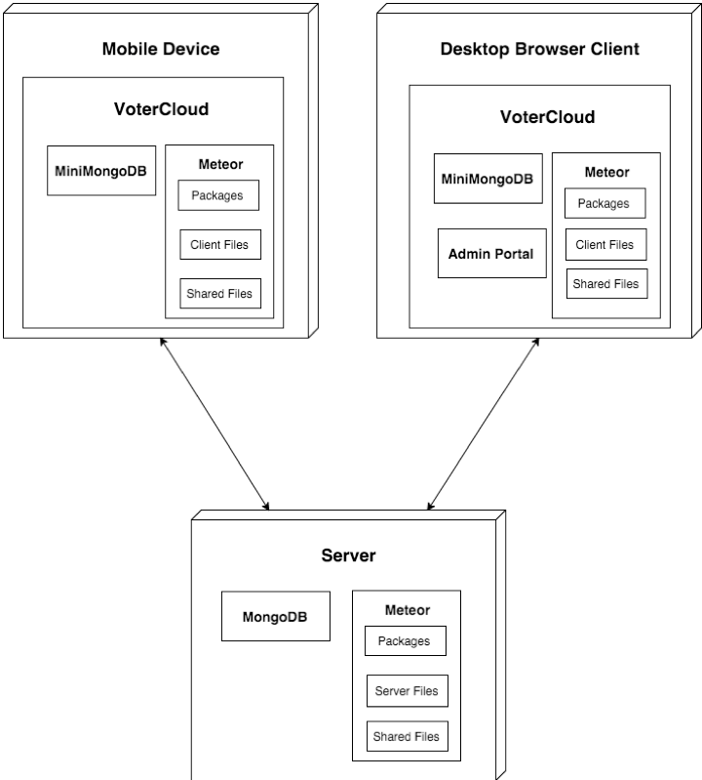
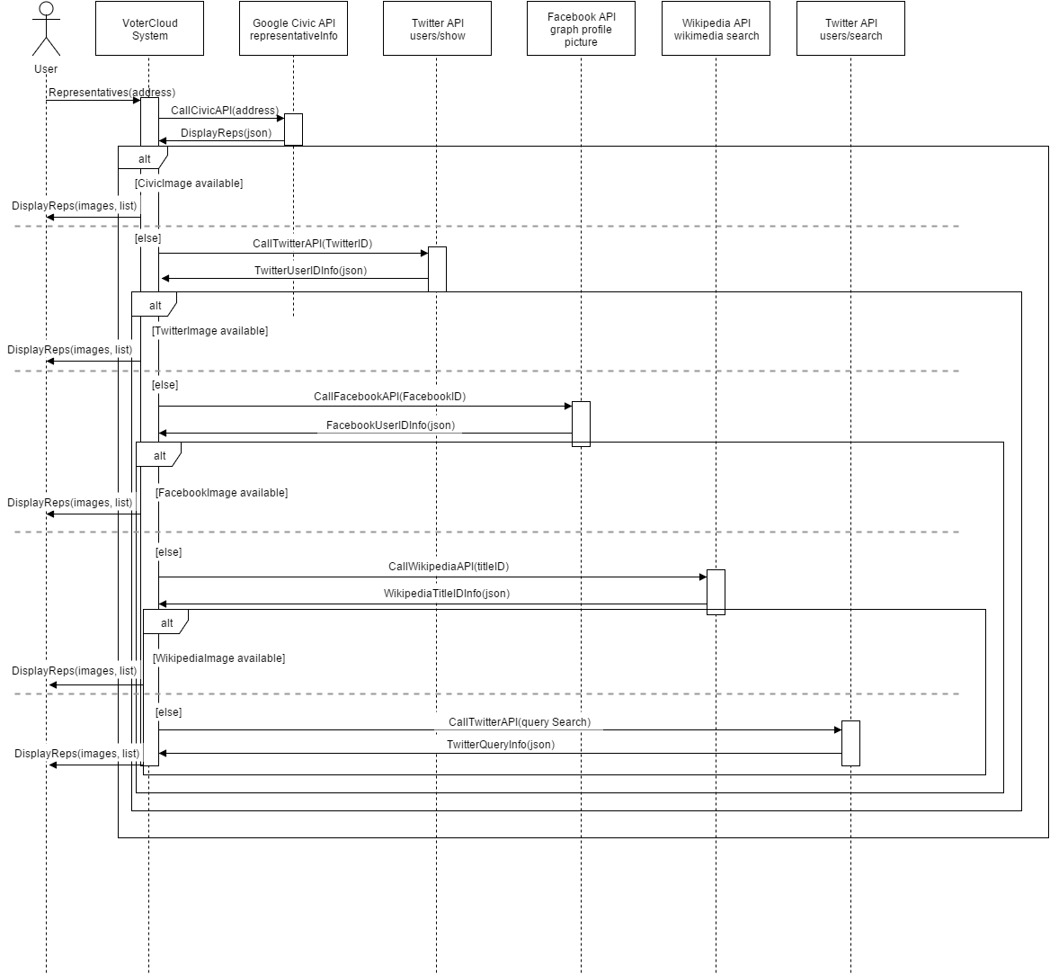
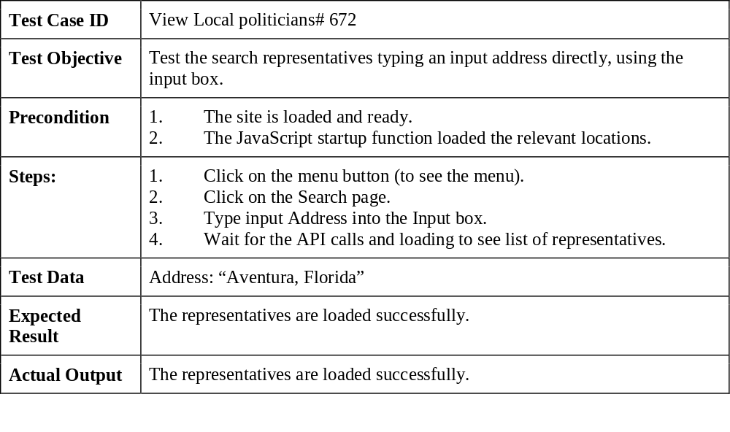
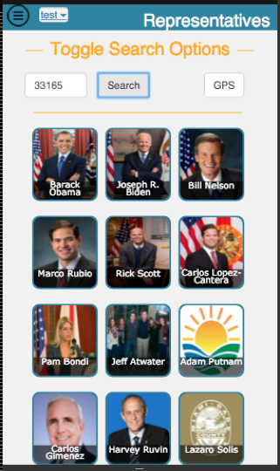
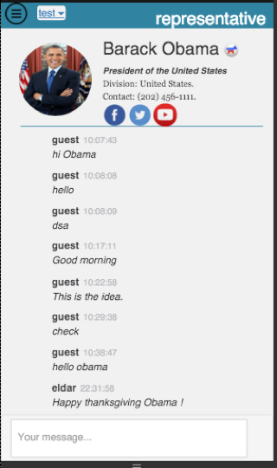
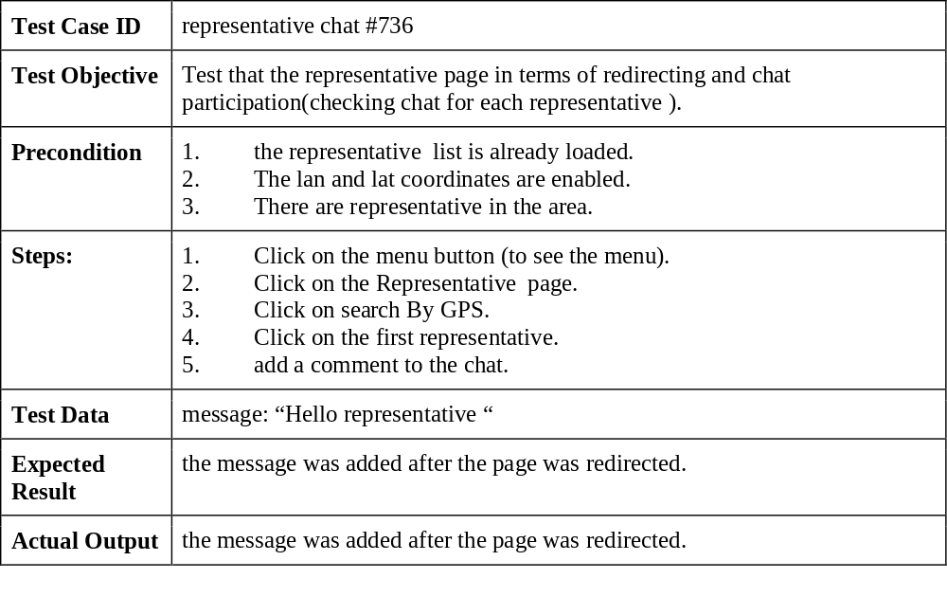
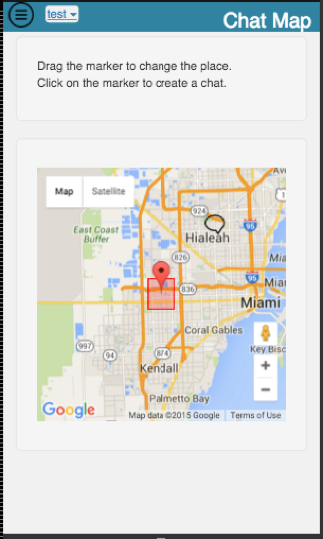
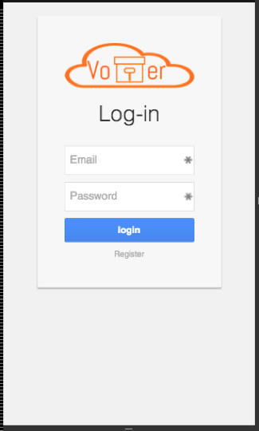
School of Computing & Information Sciences
Senior Project, <2015>, <Fall>
<VoterCloud>
Student: <Eldar Feldbeine>, Florida International University
Mentor: <Gus Monge>, <Product owner>
Instructor: Masoud Sadjadi, Florida International University
Problem
Current System
Requirements
Due to the current System and infrastructure the engaged citizen is lacked the portal/place to support or search civic information. Today media and news paper are divided into political parties, and thus restrict the information and engagement to what the media want to deliver. The media deliver the news and civic information that best match their corporate interest . Therefore, the citizens has no power on decision influence about their politicians and civics. Citizens would like to have a place where they could communicate with each other on politics. That includes engagement through chat, searching politician based on address, and participate in petitions and polls that can have a real impact on local and federal decision. In addition, the politicians who are looking for voters and supportive can now monetize and find their voters based on address areas and voter interests. Since the system as it exist now, do not prioritize or personal the political commercial business. And thus creates the gap of real business need and solution for the politicians. Moreover, the lack of engagement or participation lead to low rate of voting and participation in national and local elections. In such that the voting rate stand for less than 50% and even lower in local level. Therefore, the real problem is the lack of organized portal for the citizens to connect with each other and engage in different activities that can result in real impact on national and local level.
Citizens who want to learn about their local politicians, their politicians’ voting history, the laws proposed, and other local details that affect them currently get their information from newspapers or internet searches. Voters and citizens who wants to get their representatives information usually receive their knowledge and information from the media in filter and order manner. For example, citizen who receives his news form CNN or FOX News will get his information based on political party and therefore biased and unbalance in it’s views about certain politician and information. This biased and unfair media and connectivity is a factor of loss of interest in the politician area and engagement. Therefore, citizens who want to engage and participate on local elections usually does it privately and with lack of proper decision knowledge. Although, many voters and citizens are eagerly want to participate and engage on their local level or federal level, they still lack the technology and tools to communicate with each other. Therefore, common interest can not be amplified and heard. On the other hand of the table, politicians or representatives who looking for followers and support can not find or reach their voters, since the different media do not target specific audience or group of people. The current media and news paper distributers do not allocate any resource or work on personalize commercial/advertise based on specific audience or group. Thus the representatives finds himself in deadlock in terms of supportive and followers. Even worse than that, local politicians such as city mayors can not even locate or find supportive due to the current infrastructure.
The System shall be mobile application, that will allows any citizen or guest to connect, participate and engage in different activities. The system should be free of charge, and easy to access and download. The app should allows the users to chat with each other on national and local level. On national level the system shall provide the federal representatives information such as division, role, state and party. In addition, the system should be as informative as it can be such that the data is up-to-date relevant. On local level the system should provide the users the ability to engage and participate locally. Perhaps the most important is that the system shall be self populate in terms of user content creation. Activities such as polling, petitions and chats allows the user to express and engage in self generate content that is relevant to the current time. The system should provide information about the upcoming elections, so that users can participate and engage in the different elections. Thus, application convenience and navigation is key part of application success and engagement rate. Including fast transition and use of the best and expressiveness technology. MeteorJS is the tool that achieve that by provide one page application, and thereby allows fast navigation and functionalities.
System Design
Object Design
Implementation
Verification
Screenshots
Summary
The project solution provides the complete functionalities and acceptance criteria's described. The system allows any user to register and login to the system, participate in the general chat, participate in local level by chatting and google map. Moreover, the user can search his representatives by his current address or input. In addition the system is self content generator in terms of polls and petitions creation, and in such allows the user to engage and find relevant civic information. The system presented here is complete in it’s required functionality and design. It’s provide civic information such as upcoming election and representatives information. The representatives information includes the division, role, state, party, picture. The actors identifies here are the user and admin, where the admin has the privilege to make polls and clear content. The resulted application is user friendly and cover all of the functionalities to make this application addictable and engageable. The project itself was created with MeteorJS and mostly programmed in JavaScript. The server side is used with nodeJS and MongoDB and the client side is used with miniMongo and meteor handlebars templates. The functionalities implemented here includes google maps, mongoDB forms and update and social media APIs.
Acknowledgement
The material presented in this poster is based upon the work I did and created, I am thankful to the help that I received from my mentor Gus Monge and my teammate Raul Garay.

