Slide 1







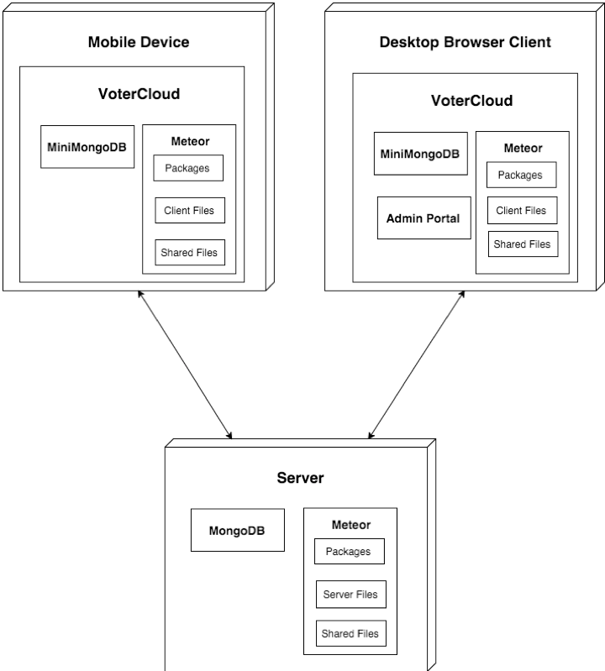
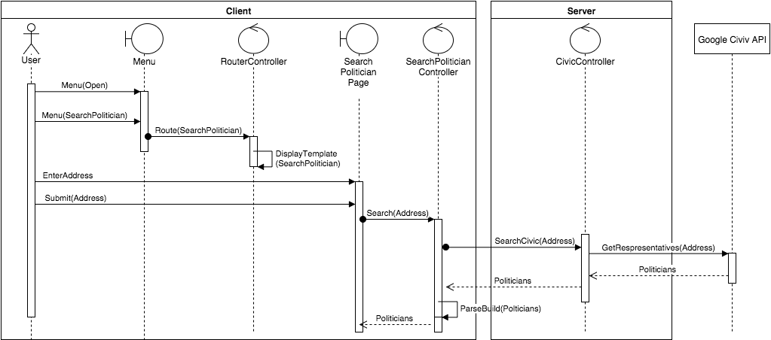
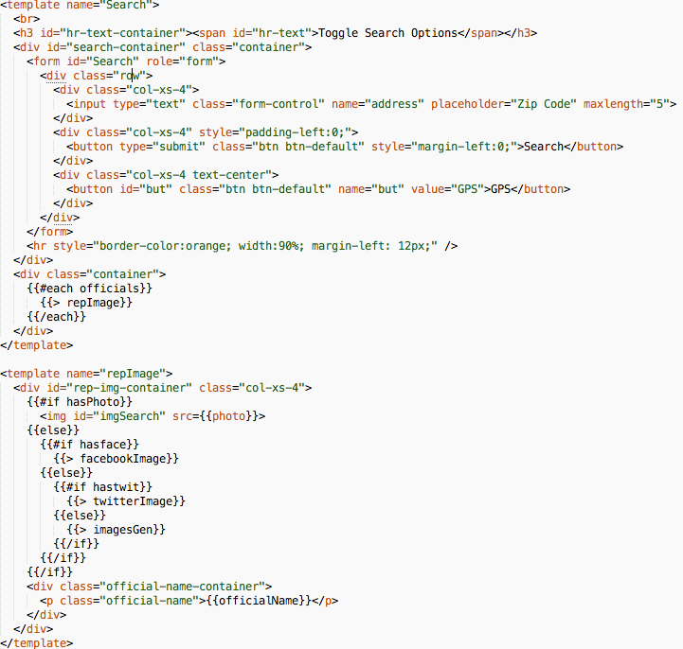
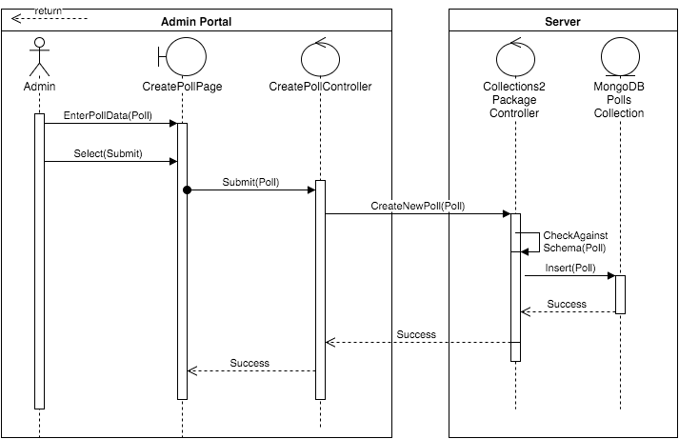
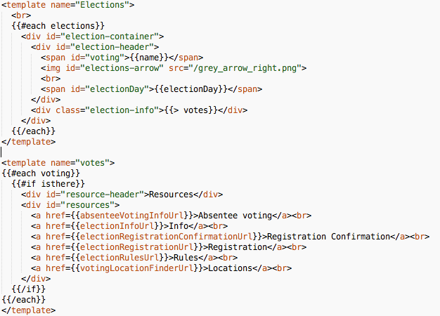
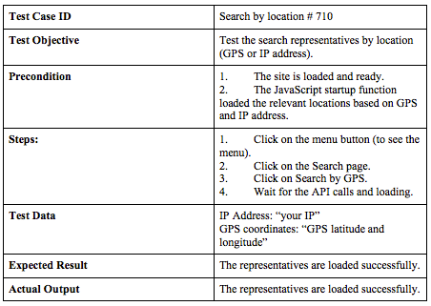
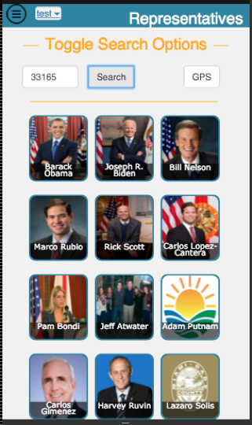
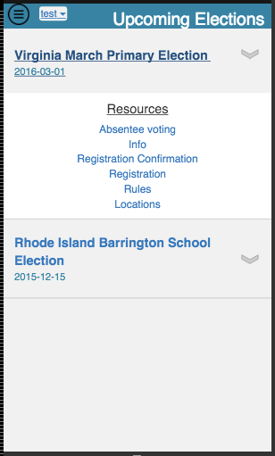
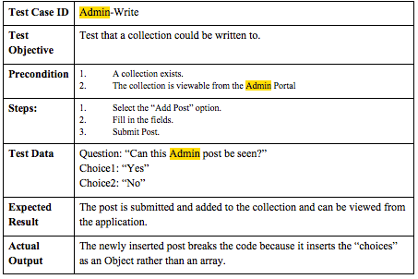
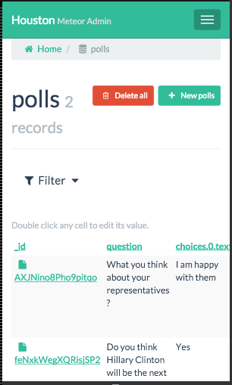
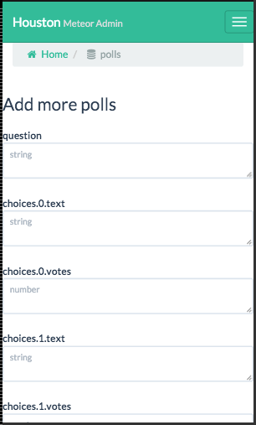
VoterCloud
School of Computing & Information Sciences
Senior Project, 2015, Fall
Student: Raul Garay, Florida International University
Mentor: Gus Monge, Product owner
Instructor: Masoud Sadjadi, Florida International University
Problem
Current System
Requirements
Public engagement in local government is notoriously low. Voter turnout for local elections across the country are at the lowest they have been in decades. The lack of engagement that exists leads to an uninformed or misinformed public with elected officials that are not representative of their community and their views. As a result, laws passed by these officials may not be in the best interest of the public.
On the other hand, citizens who are willing to engage may not know how or where to find the information and resources they need. Information for elections, current officials, policies, and what the thoughts of those around them are can be difficult and time consuming to find.
Citizens currently get their information from newspapers or internet searches. Flyers, signs, and commercials are distributed around respective election zones. Commercials are another form of communication that can provide more information to citizens, but a candidate or an interest group pays for them. Public meetings are often held to discuss issues that affect the politicians’ zone. These meetings and hearings tend to produce a low public turnout.
If a citizen wants to get involved, they would need to attend these meetings, write, email, or call their politicians. Politicians also have a need to the communities that they represent. The aforementioned meetings are open to the public so that the politicians can gauge public opinion. Politicians have also taken to social media outlets to interact with their community.
In order to remedy the problem of apathy in citizens towards local government engagement, the VoterCloud application should allow:
  Users to look up politician and election information near them.
  Polls to gauge the public interest or disinterest in a particular topic.
  The ability to create and support petitions relevant to the user.
  Connect and communicate with other users within their community based on chosen topic channels.
  Admin access to authorized users to create the polls and retrieve the data.
  User data collected to be anonymous unless it is a signed petition.
System Design
Object Design
Implementation
Search Politician
Search
Politician
Template
Create Poll
View
Elections
Template
Verification
Screenshots
Summary
VoterCloud is meant to be a one stop location for all local political needs for the engaged citizen or the citizen looking to be engaged. It allows citizens to connect and communicate with other VoterCloud users who are impacted by the same political issues. Such a communication tool is crucial to showing that they aren’t alone and that apathy is not the correct way to progress. The application also allows users to sign petitions and become actively involved in their community so that they feel their voice is being heard by their local politicians in a convenient manner.
VoterCloud is also a useful tool during election season to gain information about the elections themselves, the issues at hand, and the politicians involved. A voter should not feel lost in their political duty at any point with the VoterCloud application at hand.
Acknowledgement
The material presented in this poster is based upon the work supported by my mentor Gus Monge. I am thankful to the help that I received from my group member Eldar Feldbeine.

