Slide 1

VoterCloud
Team Members
Eldar Feldbeine – Primary Developer, System Tester
Raul Garay – architect, UI/UX, secondary developer
Mentor & product owner
Gus Monge
Instructor
Masoud Sadjadi

Slide 2
Problem
Citizen engagement in local government is low
Election, policy, and politician information not always easy to find
Elected officials may not properly represent their community
Elected officials may find it difficult to gauge public opinion

Slide 3
Current System
Citizens gather information from:
Newspapers, internet, word of mouth
Citizens can contact politicians by:
Calling, paper mail, and electronic mail
Signing petitions online and from activists on the streets
Attending public hearings and meetings
Politicians can reach out to citizens by:
Flyers and commercials
Surveys
Social media

Slide 4
Development Setup
Built on the Meteor JavaScript framework
VoterCloud = Hybrid Application
HTML5, CSS, Javascript
MongoDB Persistent Storage
Meteor.com hosting used for staging and testing server

Slide 5
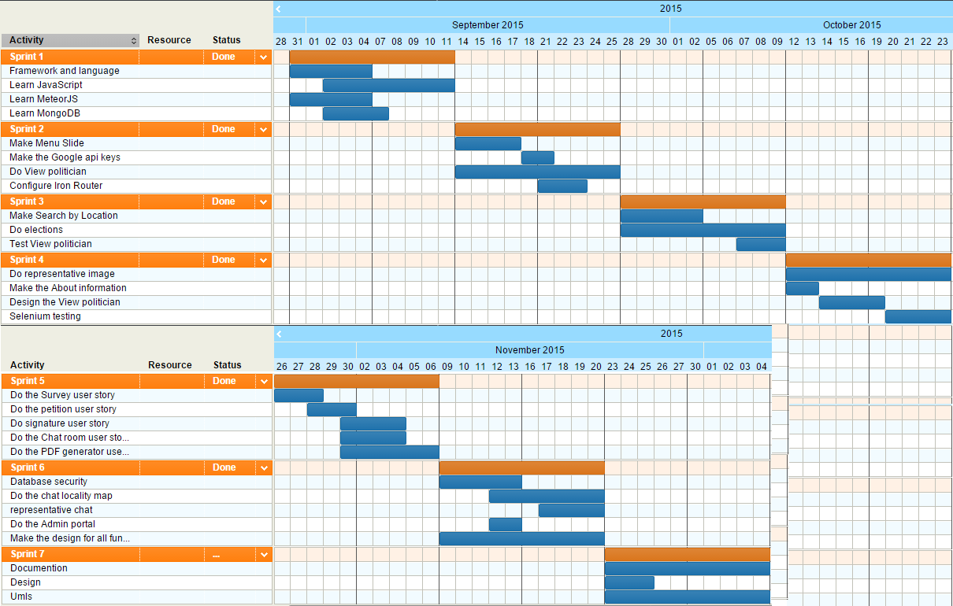
Project Management

Slide 6
User Stories Implemented
Side Menu
View Local Politicians
Search by location
Elections
Representative Image Profile
Polls
Petitions
Signature
Database Security
PDF generator and serving
chat locality
Representative chat
Admin portal
Design
Testing

Slide 7
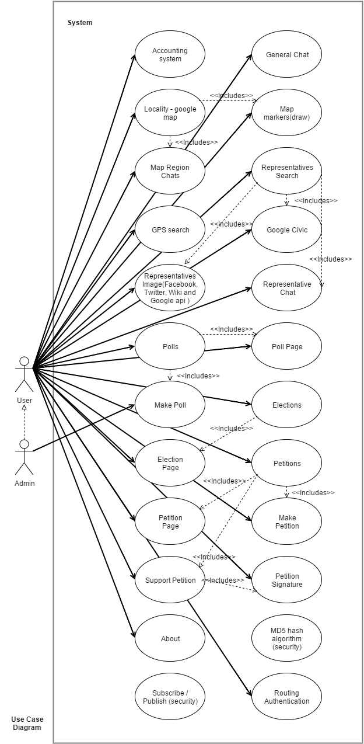
Use Case Diagram

Slide 8
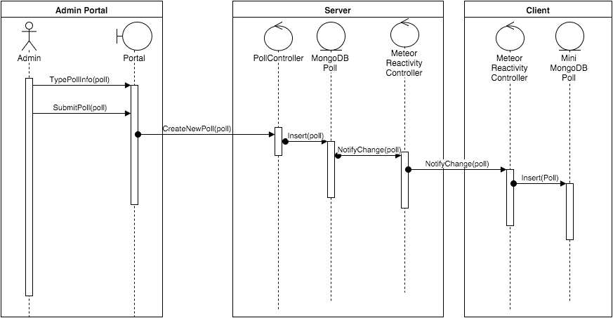
Sequence Diagram - Search Politician
Notes:
This is VoterCloud’s primary data model. At the top half, we see the collections, fields, and relations that belong to the MongoDB in the server, and in the bottom half, we see the

Slide 9
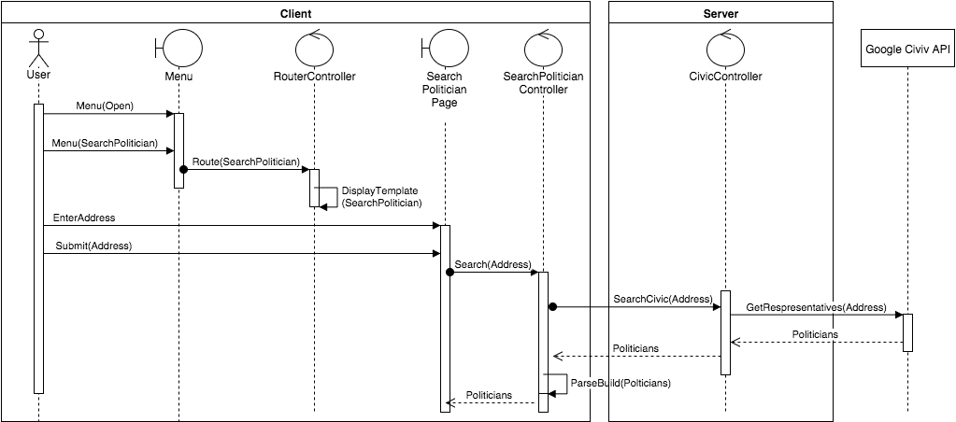
Sequence Diagram - Search Politician
Notes:
This is VoterCloud’s primary data model. At the top half, we see the collections, fields, and relations that belong to the MongoDB in the server, and in the bottom half, we see the

Slide 10
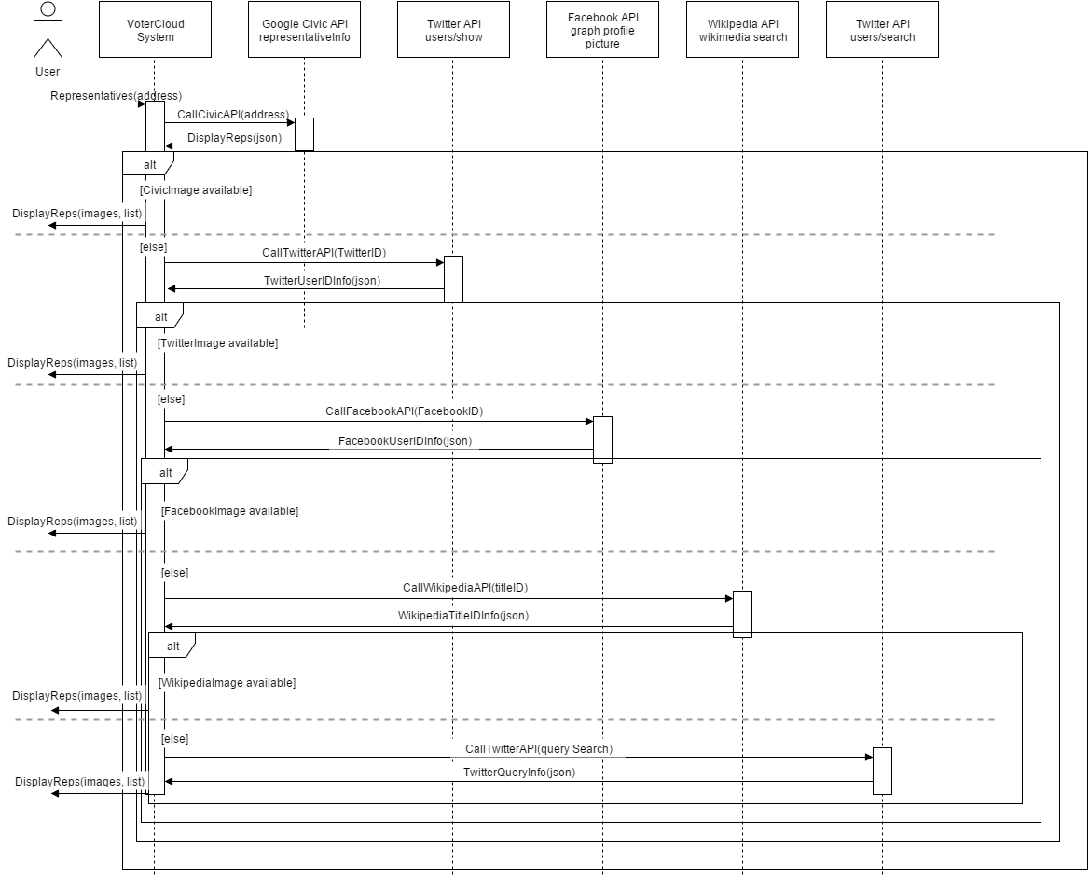
Sequence Diagram – Politician Image

Slide 11
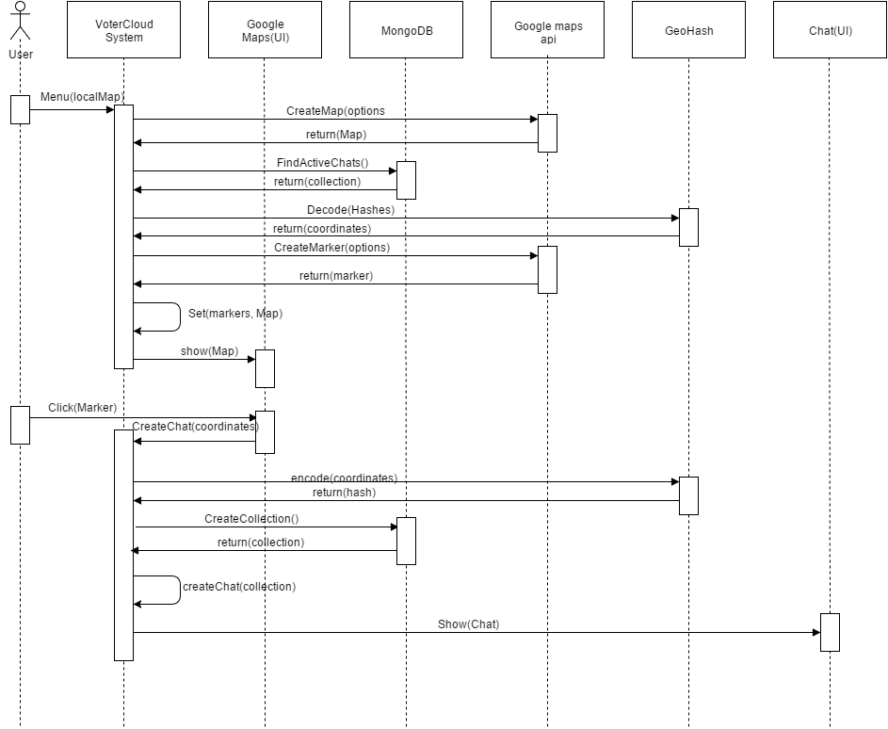
Sequence Diagram – PDF Generator

Slide 12
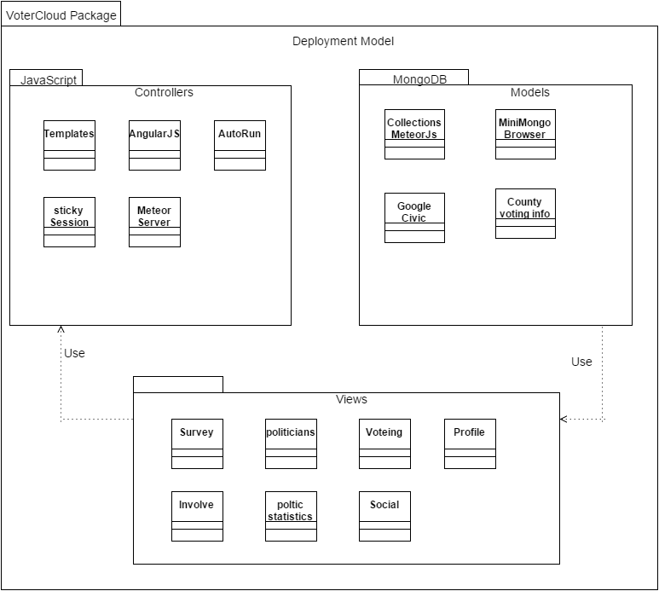
System Decomposition

Slide 13
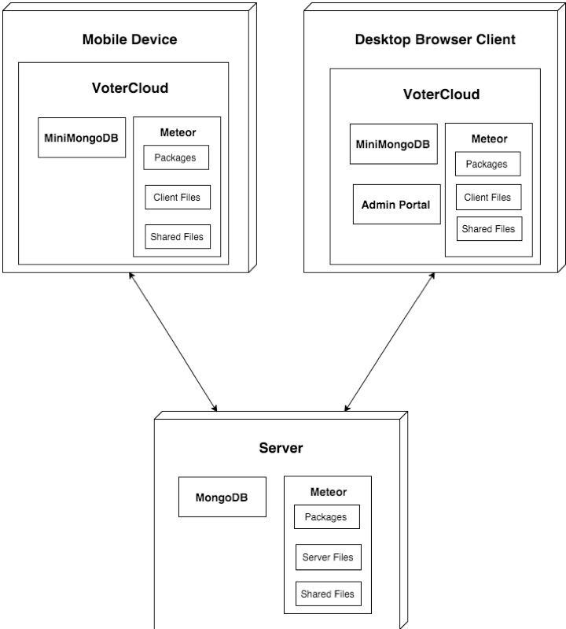
System Deployment
Browser Client
Admin Portal

Slide 14
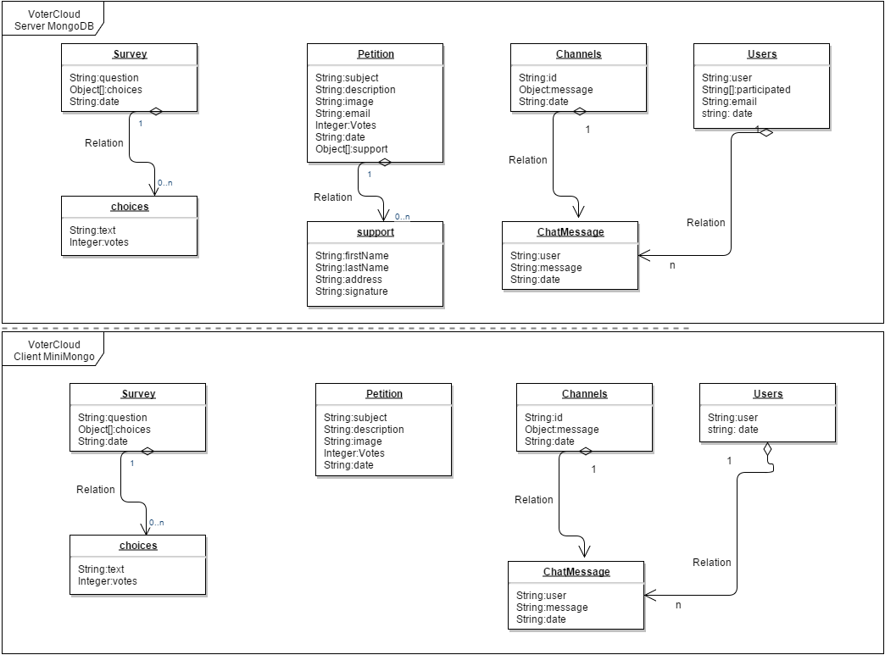
Persistent Storage
Notes:
This is VoterCloud’s primary data model. At the top half, we see the collections, fields, and relations that belong to the MongoDB in the server, and in the bottom half, we see the

Slide 15
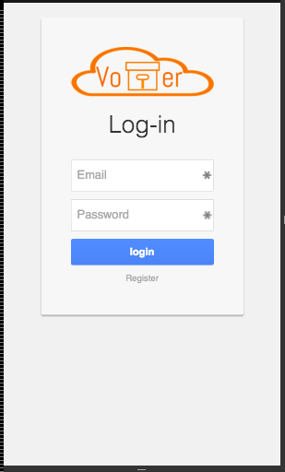
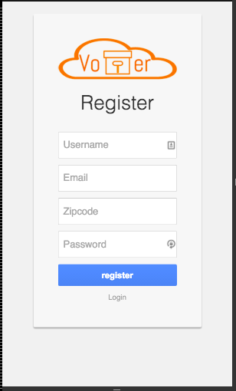
Security/Privacy

Slide 16
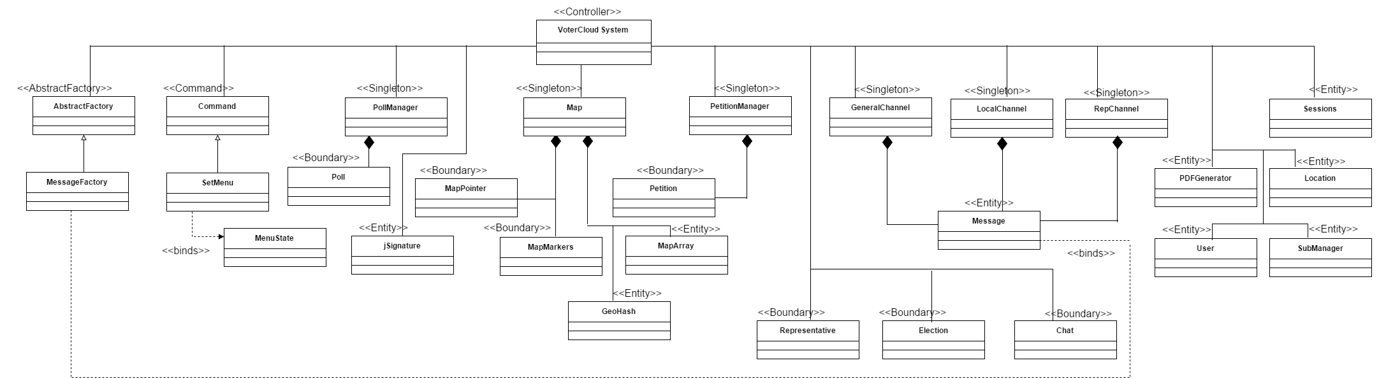
Minimal Class Diagram

Slide 17
Design Patterns
Singleton
Primarily used for security
Limit database objects to a single instance
Command
Primarily used for UI creation and Meteor Templates.
Abstract Factory
Used in creation of the Chat
For each Chat, interface is the same. Content is and metadata is the difference.

Slide 18
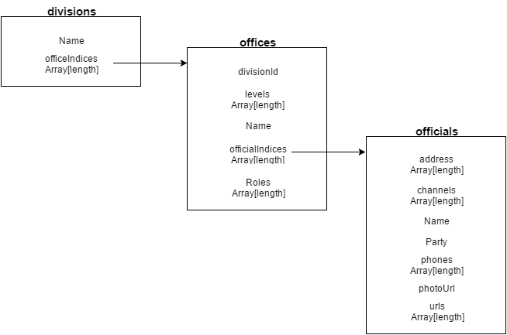
Main Algorithm

Slide 19
Sunny Day Test Case
Test Case ID | representative chat #736
Test Objective | Test that the representative page in terms of redirecting and chat participation(checking chat for each representative ).
Precondition | 1. the representative list is already loaded. 2. The lan and lat coordinates are enabled. 3. There are representative in the area.
Steps: | 1. Click on the menu button (to see the menu). 2. Click on the Representative page. 3. Click on search By GPS. 4. Click on the first representative. 5. add a comment to the chat.
Test Data | message: “Hello representative “
Expected Result | the message was added after the page was redirected.
Actual Output | the message was added after the page was redirected.

Slide 20
Rainy Day Test Case
Test Case ID | WiFi Result | 4G LTE Result
chat locality #730 | Map does not load | Map does not load
representative chat #736 | Representative photo does not load | Representative photo does not load
Petition #722 | Petition photo does not load | Petition photo does not load
Surveys #675 | Success | Success
Chat Room #724 | User photos do not load | User photos do not load
Search by location # 710 | Success | Success
Local politicians# 672 | Representatives’ photos does not load | Representatives’ photos does not load
Elections #713 | Success | Success
Registration | Success | Success
Login | Success | Success

Slide 21
Automated Test Scripts

