Slide 1
Team Members
Eldar Feldbeine – The main developer and programmer.
Raul Garay – architect, UI/UX, secondary developer.
Mentor & product owner
Gus Monge
Instructor
Masoud Sadjadi
Senior Project

Slide 2
Problem
problem is the lack of organized portal for the citizens to connect with each other and engage in different activities that can result in real impact on national and local level.
We at VoterCloud designed and implemented an exact solution for this problem. VoterCloud is an application(mobile and web) that enable users to engage and connect on local and national politics.

Slide 3
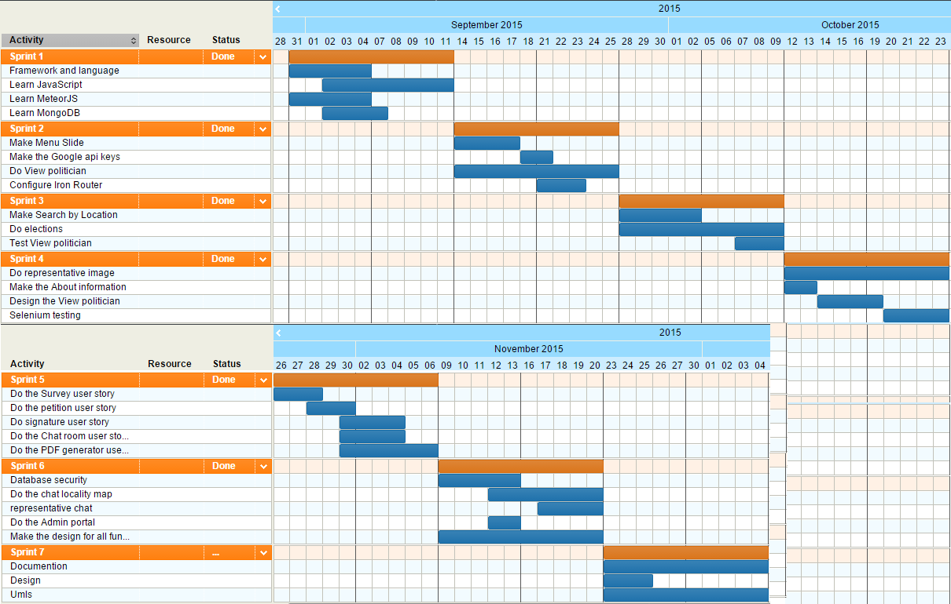
Project Management

Slide 4
User Stories Implemented
Side Menu
View Local Politicians
Search by location
Elections
Representative Image profile
Polls
Petitions
Signature
Database Security
PDF generator and serving
chat locality
Representative chat
Admin portal
Design
Testing

Slide 5
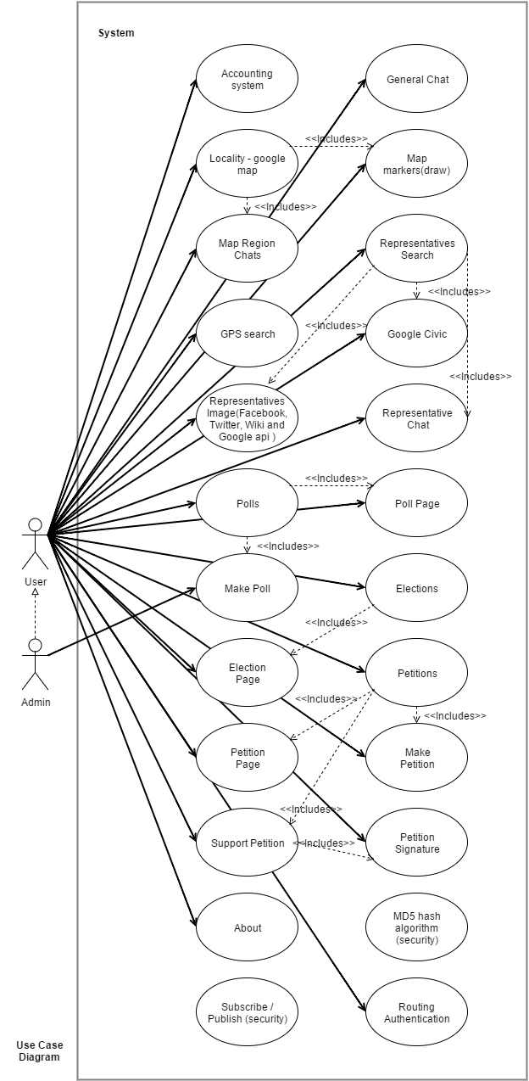
Use Case Diagram

Slide 6
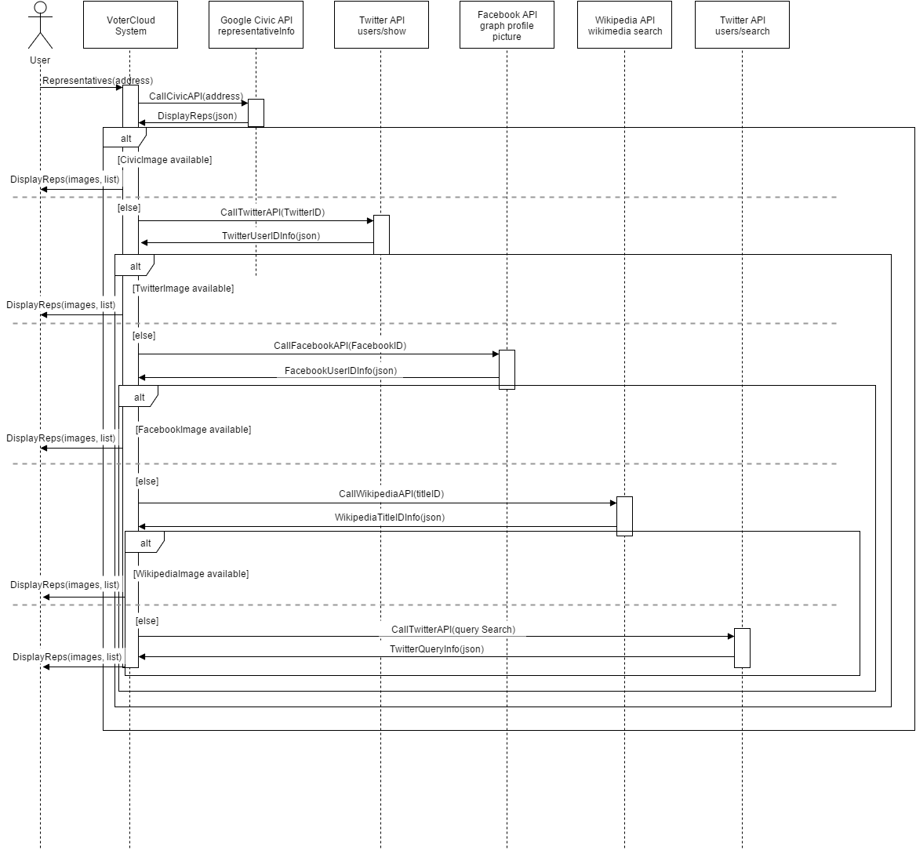
representative images: user story

Slide 7
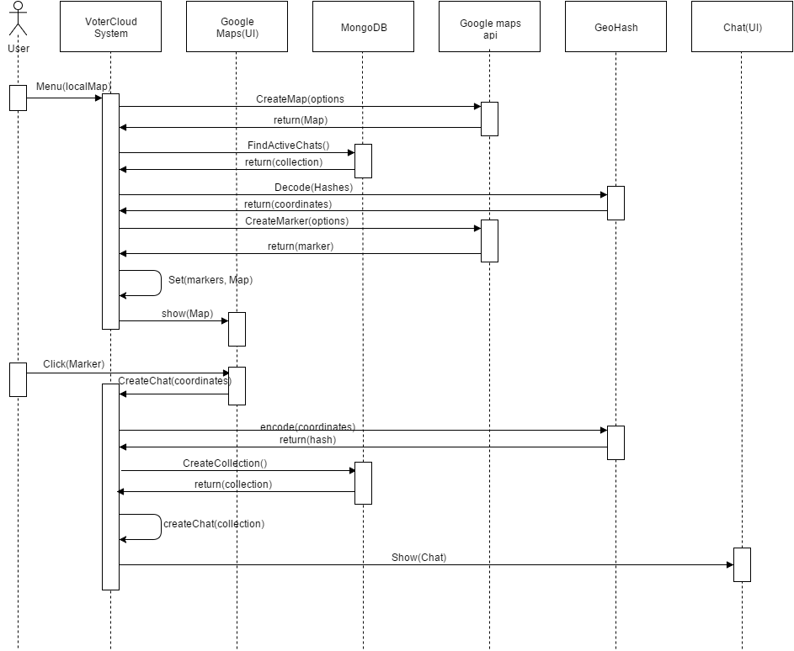
Map locality: user story

Slide 8
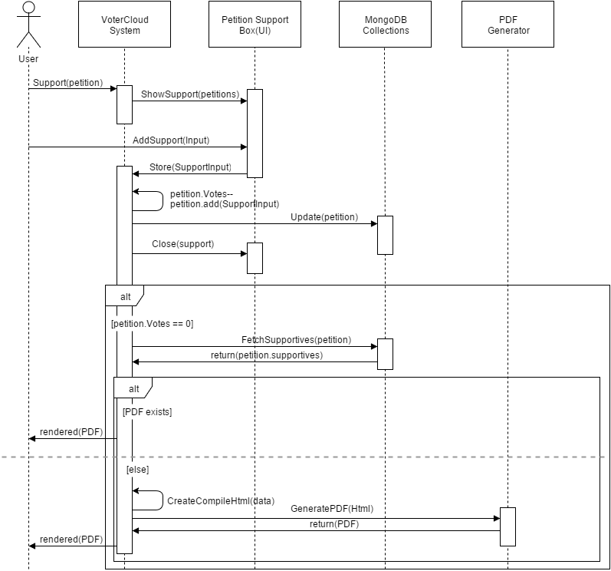
pdf creator: user story

Slide 9
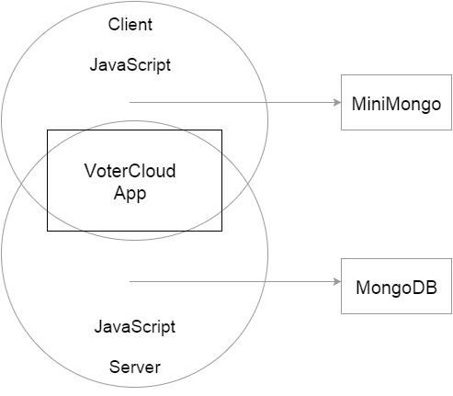
System decomposition: MVC
Model:
mongoDB
miniMongo
View
Templates
Controller
Template helpers and events.
Server methods.

Slide 10
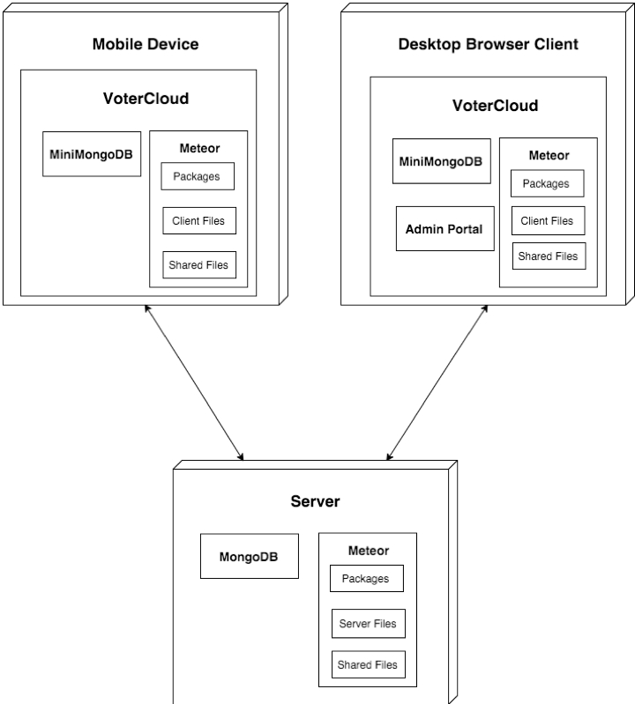
System deployment

Slide 11
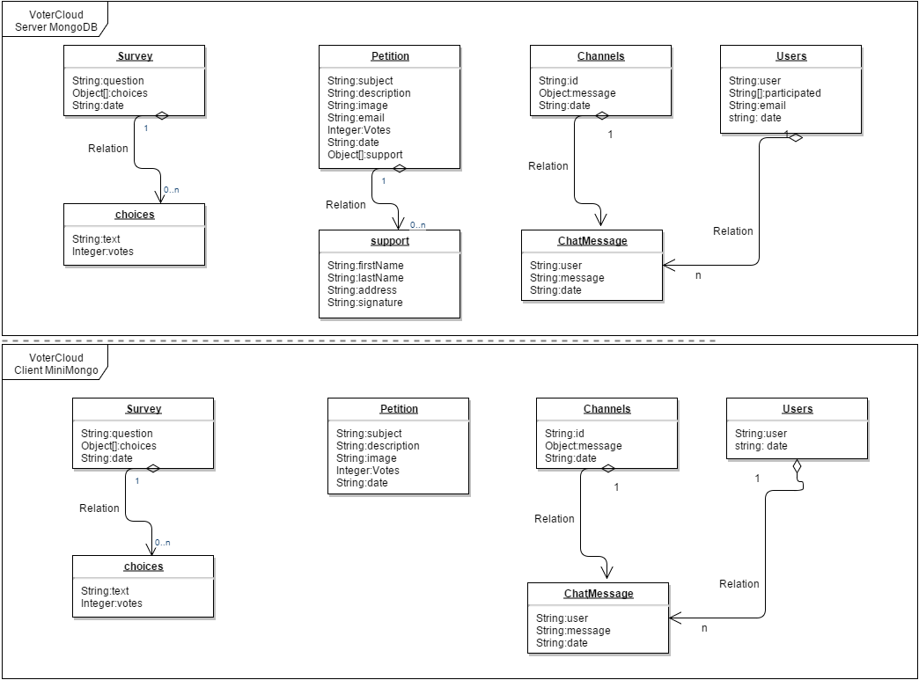
Persistent data design

Slide 12
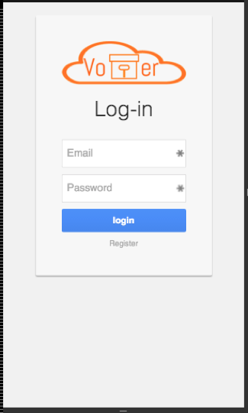
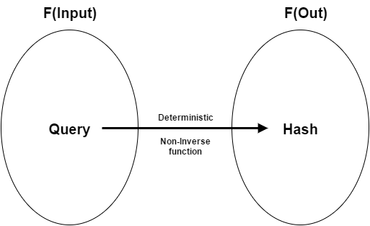
Security/Privacy
Database policies.
Login and registration.
Hash functions.

Slide 13
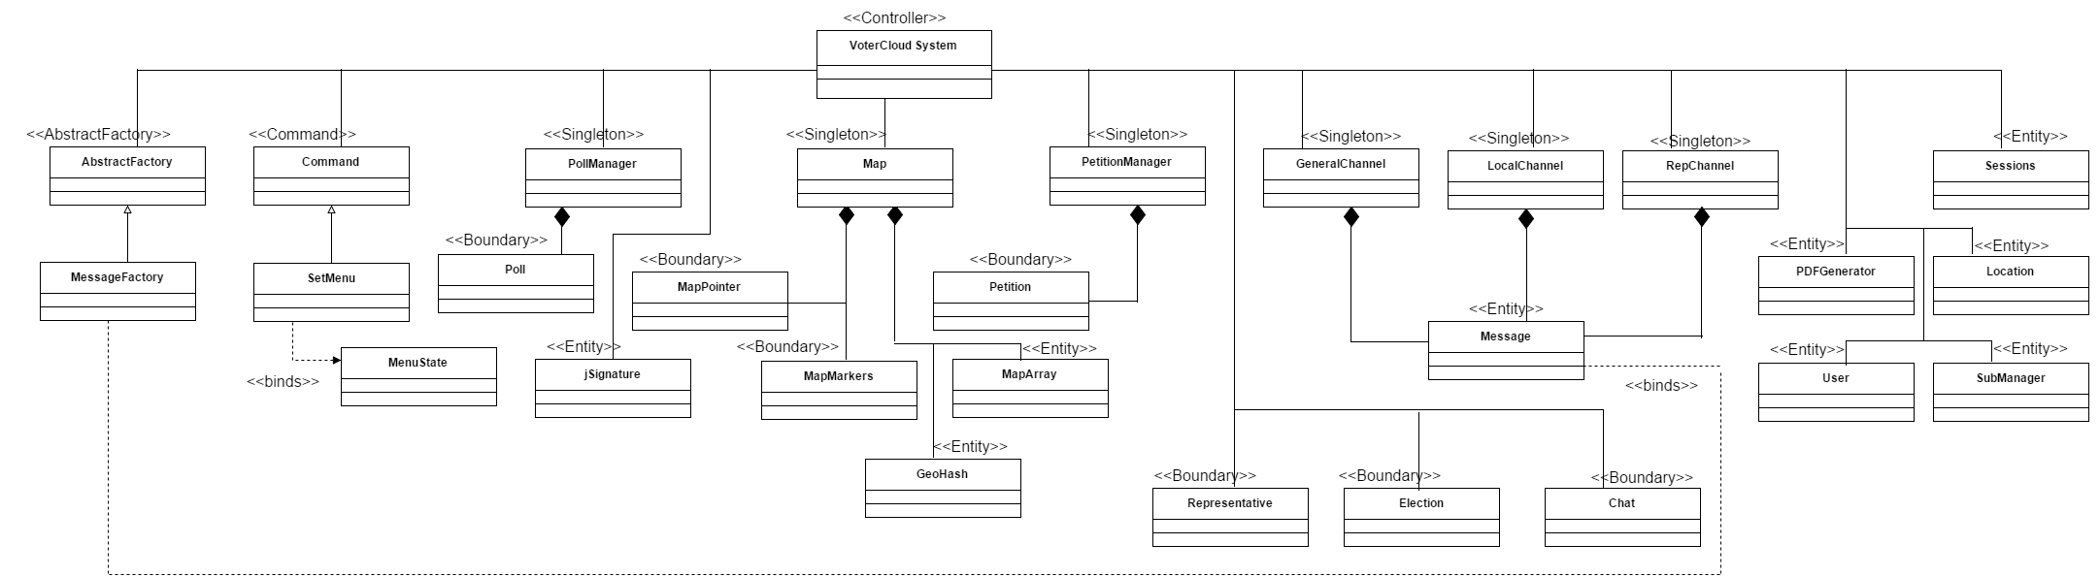
Minimal class diagram

Slide 14
design patterns
Singleton
Collections
Abstract factory
chat
Command
Set menu
Notes:
One of only three truly HD in Lubbock

Slide 15
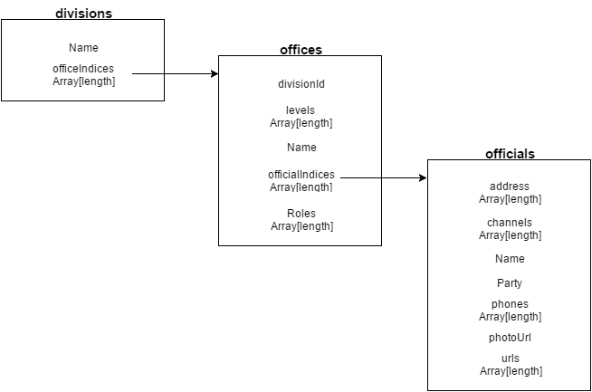
Main algorithm
Big part of the project was to parse JSON Results, like the one on the right.
Google civic information api.

Slide 16
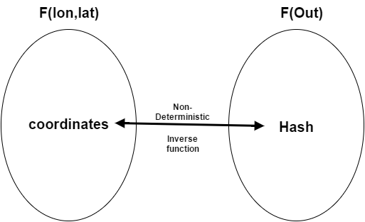
Main algorithm
Hash function consideration.
Simple hash function(identity).
MD5 hash function(security).

Slide 17
Test: sunny day
Test Case ID | representative chat #736
Test Objective | Test that the representative page in terms of redirecting and chat participation(checking chat for each representative ).
Precondition | 1. the representative list is already loaded. 2. The lan and lat coordinates are enabled. 3. There are representative in the area.
Steps: | 1. Click on the menu button (to see the menu). 2. Click on the Representative page. 3. Click on search By GPS. 4. Click on the first representative. 5. add a comment to the chat.
Test Data | message: “Hello representative “
Expected Result | the message was added after the page was redirected.
Actual Output | the message was added after the page was redirected.

Slide 18
Test: rainy day
Test Case ID | WiFi Result | 4G LTE Result
chat locality #730 | Map does not load | Map does not load
representative chat #736 | Representative photo does not load | Representative photo does not load
Petition #722 | Petition photo does not load | Petition photo does not load
Surveys #675 | Success | Success
Chat Room #724 | User photos do not load | User photos do not load
Search by location # 710 | Success | Success
Local politicians# 672 | Representatives’ photos does not load | Representatives’ photos does not load
Elections #713 | Success | Success
Registration | Success | Success
Login | Success | Success

Slide 19
Automated test
Selenium.
Please look on the documentation and intro video for code and demo.

