Slide 1





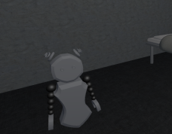
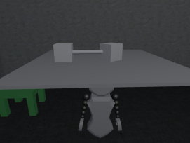
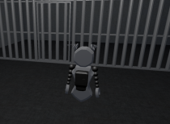
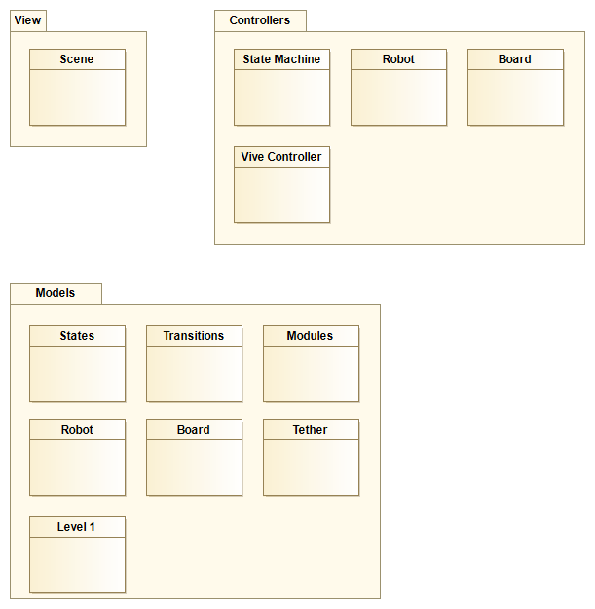
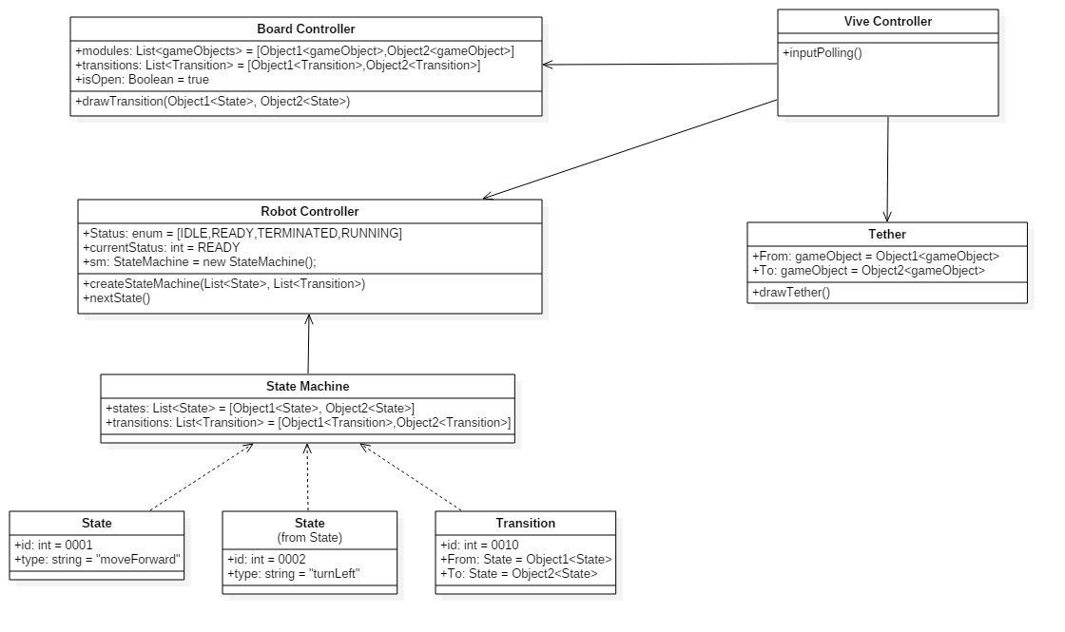
School of Computing & Information Sciences
Senior Project, 2017, Summer
WebVR – 1.0
Student: Daniel V Rivero, Florida International University
Mentor: Francisco D. Ortega, Project Manager
Instructor: Masoud Sadjadi, Florida International University
Problem
There is a stigma around getting a computer science degree. It’s regarded as too difficult. Because of this, potential students can be turned away from the department. How can we, as computer scientist, take this negative perception and turn it into something new and engaging?
Solution
Video games can be an approachable medium for learning. They are a great way to teach problem solving skills. Through virtual reality, problem solving puzzles can be framed in creative and engaging ways. We have built a game that uses VR to frame programming concepts as problem solving puzzles.
Current System
The design of the game is to build a state machine that gives direction to a robot. States are represented as modules that issue commands to the robot. The player must make transitions between modules so that correct commands are given to the robot to complete the level.
Screenshots
Requirements
Game objects represented as states to a state machine
Logic to create transitions between modules
Animation for robot and board
Issuing commands to the robot based on state machine state
HTC Vive connection logic
Level 1 objects and textures
Level puzzle: get the key and return it to the user
System Design
Implementation
HTC Vive
SteamVR Plugin
Unity3d Engine
C# Environment
Blender
Windows 7
Photoshop
Note: Bold Faced requirements are the requirements needed to run the application.
Verification
We did manual testing on the system by instantiating certain features of the game in their own unity project to test for bugs and functionality. Manual testing involved testing animations, object instantiation and collision detection. Unit testing was done on the state machine class to make sure that each state was being processed with transitions between them.
Object Design
Summary
This project was a proof of concept. We set out to prove that virtual reality video games are an excellent medium for introducing potential computer scientist into the field. We also hope that new iterations of the project can continue to express programming concepts in innovative ways.
Acknowledgement
The material presented in this poster is based upon the work supported by Francisco D. Ortega. I am thankful of the help that I received from my group member, Guido Ruiz.
Notes:
1

