Slide 1


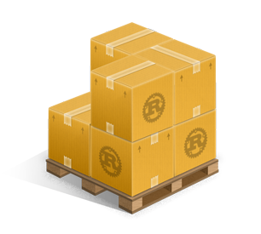


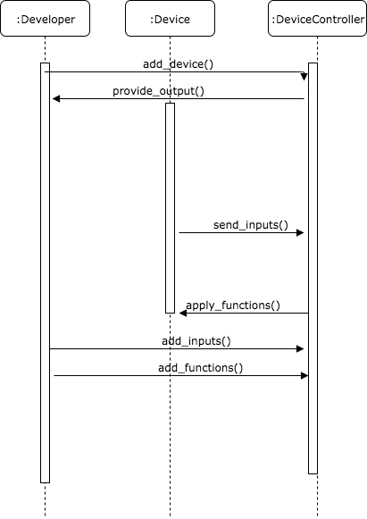
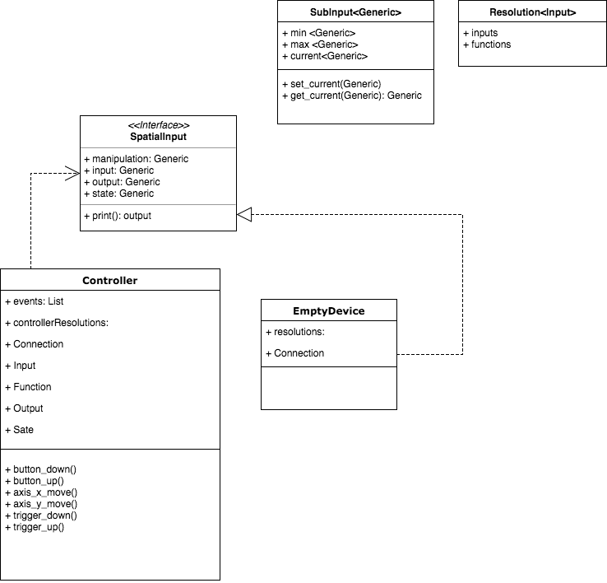
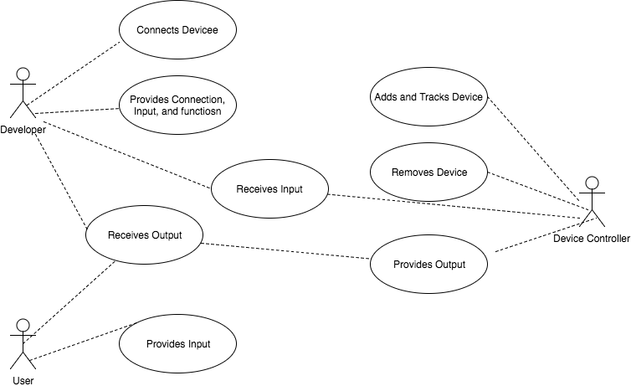
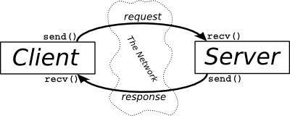
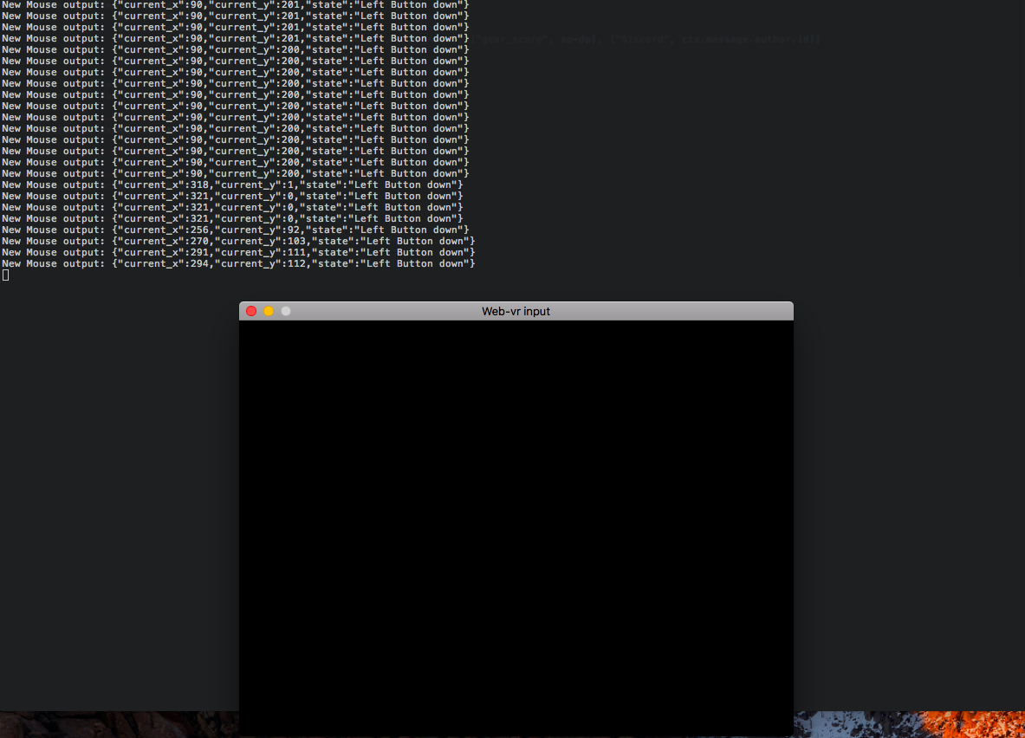
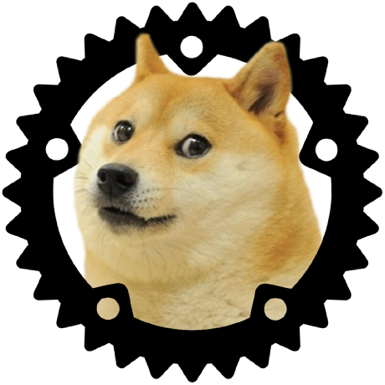

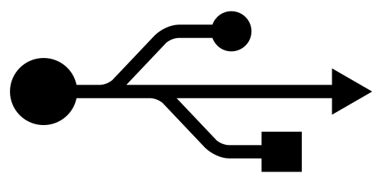

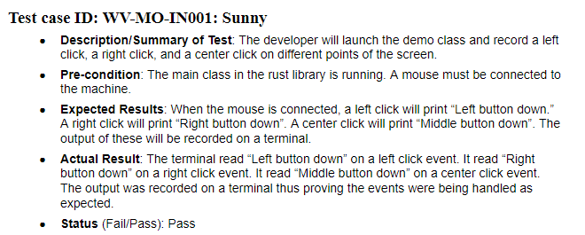
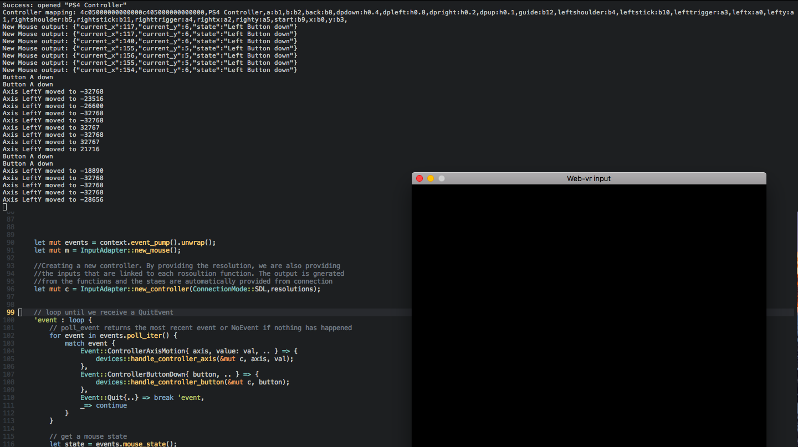
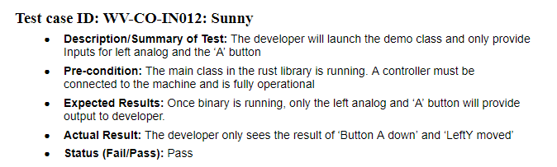
School of Computing & Information Sciences
Senior Project, 2017, Summer
WEB-VR v. 1.0
Student: Pachev Joseph, Florida International University
Mentor: Francisco Ortega, Florida International University
Instructor: Masoud Sadjadi, Florida International University
Problem
Represent connected devices universally to developers
Access input devices on any interface
Allow developers to specify which parts of the device to access
Convert proposed idea into code
Current System
The system can be used with various input devices
The system can take device specifications and restrictions
The systems provides output based on specifications
The system provides different modes of operation per device
Requirements
The system shall represent a device in 6-tuples in code
The system shall support multiple devices of different mediums
The system shall be a service to developers as a library
Contributions
Overall system architecture design and technology selection
Design and implementation of interface to be used by all other devices
Implementation of Game Controller and Mouse input devices
Object Design
Solution
Provide developers with a library for accessing connected devices
Provide meaningful output in universal JSON format
Provide developers with the tools to restrict the types of input to receive
Represent devices as a set of tuples that developers can manipulate
System Design
Implementation
Rust Programming Language
Cargo Package management
SDL for managing connections
Servo Browser for testing
LibUSB for generic devices
The system utilizes the client server architecture at its core. In addition, we use the observer pattern as a means of notifying developers on new inputs from users.
Screenshots
Verification
With each user story, several unit test were written. Below are two of such tests:
LibUSB
Summary
Web-VR input library lets device developers work without worrying about the connection
The physical connections are represented as software components that are easily manipulated
This creates a streamlined process for the developer and the end user
Acknowledgements
The material presented in this poster is based upon the work supported by Pachev Joseph. I am thankful to the help that I received from my group members, Bernado Pla, Daniel Khawand, Daniel Rivero, and Hamilton Chevez
Notes:
1

