Slide 1






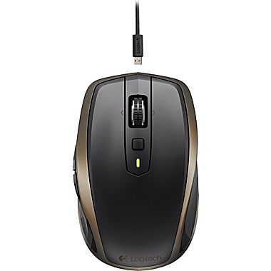
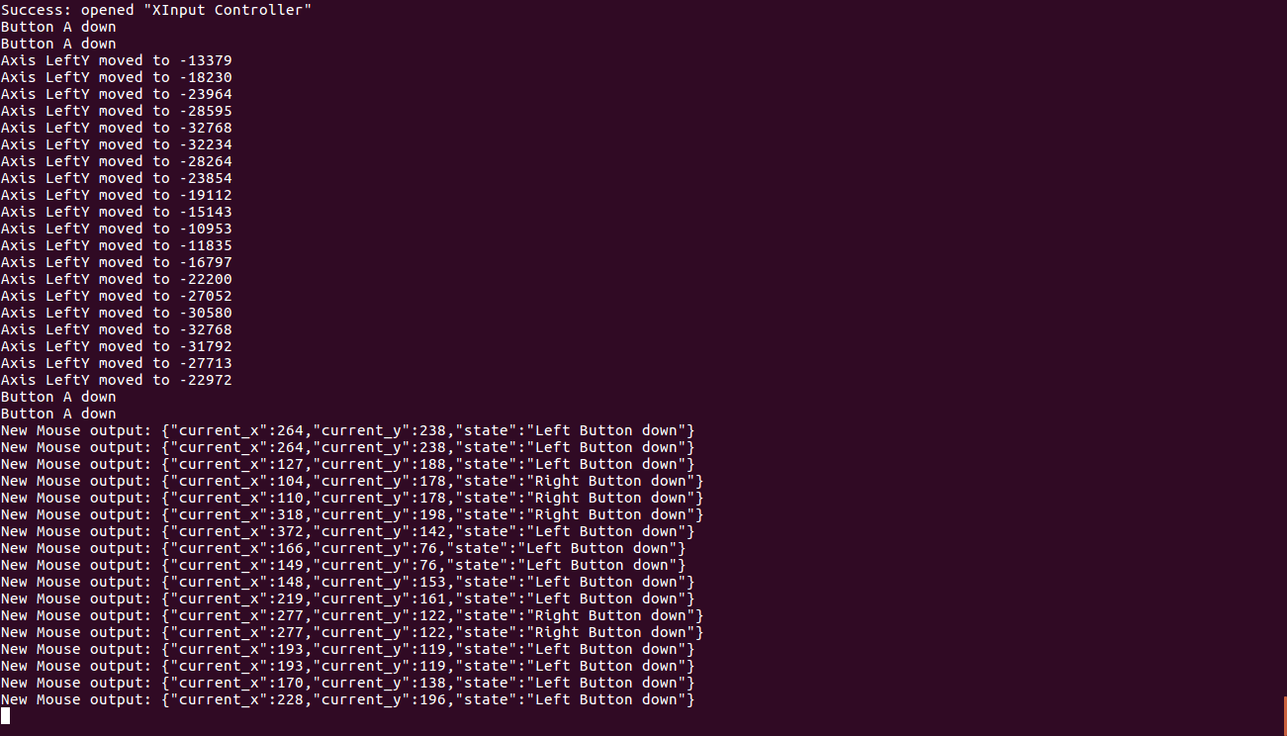
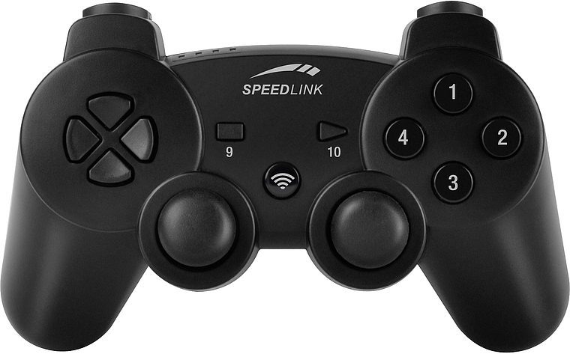
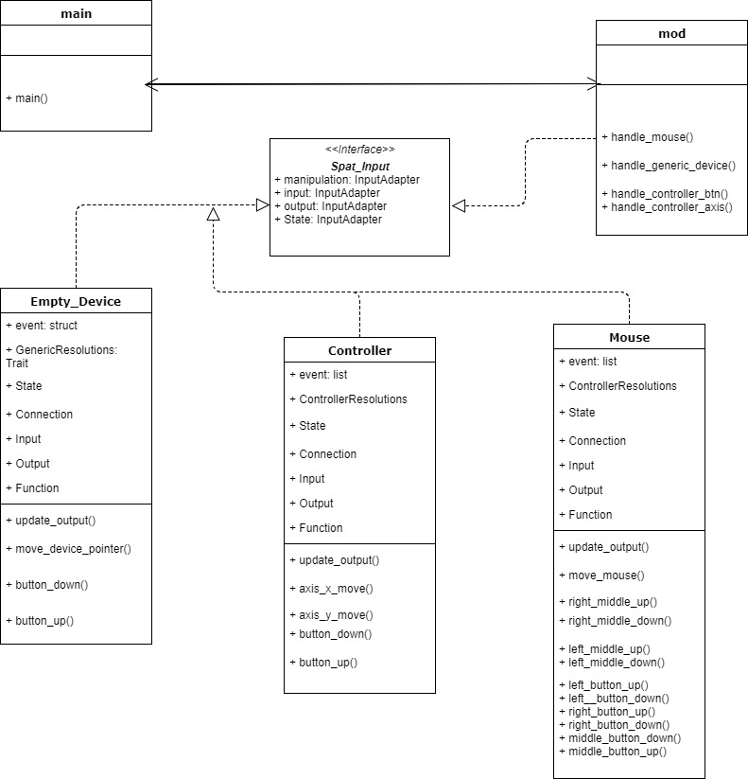

School of Computing & Information Sciences
VIP Senior, 2017, Summer
WEBVR: Virtual and Augmented Reality for WEB 1.0
Student: Bernardo Pla, Florida International University
Mentor: Francisco Ortega, Florida International University
Instructor: Masoud Sadjadi, Florida International University
Problem
Product owner wants to portray a proposed idea with code.
Originally, devices were mathematically portrayed with 4-tuples
Proposed idea mathematically portrays devices using 6-tuples
This idea needs conversion to code
Requirements
The system shall represent a device of 6-tuples in code.
The system shall support multiple devices of different mediums.
The system shall be a service to developers as a library
Solution
The solution is to design an input device library for device developers.
The developers created this library using Rust
Rust was created by Mozilla Research
Screenshots
System Design
Implementation
This library was implemented using Rust
For dependencies, the Cargo package manager was used.
SDL played a major role in handling connections supported devices
If a device could not use SDL, Libusb was used to implement devices.
Contributions
Created event behavior for mouse device class.
Event behavior was replicated to other devices that followed.
Implemented support for the Generic Device. This is an unsupported device but can still pass basic values to developers.
What’s Next?
Add more devices to support to this library using the 6-tuple representation
Perform integration of this library to web applications by converting it to a Dynamic-Link Library or Shared Object file
Publish library to Cargo to be used by Rust community
Summary
The input device library is a Rust library designed to help developers interact with devices.
This will help streamline the development process
This allows device developers to control behaviors of input devices and app developers to control app behavior
Acknowledgement
The material presented in this poster is based upon the work supported by Bernardo Pla. I am thankful to the help that I received from my group members: Pachev Joseph, Hamilton Chevez, Daniel Rivero, and Daniel Khawand
Notes:
1

