Slide 1




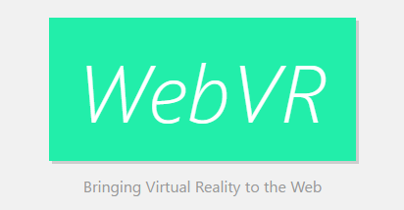

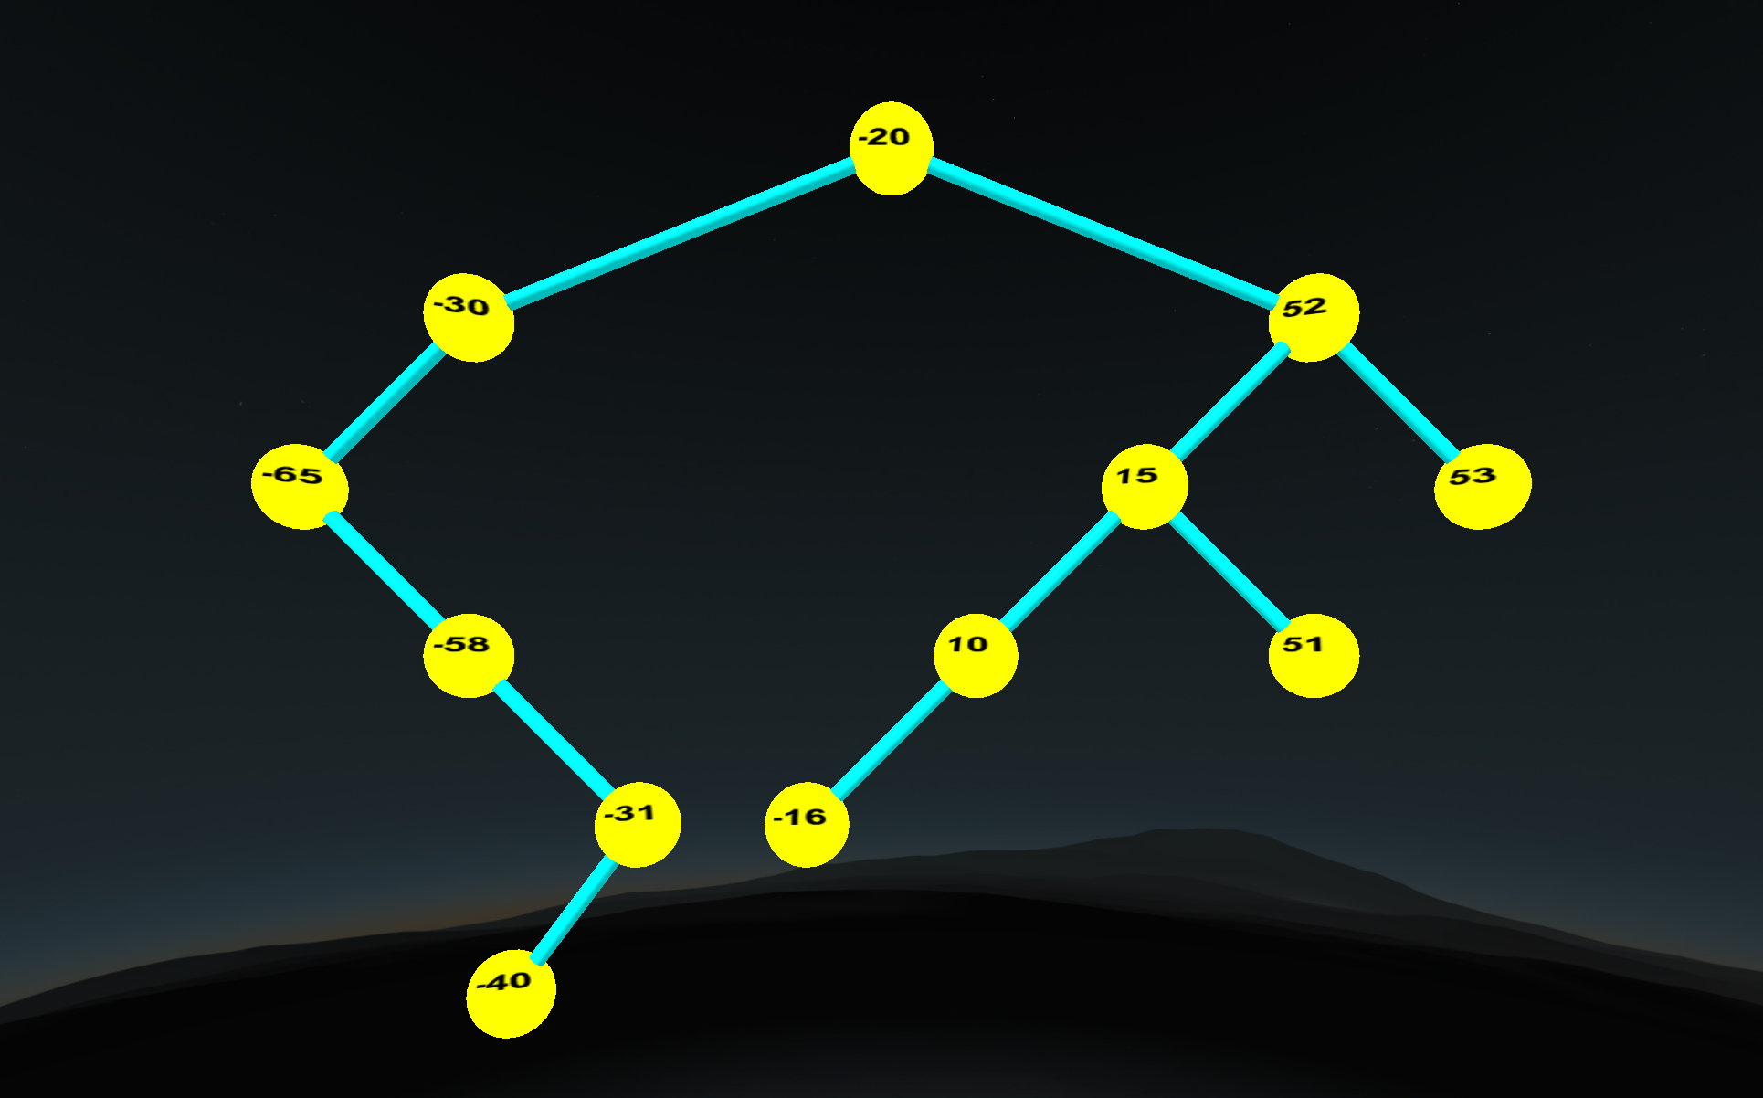
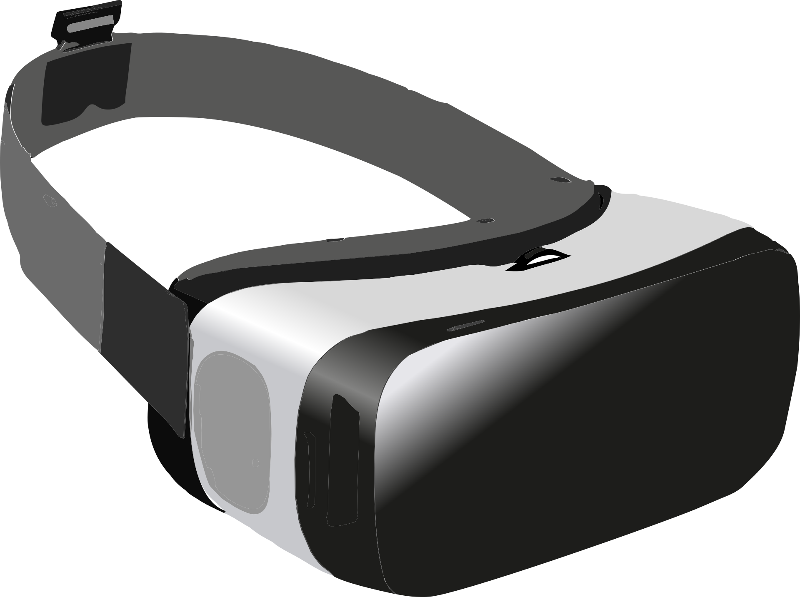
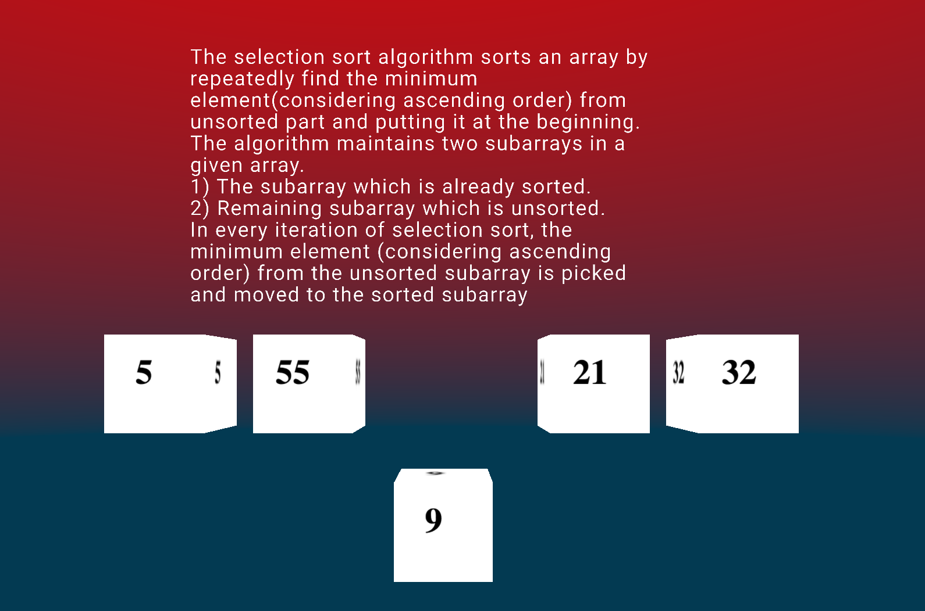
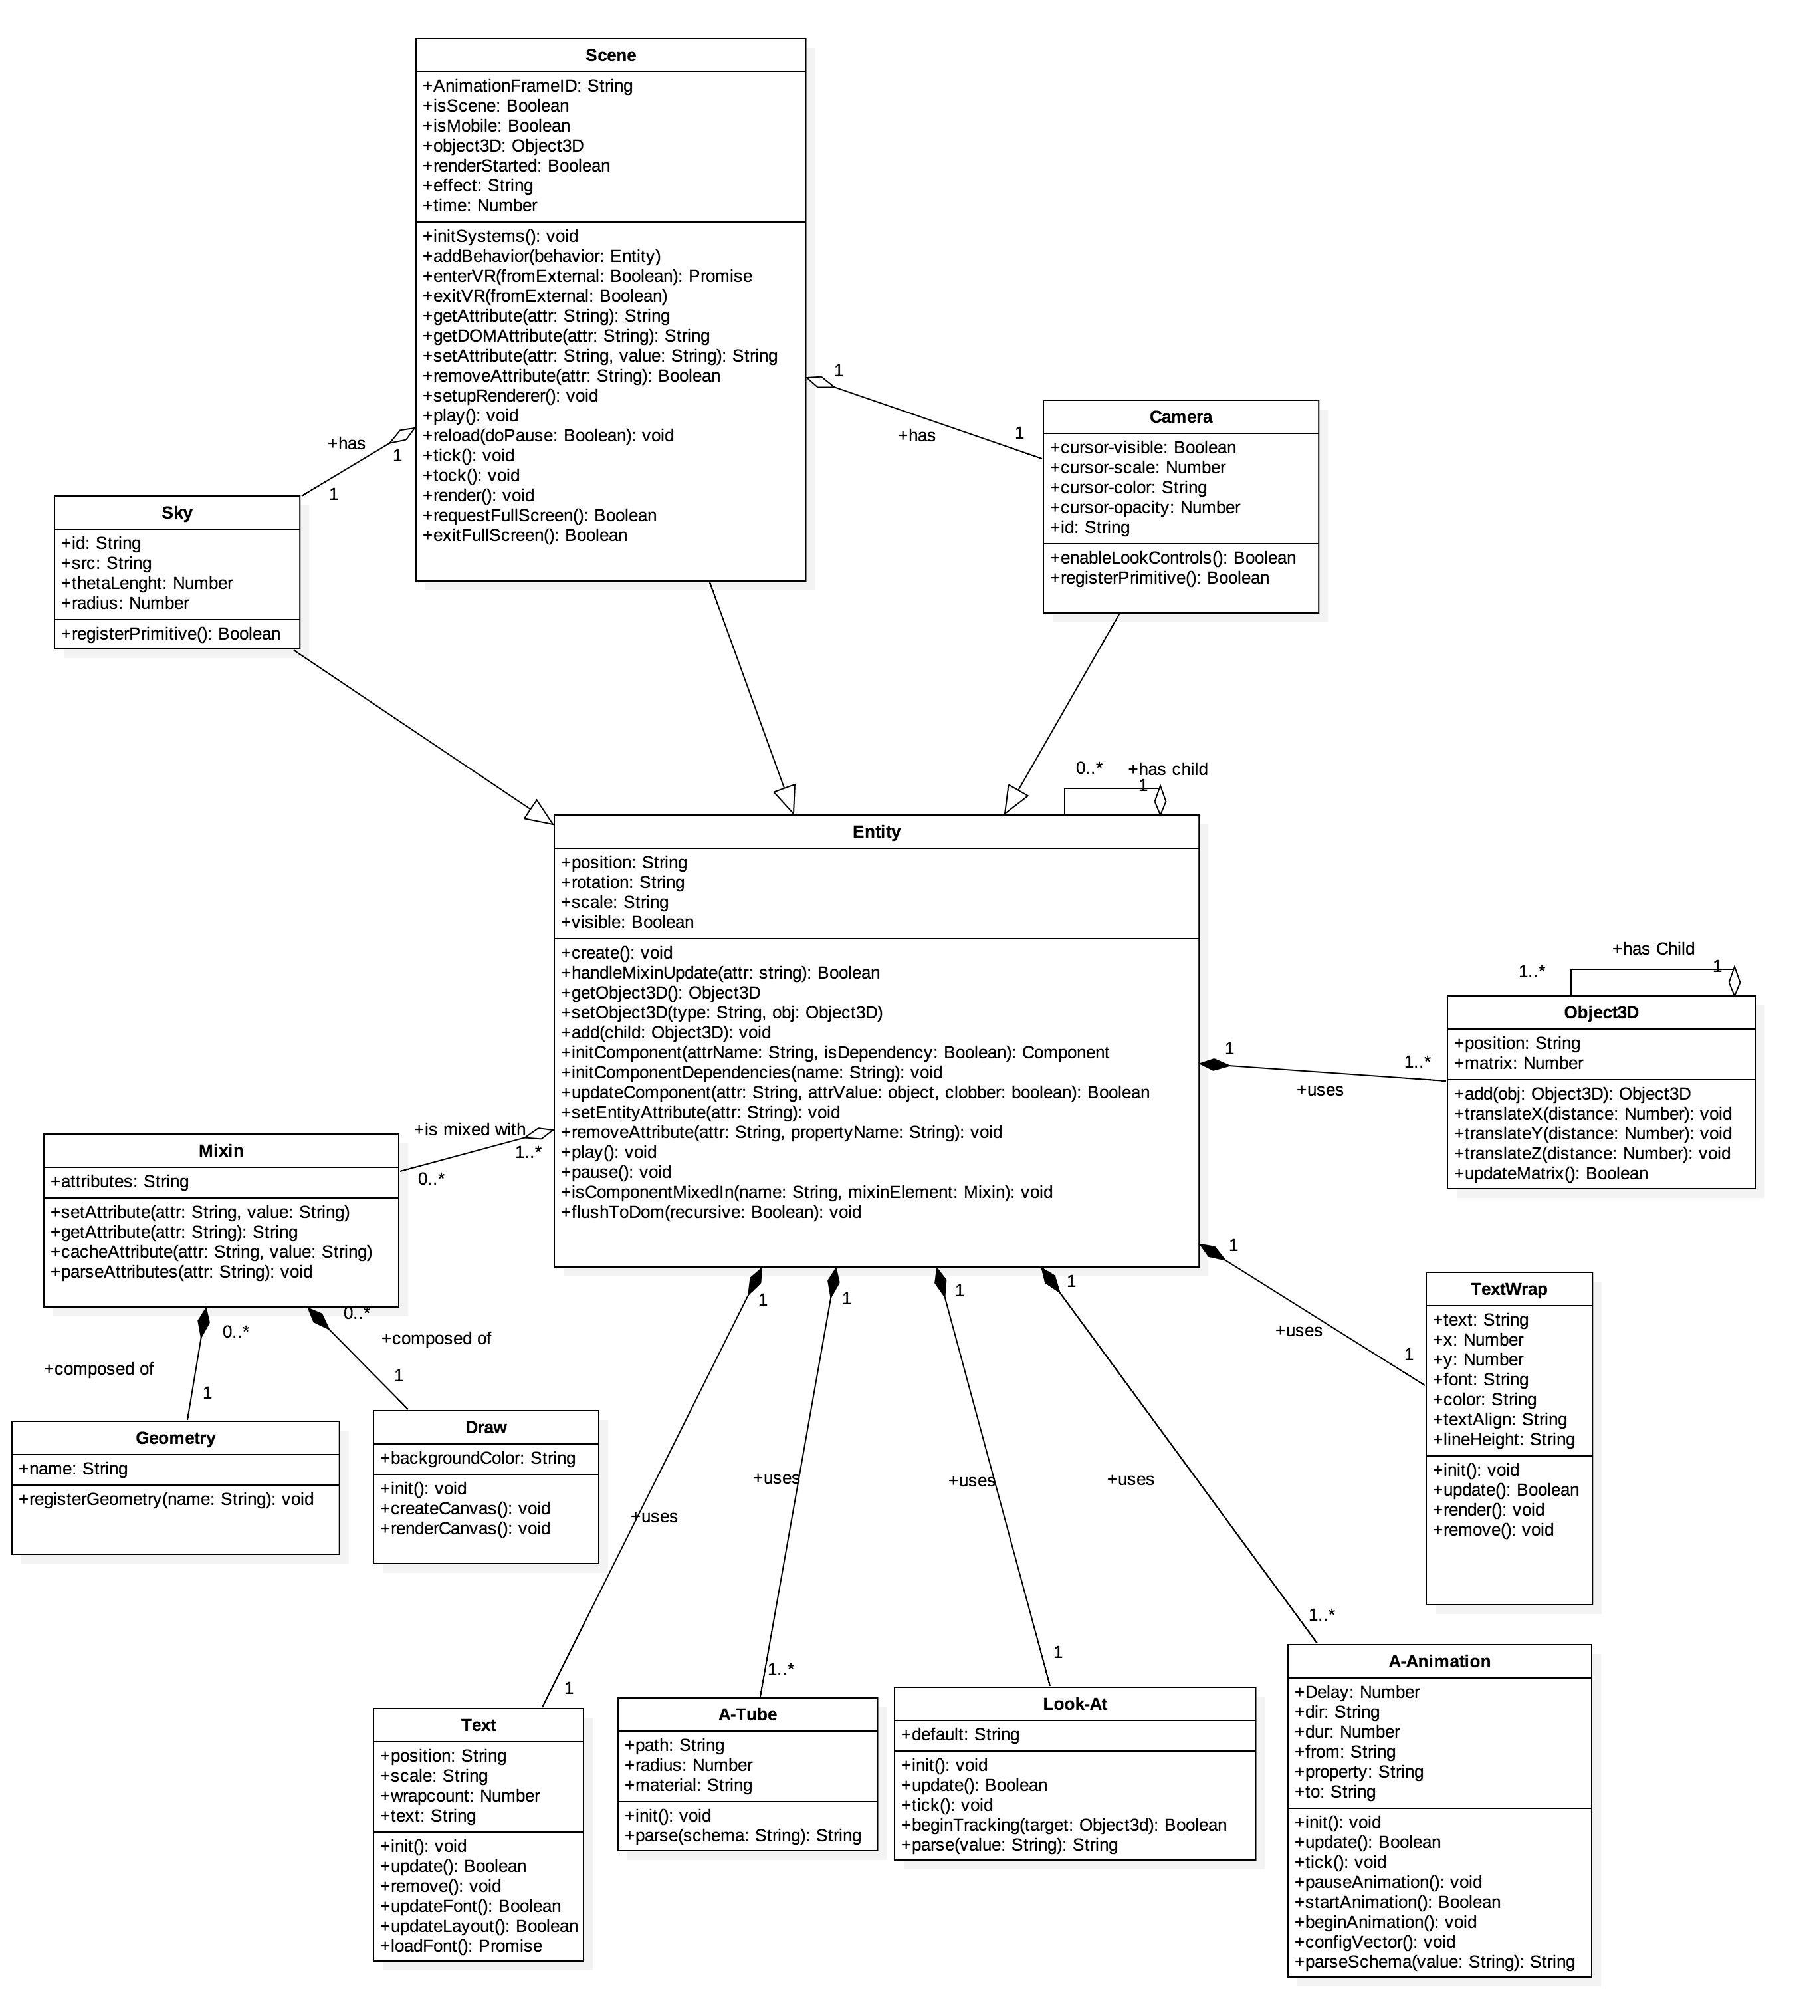
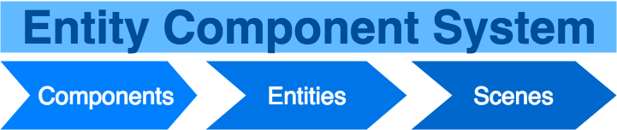

School of Computing & Information Sciences
VIP JR, 2017, Summer
WEB-VR Towards Virtual and Augmented Reality for the Web:
Education
Student: Hamilton Chevez, Florida International University
Mentor: Francisco Ortega, Florida International University
Instructor: Masoud Sadjadi, Florida International University
Purpose
Increase retention rate of Computer Science students.
Use WebVR to bring Virtual and Augmented reality to user devices.
Make visualizations of Abstract Data Structures and Algorithms.
Application
Via web access, students can explore visualized Computer Science topics.
Cross platform browser compatibility for WebVR api, allows students ease of access on desktop and mobile devices.
Financial barriers imposed by expensive hardware become smaller.
Current System
Online application accessed via (http://104.236.51.191/)
Users click on any associated VR Scene button.
User is redirected to VR Scene.
User can click on VR icon to enter VR mode.
Screenshots
Binary Search Tree Scene
Selection Sort Scene
Implementation
Built with A-Frame JavaScript framework.
The framework is an abstraction of an entity-component architecture on top of Three.JS, WebVR api, and WebGL.
Scenes : Global management of classes and entities.
Entities: Placeholder objects appearance, behavior, and functionality components.
Components: Reusable and modular chunk of data.
Requirements
Allow users to access content through their mobile devices.
Create visualizations of abstract data structures and algorithms with VR and AR.
Use the WebVR api.
Dynamically set behavior of components based on user input.
Summary
WebVR for Education has the potential to enrich material taught in Computer Science courses.
Providing access to visual learning material, the range of retention can increase for students with difficulty learning from traditional expositional teaching styles.
What’s Next
Creating dynamic content in VR Scenes.
Using Argon.js for AR content.
Optimize rendering speed with WebAssembly.
Visualizing more Computer Science concepts.
Acknowledgement
The material presented in this poster is based upon the work supported by Hamilton Chevez. I am thankful to the help that I received from my project mentor Francisco Ortega and group members Bernardo Pla, Daniel Khawand, Daniel Rivero, Pachev Joseph
Notes:
1

