Slide 1







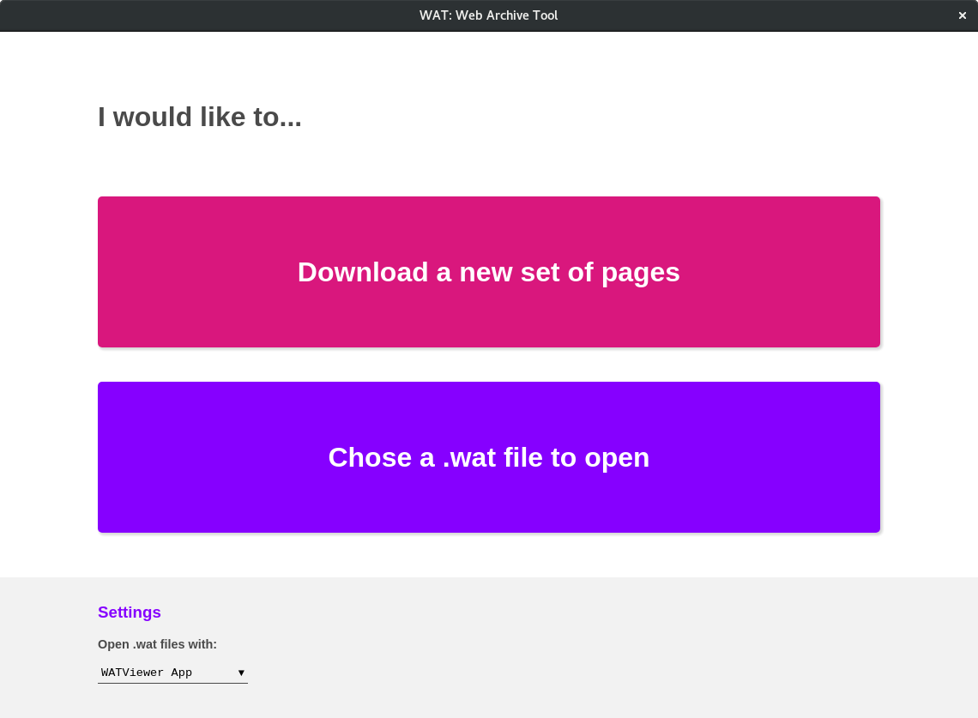
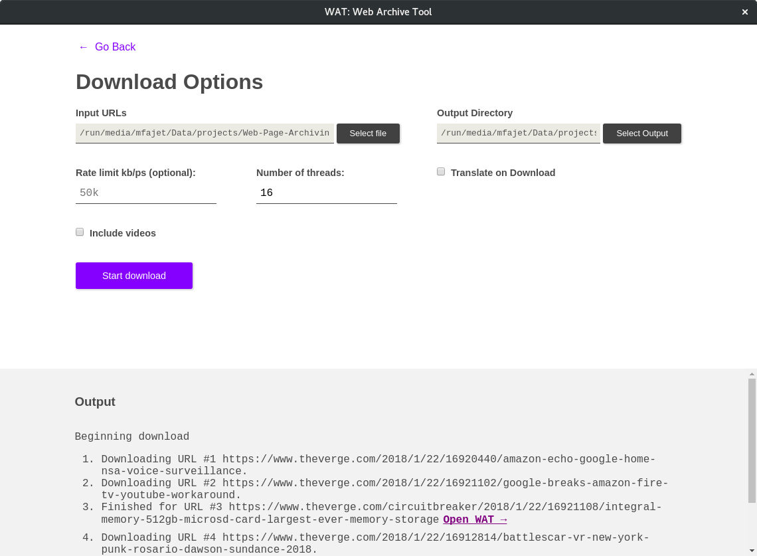
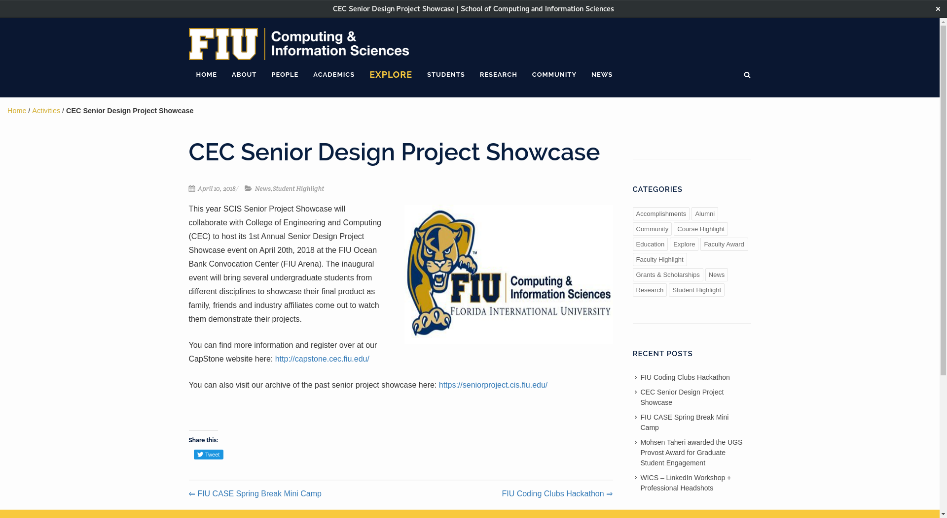
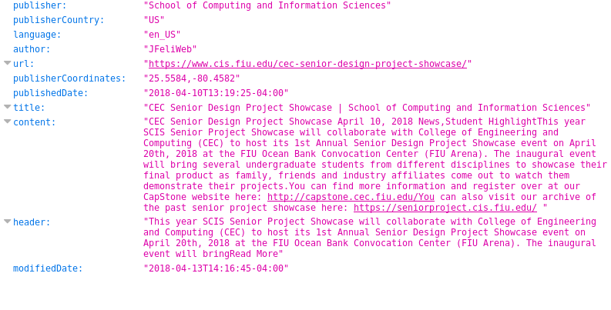
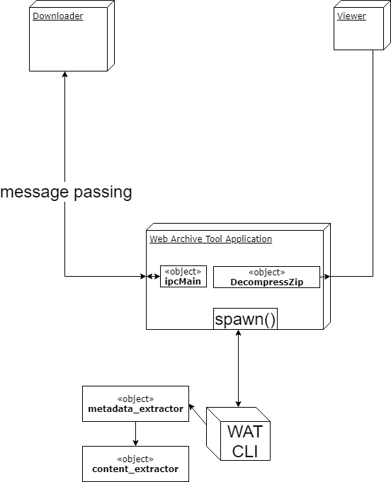
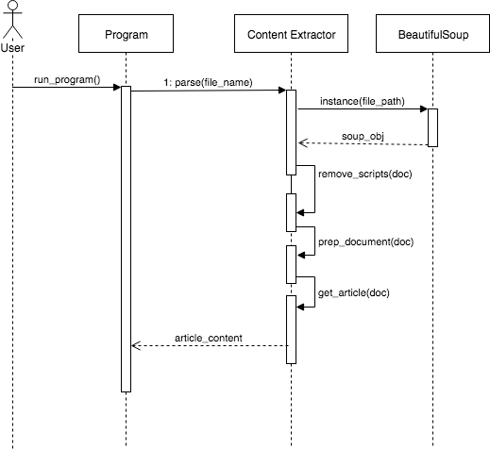
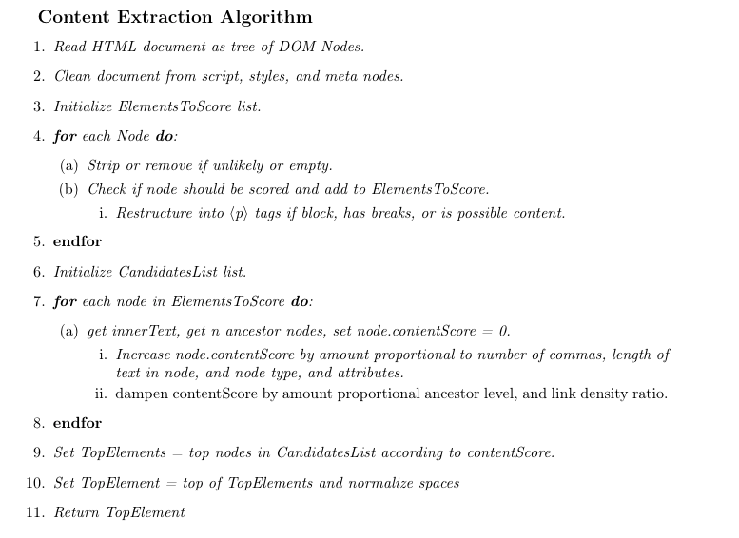
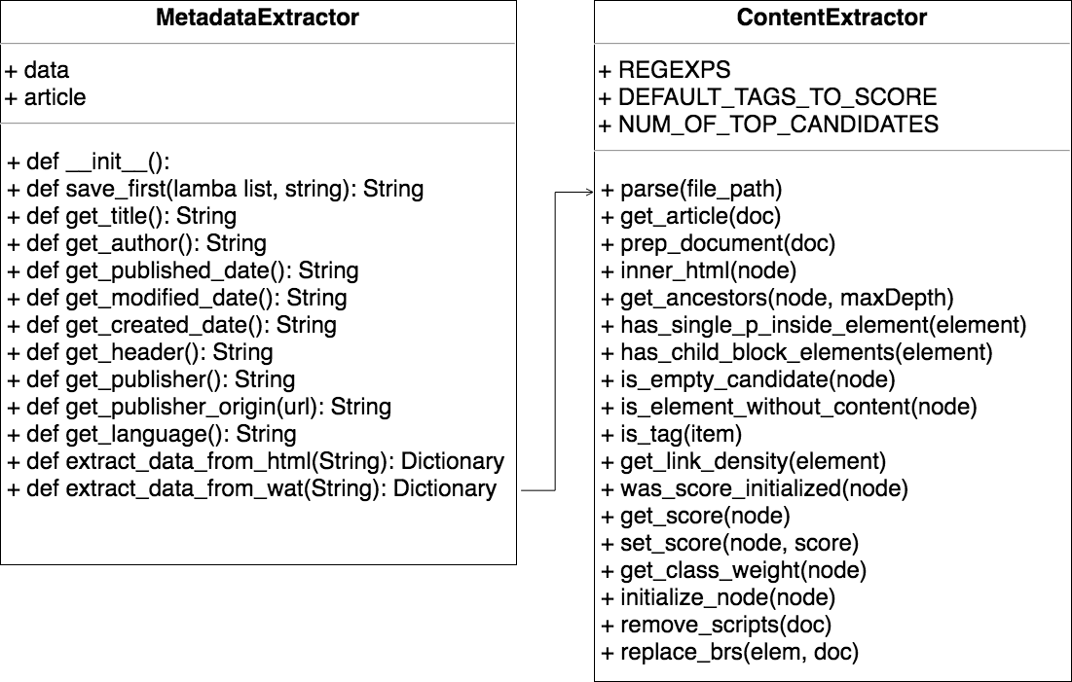
School of Computing & Information Sciences
Senior Project, 2018, Spring
Web Page Archiving and Content Analysis
Student: Juan Alvarado, Florida International University
Mentor: Mark Finlayson, Florida International University
Professor: Masoud Sadjadi, Florida International University
Problem
Temporary web content
Filtering and parsing is time consuming and difficult
Content not available for offline access and manipulation
No solution exists
Solution
Intuitive CLI for downloading
Introduce custom file format
Create GUI for viewing and interfacing with custom file format
Extract content of web pages through metadata and natural language processing
Implementation
Python2.7 and wget for the downloading CLI
Electron, HTML5, CSS3, and JS for the GUI
Python2.7 and BeautifulSoup for the content extraction
Screenshots
Viewing Screen
Main Screen
Downloading Screen
Extracted
Information
Current System
Previous projects were incomplete
Existing partial solutions have been deprecated
System Design
Content Extraction Algorithm
Requirements
Batch download large sets of pages
Archive web page in format that allows easy programmatic access
Encapsulate this archive in a single file
Ability to easily view web archive
Identify and extract the main textual content of the article
Identify and extract the metadata of the article
Cross-platform
Overview of System
Overview of Content Extraction
Object Design
Summary
Our work allows users to:
Download and archive batches of web pages
Extract important information from the web pages
View these web pages on any platform
Verification
Unit testing
Integration testing
Tested on 5GB of articles
Acknowledgment
The material presented in this poster is based upon the work supported by Mark Finlayson, Andres Cremisini, and Pedro Torres-Carrasquillo. I am thankful to the help that I received from my group member Mark Fajet.
Follow us @FIUSCIS
Notes:
1

