Slide 1








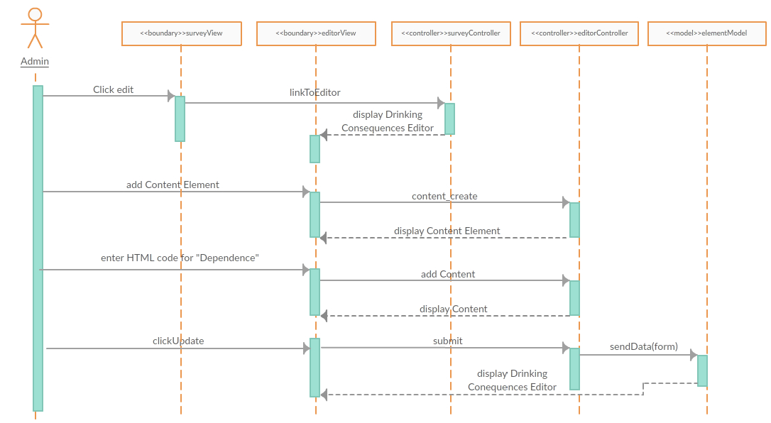
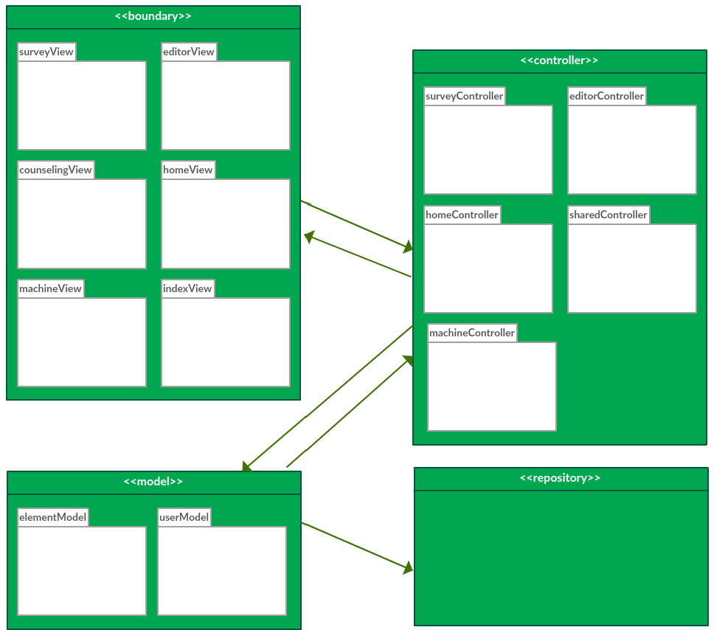
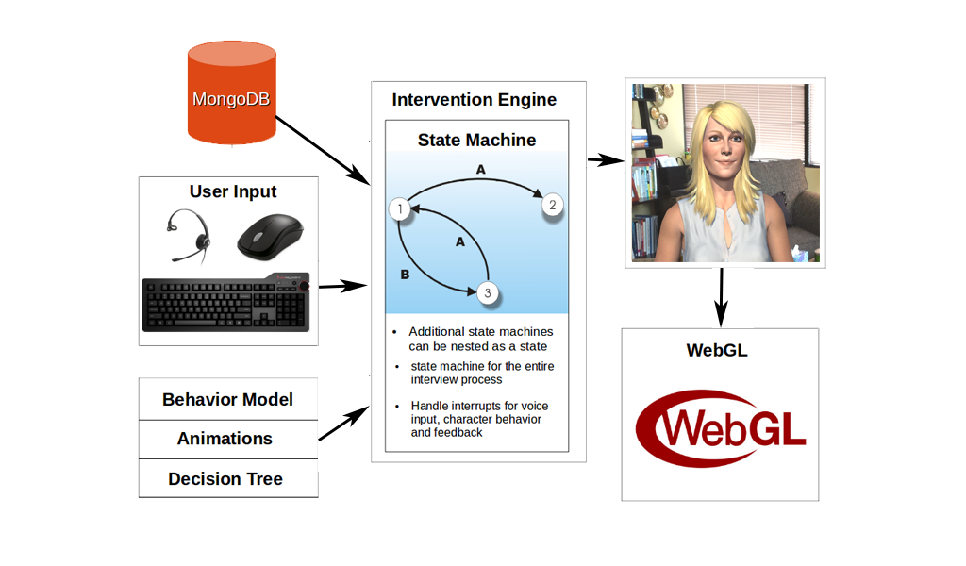
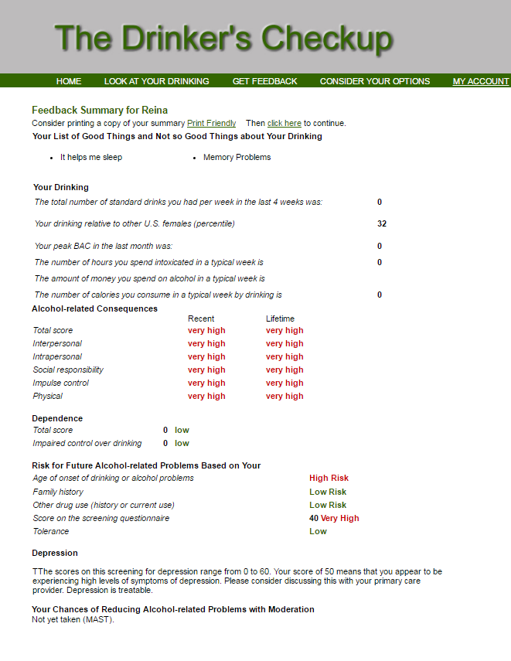
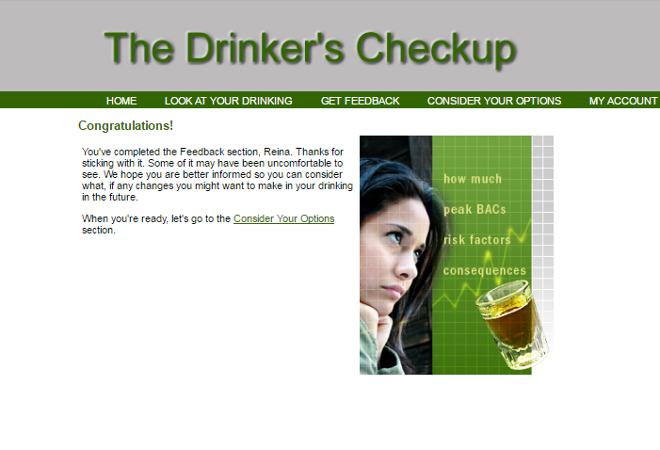
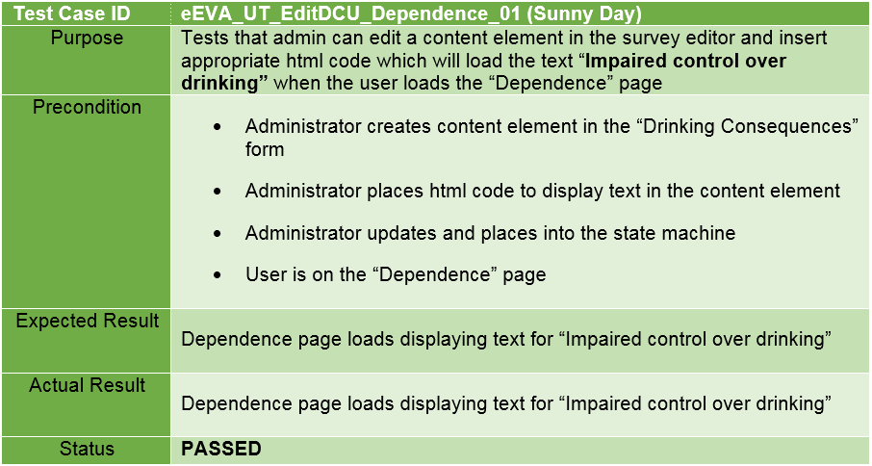
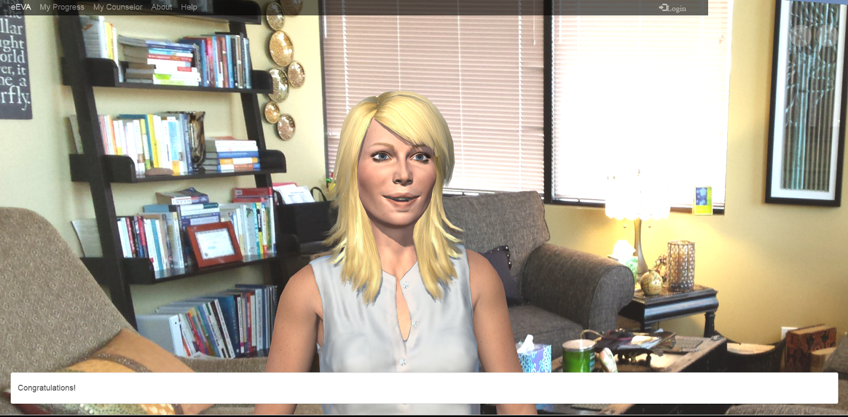
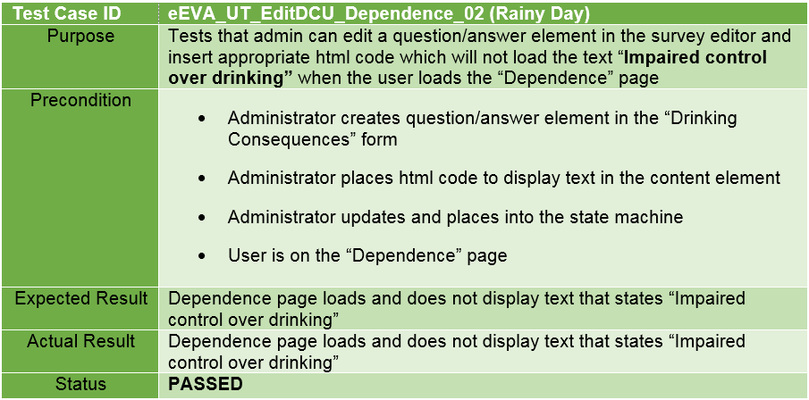
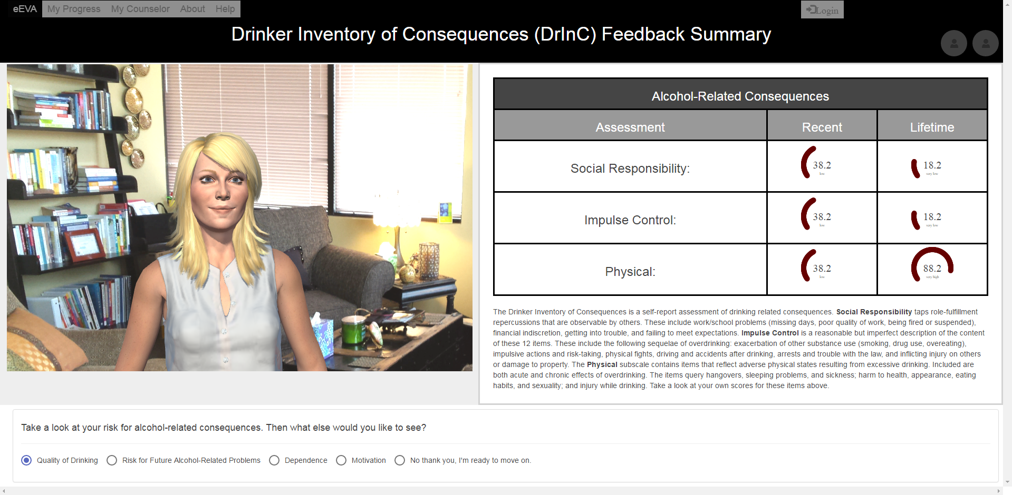
eEVA Data Generation and User
Results Analysis Version 1.0
Student: Stephanie Lunn, Florida International University
Mentor: Christine Lisetti, Florida International University
Mohsen Taheri, Florida International University
Instructor: Masoud Sadjadi, Florida International University
Senior Project: Fall 2016
Problem
Current System
Requirements
Many times, heavy drinkers are unaware that they have an issue. Brief motivational interventions have been shown to be effective at reducing problem drinking (Hester, Squires, Delaney, 2005). However, the original version of the Drinker’s Check-Up (DCU) is text only (http://drinkerscheckup.com/), and the results are delivered in dense blocks with no explanations of what they mean.
Version 1.0 System:
eEVA uses an avatar to engage users and perform assessments
Users can access results at any time, with their scores available for sections completed
Avatar uses NLP to “understand” user’s responses to questions
Feedback spoken by eEVA and the results displayed as well
Although the drinking interventions are already implemented, many features needed to be completed for the user, such as:
Automatic Counselor Toggling to View Results Content
“Next” Button for the System
Results with Explanations and Dynamic JavaScript Content
Solution
Object Interactions
Implementation
Create an empathic embodied virtual agent (eEVA) that employs Natural Language Processing (NLP) to deliver the DCU, with better explanations of the results’ scores.
Sequence Diagram for User Story #200_EditDCU_Dependence:
MEAN Stack Utilized:
Full-stack JavaScript solution
MongoDB is used for the database
Express is used as the framework for the web server
AngularJS is used for the framework of the web client
Node.js is the platform used for the server
System Implemented with:
Survey Editor
State Machine
Intervention Engine Flow Chart:
System Design
Model View Controller (MVC)
Architectural Pattern Employed:
Screenshots
Original Text-Only DCU:
eEVA Version 1.0:
Verification
Unit and Integration Testing performed.
Sample Test Case:
Summary
The eEVA Version 1.0 system is now able to display and explain a user’s results for the DCU. In addition, an administrator can implement “Next” buttons in the Survey Editor, as well as being able to toggle the counselor window size to show results content automatically. However, there is still a lot more that will need to be added in the future for a more complete administrator/user experience.
Acknowledgements
The work in this poster is based upon the efforts of Dr. Christine Lisetti and the Affective Social Computing Laboratory (http://ascl.cis.fiu.edu/), with thanks to the National Science Foundation for their support. I am also grateful to my fellow team member, Carlos Mestre.
Notes:
1

