Slide 1
PTSD Analysis
How does psychotherapy effect suicide attempts in patients with PTSD?

Slide 2
Bio
I served in the United States Marine Corps. From 2004-2009
Completed a Computer Technician course
Started my own computer consulting company
Studied Computer Science and Music at a community college.
Full Stack Developer course at Woz-U
Freelance developer for 5 months
Now I’m doing Data Science at Woz-U

Slide 3
What is PTSD?
PTSD (post traumatic stress disorder) is a mental health problem that some people develop after experiencing or witnessing a life-threatening event, like combat, a natural disaster, a car accident, or sexual assault.
During this kind of event, you may not have any control over what's happening, and you may feel very afraid. Anyone who has gone through something like this can develop PTSD.
It's normal to have upsetting memories, feel on edge, or have trouble sleeping after a traumatic event (also called "trauma").
At first, it may be hard to do daily activities you are used to doing, like go to work, go to school, or spend time with people you care about.
But most people start to feel better after a few weeks or months. For some people, PTSD symptoms may start later, or they may come and go over time.
If it's been longer than a few months and thoughts and feelings from the trauma are upsetting you or causing problems in your life, you may have PTSD.
https://www.ptsd.va.gov/understand/what/ptsd_basics.asp

Slide 4
How common is PTSD?
Operations Iraqi Freedom (OIF) and Enduring Freedom (OEF): About 11-20 out of every 100 Veterans (or between 11-20%) who served in OIF or OEF have PTSD in a given year.
Gulf War (Desert Storm): About 12 out of every 100 Gulf War Veterans (or 12%) have PTSD in a given year.
Vietnam War: About 15 out of every 100 Vietnam Veterans (or 15%) were currently diagnosed with PTSD at the time of the most recent study in the late 1980s, the National Vietnam Veterans Readjustment Study (NVVRS). It is estimated that about 30 out of every 100 (or 30%) of Vietnam Veterans have had PTSD in their lifetime.
https://www.ptsd.va.gov/understand/common/common_veterans.asp

Slide 5
Data Set
Harms.csv
https://catalog.data.gov/dataset?q=VA+PTSD&sort=views_recent+desc&as_sfid=AAAAAAUNLtgByEjmA5KLzXgZi8MNLUmlTclT5VRZPH06o0eb84hzQ3SRcXD1ZcqSG-9ZveKwOU1quWaW9iFprYasrb5244uD8TKyMhaErCdrO1NyLhf9w8X7IRtM_5IeRpHABBA%3D&as_fid=acfbc2c0203720020a0e7ae9509eebe832ea9e1e&ext_location=&ext_bbox=&ext_prev_extent=-141.6796875%2C8.754794702435618%2C-59.4140625%2C61.77312286453146

Slide 6
Harms.CSV
Records percentages of study participants that experienced various harms within each intervention group, including serious adverse events, withdrawal due to serious adverse events, suicide attempts, and suicide completions. All Intervention arms are present in this dataset, including intervention arms that reported no quantitative or qualitative data for harms. Three records with harms data are at the "Omnibus" intervention level.
Values abstracted as "NA" or "NR" from the study are represented as null values/empty cells in this dataset.
Study level variables like military status and percent female are included for filtering purposes.

Slide 7
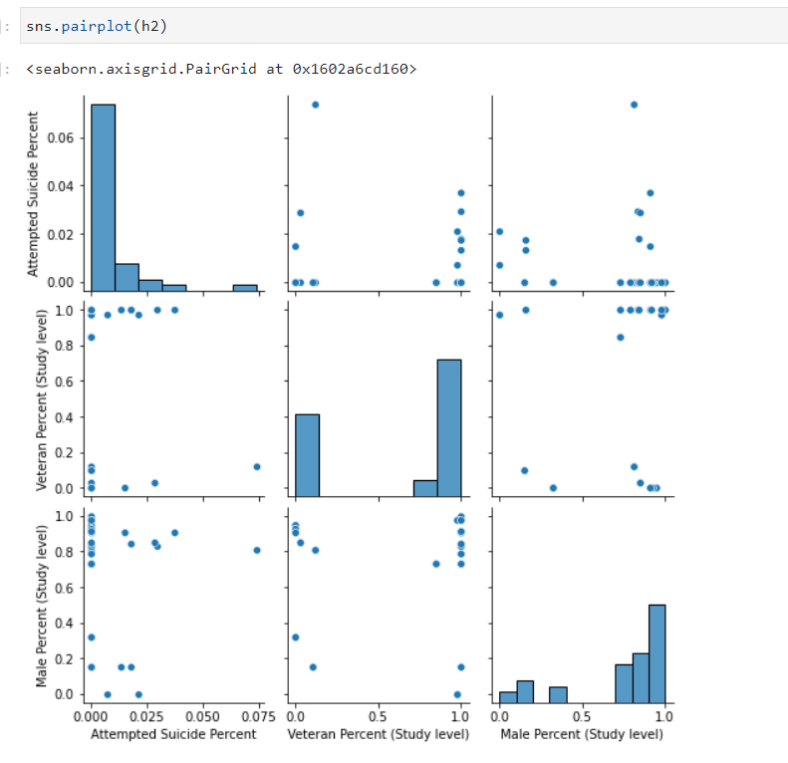
Scatter Plot Grid

Slide 8
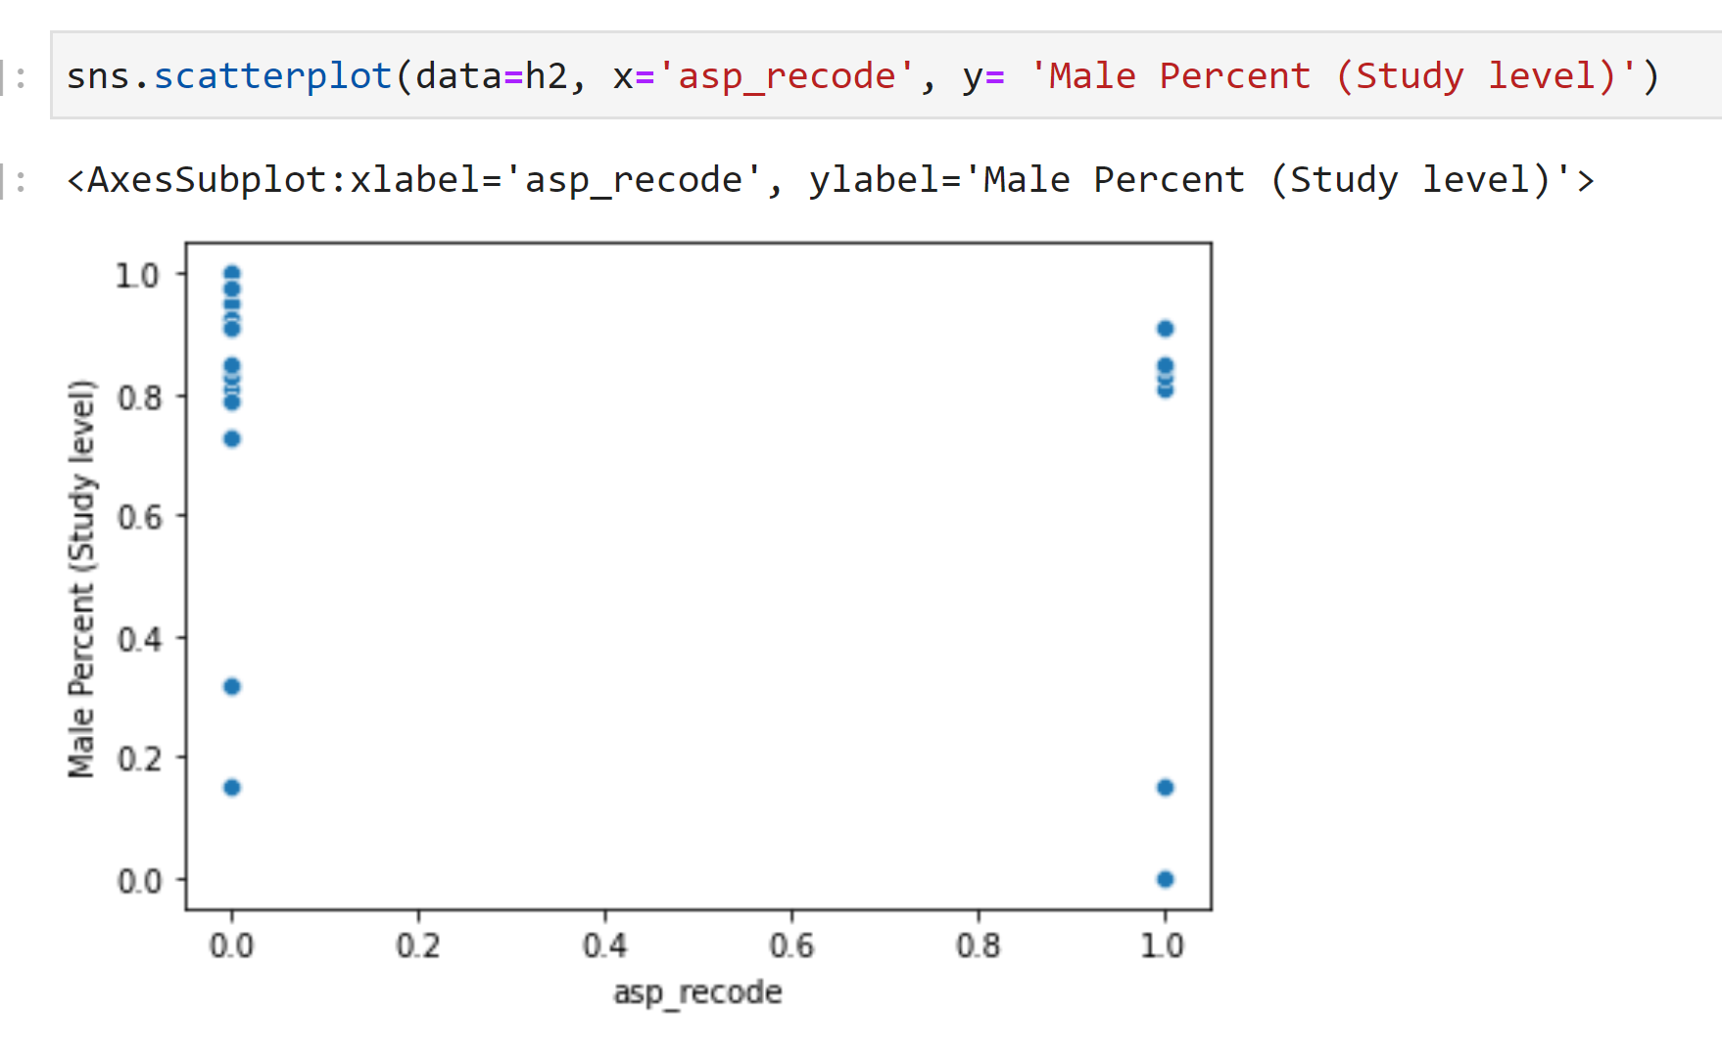
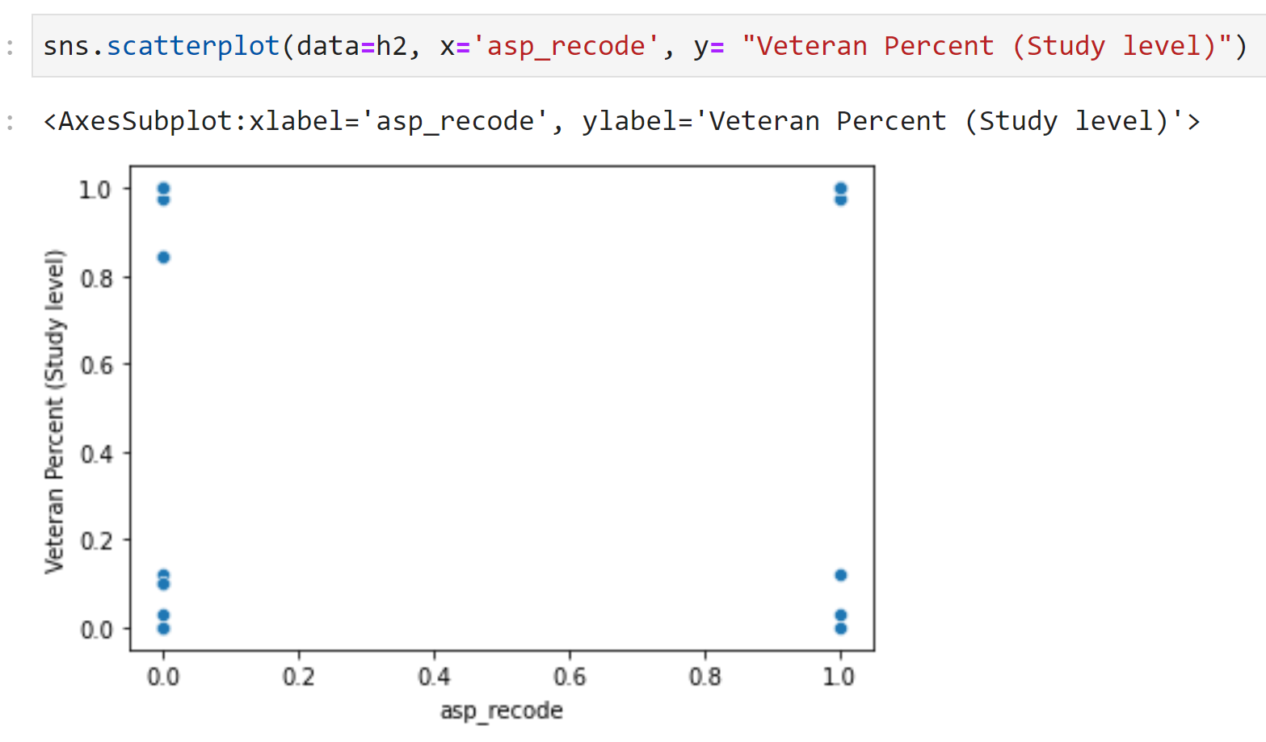
Exploring some scatter plots

Slide 9
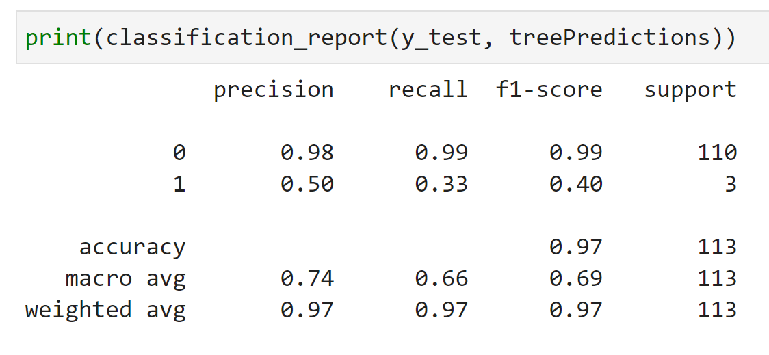
Decision Tree
What this is telling us is that the model was able to predict who was not going to have a suicide attempt, 98% of the time.
The model was only able to predict 50% of the time, when some one would attempt suicide. Our model was accurate over all 97%
The high accuracy was driven by an unbalanced data set.

Slide 10
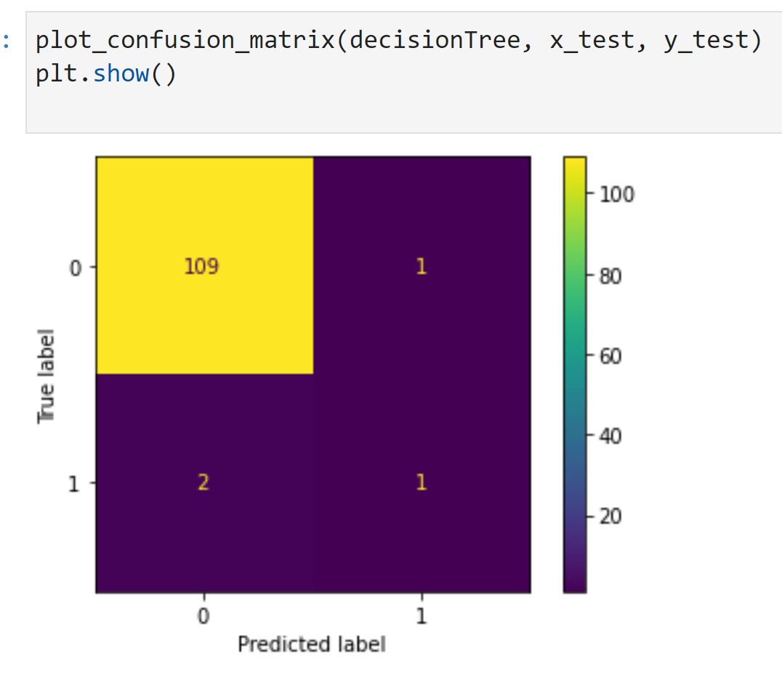
Confusion Matrix
There was 109 cases where the model predicted 0 suicides and they where 0 suicides.
2 cases where the model failed to predicted a suicide when there was one.
One case where the model predicted a suicide and got it right.
And one case where the model predicted a suicide and there was none.

Slide 11
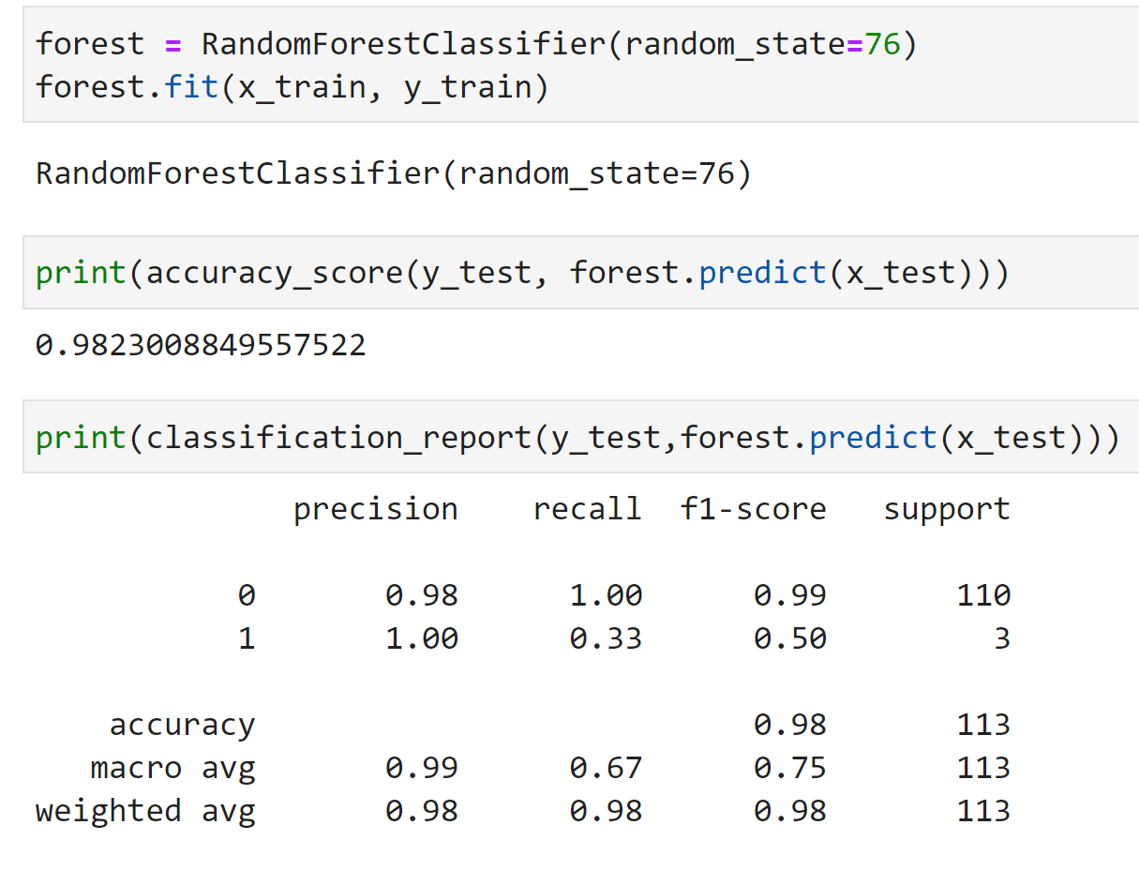
Random Forest
The model was able to predict who was not going to have a suicide attempt, 98% of the time.
For every value that is one the model was able to predict when some one would attempt suicide. Our model was accurate over all 98%
The high accuracy was driven by an unbalanced data set.

Slide 12
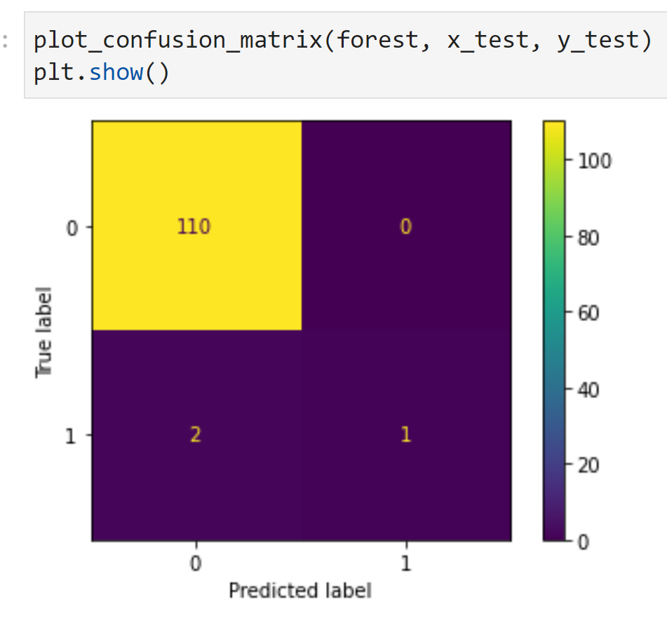
There was 110 cases where the model predicted 0 suicides and they where 0 suicides.
2 cases where the model failed to predicted a suicide when there was one.
One case where the model predicted a suicide and got it right.
There where no false positives.

Slide 13
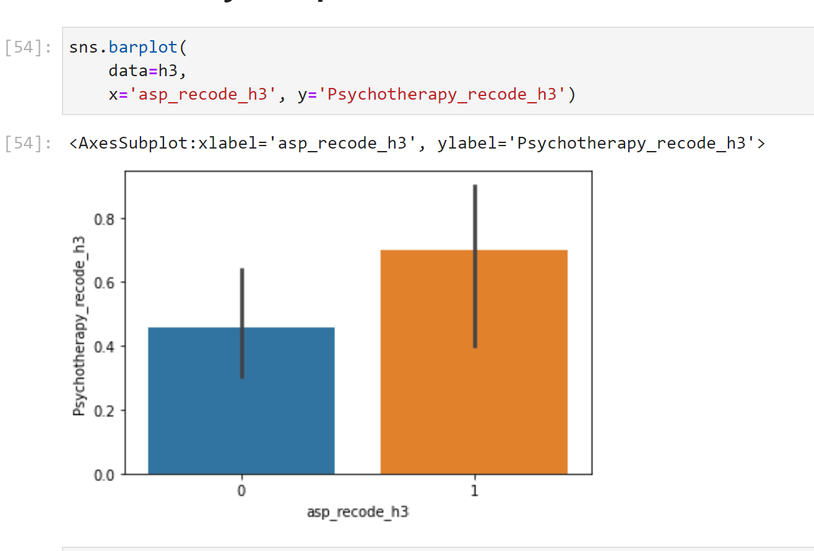
There where more suicide attempts when there was Psychotherapy present.
Versus when there wasn’t any Psychotherapy present.

Slide 14
Conclusion
The VA doesn’t have the best track record with helping its veterans.
It works with what its got
Do more with less mind set
A step forward not back wards
Give The VA a chance
Veteran Community and Non-Profits
We own it to our selves as veterans to up lift each other, during our troublesome times, and we do that by staying connected

Slide 15
Questions

