Slide 1


REQUIREMENTS DOCUMENT FOR AN INFORMATION SYSTEM DEVELOPMENT PROJECT
FOR THE PUKKI CINEMA
PHASE 2

Slide 2
TABLE OF CONTENT
Project Plan
Definitions, acronyms and abbreviations
Project Description and Scope
Functional requirements i.e.
a) business data requirements(inputs, outputs),
b) business processes requirements and
c) business interface requirements
Non-functionality requirements (categorized according to the PIECES Framework)
Candidate Systems Matrix
Feasibility Analysis Matrix
Use-Case Glossary & Use-Case Model Diagram
Examples of data, questionnaires, fact-finding techniques used
Summary, future & further planning (PERT Chart)

Slide 3
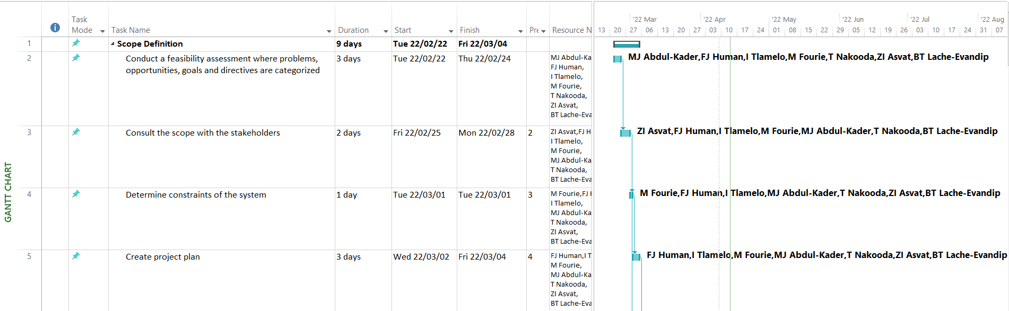
1. PROJECT PLAN

Slide 4
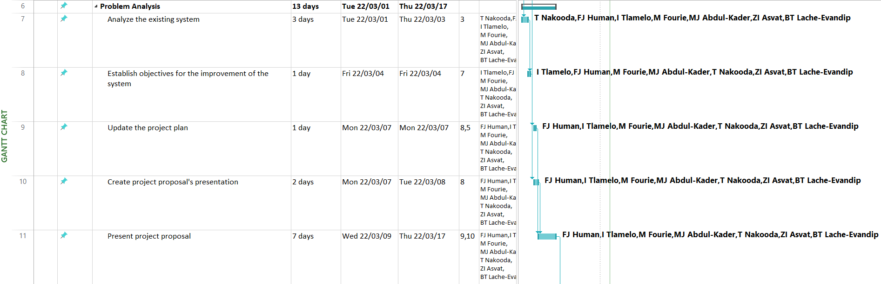
1. PROJECT PLAN continues

Slide 5
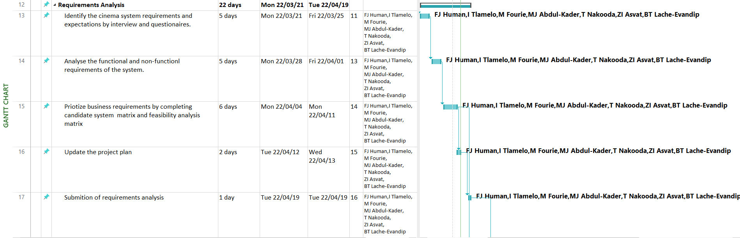
1. PROJECT PLAN continues

Slide 6
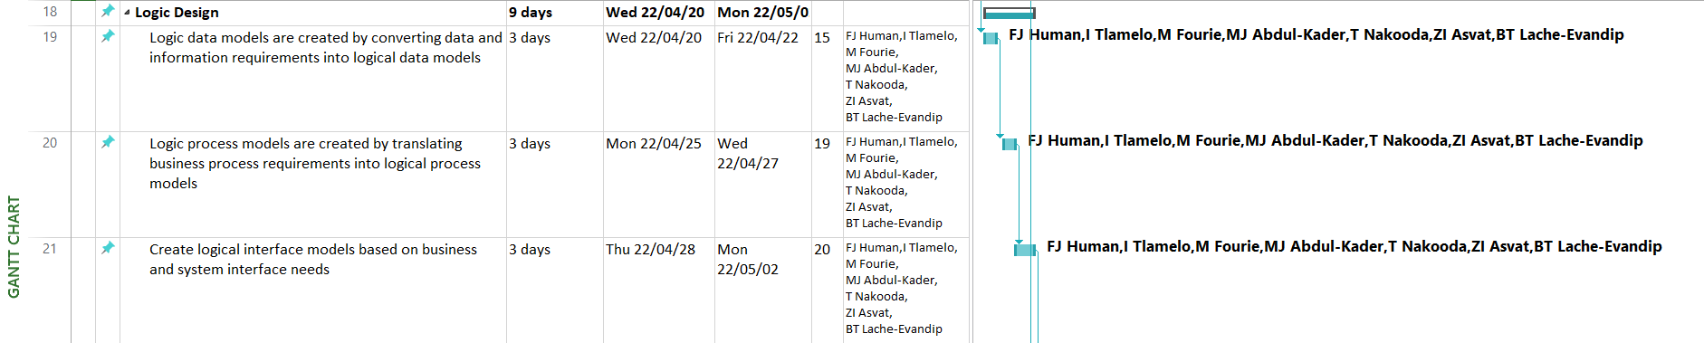
1. PROJECT PLAN continues

Slide 7
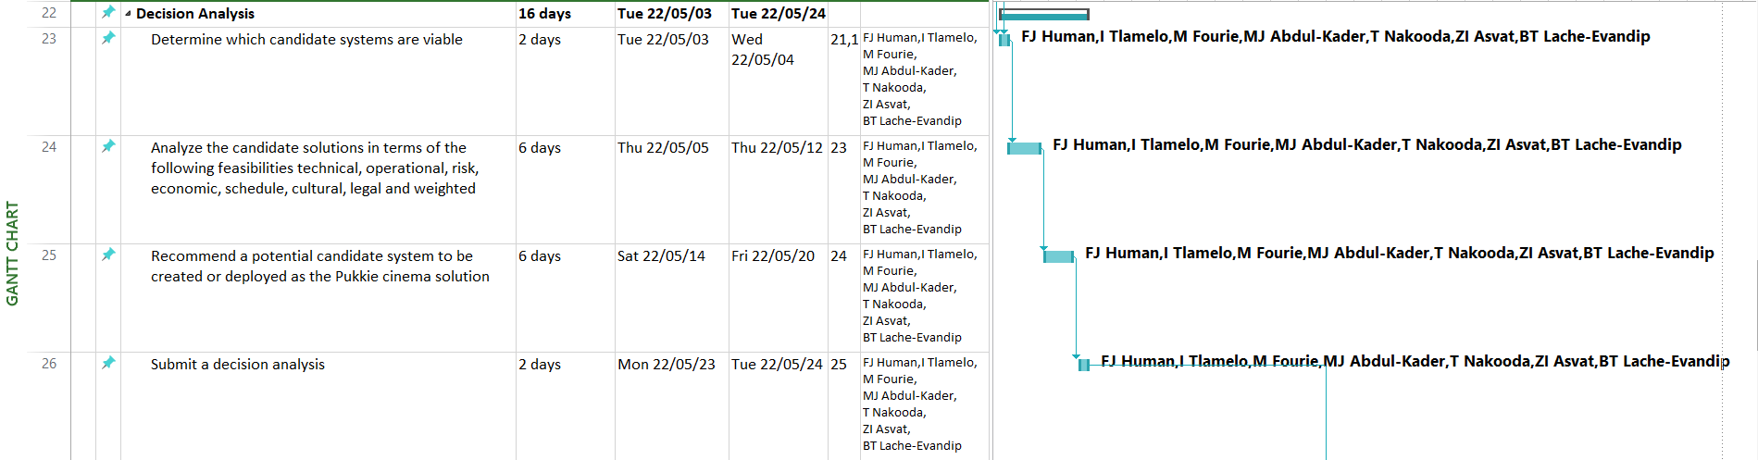
1. PROJECT PLAN continues

Slide 8
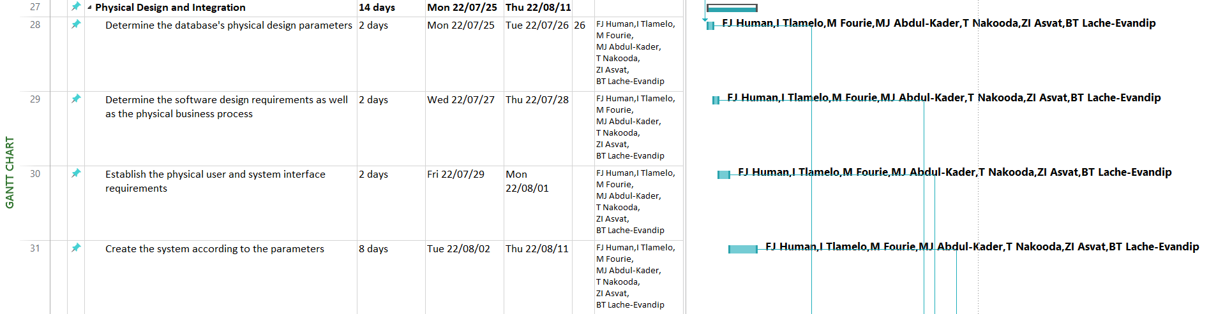
1. PROJECT PLAN continues

Slide 9
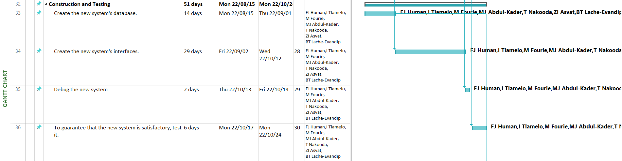
1. PROJECT PLAN continues

Slide 10
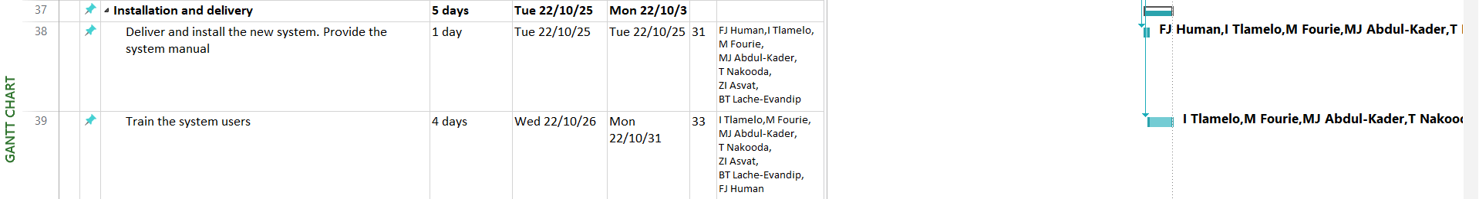
1. PROJECT PLAN continues

Slide 11
2. DEFINITIONS, ACRONYMS AND ABBREVIATIONS
Abbreviations
• PERT Chart: Program Evaluation Review Technique Chart
• GUI: Graphical User Interface
• COTS: Commercial Off-The-Shelf
• EST: Earliest Start Time
• LCT: Latest Completion Time
• FAST, Use Case
Definitions
• GANTT Chart: A bar chart that is used to illustrate a project schedule. The tasks are placed on the vertical axis with the time needed for each phase being put on the horizontal axis.
• PERT Chart: A tool used to plan, organize, schedule and coordinate tasks within a project.

Slide 12
3. PROJECT DESCRIPTION AND SCOPE
The paramount objective of this project is to provide the Pukki Cinema with a computerized system that will automate daily business procedures and provide comprehensive business reporting to aid business decisions. This will contain the flow of the selling of tickets as well as the scheduling of films to each theater. Reports include the top six genres per given time period as well as the number of tickets sold per given time period. Furthermore, the system should include extensive Help functionality, backup capability, and data security to prevent unauthorized access. All previous data must firstly be loaded into the system before it can be used in a production environment. The FAST methodology, with multiple phases, will be used to approach and implement the system in a formal way. The following functionality will be included in the scope of this project:

Slide 13
3. PROJECT DESCRIPTION AND SCOPE
The system must satisfy the following functional requirements:
Maintain Films
Maintain Genres
Maintain Theatres
Scheduling films
Selling of tickets
Request reports including:
Tickets sold per given time period
Top six genres per given time period

Slide 14
3. PROJECT DESCRIPTION AND SCOPE
In addition, the system must satisfy the following non-functional requirements:
Extensive Help functionality
Allocation of distinctive identifiers (e.g. username and password) to all system users
The database will contain data for six films (each of a different genre) divided into 3 theaters each with a seating capacity of 30 people, accumulating to 8370 tickets available per month
Queries on the database should take no longer than an estimated time of 4 seconds
There will be 2 types of system users. The administrator will have full access to the systems capabilities, while the employees will have access to only specified functionality
Booking speed will be increased by 60%

Slide 15
4. GRAPHICAL USER INTERFACE REQUIREMENTS
Films
Maintain
Genres
Login form
Schedule films
Theatres
Sell Tickets
Request reports

Slide 16
4. FUNCTIONAL DATA, PROCESS and INTERFACE REQUIREMENTS
Maintain films
Add new film
Input Data | Processing | Output
Title Film cost Selling price Length Age restriction Genre ID | Give an error message if all fields from the title to the ratings are the same. Validate that: All attributes have been assigned a value Length, Film cost, Selling price are numeric If the save button is clicked and there are no duplicates, the new film is added to the database Generate FilmID | Display a warning message if duplicates are to be entered Error message will appear stating that all fields must be filled in Send a confirmation message to show that the film was successfully saved and added

Slide 17
4. FUNCTIONAL DATA, PROCESS and INTERFACE REQUIREMENTS
Maintain films
Change details of existing film
Input Data | Processing | Output
Film ID Title Film cost Selling price Length Age restriction Genre ID | Display all attributes of selected Film and allow user to change Validate that: All attributes have been assigned a value Length, Film cost, Selling price are numeric If the save button is clicked and there are no duplicates, the film is updated to the database | Display a warning message if duplicates are to be entered Error message will appear stating that all fields must be filled in Send a confirmation message to show that the film was successfully updated.

Slide 18
4. FUNCTIONAL DATA, PROCESS and INTERFACE REQUIREMENTS
Maintain films
Delete existing film
Input Data | Processing | Output
Film ID | Display all attributes of selected Film After user requested to delete the film, ask if user is sure and if yes, then delete the corresponding database table entry | Message to indicate the film with the specified Film ID has been successfully deleted

Slide 19
4. FUNCTIONAL DATA, PROCESS and INTERFACE REQUIREMENTS
Maintain genres
Add new genres
Input Data | Processing | Output
Description | Display an error message if the description is the same as the other entries. Validate that: All attributes have been assigned a value If the save button is clicked and there are no duplicates, the new genre is added to the database Generate GenreID | Display a warning message if duplicates are to be entered Error message will appear stating that all fields must be filled in Send a confirmation message to show that the genre was successfully saved and added

Slide 20
4. FUNCTIONAL DATA, PROCESS and INTERFACE REQUIREMENTS
Maintain genres
Change existing genres
Input Data | Processing | Output
Genre ID Description | Display all attributes of selected genre and allow user to change Validate that: All attributes have been assigned a value If the save button is clicked and there are no duplicates, update the new genre to the database | Display a warning message if duplicates are to be entered Error message will appear stating that all fields must be filled in Send a confirmation message to show that the genre has been successfully updated

Slide 21
4. FUNCTIONAL DATA, PROCESS and INTERFACE REQUIREMENTS
Maintain genres
Delete genres
Input Data | Processing | Output
Genre ID | Display all attributes of selected genre After user requested to delete the genre, ask if user is sure and if yes, then delete the corresponding database table entry | Message to indicate the film with that Genre ID has been successfully deleted

Slide 22
4. FUNCTIONAL DATA, PROCESS and INTERFACE REQUIREMENTS
Maintain theatres
Add new theatres
Input Data | Processing | Output
Number Capacity Showing Time 1 Showing Time 2 Showing Time 3 | If Number is the same as other entries, display an error message Validate that: All attributes have been assigned a value Number and capacity is numeric If the save button is clicked and there are no duplicates, add the new theatre to the database Generate TheatreID | Display a warning message if duplicates are to be entered Error message will appear stating that all fields must be filled in Send a confirmation message to show that the theatre has been successfully saved and added

Slide 23
4. FUNCTIONAL DATA, PROCESS and INTERFACE REQUIREMENTS
Maintain theatre
Change existing theatre
Input Data | Processing | Output
Theatre ID Number Capacity | Display all attributes of selected theatre and allow user to change Validate that: All attributes have been assigned a value If the save button is clicked and there are no duplicates, update the new theatre to the database | Display a warning message if duplicates are to be entered Error message will appear stating that all fields must be filled in Send a confirmation message to show that the theatre has been successfully updated

Slide 24
4. FUNCTIONAL DATA, PROCESS and INTERFACE REQUIREMENTS
Maintain theatres
Delete theatre
Input Data | Processing | Output
Theatre ID | Display all attributes of selected theatre After user requested to delete the theatre, ask if user is sure and if yes, then delete from the corresponding database table | Message to indicate the film with that Theatre ID has been successfully deleted

Slide 25
4. FUNCTIONAL DATA, PROCESS and INTERFACE REQUIREMENTS
Scheduling of films
Input Data | Processing | Output
Film ID Theatre ID Time Date Ticket Counter | Display an error message if the attributes are the same as other entries Validate that: All attributes have been assigned a value If the save button is clicked and there are no duplicates, schedule the film in the Schedule table | Display a warning message if duplicates are to be entered Error message will appear stating that all fields must be filled in Send a confirmation message to show that the film has been successfully scheduled

Slide 26
4. FUNCTIONAL DATA, PROCESS and INTERFACE REQUIREMENTS
Selling of Tickets
Input Data | Processing | Output
Ticket ID Movie Title Time Number of Tickets Date Click on Availability button | Validate that all fields have values entered Check availability of ticket Increment ticket sale for the day as well as for that movie with its time slot and date as well as the genre Record the sale of the ticket in the Sales table Print out the tickets | Display a warning message if tickets are not available Error message stating that all fields must be filled in Send a confirmation message to show that the tickets were successfully purchased Print purchased tickets

Slide 27
4. FUNCTIONAL DATA, PROCESS and INTERFACE REQUIREMENTS
Request reports
Top 6 genres per time period
Input Data | Processing | Output
Click on Reports button Time period Click on Top 6 Genres | Validate that all fields have values entered Query for top 6 genres viewed | In a text or excel file, display the genres as well as the number of tickets sold

Slide 28
4. FUNCTIONAL DATA, PROCESS and INTERFACE REQUIREMENTS
Request reports
Tickets sold per time period
Input Data | Processing | Output
Click on Reports button Time period Click on Sales report button | Validate that all fields have values entered Query for tickets sold per time period | In a text or excel file, display the number of tickets sold

Slide 29
5. NON-FUNCTIONAL REQUIREMENTS
 | PIECES Framework
Extensive help functionality | Efficiency of People and Processes, Information and Data
Allocation of distinctive identifiers (e.g. username and password) to all system users | Control and Security
The database will contain data for six films (each of a different genre) divided into 3 theaters each with a seating capacity of 30 people, accumulating to 8370 tickets available per month | Performance, Information and Data
Queries on the database should take no longer than an estimated time of 4 seconds | Performance, Efficiency Of People and Processes ,Information and Data
There will be 2 types of system users. The administrator will have full access to the systems capabilities, while the employees will have access to only specified functionality | Control and security
Booking speed will be increased by 60% | Performance, Efficiency of People and Processes, Service to customers

Slide 30
6. CANDIDATE SYSTEM MATRIX
Characteristics | Candidate 1 AS-IS | Candidate 2 COTS Package Software Solution (Evergreen ILS) | Candidate 3 Custom Designed Solution
The portion of the cinemas system that will be covered by the candidate. A brief description of all the aspects of the cinemas system that would be computerized in this candidate. | Currently, the cinema is not computerized. As a result, all records are recorded by hand. This type of candidate in insufficient, as it allows room for human error. | This candidate system will cover all the theatres fundamental needs, but reports will not be customized and will not meet all their requirements, such as scheduling films in theatres, but it will allow the system user to purchase and print tickets. | This Candidate system will be a customized system that will meet all the requirements, Including the maintenance of films, theatres, genres and scheduling of films and ticket sales. The top 6 genres and the number of tickets sold per given time period will be displayed in reports.

Slide 31
6. CANDIDATE SYSTEM MATRIX continues
Characteristics | Candidate 1 AS-IS | Candidate 2 COTS Package Software Solution (Evergreen ILS) | Candidate 3 Custom Designed Solution
Benefits A brief description of the business benefits that would be realized for this candidate. | No cost involved | The system will be implemented immediately, but it will lack features such as a secure login with a username and password that the user cannot change. In terms of theatre enlargement, the system will not be customized. Technical assistance will be available, however there is a chance of a prolonged waiting time. | The system will be customized to suit the needs of the cinema. The system will feature a login screen with a username and password that the user can easily customise. The system will allow for future expansion. In a reasonable timeframe, technical assistance will be provided to this candidate.

Slide 32
6. CANDIDATE SYSTEM MATRIX continues
Characteristics | Candidate 1 AS-IS | Candidate 2 COTS Package Software Solution (Evergreen ILS) | Candidate 3 Custom Designed Solution
Additional software A description of the software needed to support the candidate’s basic functions and capabilities | N/A | The server will use Linux. To support the candidate's database, PostgreSQL is required. The system will lack the ability to export reports. | This candidate's database capabilities are supported by the SQL-server database in Visual Studios. The candidate's reporting abilities are supported by Microsoft Excel.

Slide 33
6. CANDIDATE SYSTEM MATRIX continues
Characteristics | Candidate 1 AS-IS | Candidate 2 COTS Package Software Solution (Evergreen ILS) | Candidate 3 Custom Designed Solution
Servers and Workstations A description of the servers and workstations needed to support this candidate. | N/A All the cinema’s information are stored in physical form. | The entry-level computer with Linux installed are required and the workstations can be comprised with the use of Microsoft Windows or Linux OS. | The server will require a Windows computer, and the workstations will require two tablets. Microsoft Windows can be used on the workstations, and Windows 19 will be the operating system.

Slide 34
6. CANDIDATE SYSTEM MATRIX continues
Characteristics | Candidate 1 AS-IS | Candidate 2 COTS Package Software Solution (Evergreen ILS) | Candidate 3 Custom Designed Solution
Software Tools Needed Software tools needed to design and build the candidate Not generally applicable if applications software packages are to be purchased. | N/A | Linux OS. | It'll be developed with Visual Studio 2019 using C#. The databases will be built using SQL-server on Visual Studio. All Microsoft versions will be compatible with the system.

Slide 35
6. CANDIDATE SYSTEM MATRIX continues
Characteristics | Candidate 1 AS-IS | Candidate 2 COTS Package Software Solution (Evergreen ILS) | Candidate 3 Custom Designed Solution
Method of Data Processing Generally, some combination of online, batch, deferred batch, remote batch, and real-time. | Movies are added and deleted manually. | All the data are processed online in real-time. | On the workstation, all the data will be processed in real time. Genres, show times, and films can all be added, removed, or changed by administrators and managers. They request for reports of tickets sold per given time period. The server's database will also be updated when needed.

Slide 36
6. CANDIDATE SYSTEM MATRIX continues
Characteristics | Candidate 1 AS-IS | Candidate 2 COTS Package Software Solution (Evergreen ILS) | Candidate 3 Custom Designed Solution
Application Software A description of the software to be purchased, built, accessed, or some combination of these techniques. | N/A All cinema processes were done manually | This candidate system will be unable to print tickets and will not be able to allow for a specific number of tickets to be available, schedule films, or view the sales report or the top six genres report. The system also does not assign a ticket number to each ticket and does not allocate movies accordingly. | This Candidate system will be able to maintain genres, films, schedule films and theatres, as well as request reports and sell tickets. It will also be able to allocate ticket numbers and allow for a specific number of tickets to be available, as well as the allocation of specific films to specific theatres.

Slide 37
6. CANDIDATE SYSTEM MATRIX continues
Characteristics | Candidate 1 AS-IS | Candidate 2 COTS Package Software Solution (Evergreen ILS) | Candidate 3 Custom Designed Solution
Output Devices and Implications A description of output devices that would be used, special output requirements, (e.g., network, pre-printed forms, etc.), and output considerations (e.g., timing constraints). | N/A | This Candidate system will not be able to produce an output such as a message stating that the ticket sale was successful, nor would the documentation be printable, however it will be viewable. The output can be viewed on the monitor. | The output reports will be viewable on the system and can be exported to Excel. When needed, sales and top genre data will be easily viewable and printable, at the time of sale, tickets will be printed and given to the customer. Two tablets, a monitor, as well as a printer would be used to display the output.

Slide 38
6. CANDIDATE SYSTEM MATRIX continues
Characteristics | Candidate 1 AS-IS | Candidate 2 COTS Package Software Solution (Evergreen ILS) | Candidate 3 Custom Designed Solution
Input Devices and Implications A description of Input methods to be used, input devices (e.g., keyboard, mouse, etc.), special input requirements, (e.g., new or revised forms from which data would be input), and input considerations (e.g., timing of actual inputs). | N/A | A keyboard and a mouse is required for basic GUI input | A keyboard and a mouse is required for basic GUI input. Two tablets also used at point of sale.

Slide 39
6. CANDIDATE SYSTEM MATRIX continues
Characteristics | Candidate 1 AS-IS | Candidate 2 COTS Package Software Solution (Evergreen ILS) | Candidate 3 Custom Designed Solution
Storage Devices and Implications A brief description of what data would be stored, what data would be accessed from existing stores, what storage media would be used, how much storage capacity would be needed, and how data would be organized. | The system users book records containing information about the films. Reports are stored in a hard copy in a storage room. | All the candidate's storage requirements are met with the use of a text file and a spreadsheet program using an entry-level computer. This consumes a significant amount of memory on the computer, reducing the operating processes. As a result, cloud storage services like Dropbox can be utilised. | Using a database system, the applicant can meet the storage requirements. The database can store all the information that the information system requires, and it can be stored on a central server that can be accessed by all the individual workstations. As a result, storage consumption is reduced, and the system is more versatile, allowing it to be used on multiple workstations.

Slide 40
6. CANDIDATE SYSTEM MATRIX continues
Characteristics | Candidate 1 AS-IS | Candidate 2 COTS Package Software Solution (Evergreen ILS) | Candidate 3 Custom Designed Solution
Output Software The software needed by the system to display certain forms of output from the system. | N/A | The candidate is independent of other output applications and formats | The candidate produces most of its own output, however Excel is utilized for reporting.

Slide 41
7. FEASIBILITY ANALYSIS MATRIX
Characteristics | Wt. | Candidate 1 AS-IS | Candidate 2 COTS Package Software Solution (Evergreen ILS) | Candidate 3 Custom Designed Solution
Technical feasibility | 20 | The project team can use this candidate, but it cannot be altered. Score: 0 | Installing this candidate can be relatively straightforward however making necessary adjustments will be challenging since the project team members are not familiar with the programming languages and database systems used in the system. Score: 30 | Since the candidate will be written in C# on Visual Studios, which are well-known to the team, project team members have the knowledge and experience to design and develop the entire system and all the interfaces. Score: 85

Slide 42
7. FEASIBILITY ANALYSIS MATRIX continues
Characteristics | Wt. | Candidate 1 AS-IS | Candidate 2 COTS Package Software Solution (Evergreen ILS) | Candidate 3 Custom Designed Solution
Operational feasibility | 15 | The candidate system which is currently being used by the theatre fulfils the requirements. The system is inefficient, and is open to the loss of data through human error. The candidate is extremely time consuming and frustrating for the users and customers. Score: 25 | The candidate which will fulfil most of the system users’ requirements, except for the scheduling of films and for allowing theatre expansion. The candidate will increase proficiency in the business work environment. This will decrease the workload on the users. This candidate will allow for better efficiency when it comes to dealing with the customers. However, the candidate system is very complex, and the users will therefore struggle to learn how to use it, but because the system, is well known, it may allow users to place their trust in the system. Score: 70 | The candidate will fulfil all of the users’ requirements and will allow for extra features such as scheduling of films and allowing for theatre expansion. The candidate will, like candidate 2, make the work environment more efficient and will decrease the workload on the users greatly. This candidate will allow for better efficiency when it comes to dealing with the customers. This candidate system’s interfaces are created to be simple and easily usable. On delivery of the system a user manual will be provided as well as technical services. There will also be training provided as soon as the system is installed. Thus, ensures the users of the ability of the system if there as any uncertainty. Score: 90

Slide 43
7. FEASABILITY ANALYSIS MATRIX continues
Characteristics | Wt. | Candidate 1 AS-IS | Candidate 2 COTS Package Software Solution (Evergreen ILS) | Candidate 3 Custom Designed Solution
Risk feasibility | 25 | The system stores physical data which poses a risk of theft or damage. Score: 0 | Since the project team is unfamiliar with the technical features and technologies of the system, the chances of a successful implementation are slim. Score: 60 | The project team's understanding of the programming language and software utilized in the system increases the chances of a successful implementation. Score: 95

Slide 44
7. FEASIBILITY ANALYSIS MATRIX continues
Characteristics | Wt. | Candidate 1 AS-IS | Candidate 2 COTS Package Software Solution (Evergreen ILS) | Candidate 3 Custom Designed Solution
Economic feasibility The cost to develop: Payback period: Net present value: Detailed calculation: Score | 20 | N/A N/A N/A N/A 100 | R650 000.00 Approx. 3.5 years R593 000.00 See attachment A 85 | R604 800 Approximately 3.5 years R529 800 See attachment A 90

Slide 45
7. FEASIBILITY ANALYSIS MATRIX continues
Characteristics | Wt. | Candidate 1 AS-IS | Candidate 2 COTS Package Software Solution (Evergreen ILS) | Candidate 3 Custom Designed Solution
Schedule feasibility | 10 | If this candidate is chosen, no changes will be made. Score: 5 | The programming language and software (Linux) utilized by the team are unfamiliar. As a result, there is a possibility that there'll be a delay and that additional time would be required. (~3 months needed for adjustments) Score: 45 | This candidate requires that the project team construct all interfaces from the beginning, so that the system can be completed on time by using reverse scheduling and resource levelling. (~8 months needed) Score: 85

Slide 46
7. FEASIBILITY ANALYSIS MATRIX continues
Characteristics | Wt. | Candidate 1 AS-IS | Candidate 2 COTS Package Software Solution (Evergreen ILS) | Candidate 3 Custom Designed Solution
Cultural feasibility | 10 | Users have resistance to this solution due to the strenuous efforts required to accomplish the tasks. Score: 10 | Although there is less opposition to the system, those who are unfamiliar with Linux continue to oppose it. Score: 40 | There will be opposition. Although the users' requirements are considered, the opposing and intimidating factors are not as severe. Score: 60
Weighted feasibility | 100% | 25.25% | 57.00% | 86.75%

Slide 47
8. USE-CASE GLOSSARY
Use Case Name | Use Case Description | Participating Actors and Roles
Log into system | The event where a user gets access to the system by providing a username and password. | Administrator and Manager Employees
Maintain Films | The event where a new film will be added to the system, the details of the existing films is changed or an existing film is removed from the system. | Administrator and Manager
Maintain Genres | The event where a new Genre will be added to the system, the details of the existing genre is changed or the existing genre is removed. | Administrator and Manager
Maintain Theatres | The event where a new Theatre will be added to the system, the details of the existing theatre is changed or the existing theatre is removed. | Administrator and Manager
Scheduling Films | The scheduling of films to selected theaters. | Administrator and Manager
Selling of tickets | The use case describes the event where the Film ticket is sold to the consumer. | Administrator and Manager Employees
Request Reports | This use case describes the process of requesting a report from the system and viewing it on a computer screen using Excel. For a given time period, the system will generate reports for the top 5 genres and the best selling film tickets. It is also possible to print a hard copy. | Administrator and Manager

Slide 48
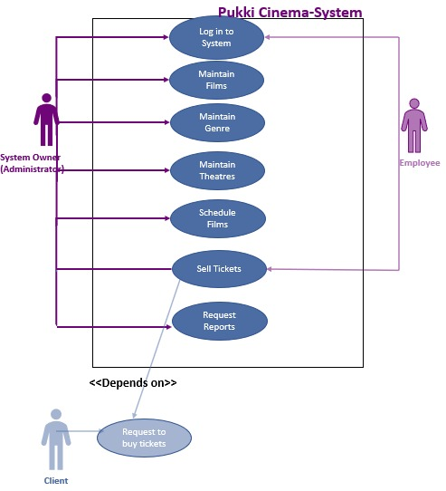
8. USE-CASE MODEL DIAGRAM

Slide 49
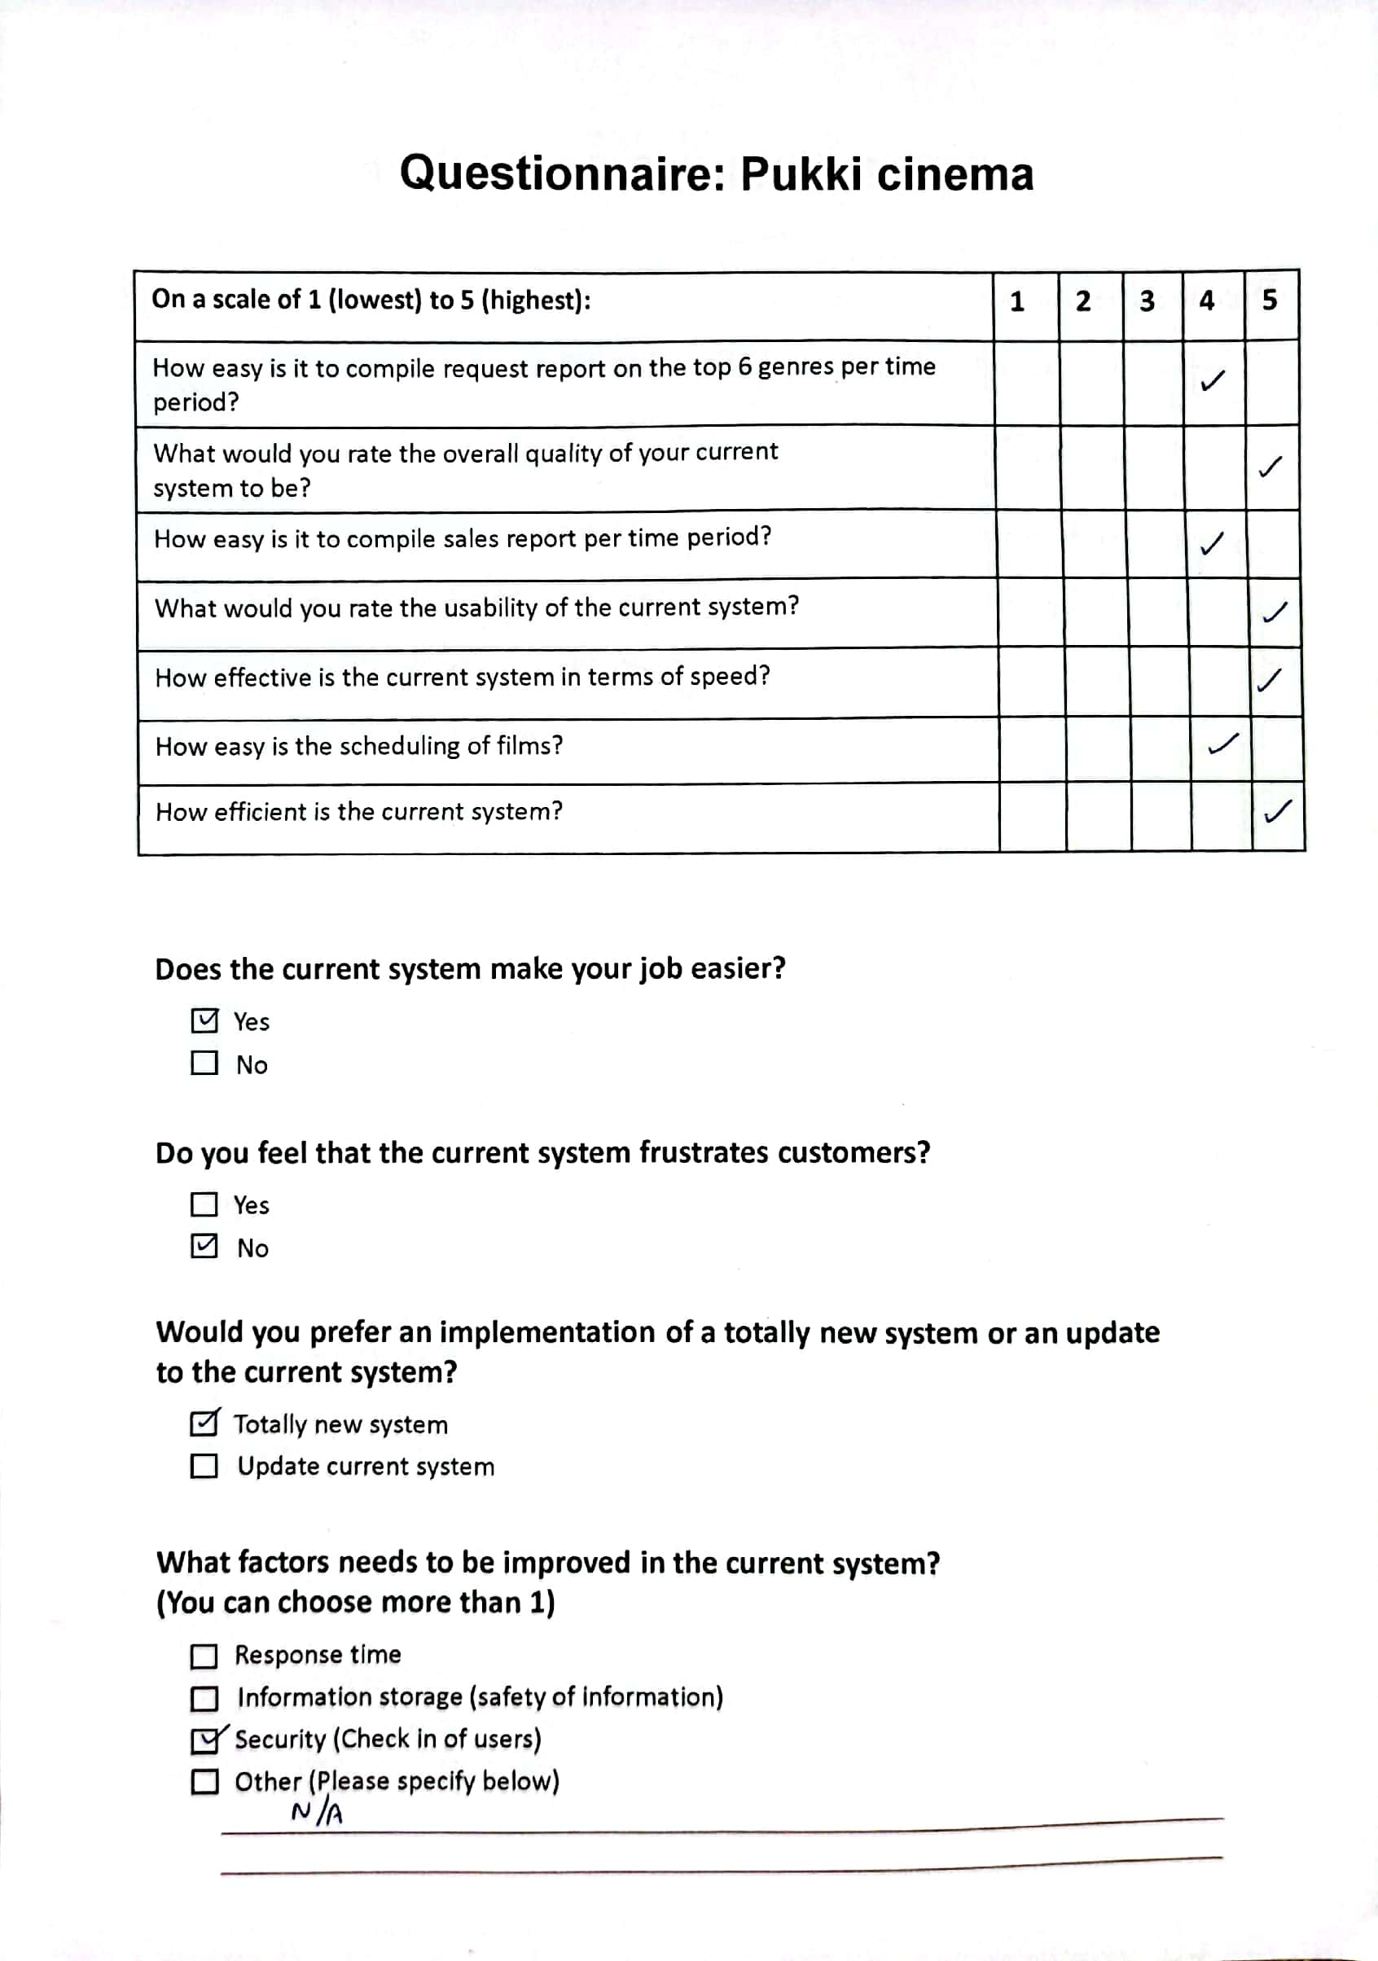
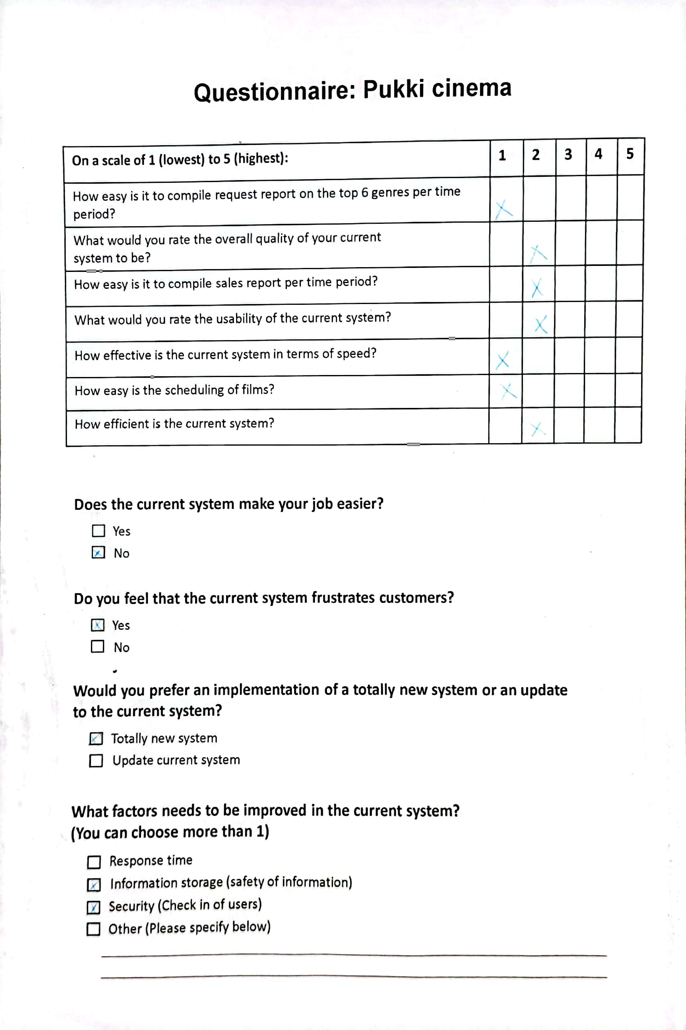
9. EXAMPLE OF DATA,
QUESTIONNAIRES AND
FACT_FINDING
TECHNIQUES USED
Questionnaires:

Slide 50
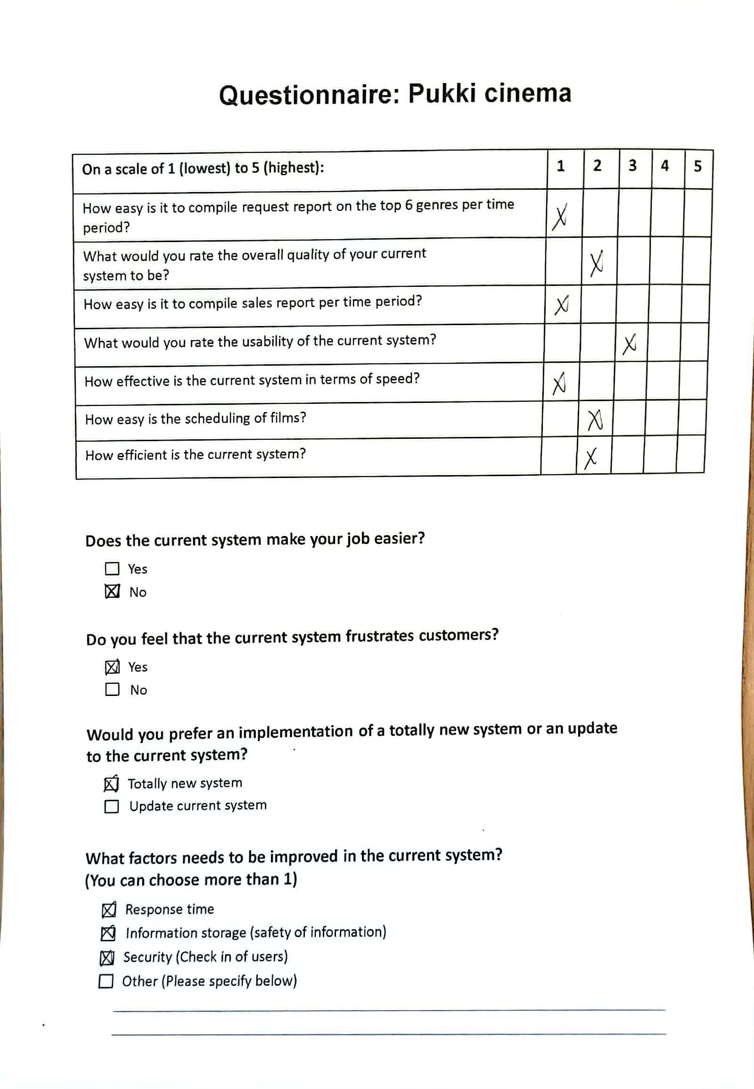
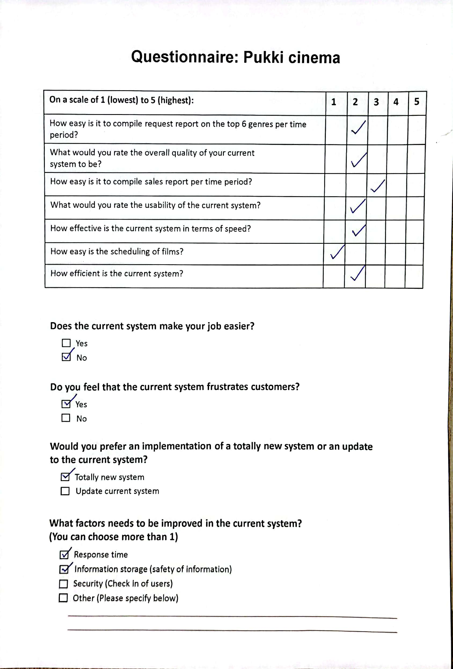
9. EXAMPLE OF DATA,
QUESTIONNAIRES AND
FACT_FINDING
TECHNIQUES USED
Questionnaires
(continues):

Slide 51
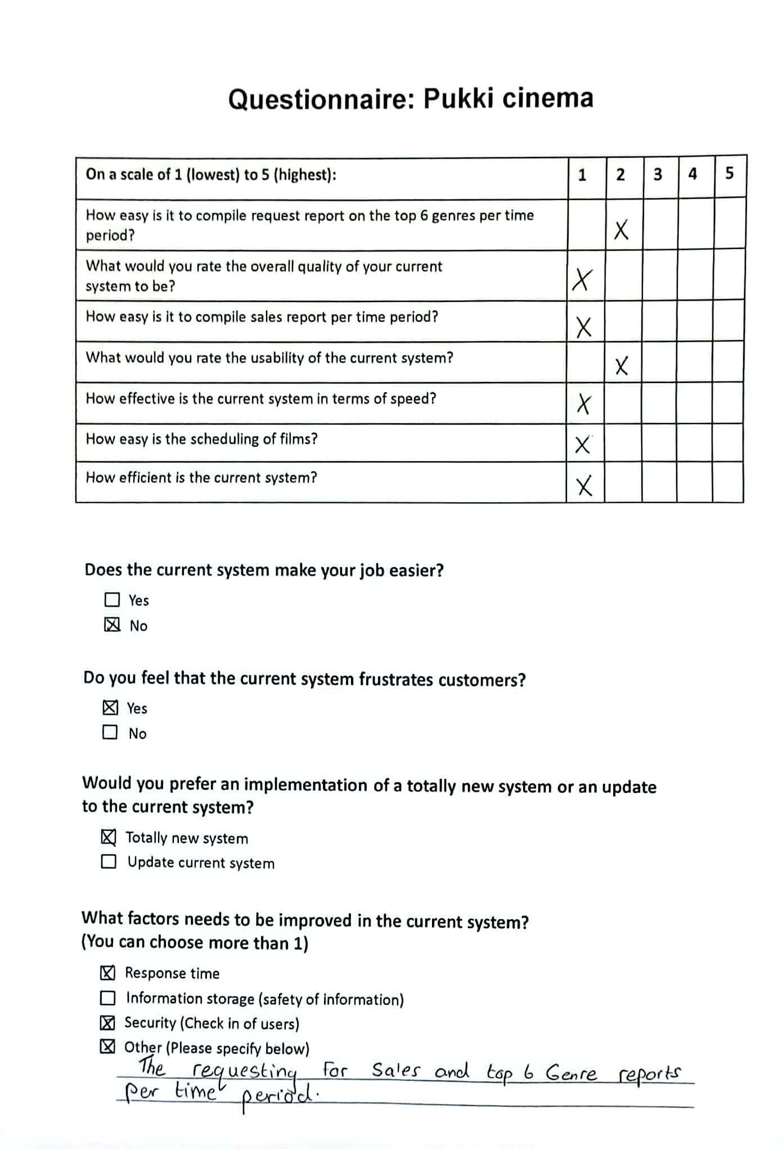
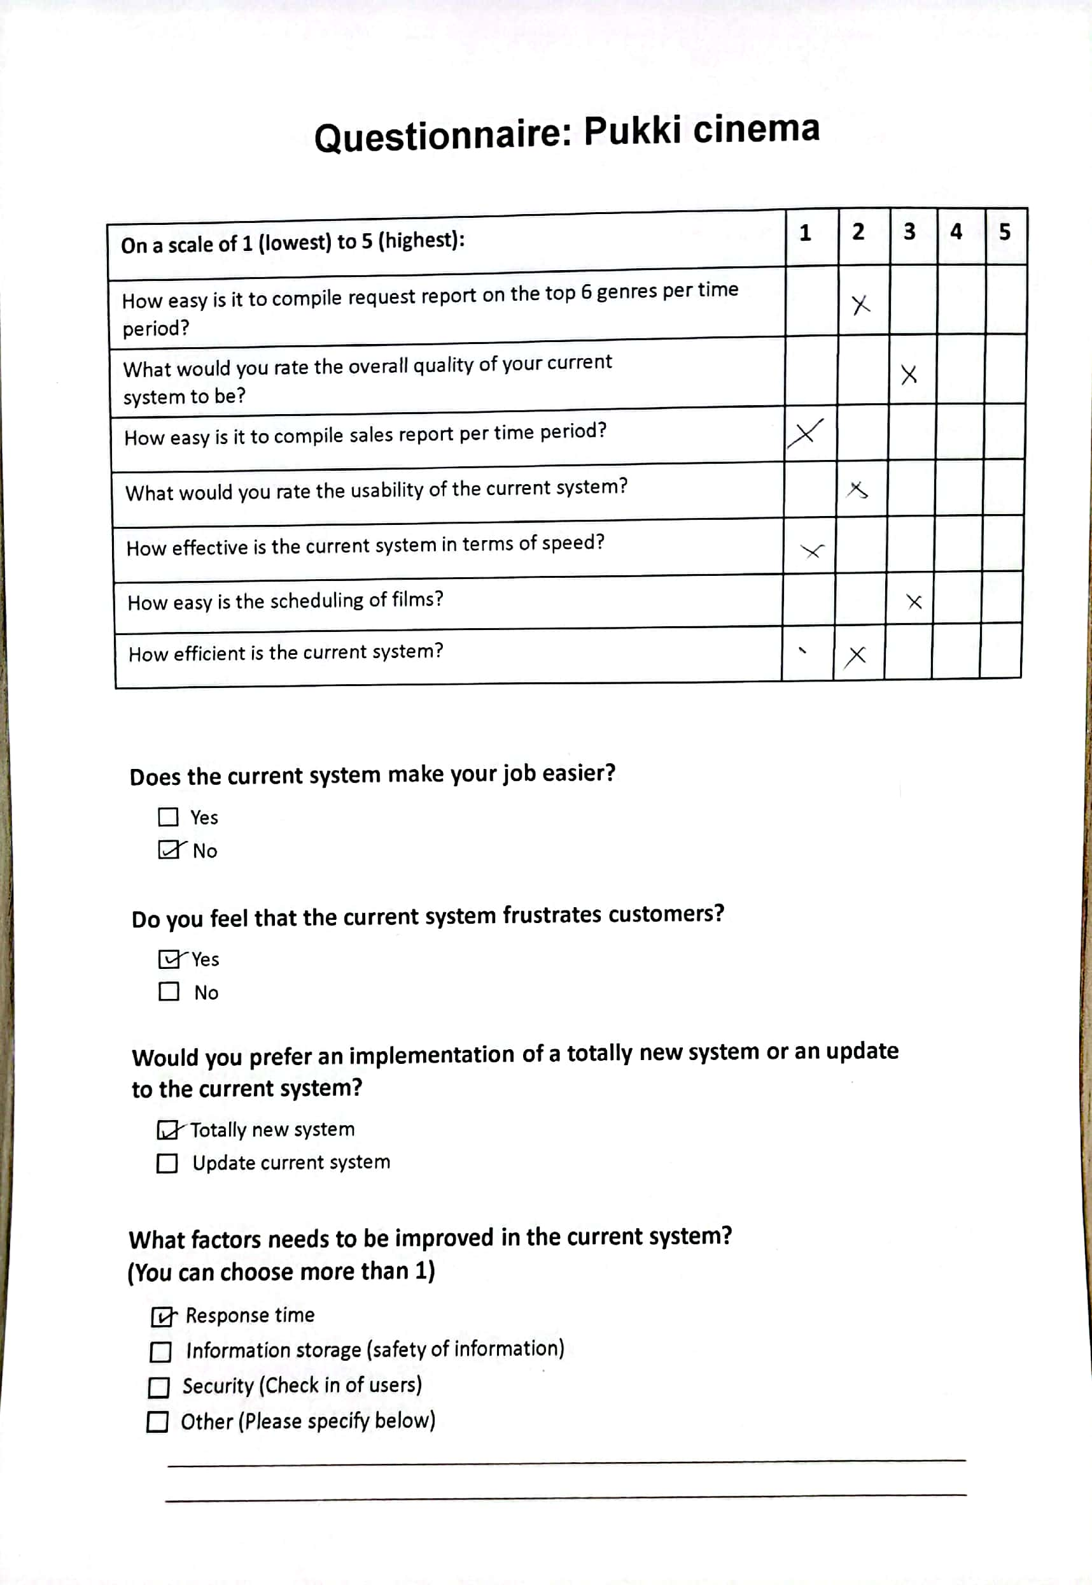
9. EXAMPLE OF DATA,
QUESTIONNAIRES AND
FACT_FINDING
TECHNIQUES USED
Questionnaires
(continues):

Slide 52
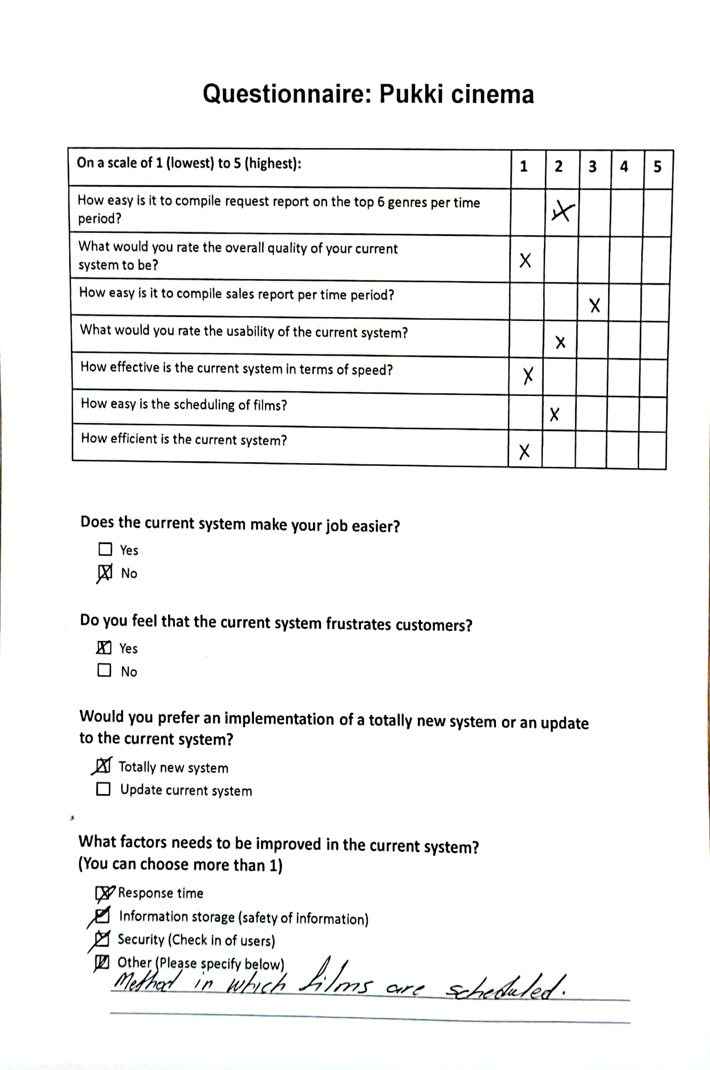
9. EXAMPLE OF DATA,
QUESTIONNAIRES AND
FACT_FINDING
TECHNIQUES USED
Questionnaires
(continues):

Slide 53
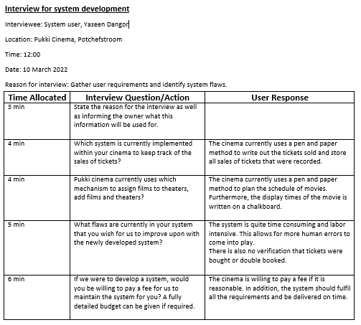
9. EXAMPLE OF DATA,
QUESTIONNAIRES AND
FACT_FINDING
TECHNIQUES USED
Interview:

Slide 54
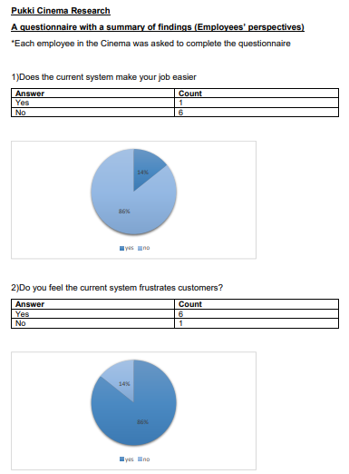
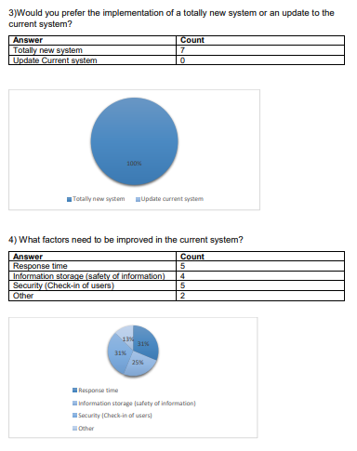
9. EXAMPLE OF DATA,
QUESTIONNAIRES AND
FACT_FINDING
TECHNIQUES USED
Summary of findings:

Slide 55
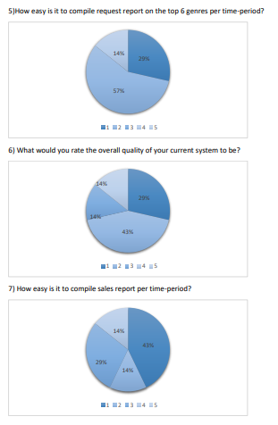
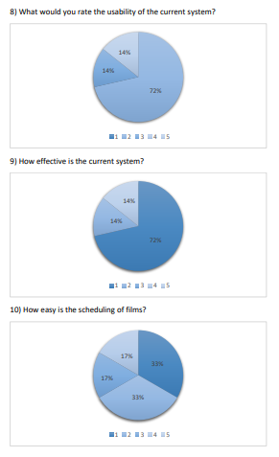
9. EXAMPLE OF DATA,
QUESTIONNAIRES AND
FACT_FINDING
TECHNIQUES USED
Summary of findings:

Slide 56
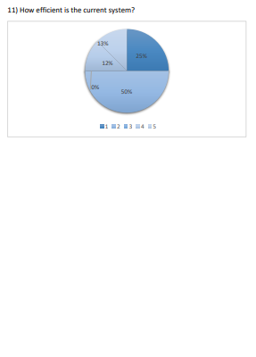
9. EXAMPLE OF DATA,
QUESTIONNAIRES AND
FACT_FINDING
TECHNIQUES USED
Summary of findings:

Slide 57
10. SUMMARY, FUTURE & FURTHER PLANNING (PERT CHART)
This document covered all necessary requirements for the operating system of Pukki Cinema. Therefore this would conclude that the Requirements Analysis phase, including the scope definition and problem analysis have been successfully accomplished. Once this requirement document has been accepted ,the team will commence to work on the Logical Design Phase which is completed on the 24th May 2022.

Slide 58
10. SUMMARY, FUTURE & FURTHER PLANNING (PERT CHART)
9,13
0,0
A
13,13
35,35
44,44
60,60
74,74
125,125
130,130
9
B
D
E
F
G
C
H
13
22
9
16
14
51
5
A - Scope Definition
B - Problem Analysis
C - Requirements Analysis
D - Logic Design
E – Decision Analysis
F – Physical Design and Integration
G – Construction and Testing
H – Installation and Delivery

Slide 59
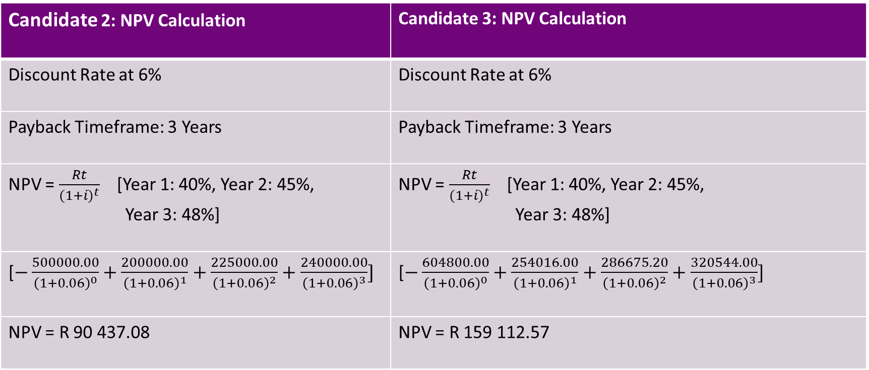
ATTACHMENT A
Candidate 2: NPV Calculation | Candidate 3: NPV Calculation
Discount Rate at 6% | Discount Rate at 6%
Payback Timeframe: 3 Years | Payback Timeframe: 3 Years
NPV = $\frac{Rt}{{(1+i)}^{t}}$ [Year 1: 40%, Year 2: 45%, Year 3: 48%] | NPV = $\frac{Rt}{{(1+i)}^{t}}$ [Year 1: 40%, Year 2: 45%, Year 3: 48%]
[$−\frac{500000.00}{{\left(1+0.06\right)}^{0}}+\frac{200000.00}{{\left(1+0.06\right)}^{1}}+\frac{225000.00}{{\left(1+0.06\right)}^{2}}+\frac{240000.00}{{\left(1+0.06\right)}^{3}}]$ | [$−\frac{604800.00}{{\left(1+0.06\right)}^{0}}+\frac{254016.00}{{\left(1+0.06\right)}^{1}}+\frac{286675.20}{{\left(1+0.06\right)}^{2}}+\frac{320544.00}{{\left(1+0.06\right)}^{3}}]$
NPV = R 90 437.08 | NPV = R 159 112.57

