Slide 1

Kim’s Collection
A Meta-Data Collection App
Oluwafolajinmi Olugbodi - Dr. Kim’s Lab

Slide 2
Concepts of Metadata and Data Provenance
What is data provenance? Historical ledger of data
Why is this relevant to genomics data? Data quality and authenticity
What is metadata? Data that describes other data
What kind of metadata are relevant to HuBMAP—examples
SampleID, HarvestBy, Species, Strain
Notes:
where a piece of data comes from, historical ledger of data)
genomics data is collected after a complex set of protocols all of which can affect the quality and authenticity of the data
Metadata decribes, explains, and makes it easier to manage information or and informative resource
RNA sequence Samples → sampleID, harvestBy-researcher who collected the sample from the source material be it culture dish, tissue; Species- the species from which the source material is derived, Strain- strain of source animal

Slide 3
Problems with Collecting Metadata and Our Solution
labor-intensive process
the task of recalling prerecorded data time consuming
We want to propose a solution where experimenters can capture metadata on the fly while doing experiments

Slide 4
Objective
We want to capture metadata to establish data provenance for HuBMAP
Gather and assemble data procured by Lab Technicians before, during, and after a procedure using an elegant, mobile, user-friendly and uncomplicated input methodology

Slide 5



Foreknown Knowledge and Action Plan
Foreknown:
Already have the meta-data attributes
A pre-existing notion of inputting data into the SQL repository
Pre-existing system’s UI needs a new perspective
Plan:
Learn Swift/SwiftUI 5.0 and XCode 13
Build an iOS app that can store meta-data attributes on-board device
User-friendly and uncomplicated input methodology

Slide 6
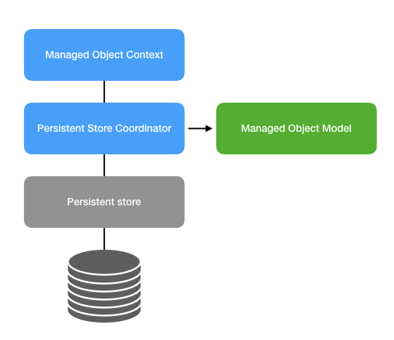
iOS Core Data Structure
NSManagedObjectModel - define entities and attributes
NSManagedObject – serializes/de-serializes object graph in memory
NSManagedObjectContext – save and retrieve objects
NSPersistentStoreContainer – the ”database”/ data storage unit
developer.apple.com

Slide 7
Hierarchical Approach
Batch 1
Group 1
Sample 1
Sample 2
Group 2
Sample 3
Batch
Group
Sample

Slide 8
Hierarchical Attributes
Batch
Attribute 1
Attribute 2
Group
Attribute 1
Attribute 2
Sample
Attribute 1
Attribute 2

Slide 9
Prototype Snapshots

Slide 10
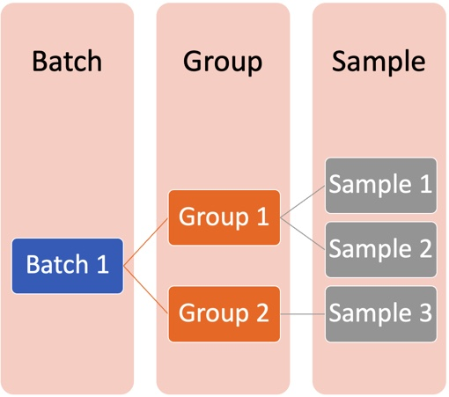
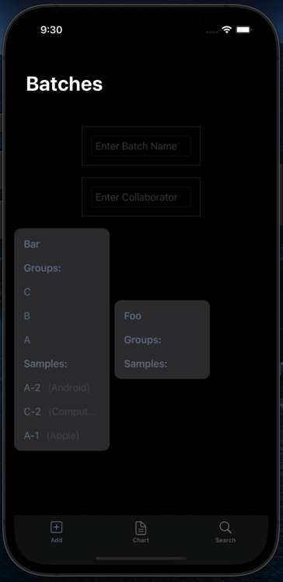
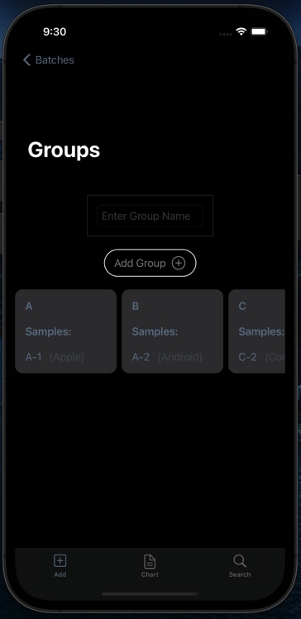
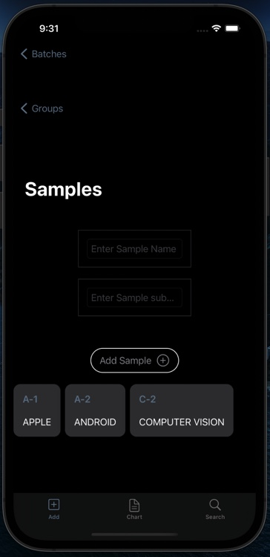
Hierarchical Setup
Notes:
Change Sample Bank Samples

Slide 11
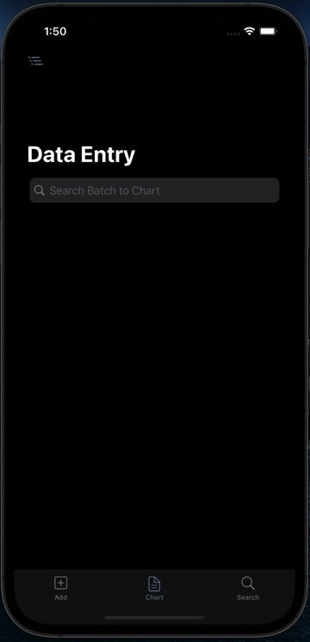
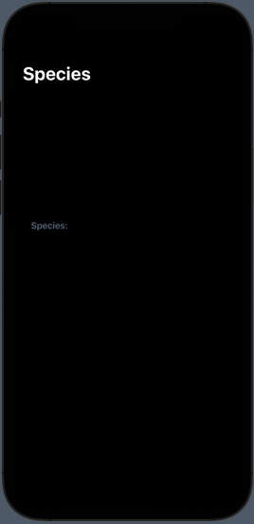
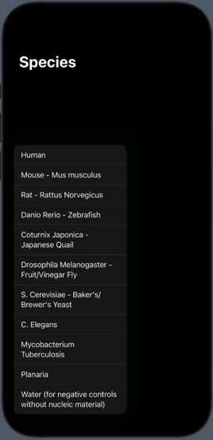
Data Entry View

Slide 12
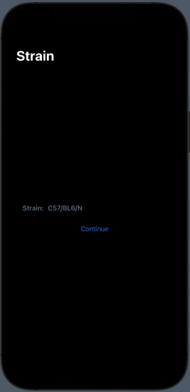
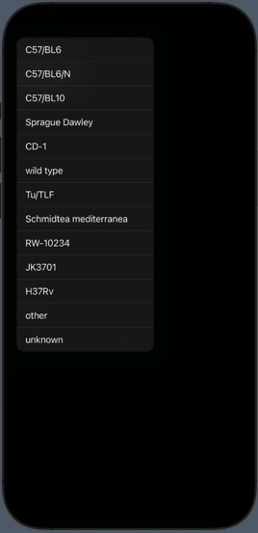
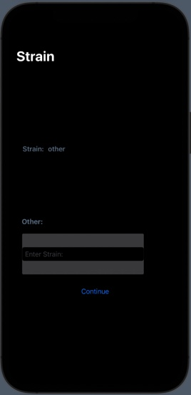

Slide 13
App Structure

Slide 14
App Structure – iOS Core Data Object Graph and Persistence Framework
” Persist or cache data on a single device, or sync data to multiple devices with CloudKit.” – Apple
Core Data allows temporary or permanent caching of data locally offline
Entities, relationships, and class definitions defined and generated through Core Data’s Data Model editor
Persistence:
A high-level abstract mapping of objects to a store

Slide 15
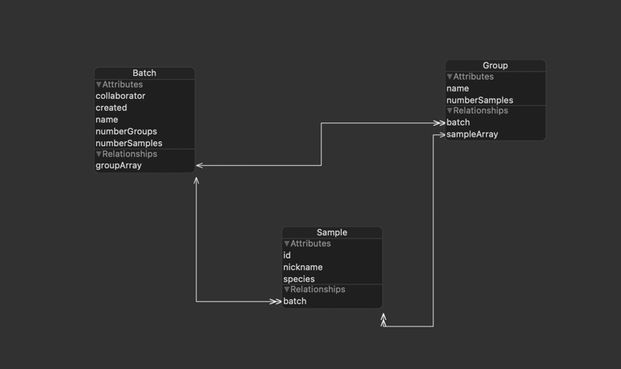
Hierarchical Approach In Relation to Core Data

Slide 16
Timeline and Future Prospects
Timeline and Completed Benchmarks
Began Developing July 8, 2021
Created object graph model with relationships
Instituted Batch-Group-Sample creation and hierarchical relationship
Search View and Content View
Prospects:
Data Entry Tab View as well as the Information View

Slide 17
Acknowledgements
NHGRI
NIH
Dr. Junhyong Kim
Dr. Stephen Fisher and Dr. Erik Nordgren
The Kim Lab
Notes:
Add

