Slide 1
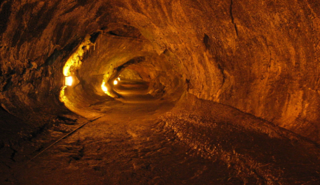
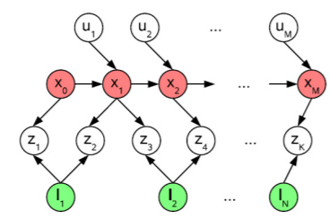

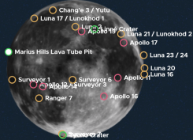
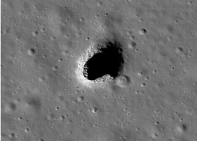
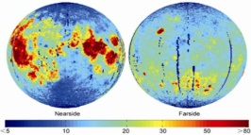
Video ¿Cómo Alunizar?
0:47 – 0:58
Advantages of a Sphere Design
-Accesibility to more types of cavern not only lave tube like Earth
-Solidity: flexi and strong material to avoid impacts
-Size depends on type of submission
-Weight not much because not any ball contains all exploration instrument
-Scalabilty: Use in other spacial missions like Mars
https://www.youtube.com/watch?v=2Eqy8nxX2XY
Rover en Tunel de Lava
1:19 – 1:26
New variants of SLAM algorithm based on Bayesian Networks allows the building of Cavern plans
Exploration of Marius Hills
https://www.youtube.com/watch?v=2Eqy8nxX2XY
High concentration of He-3
Possible water existence inside
Bola de Noelia
0:24 – 0:34
Set of human base under suface
Geological Interest:
-Study of convection in the planetary body
-Many and different materials
-Diverse secure landings in different places around
Technical Challenges:
-Not sample collection only exploration
-Issue with lunar lunar dust since second ball
-Termic control of batteries
https://www.youtube.com/watch?v=ovrkz12UFBM

