Slide 1
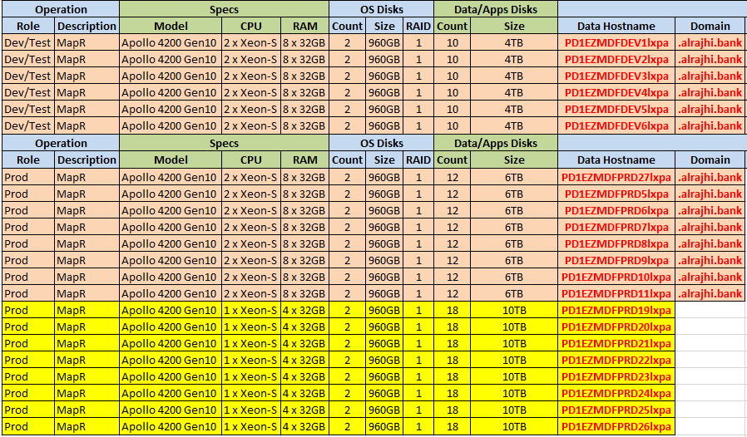
MapR Layout

Slide 2
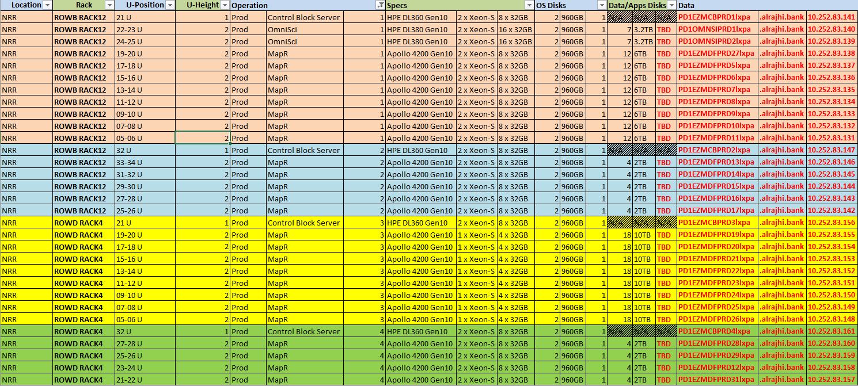
Nodes List

Slide 3
Gateway Hosts
Gateway Hosts
Gateway Hosts
Gateway Hosts
Gateway Hosts
Controller Hosts
Auth Proxy
LDAP Server
Control Plane

