Slide 1
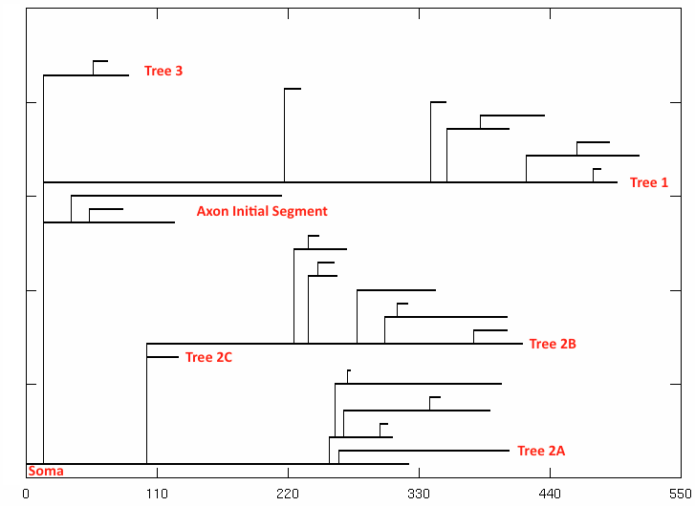
SR
SLM
Tree 3
Tree 1
AIS
Tree 2B
Tree 2A
Soma
Distance from Soma (μm)

