Slide 1
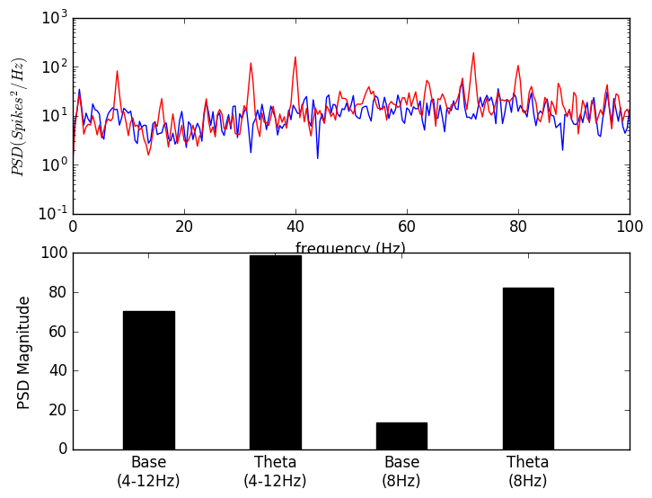
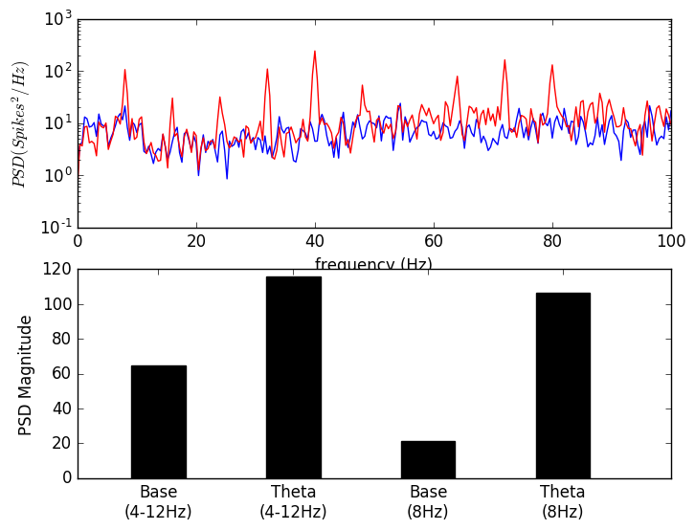
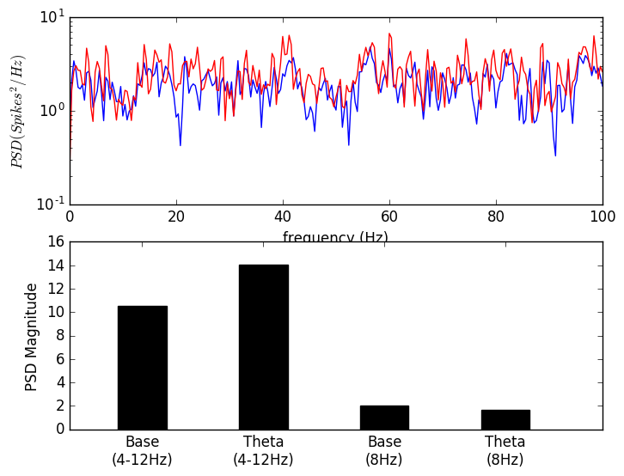
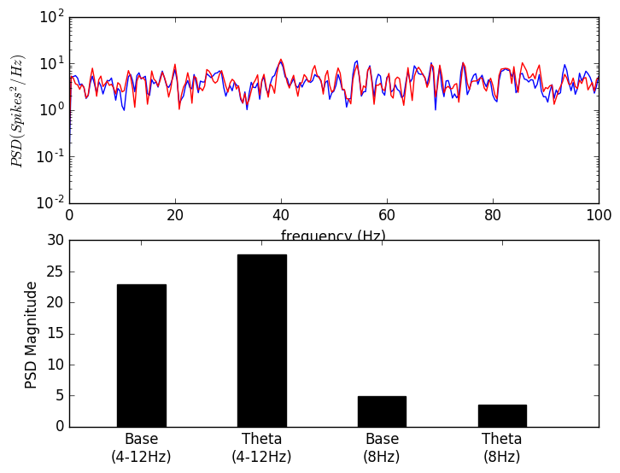
SDprox1 LNI_LNE_LIS_LES
SDprox2 LNI_LNE_LIS_LES
Frequency (Hz)
Frequency (Hz)
SDprox1 HNI_HNE_HIS_HES
SDprox2 HNI_HNE_HIS_HES
Frequency (Hz)
Frequency (Hz)

