Slide 1
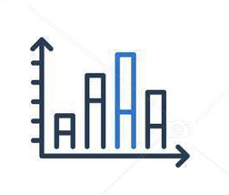






Define new stop words
Data where the most relevant features have been chosen. And the most fundamental pre-processing have been made
The most relevant data subsets have been found based on a specific food category
Every feature have been pre-processed, so our dataset is strictly numeric.
Raw data
Raw data as an pandas object
Create_data.py
Prepare_data.py
Exploratory.py
Preprocess.py
Train_lda.py
Conclusion and recommendation for amazon
Interpretability.ipynb
TrainModel.py
A sklearn object with our best regression model.
A sklearn object have been created containing our LDA model, as well as a new pandas object with our pre-processed data and LDA features
Visualizations to give us a better understanding of which features contribute to a better or worse performance (value of the target variable).

