Slide 1






Monitoring
Cloud IAM
App engine is hosting app, from where customer ID and number of desired recommendations can be inputted
Monitoring allows us to keep an eye on traffic and failures. Cloud IAM help handle access using a key.
The model triggered will be used to make the necessary computations
The recommendations are shown in the app
App engine triggers model, as well as data. Also it parses the customer id and number of recommendations, which were given by the user
App Engine
Cloud ML
Compute Engine
App Engine
Recommendations are computed using the compute engine
Cloud Storage

Slide 2



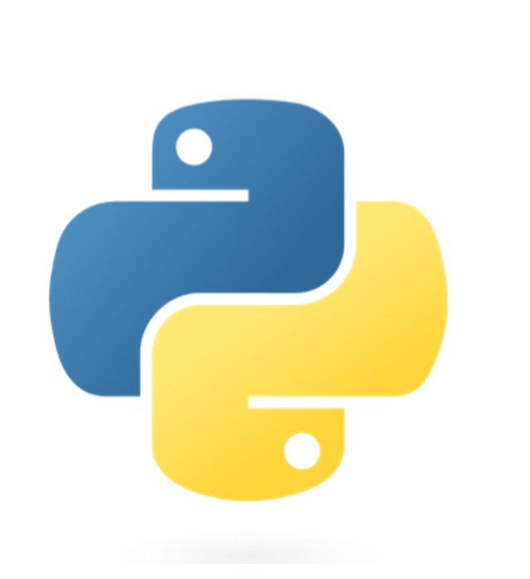




Monitoring
Cloud IAM
Monitoring allows us to keep an eye on traffic and failures. Cloud IAM help handle access using a key.
Cloud run starts an compute engine (virtual machine), which unfolds the docker image, and hosts the application.
Compute engine will run the python script and other commands in the docker container.
Relevant recommendations are made for the user
Cloud Run
Compute Engine
Application created in python using the streamlit library
Relevant recommendations
The python script requests and receives data and models
Cloud run manages the image in the container and scales the cloud infrastructure whenever it is necessary.
User react with the application by supplying a customer id and a desired amount of recommendations
The docker image have been uploaded to Container Registry.
Container Registry
User
Cloud Storage
Timeline

