Slide 1
OutDoorVibez
Tyler Wiggins & Ana Sanchez

Slide 2
Application Features
Users can create account
Admin permissions- create, edit, delete products and users
Search and view a catalog of products
Dynamic Shopping Cart
Product, Order, and User data storage
Non-users can also create orders and purchase products
Admins can access a sales report
Users can utilize coupons

Slide 3
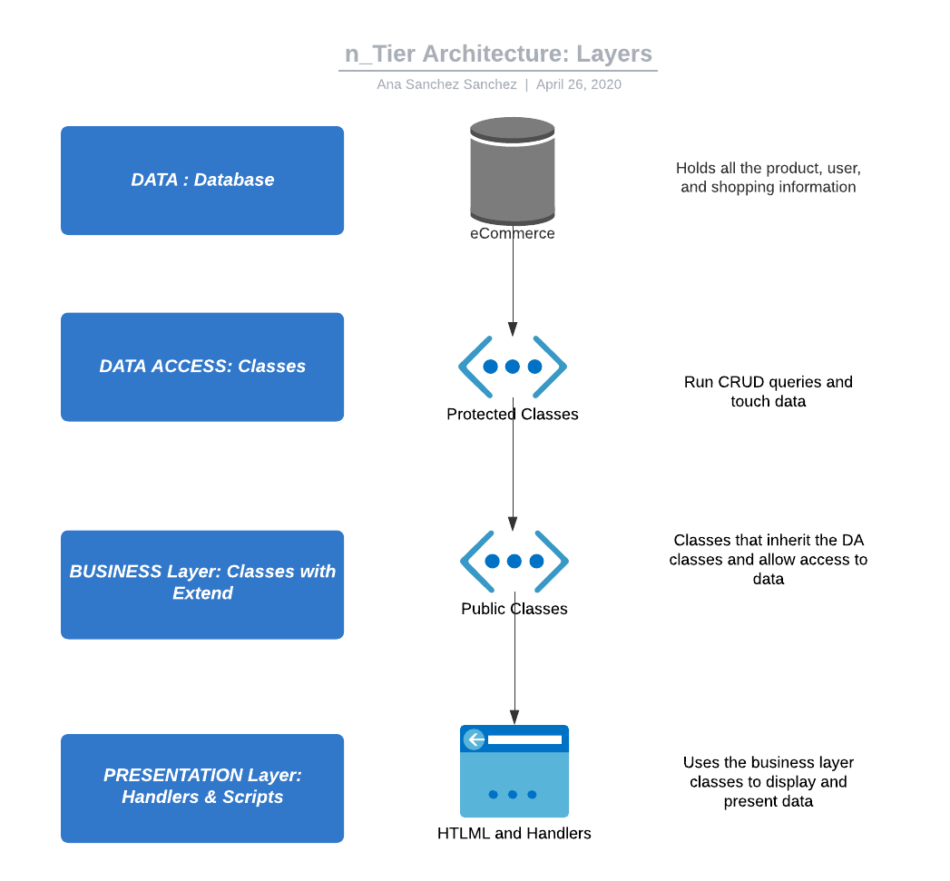
Design Decisions for Classes
All the classes for our web application are either in the data access or business layer. Those in the data access layer are the classes that run the queries and CRUD data throughout the program. The classes in the presentation layer allow access to data while securing the data and encapsulate the data access layer methods that modifier or create data from the database.

Slide 4
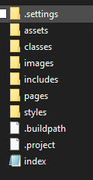
Design Decision For Folder Structure
Our goal for the file structure is to keep the files as organized as possible to allow the easy navigation as we developed these files. Keeping classes, handlers, pages, includes, images and resources separate.

Slide 5
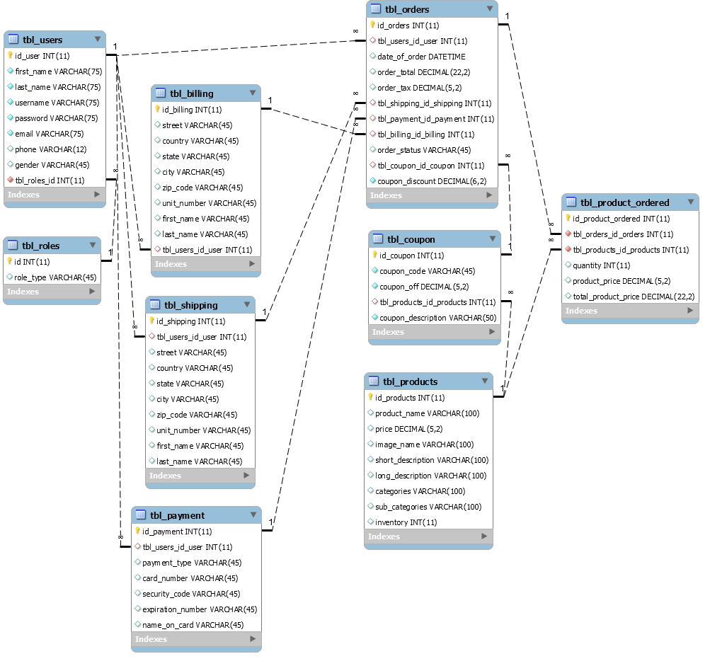
Design Decision For Database Structure
We used relational tables and entities for this web application. Every entity has its own table and a primary key to allow uniqueness and for retrieving the entity at a later time. We also used foreign keys because every table/entity has a relationship with another.

Slide 6
Usability Decisions For Navigation
Very clear and easy to follow navigation, nav bar implemented throughout the web application except for the shopping process.

Slide 7
Usability Decisions For CSS Design
With the help of CSS and Boostrap Studio we were able to keep the layout and format of the pages very consistent. The same CSS classes were used through the HTML pages with some in-line styling for exceptions.
Boostrap was really helpful for keeping the images formated in rows

Slide 8
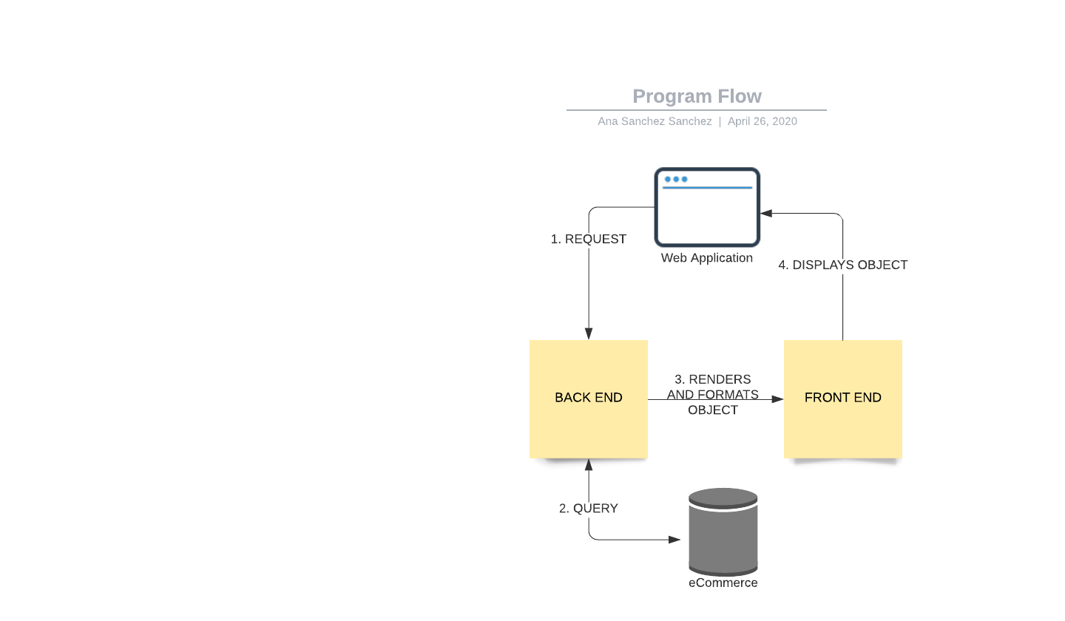
Usability Decisions For Program Flow
Allowing objects in the back-end to be communicated through the front-end from the database a request.

Slide 9
Limitations & Bugs
Limitations:
Shipping not yet calculated based on products
When two or more of the same product are added to cart they do not combine
No way for the user to manage their own information for orders or user information
No way that user can see previous order history
No connection between a non-user and their order after leaving the web application
Bugs:
Order can be completed even through the order has not products
Cannot insert special characters in the text inputs for registering, returns a SQL error, this can be bothersome, adding html entities would resolve the issue

Slide 10
Ideas for Future Versions
Implement the PayPal API as payment form
User Profile for users to manage their information and billing, shipping, and payment information
Wishlist/Liked products for users
Order history for users with the products purchased and details
Prime membership
Admin ability to add/delete/discontinue coupons from admin page

