Slide 1

PROJECT – 1i
Indian agriculture analysis with power bi
by – suvodeep chakraborty (MIP-DA-04 Batch)

Slide 2
introduction
Power BI is a Data Visualization and Business Intelligence tool that converts data from different data sources to interactive dashboards and BI reports. Power BI suite provides multiple software, connector, and services - Power BI desktop, Power BI service based on SaaS, and mobile Power BI apps available for different platforms. These set of services are used by business users to consume data and build BI reports.
Power BI desktop app is used to create reports, while Power BI Services (Software as a Service - SaaS) is used to publish the reports, and Power BI mobile app is used to view the reports and dashboards.

Slide 3
Steps for data analysis
Identify business questions
Collect and store data
Clean and prepare data
Analyze data
Visualize and communicate data

Slide 4
Indian agriculture Database description
The dataset encompasses a wide range of agricultural variables Which are including crop areas, production, quantities, and yields for different crops such as –
Rice
Wheat
Sorghum
Millets
Pulses
Oilseeds
Sugarcane
Fruits
Vegetables
Potato
Onion

Slide 5
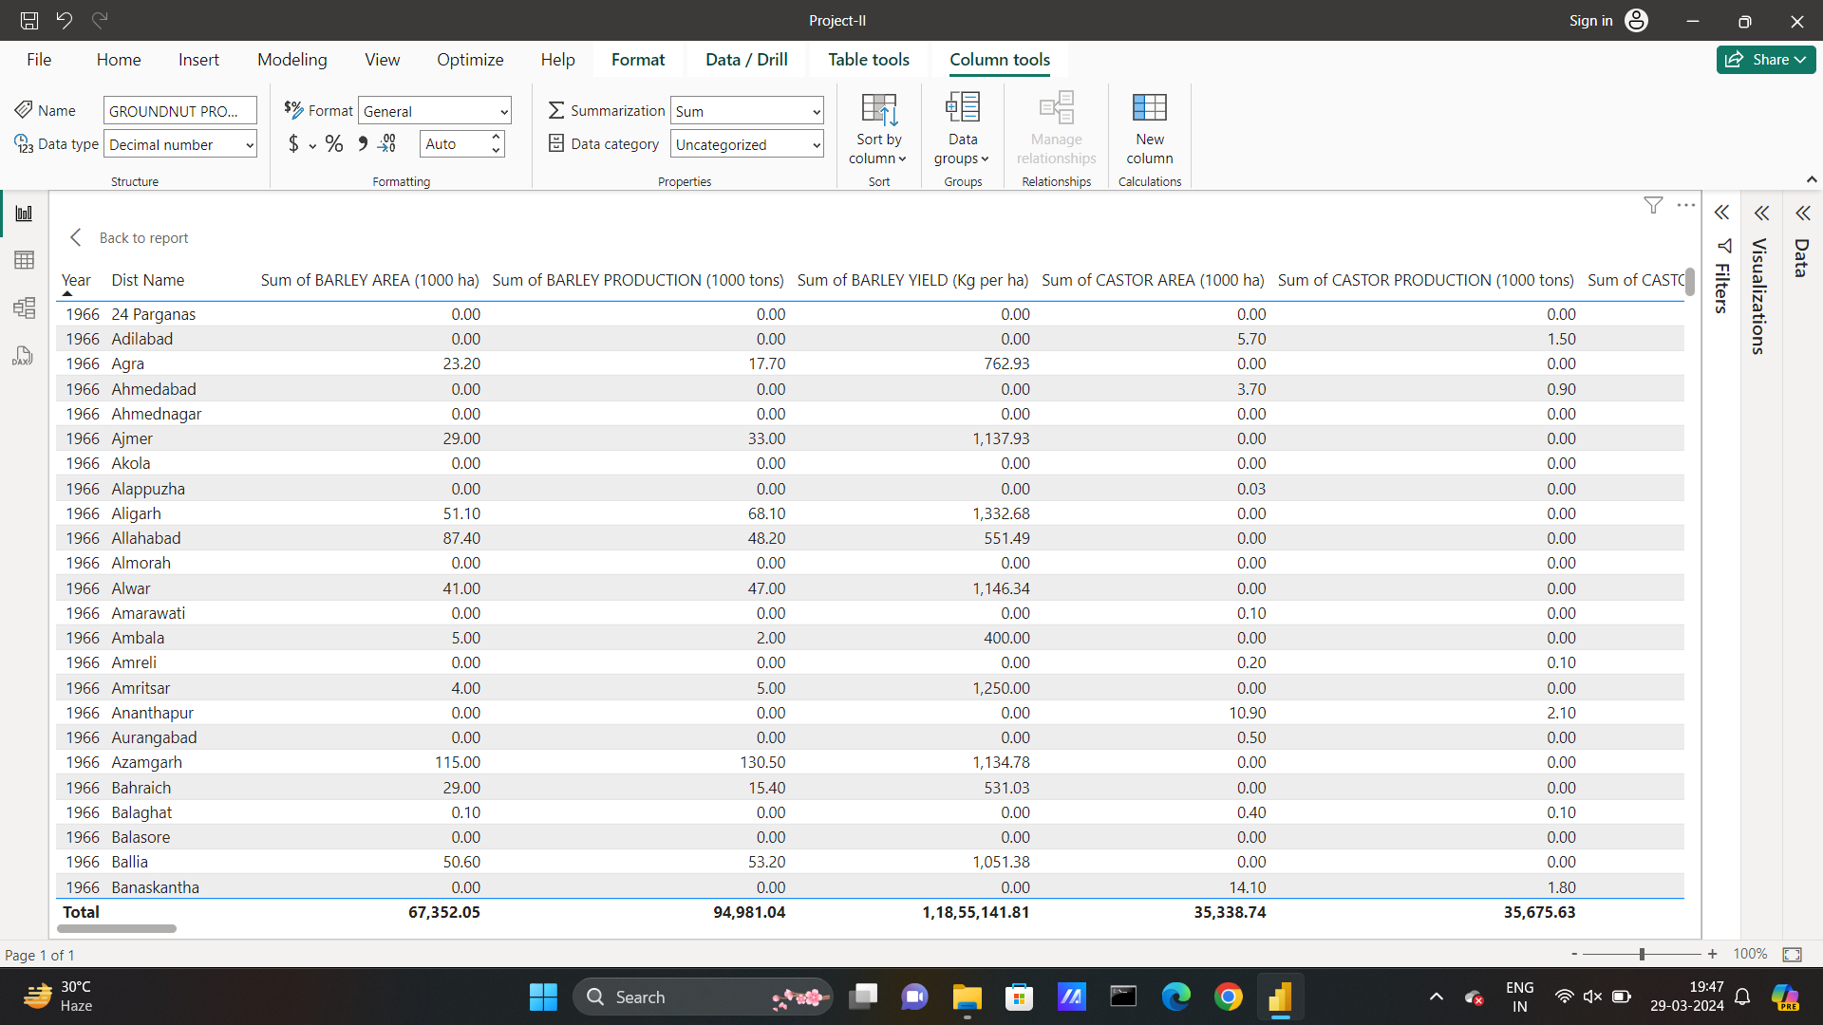
problem statements and solutions
Data Exploration: Explore the dataset to understand the distribution of agriculture variables across districts and years.

Slide 6
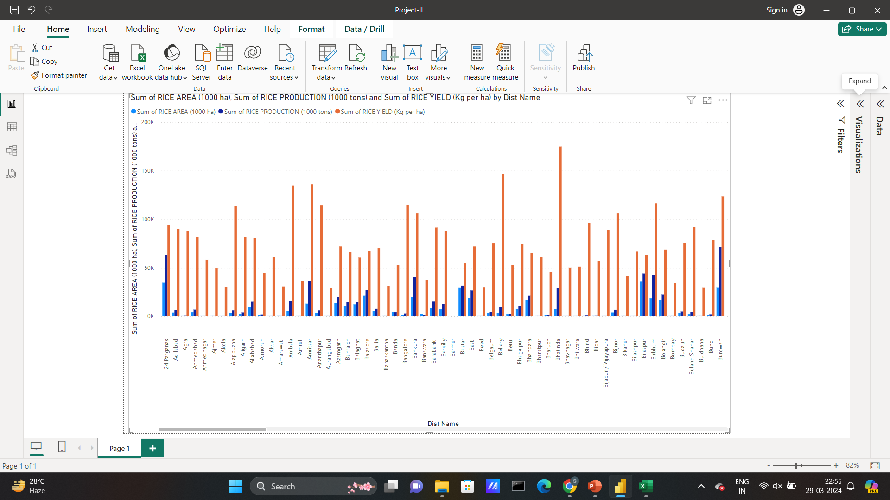
problem statements and solutions
Crop-specific Analysis: Analyze the trends in the cultivation of major crops, including rice, wheat, and pulses, focusing on change area, production, and yield.

Slide 7
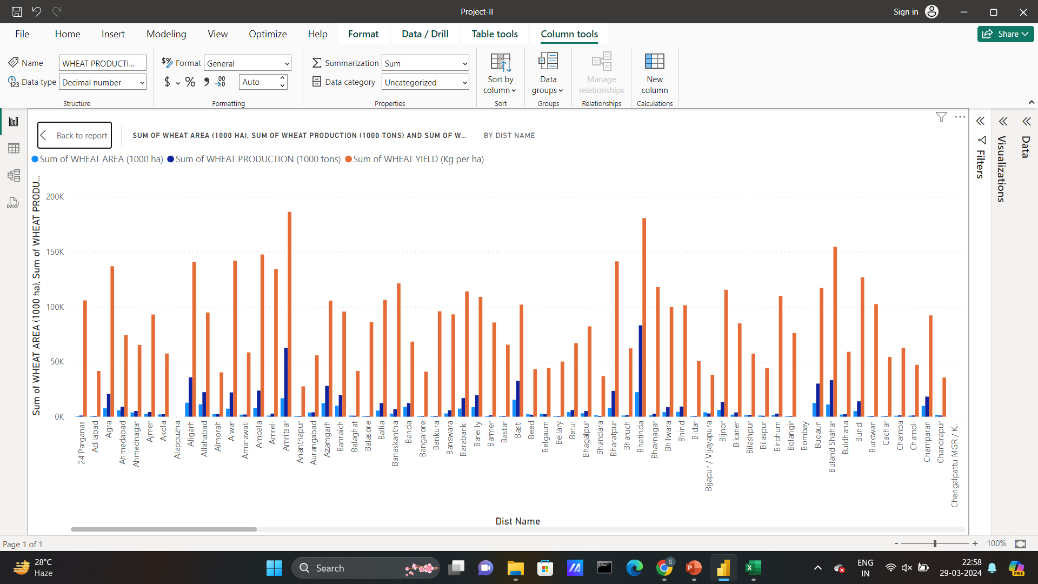
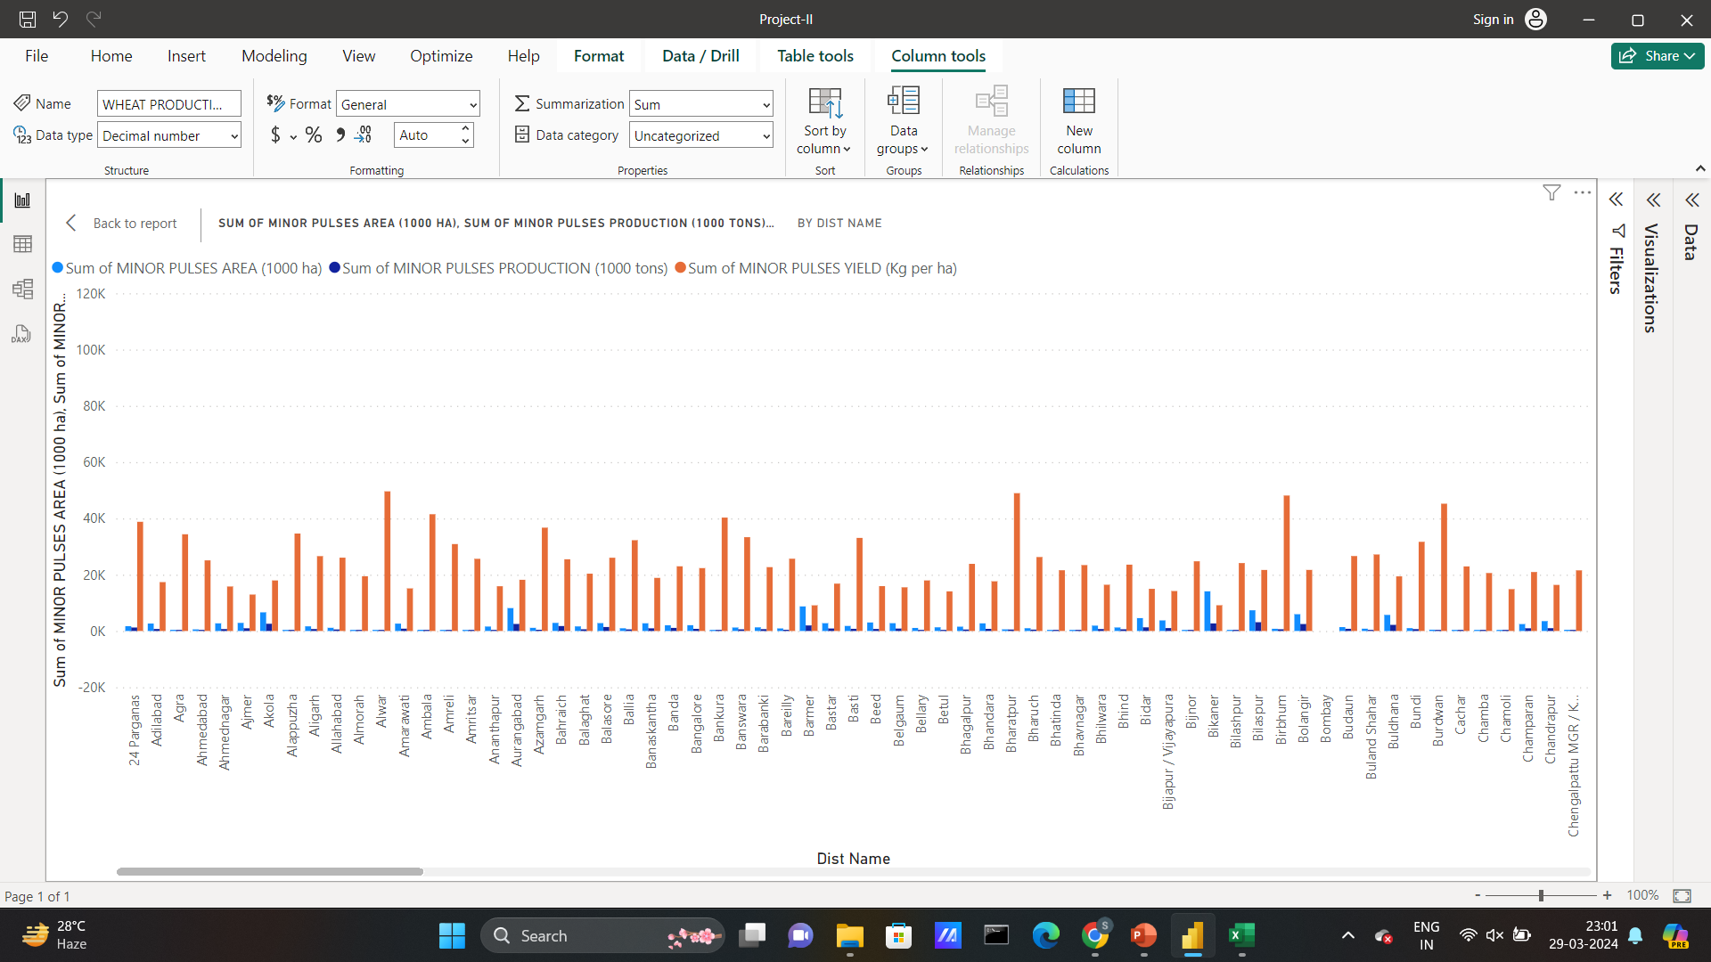
problem statements and solutions

Slide 8
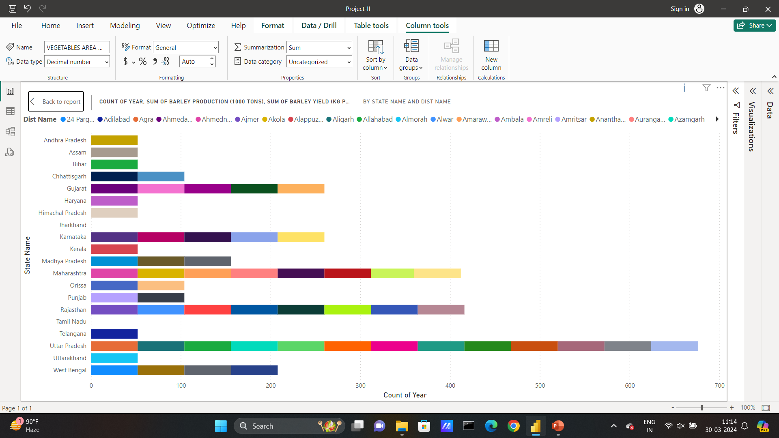
problem statements and solutions
Regional Disparities: Identify disparities and variations in agriculture practices and outcomes across different districts and states.

Slide 9
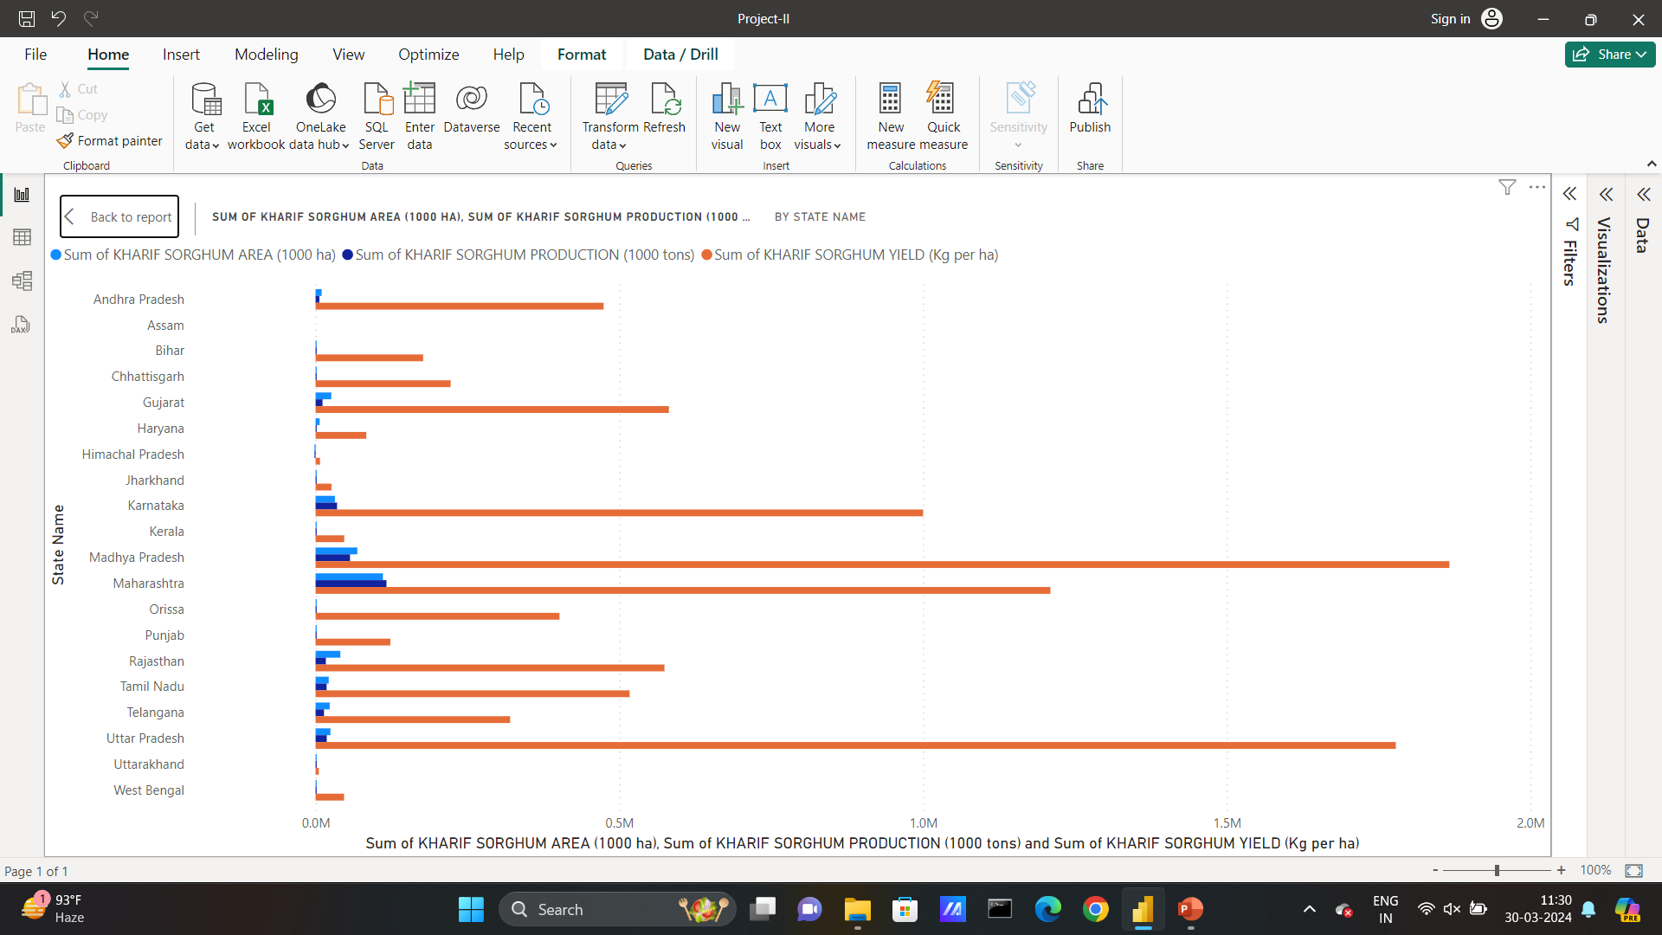
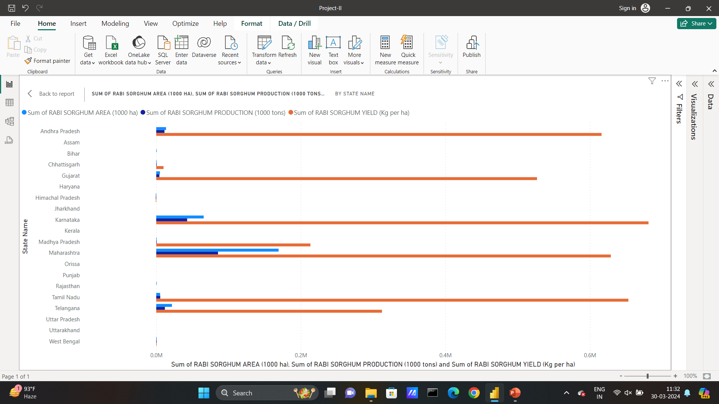
problem statements and solutions
Seasonal Patterns: Explore seasonal patterns in crop cultivation, considering kharif and rabi seasons.

Slide 10
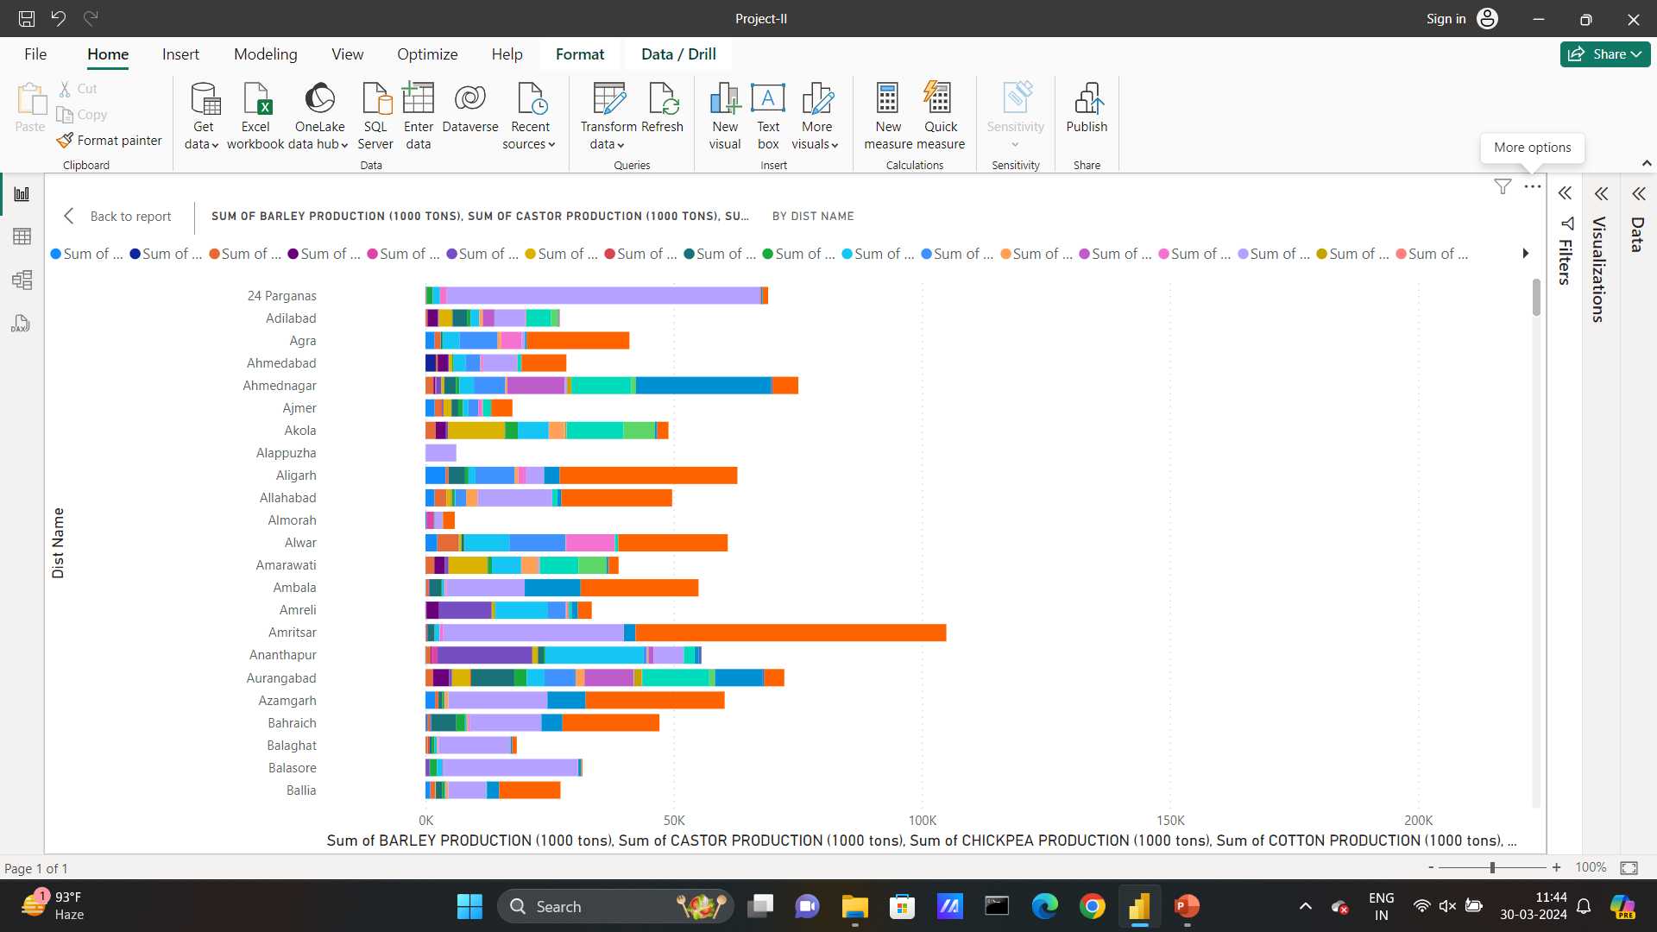
problem statements and solutions
Impact of External Factors: Investigate the impact of external factors like weather conditions on crop performance.

Slide 11
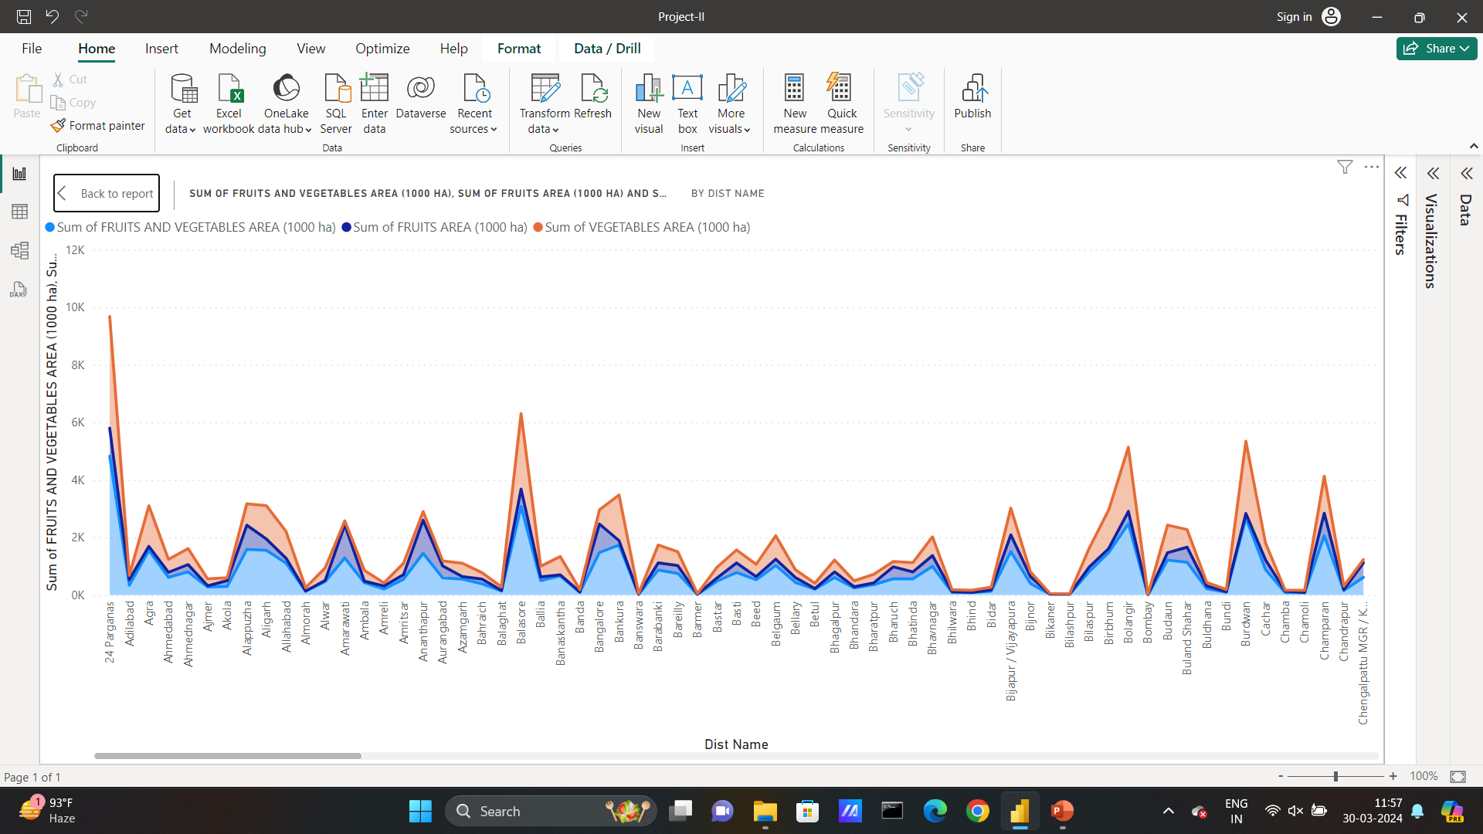
problem statements and solutions
Fruits and Vegetables Analysis: Analyze the cultivation trends of fruits, vegetables, and their overall contribution to agricultural practices.

Slide 12
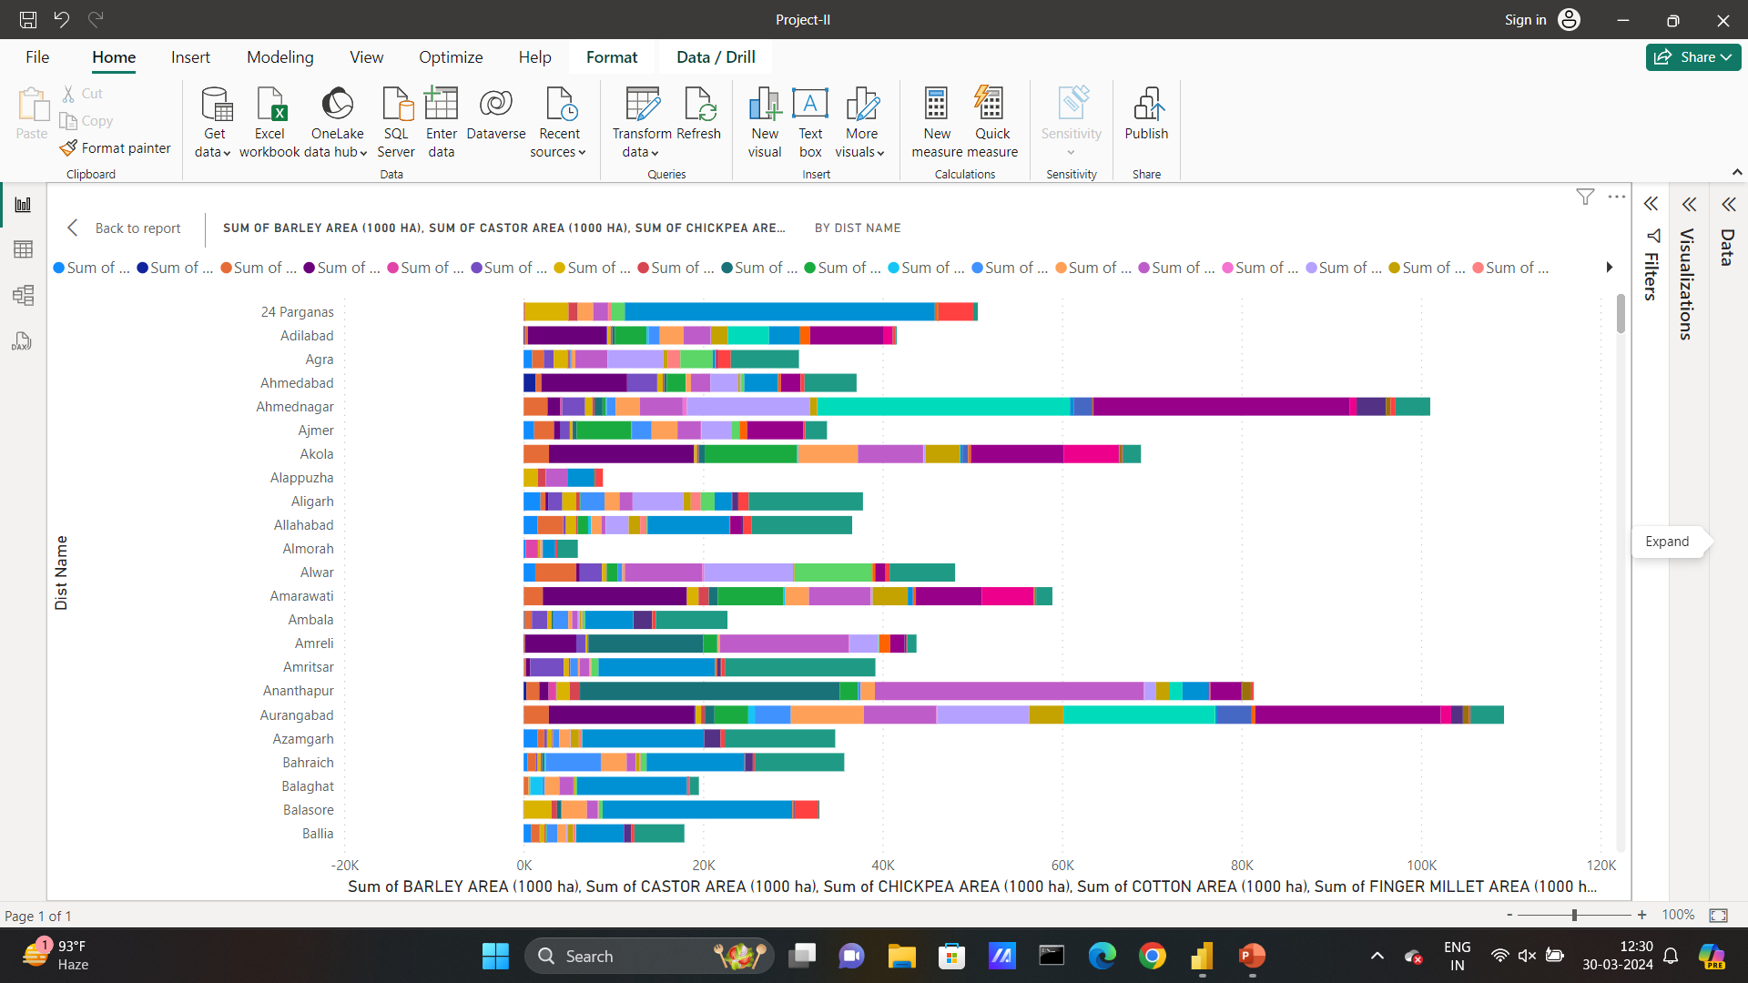
problem statements and solutions
Sustainable Farming Insights: Derive insights that can contribute to promoting sustainable farming practices and optimizing resource allocation.

Slide 13
conclusion
Power BI reports serve as the foundation for dashboards, data exploration, and content collaboration and distribution in Power BI. Power BI Desktop provides data visualization features and options in abundance, enabling the construction of highly targeted and user-friendly reports across devices. In this presentation, we developed and described the most fundamental report visualizations and design concepts.
Power BI is a cloud-based business analytics service for pulling together live views across all your data. Connecting to data that resides on premises in SQL Server Analysis Services, data from Microsoft Cloud properties like Dynamics and Office 365 or from Azure data services like SQL DB, Azure Stream Analytics or from a partner solution hosted on Azure.

