Slide 1
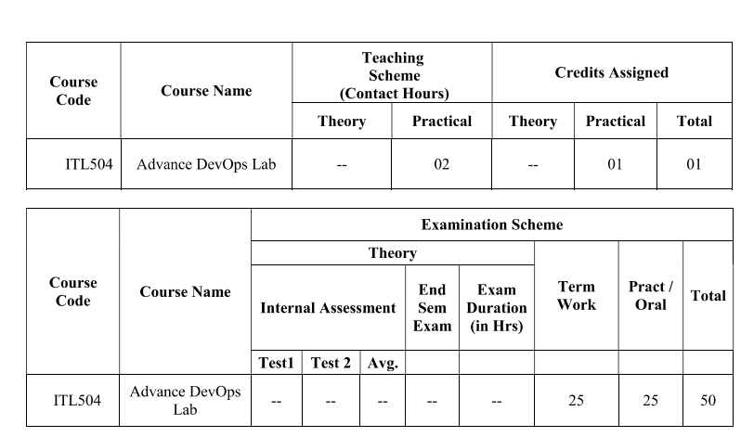

Slide 2
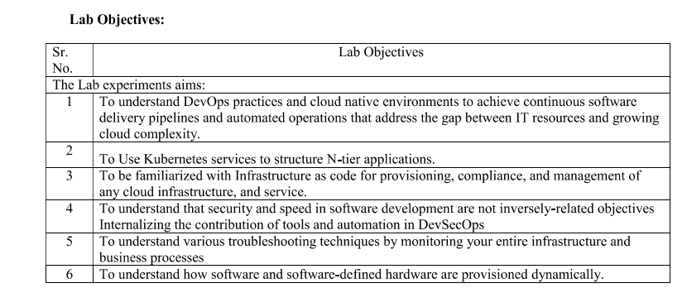

Slide 3
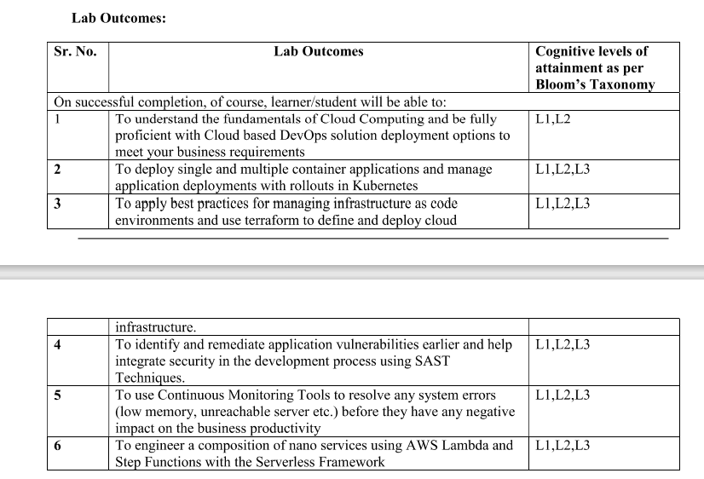

Slide 4
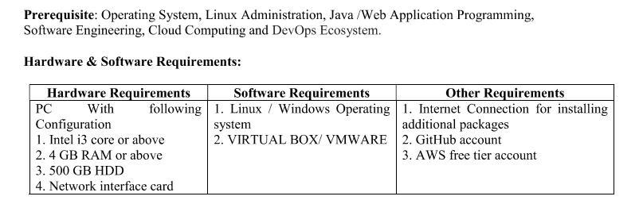

Slide 5
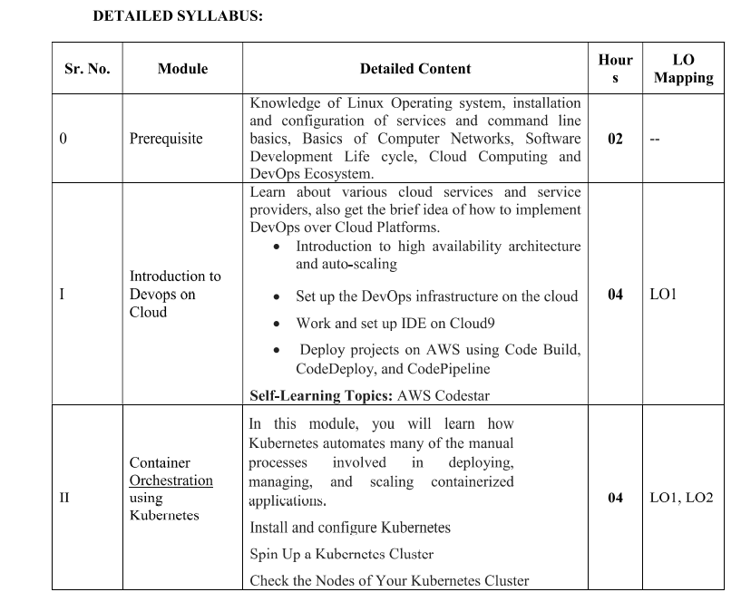
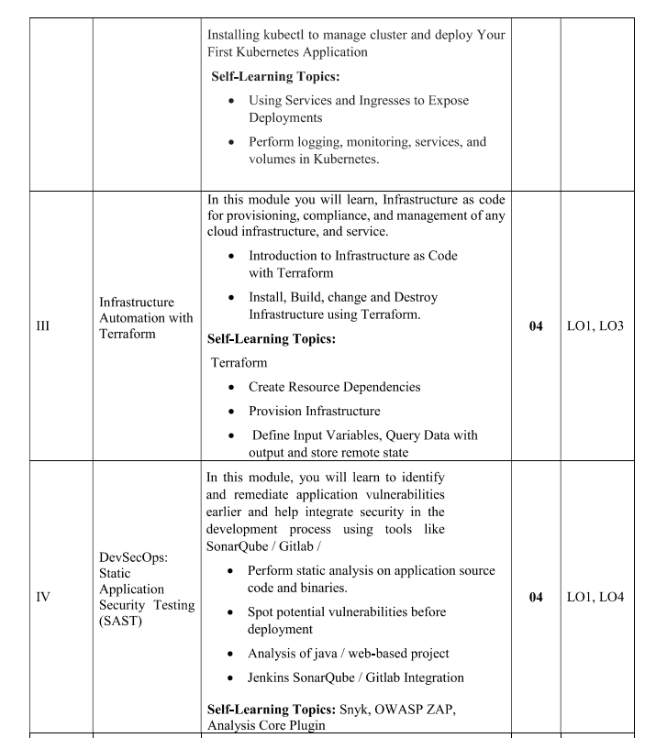
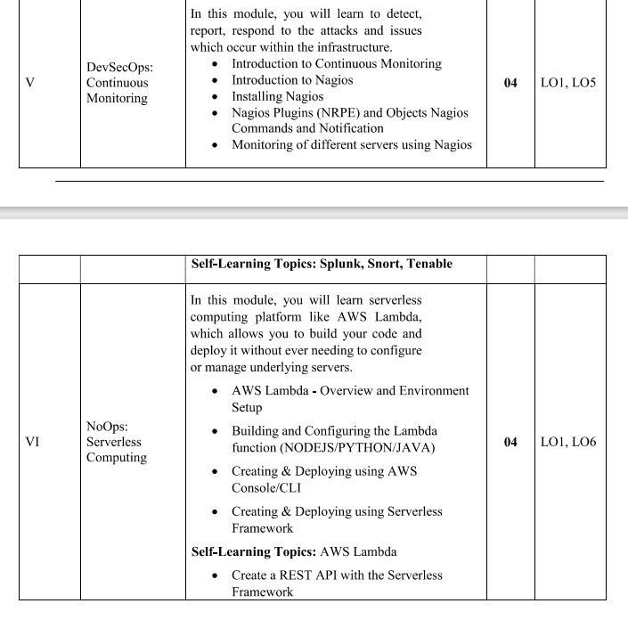

Slide 6
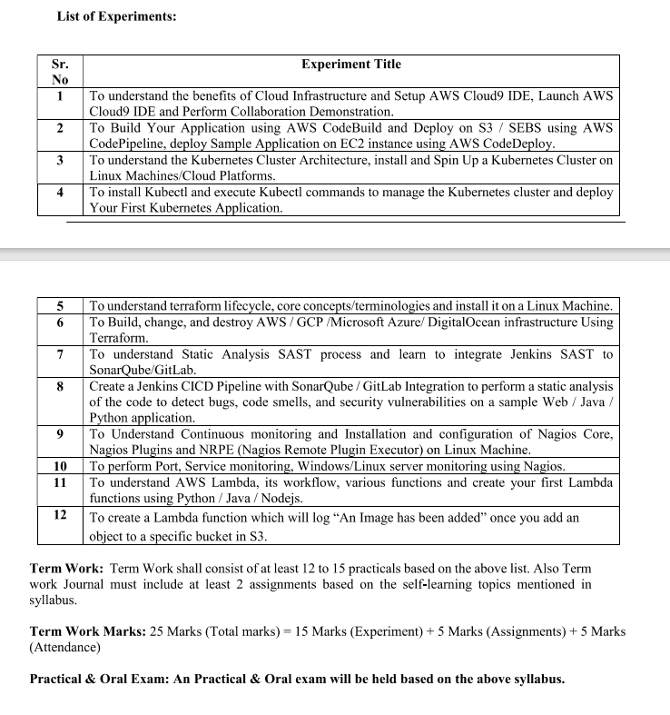

Slide 7
Advance DevOps
By- Ms. Snehal Mhatre

Slide 8
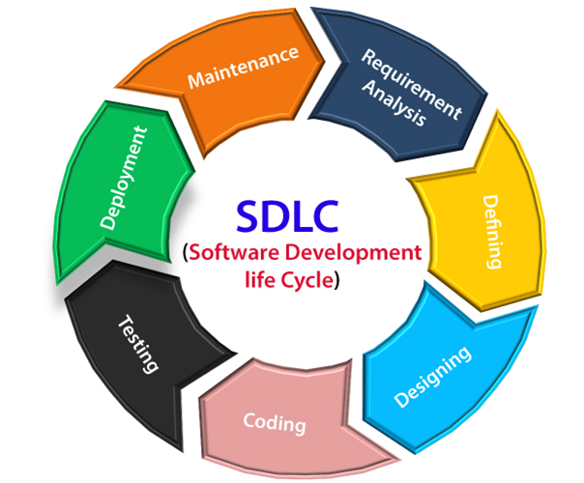
Software Development Life Cycle (SDLC)
A software life cycle model (also termed process model) is a pictorial and diagrammatic representation of the software life cycle. A life cycle model represents all the methods required to make a software product transit through its life cycle stages. It also captures the structure in which these methods are to be undertaken.
SDLC Cycle SDLC Cycle represents the process of developing software. SDLC framework includes the following steps:

Slide 9
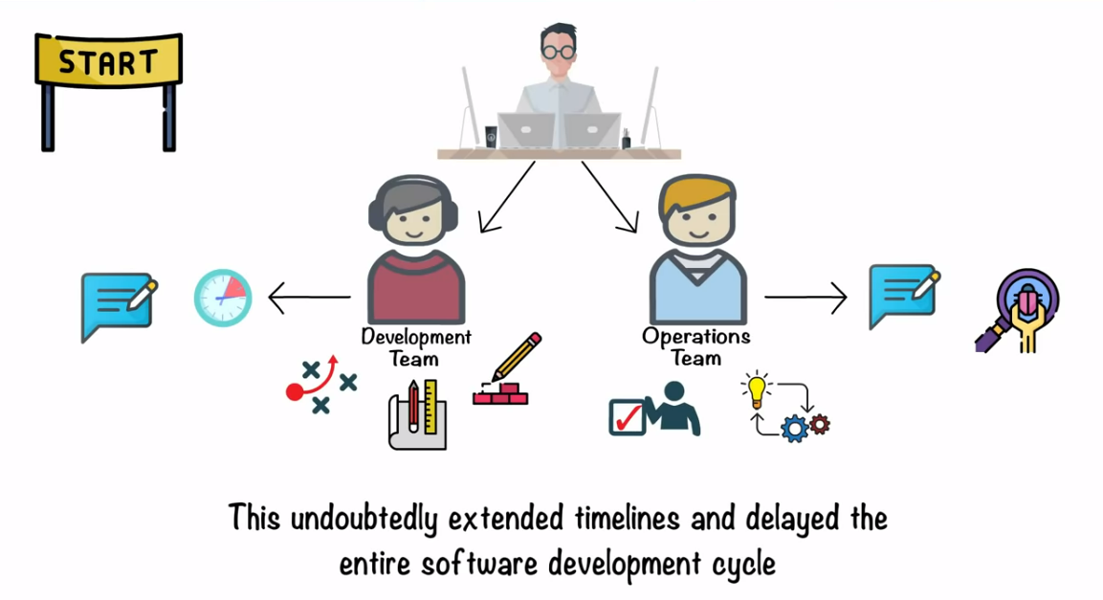

Slide 10
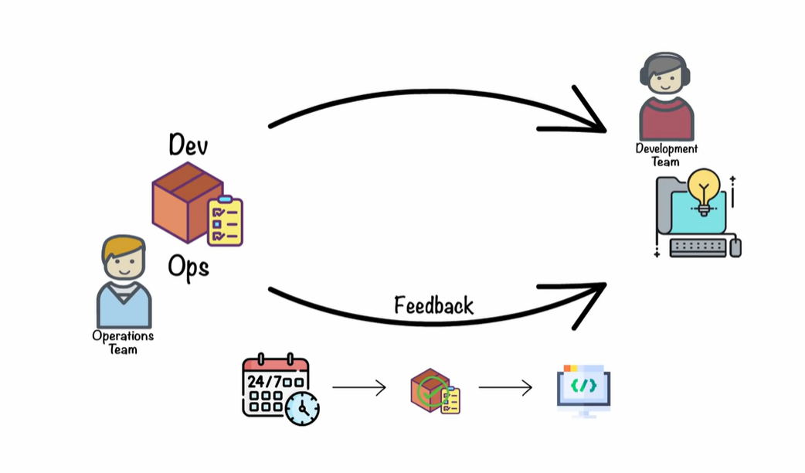

Slide 11
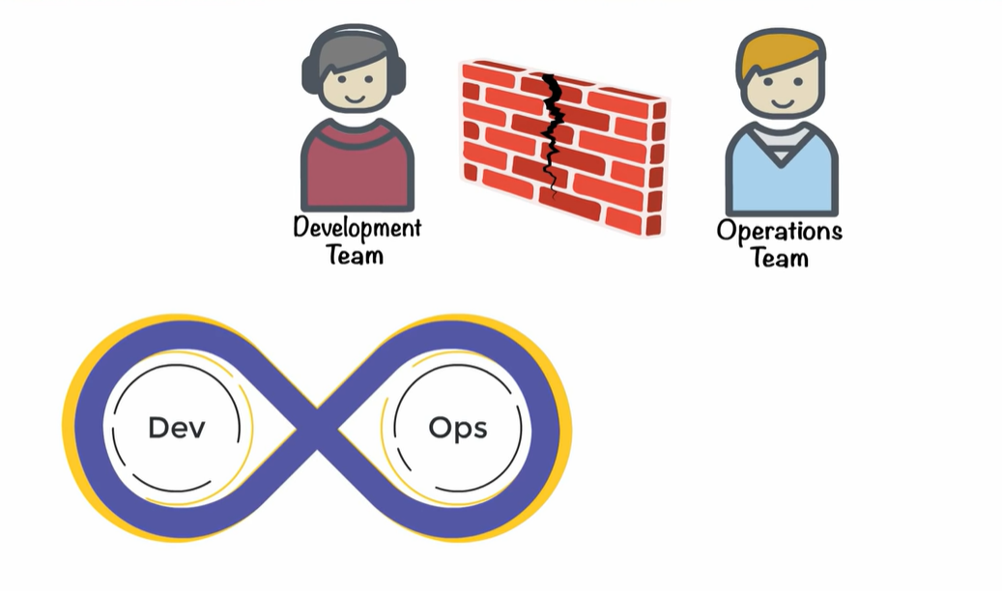

Slide 12
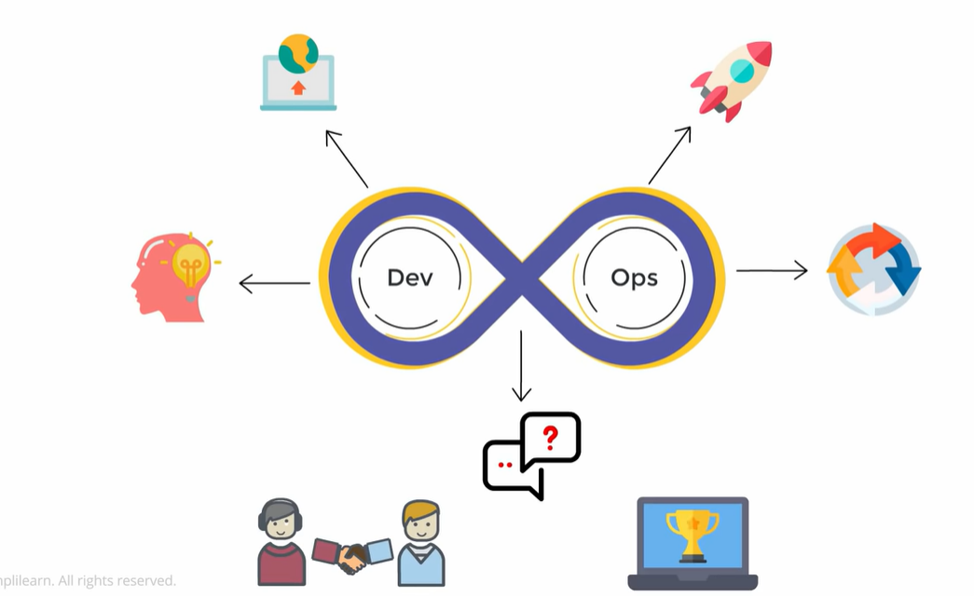

Slide 13
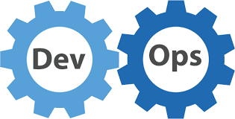
DevOps Lifecycle:
DevOps is a culture that maintains collaboration between Development and Operation. So it’s a combination of two words “Development” and “Operation”.
DevOps aims to increase the organization’s speed to deliver an application from the development phase to production.

Slide 14
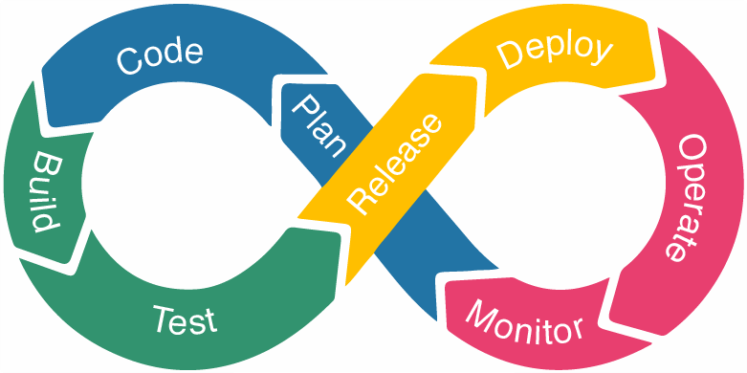
As everybody knows after development, the application needs to go under some phases like build, test, deploy, operate and monitor. Each phase has its standards.

Slide 15
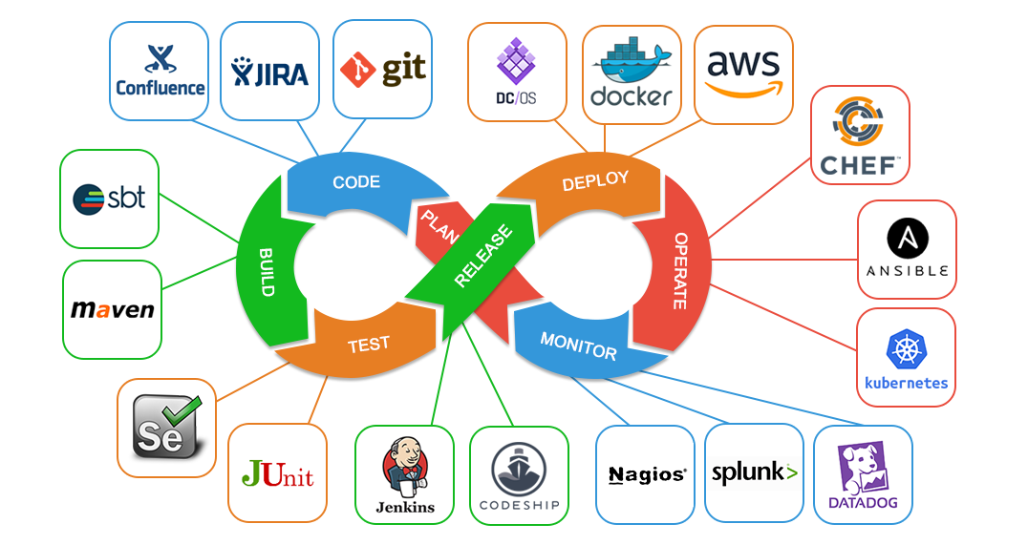

Slide 16
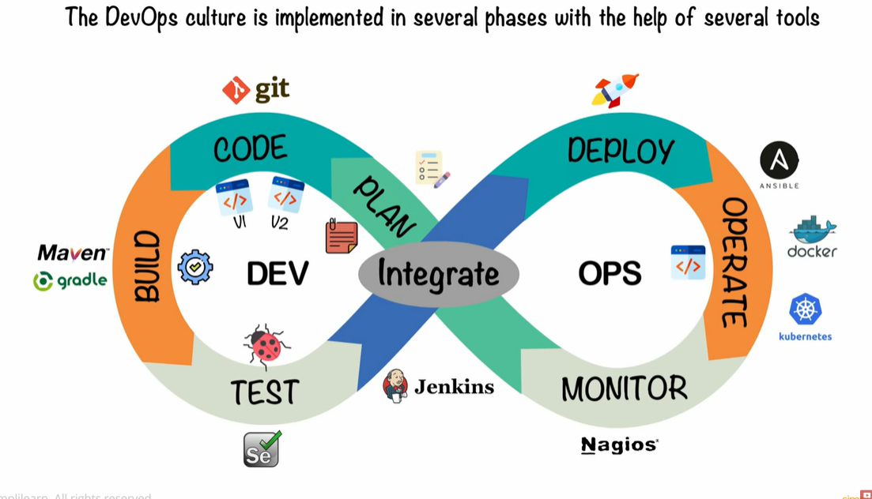

Slide 17
Plan: In this stage, teams identify the business requirement and collect end-user feedback. They create a project roadmap to maximize the business value and deliver the desired product during this stage.
Code: The code development takes place at this stage. The development teams use some tools and plugins like Git to streamline the development process, which helps them avoid security flaws and lousy coding practices.
Build: In this stage, once developers finish their task, they commit the code to the shared code repository using build tools like Maven and Gradle.
Test: Once the build is ready, it is deployed to the test environment first to perform several types of testing like user acceptance test, security test, integration testing, performance testing, etc., using tools like JUnit, Selenium, etc., to ensure software quality.

Slide 18
Release: The build is ready to deploy on the production environment at this phase. Once the build passes all tests, the operations team schedules the releases or deploys multiple releases to production, depending on the organizational needs.
Deploy: In this stage, Infrastructure-as-Code helps build the production environment and then releases the build with the help of different tools.
Operate: The release is live now to use by customers. The operations team at this stage takes care of server configuring and provisioning using tools like Chef.
Monitor: In this stage, the DevOps pipeline is monitored based on data collected from customer behavior, application performance, etc. Monitoring the entire environment helps teams find the bottlenecks impacting the development and operations teams’ productivity.

Slide 19
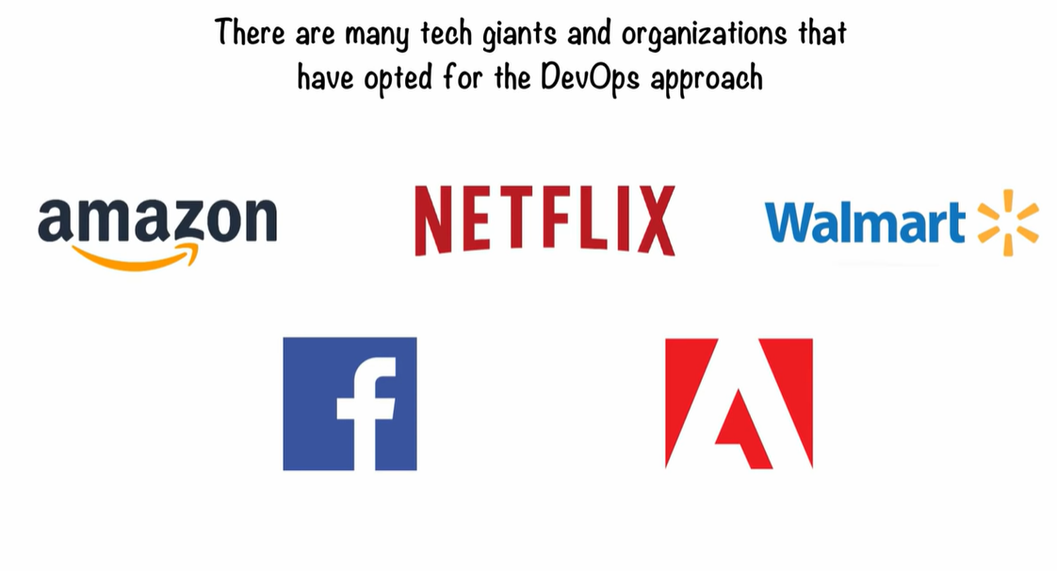

Slide 20
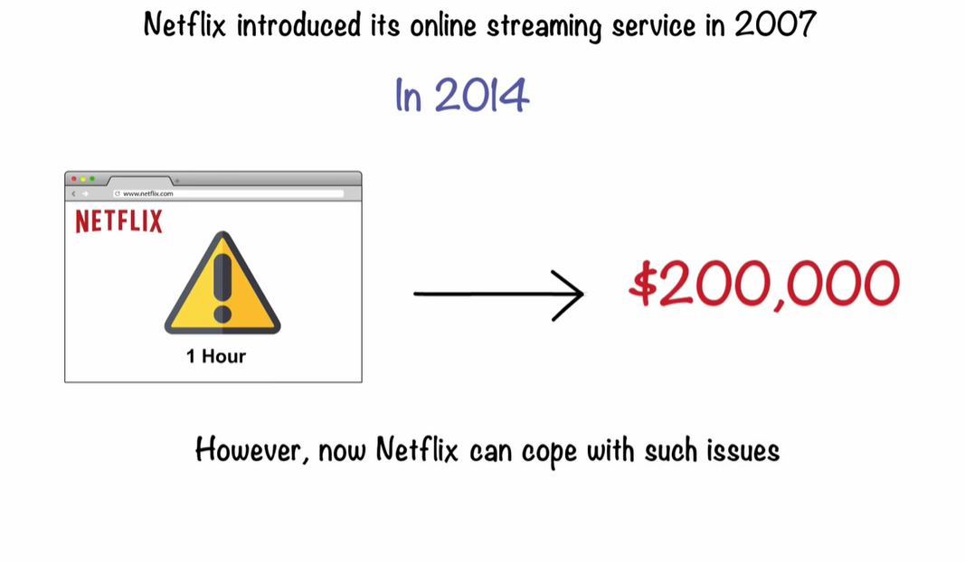

Slide 21
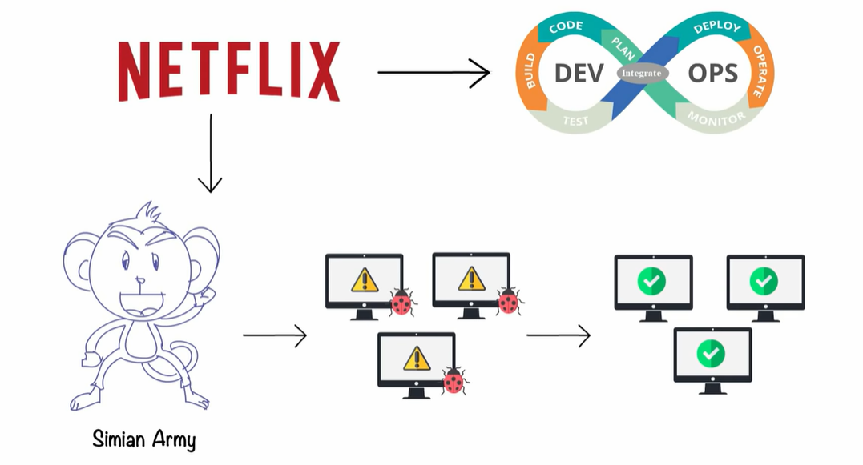

Slide 22
