Slide 1
Autoscaling
Cloud scaling is the process of adding or removing cloud computing resources as you need them. Cloud infrastructure and platforms are typically priced on a utility model such that you are billed for what you use at a finely grained level. This allows cloud services, systems and applications to be quickly scaled up and down to meet demands.

Slide 2
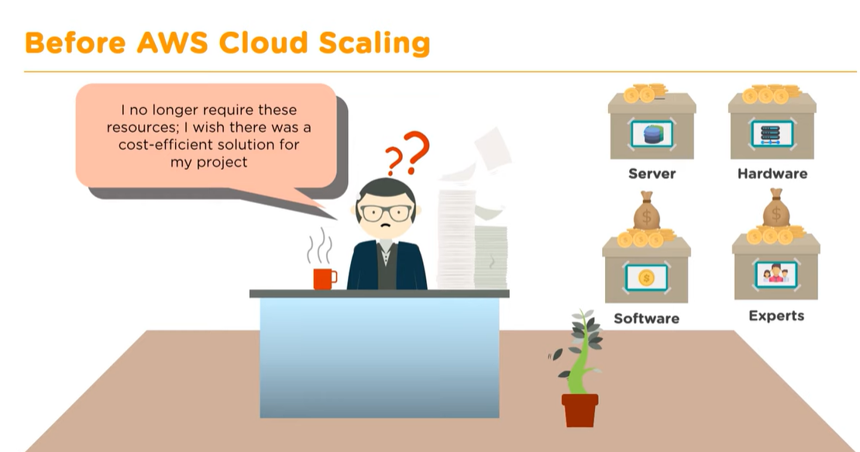
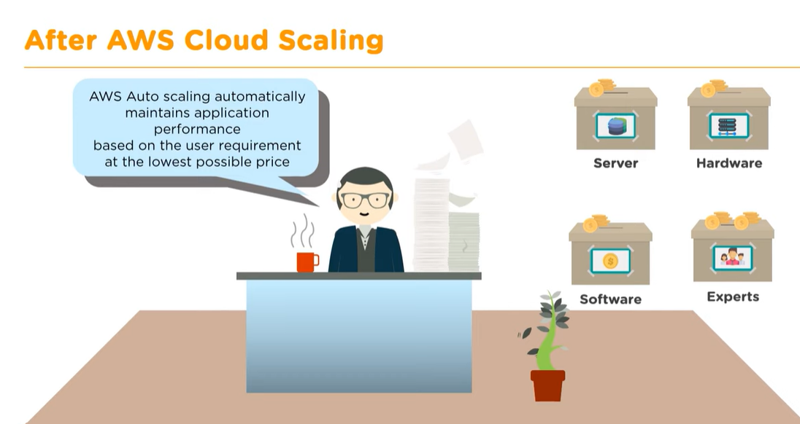
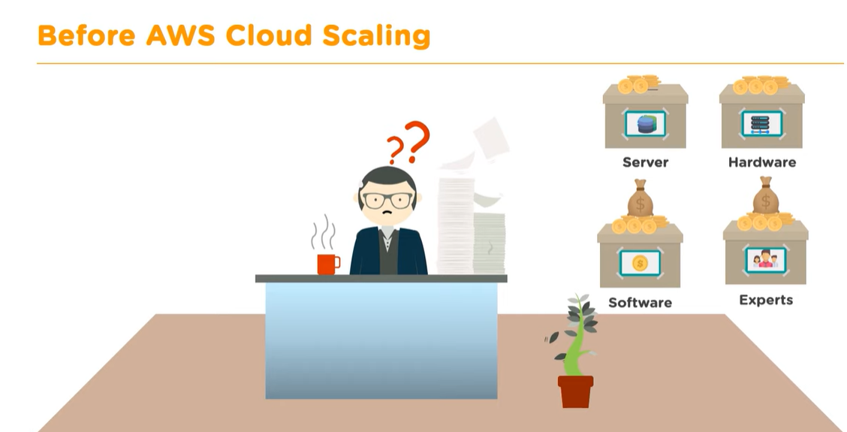

Slide 3
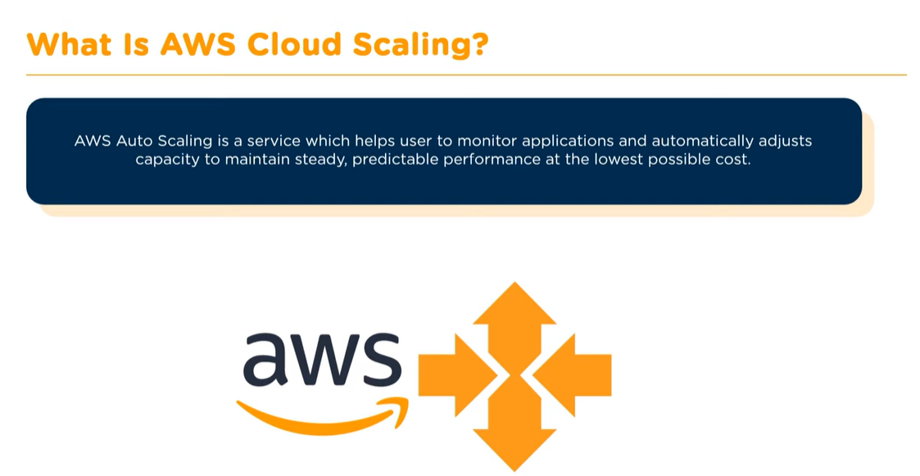

Slide 4
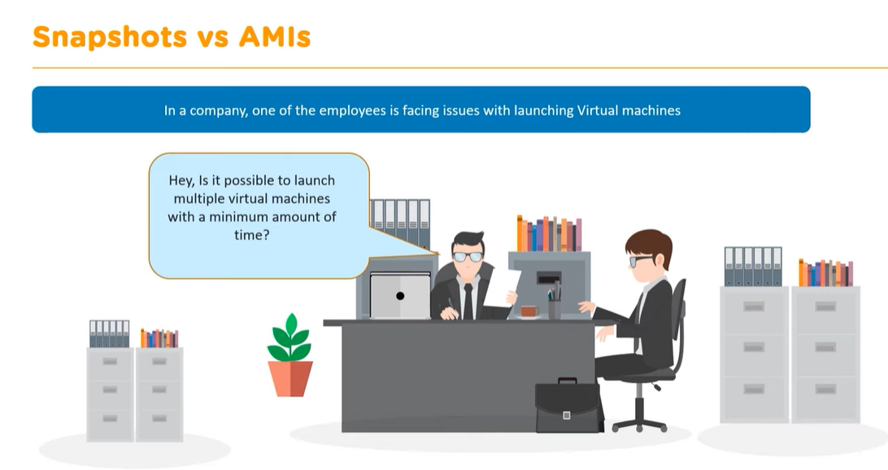
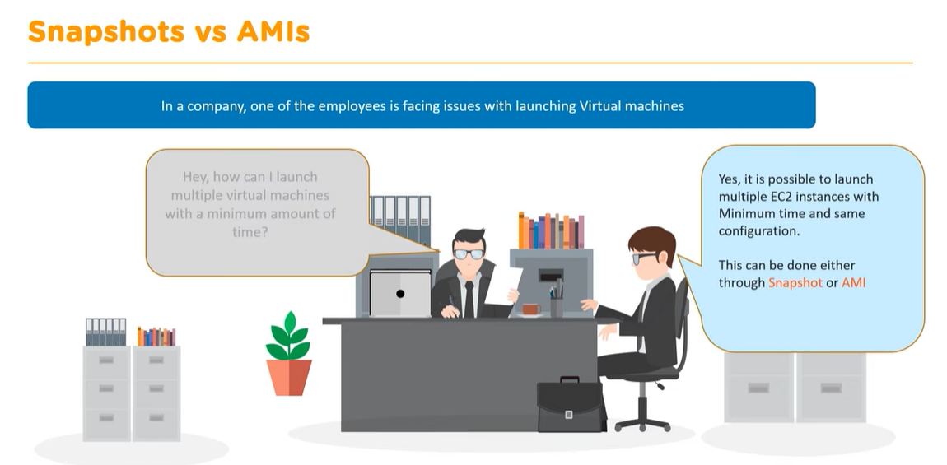
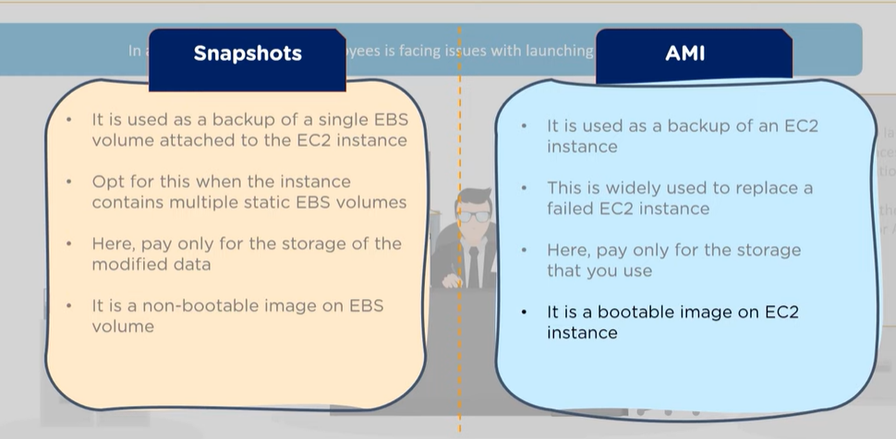


Slide 5
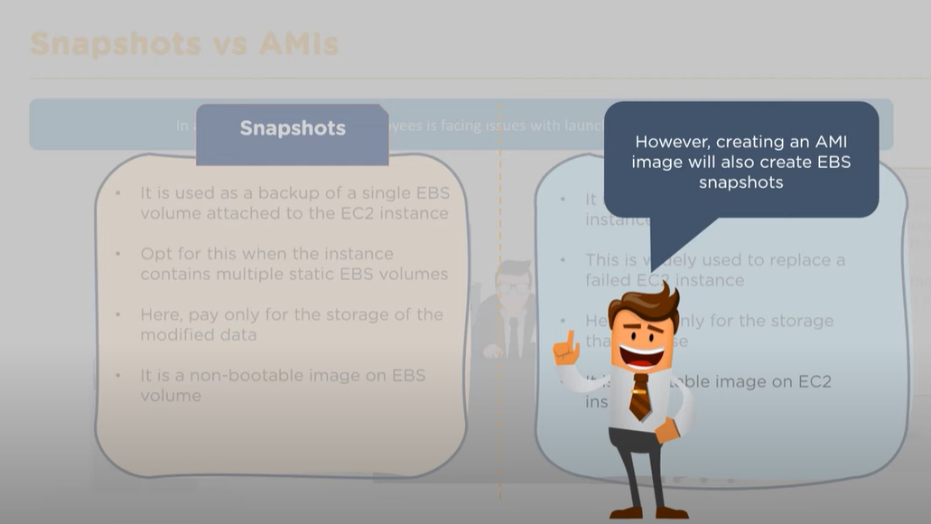

Slide 6
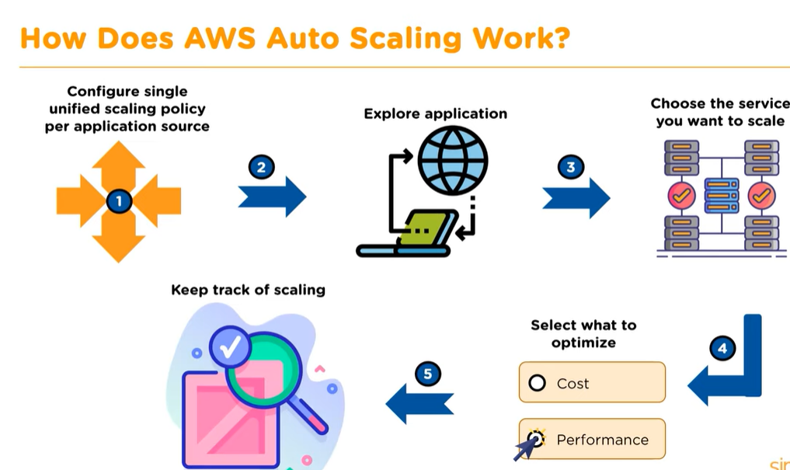

Slide 7
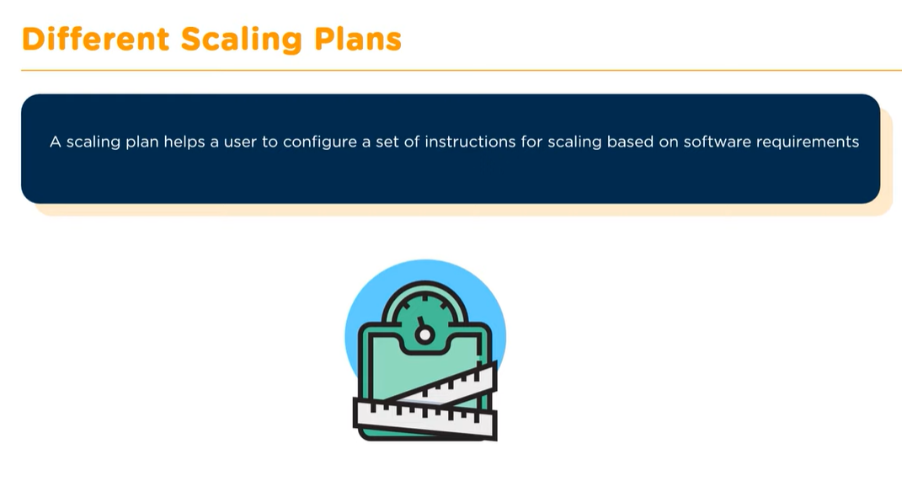
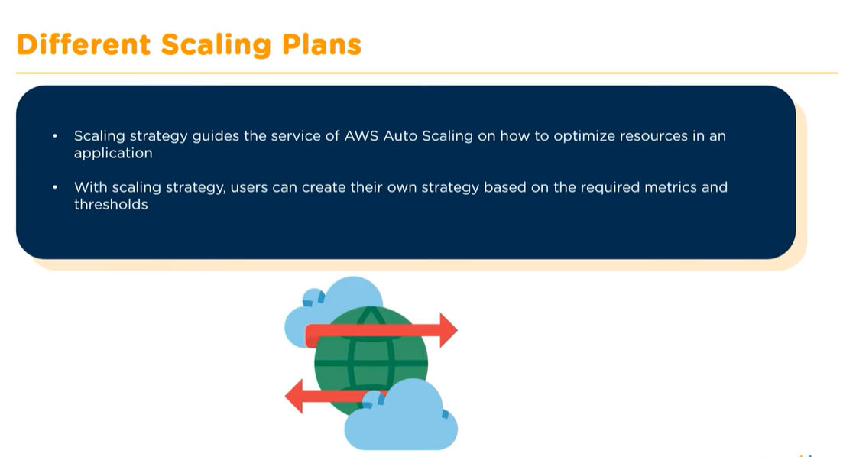
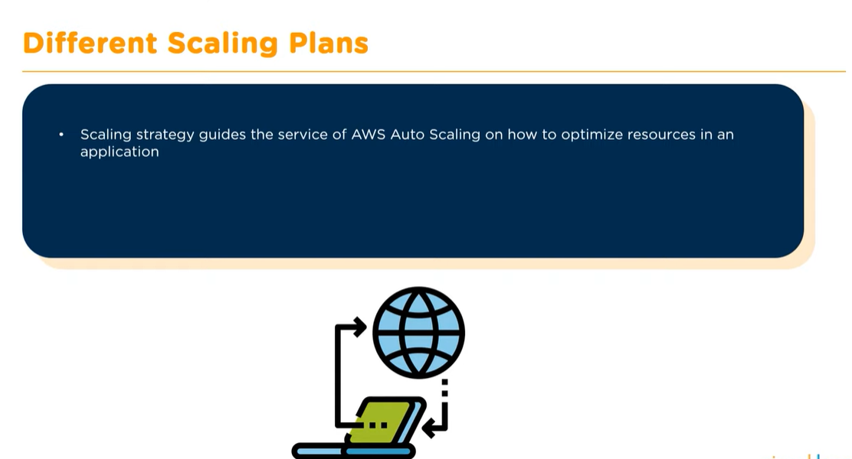

Slide 8
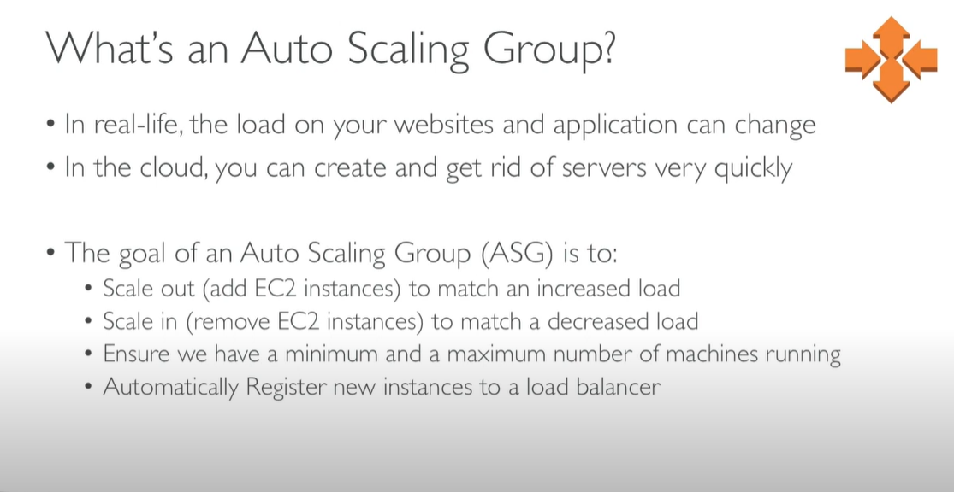

Slide 9
Types of Scaling
Manual Scaling
Scheduled Scaling
Dynamic Scaling

Slide 10
