Slide 1
What are containers?
Containers are packages of software that contain all of the necessary elements to run in any environment.
In this way, containers virtualize the operating system and run anywhere, from a private data center to the public cloud or even on a developer’s personal laptop.
From Gmail to YouTube to Search, everything at Google runs in containers. Containerization allows our development teams to move fast, deploy software efficiently, and operate at an unprecedented scale.

Slide 2
Containers defined
Containers are lightweight packages of your application code together with dependencies such as specific versions of programming language runtimes and libraries required to run your software services.

Slide 3
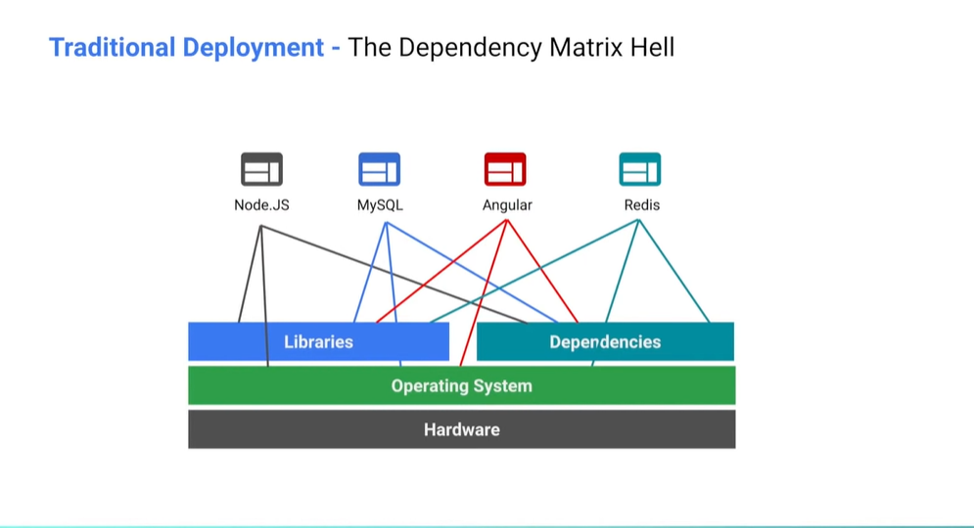

Slide 4
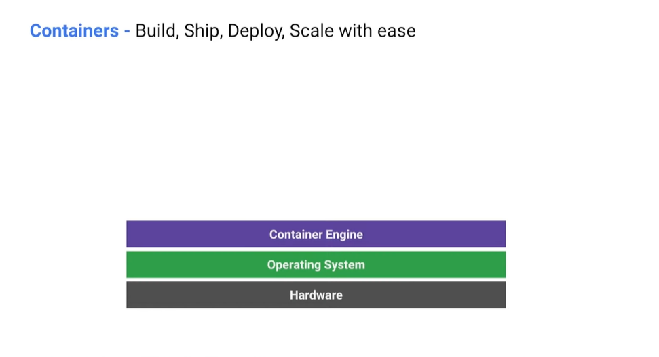
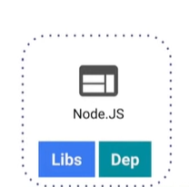
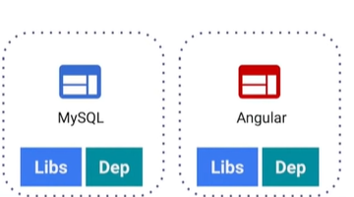

Slide 5
