Slide 1

Bypassing Network Access Control Systems
Ofir Arkin, CTO
Blackhat USA 2006
ofir.arkin@insightix.com
http://www.insightix.com

Slide 2
What this talk is about?
Introduction to NAC
The components of a NAC solution
  Pre-Admission
    Element Detection
    Risk Profiling
    Quarantine Methods
    Managed Vs. Unmanaged Elements
    Enforcement at L2 Vs. L3
  Post-Admission
    Behavior related
How to bypass NAC solutions

Slide 3
Updated Presentation
http://www.sys-security.com/OA_NAC_BH06.ppt.zip

Slide 4
Ofir Arkin
CTO and Co-Founder, Insightix http://www.insightix.com
Founder, The Sys-Security Group http://www.sys-security.com
Computer Security Researcher
  Infrastructure Discovery
    ICMP Usage in Scanning
    Xprobe2 (The Active OS Fingerprinting Tool)
  VoIP Security
  Information Warfare
Member
  VoIPSA (Board member, Chair security research committee)

Slide 5
NAC
An Introduction

Slide 6
Introduction
The Motivation
The threat of viruses, worms, information theft, roaming users, and the lack of control of the IT infrastructure lead companies to implement security solutions to control the access to their internal IT networks
A new breed of software and hardware solutions from a variety of vendors has emerged recently
All are tasked with one goal – controlling the access to a network using different methods and solutions

Slide 7
Introduction
Definition
Network Access Control (NAC) is a set of technologies and defined processes, which its aim is to control access to the network
NAC is a valid technology that should play a key role in internal network security
A common criterion for NAC does not exist and therefore the definition of what does a NAC solution should (and/or must) contain varies from one vendor to another

Slide 8
Introduction
Vendors/Initiatives
Various initiatives:
  Cisco Network Admission Control (NAC)
  Microsoft Network Access Protection (NAP)
  The Trusted Computing Group (TCG), Trusted Network Connect (TNC)
  Other
Many different vendors offer NAC solutions

Slide 9
NAC Capabilities

Slide 10
The Basics
Capabilities
The most essential capabilities any NAC solution must have are the ability to detect a new element connecting to the network, and the ability to verify whether or not it complies with a defined security policy
If the element does not comply with the defined security policy, the NAC solution must restrict the element’s access to the network

Slide 11
NAC Functions
Capabilities
The following is a list of functions that may, or may not, be included with a vendor’s NAC offering:
  Element detection – The ability to detect new elements as they are introduced to the network
  Authentication – The ability to authenticate each user accessing the network no matter where they are authenticating from and/or which device they are using

Slide 12
NAC Functions
Capabilities
  End point security assessment – The ability to assess whether a newly introduced network element complies with the security policy. These checks may include the ability to gather knowledge regarding an element’s operating system, the list of installed patches, the presence of an A/V software and its virus signatures date, etc. In most cases it involves the installation of a client software on the end system
  Remediation – The process of quarantine an element not complying with the defined security policy until the issues causing it to be non-compliant are fixed. When quarantined, the element is able to access a defined set of remediation servers allowing the user fixing the non-compliant issues

Slide 13
NAC Functions
Capabilities
  Enforcement – If the element does not comply with the defined security policy, the NAC solution must restrict the element’s access to the network
  Authorization – The ability to verify access by users to network resources complies with an authorization scheme defined in an existing authorization system (such as Active Directory, RADIUS servers, etc.) allowing enforcing identity-based policies
  Post-Admission Protection – Is the process of continuously monitoring users, elements and their sessions for suspicious activity (i.e. worms, viruses, malware, etc.). If detected the action taken by a NAC system may vary from isolating the offending system to dropping the session. Post admission protection functions are similar to Intrusion Prevention Systems (IPS)

Slide 14
NAC Capabilities
Implications

Slide 15
Implications
The ability to control each user and/or element accessing the network no matter where they are accessing the network from and/or which device they are using
  Local Network
  VPN
    Client-based
    SSL-VPN
    IPSEC
Heavily rely on Client-based software
Heavily rely on Host-based security
Must have intimate knowledge regarding the enterprise network

Slide 16
NAC
Attack Vectors

Slide 17
Attack Vectors
A solution’s architecture
  The placement of the different pieces of a solution
Technology used
  Element detection
  Quarantine abilities
  Enforcement methods
A solution’s components
  Client-side software
  Server-side software (and hardware)

Slide 18
Element Detection

Slide 19
Methods
Element Detection
Software
  DHCP Proxy
  Authenticated DHCP / DHCP in-a-box
  Broadcast Listeners
  Switch Integration
  Cisco and 802.1x
Hardware
  In-Line devices
  Out-of-Band devices

Slide 20
Methods
Element Detection
The examples following were taken from different vendor offerings
There may be other combinations/offerings which are not covered in this presentation
The information provided would allow to figure out their issues

Slide 21
DHCP Proxy

Slide 22
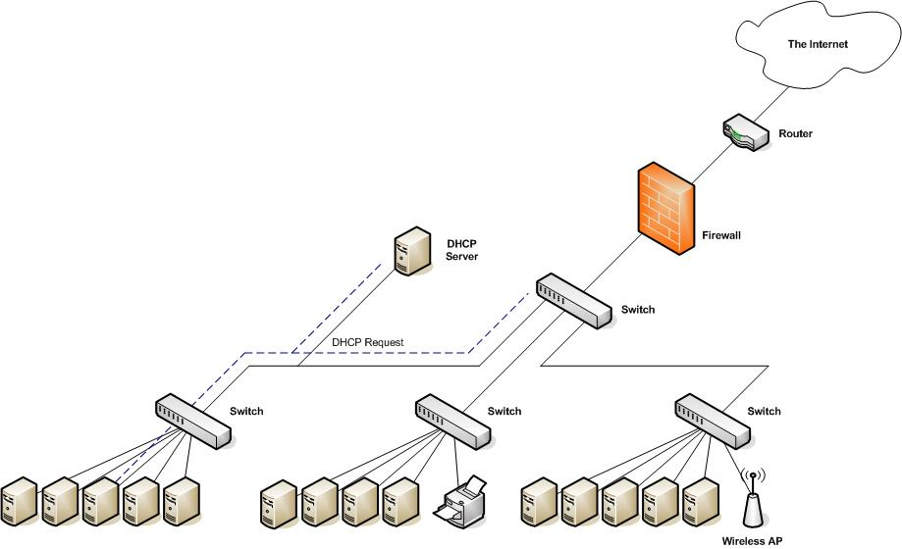
Architecture
DHCP Proxy

Slide 23
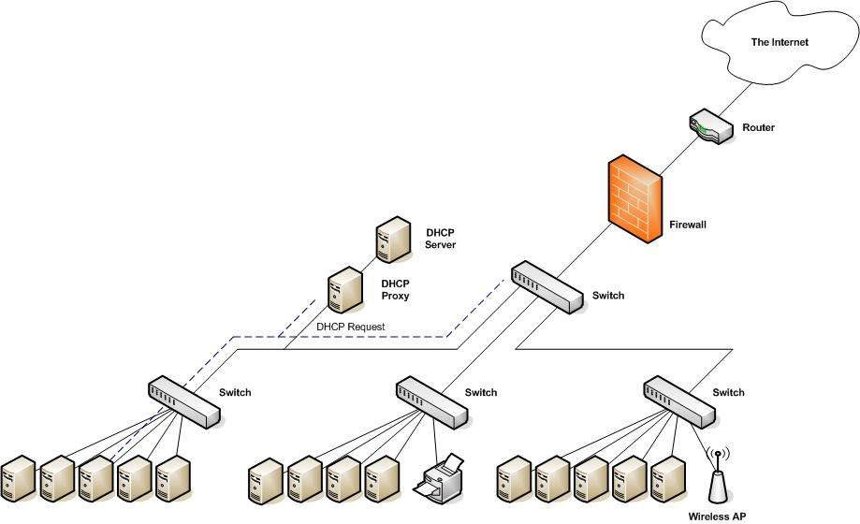
Architecture
DHCP Proxy

Slide 24
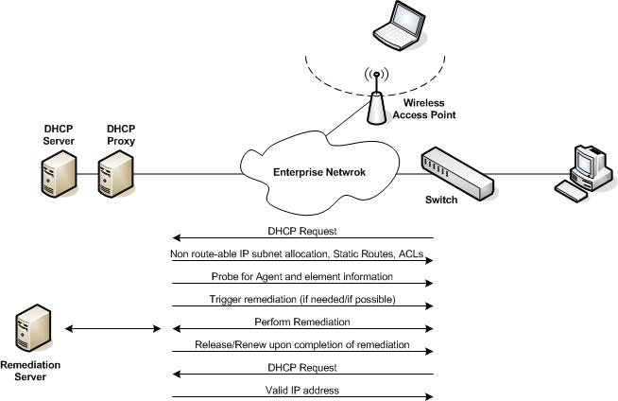
Information Exchange
DHCP Proxy

Slide 25
Strengths
DHCP Proxy
Most organizations use DHCP
Easy to deploy

Slide 26
Weaknesses
DHCP Proxy
Detected elements are only those using DHCP
  Incomplete detection of elements operating on the network
  Other elements may exist and operate on the network
  Bypassing DHCP Proxy NAC by assigning an element a static IP Address
  Not all of the elements residing on the enterprise network will be using DHCP (I.e. Servers, Printers, etc.)
Elements must use agent software, which is usually restricted to Windows-based operating systems
  Without the usage of agent-based software there is an inability to determine whether an element comply, or not, with the enterprise security policy
Detection of elements is done at Layer 3 only
  An element can connect to the network without being detected
  Access to at least the local subnet will not be restricted
  In case multiple IP subnets share the same broadcast domain the problem may be far worse

Slide 27
Weaknesses
DHCP Proxy_x0003_
Enforcement is performed at Layer 3 only
  Elements can infect and/or penetrate other elements on their subnet, and cannot be stopped
  Bypassing enforcement by attacking a system on the local subnet using it as an ‘access proxy’ to other parts of the enterprise network
Quarantine of an element is done using non-routable IP addresses and ACLs on routers (Layer 3 only)
  Bypassing the quarantine by assigning an element a static IP address
No actual knowledge regarding the enterprise network
  No actual knowledge of what is on the network
  No knowledge on the actual network topology may lead the existence of other, uncovered venues to access the network

Slide 28
Weaknesses
DHCP Proxy_x0003_
Not able to detect masquerading elements hiding behind an allowed elements (i.e. NAT)
  Virtualization as a major issue (i.e. Freebee virtualization software such as Virtual PC, Vmware, etc.)
Exceptions needs to be manually inputted (i.e. printers)
  There is no knowledge about the exception element (i.e. OS, exact location, and other properties)
  It is possible to spoof the MAC address and/or the IP address of an exception is order to receive full access to the enterprise network
Cannot be extended to include remote users
There is no form of user authentication (i.e. theoretically, install an appropriate client, be compliant with the security policy, access is granted)

Slide 29
Weaknesses
DHCP Proxy
The problem of unmanaged elements
  “Systems without agents can be granted network access two ways. First, a non-windows exception can be made that exempts non-windows clients from the NAC process. Second, a MAC address-based exemption list can be built. This MAC address list accepts wildcards, allowing the exemption of whole classes of systems such as IP phones using their Organizationally Unique Identifiers.”
  There is no knowledge about the exception element (i.e. OS, exact location, and other properties)
  It is possible to spoof the MAC address and the IP address of an exception is order to receive full access to the enterprise network
Source: “Network Access Control Technologies and Sygate Compliance on Contact”, Sygate/Symantec

Slide 30
Authenticated DHCP or
DHCP In-a-Box

Slide 31
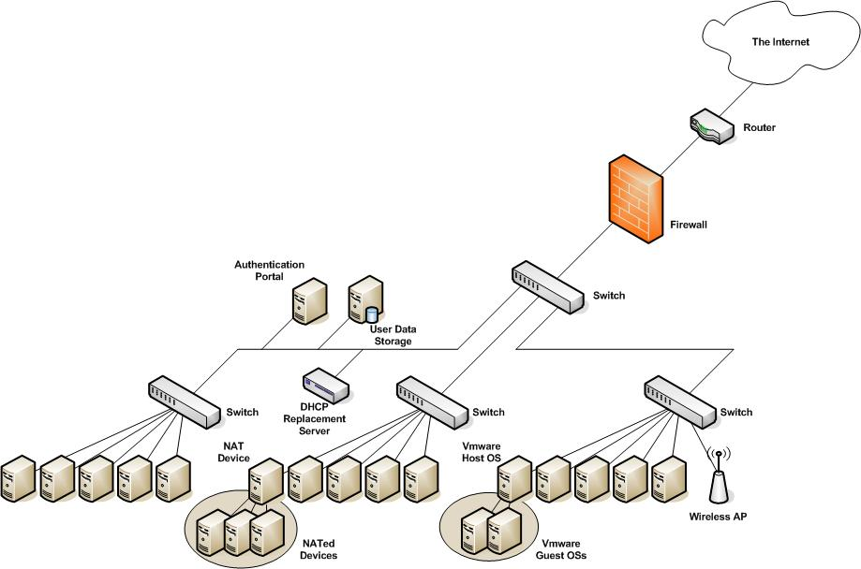
Architecture
DHCP In-A-Box

Slide 32
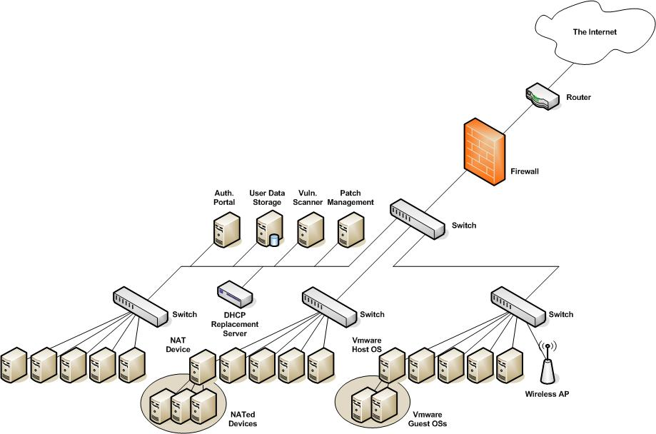
Architecture
DHCP In-A-Box

Slide 33
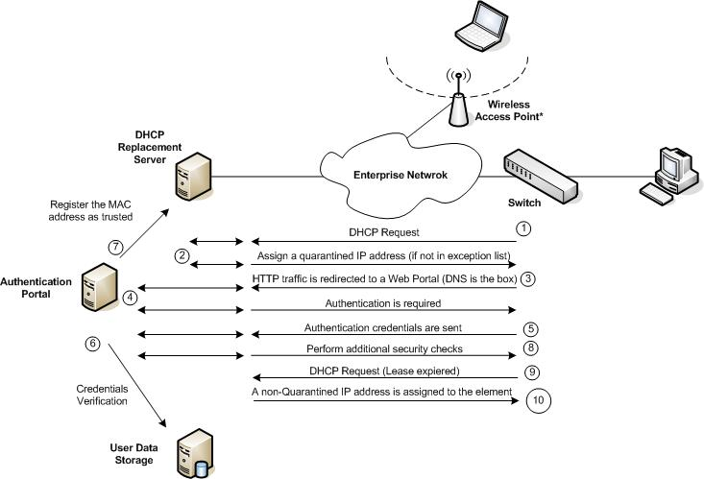
Information Exchange
DHCP In-A-Box

Slide 34
Strengths
DHCP In-A-Box
Theoretically, may authenticate any user trying to access the network
Theoretically, operating system independent

Slide 35
Weaknesses (Highlights)
DHCP In-A-Box
Detected elements are only those using DHCP
Enforcement is performed at Layer 3 only
  Elements can infect and/or penetrate other elements on their subnet, and cannot be stopped (there are no clients with this type of solutions)
  Bypassing enforcement by attacking a system on the local subnet to be used as an ‘access proxy’ to other parts of the enterprise network
No knowledge of the grounds
There is no knowledge about the exception elements
Uses 3rd party products to asset the security of elements
  No real-time assessment
  In some cases, these checks would prove useless
All other DHCP Proxy weaknesses apply

Slide 36
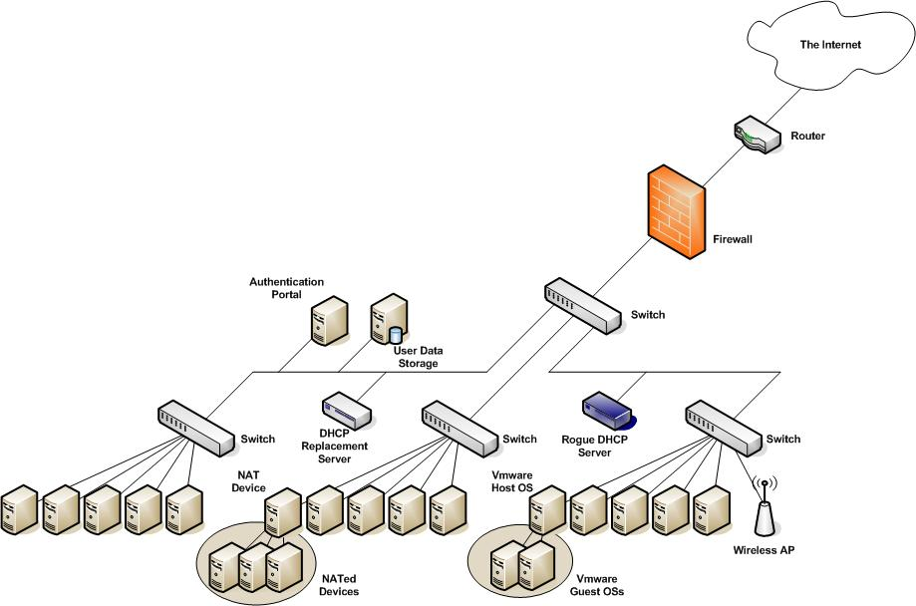
Rogue DHCP Server
DHCP In-A-Box

Slide 37
Rogue DHCP Server
DHCP In-A-Box
The first DHCP server’s reply to reach a host sending a DHCP request would assign the DHCP server responding to be used by the element
  Assign the element a “quarantined” IP address
  Direct DNS traffic to the rogue DHCP Server by assigning the DNS server’s IP address with the DHCP reply to the rogue DHCP server
  Present the user with a look-a-like authentication page (using HTTPS, preferred)
  Abuse the credentials collected
    For example, wait for the disconnection of the element and abuse its credentials
    Etc.

Slide 38
Broadcast Listeners

Slide 39
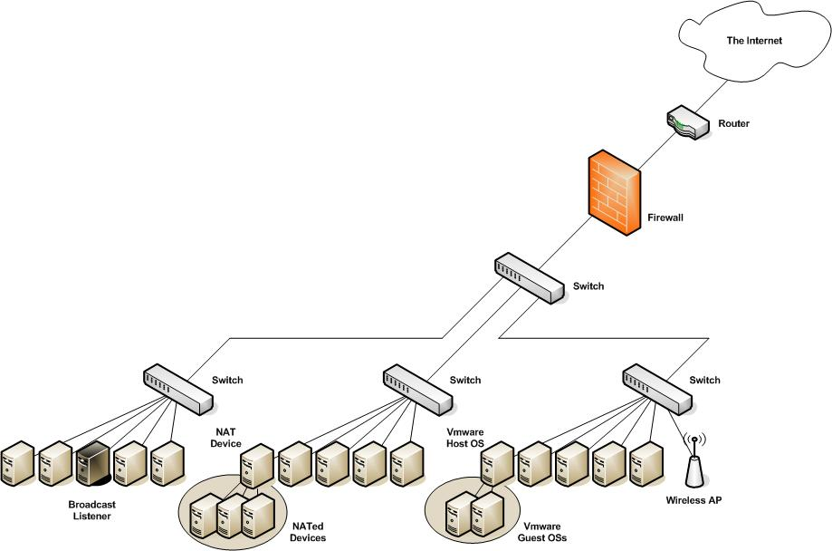
Architecture
Broadcast Listeners

Slide 40
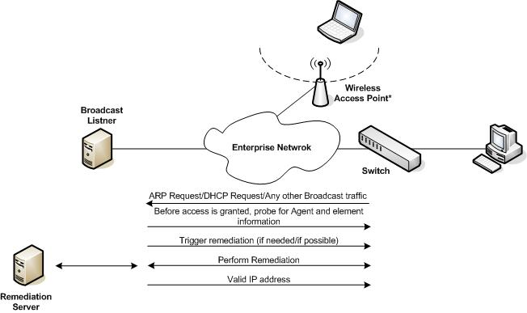
Architecture - Managed Elements
Broadcast Listeners

Slide 41
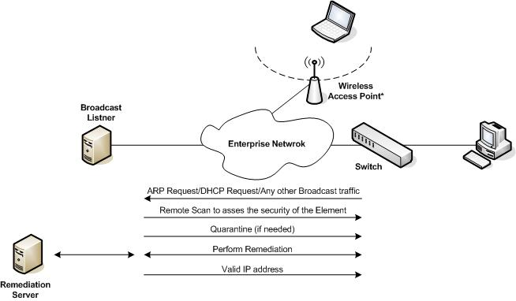
Architecture - Unmanaged Elements
Broadcast Listeners
Who can tell what is the
architectural flaw with this scenario?

Slide 42
Weaknesses
Broadcast Listeners
Software must be deployed on each and every subnet
  A lot of moving parts
A prior knowledge regarding the enterprise network must be obtained prior to deployment
  What are the enterprise subnets?
  Where are the locations to be deployed?
  The approach of “the client tells us where to install the software” simply does not work
Must integrate with switches in order to perform quarantine
  No knowledge who these switches are
  In most cases this might be a manual process
  Switches may reside on their own VLAN/Subnet
  Switches serving a certain subnet may reside on different subnets
  In many cases switches can be accessed only from a management network (a sever deployment issue)

Slide 43
Weaknesses
Broadcast Listeners
No knowledge on actual network topology lead existence of other, uncovered venues to access the network
  Other subnets which may not be monitored
  Forgotten switches
Not able to detect masquerading elements hiding behind an allowed elements (i.e. NAT)
  Virtualization as a major issue (i.e. Freebee virtualization software such as Virtual PC, Vmware, etc.)
Exceptions needs to be manually inputted
  There is no knowledge about the exception element (i.e. OS, exact location, and other properties)
  It is possible to spoof the MAC address and/or the IP address of an exception is order to receive its access to the enterprise network
Cannot be extended to include remote users

Slide 44
Weaknesses
Broadcast Listeners
Unmanaged Elements
  No Client-software for non-Windows operating systems
  Non-Windows operating systems cannot be scanned for compliance (i.e. using a portal, client, active-X, etc.)
  External vulnerability scans takes time to complete
  An increasing number of operating systems will be using a personal firewall. Remote scanning will not reveal information regarding the scanned elements
  The number of exceptions would be high
Some elements may not generate broadcast traffic
Configuring static ARP entries bypasses the detection of broadcast traffic
Abusing manipulated ARP requests bypasses the detection of broadcast traffic
  Instead of aiming the request to the broadcast address, aim it directly to the MAC address you wish to communicate with

Slide 45
Switch Integration
SNMP Traps

Slide 46
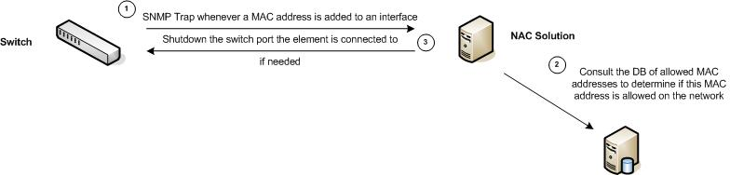
Architecture
SNMP Traps

Slide 47
Weaknesses
SNMP Traps
Must rely on prior knowledge regarding the IT infrastructure
  A list of switches which needs to be configured to send SNMP traps
  Incomplete information leads to discrete access venues
Total dependency on switches
  The switch ability to provide with information through the usage of SNMP traps
    Not all switches supports this type of SNMP traps and notifications
  The ability to quarantine an element to a certain VLAN
When an element is detected to operate on the network, the real location of the element is unknown
  Multiple SNMP traps regarding the registration of the element’s MAC address may be received
  No classification is made regarding the interface alerting about the added MAC address (i.e. direct connect, multiple elements, etc.)
  Solutions that may shutdown a switch port may lead to the disconnection of other, allowed elements
  Quarantine may not be trivial

Slide 48
Weaknesses
SNMP Traps
Must integrate with switches
  No knowledge who the switches are
  Always a manual configuration process
Not able to detect masquerading elements hiding behind allowed elements (i.e. NAT)
  Virtualization as a major issue (i.e. Freebee virtualization software such as Virtual PC, Vmware, etc.)
Any reference to an element is done using its MAC address
  There is no knowledge about the exception element (i.e. OS, exact location, and other properties)
  It is possible to spoof the MAC address of an exception in order to receive its access to the enterprise network
Cannot be extended to include remote users

Slide 49
Cisco and 802.1x

Slide 50
Architecture
Components
  Cisco Trust Agent (CTA)
  Cisco network access device (NAD) with NAC enabled on one or more interfaces for network access enforcement
  Cisco Secure Access Control Server (ACS) for endpoint compliance validation
Enforcement strategies
  NAC L3 IP
    Deployed using Routers
    Triggered by an IP packet
  NAC L2 IP
    Deployed using switches/routers
    Apply per interface
    Triggered by either a DHCP packet or an ARP request
  NAC L2 802.1x
    Triggered by any data-link packet

Slide 51
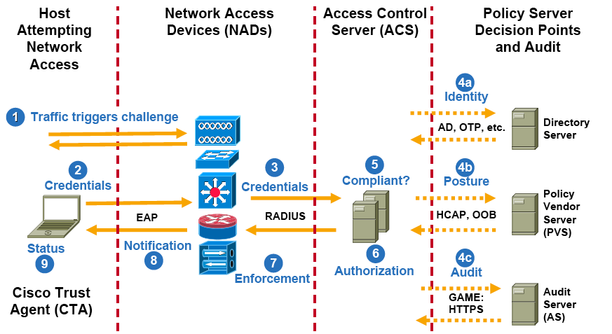
Information Exchange
Cisco and 802.1x
Source: Cisco

Slide 52
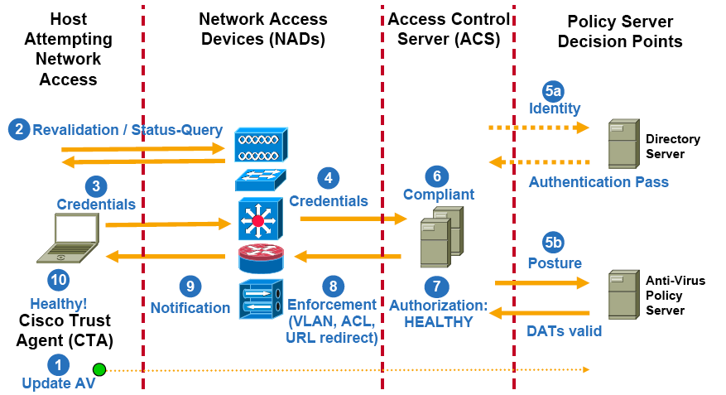
Information Exchange
Cisco and 802.1x
Source: Cisco

Slide 53
Strengths
Cisco and 802.1x
NAC L2 802.1x
  Can prevent elements to connect to the network even before assigned an IP address (when implemented on switches)
  Embedded with the underlying networking gear

Slide 54
Weaknesses
Cisco and 802.1x
Works only with Cisco equipment
  Only Cisco devices support the EAPoUDP protocol
Difficult manageability
  All elements on the network must be configured to use 802.1x
  Al the network elements on the network must be Cisco’s
  Legacy networking elements must be upgraded to support 802.1x
Not all of the networking elements can support 802.1x
Not all of the elements residing on the network are 802.1x capable (i.e. legacy equipment, AS-400, printers, etc.)
The cost for implementing a solution which is based on 802.1x is currently high (time, resources, infrastructure upgrade, etc.)

Slide 55
Weaknesses
Cisco and 802.1x
Not all of the enforcement strategies are bullet proof
  NAC L3 IP
    Deployed using Routers
    Triggered by an IP packet
    Local network is vulnerable to viruses, worms, and local compromises
  NAC L2 IP
    Apply per interface
    Triggered by either a DHCP packet or an ARP request
    Information might be tunneled through
    Also applies when a hub is connected to the interface

Slide 56
Weaknesses
Unmanaged Elements
Cisco and 802.1x
Static Exceptions
  “Hosts that cannot run the CTA (Cisco Trust Agent) can be granted access to the network using manually configured exceptions by MAC or IP address on the router or ACS. Exceptions by device types such as Cisco IP phones can also be permitted using CDP on the router. “ - Cisco NAC FAQ
  There is no knowledge about the exception element (i.e. OS, exact location, and other properties)
  It is possible to spoof the MAC address and/or the IP address of an exception is order to receive the same access that element has to the enterprise network

Slide 57
Weaknesses
Unmanaged Elements
Cisco and 802.1x
Dynamic Audit
  “The newest component in the NAC solution is the audit server, which applies vulnerability assessment (VA) technologies to determine the level of compliance or risk of a host prior to network admission. “
    The level of response from various elements is questionable
    Many elements uses a personal firewall by default (even if the element is responsive, closing all “hatches” may still grant access to the network)

Slide 58
Weaknesses
Cisco and 802.1x
Not able to detect masquerading elements hiding behind an allowed elements (i.e. NAT)
  Virtualization as a major issue (i.e. Freebee virtualization software such as Virtual PC, Vmware, etc.)
No knowledge on actual network topology may lead existence of other, uncovered venues to access the network
  The network might be composed from different networking equipment from different companies other then Cisco

Slide 59
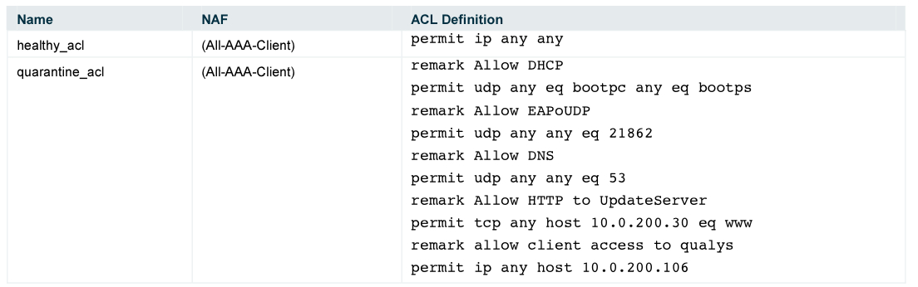
Weaknesses
Example: Default Quarantine ACL
Cisco and 802.1x
Source: Network Admission Control (NAC) Framework Configuration Guide, Cisco

Slide 60
In-Line Devices

Slide 61
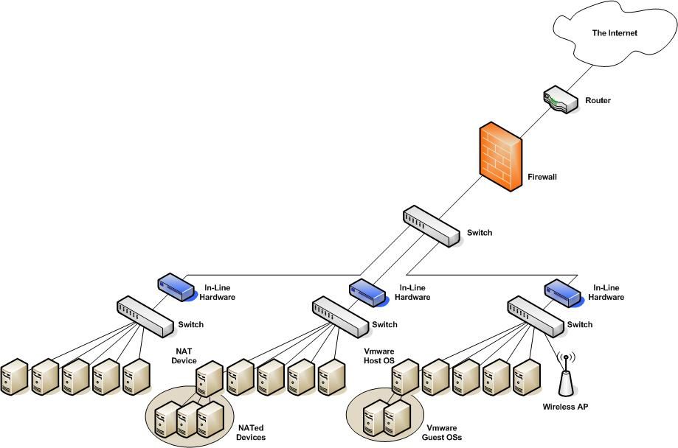
Architecture
In-Line Devices

Slide 62
Weaknesses
In-Line Devices
No knowledge on actual network topology may lead existence of other, uncovered venues to access the network
  Where to install the in-line devices
Deployment must involve a network re-architecture
Deployment must be as close as possible to the access layer to be efficient and productive
A possible point of failure
Deployment is time consuming (the networking people in IT would fiercely resist it)
The infection/compromise of other elements on the local subnet and/or switch is possible
Some elements may only generate Layer 2 traffic
Cost

Slide 63
Weaknesses
In-Line Devices
Element detection is performed at Layer 3 only
  Elements can infect and/or penetrate other elements on their local subnet, and cannot be stopped
  If elements are detected due to their IP traffic (rather then according to their Layer 2 traffic) there would be many different venues to bypass the in-line device
  If elements are detected due to their broadcast traffic, it is still possible to bypass the in-line device’s element detection capabilities (see: Broadcast Listeners)
  Bypassing enforcement by attacking a system on the local subnet using it as an ‘access proxy’ to other parts of the enterprise network
    With many IT networks servers will share the same subnet with desktops
Encryption

Slide 64
Weaknesses
In-Line Devices
Not able to detect smart masquerading
  Using the same underlying operating system as the NAT service provider will completely hide the NATed element (i.e. using random ID numbers, etc.)
Exceptions needs to be manually inputted (i.e. printers)
  There is no knowledge about the exception element (i.e. OS, exact location, functionality, and other properties)*
  It is possible to spoof the MAC address and/or the IP address of an exception is order to receive its access to the enterprise network
* If the operating system of the element is being tracked, mimicking the OS responses would yield the same access rights to the network

Slide 65
Out-of-Band Devices

Slide 66
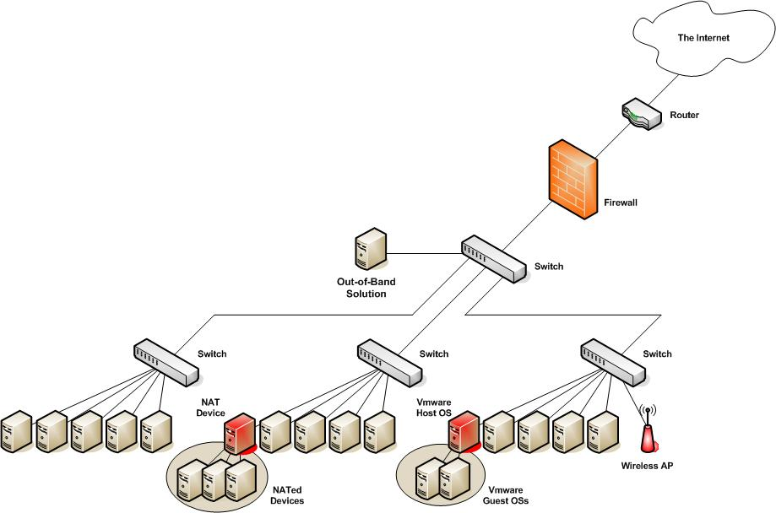
Architecture
Out-of-Band Devices

Slide 67
Strengths
Out-of-Band Devices
Fast to implement
Less moving parts
Real-time
Detection at L2 (if deployed close enough to the access layer)

Slide 68
Weaknesses
Out-of-Band Devices
Incomplete discovery
  Inactive elements will not be detected
As long as the traffic generated is not broadcast traffic and does not pass through the monitoring point of the out-of-band solution, the element would not be detected
May suffer from the different issues as Broadcast Listeners
For more issues please see: Risks of Passive Network Discovery Systems (PNDS), Ofir Arkin, 2005. Available from: http://www.insightix.com/resources/whitepapers.html

Slide 69
End Point Security Assessment

Slide 70
Agent-based
End Point Security Assessment
Strengths
  Provides a wealth of information regarding a host and its known* security state (OS, patches, A/V Signatures)
  Can provide a full featured solution
Weaknesses
  Usually available for Microsoft Windows operating systems only
  Management can be a nightmare
  Where to install the clients?
  No awareness of the entire network, not everything is covered
  The information which needs to be extracted from the elements may be easily spoofed (For example, Windows OS version, Service Pack version installed, patches installed, etc.)
* What the general public is aware of

Slide 71
Agent-less
End Point Security Assessment
Strengths
  No need to install additional software
  Deployment might be fast (depends on the type of solution)
Weaknesses
  Information regarding a certain element might not always be available (i.e. querying the host to receive a certain property of the host may not unveil the required information)
  Less granular information about elements operating on the network

Slide 72
The Real Risk
End Point Security Assessment
It all breaks down to what is being checked, and does the information is helpful or not
  Patches
    Security related patches (and other patches) are not enrolled into the enterprise as soon as they are available
    It may take months to enroll a major security update of an operating system (i.e. Microsoft Windows XP SP2)
  Zero day is not blocked
    The checks performed may be useless. Zero day viruses, worms, and vulnerabilities may not be detected, and remediation will not be available
  Understanding the real risk
    The risk from an element does not only rely on the version of the A/V signature file it may be running (I.e. information theft, unauthorized access, etc.)

Slide 73
Enforcement/Quarantine

Slide 74
Separate Subnet/VLAN
Quarantine Methods_x0003_
Weaknesses
  Creates a self infecting quarantine area of restricted elements
  In some cases (i.e. DHCP) it can be easily bypassed by assigning an element a static IP address (and changing routes)
  The best attack vector for an attacker
    The level of security of these elements will be the lowest of all elements residing on the network
    May share a common security-related issue which had prevented them from being allowed on the network

Slide 75
Separate Subnet/VLAN
Quarantine Methods_x0003_
Attack steps
  An attacker connects its machine to the network
  The attacker’s machine will be put into the quarantined subnet/VLAN
  The attacker can attack any element on the local quarantined subnet
  Infection
  Control
Solution
  Private VLAN per quarantined element with no access to other elements on the network except for the remediation servers

Slide 76
Switch Integration
Quarantine Methods_x0003_
Shutting down a switch port
  Shutting down a switch port without knowing the topology of the network and without relating to who is connected to that particular switch
  Creates situations in which legitimate elements may be disconnected from the network
  Must have a prior knowledge on who are all of the switches which are available on the network
  Must have SNMP R/W access to all of the switches
  Unmanaged switches are a big issue
ACLs
  ACLs provides enforcement at L3 only. Not all routers are capable of using them. Creates an extra load on a router

Slide 77
ARP Poisoning
Quarantine Methods_x0003_
Strengths
  Effective method
  Performed at L2
  Does not rely on switch integration
Weaknesses
  Must be deployed and/or connected to each subnet

Slide 78
802.1x
Quarantine Methods_x0003_
As long as it is provided at the access layer, it is the best element detection and quarantine method

Slide 79
Other Problematic Issues

Slide 80
Other Problematic Issues
Authentication as the only supervision means
  No supervision on an element’s action on the network once it is cleared to operate
Authorization is not part of many NAC solutions
Traffic is still possible to be tunneled through allowed protocols
Falsifying return information (i.e. windows registry information, etc.), for example, when scanned using a technology such as ActiveX
Attacks directing solution components (i.e. the possibility to compromise a certain element)
Enforcement and Element Detection at L2 Vs. at L3
Managed Vs. Unmanaged Elements
No knowledge regarding the ‘big picture’

Slide 81
Microsoft NAP

Slide 82
Microsoft NAP
“When evaluating the following, keep in mind that Network Access Protection is not a security solution. It is designed to help prevent computers with unsafe configurations from connecting to a network, not to protect networks from malicious users who have valid sets of credentials and computers that meet current health requirements.” - Introduction to Network Access Protection, Microsoft

Slide 83
Microsoft NAP Components
Source: Microsoft
Source: Microsoft

Slide 84
Microsoft NAP Components Interaction
Source: Microsoft

Slide 85
Microsoft NAP
IPsec
802.1x
DHCP
VPN

Slide 86
Questions?

Slide 87
Resources
Microsoft NAP http://www.microsoft.com/technet/itsolutions/network/nap/default.mspx
Cisco NAC http://www.cisco.com/en/US/netsol/ns466/networking_solutions_package.html
TCG https://www.trustedcomputinggroup.org/home

Slide 88
Thank You

