Slide 1


Neurasmus, Amsterdam, July 4th 2024 Mathematical Models of Neural Activity
NicolasDoyon
Laval University, Québec Canada

Slide 2
Introduction and biophysical principles

Slide 3
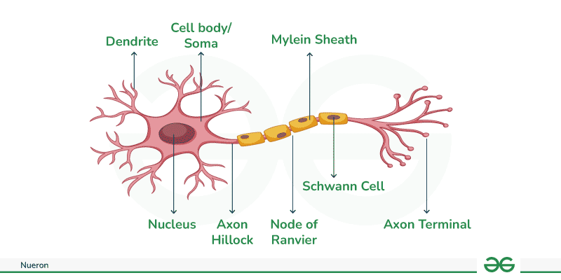
What do neurons do?
Neurons receive information through their dendrites,
They integrate information in their soma,
They transmit information to other neurons through their axon.

Slide 4

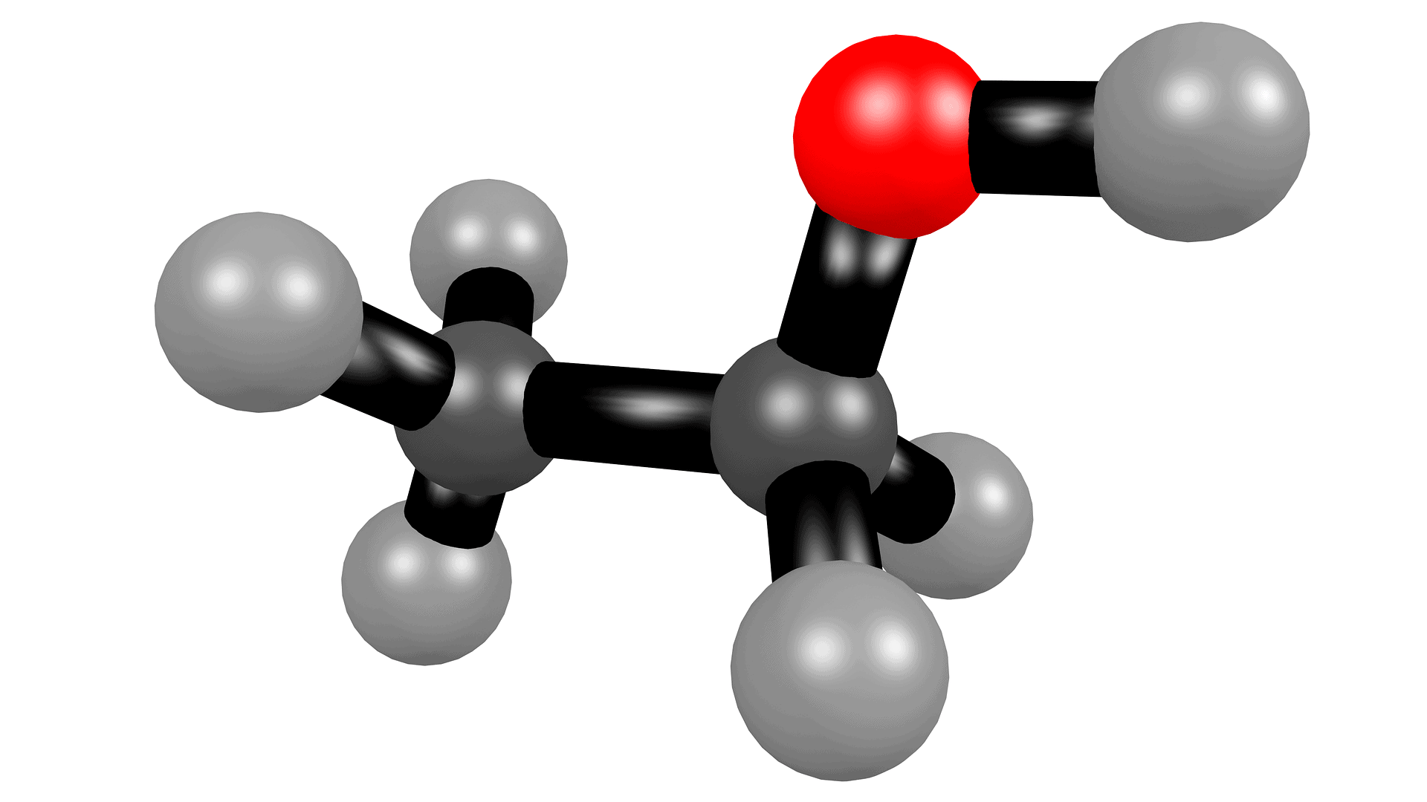
Different types of models
According to the level of details we want to include, there are several possible modeling approaches.
A more complex or more complete model is not always better.
Scale matters
(single protein, synapse, single cell, network)

Slide 5

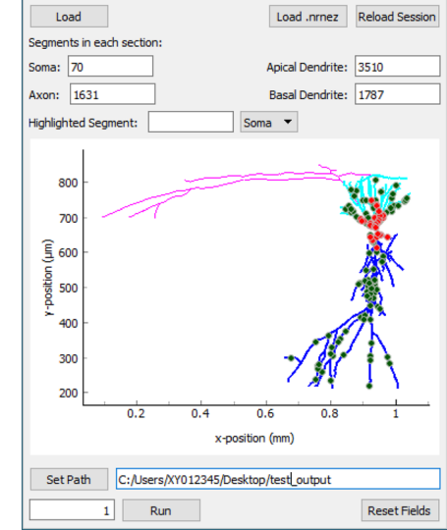
The NEURON software
For those who want to know more about detailed single cell models, the NEURON software is taylor made to develop modular models of single neurons. https://modeldb.science/

Slide 6
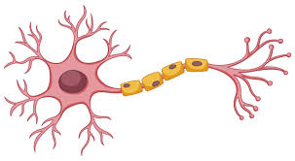
Single compartment models
We will neglect the spatial dimension of the neuron and treat the intracellular space as a single homogeneous compartment.
Extra
Intra

Slide 7
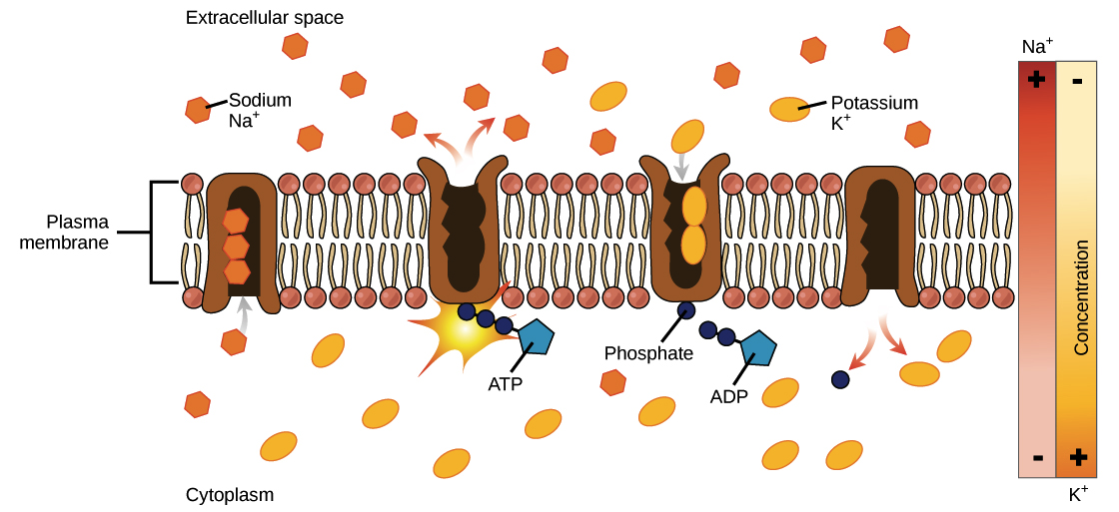
Some biophysical principles
The membrane acts as a separation between the intracellular and extracellular medium.
Intra and extracellular concentrations are different.
This difference is maintained by the sodium potassium pump which uses ATP to transport ions against their concentration gradient.
Typical ionic concentrations
Ion type | Intra | Extra
chloride | 10 mM | 140 mM
Sodium | 15 mM | 120 mM
Potassium | 140 mM | 3 mM
Calcium | 100 nm | 1 mM
https://www.khanacademy.org/science/ap-biology/cell-structure-and-function/facilitated-diffusion/a/active-transport

Slide 8


The Nernst potential
Ion gradients =
Two forces regulate ion movement across the membrane.
Electric
force
Diffusion
1. Diffusion (technically not a force)
2. Electric force
Nernst
pot.
The Nernst reversal potential of an ion is the value of the membrane potential for which these two forces balance each other out.

Slide 9
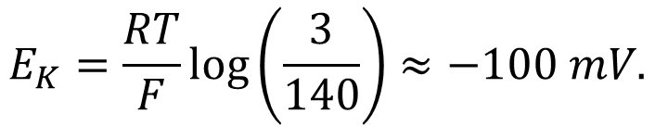
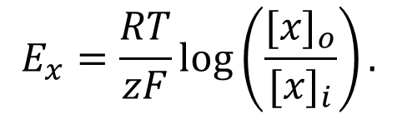
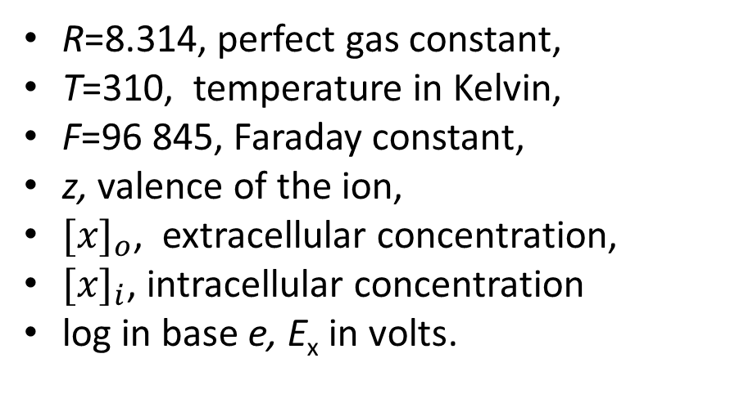
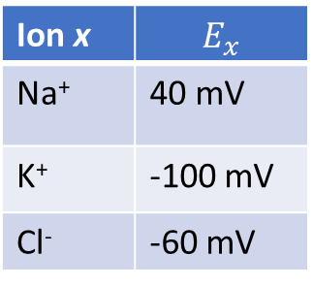
The Nernst potential
The Nernst equation is given by:
For potassium for example, we have
$$E_{x}=\frac{RT}{zF}log\left(\frac{{[x]}_{o}}{{[x]}_{i}}\right).$$
$$E_{K}=\frac{RT}{F}log\left(\frac{3}{140}\right)≈−100 mV.$$
R=8.314, perfect gas constant,
T=310, temperature in Kelvin,
F=96 845, Faraday constant,
z, valence of the ion,
${[x]}_{o}$, extracellular concentration,
${[x]}_{i}$, intracellular concentration
log in base e, E_{x} in volts.
When V_{m}=-100 mV:
The negative potential attracts potassium (K⁺) inside the cell.
This balances the diffusion that drives K⁺ out.
Ion x | $$E_{x}$$
Na⁺ | 40 mV
K⁺ | -100 mV
Cl⁻ | -60 mV
E_{K}=-100 mV
E_{Na}=40 mV
V_{rest}=-60 mV

Slide 10
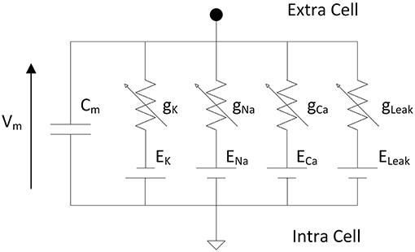
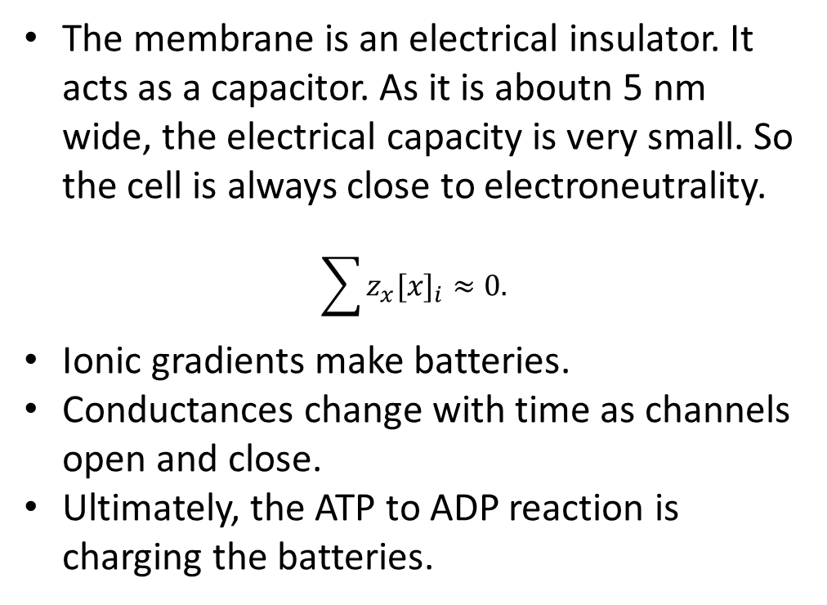
Neurons as electrical circuits
Neurons are often schematized as an electrical circuit.
The membrane is an electrical insulator. It acts as a capacitor. As it is aboutn 5 nm wide, the electrical capacity is very small. So the cell is always close to electroneutrality.
$$\sum{z_{x}{[x]}_{i}}≈0.$$
Ionic gradients make batteries.
Conductances change with time as channels open and close.
Ultimately, the ATP to ADP reaction is charging the batteries.
https://www.frontiersin.org/journals/neuroscience/articles/10.3389/fnins.2019.00377/full
.

Slide 11
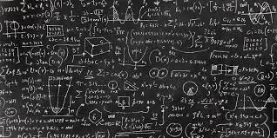
Now some math…
Just a little bit…

Slide 12



Ordinary Differential Equations (ODEs)
Ordinary differential equations are a powerfull mathematical tool to describe variables that evolve continuously with time.
If x is the heigth of a falling apple:
$$x^{′′}=−g.$$
$$\frac{dx}{dt}=f\left(x,t\right).$$
The general form of an ode is given by:
Here $x$ can be a single variable or a vector describing several variables.

Slide 13



Ordinary differential equations
ODEs describe the rate of change of certain quantities. To obtain solutions, we always have to specify the initial state of the system (initial conditions).
It is very rarely possible find an exact solution to ODEs.
We have to use numerical methods.
Don’t worry, python (or any language, does it for you).
In Python, there are several options, odeint is a simple one.

Slide 14
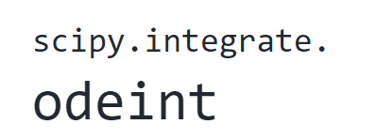
Ordinary differential equations
odeint(func, y0, t, args=())
Parameters such as conductances
The equation you want to solve
Initial conditions
A list of the time points on wich you want the solution
You have to importe the package

Slide 15
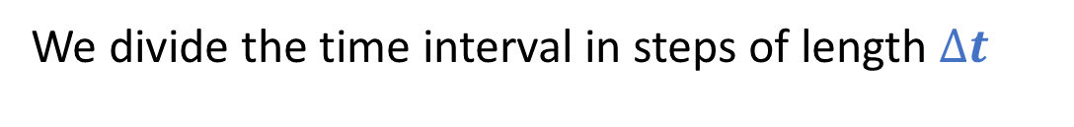


Ordinary differential equations
How does the computer do it?
Some integration methods can be quite complicated…
We present the Euler forward method.
Downside: Imprecise.
Upside: Simple we can implement it manually in a for loop when odeint cannot be used.
We divide the time interval in steps of length $∆t$
…
$$∆t$$
t_{init}
t_{end}
We compute on each time step:
$$x^{′}=f\left(x\right)→x\left(t+∆t\right)≈x+∆tf\left(x\right).$$

Slide 16







Ordinary differential equations
Example: Suppose you want to solve
$$x^{′}\left(t\right)=x, x\left(0\right)=1, 0≤t≤4.$$
For $∆t=1,$ we have
$$x\left(1\right)≈x\left(0\right)+x^{′}\left(0\right)=2,$$
$$x\left(2\right)≈x\left(1\right)+x^{′}\left(1\right)=4,$$
$$x\left(3\right)≈x\left(2\right)+x^{′}\left(2\right)=8,$$
$$x\left(4\right)≈x\left(3\right)+x^{′}\left(3\right)=16.$$
For $∆t=0.5,$ we have
$$x\left(0.5\right)≈x\left(0\right)+0.5 x\left(0\right)=1.5,$$
$$x\left(1\right)≈x\left(0.5\right)+{0.5x}^{′}\left(0.5\right)=2.25,$$
….
$$x\left(4\right)≈x\left(3.5\right)+0.5x^{′}\left(3.5\right)=\text{25.62}.$$
When we choose a smaller $∆t$, the solutions are more precise but resolution takes longer.

Slide 17
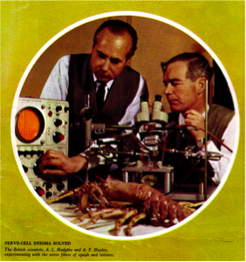
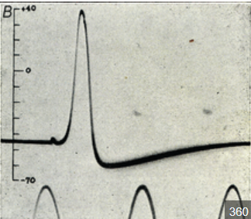
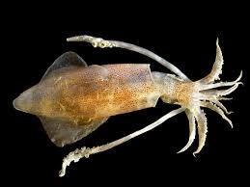
The Hodgkin-Huxley model

Slide 18
The Hodgkin-Huxley model
The Hodgkin-Huxley model has an historical and practical importance.
It has been derived from experiments on the giant squid axon.
The authors won the Nobel prize in Physiology or Medicine in 1963 for their work.
Their model rely on the description of voltage gated sodium and potassium channel.

Slide 19
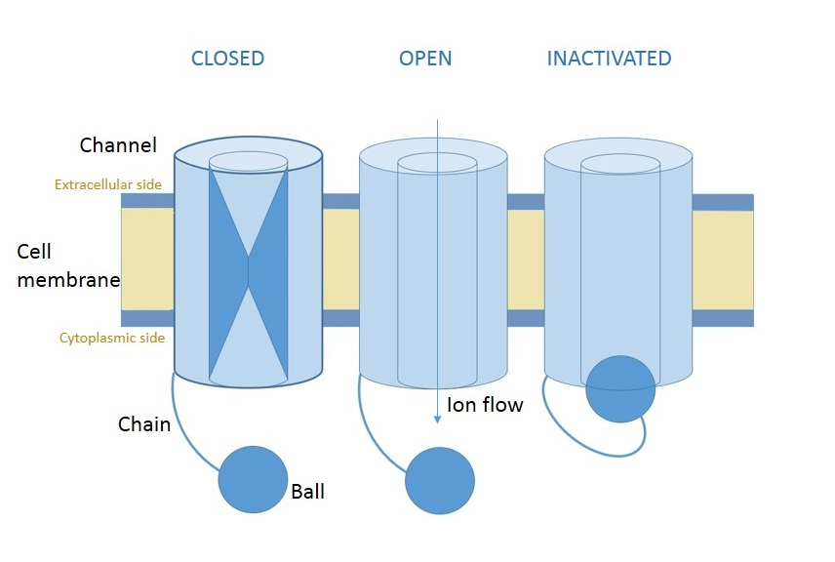
Sodium and potassium voltage gated channels
The voltage gated potassium and sodium channels are responsible for generating the action potential.
Gates open and close according to the membrane potential.
Sodium channels have two types of gates, including an inactivating one.
wikipedia

Slide 20
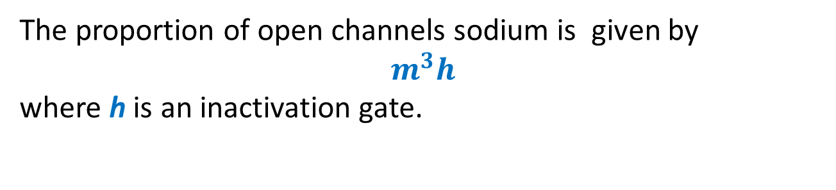
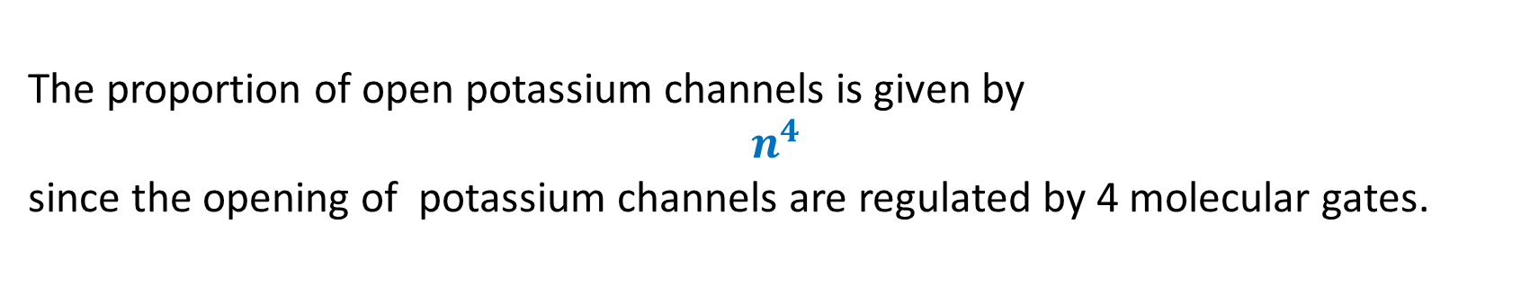
Sodium and potassium voltage gated channels
The proportion of open channels sodium is given by
$$m^{3}h$$
where h is an inactivation gate.
The proportion of open potassium channels is given by
$$n^{4}$$
since the opening of potassium channels are regulated by 4 molecular gates.
The presence of exponents may seem surprinsing. Their values have been emipirically derived.

Slide 21
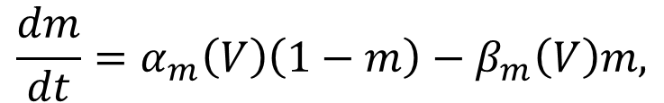
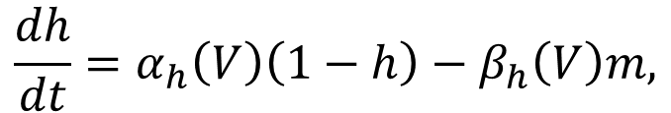
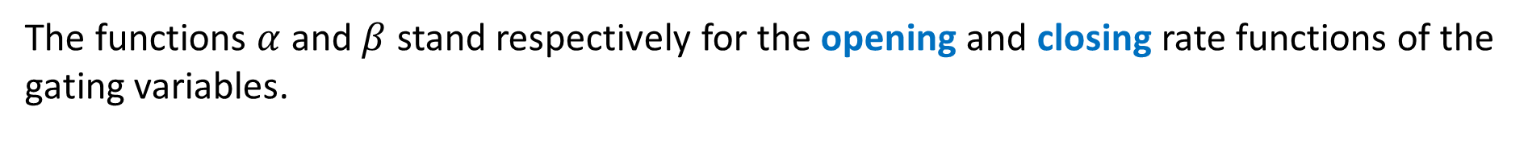
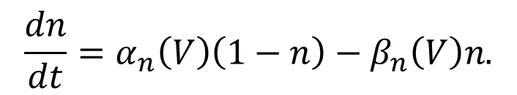
The Hodgkin-Huxley equations
Putting all this together, we get the following system of equations that specify the HH model:
$$C\frac{dV}{dt}=g_{L}\left(E_{l}−V\right)+\overline{g_{Na}}m^{3}h\left(E_{Na}−V\right)+\overline{g_{K}}n^{4}\left(E_{K}−V\right)+I,$$
$$\frac{dm}{dt}=α_{m}\left(V\right)\left(1−m\right)−β_{m}\left(V\right)m,$$
$$\frac{dh}{dt}=α_{h}\left(V\right)\left(1−h\right)−β_{h}\left(V\right)m,$$
$$\frac{dn}{dt}=α_{n}\left(V\right)\left(1−n\right)−β_{n}\left(V\right)n.$$
The functions $α$ and $β$ stand respectively for the opening and closing rate functions of the gating variables.
Due to the form of the equations, the gating variables will always remain between 0 and 1.

Slide 22
Qualitative behaviour of the Hodgkin-Huxley model
The parameter I corresponds to the external current injected into the cell. Its value determines the behaviour of the neuron
If the value of I is small, than the neuron remains at resting state.
For intermediate values of I, the neuron emits action potentials.
For very strong values of I, the neuron is in an inactive depolarized state.

Slide 23
Stages of an action potential in the HH model
The membrane depolarizes.
The m gates open, sodium enters and membrane further depolarizes (around -30 mV to 20 mV)
When the cell is depolarized, the h gate closes and the n gates opens.
Due to potassium currents, the cell hyperpolarizes.
The n gates close and the h gate opens.

Slide 24
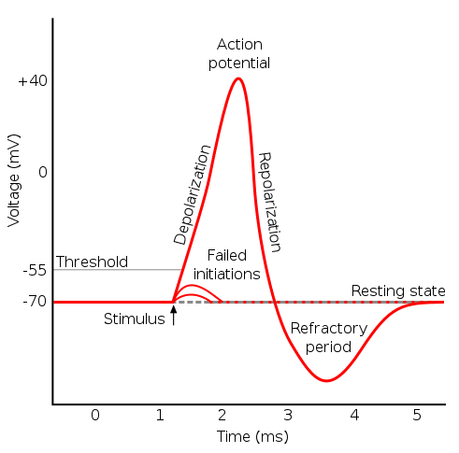
Leaky Integrate and Fire model (LIF)
One possible simplification is to omit the description of the action potential altogether.
This is interesting from the point of view of model simplicity since the typical shape of an action potential is rather difficult to replicate.

Slide 25
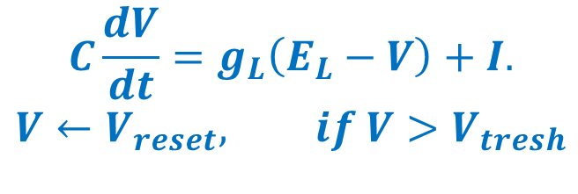
Leaky Integrate and Fire model (LIF)
The equation specifying the LIF model is given by:
$$C\frac{dV}{dt}=g_{L}\left(E_{L}−V\right)+I.$$
$$V←V_{reset}, if V>V_{tresh}$$
The second line is to be interpreted as:
When V reaches a threshold value (V_{tresh} usually around -30 mV), we assume that an action potential occurs and that the potential is instantaneously resetted.
The LIF model is not specified by ODEs.
Since it is discontinuous, we cannot directly use odeint to solve it.
We will solve it ‘manually’, by updating the value of the membrane potential at each time step in a for loop.

Slide 26
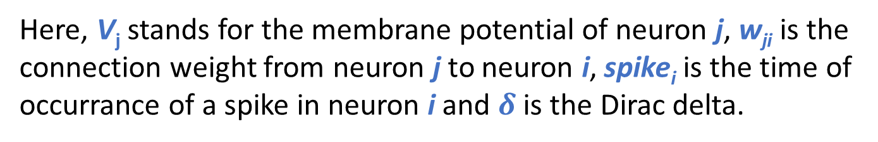
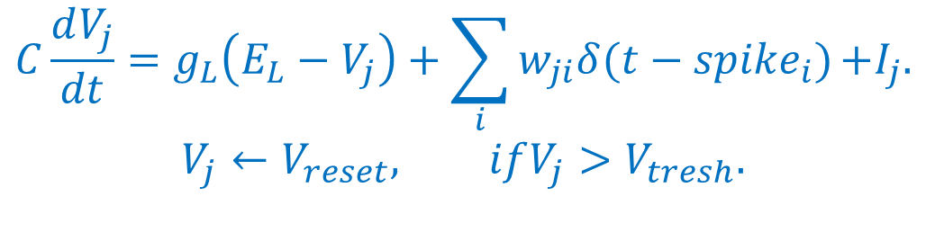
Leaky Integrate and Fire models.
Thanks to their simplicity, LIF models are often used to describe neurals networks.
When used in a network context, the equation describing the evolution of LIF neurons becomes:
$$C\frac{dV_{j}}{dt}=g_{L}\left(E_{L}−V_{j}\right)+\sum_{i}{w_{ji}δ(t−{spike}_{i})}{+I}_{j}.$$
$$V_{j}←V_{reset}, ifV_{j}>V_{tresh}.$$
Here, V_{j} stands for the membrane potential of neuron j, w_{ji} is the connection weight from neuron j to neuron i, spike_{i} is the time of occurrance of a spike in neuron i and $δ$ is the Dirac delta.

Slide 27
Wilson-Cowan (WC) models
Another approach to simplify models of neural activity is to divide the states of neurons into a finite set of possible states according to their level of activity.
The Wilson-Cowan model divides neurons into 3 states:
Active: The neuron emits an action potential.
Susceptible
Susceptible: Neurons are at resting state but can become active if they receive enough stimulation.
Refractory
Active
Refractory: Shortly after firing, neurons cannot firing again no matter the input.

Slide 28
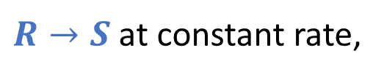
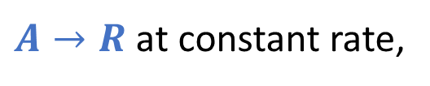
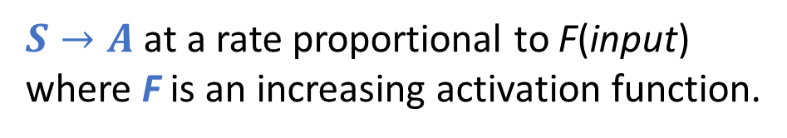
Wilson-Cowan model
Remark: Wilson-Cowan models don’t describe the state of individual neurons.
Transitions:
A(t): The proportion of neurons in active state at time t.
$A→R$ at constant rate,
R(t): The proportion of neurons in refractory state at time t.
$R→S$ at constant rate,
S(t): The proportion of neurons in susceptible state at time t.
$S→A$ at a rate proportional to F(input)
where F is an increasing activation function.

Slide 29
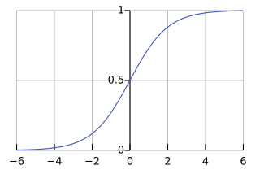
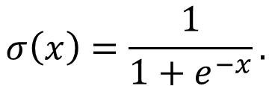
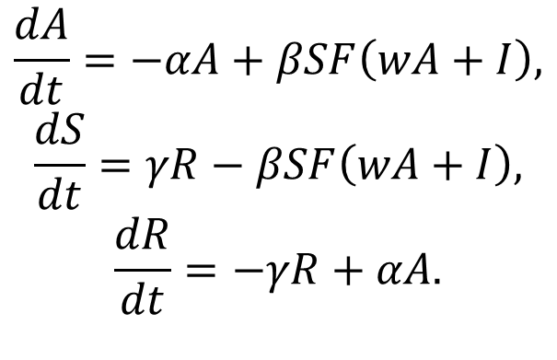
Wilson-Cowan model
The Wilson Cowan model is specified by the equations:
$$\frac{dA}{dt}=−αA+βSF\left(wA+I\right),$$
$$\frac{dS}{dt}=γR−βSF\left(wA+I\right),$$
$$\frac{dR}{dt}=−γR+αA.$$
The parmater w can be interpreted as the mean connection weight between two neurons.
The sigmoid function is often used as an activation function
$$σ\left(x\right)=\frac{1}{1+e^{−x}}.$$

Slide 30
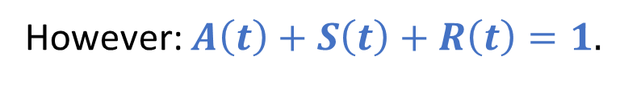
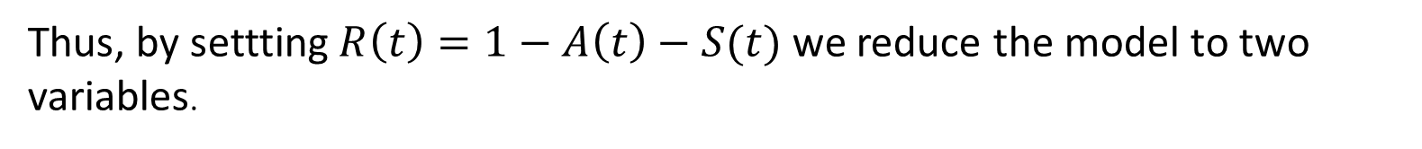
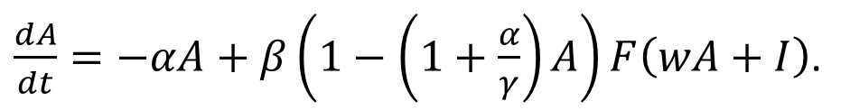
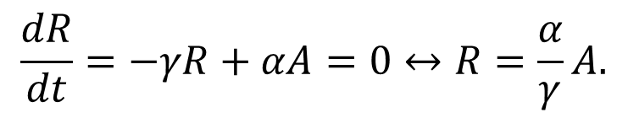
The Wilson-Cowan model
At first glance, the Wilson-Cowan model has 3 dimension (3 independant variables).
However: $A\left(t\right)+S\left(t\right)+R\left(t\right)=1.$
Thus, by settting $R\left(t\right)=1−A\left(t\right)−S(t)$ we reduce the model to two variables.
We can also assume that the proportion of refractory neurons is at equilibrium.
$$\frac{dR}{dt}=−γR+αA=0↔R=\frac{α}{γ}A.$$
With this, we obtain a one dimensional version of the model
$\frac{dA}{dt}=−αA+β\left(1−\left(1+\frac{α}{γ}\right)A\right)F\left(wA+I\right)$.

Slide 31
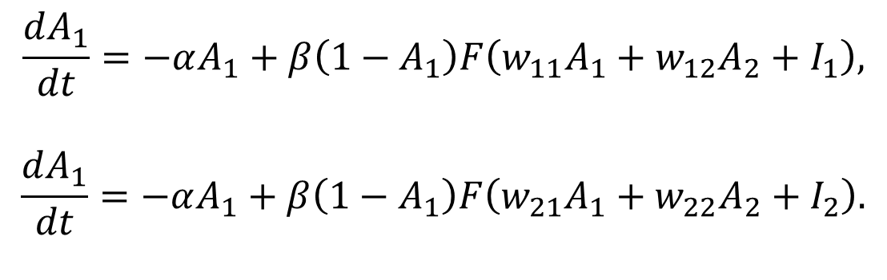
The Wilson-Cowan model
The WC model can also be applied to models with several populations.
In this context, a population of neurons is an abstract and somewhat arbitrary concept.
A population is a group of neurons with similar properties and expected to have similar levels of activity.
Neurons are often divided into populations of inhibitory and excitatory neurons. Populations can also be defined according to the spatial positions of neurons.
The equations for two population WC models are given by:
$$\frac{dA_{1}}{dt}=−αA_{1}+β\left(1−A_{1}\right)F\left(w_{11}A_{1}+w_{12}A_{2}+I_{1}\right),$$
$$\frac{dA_{1}}{dt}=−αA_{1}+β\left(1−A_{1}\right)F\left(w_{21}A_{1}+w_{22}A_{2}+I_{2}\right).$$

