Slide 1
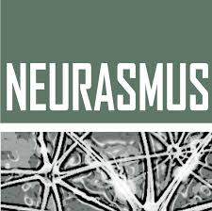


Research application: Zebrafish brain data analysis
Workshop - Introduction to Computational Neuroscience
Neurasmus : European Master in Neuroscience
2024 July 3rd - 6th, Amsterdam, Netherlands
Patrick Desrosiers
Dynamica Research Lab
CERVO Brain Research Center
Département de physique, de genie physique et d’optique, Université Laval

Slide 2
















Slide 3
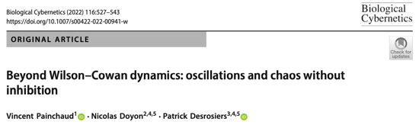
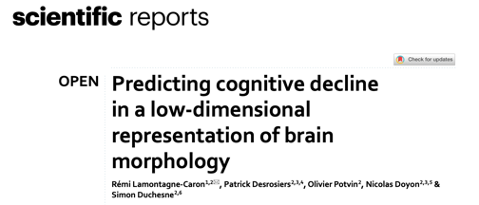
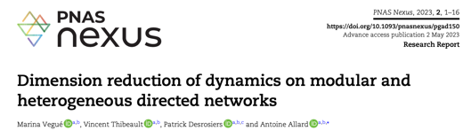



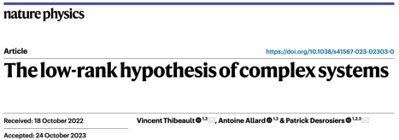
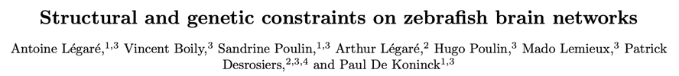

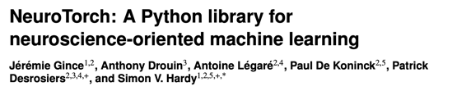
Two main research axes
Theoretical work
Data analysis
bioRxiv, July 2024
Extracting structural properties from cultured neurons using digital holography microscopy and U-Net
Nature Communications (2024, In Press)
Z. Yazdani, E.Bélanger, M. Moreaud, M. Haouet, M.È. Crochetière, P. Marquet, A. Allard, P. Desrosiers
bioRxiv, August 2024
Submitted to Network Neuroscience (2023)
In progress

Slide 4







bioRxiv, expected August 2024

Slide 5
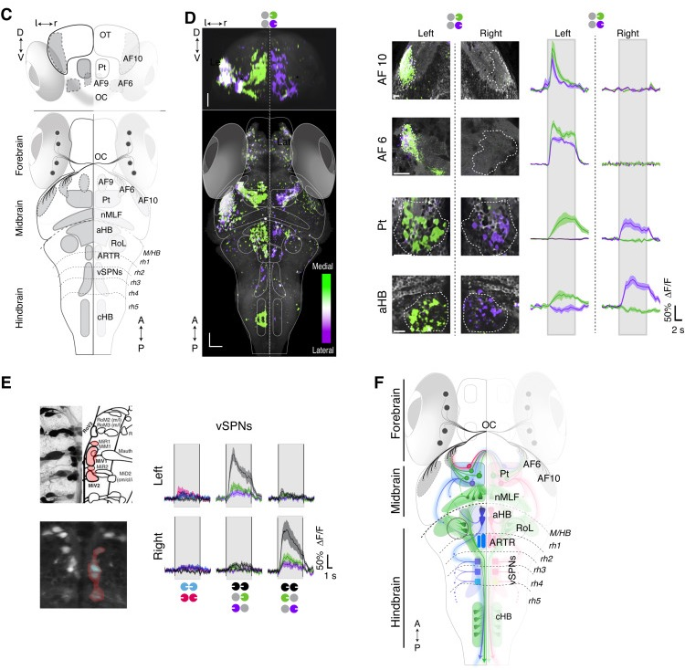
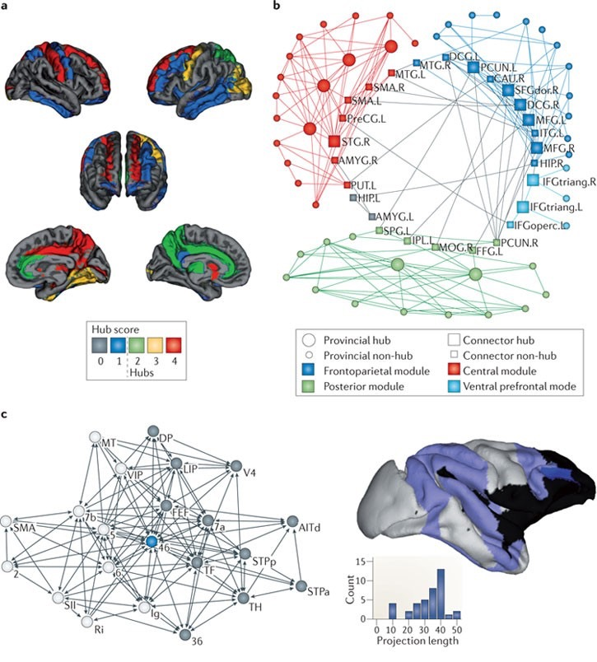
zebrafish brain
zebrafish brain networks
brain networks
Naumann et al. (2016) Cell
Bullmore & Sporns (2012) Nat. Rev. Neurosci.
Elaborate circuit reconstructions, single-cell resolution, optogenetics
Human neuroimaging, large-scale cognitive systems, network science
Notes:
By venturing into the zebrafish brain networks literature, I was exposed on one hand to the zebrafish brain research, which consists of extremely elaborate circuit reconstructions at single-cell resolution using optical approaches; and on the other hand, to the brain networks literature, which is dominated by the human neuroimaging field which uses non-invasive imaging and network science to study large-scale cognitive systems

Slide 6
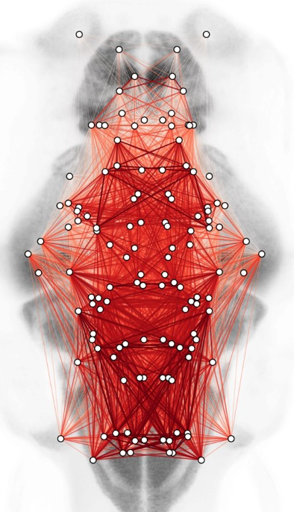
Zebrafish brain networks
Mesoscopic dynamics with cellular information
Naumann et al. (2016) Cell
Bullmore & Sporns (2012) Nat. Rev. Neurosci.
Behavior and circuit reconstructions at single-cell resolution, optogenetics
Human neuroimaging, large-scale cognitive systems and network science
Notes:
Our research tries to squeeze right in the middle, by bringing network approaches to a small vertebrate model where we have access to fine-grained, cellular information

Slide 7
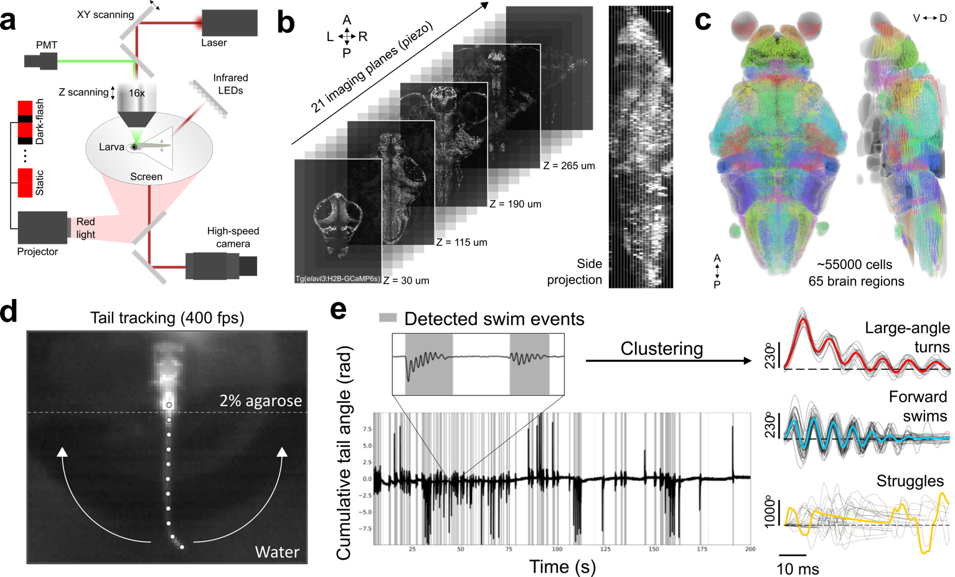
PDK Lab developed a system for whole-brain calcium imaging & behavioral monitoring
Whole-brain calcium imaging & behavioral monitoring
Brain imaging
(mapZebrain)
Behavior
1
Notes:
This way, we can project all the identified cell coordinates into different anatomical brain regions of the atlas, which is the anatomical basis for the network analysis.
We also have a high-speed monitoring system to track the unrestrained tail of the fish.

Slide 8
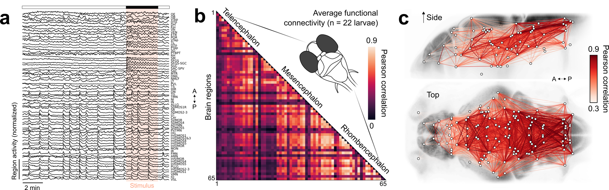
We inferred mesoscopic brain networks from calcium imaging data
Calcium imaging of mesoscopic brain networks
Dataset of 22 larvae (5-7 dpf): 15 minutes, spontaneous activity followed by light/dark visual stimuli.
Networks are computed using spontaneous activity.
Average calcium activity
65 brain regions
Group-average functional connectivity (FC)
Mesoscopic functional network
Notes:
For this, we measured spontaneous and visually-evoked activity in multiple larvae. To compute functional networks, we first extract the average activity of each brain region, and then we compute pairwise correlations, yielding a correlation matrix which encapsulates the temporal dependencies between activity patterns across the brain. We can visualize this network, which has very strong positive links in the visual and motor regions.

Slide 9

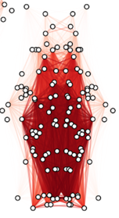
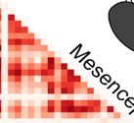
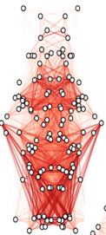
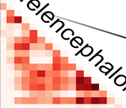
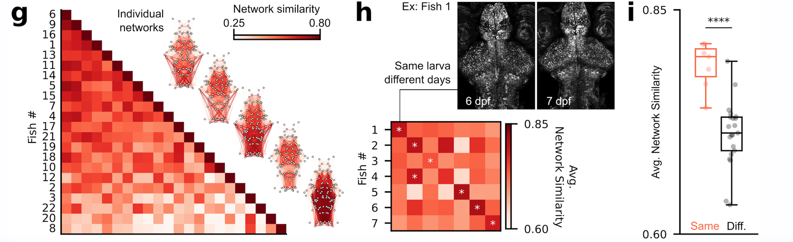
Specificity of FC was validated
Validating the reproducibility and specificity of FC
Pearson coefficient
Connectome fingerprinting works for fish too. Finn et al. (2015) Nat. Neurosci.
Notes:
We then wanted to validate if those measurements were robust and specific. We first compared our recently acquired data to an older dataset from last summer, measuring very similar correlation values. We then compared with lightsheet data from Misha Ahrens Lab, observing similar correlations as well, though the differences here could be explained by the different calcium indicator used in their study. Next we wanted to make sure we were picking up biologically meaningful patterns. As zebrafish larvae undergo a very strict neurodevelopmental course, we expect their brain activity patterns to be similar, which is indeed what we see here. We wondered if this similarity was even greater in the same individuals over time, so we imaged larvae on consecutive days and we were able to recover their identity purely by comparing their functional connectivity, replicating the well-known connectome fingerprinting and individuality of human brain networks, although this is a very small sample

Slide 10
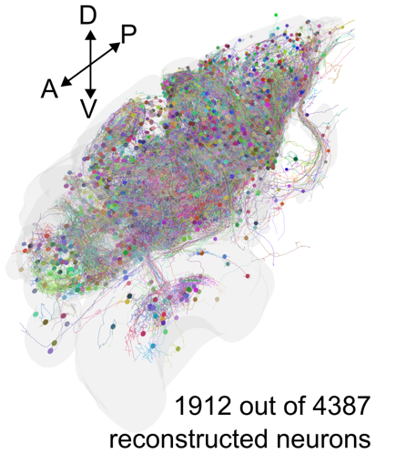
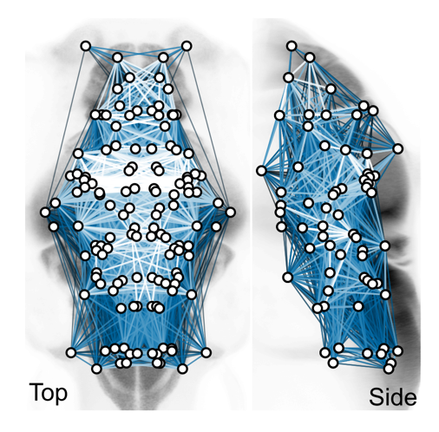
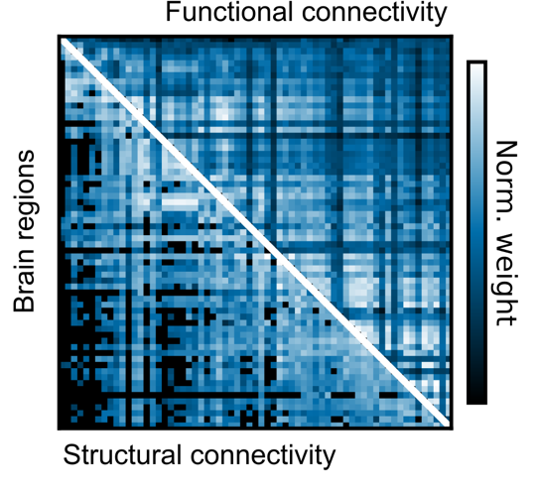
SC-FC comparison
How similar are structural and functional networks?
Mesoscopic SC
SC/FC comparison
Kunst et al. (2019) Neuron
Observations:
SC and FC are significantly correlated (Pearson $r=0.568$, spatially-constrained null model)
However, high correlations exist between structurally unconnected regions

Slide 11

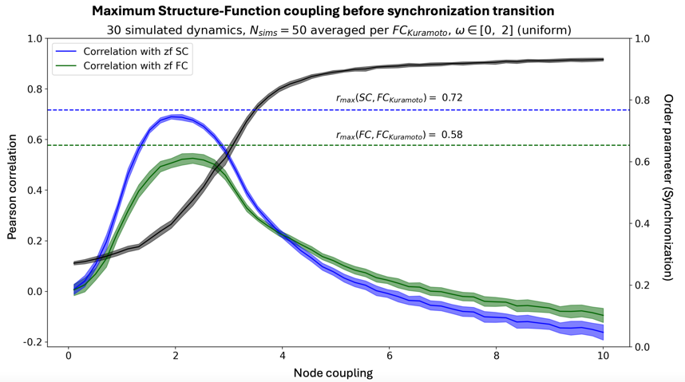
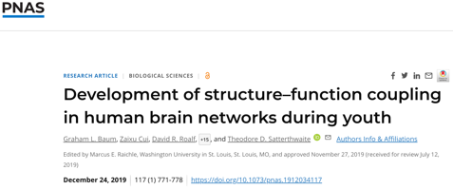
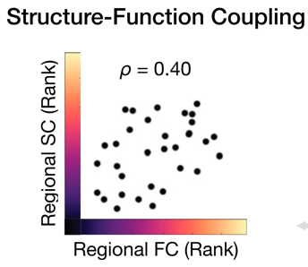
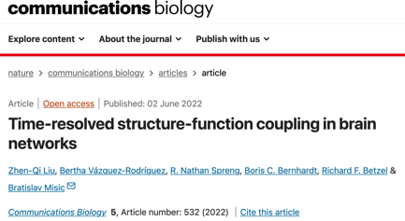
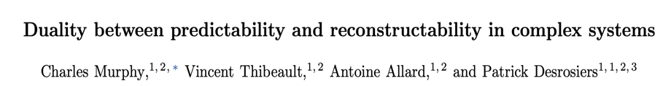
SC-FC comparison
How similar are structural and functional networks?
Consistent with previous empirical observations …
and numerical simulations on the SC …
Mesoscopic SC
SC/FC comparison
and Information-theoretic analysis of stochastic dynamics on random networks
Nature Communications (2024, In Press)
Observations:
SC and FC are significantly correlated (Pearson $r=0.568$, spatially-constrained null model)
However, high correlations exist between structurally unconnected regions

Slide 12
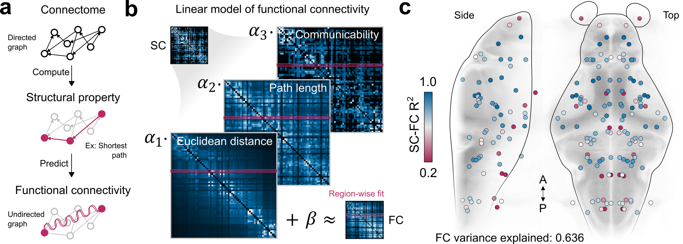
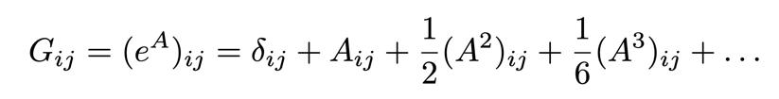
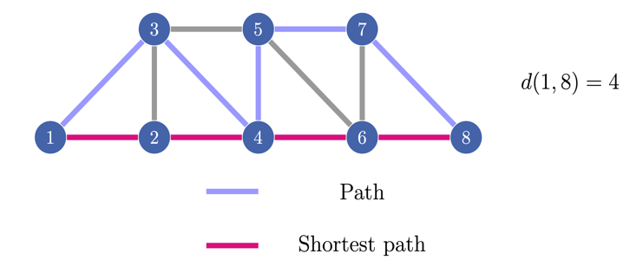
But three structural measures better predict function
Linear modeling of multiple communication mechanisms
Correlated activity emerges from complex network interactions that go beyond pairwise interactions
Network communicatibitily G measures of how efficiently information can spread between nodes in a network.
The communicability between nodes 𝑖 and 𝑗 is the sum of all possible paths between them, each weighted by its length to favor shorter, more efficient routes:
Network communicability is a measure of how efficiently information can spread between nodes in a network. It is calculated using the exponential of the adjacency matrix:
Topological
Topological
Non-topological, geometrical
Different predictors assume different communication mechanisms for each brain region
Notes:
as this is a complex network, we can expect correlations to emerge from interactions that go beyond simple direct connections. As an example, correlations could emerge from polysynaptic pathways, as depicted here. To account for multiple mechanisms, we used a common linear modeling approach to predict functional connectivity patterns of each region using three predictors derived from the structural network. Overall, this model explains 63% of variance, which beats a random graph null model. Visual regions can be better predicted, though we still have to fully characterize this spatial heterogeneity.

Slide 13
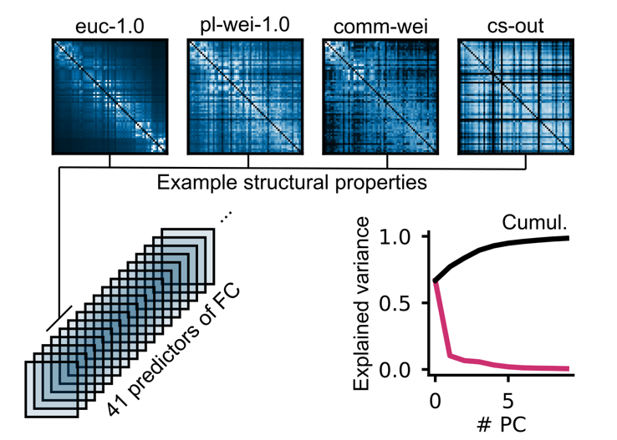
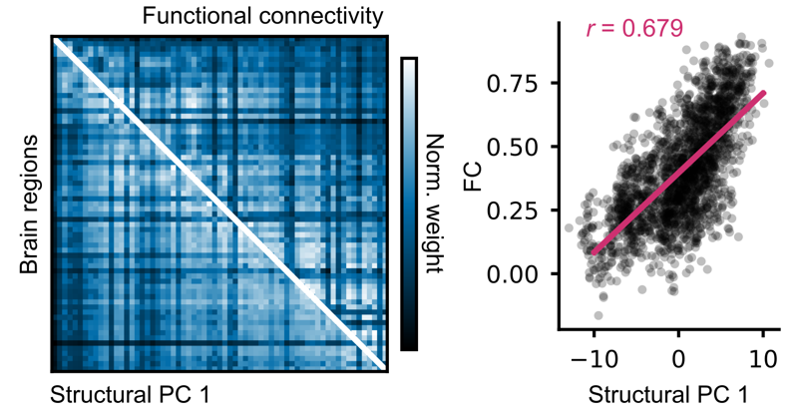
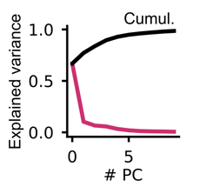
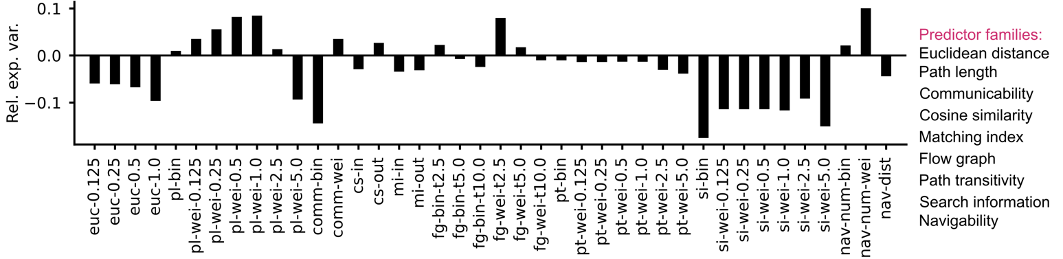
Multiple structural factor drive inter-regional correlation
Multiple factors driving inter-regional correlations
Zamani Esfahlani et al. (2022)
Compiling a whole bunch of network properties to evaluate which ones are predictive of activity
PCA
Path length
Flow graph
Diffusion process
Spatial distance

Slide 14
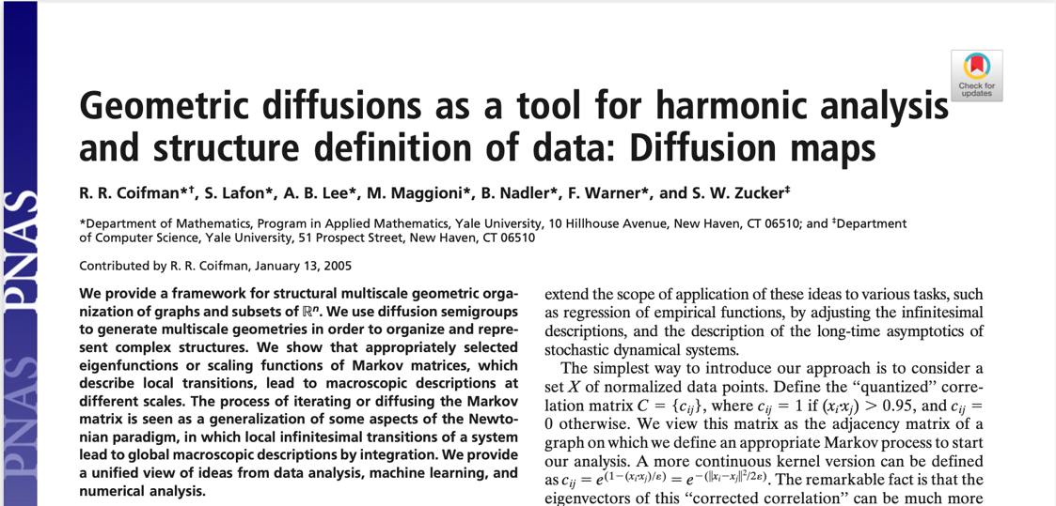
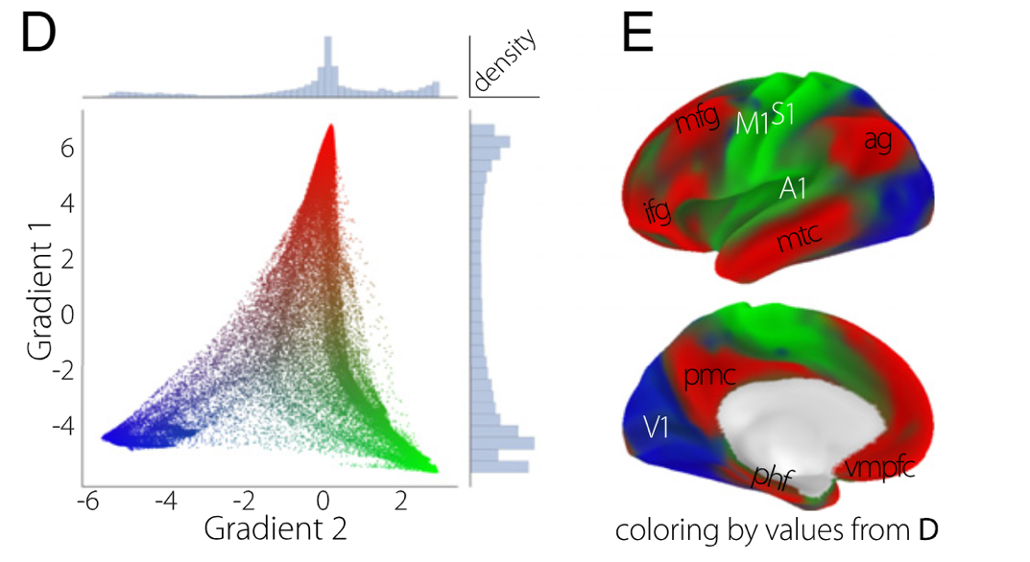
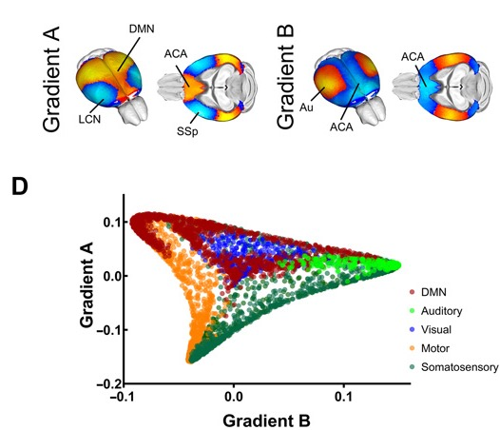

Diffusion map embeddings revealed functional gradients
Functional gradients in mammalian brain networks
Recent investigations suggest that gradients of functional connectivity (typically diffusion eigenmodes) separate visual, motor, and higher-order regions in mammals.
Margulies et al. (2016)
Coletta et al. (2020)
Cognitive
Visual
Motor
Human and macaque
Mouse

Slide 15
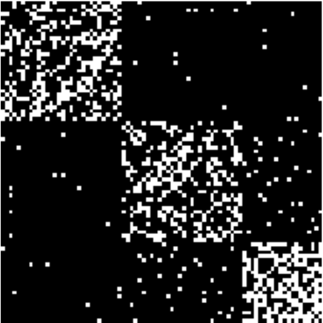
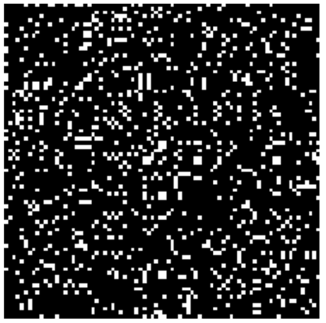
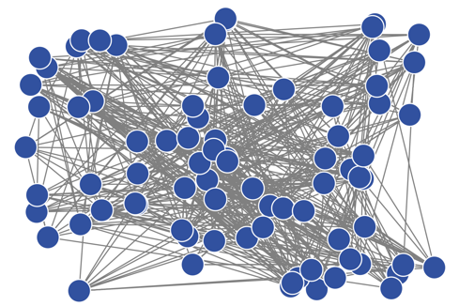
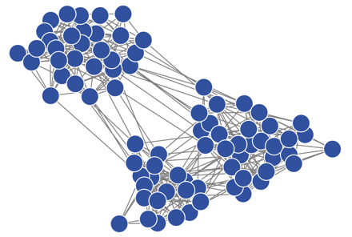
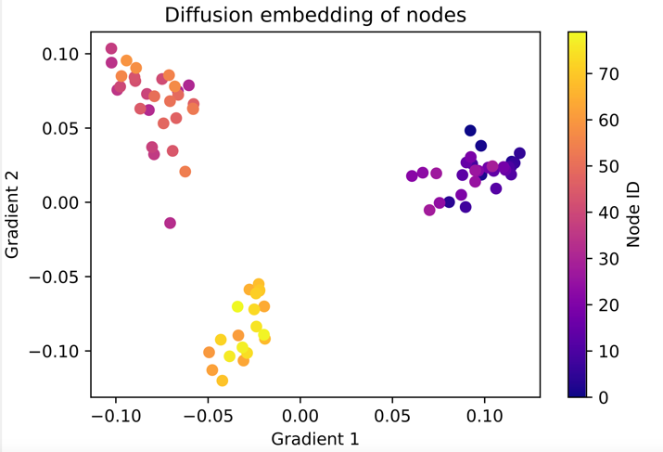
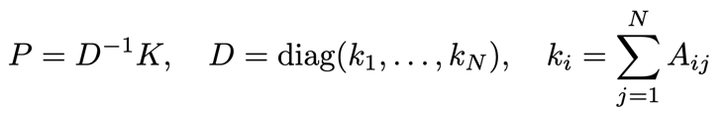
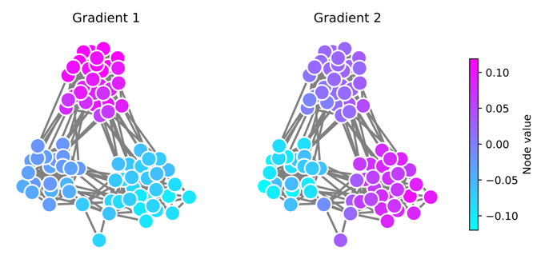
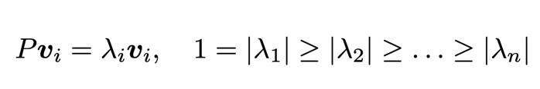

How diffusion map works?
Desired result, not available before analysis
node = high-dimensional vector
2d projection
1. Diffusion transition matrix:
2. Eigen-decomposition:
3. Map:
Gradient 1
Gradient 2

Slide 16
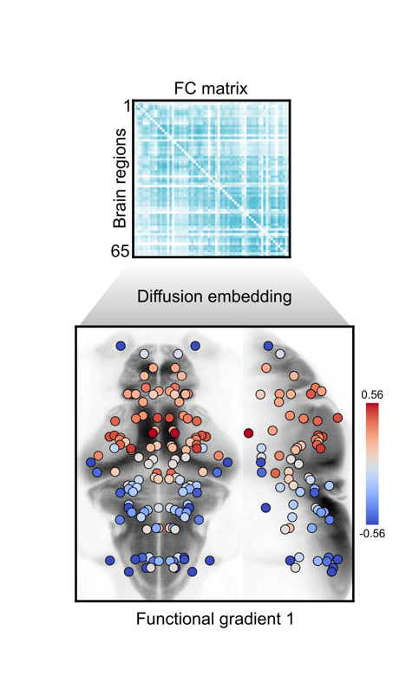
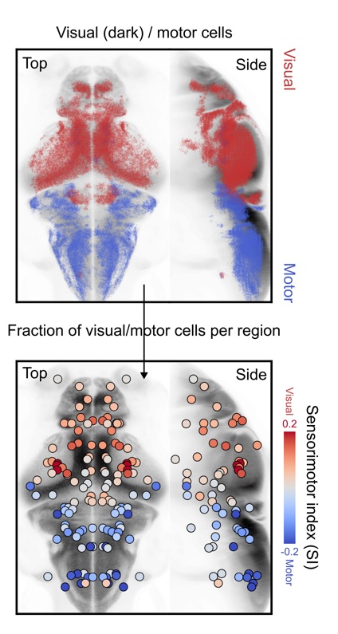
Uncovering a sensorimotor functional gradient
Result: The dominant axis of FC (and SC, not shown) predicts sensorimotor affiliation.
1. Diffusion embedding
2. Sensorimotor index

Slide 17
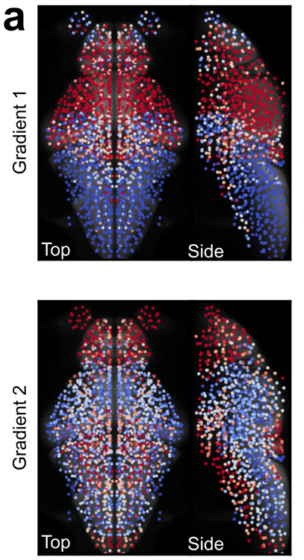
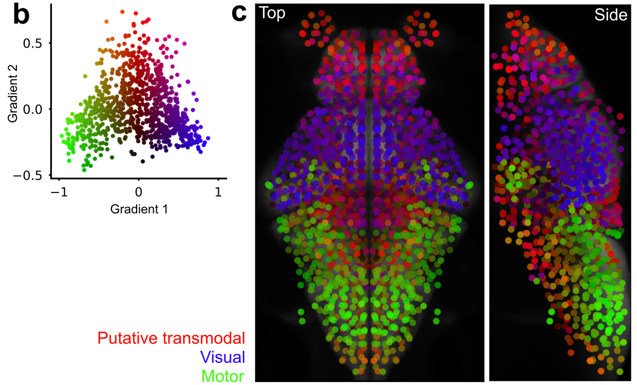
What about the other gradient?
Hypothesis: A second functional gradient separates visual/motor regions from putative transmodal regions in the non-mammalian zebrafish brain

Slide 18
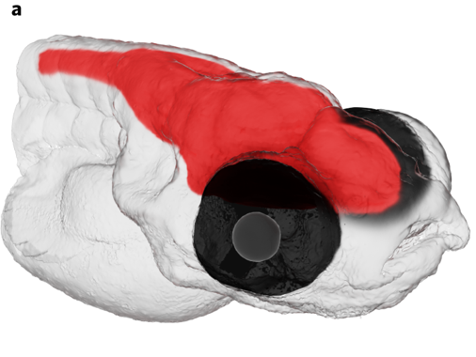
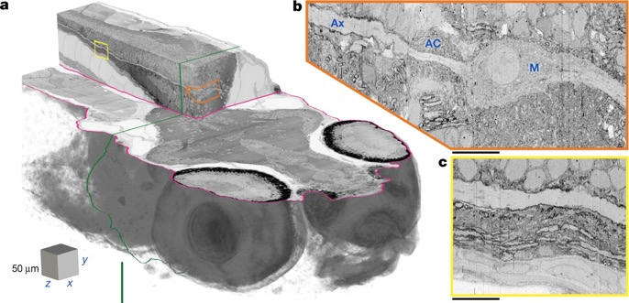
Take-home message about functional connectivity in zebrafish
Take home & future directions
Functional connectomes can be used to identify an individual.
Functional connectivity is well approximated by only 3 structural measures or a singe PC.
A graph-based dimensionality reduction technique, diffusion map, revealed a gradient, strongly correlated with the sensorimotor axis.
All made possible by brain atlases
Finer connectivity measurements will take these studies to the next level!
Hildebrand et al. (2017) Nature
Svara et al. (2023) Nature Methods
Notes:
To wrap this up, many features of large-scale brain networks can be replicated in the larval zebrafish, which is all made possible by these wonderful open-access databases. As finer connectivity measurements are established, these studies will eventually move to the next level, at much finer spatial scales.

