Slide 1


Neurasmus, Amsterdam, July 4th 2024 Mathematical Models of Neural Activity
NicolasDoyon
Laval University, Québec Canada

Slide 2
Introduction and biophysical principles

Slide 3
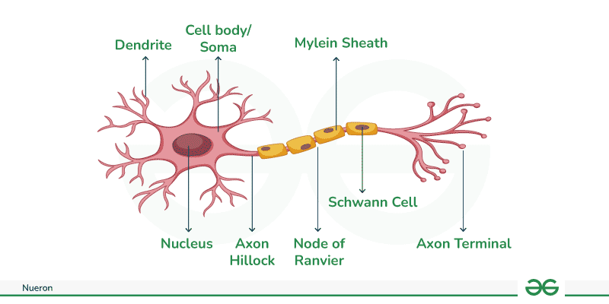
What do neurons do?
Neurons receive information through their dendrites,
They integrate information in their soma,
They transmit information to other neurons through their axon.

Slide 4

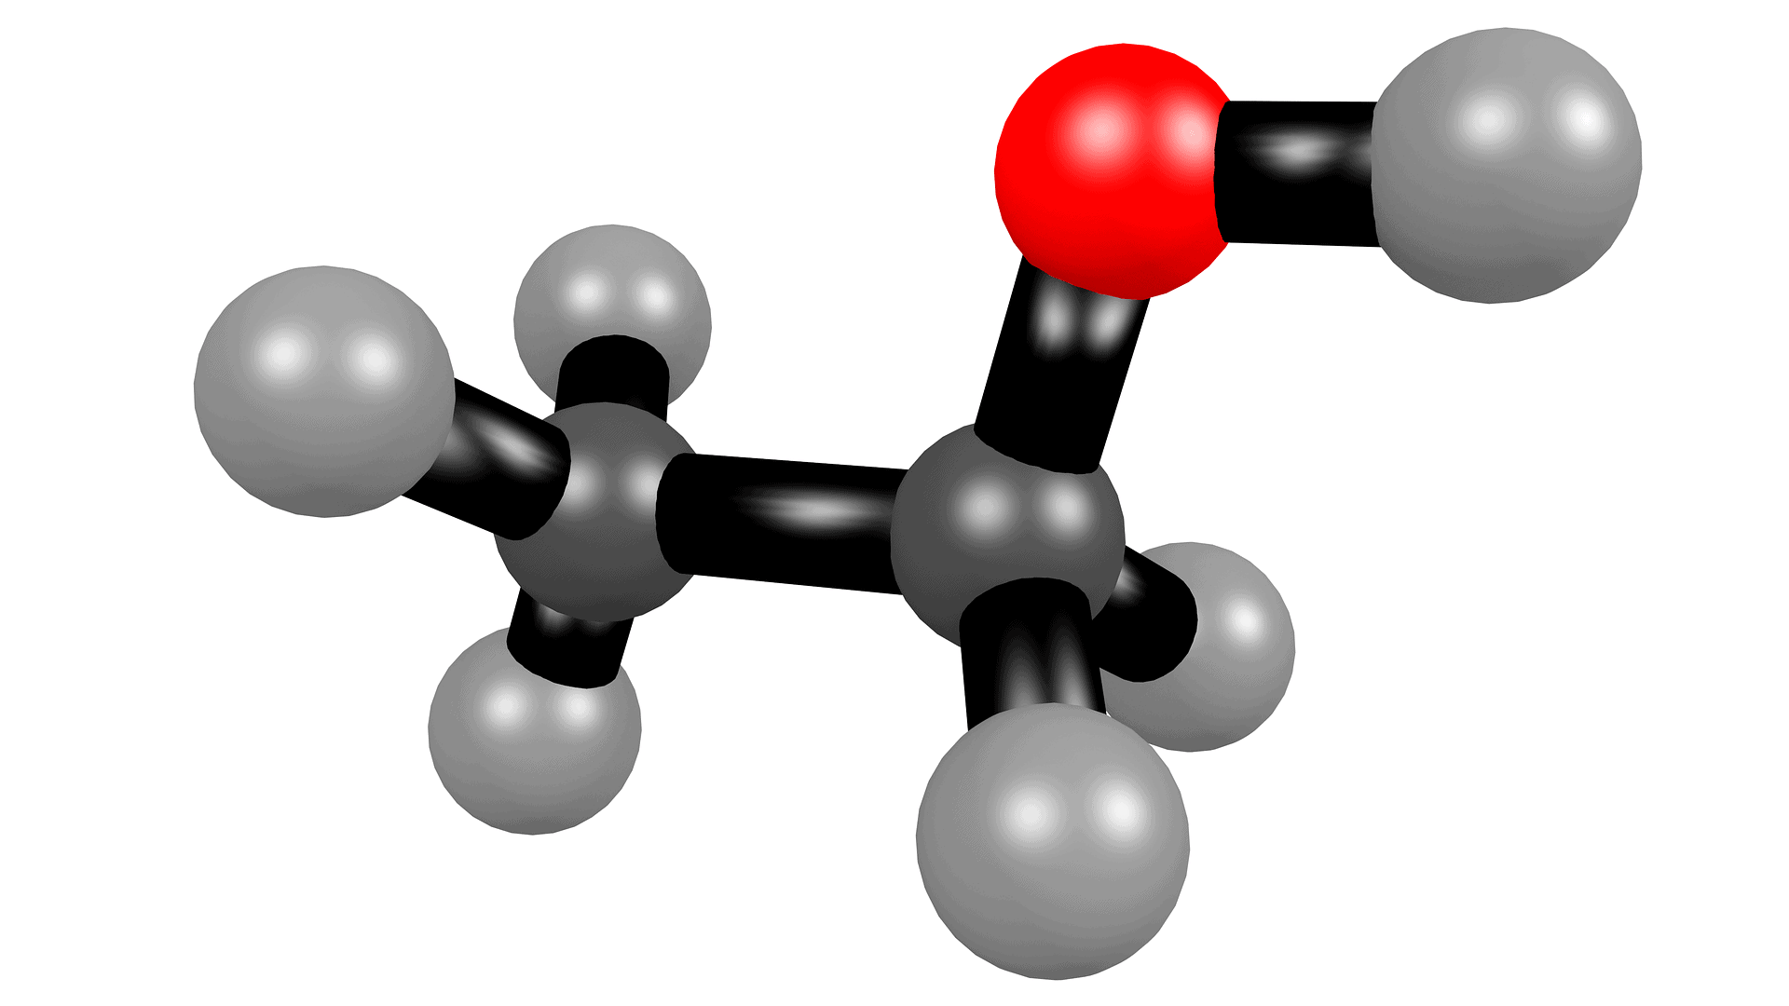
Different types of models
According to the level of details we want to include, there are several possible modeling approaches.
A more complex or more complete model is not always better.
Scale matters
(single protein, synapse, single cell, network)

Slide 5

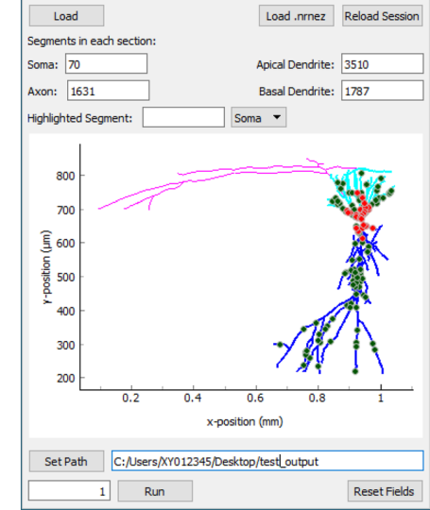
The NEURON software
For those who want to know more about detailed single cell models, the NEURON software is taylor made to develop modular models of single neurons. https://modeldb.science/

Slide 6
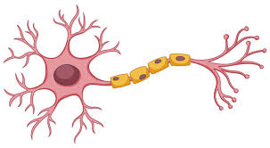
Single compartment models
We will neglect the spatial dimension of the neuron and treat the intracellular space as a single homogeneous compartment.
Extra
Intra

Slide 7
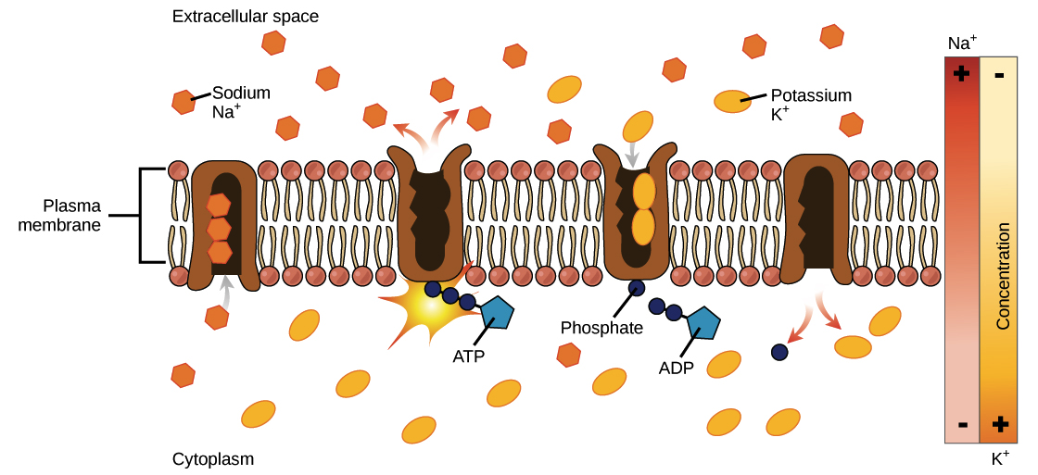
Some biophysical principles
The membrane acts as a separation between the intracellular and extracellular medium.
Intra and extracellular concentrations are different.
This difference is maintained by the sodium potassium pump which uses ATP to transport ions against their concentration gradient.
Typical ionic concentrations
Ion type | Intra | Extra
chloride | 10 mM | 140 mM
Sodium | 15 mM | 120 mM
Potassium | 140 mM | 3 mM
Calcium | 100 nm | 1 mM
https://www.khanacademy.org/science/ap-biology/cell-structure-and-function/facilitated-diffusion/a/active-transport

Slide 8


The Nernst potential
Ion gradients =
Two forces regulate ion movement across the membrane.
Electric
force
Diffusion
1. Diffusion (technically not a force)
2. Electric force
Nernst
pot.
The Nernst reversal potential of an ion is the value of the membrane potential for which these two forces balance each other out.

Slide 9
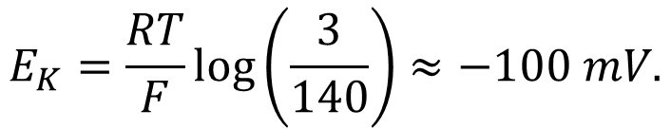
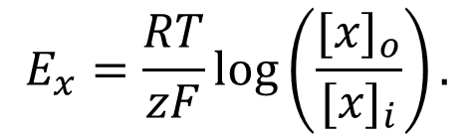
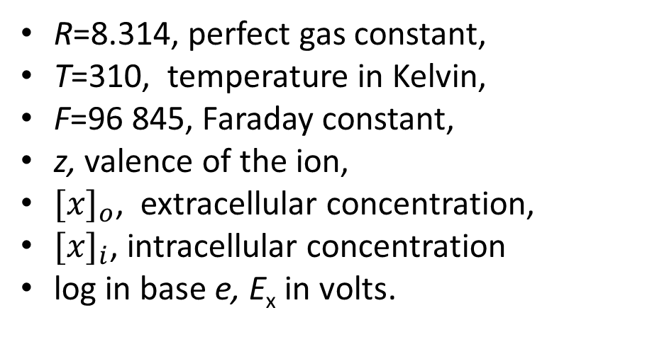
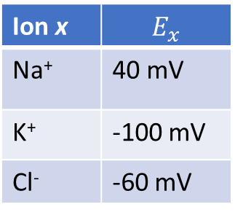
The Nernst potential
The Nernst equation is given by:
For potassium for example, we have
$$E_{x}=\frac{RT}{zF}log\left(\frac{{[x]}_{o}}{{[x]}_{i}}\right).$$
$$E_{K}=\frac{RT}{F}log\left(\frac{3}{140}\right)≈−100 mV.$$
R=8.314, perfect gas constant,
T=310, temperature in Kelvin,
F=96 845, Faraday constant,
z, valence of the ion,
${[x]}_{o}$, extracellular concentration,
${[x]}_{i}$, intracellular concentration
log in base e, E_{x} in volts.
When V_{m}=-100 mV:
The negative potential attracts potassium (K⁺) inside the cell.
This balances the diffusion that drives K⁺ out.
Ion x | $$E_{x}$$
Na⁺ | 40 mV
K⁺ | -100 mV
Cl⁻ | -60 mV
E_{K}=-100 mV
E_{Na}=40 mV
V_{rest}=-60 mV

Slide 10
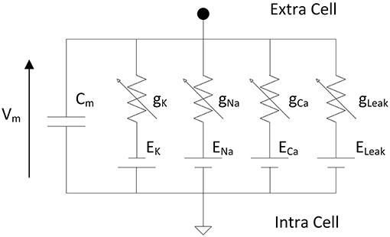
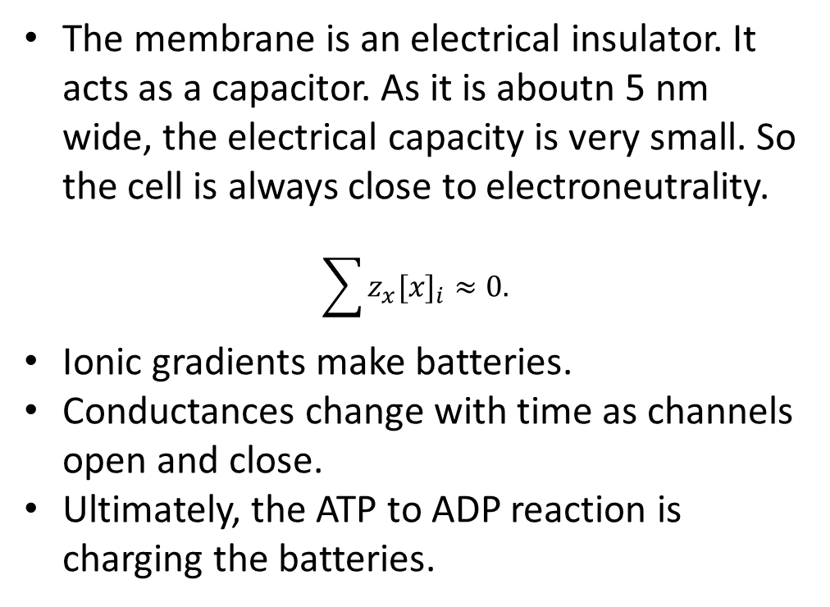
Neurons as electrical circuits
Neurons are often schematized as an electrical circuit.
The membrane is an electrical insulator. It acts as a capacitor. As it is aboutn 5 nm wide, the electrical capacity is very small. So the cell is always close to electroneutrality.
$$\sum{z_{x}{[x]}_{i}}≈0.$$
Ionic gradients make batteries.
Conductances change with time as channels open and close.
Ultimately, the ATP to ADP reaction is charging the batteries.
https://www.frontiersin.org/journals/neuroscience/articles/10.3389/fnins.2019.00377/full
.

Slide 11
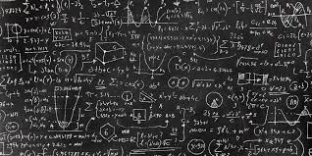
Now some math…
Just a little bit…

Slide 12



Ordinary Differential Equations (ODEs)
Ordinary differential equations are a powerfull mathematical tool to describe variables that evolve continuously with time.
If x is the heigth of a falling apple:
$$x^{′′}=−g.$$
$$\frac{dx}{dt}=f\left(x,t\right).$$
The general form of an ode is given by:
Here $x$ can be a single variable or a vector describing several variables.

Slide 13

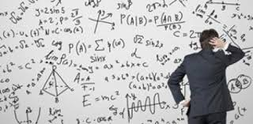

Ordinary differential equations
ODEs describe the rate of change of certain quantities. To obtain solutions, we always have to specify the initial state of the system (initial conditions).
It is very rarely possible find an exact solution to ODEs.
We have to use numerical methods.
Don’t worry, python (or any language, does it for you).
In Python, there are several options, odeint is a simple one.

Slide 14
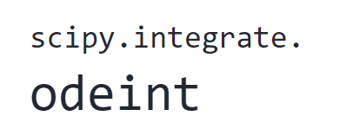
Ordinary differential equations
odeint(func, y0, t, args=())
Parameters such as conductances
The equation you want to solve
Initial conditions
A list of the time points on wich you want the solution
You have to importe the package

Slide 15
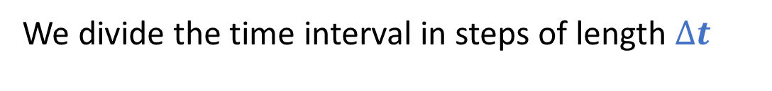


Ordinary differential equations
How does the computer do it?
Some integration methods can be quite complicated…
We present the Euler forward method.
Downside: Imprecise.
Upside: Simple we can implement it manually in a for loop when odeint cannot be used.
We divide the time interval in steps of length $∆t$
…
$$∆t$$
t_{init}
t_{end}
We compute on each time step:
$$x^{′}=f\left(x\right)→x\left(t+∆t\right)≈x+∆tf\left(x\right).$$

Slide 16



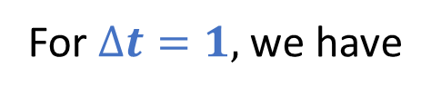

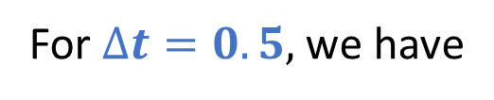

Ordinary differential equations
Example: Suppose you want to solve
$$x^{′}\left(t\right)=x, x\left(0\right)=1, 0≤t≤4.$$
For $∆t=1,$ we have
$$x\left(1\right)≈x\left(0\right)+x^{′}\left(0\right)=2,$$
$$x\left(2\right)≈x\left(1\right)+x^{′}\left(1\right)=4,$$
$$x\left(3\right)≈x\left(2\right)+x^{′}\left(2\right)=8,$$
$$x\left(4\right)≈x\left(3\right)+x^{′}\left(3\right)=16.$$
For $∆t=0.5,$ we have
$$x\left(0.5\right)≈x\left(0\right)+0.5 x\left(0\right)=1.5,$$
$$x\left(1\right)≈x\left(0.5\right)+{0.5x}^{′}\left(0.5\right)=2.25,$$
….
$$x\left(4\right)≈x\left(3.5\right)+0.5x^{′}\left(3.5\right)=\text{25.62}.$$
When we choose a smaller $∆t$, the solutions are more precise but resolution takes longer.

Slide 17
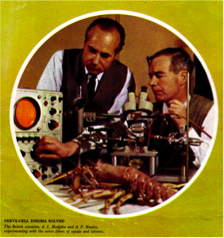
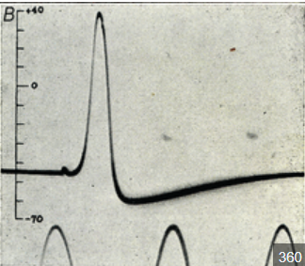
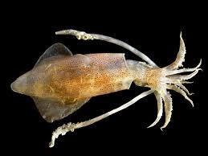
The Hodgkin-Huxley model

Slide 18
The Hodgkin-Huxley model
The Hodgkin-Huxley model has an historical and practical importance.
It has been derived from experiments on the giant squid axon.
The authors won the Nobel prize in Physiology or Medicine in 1963 for their work.
Their model rely on the description of voltage gated sodium and potassium channel.

Slide 19
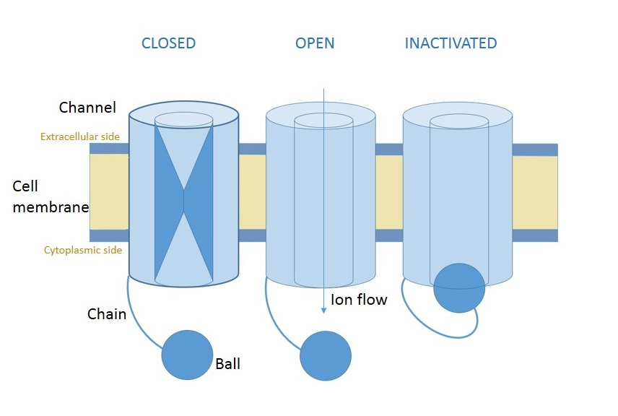
Sodium and potassium voltage gated channels
The voltage gated potassium and sodium channels are responsible for generating the action potential.
Gates open and close according to the membrane potential.
Sodium channels have two types of gates, including an inactivating one.
wikipedia

Slide 20
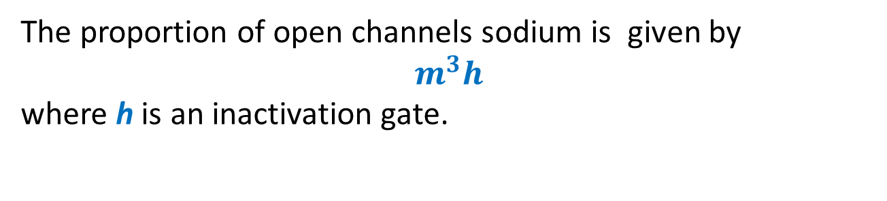
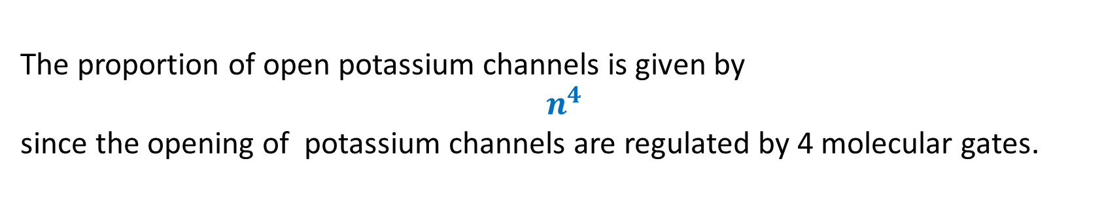
Sodium and potassium voltage gated channels
The proportion of open channels sodium is given by
$$m^{3}h$$
where h is an inactivation gate.
The proportion of open potassium channels is given by
$$n^{4}$$
since the opening of potassium channels are regulated by 4 molecular gates.
The presence of exponents may seem surprinsing. Their values have been emipirically derived.

Slide 21
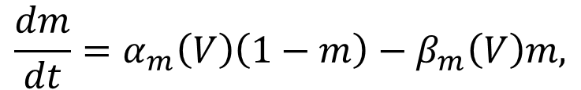
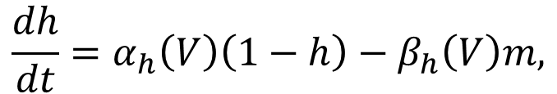
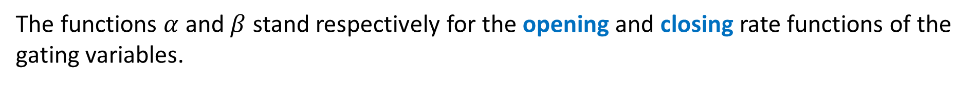
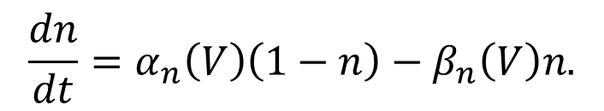
The Hodgkin-Huxley equations
Putting all this together, we get the following system of equations that specify the HH model:
$$C\frac{dV}{dt}=g_{L}\left(E_{l}−V\right)+\overline{g_{Na}}m^{3}h\left(E_{Na}−V\right)+\overline{g_{K}}n^{4}\left(E_{K}−V\right)+I,$$
$$\frac{dm}{dt}=α_{m}\left(V\right)\left(1−m\right)−β_{m}\left(V\right)m,$$
$$\frac{dh}{dt}=α_{h}\left(V\right)\left(1−h\right)−β_{h}\left(V\right)m,$$
$$\frac{dn}{dt}=α_{n}\left(V\right)\left(1−n\right)−β_{n}\left(V\right)n.$$
The functions $α$ and $β$ stand respectively for the opening and closing rate functions of the gating variables.
Due to the form of the equations, the gating variables will always remain between 0 and 1.

Slide 22
Qualitative behaviour of the Hodgkin-Huxley model
The parameter I corresponds to the external current injected into the cell. Its value determines the behaviour of the neuron
If the value of I is small, than the neuron remains at resting state.
For intermediate values of I, the neuron emits action potentials.
For very strong values of I, the neuron is in an inactive depolarized state.

Slide 23
Stages of an action potential in the HH model
The membrane depolarizes.
The m gates open, sodium enters and membrane further depolarizes (around -30 mV to 20 mV)
When the cell is depolarized, the h gate closes and the n gates opens.
Due to potassium currents, the cell hyperpolarizes.
The n gates close and the h gate opens.

Slide 24
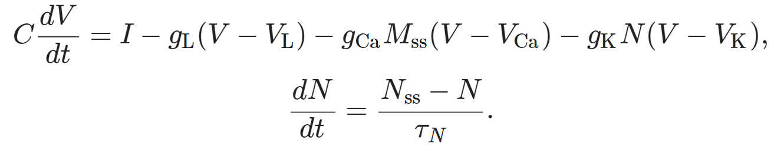
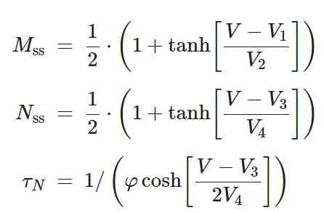

Slide 25
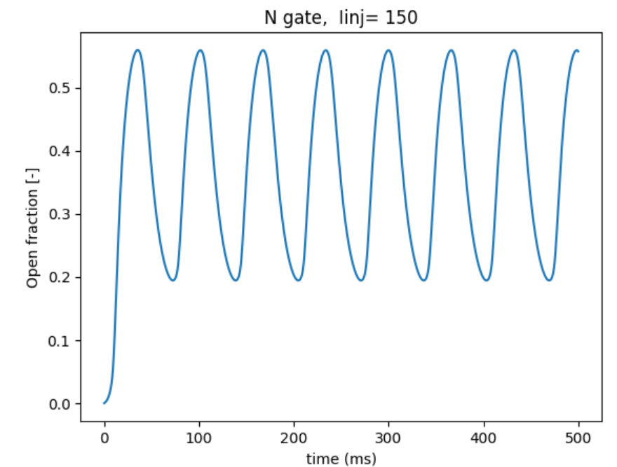
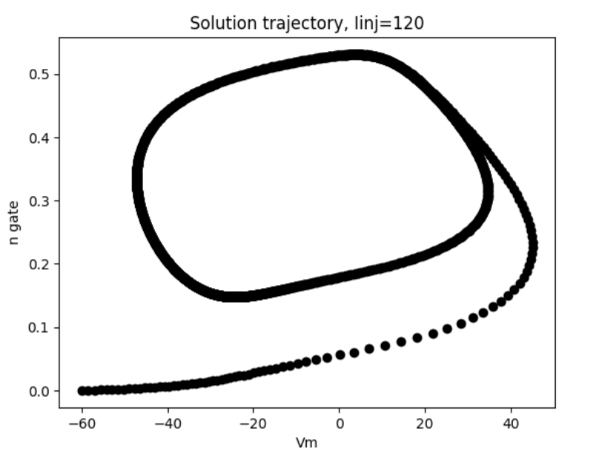
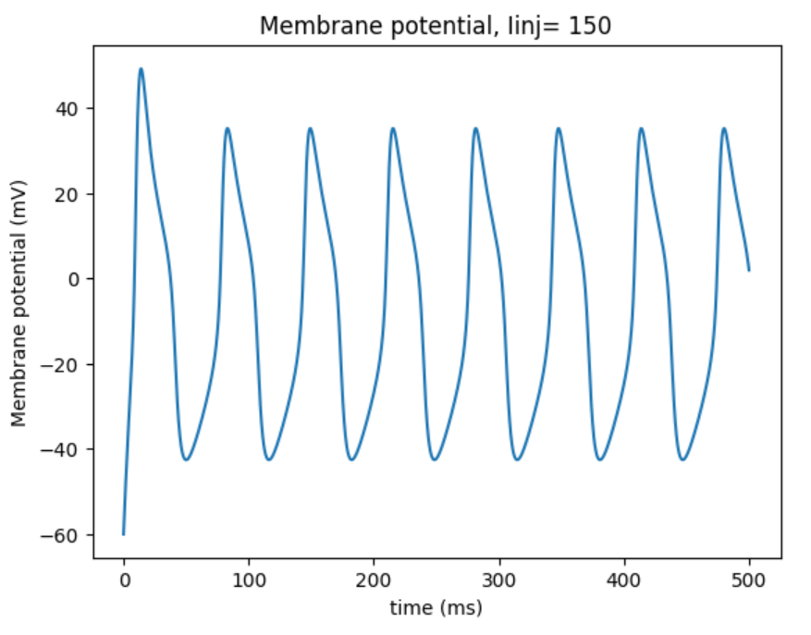
Time course
(v₁,n₁)
(v₂,n₂)
…
(v_{k},n_{k})
Phase plane

Slide 26


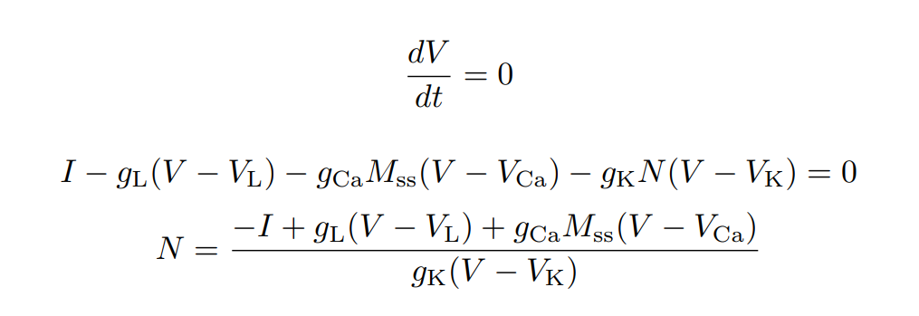

Nullclines
The nullclines correspond correspond to the curves
and
We can explicitely compute these nullclines. We have
and

Slide 27
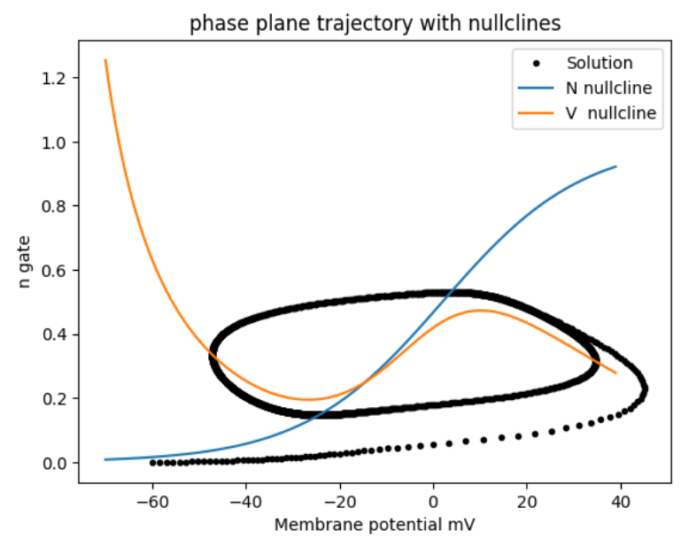
Choose a point
V=-20, N=0.6
Compute dV/dt and dN/dt at this point.
Obtain the direction of the solution trajectory and illustrate it with an arrow.

Slide 28
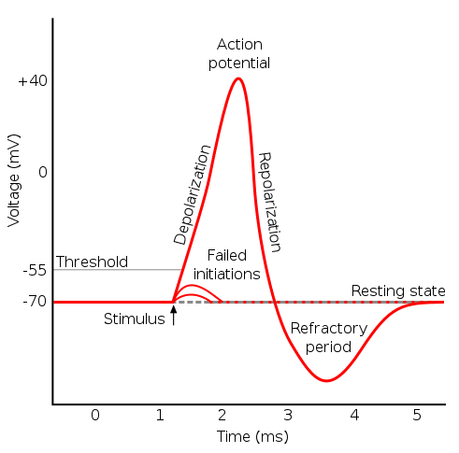
Leaky Integrate and Fire model (LIF)
One possible simplification is to omit the description of the action potential altogether.
This is interesting from the point of view of model simplicity since the typical shape of an action potential is rather difficult to replicate.

Slide 29
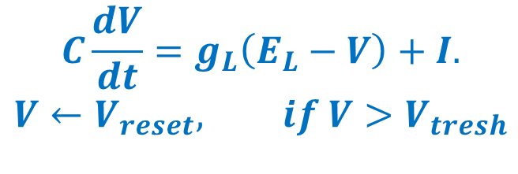
Leaky Integrate and Fire model (LIF)
The equation specifying the LIF model is given by:
$$C\frac{dV}{dt}=g_{L}\left(E_{L}−V\right)+I.$$
$$V←V_{reset}, if V>V_{tresh}$$
The second line is to be interpreted as:
When V reaches a threshold value (V_{tresh} usually around -30 mV) we assume that an action potential occurs and that the potential is instantaneously resetted.
The LIF model is not specified by ODEs.
Since it is discontinuous, we cannot directly use odeint to solve it.
We will solve it ‘manually’, by updating the value of the membrane potential at each time step in a for loop.

Slide 30
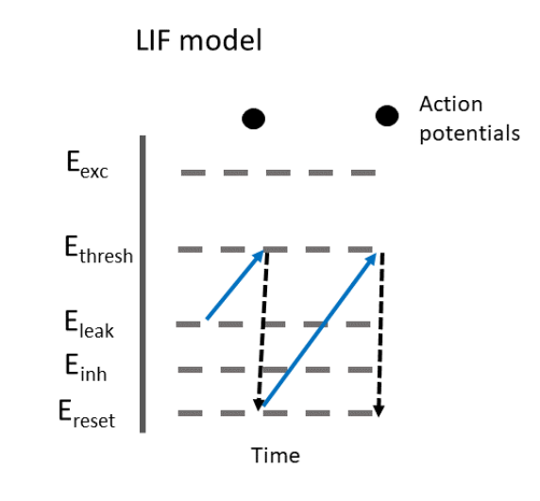

Slide 31
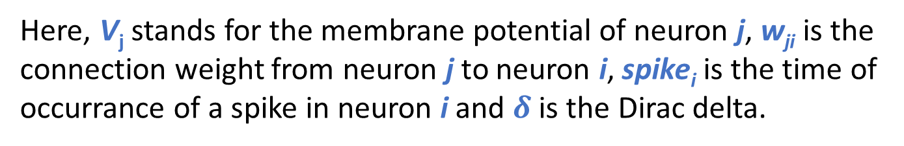
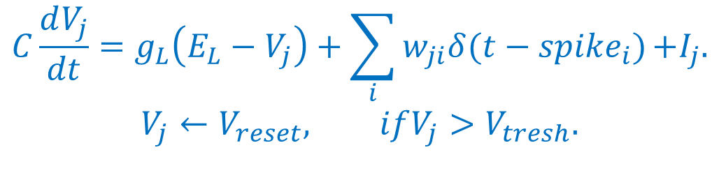
Leaky Integrate and Fire models.
Thanks to their simplicity, LIF models are often used to describe neurals networks.
When used in a network context, the equation describing the evolution of LIF neurons becomes:
$$C\frac{dV_{j}}{dt}=g_{L}\left(E_{L}−V_{j}\right)+\sum_{i}{w_{ji}δ(t−{spike}_{i})}{+I}_{j}.$$
$$V_{j}←V_{reset}, ifV_{j}>V_{tresh}.$$
Here, V_{j} stands for the membrane potential of neuron j, w_{ji} is the connection weight from neuron j to neuron i, spike_{i} is the time of occurrance of a spike in neuron i and $δ$ is the Dirac delta.

Slide 32
Leaky Integrate and Fire models.
We will apply the LIF model to neural networks with different random structure. We will investigate
A completely random network (Erdos-Renyi).
A feed forward network.
A network with a negative feedback loop.

Slide 33
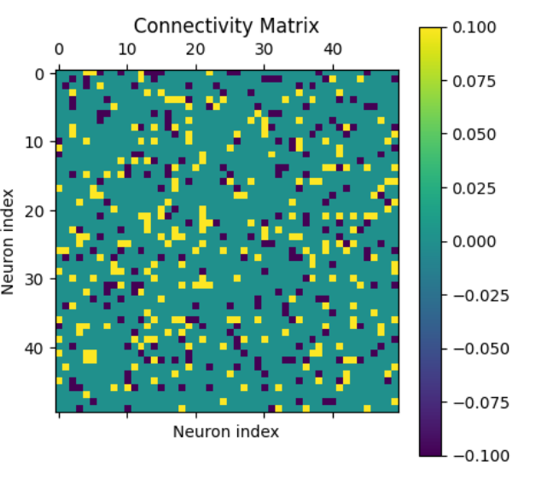
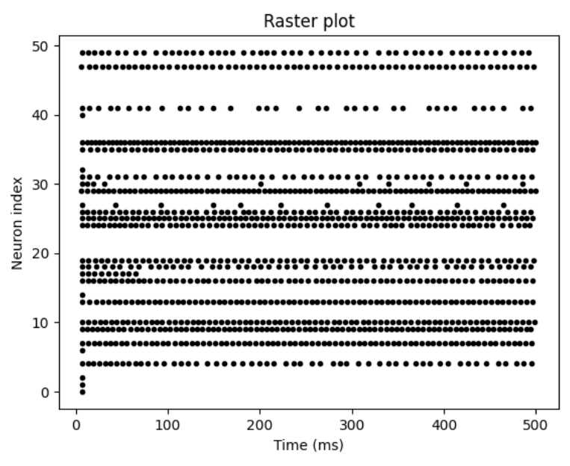
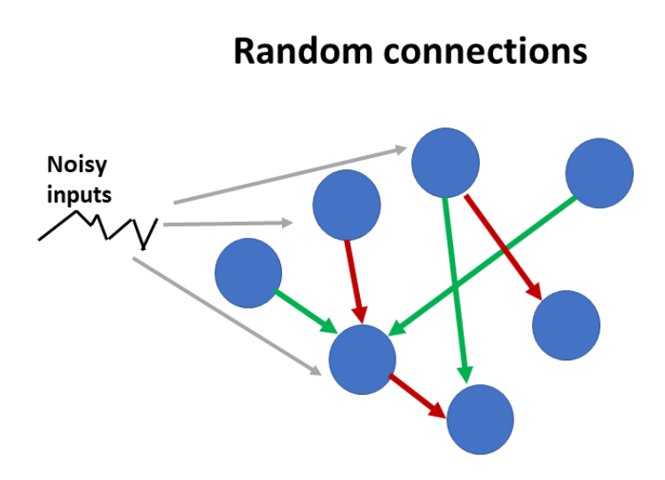
LIF model on a completely random network.

Slide 34
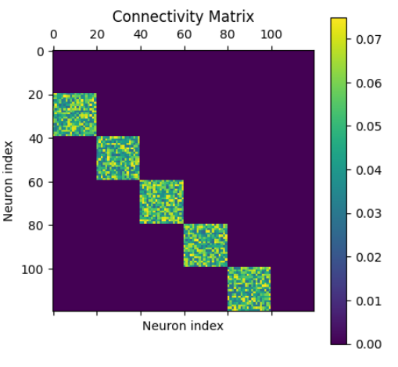
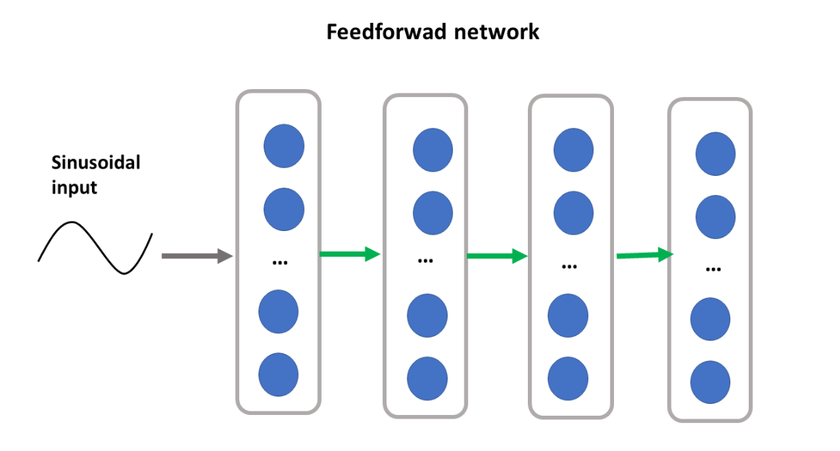
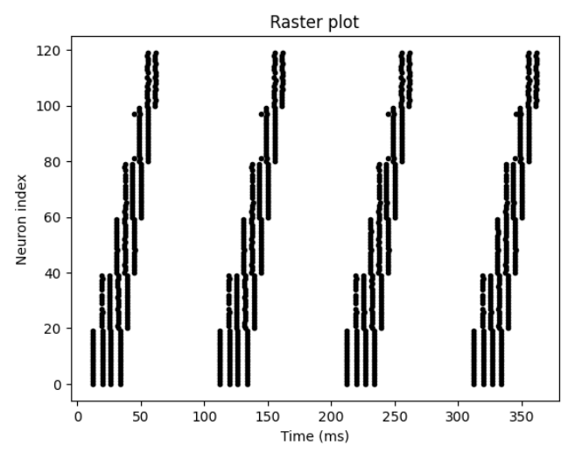
LIF model on a feedforward network.

Slide 35
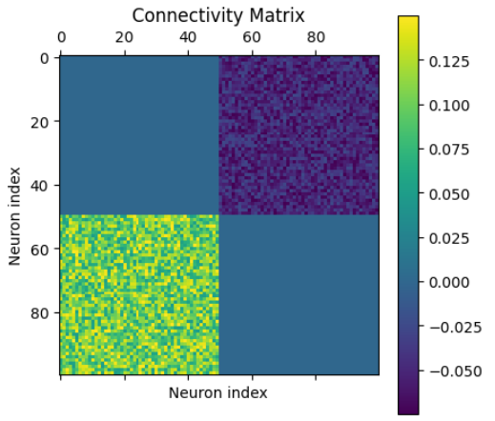
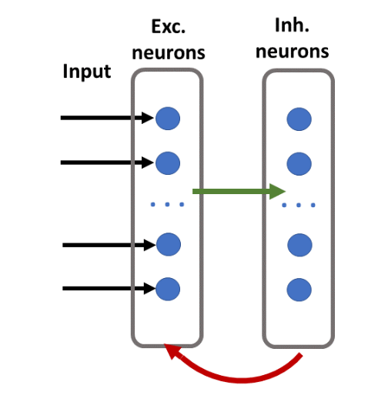
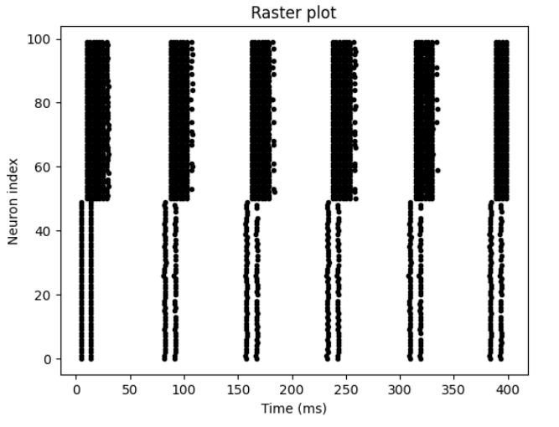
LIF model on a network with a negative feedback loop.

Slide 36


The Izhikevich model
The Izikevich model is a modification of the LIF model.
Objective: Biological neurons have different spike patterns. Some neurons are intrinsically bursting.
The Izikevich model allows to replicate different types of spiking patterns.
The Izikevich model is defined by the following equations:

Slide 37
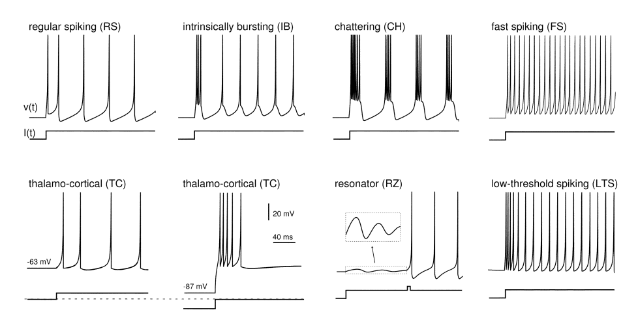

The Izhikevich model
https://www.izhikevich.org/publications/spikes.htm

Slide 38


The Izhikevich model on a network
We launch the Izhikevich model on a network of randomly connected neurons with 800 excitatory and 200 inhibitory neurons.
The author claims that the model can replicate characteristic frequencies of brain activity. (alpha and gamma).

Slide 39
Wilson-Cowan (WC) models
Another approach to simplify models of neural activity is to divide the states of neurons into a finite set of possible states according to their level of activity.
The Wilson-Cowan model divides neurons into 3 states:
Active: The neuron emits an action potential.
Susceptible
Susceptible: Neurons are at resting state but can become active if they receive enough stimulation.
Refractory
Active
Refractory: Shortly after firing, neurons cannot firing again no matter the input.

Slide 40



Wilson-Cowan model
Remark: Wilson-Cowan models don’t describe the state of individual neurons.
Transitions:
A(t): The proportion of neurons in active state at time t.
$A→R$ at constant rate,
R(t): The proportion of neurons in refractory state at time t.
$R→S$ at constant rate,
S(t): The proportion of neurons in susceptible state at time t.
$S→A$ at a rate proportional to F(input)
where F is an increasing activation function.

Slide 41



Wilson-Cowan model
The Wilson Cowan model is specified by the equations:
$$\frac{dA}{dt}=−αA+βSF\left(wA+I\right),$$
$$\frac{dS}{dt}=γR−βSF\left(wA+I\right),$$
$$\frac{dR}{dt}=−γR+αA.$$
The parmater w can be interpreted as the mean connection weight between two neurons.
The sigmoid function is often used as an activation function
$$σ\left(x\right)=\frac{1}{1+e^{−x}}.$$

Slide 42




The Wilson-Cowan model
At first glance, the Wilson-Cowan model has 3 dimension (3 independant variables).
However: $A\left(t\right)+S\left(t\right)+R\left(t\right)=1.$
Thus, by settting $R\left(t\right)=1−A\left(t\right)−S(t)$ we reduce the model to two variables.
We can also assume that the proportion of refractory neurons is at equilibrium.
$$\frac{dR}{dt}=−γR+αA=0↔R=\frac{α}{γ}A.$$
With this, we obtain a one dimensional version of the model
$\frac{dA}{dt}=−αA+β\left(1−\left(1+\frac{α}{γ}\right)A\right)F\left(wA+I\right)$.

Slide 43


Bistability in the Wilson-Cowan model
Bistability: the end state of the system depends on the initial condition. We have several fixed points.

Slide 44

The Wilson-Cowan model
The WC model can also be applied to models with several populations.
In this context, a population of neurons is an abstract and somewhat arbitrary concept.
A population is a group of neurons with similar properties and expected to have similar levels of activity.
Neurons are often divided into populations of inhibitory and excitatory neurons. Populations can also be defined according to the spatial positions of neurons.
The equations for two populations WC model are given by:
$$\frac{dA_{1}}{dt}=−αA_{1}+β\left(1−A_{1}\right)F\left(w_{11}A_{1}+w_{12}A_{2}+I_{1}\right),$$
$$\frac{dA_{1}}{dt}=−αA_{1}+β\left(1−A_{1}\right)F\left(w_{21}A_{1}+w_{22}A_{2}+I_{2}\right).$$

Slide 45




A WC model of lateral inhibition

Slide 46



A WC model of lateral inhibition
We implement a WC model on each point of a grid.
Each population sends inhibitory connections to their spatial neighbours.
Network response, we observe edge enhancement.
Connection weights between neighbours
Visual stimulus

Slide 47
Simple models of synaptic activity
Synaptic transmission is an important comportement of information processing in neural networks.
Even small perturbations in synaptic properties can have important functional consequences
Synaptic transmission can be divided into the following steps:
An action potential reaches the presynaptic bouton.
Depolarization of the membrane leads to the opening of vesicles.
Neurotransmitters are released in the synaptic cleft.
Neurotransmitters bind to postsynaptic receptors.
Receptors change state and open
Synaptic current mediated by ions occurs through receptor channels.

Slide 48


Slide 49
A few order of magnitudes
A synaptic vesicle contains 100- 20 000 neuro transmitters.
There are a few tens synaptic channels.
The conductance of individual channel can be 10 pS-40 pS.
The width of the synapse is around 10 nm.
Neurotransmitters stay in the synapses for only a few ms.

Slide 50

Stochastic transitions
Synaptic channels can be in several close, open or desensitized sates.
The binding of 2 or 3 neurotransmitters is usually required for the channel to become open.
A channel in a desensitized state usually stays in this state for a relatively long period of time.
Transition between each of these states is stochastic.
Say the transition rate from state S₁ to state S₂ is k, then the probability that this transition occurs during a time step of length $∆t$ is $k∙∆t$.
For example, a channel is in a close state, the transition rate from close to open is $0.1 {ms}^{−1}.$ We run a simulation with time steps of length equal to $∆t=0.5 ms.$The probability that the channel is open at the next time step is 0.04.
A possible simplification is to treat the proprotion of channels in each state as a continuous quantity and to use ordinary differential equations.

Slide 51


An example of channel states and transitions

Slide 52

GABA synapses
HCO₃⁻
$H$C$O_{3}^{−}+H^{+}↔CO_{2}+H_{2}O$
GABA synapses are responsible for fast inhibition in the mammalian brain.
GABA channels are permeable to both chloride and bicarbonate ions with a greater permeability to chloride.
Bicarbonate concentration is kept constant.
GABA synapses are excitatory in the young and inhibitory in the mature animal.
This is related to shift in chloride concentration, about 20 mM in the young and about 5mM in the adult.
Cl⁻
Young
NKCC1
1K⁺
2Cl⁻
1Na⁺
1K⁺
1Cl⁻
Adult
KCC2

Slide 53


GABA synapses
The polarity of GABA current can change as the result to repeated stimulations.
This is due to the accumulation of intracellular chloride which leads to a depolarization of the synaptic potential.

Slide 54
Spike timing dependant plasticity (STDP)
Synaptic weights evolve with time according to neuron activity.
But how do synapse know they have to change?
It’s calcium!
The weight of a synapse will increase if a spike in the presynaptic neuron causes a spike in the post synaptic neuron.
Causality: the post synaptic neuron fires a few millisecond after the presynaptic one.
This is referred to as spike timing dependant plasticity

Slide 55


Spike timing dependant plasiticity

Slide 56



Postsynaptic
neuron
Presynaptic
neuron
pre
Ca²⁺
Ca²⁺
Slow NMDA synaptic channels
post
Voltage gated calcium channel
Ca²⁺
Ca²⁺

