Slide 1


Neurasmus, Berlin, July 3rd 2025 Mathematical Models of Neural Activity
NicolasDoyon
Laval University, Québec Canada

Slide 2
Plan
Introduction
Biophysical principles
The Hodgkin-Huxley model
A brief mathematical parenthesis
Leaky integrate and fire (LIF) models
Synapses
Network of LIF neurons
Wilson-Cowan models

Slide 3
Introduction

Slide 4

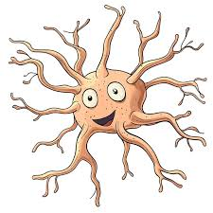
Why models?
Building digital twins of neurons allow to perform in silico experiments.
DATA
Experiments
Data analysis
Virtual experiments on digital twin
New hypotheses
AI

Slide 5
What properties of neurons do we want our model to capture? A compromise between simplicity and expressivity
The answer is context dependant
Don’t
Surely, we do not want to describe the vibration of every atom….
Don’t include feature that cannot experimentally tested…
Do
Neurons receive, transform and transmit information…
Neurons are arrange in networks with rich structures…
Include populations and structures on which you can experiment and/or that are of interest to your research question…

Slide 6
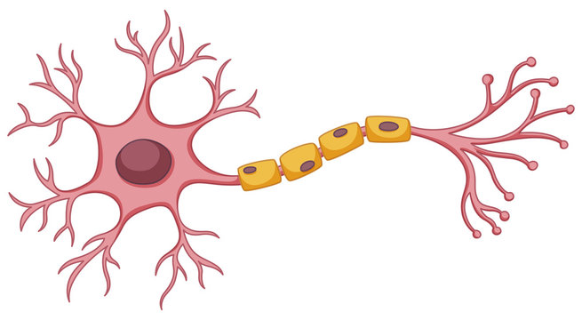
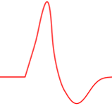
Mimicking the generation of action potential
Axon
Soma
Dendrites
All or none action potential

Slide 7

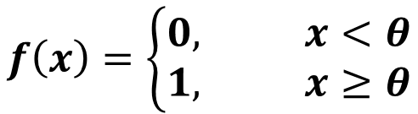


The all or none principle and the Heaviside function
$$f\left(x\right)=\left\{\begin{matrix}0, x<θ \\ 1, x≥θ\end{matrix}\right.$$
$$1$$
$$0$$
$$θ$$

Slide 8
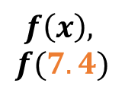
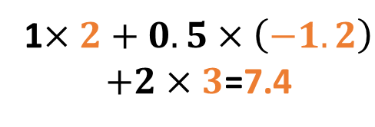

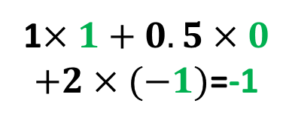
Artificial neurons for simple artificial neuron networks
Synaptic
weigths
Weigthed sum
Application
of the Heaviside
function
Input
Output
1
2
1
1$×2+0.5×\left(−1.2\right)$
$+2×3$=7.4
$$f\left(x\right),$$
$$f(7.4)$$
0.5
-1.2
0
1
0
1$×1+0.5×0$
$+2×(−1)$=-1
-1
$$f(−1)$$
3
2

Slide 9
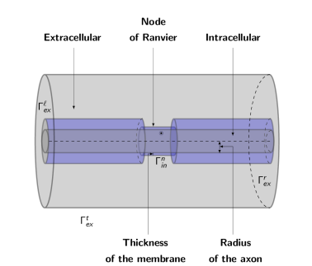
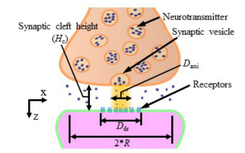
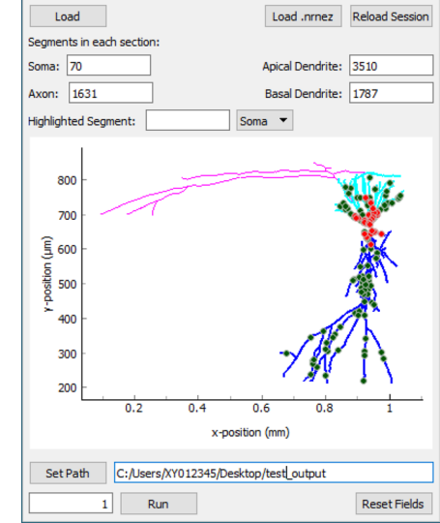

Several families of neural models
Models of subneuronal
structures
Multicompartmental models,

Slide 10

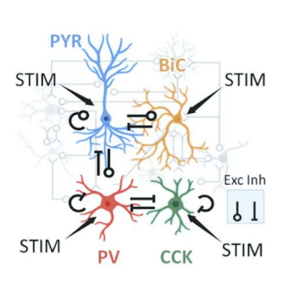
Several families of neural models
Single compartment models,
Population models
Extra
Intra

Slide 11
Biophysical Principles

Slide 12
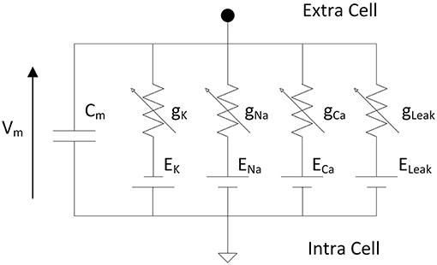
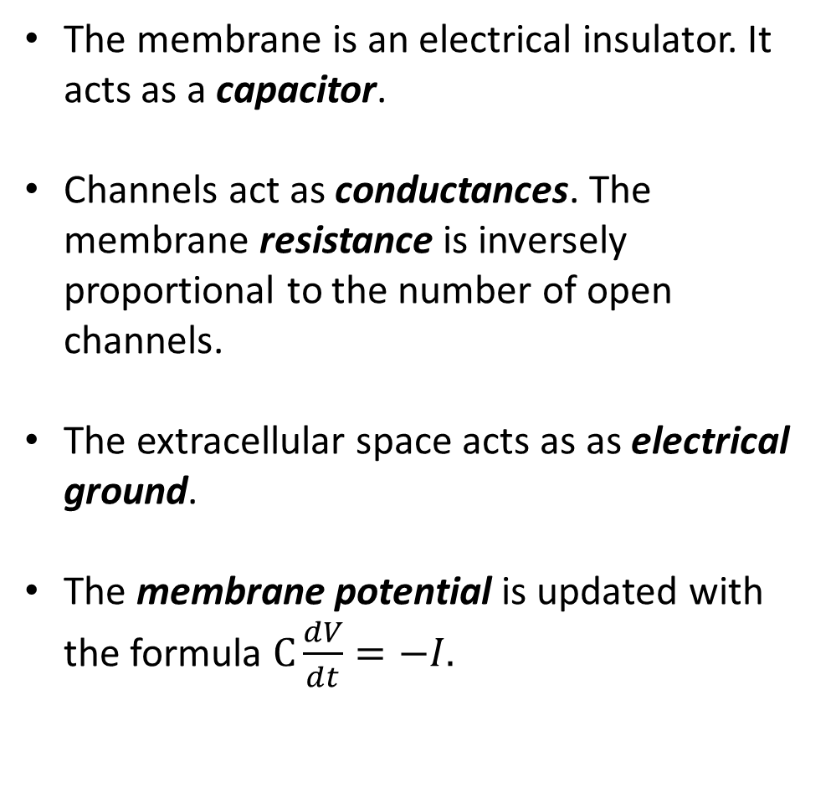
Neurons as electrical circuits
The membrane is an electrical insulator. It acts as a capacitor.
Channels act as conductances. The membrane resistance is inversely proportional to the number of open channels.
The extracellular space acts as as electrical ground.
The membrane potential is updated with the formula $C\frac{dV}{dt}=−I.$
Neurons are often schematized as an electrical circuit.
https://www.frontiersin.org/journals/neuroscience/articles/10.3389/fnins.2019.00377/full
.

Slide 13
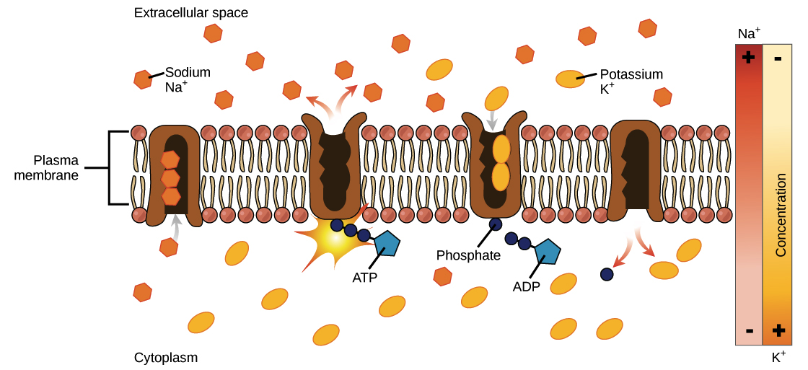
Neurons as a soup of ions
The membrane acts as a separation between the intracellular and extracellular medium.
Intra and extracellular concentration of different ions are different.
This difference is maintained by the sodium potassium pump which uses ATP to transport ions against their concentration gradient.
Typical ionic concentrations
Ion type | Intra | Extra
chloride | 10 mM | 140 mM
Sodium | 15 mM | 120 mM
Potassium | 140 mM | 3 mM
Calcium | 100 nm | 1 mM
https://www.khanacademy.org/science/ap-biology/cell-structure-and-function/facilitated-diffusion/a/active-transport

Slide 14


The Nernst potential
Ion gradients =
Two forces regulate ion movement across the membrane.
Electric
force
Diffusion
1. Diffusion (technically not a force)
2. Electric force
Nernst
pot.
The Nernst reversal potential of an ion is the value of the membrane potential for which these two forces balance each other out.

Slide 15
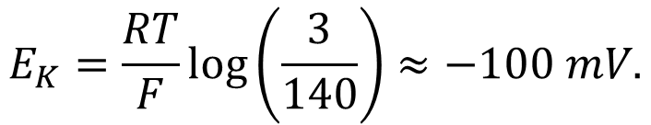
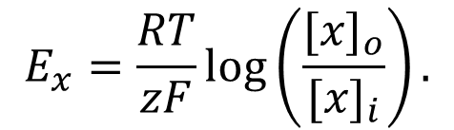
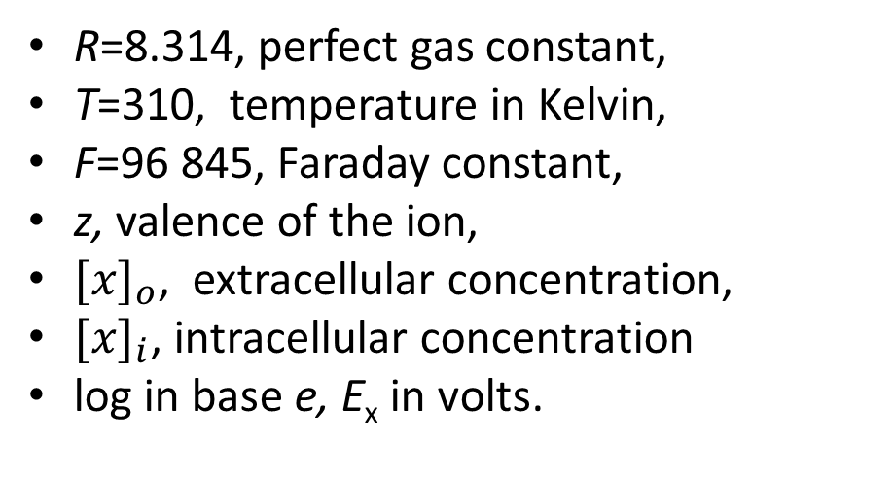
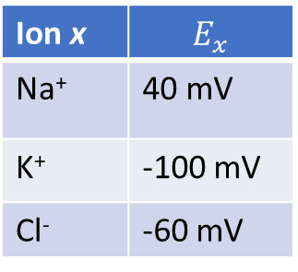
The Nernst potential
The Nernst equation is given by:
For potassium for example, we have
$$E_{x}=\frac{RT}{zF}log\left(\frac{{[x]}_{o}}{{[x]}_{i}}\right).$$
$$E_{K}=\frac{RT}{F}log\left(\frac{3}{140}\right)≈−100 mV.$$
R=8.314, perfect gas constant,
T=310, temperature in Kelvin,
F=96 845, Faraday constant,
z, valence of the ion,
${[x]}_{o}$, extracellular concentration,
${[x]}_{i}$, intracellular concentration
log in base e, E_{x} in volts.
When V_{m}=-100 mV:
The negative potential attracts potassium (K⁺) inside the cell.
This balances the diffusion that drives K⁺ out.
Ion x | $$E_{x}$$
Na⁺ | 40 mV
K⁺ | -100 mV
Cl⁻ | -60 mV

Slide 16
Membrane resting potential
The resting membrane potential is an equilibrium resulting from the Nernst potential of different ions.
E_{K}=-100 mV
E_{Na}=40 mV
V_{rest}=-60 mV

Slide 17
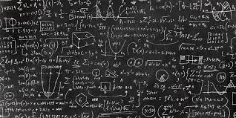
A (short) mathematical interlude…
Ordinary differential equations (ODEs)…

Slide 18



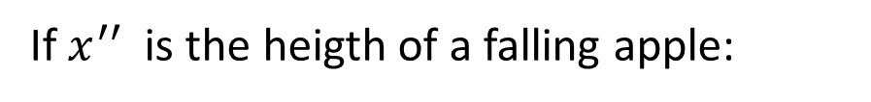
Ordinary Differential Equations (ODEs)
Ordinary differential equations are a powerfull mathematical tool to describe variables that evolve continuously with time.
If $x^{′′}$ is the heigth of a falling apple:
$$x^{′′}=−g.$$
$$\frac{dx}{dt}=f\left(x,t\right).$$
The general form of an ode is given by:
Here $x$ can be a single variable or a vector describing several variables.

Slide 19

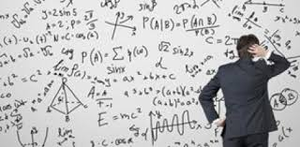

Ordinary differential equations
ODEs describe the rate of change of certain quantities. To obtain solutions, we always have to specify the initial state of the system (initial conditions).
It is very rarely possible find an exact solution to ODEs.
We have to use numerical methods.
Don’t worry, python (or any language, does it for you).
In Python, there are several options, odeint is a simple one solve_ivp is another..

Slide 20
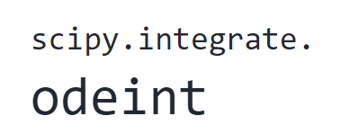
Ordinary differential equations
odeint(func, y0, t, args=())
Parameters such as conductances
The equation you want to solve
Initial conditions
A list of the time points on wich you want the solution
You have to importe the package

Slide 21
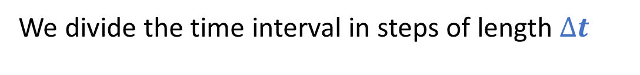


Ordinary differential equations
How does the computer do it?
Some integration methods can be quite complicated…
We present the Euler forward method.
Downside: Imprecise.
Upside: Simple we can implement it manually in a for loop when odeint cannot be used.
We divide the time interval in steps of length $∆t$
…
$$∆t$$
t_{init}
t_{end}
We compute on each time step:
$$x^{′}=f\left(x\right)→x\left(t+∆t\right)≈x+∆tf\left(x\right).$$

Slide 22







Ordinary differential equations
Example: Suppose you want to solve
$$x^{′}\left(t\right)=x, x\left(0\right)=1, 0≤t≤4.$$
For $∆t=1,$ we have
$$x\left(1\right)≈x\left(0\right)+x^{′}\left(0\right)=2,$$
$$x\left(2\right)≈x\left(1\right)+x^{′}\left(1\right)=4,$$
$$x\left(3\right)≈x\left(2\right)+x^{′}\left(2\right)=8,$$
$$x\left(4\right)≈x\left(3\right)+x^{′}\left(3\right)=16.$$
For $∆t=0.25,$ we have
$$x\left(0.25\right)≈x\left(0\right)+0.25 x′\left(0\right)=1.25,$$
$$x\left(0.5\right)≈x\left(0.25\right)+{0.2x}^{′}\left(0.25\right)=\text{1.5625},$$
….
$$x\left(1\right)≈\text{2.4414},$$
….
$$x\left(4\right)≈\text{35.5}.$$
When we choose a smaller $∆t$, the solutions are more precise (truth $≈$54.60) but resolution takes longer.
solve_ivp automatically uses more complex but more precise approaches..

Slide 23
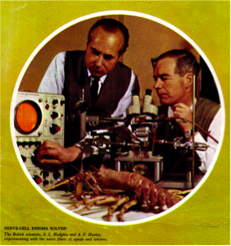
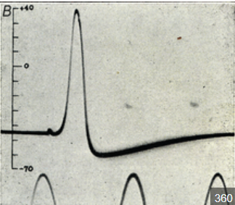
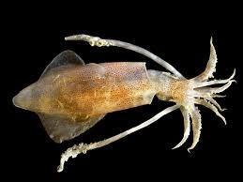
The Hodgkin-Huxley model

Slide 24
The Hodgkin-Huxley model
The Hodgkin-Huxley model has an historical and practical importance.
It has been derived from experiments on the giant squid axon.
The authors won the Nobel prize in Physiology or Medicine in 1963 for their work.
Their model rely on the description of voltage gated sodium and potassium channels.

Slide 25
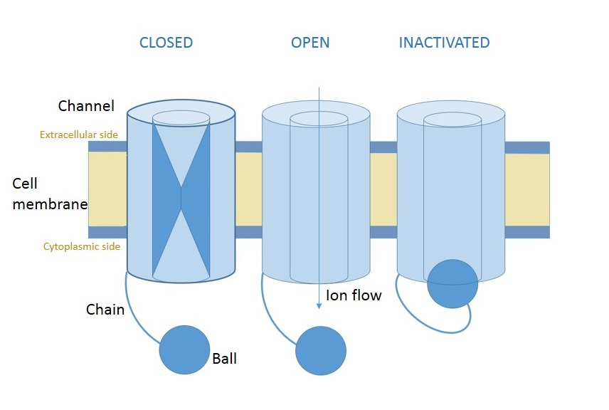
Sodium and potassium voltage gated channels
The voltage gated potassium and sodium channels are responsible for generating the action potential.
Gates open and close according to the membrane potential.
Sodium channels have two types of gates, including an inactivating one.
wikipedia

Slide 26
Stages of an action potential in the HH model
The membrane depolarizes.
The m gates open, sodium enters and membrane further depolarizes (around -30 mV to 20 mV)
When the cell is depolarized, the h gate closes and the n gates opens.
Due to potassium currents, the cell hyperpolarizes.
The n gates close and the h gate opens.

Slide 27
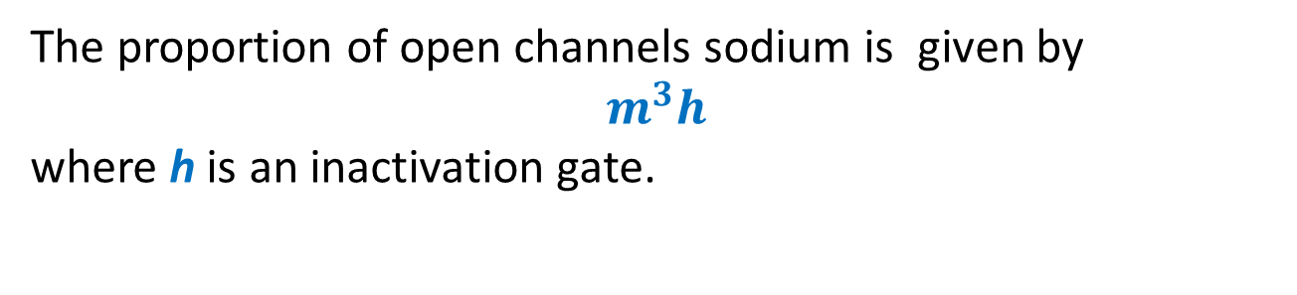
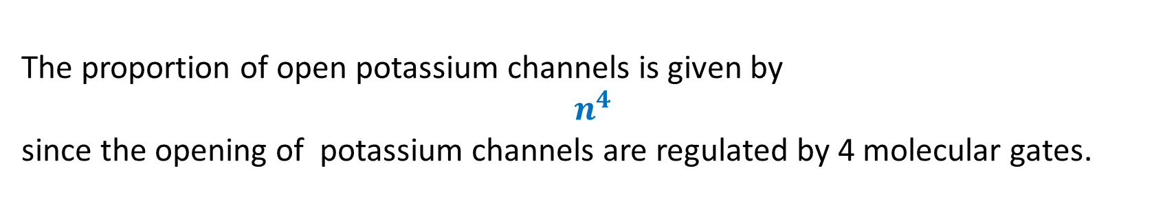
Sodium and potassium voltage gated channels
The proportion of open channels sodium is given by
$$m^{3}h$$
where h is an inactivation gate.
The proportion of open potassium channels is given by
$$n^{4}$$
since the opening of potassium channels are regulated by 4 molecular gates.
The presence of exponents may seem surprinsing. Their values have been emipirically derived.

Slide 28
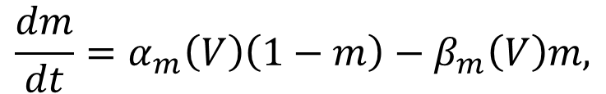
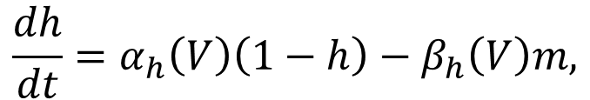
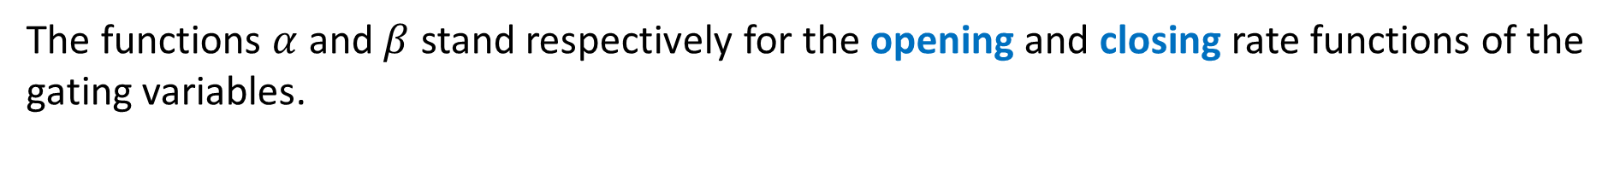
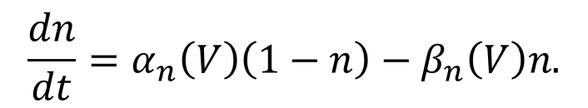
The Hodgkin-Huxley equations
Putting all this together, we get the following system of equations that specify the HH model:
$$C\frac{dV}{dt}=g_{L}\left(E_{l}−V\right)+\overline{g_{Na}}m^{3}h\left(E_{Na}−V\right)+\overline{g_{K}}n^{4}\left(E_{K}−V\right)+I,$$
$$\frac{dm}{dt}=α_{m}\left(V\right)\left(1−m\right)−β_{m}\left(V\right)m,$$
$$\frac{dh}{dt}=α_{h}\left(V\right)\left(1−h\right)−β_{h}\left(V\right)m,$$
$$\frac{dn}{dt}=α_{n}\left(V\right)\left(1−n\right)−β_{n}\left(V\right)n.$$
The functions $α$ and $β$ stand respectively for the opening and closing rate functions of the gating variables.
Due to the form of the equations, the gating variables will always remain between 0 and 1.

Slide 29
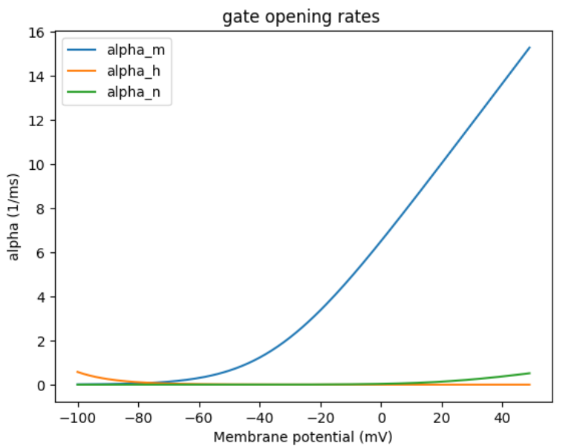
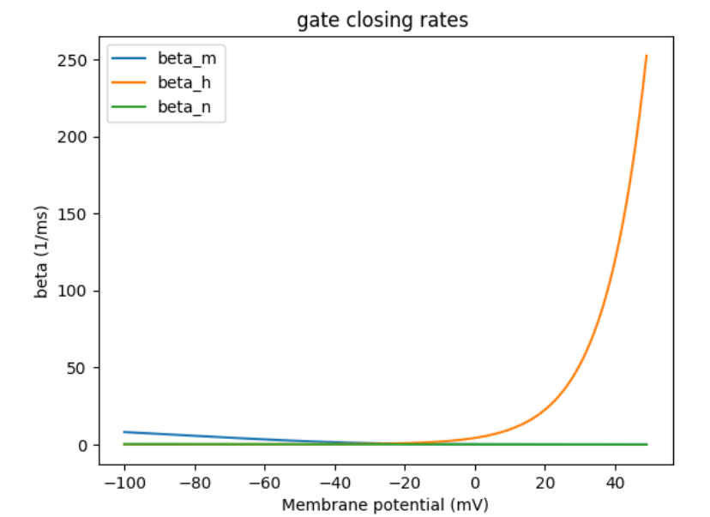
The behaviour of m, n and h gates
These figures are difficult to interpret…

Slide 30
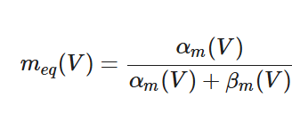

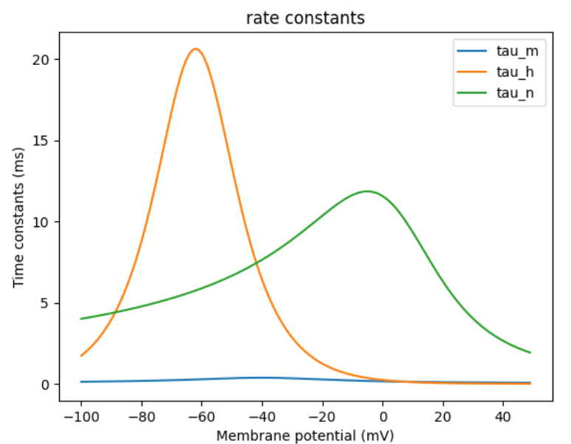
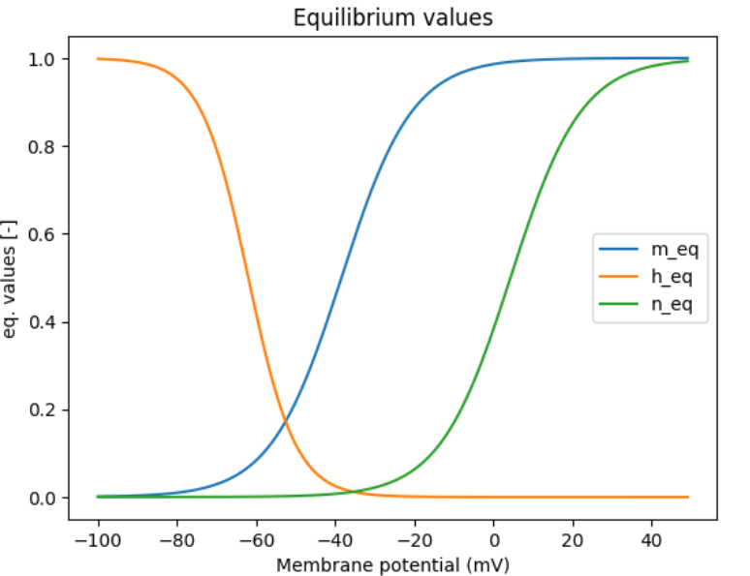
The behaviour of m, n and h gates
We can compute the equilibrium values and time constants of these gates

Slide 31
Qualitative behaviour of the Hodgkin-Huxley model
The parameter I corresponds to the external current injected into the cell. Its value determines the behaviour of the neuron
If the value of I is small, than the neuron remains at resting state.
For intermediate values of I, the neuron emits action potentials.
For very strong values of I, the neuron is in an inactive depolarized state.

Slide 32
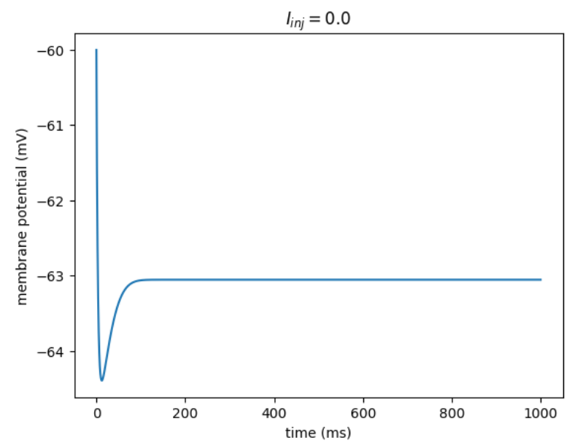
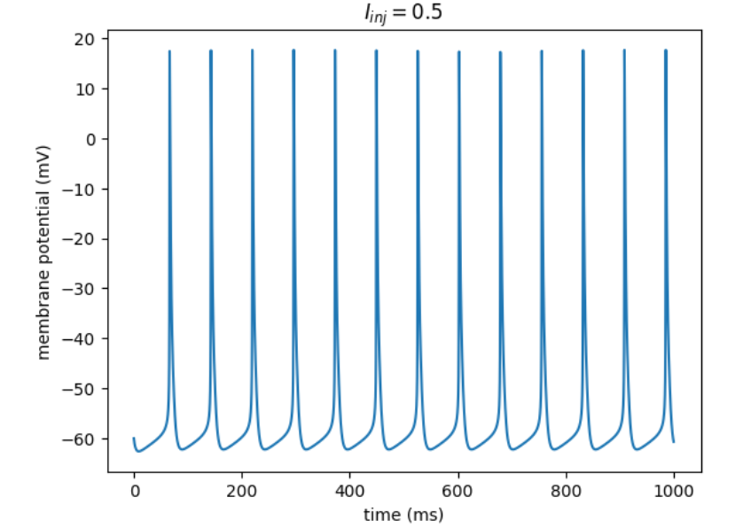
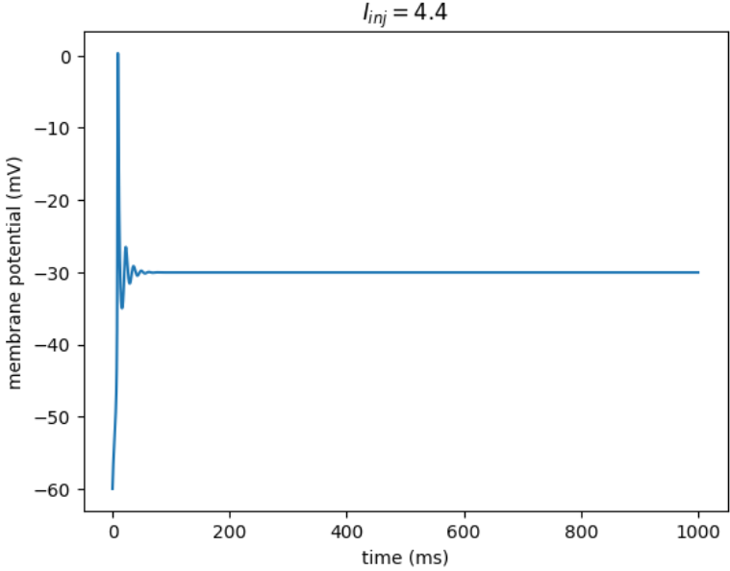
Qualitative behaviour of the Hodgkin-Huxley model

Slide 33
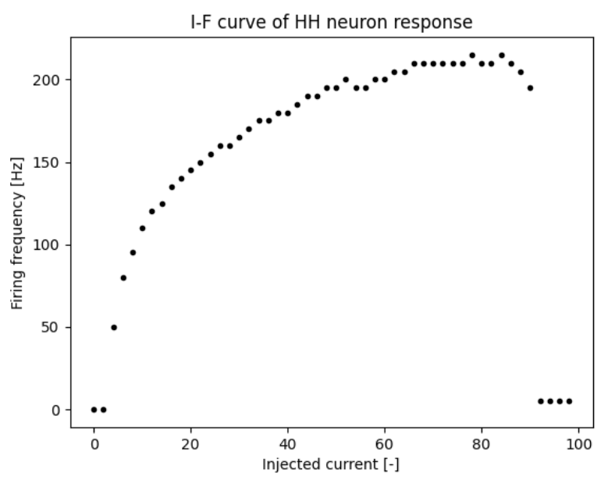
Qualitative behaviour of the Hodgkin-Huxley model

Slide 34
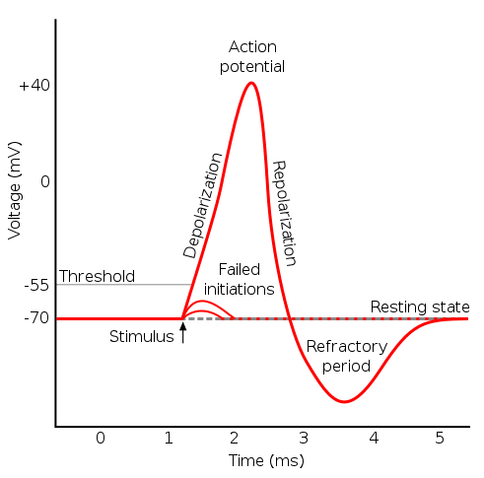
Leaky Integrate and Fire model (LIF)
One possible simplification is to omit the description of the action potential altogether.
This is interesting from the point of view of model simplicity since the typical shape of an action potential is rather difficult to replicate.

Slide 35
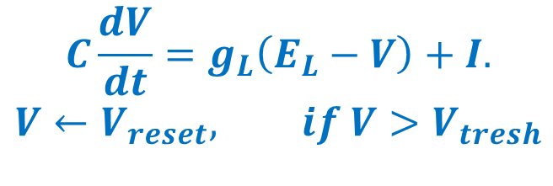
Leaky Integrate and Fire model (LIF)
The equation specifying the LIF model is given by:
$$C\frac{dV}{dt}=g_{L}\left(E_{L}−V\right)+I.$$
$$V←V_{reset}, if V>V_{tresh}$$
The second line is to be interpreted as:
When V reaches a threshold value (V_{tresh} usually around -30 mV) we assume that an action potential occurs and that the potential is instantaneously resetted.
The LIF model is not specified by ODEs.
Since it is discontinuous, we cannot directly use odeint or solve_ivp to solve it.
We will solve it ‘manually’, by updating the value of the membrane potential at each time step in a for loop.

Slide 36
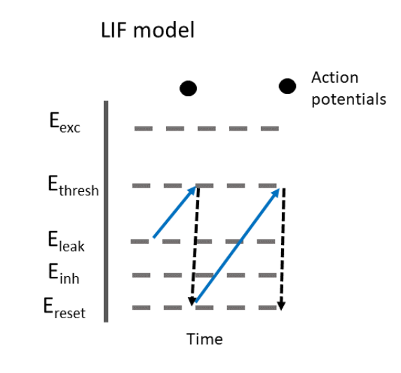
Leaky Integrate and Fire model (LIF)
-35 mV
-35 mV
-60 mV
-70 mV
-80 mV

Slide 37
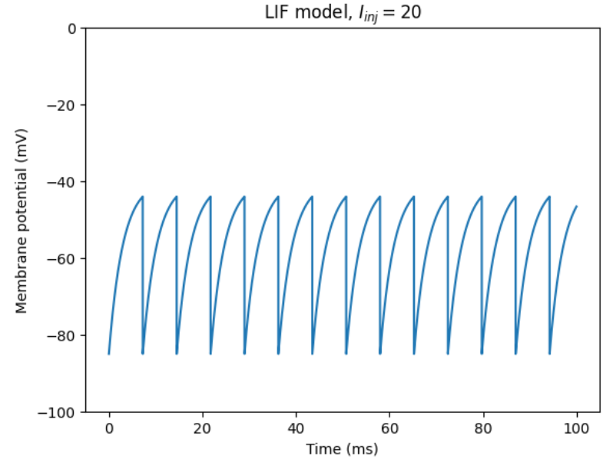
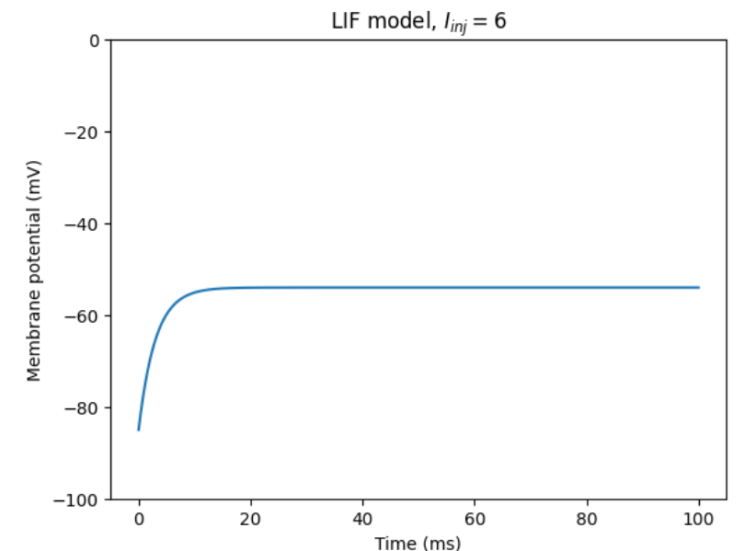
Leaky Integrate and Fire model (LIF)

Slide 38
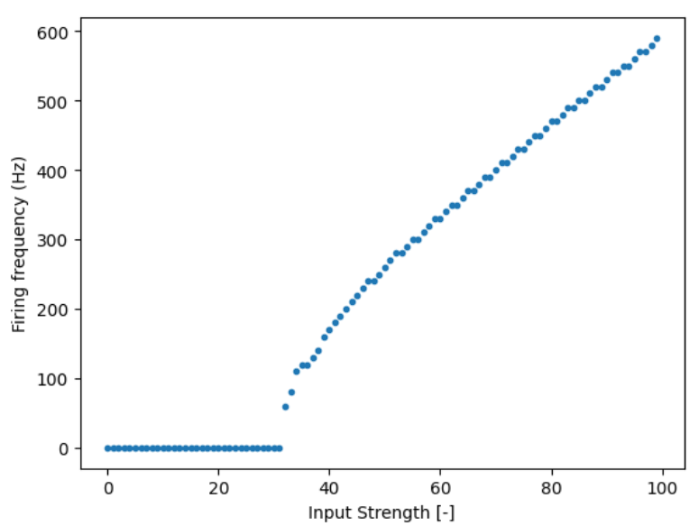
LIF models with refractory periods
The base version of the LIF models can be seen as unrealistic
The firing can be arbitrarily large when the input strength is increased.
In reality, neurons have a maximal firing rate.

Slide 39
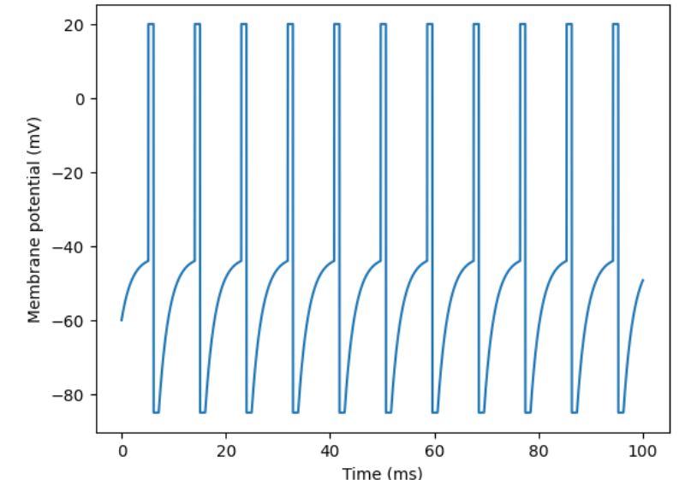
LIF models with refractory periods
This can be fixed by imposing a refractory period after each spike during which the neuron cannot be depolarized.
The refractory period is usually a few milliseconds (1 ms - 5 ms)

Slide 40
Convolution and fluorescence response
In some experiments, the membrane membrane potential are not measured directly.
The timing of action potentials is also impossible to precisely determine.
Depolarization during an action potential triggers the opening of calcium channels.
The subsequent increase in calcium concentration triggers a fluorescent signal.
The fluorescence response is measured. It is a slower image of the membrane potential.

Slide 41



Convolution and fluorescFence response
An action potential triggers an instantaneous rise in fluorescence signal.
When there is no action potential, the intensity of the fluorescence signal decreases exponentially.
$$F\left(t\right)=\sum_{s<t}{δ(s)e^{−(t−s)/τ}}$$

Slide 42
Synapses
Synaptic transmission is an important comportement of information processing in neural networks.
Even small perturbations in synaptic properties can have important functional consequences
Synaptic transmission can be divided into the following steps:
An action potential reaches the presynaptic bouton.
Depolarization of the membrane leads to the opening of vesicles.
Neurotransmitters are released in the synaptic cleft.
Neurotransmitters bind to postsynaptic receptors.
Receptors change state and open
Synaptic current mediated by ions occurs through receptor channels.

Slide 43

https://bio.libretexts.org/

Slide 44
Inhibitory and excitatory synapses
Different types of synaptic channels are permeable to different ionic species
AMPA receptors are permeable to sodium and potassium ions.
NMDA receptors are highly permeable to calcium ions.
GABA and glycine receptors are permeable to chloride and bicarbonate ions.
The synaptic potential is the membrane potential for which there is no net current through the synapse. It is analogous to the Nernst potential,

Slide 45


Inhibitory and excitatory synapses
Explicitly, the synaptic potential of GABAergic synapses is given by
$$g_{syn}=1000\frac{RT}{F}log⁡\left(\frac{{0.8 \left[{Cl}^{−}\right]}_{i}+{0.2 \left[{HCO_{3}}^{−}\right]}_{i}}{{0.8 \left[{Cl}^{−}\right]}_{o}+{0.2 \left[{HCO_{3}}^{−}\right]}_{o}}\right)$$
normal
rest
A synapse is excitatory if the synaptic potential is above the resting potential and inhibitory if the synaptic potential is below the resting potential.

Slide 46

Synaptic channels
Synaptic channels can be in several close, open or desensitized sates.
The binding of 2 or 3 neurotransmitters is usually required for the channel to become open.
A channel in a desensitized state usually stays in this state for a relatively long period of time.
Transition between each of these states is stochastic.
Say the transition rate from state S₁ to state S₂ is k, then the probability that this transition occurs during a time step of length $∆t$ is $k∙∆t$.
For example, a channel is in a close state, the transition rate from close to open is $0.1 {ms}^{−1}.$ We run a simulation with time steps of length equal to $∆t=0.5 ms.$The probability that the channel is open at the next time step is 0.04.
A possible simplification is to treat the proprotion of channels in each state as a continuous quantity and to use ordinary differential equations.

Slide 47


Synaptic channels
Schematic of possible transitions between the states of AMPA receptors
Time course of
synaptic current

Slide 48


Modelling synaptic transmission
When we model synaptic activity, we extract three features of the synaptic connection:
The synaptic potential $E_{syn},$
The maximal synaptic conductance $g_{max},$
The time course of channel openning $f\left(t\right).$
The synaptic current is given by:
$$I_{syn}=g_{max}\left(E_{syn}−V_{m}\right).$$

Slide 49


Networks of Leaky Integrate and Fire neurons.
Thanks to their simplicity, LIF models are often used to describe neurals networks.
When used in a network context, the equation describing the evolution of LIF neurons becomes:
$$C\frac{dV_{j}}{dt}=g_{L}\left(E_{L}−V_{j}\right)+\sum_{i}{w_{ji}δ(t−{spike}_{i})}{+I}_{j}.$$
$$V_{j}←V_{reset}, ifV_{j}>V_{tresh}.$$
Here, V_{j} stands for the membrane potential of neuron j, w_{ji} is the connection weight from neuron j to neuron i, spike_{i} is the time of occurrance of a spike in neuron i and $δ$ is the Dirac delta.

Slide 50
Networks of Leaky Integrate and Fire neurons.
We will illustrate different network structures. We will investigate
A completely random network (Erdos-Renyi).
A feed forward network.
A network with a negative feedback loop.

Slide 51



LIF model on a completely random network.

Slide 52



LIF model on a feedforward network.

Slide 53



LIF model on a network with a negative feedback loop.

Slide 54
Wilson-Cowan (WC) models
Another approach to simplify models of neural activity is to divide the states of neurons into a finite set of possible states according to their level of activity.
The Wilson-Cowan model divides neurons into 3 states:
Active: The neuron emits an action potential.
Susceptible
Susceptible: Neurons are at resting state but can become active if they receive enough stimulation.
Refractory
Active
Refractory: Shortly after firing, neurons cannot firing again no matter the input.

Slide 55



Wilson-Cowan model
Remark: Wilson-Cowan models don’t describe the state of individual neurons.
Transitions:
A(t): The proportion of neurons in active state at time t.
$A→R$ at constant rate,
R(t): The proportion of neurons in refractory state at time t.
$R→S$ at constant rate,
S(t): The proportion of neurons in susceptible state at time t.
$S→A$ at a rate proportional to F(input)
where F is an increasing activation function.

Slide 56



Wilson-Cowan model
The Wilson Cowan model is specified by the equations:
$$\frac{dA}{dt}=−αA+βSF\left(wA+I\right),$$
$$\frac{dS}{dt}=γR−βSF\left(wA+I\right),$$
$$\frac{dR}{dt}=−γR+αA.$$
The parmater w can be interpreted as the mean connection weight between two neurons.
The sigmoid function is often used as an activation function
$$F\left(x\right)=σ\left(x\right)=\frac{1}{1+e^{−x}}.$$

Slide 57




The Wilson-Cowan model
At first glance, the Wilson-Cowan model has 3 dimensions (3 independant variables).
However: $A\left(t\right)+S\left(t\right)+R\left(t\right)=1.$
Thus, by settting $R\left(t\right)=1−A\left(t\right)−S(t)$ we reduce the model to two variables.
We can also assume that the proportion of refractory neurons is at equilibrium.
$$\frac{dR}{dt}=−γR+αA=0↔R=\frac{α}{γ}A.$$
With this, we obtain a one dimensional version of the model
$\frac{dA}{dt}=−αA+β\left(1−\left(1+\frac{α}{γ}\right)A\right)F\left(wA+I\right)$.

Slide 58

The Wilson-Cowan model
The WC model can also be applied to models with several populations.
In this context, a population of neurons is an abstract and somewhat arbitrary concept.
A population is a group of neurons with similar properties and expected to have similar levels of activity.
Neurons are often divided into populations of inhibitory and excitatory neurons. Populations can also be defined according to the spatial positions of neurons.
The equations for two populations WC model are given by:
$$\frac{dA_{1}}{dt}=−αA_{1}+β\left(1−A_{1}\right)F\left(w_{11}A_{1}+w_{12}A_{2}+I_{1}\right),$$
$$\frac{dA_{2}}{dt}=−αA_{2}+β\left(1−A_{2}\right)F\left(w_{21}A_{1}+w_{22}A_{2}+I_{2}\right).$$

Slide 59




A WC model of lateral inhibition

Slide 60



A WC model of lateral inhibition
We implement a WC model on each point of a grid.
Each population sends inhibitory connections to their spatial neighbours.
Network response, we observe edge enhancement.
Connection weights between neighbours
Visual stimulus

Slide 61
Bibliography
Wilson, H.R.; Cowan, J.D. (1972). Excitatory and inhibitory interactions in localized populations of model neurons. Biophys. J. 12 (1): 1–24
Kramer RH, Davenport CM. Lateral Inhibition in the Vertebrate Retina: The Case of the Missing Neurotransmitter. PLoS Biol. 2015 Dec 10;13(12):e1002322.
Carnevale NT, Hines ML. The NEURON Book. Cambridge University Press; 2006
Hodgkin AL, Huxley AF (April 1952). Currents carried by sodium and potassium ions through the membrane of the giant axon of Loligo. The Journal of Physiology. 116 (4): 449–72.
Burkitt AN. A review of the integrate-and-fire neuron model: I. Homogeneous synaptic input. Biol Cybern. 2006 Jul;95(1):1-19.

Slide 62
Bibliography
Chacron MJ, Pakdaman K, Longtin A. Interspike interval correlations, memory, adaptation, and refractoriness in a leaky integrate-and-fire model with threshold fatigue. Neural Comput. 2003 Feb;15(2):253-78.
I Dione, J Deteix, T Briffard, E Chamberland, N Doyon, Improved Simulation of Electrodiffusion in the Node of Ranvier by Mesh Adaptation PloS one 11 (8), e0161318
X Li, G Hémond, AG Godin, N Doyon, Computational modeling of trans-synaptic nanocolumns, a modulator of synaptic transmission,Frontiers in Computational Neuroscience 16, 969119
Painchaud V, N Doyon, P Desrosiers, Beyond Wilson–Cowan dynamics: oscillations and chaos without inhibition, Biological Cybernetics 116 (5), 527-543
Sengupta S, Talidou A, Lefebvre J, Skinner FK. Cell-type-specific contributions to theta-gamma coupled rhythms in the hippocampus. Netw Neurosci. 2025

