Slide 1

SQL Injection
Structured Query Language Injection
20411 Jung Hee Shin

Slide 2
SQL Injection

Slide 3
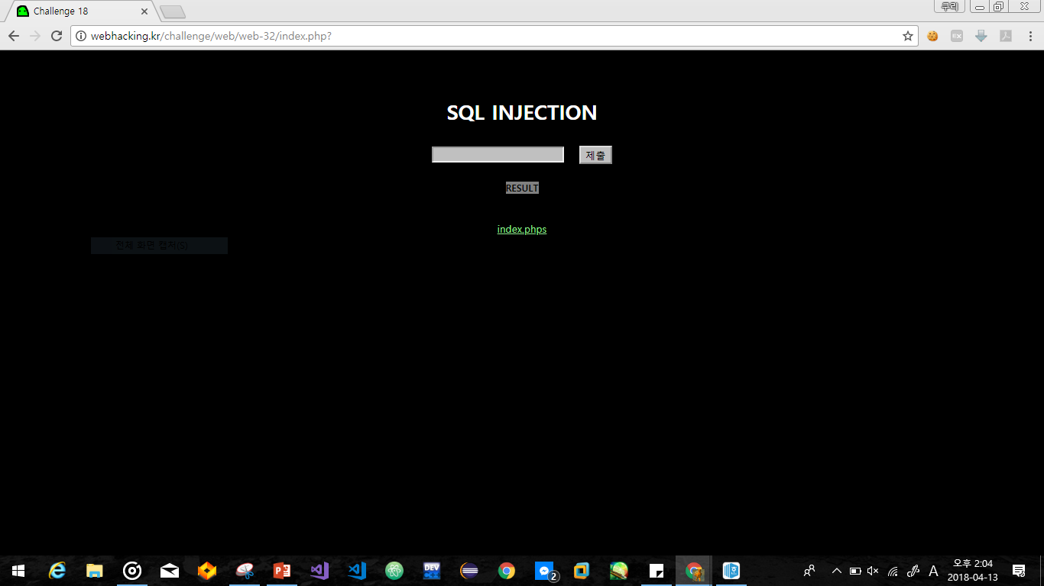
Web hacking no.18
SQL Injection

Slide 4
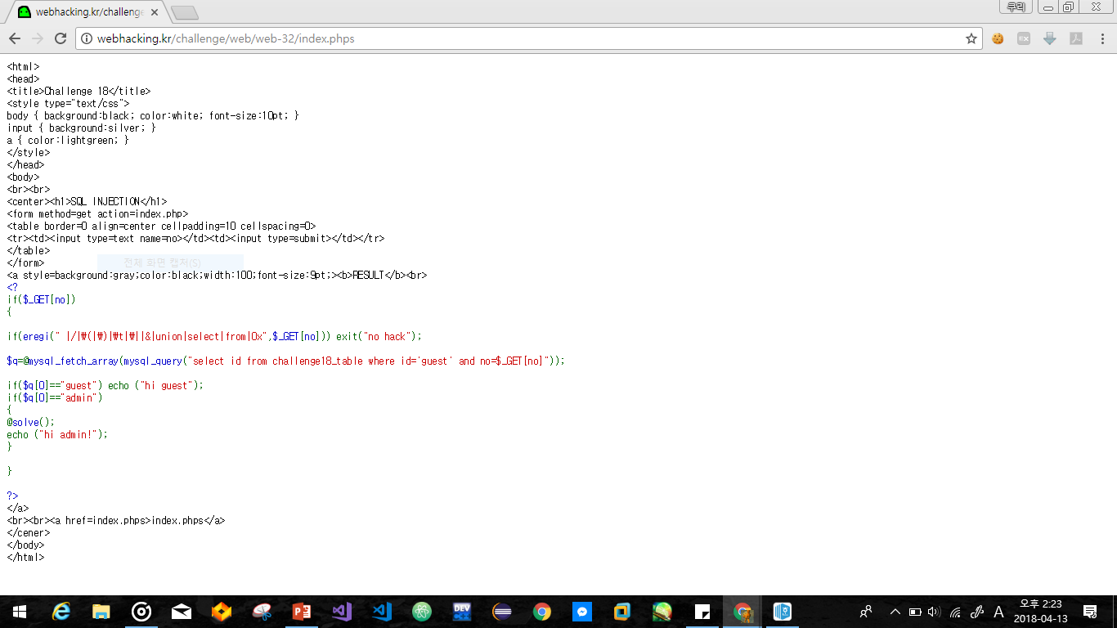

Slide 5
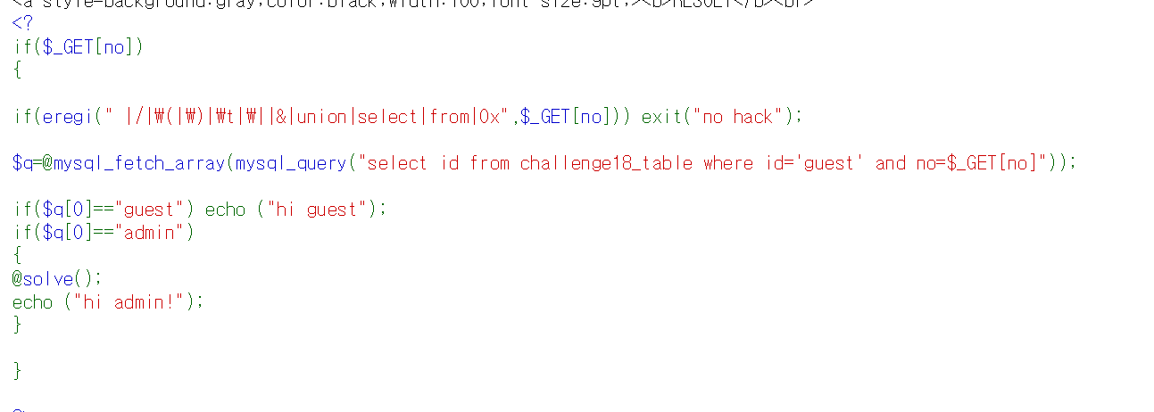
SQL Injection

Slide 6
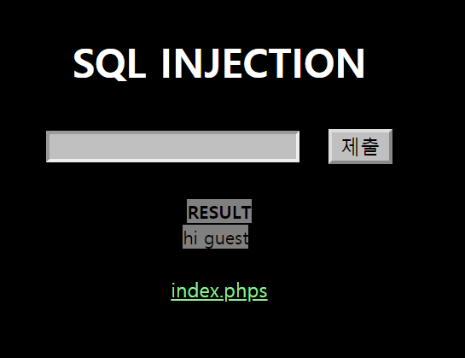
SQL Injection

Slide 7
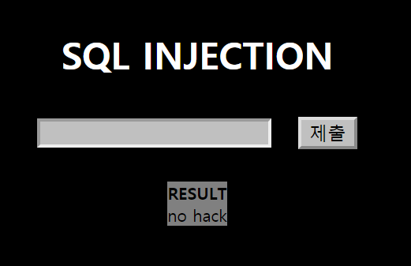
SQL Injection

Slide 8
no=0 or no=2
SQL Injection
%20 : space -> 공백
%0a : \n -> 계행
no=0%0aor%0ano=2

Slide 9
HaHaHa
SQL Injection

Slide 10
THE END
Thank you for listening

