Slide 1

In the Name Of Allah
Chapter 1-Introduction
Book: Maria Schuld and Francesco Petruccione, “Machine Learning with Quantum Computers”, Springer, 2021, 2nd Ed.

Slide 2
Chapter 1-Introduction
Background
Merging Two Disciplines
The Rise of Quantum Machine Learning
Fault-Tolerant Versus Near-Term Approaches
A Toy Example of a Quantum Algorithm for Classification
The Squared-Distance Classifier
Interference with the Hadamard Transformation
Quantum Squared-Distance Classifier
Insights from the Toy Example

Slide 3
What is quantum machine learning?
QML is a sub-discipline of quantum computing
ML is about making computers to learn from data to solve problems rather than being explicitly programmed.
QC is computation and information processing based on the laws of quantum theory.
In this course we will use a narrow definition of QML, i.e. machine learning with quantum computers or quantum-assisted machine learning.
This course is meant to learn different approaches for thinking of machine learning from a quantum computing perspective.

Slide 4
Merging two disciplines
If microscopic systems such as photons, electrons, and atoms are directly used to process information, they required another mathematical framework which is called quantum theory. Quantum was born at the beginning of 20th century.
A computer whose computations can only be described with the laws of quantum theory is called a quantum computer.

Slide 5
Merging two disciplines
Algorithms are the recipes for manipulating information in order to execute computations.
A wide variety of quantum algorithms (QA) exist and wait for being used on physical hardware.
Circuit model is the most famous language for implementing QAs. The central concepts in circuit models are qubit and quantum gates, to perform computations on qubits.
In order to preserve quantum coherence throughout thousands of computational operations, error correction becomes crucial. To overcome these challenges “Noisy Intermediate-Scale Quantum (NISQ)” devices were developed, which they work with the order of 10-100 qubits that do not necessarily interact with each other and have no error correction.
NISQ devices have the power to test the advantages of QC, but limits the algorithms to a few qubits and gates.

Slide 6
Merging two disciplines
The ultimate goal is to find useful computational problems that can be solved by small-scale quantum devices while exhibiting (exponential) speedups in runtime as compared with the best known classical algorithms.
Machine learning and its core mathematical problem, which is optimization, are often listed as two promising candidates for NISQ quantum computing.
ML lies in the intersection of statistics, mathematics, and computer science. It analyses how computers can learn from prior examples and solve unseen problem instances.

Slide 7
Merging two disciplines
A good ML method is a complex interplay of different parts: the data, the model, and the optimization algorithm.
Deep learning based on neural network algorithms was successful in building large architectures that are fed with big amount of data and trained by high-performance computing systems.
Applications of ML: image recognition, language processing, and decision making.
The development in machine learning research put QML onto moving ground which is exciting as it is challenging to navigate.

Slide 8
The rise of quantum machine learning
Some of the earliest contributions, began in 1995, in which authors looked at quantum models of neural networks to understand within quantum theory how does brain work.
The term “Quantum Machine Learning” was first mentioned in 2013 by Lloyd, Mohseni, and Rebentrost.
In 2014, Wittek published a monograph entitled “Quantum machine learning-What quantum computing means to data mining”
From 2014 onwards, interest in the topic have increased significantly.
QML while still a young discipline, but has witnessed rapid growth in its first few years.

Slide 9
The rise of quantum machine learning
Today, QML has established itself as an active sub-discipline of Quantum Computing and comes with a range of sub-areas. It has a strong basis in QC companies and startups.
QML boasts various open-source software frameworks such as PennyLane, TensorFlow Quantum, Yao, …

Slide 10
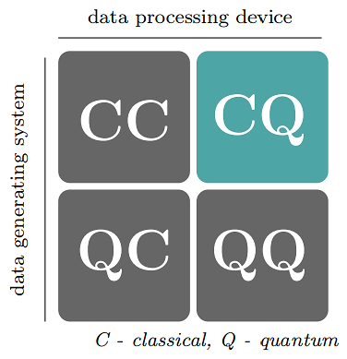
Four intersections for QML
Four approaches for combining QC and ML are shown in the figure, depending on whether one assumes the data to be generated by quantum (Q) or classical (C) system, and if the information processing device is quantum (Q) or classical (C). For instance: CC refers to classical data being processed classically, which is the conventional approach to ML.
In this course, we focus on CQ definition of QML, i.e. data gathered from classical systems, e.g. text, images, or time series of macroeconomic variables, which are then fed into a quantum computer for analysis

Slide 11
Fault-TOLERANT VERSUS NEAR-TERM APPROACHES
Algorithms resulting from the fault-tolerant approach require a full error-corrected quantum computer, which is prohibitive for the NISQ era.
The near-term approach of QML often starts with a quantum device of given constraints and asks what type of machine learning model might fit its physical characteristics.
How do we quantify the performance of a QML model? The common practice in classical machine learning is to benchmark a model by running it against other models on standard datasets.

Slide 12
A TOY EXAMPLE OF A QUANTUM ALGORITHM FOR CLASSIFICATION

Slide 13
A TOY EXAMPLE OF A QUANTUM ALGORITHM FOR CLASSIFICATION
In order to build a first intuition of what it means to learn from classical data with a quantum computer, we present a toy example that illustrates a range of topics discussed throughout of this course.
To understand this example no previous knowledge in either field is required.
The toy example is: how to implement a type of nearest neighbor method with quantum interference induced by a Hadamard gate?

Slide 14
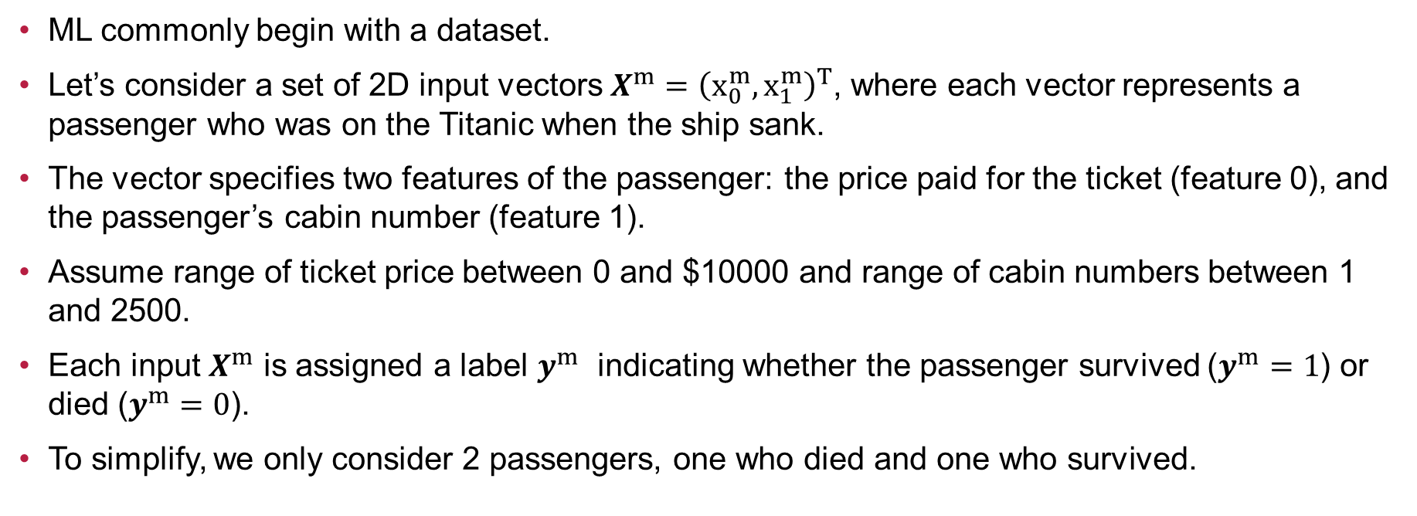
The squared-distance classifier
ML commonly begin with a dataset.
Let’s consider a set of 2D input vectors $X^{m}={\left(x_{0}^{m}, x_{1}^{m}\right)}^{T}$, where each vector represents a passenger who was on the Titanic when the ship sank.
The vector specifies two features of the passenger: the price paid for the ticket (feature 0), and the passenger’s cabin number (feature 1).
Assume range of ticket price between 0 and $10000 and range of cabin numbers between 1 and 2500.
Each input $X^{m}$ is assigned a label $y^{m}$ indicating whether the passenger survived ($y^{m}=1$) or died ($y^{m}=0$).
To simplify, we only consider 2 passengers, one who died and one who survived.

Slide 15
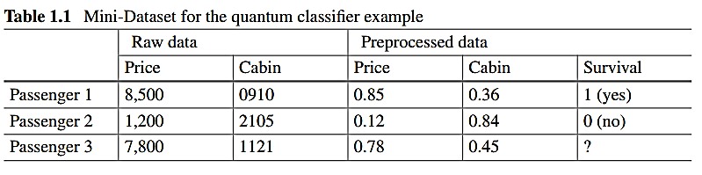
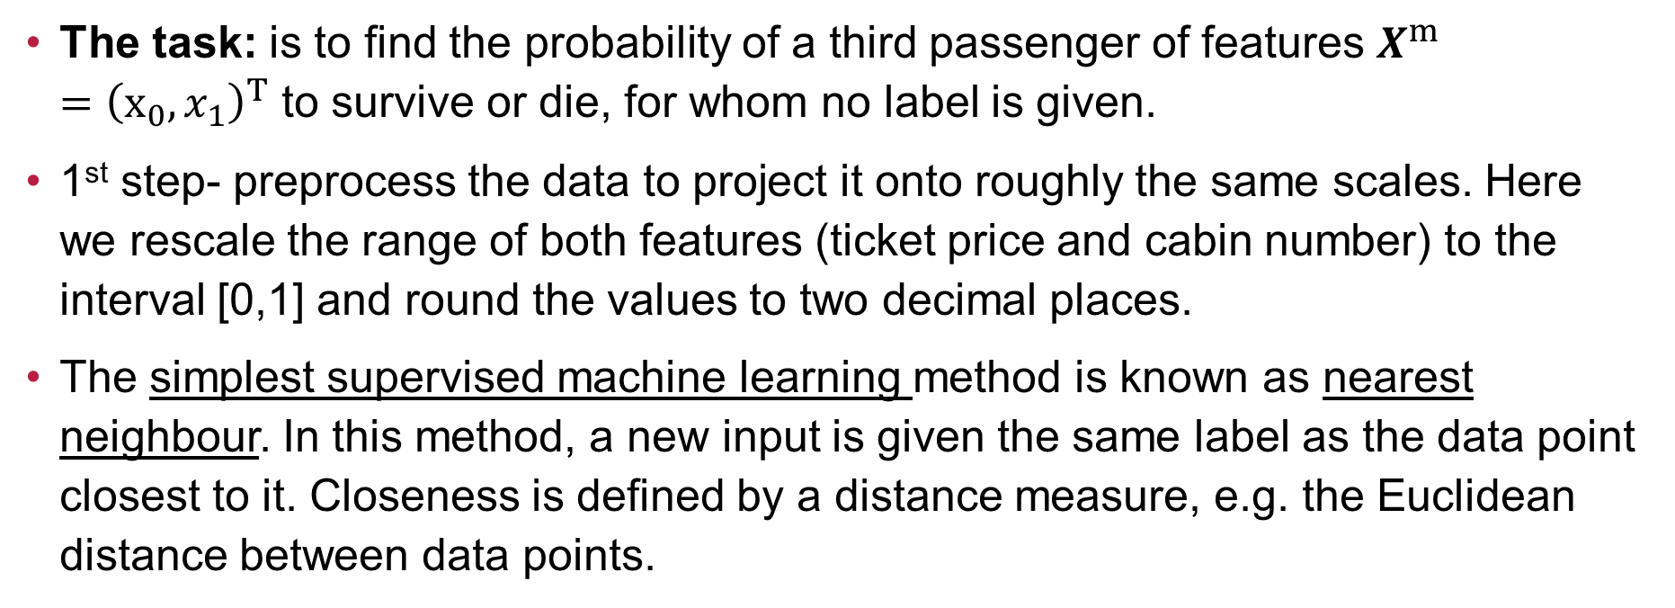
The task: is to find the probability of a third passenger of features $X^{m}={\left(x_{0}, x_{1}\right)}^{T}$ to survive or die, for whom no label is given.
1st step- preprocess the data to project it onto roughly the same scales. Here we rescale the range of both features (ticket price and cabin number) to the interval [0,1] and round the values to two decimal places.
The simplest supervised machine learning method is known as nearest neighbour. In this method, a new input is given the same label as the data point closest to it. Closeness is defined by a distance measure, e.g. the Euclidean distance between data points.

Slide 16

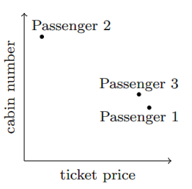
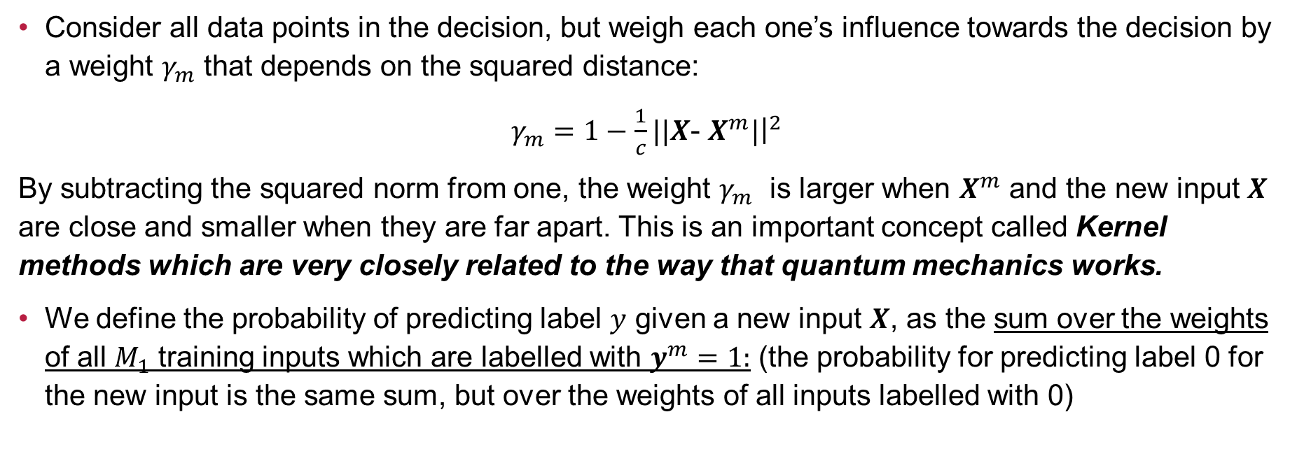

Consider all data points in the decision, but weigh each one’s influence towards the decision by a weight $γ_{m}$ that depends on the squared distance:
$γ_{m}=1−\frac{1}{c}||X$- $X^{m}|{\left.​\right|}^{2}$
By subtracting the squared norm from one, the weight $γ_{m}$ is larger when $X^{m}$ and the new input $X$ are close and smaller when they are far apart. This is an important concept called Kernel methods which are very closely related to the way that quantum mechanics works.
We define the probability of predicting label $y$ given a new input $X$, as the sum over the weights of all $M_{1}$ training inputs which are labelled with $y^{m}=1:$ (the probability for predicting label 0 for the new input is the same sum, but over the weights of all inputs labelled with 0)
The factor $1/χ$ is to make sure that $p\left(y=1 | x\right)+p\left(y=0 | x\right)=1$
We call this model the squared-distance classifier.

Slide 17
Interference with a Hadamard transformation
How to use a quantum computer in the simplest way to compute the result of the squared-distance classifier?
Most quantum computers work based on qubit (quantum bit), which somehow can be understood as a random bit whose description is not governed by classical probability theory but by quantum mechanics.
The QML algorithm requires us to understand only one single-qubit operation or gate that acts on qubits. This operation is called Hadamard transformation or Hadamard gate.

Slide 18
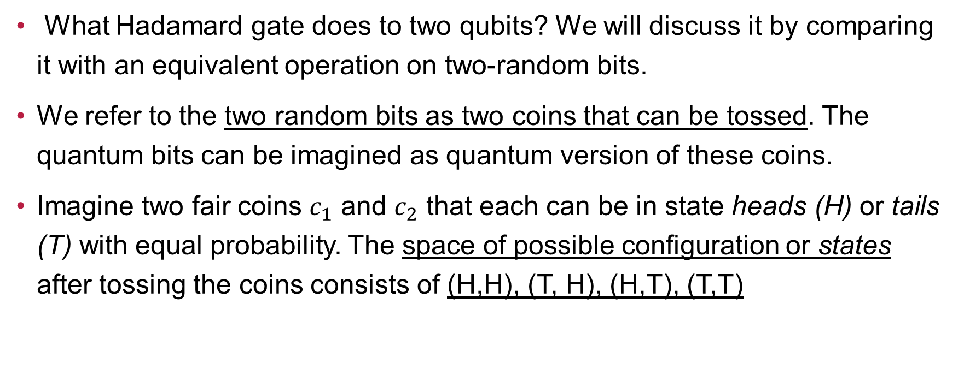
Interference with a Hadamard transformation
What Hadamard gate does to two qubits? We will discuss it by comparing it with an equivalent operation on two-random bits.
We refer to the two random bits as two coins that can be tossed. The quantum bits can be imagined as quantum version of these coins.
Imagine two fair coins $c_{1}$ and $c_{2}$ that each can be in state heads (H) or tails (T) with equal probability. The space of possible configuration or states after tossing the coins consists of (H,H), (T, H), (H,T), (T,T)

Slide 19
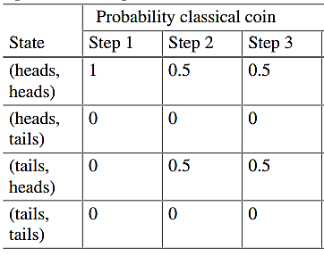
Interference with a Hadamard transformation
Step 1: As a preparation, turn both coins to heads. The state is by definition (H,H)
Step 2: Toss only the first coin and check the results.
Step 3: Toss the first coin for the second time and check the results
Repeat this procedure from scratch a sufficiently large number of times to estimate
the probability of observing the coins in either of the 4 states.
The table shows the result of this procedure for our example
Conclusion: we can not go from a state of large uncertainty
to a state of lower uncertainty by an act of randomization.

Slide 20
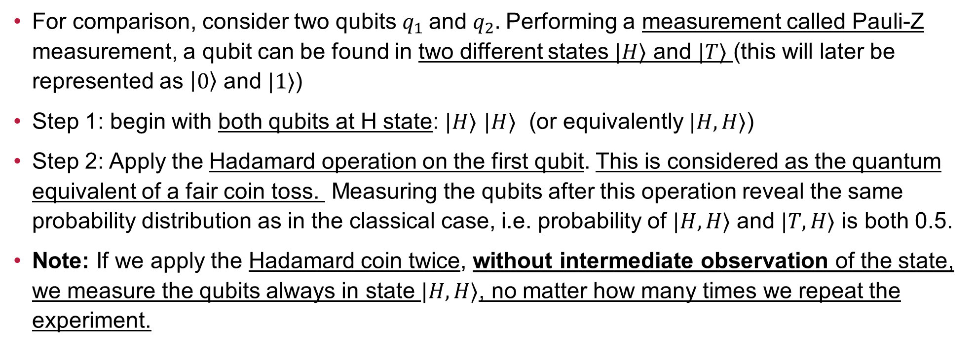
Compare the classical approach with quantum approach
For comparison, consider two qubits $q_{1}$and $q_{2}.$ Performing a measurement called Pauli-Z measurement, a qubit can be found in two different states $|H⟩$ and $|T⟩$ (this will later be represented as $\left|0\right\rangle$ and $|1⟩$)
Step 1: begin with both qubits at H state: $|H⟩$ $|H⟩$ (or equivalently $|H, H⟩$)
Step 2: Apply the Hadamard operation on the first qubit. This is considered as the quantum equivalent of a fair coin toss. Measuring the qubits after this operation reveal the same probability distribution as in the classical case, i.e. probability of $|H, H⟩$ and $|T, H⟩$ is both 0.5.
Note: If we apply the Hadamard coin twice, without intermediate observation of the state, we measure the qubits always in state $|H, H⟩$, no matter how many times we repeat the experiment.

Slide 21
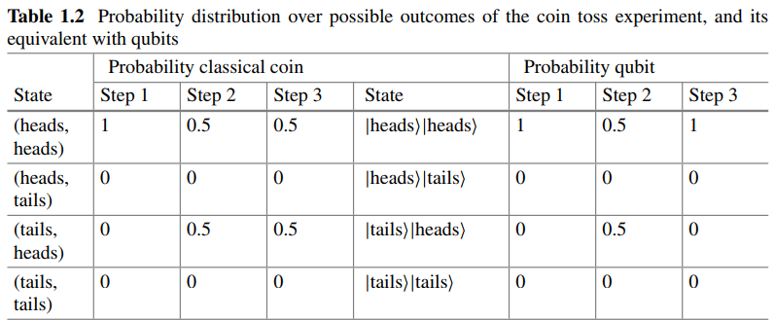
Compare the classical approach with quantum approach
Conclusion: This transition from high uncertainty to a state of lower uncertainty is counterintuitive for classical stochastic operations.
Note: It is crucial not to measure the state of the qubit after Step 2, since this would return a different distribution for Step 3, which is another interesting characteristic of quantum mechanics.

Slide 22
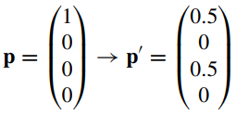
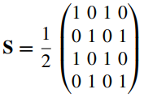
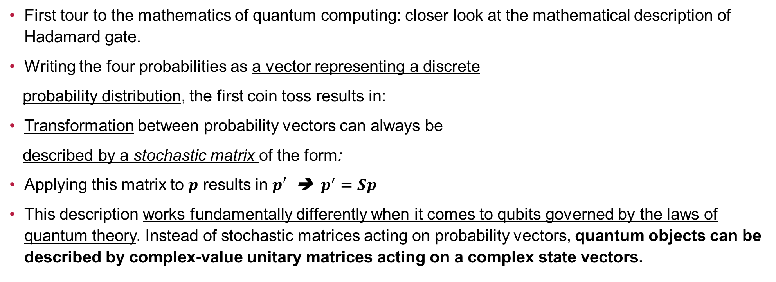
Mathematical description of the Hadamard operation
First tour to the mathematics of quantum computing: closer look at the mathematical description of Hadamard gate.
Writing the four probabilities as a vector representing a discrete
probability distribution, the first coin toss results in:
Transformation between probability vectors can always be
described by a stochastic matrix of the form:
Applying this matrix to $p$ results in $p′$ ➔ $p^{′}=Sp$
This description works fundamentally differently when it comes to qubits governed by the laws of quantum theory. Instead of stochastic matrices acting on probability vectors, quantum objects can be described by complex-value unitary matrices acting on a complex state vectors.

Slide 23

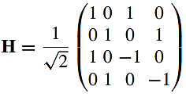
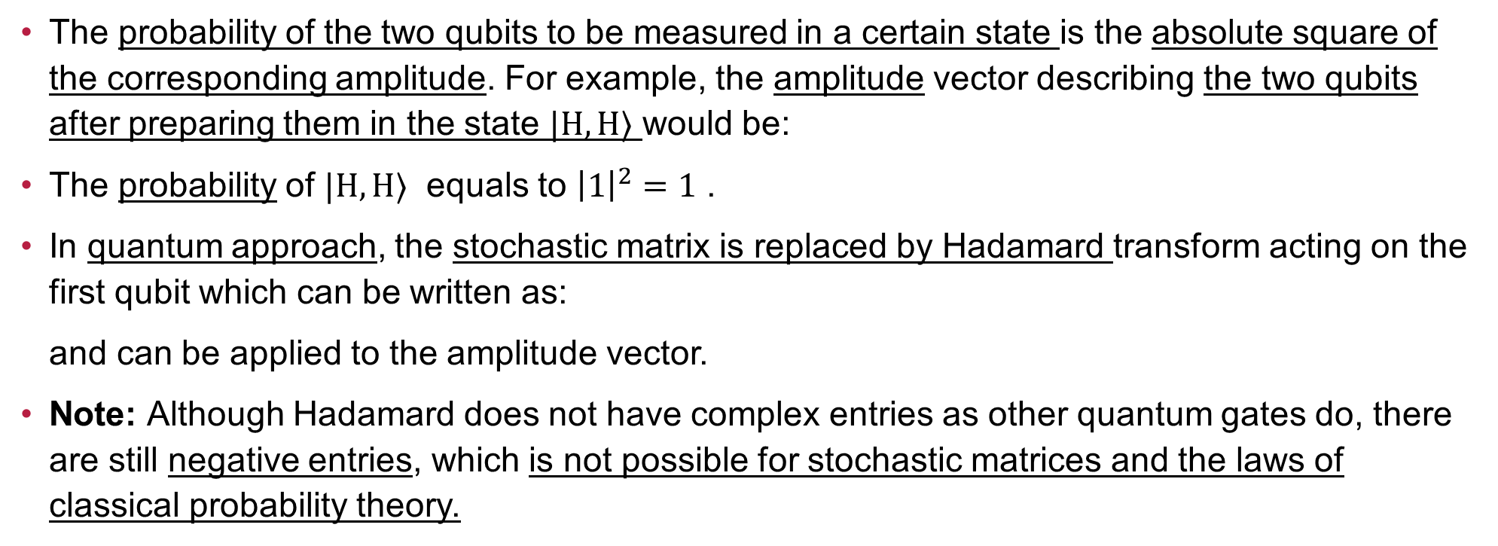
Mathematical description of the Hadamard operation
The probability of the two qubits to be measured in a certain state is the absolute square of the corresponding amplitude. For example, the amplitude vector describing the two qubits after preparing them in the state $|H, H⟩$ would be:
The probability of $|H, H⟩$ equals to ${\left|1\right|}^{2}=1$ .
In quantum approach, the stochastic matrix is replaced by Hadamard transform acting on the first qubit which can be written as:
and can be applied to the amplitude vector.
Note: Although Hadamard does not have complex entries as other quantum gates do, there are still negative entries, which is not possible for stochastic matrices and the laws of classical probability theory.

Slide 24
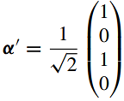
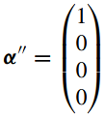
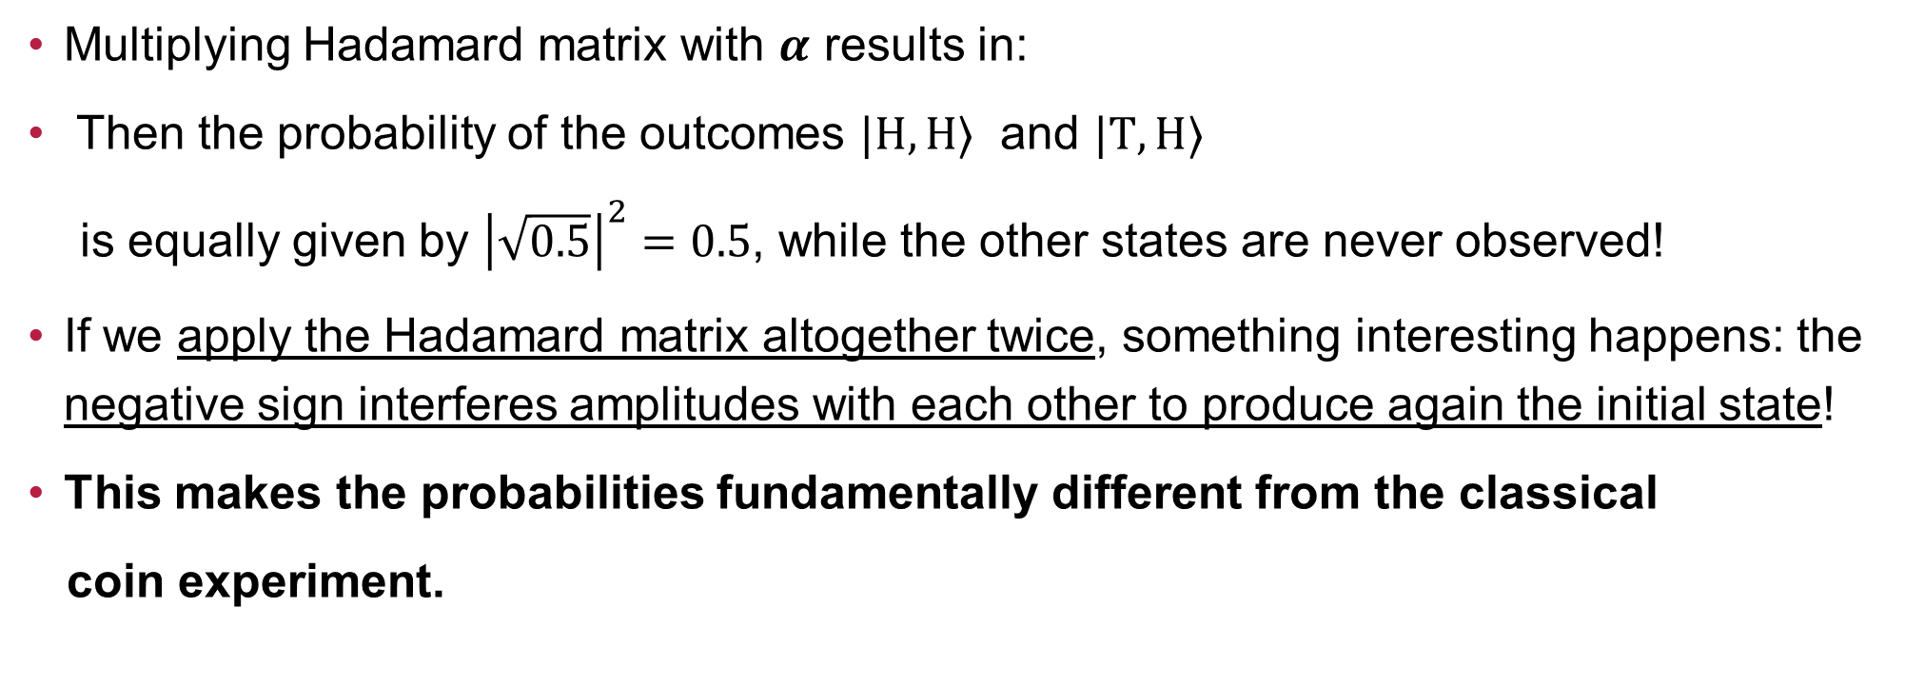
Mathematical description of the Hadamard operation
Multiplying Hadamard matrix with $α$ results in:
Then the probability of the outcomes $|H, H⟩$ and $|T, H⟩$
is equally given by ${\left|\sqrt{0.5}\right|}^{2}=0.5$, while the other states are never observed!
If we apply the Hadamard matrix altogether twice, something interesting happens: the negative sign interferes amplitudes with each other to produce again the initial state!
This makes the probabilities fundamentally different from the classical
coin experiment.

Slide 25

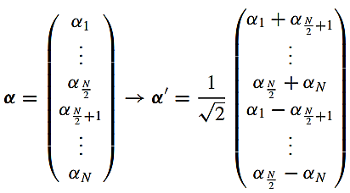
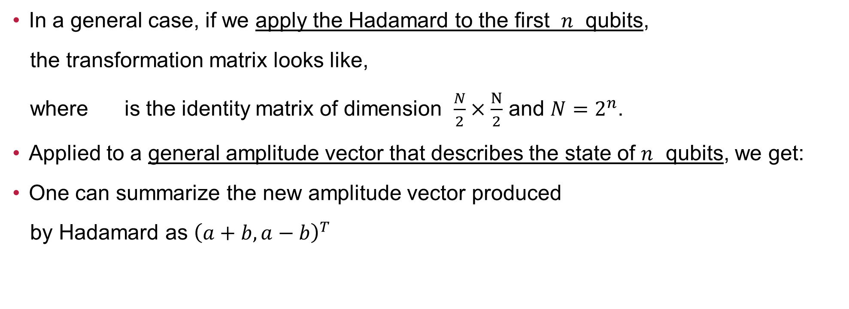
Mathematical description of the Hadamard operation
In a general case, if we apply the Hadamard to the first $n$ qubits,
the transformation matrix looks like,
where is the identity matrix of dimension $\frac{N}{2}×\frac{N}{2}$ and $N=2^{n}$.
Applied to a general amplitude vector that describes the state of $n$ qubits, we get:
One can summarize the new amplitude vector produced
by Hadamard as ${\left(a+b, a−b\right)}^{T}$

Slide 26
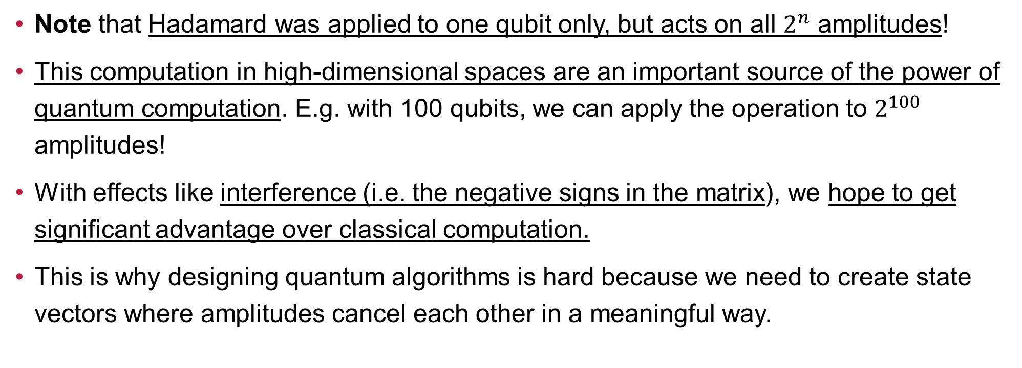
Mathematical description of the Hadamard operation
Note that Hadamard was applied to one qubit only, but acts on all $2^{n}$ amplitudes!
This computation in high-dimensional spaces are an important source of the power of quantum computation. E.g. with 100 qubits, we can apply the operation to $2^{100}$ amplitudes!
With effects like interference (i.e. the negative signs in the matrix), we hope to get significant advantage over classical computation.
This is why designing quantum algorithms is hard because we need to create state vectors where amplitudes cancel each other in a meaningful way.

Slide 27
Quantum squared-distance classifier
Getting back to our toy-model QML algorithm, we can use Hadamard to compute the prediction of the squared-distance classifier by following 5 steps:
Step 1: Some more data preprocessing
Step 2: Data encoding
Step 3: Hadamard transformation
Step 4: Measuring the first qubit
Step 5: Measuring the last qubit

Slide 28
Step 1-data preprocessing
We need another round of data preprocessing in which the length of each input vector, i.e. the ticket price and cabin number for each passenger, gets normalized to 1
This act would project the data onto a unit circle, so that only information about the angles between data vectors remains.
Note: For some datasets, this is the desired effect because the length of data vectors has no expressive power, while for others the loss of information happens for which we can use tricks which will be discussed in Chapter 4. For this toy model, normalization does not change the outcome of a distance-based classifier.

Slide 29
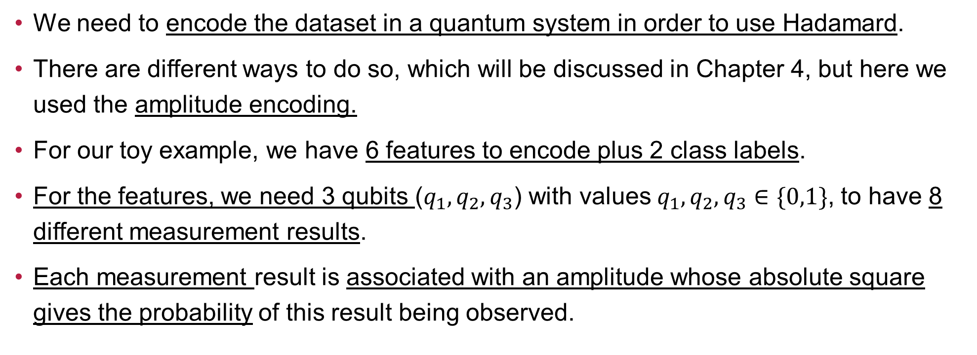
Step 2- DATA ENCODING
We need to encode the dataset in a quantum system in order to use Hadamard.
There are different ways to do so, which will be discussed in Chapter 4, but here we used the amplitude encoding.
For our toy example, we have 6 features to encode plus 2 class labels.
For the features, we need 3 qubits ($q_{1},q_{2},q_{3}$) with values${ q}_{1},q_{2},q_{3}∈\{0,1\}$, to have 8 different measurement results.
Each measurement result is associated with an amplitude whose absolute square gives the probability of this result being observed.

Slide 30
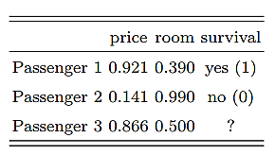

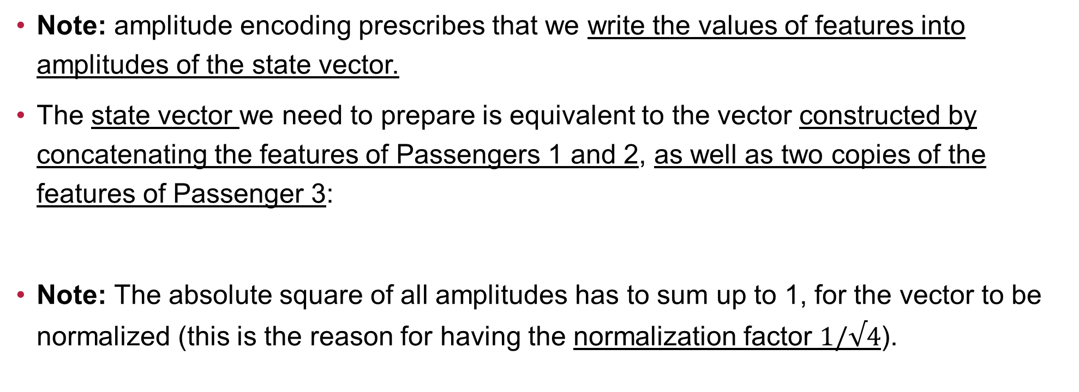
Step 2- DATA ENCODING
Note: amplitude encoding prescribes that we write the values of features into amplitudes of the state vector.
The state vector we need to prepare is equivalent to the vector constructed by concatenating the features of Passengers 1 and 2, as well as two copies of the features of Passenger 3:
Note: The absolute square of all amplitudes has to sum up to 1, for the vector to be normalized (this is the reason for having the normalization factor $1/√4$).

Slide 31
Step 2- DATA ENCODING
We now need to extend the state by a 4th qubit! This qubit corresponds to the label (i.e. passenger is live or dead) of that feature vector.
Adding the 4th qubit pads the amplitude vector by some intermittent zeros:
More details can be seen in the table of the next slide.

Slide 32
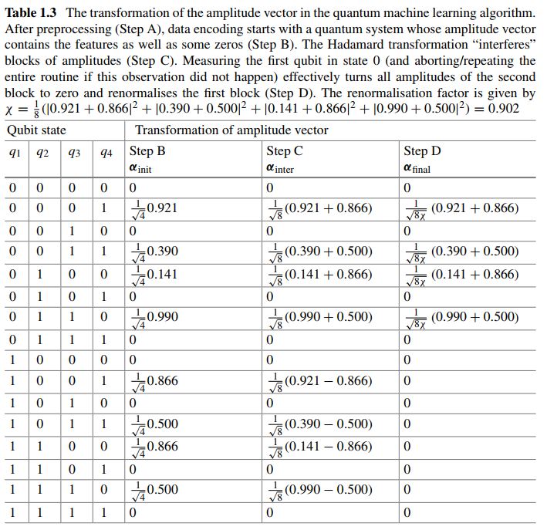
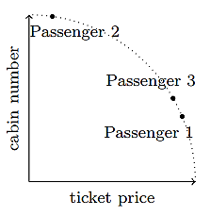

Slide 33
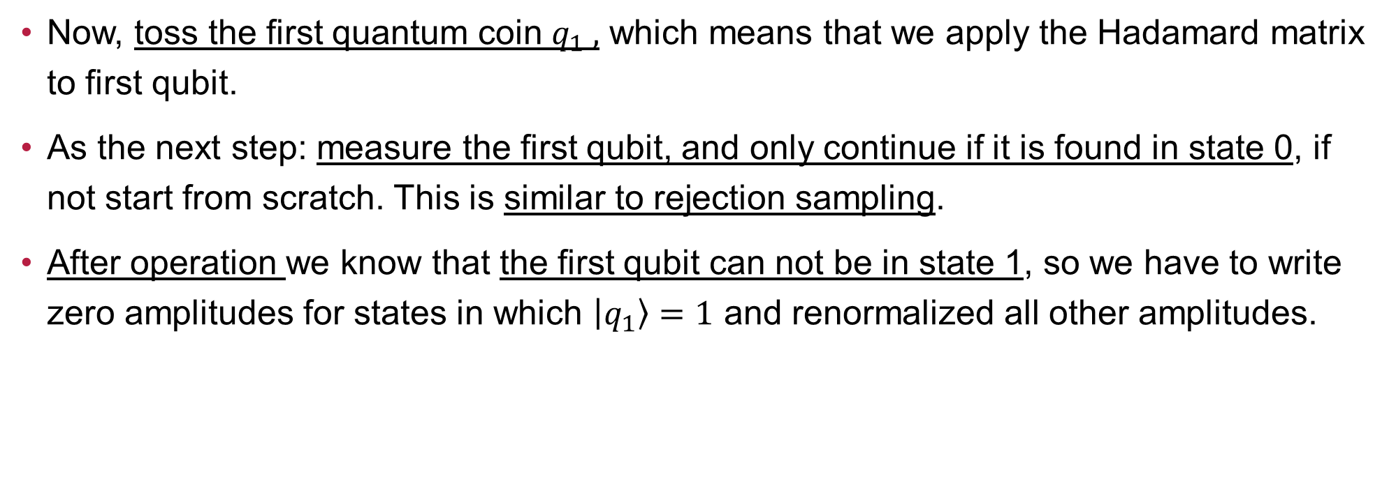
Step 3- Hadamard and setp 4-measuring 1st qubit
Now, toss the first quantum coin $q_{1} ,$ which means that we apply the Hadamard matrix to first qubit.
As the next step: measure the first qubit, and only continue if it is found in state 0, if not start from scratch. This is similar to rejection sampling.
After operation we know that the first qubit can not be in state 1, so we have to write zero amplitudes for states in which $\left|q_{1}\right\rangle =1$ and renormalized all other amplitudes.

Slide 34
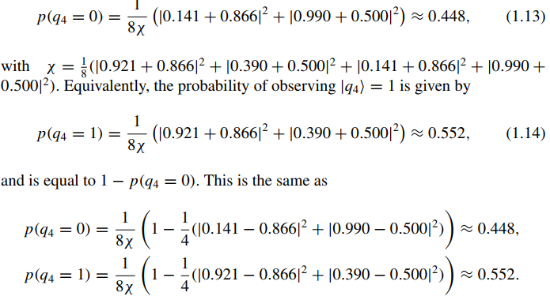
Step 5- Measure the last qubit
Then we measure the last qubit. We have to repeat the entire routine a number of times to estimate the probability of finding it in a certain state.
If we compare these last results with
the previous ones, we see that this is
exactly the output of the squared
distance classifier with the constant
c equals to 4.

Slide 35
Insights from the toy model
For QML with classical data, the data encoding is often the most crucial step.
The Q. algorithm imposes certain preprocessing requirements on classical data.
The result of a QML is always facilitated by a measurement.
QML algorithms are often inspired by classical algorithms. (e.g. nearest neighbour or kernel method)
The way quantum computers work may required adaptions to classical models (e.g. we used the squared distance in the toy model example because it suited the quantum formalism).
These ideas will be reoccurring over and over in the following chapters!

Slide 36
Open questions from GPT POINT OF VIEW
Some of the most important open questions in QML include:
What are the best quantum algorithms for specific machine learning tasks?
How can quantum machine learning algorithms be made more robust against noise and errors?
What are the most efficient ways to encode classical data into a quantum format for processing?
How can quantum machine learning be integrated with classical machine learning?
How can we design and build practical quantum hardware that can support the large number of
qubits and high levels of connectivity required for quantum machine learning?
Overall, these questions highlight some of the key challenges that must be addressed in order
for quantum machine learning to reach its full potential.

